Slide 1

Fashionable Sales Analytics
End to End Data Engineering case study comprises Kimball-style data warehouse developed on DuckDB and dbt, with a simple Power BI dashboard for marketing analysis.
Damodar Krishnakumar
Notes:
Title slide. Introduce the project as an end-to-end pipeline: CSV to DuckDB to dbt to Power BI.

Slide 2
Table of Contents
Section : approach, data model, testing and CI, pipeline, dashboard, findings, next steps
01
Problem Statement & Approach
02
Technology Stack & Pipeline
What marketeers need to know and why a star schema helps
CSV ingestion, DuckDB storage, dbt layers, environment setup and Power BI
03
Semantic Layer and Data Model
04
Dashboard Walkthrough
Kimball star schema with Type 2 Slowly Changing and junk dimensions, 12 business marts, full dbt tests and CI
Three pages: Sales Overview, Operation/Quality Level Insights and Location/Product Level Insights
05
Key Findings
06
Future Improvements
What the data shows about customers, products and regions
What we'd add with more time or more data
Notes:
Walk through the six sections quickly before diving in.

Slide 3



Problem Statement & Approach
What marketeers need to ask Fashionable's sales data , and why a star schema is chosen
Possible business level Questions from marketeers
Reliable foundation
Build a Kimball star schema so every metric is computed once, consistently, and is easy to trust.
→
Which styles and categories sell best in a given region?
→
What is the sales trend across seasons?
BI-ready marts
→
How do cancellation rates vary by shipping tier?
Expose clean fact and dimension tables data and build simple BI marts , so Power BI never needs heavy Power Query transforms.
→
Which states and cities drive the most revenue?
→
Do promotions actually move order volume?
Self-serve analysis
→
Is B2B or B2C revenue more significant?
Let marketeers slice by Category and other attributes without writing SQL.
Notes:
Frame the business need: marketeers want self-serve answers without writing SQL each time.

Slide 4




Technology Stack
Python
Power BI
CSV INGESTION
DASHBOARD
Discovers the CSV in the local storage, assigns clean column names, loads it into DuckDB as raw_sales.
3 page report built on 12 business marts exported as Parquet. No relationships between marts, conformed dimension lookup tables drive cross page slicers instead.
DuckDB
dbt
LOCAL DATABASE
DATA MODELLING
Embedded analytical database. Single .duckdb file holds raw, staging and mart layers.
Multi layer transformation: staging, intermediate, snapshots for Type 2 history, then marts (Kimball model, star schema, BI ready).
Notes:
Five tools, simple linear flow. Emphasize DuckDB as the single source of truth file.

Slide 5
Data Pipeline
From CSV to a Power BI dashboard in four steps
1
2
3
4
Raw CSV File
DuckDB raw_sales
dbt Layers
Power BI
Fashionable Sale Report.csv
Python load_to_duckdb.py
stg -> int -> snapshots -> marts
DuckDB → Dashboard
→
→
→
CSV file with 23 columns covering order, product, shipping and promotion attributes ( one unnamed column ignored )
Python script for discovers the CSV, assigns column names, writes raw_sales table. sanity tests run on load.
1 staging view, 1 intermediate view, 2 Type 2 snapshots, then marts: 5 core tables plus 12 business marts, Kimball star schema.
dbt tests, a model contract and a GitHub Actions CI check cover the project end to end; mart data exported as Parquet.
Mart data imported from Parquet exports as separate tables. No relationships between marts; a conformed dimension table drives synced slicers across all 3 pages instead.
Notes:
Linear pipeline, easy to reason about. Each arrow represents a clear handoff.

Slide 6






Environment Setup: Git, dbt and Power BI
What it takes to run this project end to end, from a clean machine
Install Git
Python and dbt
Install dbt dependencies
Install Git, then clone or initialise the repository holding the dbt project, tests, macros and this deck's source files.
Create a virtual environment using any IDE, then pip install dbt-core and dbt-duckdb. Verify exact versions against current docs before relying on any command.
Run dbt deps to download dbt_utils and dbt_expectations, the two packages this project's tests and macros depend on.
profiles.yml and dbt_project.yml
Run order matters
Power BI connection
Create a local profiles.yml pointing at the project's DuckDB file. It stays gitignored on purpose since it can hold connection details. Also add dbt_project.yml file for project related data and for docs.
Run the staging and intermediate models and then dbt snapshot before dbt run, every time, so Type 2 history is captured before marts rebuild from it. Then dbt test.
Import each mart's Parquet export as its own table, delete any auto detected relationships, and set ratio columns to Don't summarize.

Slide 7
Semantic layer architecture : dbt
raw -> staging -> intermediate -> snapshots -> marts (1 fact table, 4 dimension tables, 12 business marts)
RAW
raw_sales : loaded as-is from the CSV by the Python script, no transformation
1 table
▼
STAGING + INTERMEDIATE
stg_fashionable_sales and int_sales_enriched: typed, cleaned, deduplicated, then business rules and surrogate keys added
2 views
▼
MARTS
dim_date, dim_product, dim_ship_location, dim_fulfilment, fct_order_lines, feeding 12 business marts, BI ready
5 core + 12 business
Key design note: Type 2 history is tracked with dbt snapshots on dim_product and dim_ship_location, each with an explicit Unknown member row so a fact line never carries a null foreign key. fct_order_lines is incremental with a dbt model contract enforced, backed by generic, custom and singular tests plus a GitHub Actions CI check.
Notes:
Explain why surrogate keys needed extra columns — same SKU had multiple ASINs, same order_id had multiple courier statuses.

Slide 8
Star Schema : Entity Relationship Diagram
Fact table fct_order_lines with 4 dimensions around. Every dimension joins via a surrogate key
dim_date
dim_date
date_key (PK)
year, month, quarter, season
fct_order_lines
dim_product
fct_order_lines
dim_ship_location
sku (PK), Type 2 history
style, category, size
asin, valid_from, valid_to, is_current
order_line_key (PK)
date_key (FK)
product_sk (FK)
ship_location_sk (FK)
fulfilment_sk (FK)
order_id, qty, amount
ship_postal_code (PK), Type 2 history
ship_city, ship_state, ship_country
valid_from, valid_to, is_current, Unknown row
dim_fulfilment
dim_fulfilment
fulfilment_sk (PK), junk dim
fulfilment, sales_channel, ship_service_level
courier_status, fulfilled_by, is_b2b
Notes:
Walk through each spoke. Emphasize that every measure (qty, amount) lives only in the fact table.

Slide 9
Data Quality, Testing and CI/CD
How the pipeline defends itself against bad data, on every run
Generic tests
Grain proof tests
Custom test
unique, not_null, accepted_values and relationships tests cover every primary and foreign key across the project.
dbt_utils unique_combination_of_columns checks the stated grain of every staging model, the fact table and all 12 marts.
A reusable non_negative_or_null generic test guards quantity and amount without over testing intentional nulls.
Singular tests
Model contract
CI on every push
6 business rule tests: cancelled lines carry no amount, no future order dates, fact row counts match source, and 3 mart to fact reconciliation checks.
fct_order_lines enforces a dbt contract: column names, order and data types are a stable interface, not just documentation.
GitHub Actions runs dbt deps, parse and compile on every push and pull request, catching broken refs before merge.

Slide 10
Extended Mart Layer: 12 Business Questions
Product mix
Time trends
4 MARTS
3 MARTS
mart_sales_by_region, mart_sales_by_category_style, mart_top_products and mart_size_performance answer what sells best, and where.
mart_seasonal_trends, mart_monthly_trends and mart_weekday_performance track demand across seasons, months and days of the week.
Economics
Operations
2 MARTS
3 MARTS
mart_order_summary and mart_promotion_performance cover average order value, basket size and whether promotions move volume.
mart_channel_performance, mart_cancellation_deep_dive and mart_location_repeat_activity flag fulfilment issues and repeat ship to locations.

Slide 11
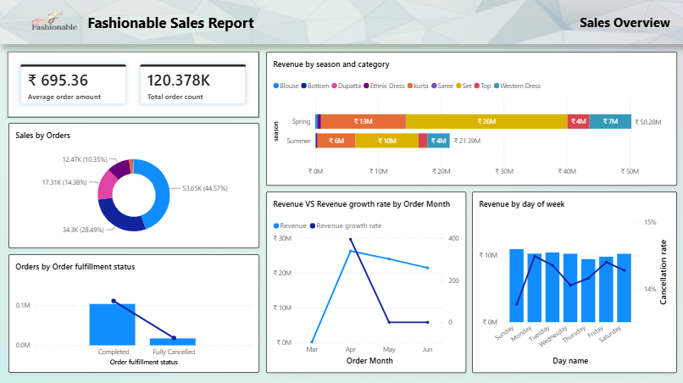
Dashboard : Sales Overview
PAGE 1 OF 3
Top line KPIs, revenue by season and category, month over month growth and weekday pattern
2 KPI Cards
Average order amount and total order count, the two headline numbers for the page.
Revenue by Season and Category
Revenue broken out across 9 categories and the seasons observed in the data.
Spring leads by a wide margin over Summer across nearly every category, roughly 50M versus 21M.
Revenue vs Growth, and Weekday Pattern
Revenue by order month plotted against month over month growth rate.
Daily revenue holds steady near 10M, with cancellation rate hovering around 14 to 15 percent.
Order Mix and Fulfilment Status
A large majority of orders complete successfully, with a much smaller share fully cancelled. The order mix donut splits total orders into four segments, the largest at 44.57%.
Notes:
Walk through KPI cards first, then revenue trend, then the two breakdown charts.

Slide 12
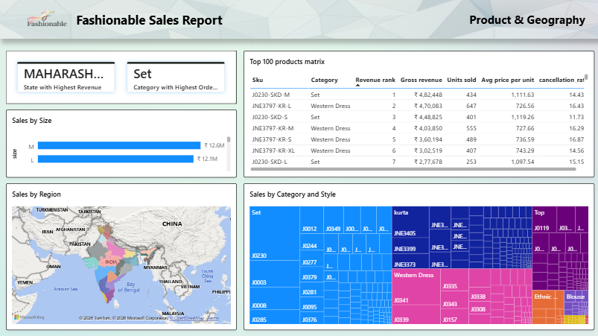
Dashboard : Product & Geography
PAGE 2 OF 3
What sells and where: top products, size mix, regional spread and category style breakdown
2 KPI Cards
State with the highest revenue (Maharashtra) and category with the highest order line count (Set), both computed as dedicated DAX measures.
Sales by Size and Region
M and L lead by revenue among sizes. A filled map shows revenue spread across Indian states.
Top 100 Products Matrix
Ranked by revenue: J0230 SKD M (Set) leads at roughly 4.82 lakh, with avg price per unit and cancellation rate shown per SKU.
Sales by Category and Style
A treemap sized by revenue: Set, kurta and Western Dress form the largest blocks, broken down further by individual style.
Notes:
Highlight the matrix at the end — conditional formatting makes the top combination instantly visible.

Slide 13
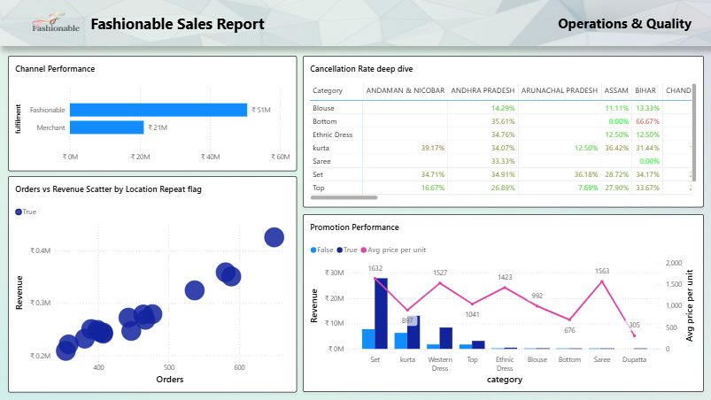
Dashboard : Operations & Quality
PAGE 3 OF 3
Fulfilment channel performance, cancellation hotspots and repeat location activity
Channel Performance
Fashionable fulfilled orders generate roughly 51M in revenue, more than double Merchant fulfilled orders at 21M.
Cancellation Rate Deep Dive
A category by state heatmap, conditionally formatted, surfaces where cancellation rates run highest and lowest.
Orders vs Revenue by Repeat Location
Locations that ordered more than once cluster on a rising line: more orders track with more revenue.
Promotion Performance
Revenue by category, split by whether a promotion was applied, with average price per unit overlaid as a line.
Notes:
Use the cancellation hotspot chart to segue into operational recommendations.

Slide 14
Key Findings
What the dashboard tells us about customers, products and regions
01
Spring drives far more revenue than Summer
02
Average order value sits at 695 rupees
Across nearly every category, Spring revenue runs well ahead of Summer, roughly 50M versus 21M, a clear signal for seasonal planning.
Across 120K plus orders, the average order amount is 695.36 rupees, a useful baseline for tracking promotional lift.
03
Maharashtra and Set lead their categories
04
Fashionable fulfilled orders far outsell Merchant
Maharashtra leads every state by revenue, and Set leads every category by order line count, both confirmed with dedicated DAX measures.
Fashionable fulfilled orders bring in roughly 51M in revenue against 21M for Merchant fulfilled orders, a 2 to 1 split worth understanding.
05
Cancellation rate is highly uneven by category and state
06
Repeat locations show revenue scaling with order count
The category by state heatmap shows some combinations cancelling far more than others, a concrete target list for operations.
Among ship to locations that ordered more than once, revenue rises roughly in step with order count, a proxy signal for loyal demand.
Notes:
Each finding ties directly to a chart shown in the previous three slides.

Slide 15
Future Improvements
What can be added as next steps, given more time or more data
Full data CI
Longer date history
Product cost data
Extend CI past parse and compile: run dbt test in GitHub Actions against a small seeded fixture database.Orchestrators can come into picture is data is from API, like Airflow or Dagster.
Current data covers few months in just one year of data.A full year or more than 2 years would make season and trend analysis much more reliable.
Adding cost-of-goods would let us calculate margin, not just revenue, which a much sharper view for marketeers.
Customer-level dimension
Contracts everywhere
Automated refresh
A dim_customer table (if an anonymised customer ID becomes available) would unlock repeat-purchase and cohort analysis.
Extend the enforced dbt contract and Type 2 history from fct_order_lines and 2 dimensions to the full model.
Schedule the Python load + dbt run + Power BI refresh end-to-end instead of running each step manually and connecting directly to duckdb or any db tables.
Notes:
Frame this as scope cut for time, not as gaps in understanding.

Slide 16
Thank You
Notes:
Close and open the floor for questions.

