Slide 1

Family Grill
House restaurant
Location Success
Prediction
Damodhar, Jangam
Data Scientist
DataCamp

Slide 2
About Family Grill House
Family Grill House is a major franchise restaurant chain with over a thousand locations. The company allows franchise operators to suggest new locations and helps them get the restaurants open and running.

Slide 3
Business goals
Identify which factors are most important in determining the profitability of a new location
Given this data, predict whether the third-year profits are positive with 75% accuracy

Slide 4
Part 1 Exploratory Data Analysis (EDA)

Slide 5
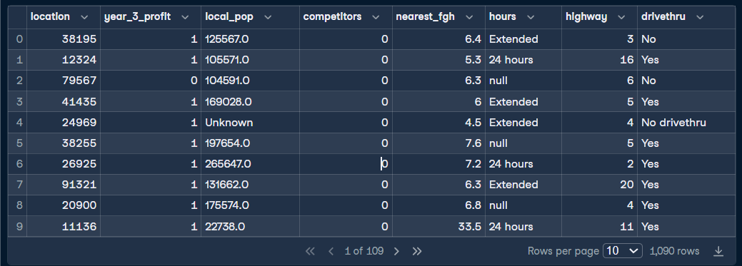
Sample data

Slide 6
Data Validation
This dataset comprises 1090 rows and 8 columns. I have validated all variables, and below are the changes made in accordance with the given data requirements:
1. location: This column is discrete and contains a unique identifier for each restaurant. It was validated to ensure uniqueness.
2. year_3_profit: This column is nominal and binary in nature, indicating whether a restaurant was profitable after 3 years or not.
3. local_pop: This column is discrete and contains the population within 30 minutes of travel to the restaurant. Any positive integer. The 'Unknown' values were replaced with the mean of the data.
4. competitors: This column is discrete and contains the number of competitor restaurants within 2 kilometers. Any positive integer.
5. nearest_fgh: This column is continuous and contains the distance in kilometers to the nearest Family Grill House location. Any positive value.
6. hours: This column is ordinal, containing one of "Regular", "Extended", or "24 hours". Since this is ordinal data, it has been mapped to preserve the order. Empty hours were substituted with the most frequent data.
7. highway: This column is discrete and contains travel time in minutes to the nearest highway. Should be at least 1 minute. Negative values were replaced with the mean to comply with the requirement of a minimum time of one minute.
8. drivethru: This column is binary and contains whether the location has a drive-through order and collection service ("Yes" or "No"). As an ordinal feature, 'No drivethru' has been replaced with 'No'.

Slide 7
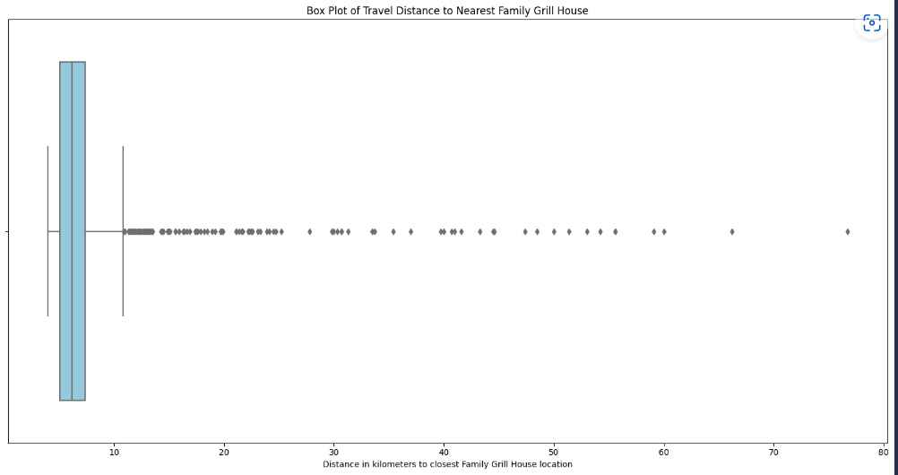
graph
GRAPH
There are many outliers in the nearest_fgh feature
The median distance from the fgh restaurant to the highway is ~15

Slide 8
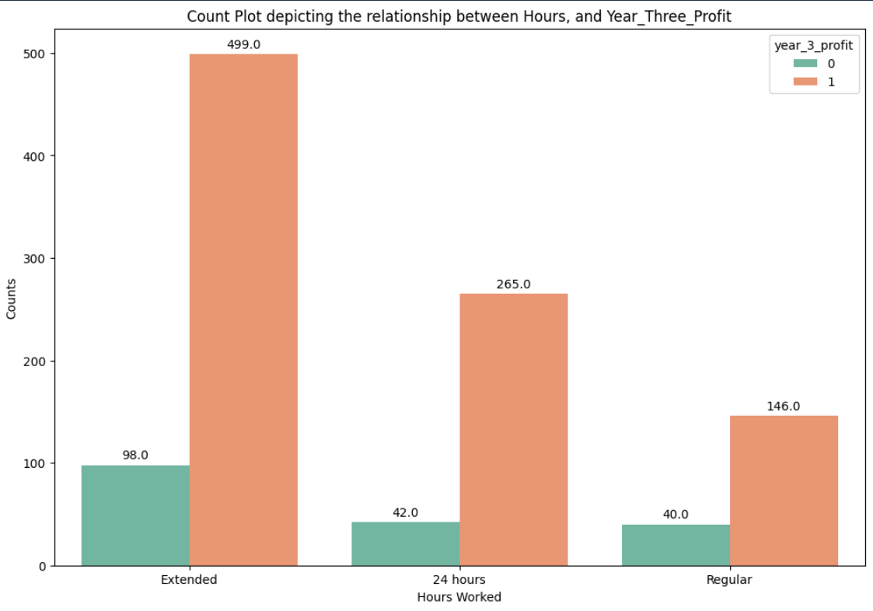
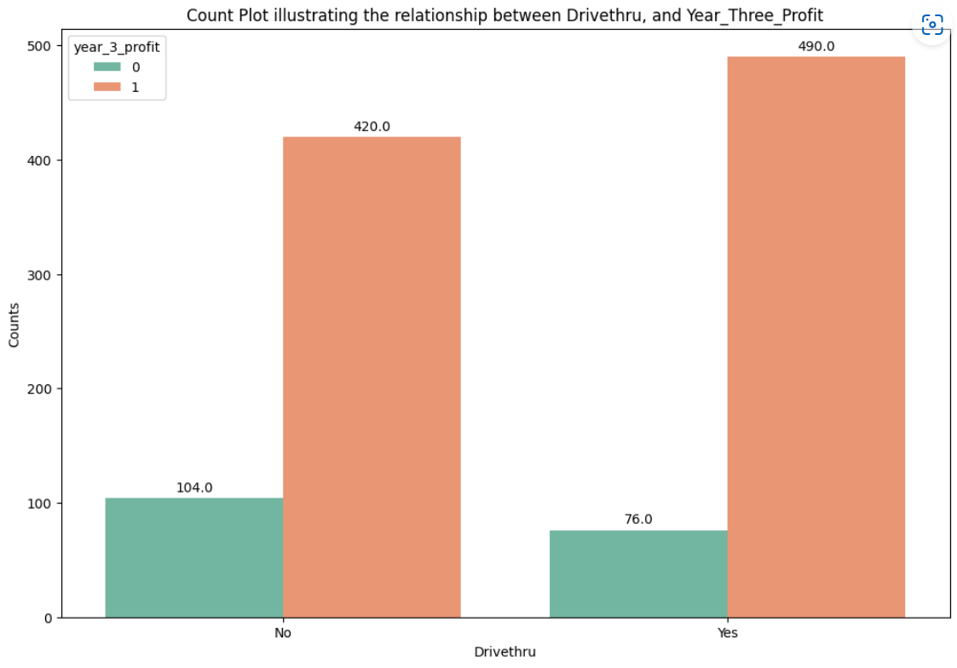
graphs
Stores with extended hours appear to be more profitable.
Drive-thru establishments seem to generate more profit than those without drive-thru.

Slide 9
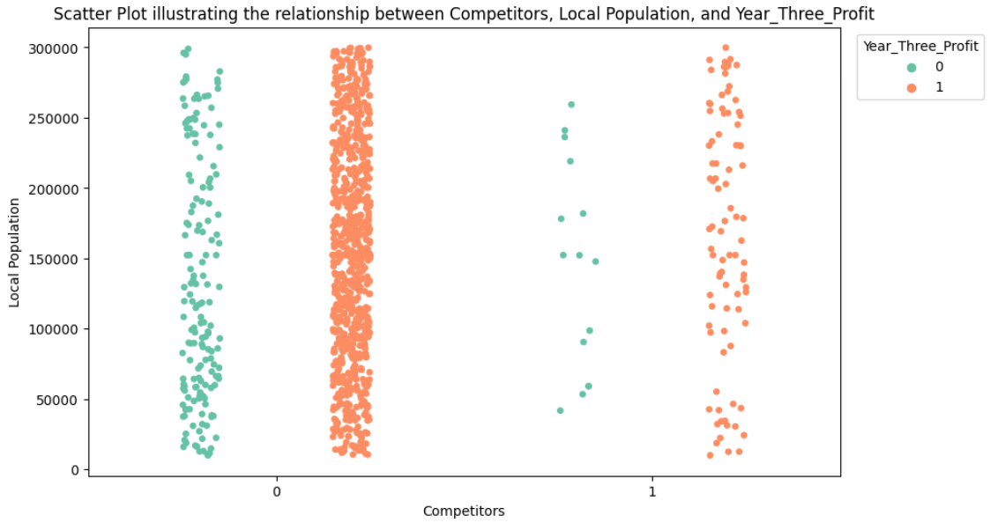
graph
Stores without competitors and with higher local populations seem to be more profitable.

Slide 10
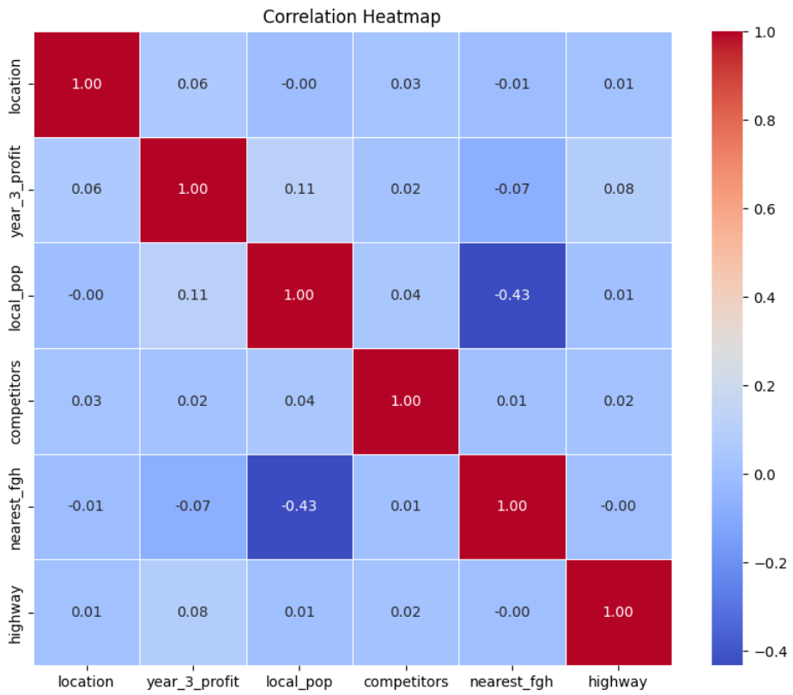
Data Correlation:

Slide 11
Part 2 Model development

Slide 12
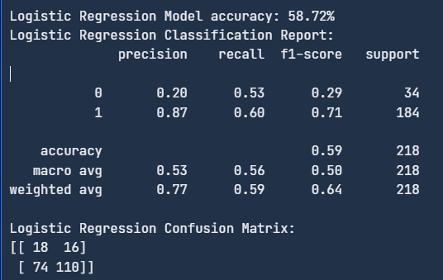
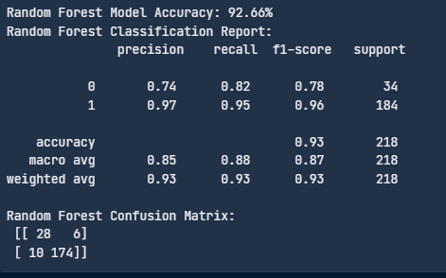





Logistic Regression Vs Random Forest

Slide 13
metrics
These are performance metrics commonly used in machine learning and data science to evaluate the accuracy of a classification model.
Precision: Precision is the proportion of true positive predictions out of all positive predictions made by the model. It measures how precise or accurate the positive predictions are. Mathematically, Precision = True positives / (True positives + False positives).
Recall: Recall is the proportion of true positive predictions out of all actual positive cases in the data. It measures how well the model is able to identify positive cases from the total number of positive cases. Mathematically, Recall = True positives / (True positives + False negatives).
F1 Score: F1 score is the harmonic mean of precision and recall, and is another measure of the model's accuracy. It ranges from 0 to 1, with higher scores indicating better performance. Mathematically, F1 score = 2*(Precision * Recall) / (Precision + Recall).

Slide 14
Logistic Regression Vs Random Forest

Slide 15
Model comparison
Random Forest is an ensemble learning method that combines multiple decision trees. This ensemble approach often results in more robust and accurate predictions, reducing overfitting compared to individual decision trees, hence the random forest should fit better than the baseline model logistic or any decision tree model
The accuracy of logistic regression is 58.7%, while the random forest achieves 92.6%.
Classification metrics reveals that the ensemble random forest exhibits better precision, recall, and F1 score.

Slide 16
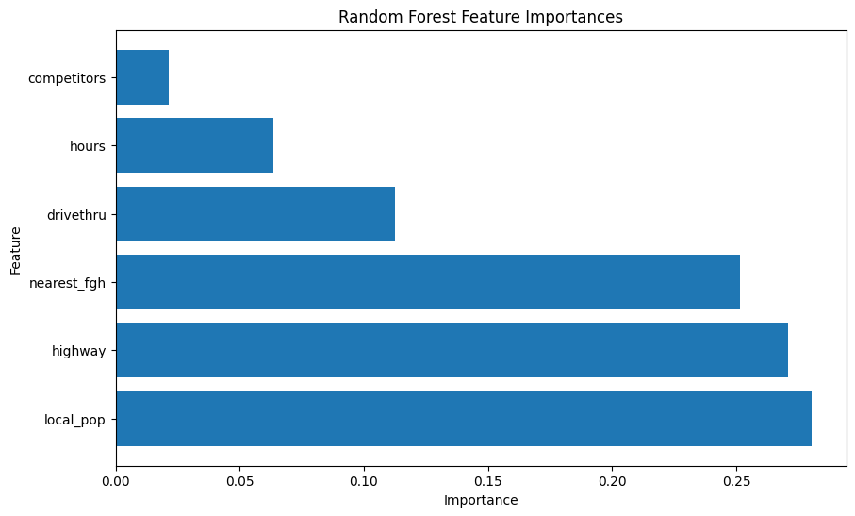
Feature Importance

Slide 17
Business
Identify which factors are most important in determining the profitability of a new location
local_pop (28%)
Highway (27%)
nearest_fgh (25%).
Given this data, predict whether the third-year profits are positive with 75% accuracy
Model able to predict 92% accuracy

Slide 18
Recommendations:
Continuously improve the model by collecting more data, performing feature engineering, and fine-tuning parameters.
Despite this, it is important to take note of unrepresented factors, such as the manageable by owner, and the residential or business district location.

Slide 19
Thank you

