Slide 1


Dynamic Synthetic Data Generator
Vyasa and Damodhar
lvyasakoundinya@deloitte.com , jdamodhar@deloitte.com
October 6th, 2023
Notes:
This presentation will introduce you to our innovative tool - the Dynamic Synthetic Data Generator. We believe that data generation is a critical part of any software development process, and we have developed a tool that simplifies the process and saves valuable time and effort. Our presentation will explain the features of the tool and demonstrate how it can be used for generating mock data for different types of configuration items. We hope you find the presentation informative and helpful.

Slide 2

Problem Statement
Generating mock data is an essential part of development and testing. However, manually creating mock data can be a time-consuming and error-prone process. We faced several challenges when generating mock data manually,
including:
Tediousness: Manually creating mock data for large datasets is a tedious and time-consuming process that can take up valuable time that could be better spent on more important tasks.
Data inconsistencies: Manual data creation can lead to inconsistencies in data, which can lead to problems during testing or in production.
Limited data: Manually creating data limits the amount of data that can be generated and increases the likelihood of data errors..
Outcomes
To address these challenges, we developed the Dynamic Syntactic Data Generator - a tool that decreases manual work to create data, generates millions of records in one go, and is easy to interact with on any platform. The tool can even generate PII mock data and can generate data based on logic testing for multiple tables. Using our tool, we were able to generate unique records and 1 million records quickly in just a few minutes for our present client. We have also observed that the generated data is consistent and accurate, which is crucial in development stories and testing stories.
Services Used
We have used this tool in various data domains, including business logic testing, data testing, values testing, etc. The tool's flexibility and ability to support all possible data types have made it an indispensable part of our data generation process.
In summary, the Dynamic Syntactic Data Generator has proved to be an efficient and effective solution to the challenges of manual mock data creation. It has saved valuable time and effort, improved data consistency, and generated large volumes of data quickly and accurately.

Slide 3

Issue
One of the issues with other mock data generation tools is that they generate random data, which often does not represent real-world data's complexity and diversity. This can lead to data inconsistencies and challenges when testing.
Solution
To address this, our Dynamic Syntactic Data Generator offers users the flexibility to create mock data based on specific number ranges, date ranges, formats, PII data, etc. This allows for the creation of more diverse and complex data that is closer to real-world data.
The tool can integrate with databases such as Teradata, Hive, SQL Server, etc. to ingest data with proper schema
Impact
The impact of this solution has been significant. Our tool has reduced manual efforts to generate data and has been integrated with ingestion tools such as Teradata and Hive for our clients. The overall process to generate 1000 - 2000 records and ingest them into a table with 100 columns has been reduced from 16-20 hours to just 20 minutes. This efficiency has saved our clients valuable time and effort and has allowed for quicker software development and testing.
With Teradata integration, ingested 1million records with 250 columns in 4hr which in unimaginable to generate and ingest manually.

Slide 4
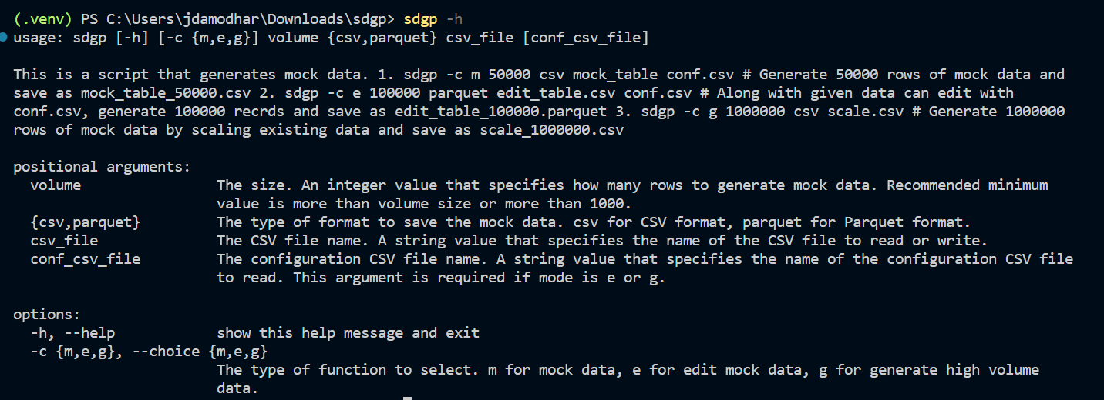
Command-line interfaces (CLI)

Slide 5
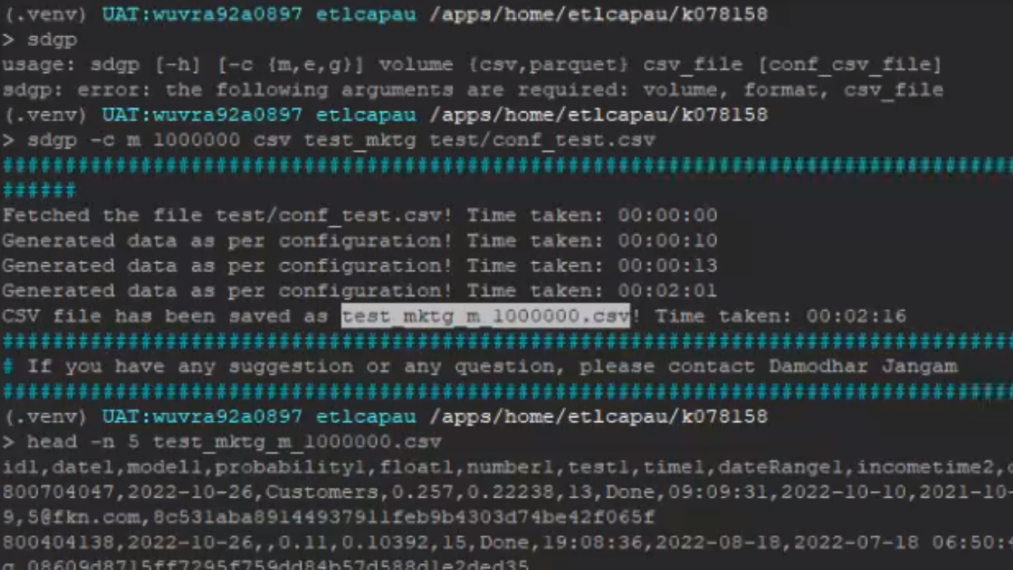

Slide 6
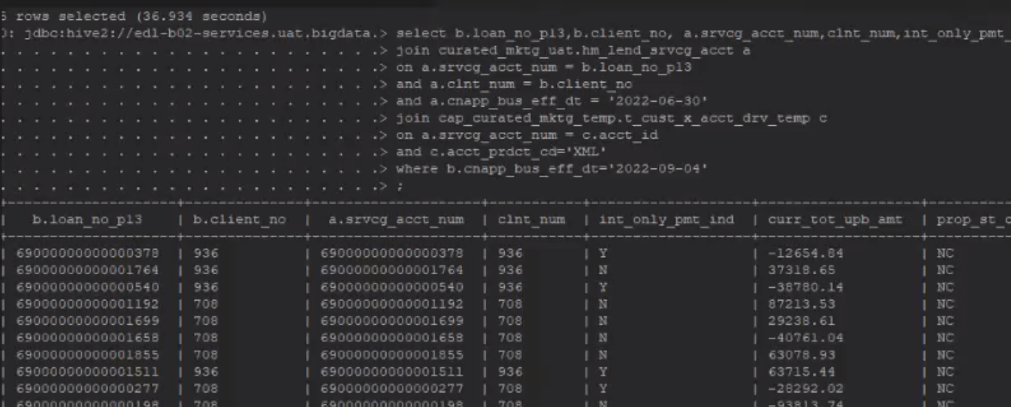
Ingested in Hive with partition and schema tested logic here below.

Slide 7
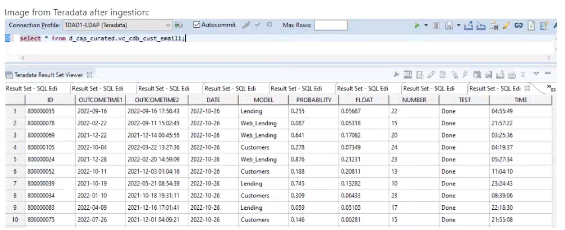
Ingested in Teradata with schema

Slide 8


Tool Documentation Link
Solution
https://jdamodhar.github.io/sdgp/

Slide 9

Vote our tool Dynamic Synthetic Data Generator
Notes:
This presentation will introduce you to our innovative tool - the Dynamic Synthetic Data Generator. We believe that data generation is a critical part of any software development process, and we have developed a tool that simplifies the process and saves valuable time and effort. Our presentation will explain the features of the tool and demonstrate how it can be used for generating mock data for different types of configuration items. We hope you find the presentation informative and helpful.

Slide 10
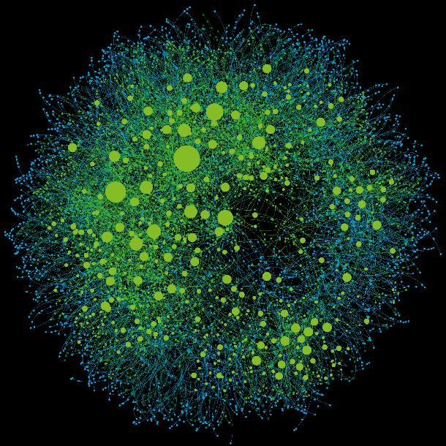
Appendix

