Slide 1
iCEDQ
-Damodhar

Slide 2
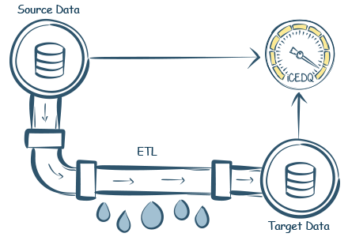
What is iCEDQ
(Integrity Check Engine for Data Quality)
iCEDQ is an ETL Testing platform, designed to identify any data issues in and across structured and semi-structured data.

Slide 3
How iCEDQ Works?
Connect
The engine connects to the configured data sources. Then it reads the data from source and target into the memory.
Identify
With complete accuracy, the engine then identifies matching records and missing records based on a defined business key or a natural key.
Validate
Once it identifies the matching record, the engine then validates the attributes for transformation, conversion, calculation failures based on the defined groovy expression.
Report
The engine captures all the missing records and expression failures in an exception report. This report is available for users to analyze the data issues and take actions based on the results.

Slide 4
What are the different types of Rules?
Checksum Rule
- Allows users to compare aggregated values between source and target
- Use cases include comparing counts between tables and files
Recon Rule
- Allows users to compare the full volume of data between the source and target
- Compares data row by row and column by column - Use cases include identifying missing records and validating data transformation ETL or business rules
Validation Rule
Enables users to verify a single source to be accurate
Can test multiple columns or rows at once
Use cases include format and null value checks and duplicate data checks
Script Rule
Allows users to write a custom groovy script in iCEDQ
Can be used as a pre-processing or post-processing Rule
Use cases include creating tables and populating them with test data and triggering PowerShell/shell/batch script

Slide 5
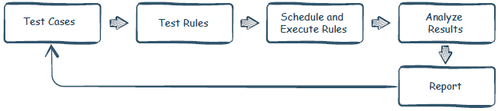
Testing Strategy
Test Rules: Create actual executable testing rules and link them to test cases.
Schedule and execute Rules: Run the test rules to get results.
Analyze Results: Understand the results so that developers can fix the processes.
Report: Generate execution reports as well as summary reports.
Test Cases: Based on the business requirements and the mapping document, create testcases

Slide 6
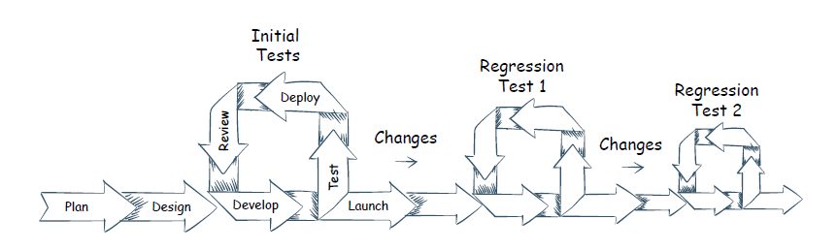
Regression Testing
Some of the factors that cause refactoring
1. Defects in code.
2. Changes in business logic.
3. Data sources change.

