Slide 1
Practical study of a basic genetic algorithm on the knapsack problem
Resolución de problemas con metaheurísticas
Master Universitario en Investigación en Inteligencia Artificial (UIMP)
Author: David Mora Garrido

Slide 2
INDEX
1. Introduction
2. Problem formulation
3. ssGA implementation
4. Methodology
5. Results
6. Conclusions

Slide 3
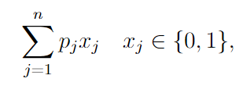
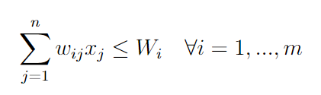
introduction
Multidimensional Knapsack Problem: generalization of the basic binary Knapsack Problem to multiple knapsacks or dimensions.
Given a list of n items, the profit p_{j} for item j, a number m of dimensions (‘knapsacks’), the weight (required capacity) w_{ij} of item j for knapsack i, and a total per-dimension capacity W_{i} :
Maximize
subject to

Slide 4
DISAMBIGUATION
Multiple knapsacks - not to be confused with physical dimensions
When an item is selected, it consumes a certain capacity from all knapsacks/dimensions
Better problem formulation or real use case by [Petersen, 1967]:
Each item is an R&D project
A knapsack is a required resource: R&D, marketing, implementation, etc.
Each R&D project consumes a certain amount of each resource
Each resource is limited, there’s a maximum amount or capacity

Slide 5

Problem formulation (for a GENETIC ALGORITHM)
Problem data:
number of items (n),
profit of the items (p₁, ..., p_{n}),
number of knapsacks/dimensions (m),
total capacity of each knapsack (W₁, ..., W_{m}),
weight or consumed capacity of each item for each dimension (m times n matrix containing w_{ij} weights).
Solution representation: binary vector of length n, position j is 1 if the j^{th} item is selected, otherwise it’s 0.
Infeasible solutions exist
Size of the state space depends on the problem instance, upper bounded by 2^{n}.

Slide 6


ssGA implementation
Base implementation (NEO investigation group, Universidad de Málaga):
Selection scheme: binary tournament
Operators:
Single-point crossover applied given a probability, only one child is generated.
Mutation: per-gene (bit) evaluation given the specified probability.
Insertion: generated individual replaces the worst individual.
Our modifications/additions:
New class (ProblemMKP.java) with the required attributes to hold the problem instance data and the functionality to compute whether a solution is feasible and depending on that the fitness (infeasible solutions are tolerated, their fitness is -1).
[Chu and Beasly, 1998] proposes different alternatives to deal with these solutions.
Execution functions to carry out the execution/evaluation/gathering of results (Exe.java)
https://github.com/damogad/MKP

Slide 7

input .txt file with all the MKP instances
code implementation of the ssGA
contains .csv with all the results
instructions on how to execute (compiled or .jar), used input parameters
.jar file
R notebook executable in RStudio
html output of the R notebook

Slide 8
methodology
Employed instances:
3 different different instances, each of a different relative size (small, medium, large), extracted from [Petersen, 1967]. 3rd, 5th and 7th problems in http://people.brunel.ac.uk/~mastjjb/jeb/orlib/files/mknap1.txt
Fixed population size: 100, 100 and 200, respectively.
Types of studies:
Fixed number of evaluations: evaluate obtained fitness
Reach the optimal fitness: evaluate the needed number of evaluations
25 candidates/combinations of these hyperparameters:
Crossover probability: {0.6, 0.7, 0.8, 0.9, 1.0}
Mutation probability: x / n, where x is {1, 2, 3, 4, 5} and n is the number of items (number of genes). Meaning: average expected number of mutated genes per individual.

Slide 9

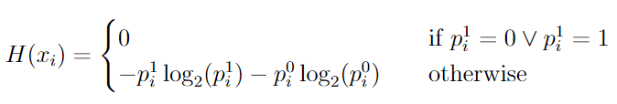
methodology
Metrics:
Required number of evaluations (2nd study). 1st study: 1000, 10000 and 1000000, respectively
Fitness of the best individual in the last population. Relevant for both studies, as we may obtain an ‘unfinished’ execution in the 2nd study (50000000 max. evaluations).
Average fitness in the complete last population
Measure of the variety in the last population genotype: Shannon Entropy
where

Slide 10
methodology
The ssGA is executed 30 times for each combination of hyperparameters (crossover+mutation)
Statistical hypothesis testing:
Parametric methods:
Shapiro-Wilk normality test
ANOVA
Non-parametric methods:
Kruskal-Wallis test
Wilcoxon rank-sum test (Mann-Whitney U test) with [Benjamini and Hochberg, 1995] correction to avoid inflating the Type I error
Tested variables:
1st study: relative deviation from the target fitness -> (target – obtained)/target
2nd study: number of evaluations
0.02 level of significance (α)

Slide 11
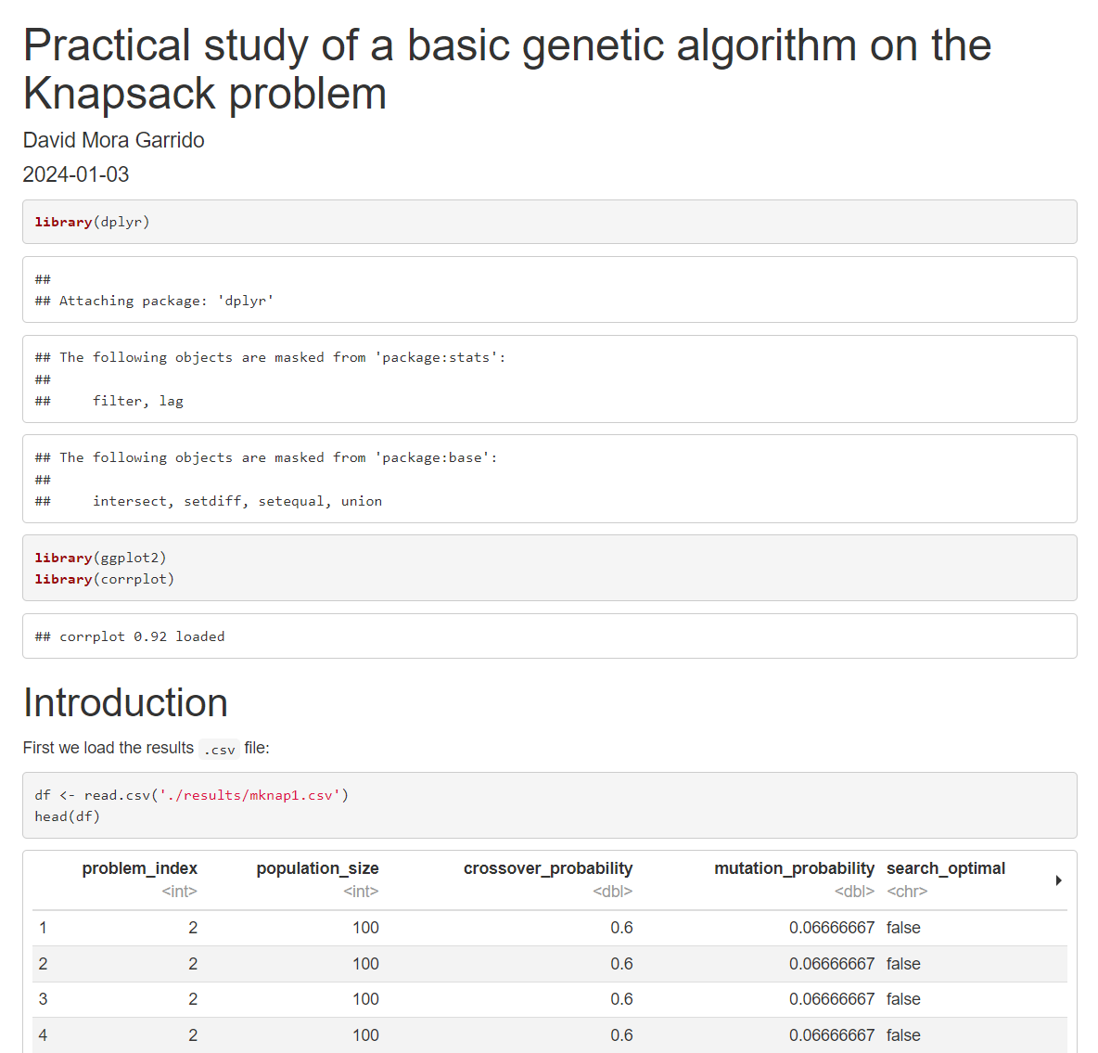
RESULTS
Processing/evaluation of the results in R: https://github.com/damogad/MKP/blob/main/results_notebook.Rmd
Already generated output (html): https://github.com/damogad/MKP/blob/main/results_notebook.html

Slide 12
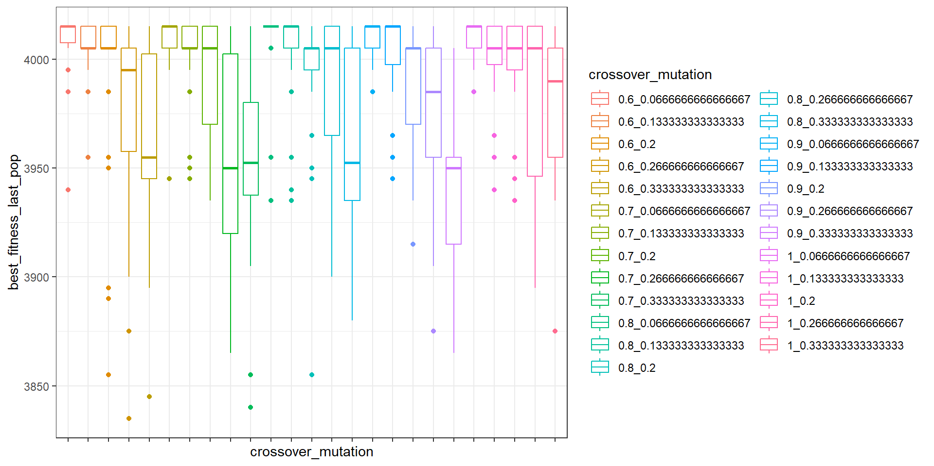
RESULTS: 1st study
Graphical depiction of the results for each combination of crossover and mutation probabilities (small instance):
See the similarities/pattern?

Slide 13
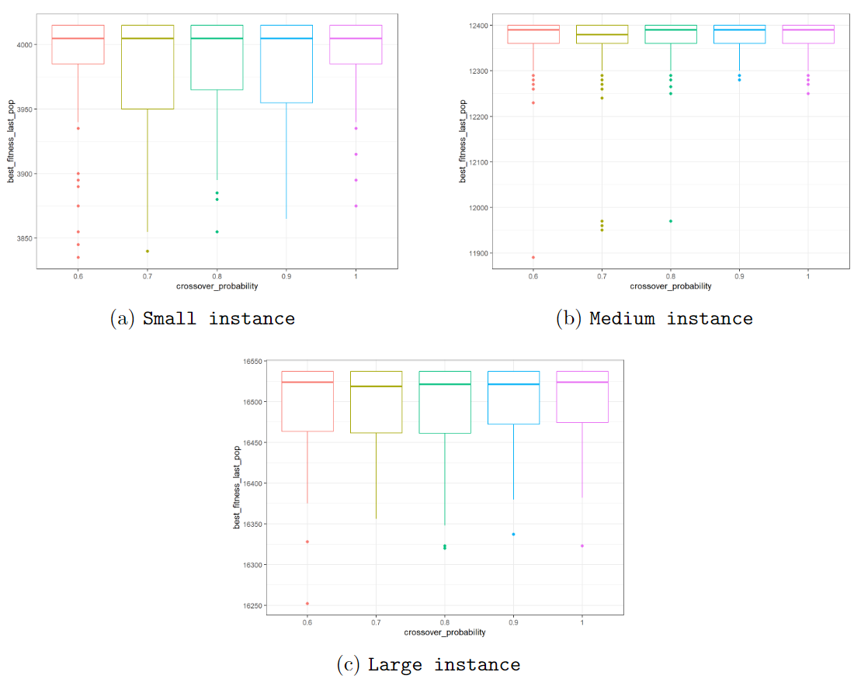
RESULTS: 1st study
Crossover probability does not seem to have a big effect…

Slide 14
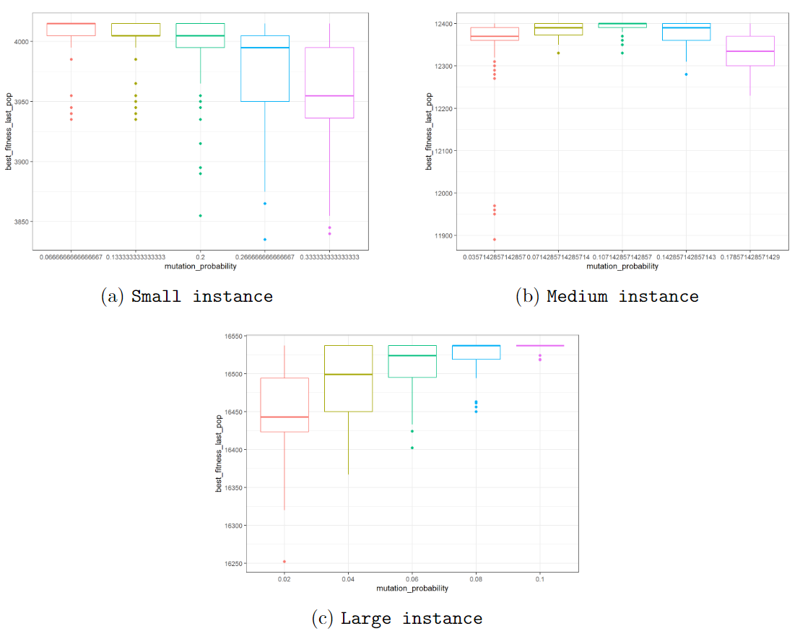
RESULTS: 1st study
However, the mutation probability does seem to influence the best obtained fitness

Slide 15
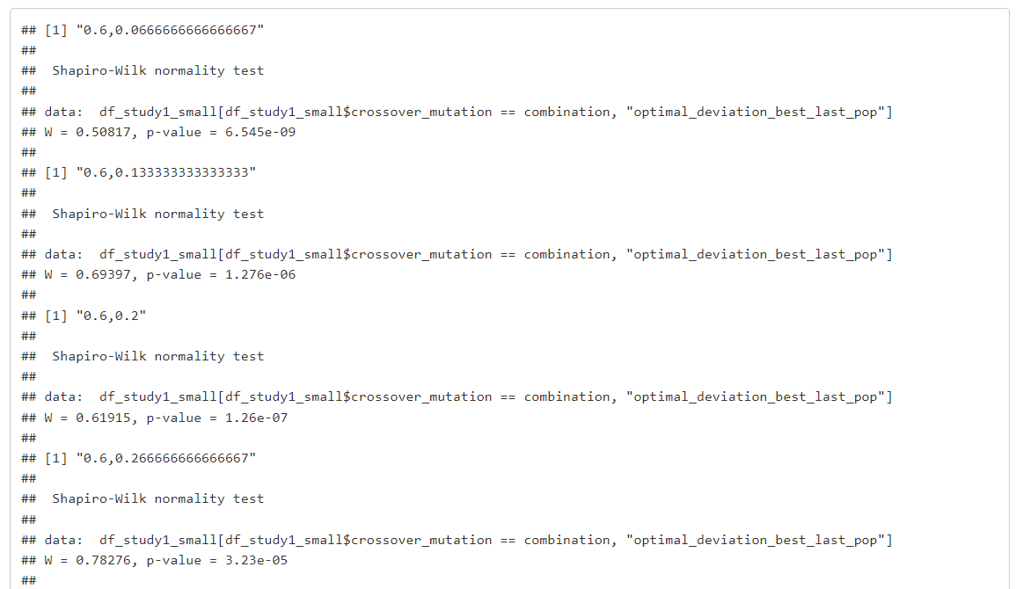
RESULTS: 1st study
Verification of assumptions: hypothesis tests
Shapiro-Wilk normality test: null hypothesis rejected for most combinations, for the 3 instances
…

Slide 16
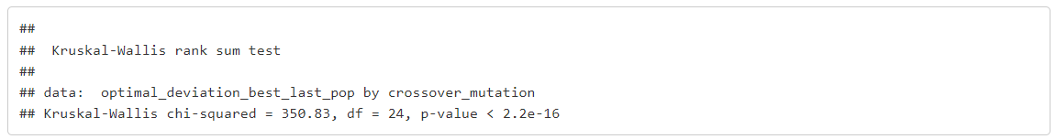
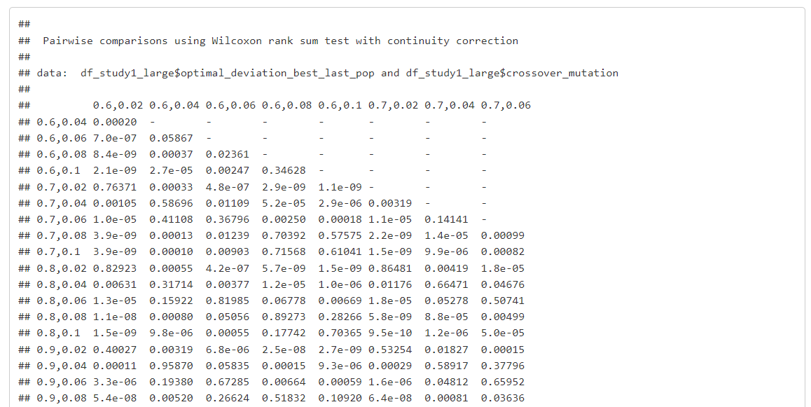
RESULTS: 1st study
Verification of assumptions: hypothesis tests
Kruskal-Wallis test on the equality of the deviation from the optimal among all the combinations of crossover + mutation probabilities: null hypothesis rejected for the 3 instances → the distribution of at least one combination is not the same as the rest
Next step: Wilcoxon rank-sum test between every pair (300 total tests) with BH correction → significant number of pairs that are not equal between them (154, 160 and 186, respectively)
…

Slide 17
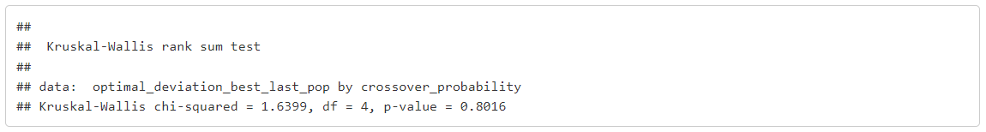
RESULTS: 1st study
Verification of assumptions: hypothesis tests
But we saw that the crossover probability did not seem to affect the best obtained fitness significantly…
Grouped by crossover probability (only):
Kruskal-Wallis test: null hypothesis not rejected for the 3 instances → obtained fitness can be considered equal regardless of the crossover probability (on the tested set of values)
Grouped by mutation probability (only):
Kruskal-Wallis test: null hypothesis rejected for the 3 instances → at least one mutation probability yields a different fitness
Wilcoxon rank-sum tests (5 mutation probabilities = 10 pairs to be tested) → 10, 9 and 10 tests are rejected, respectively, so there’s a significant influence of the mutation probability on the fitness

Slide 18
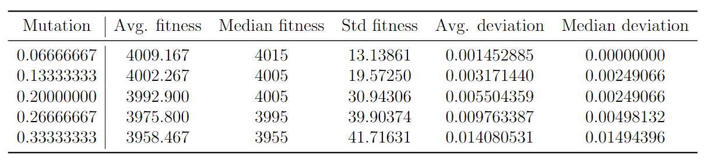
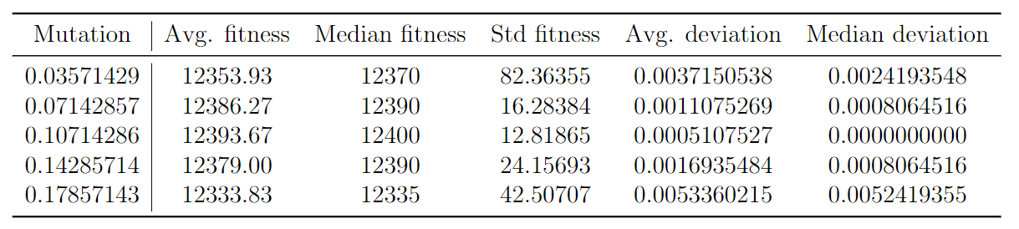
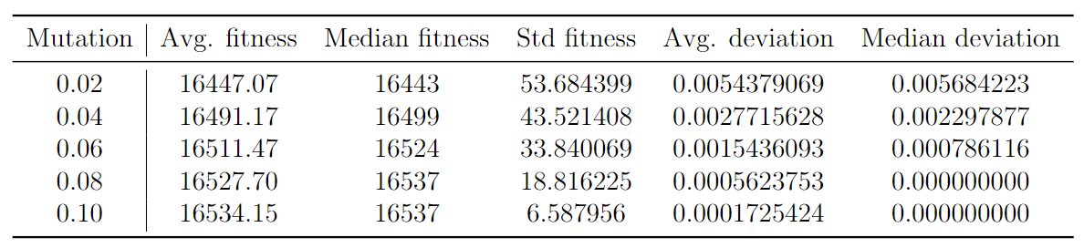
RESULTS: 1st study
Numerical results (mean/median/std best fitness, mean/median deviation from optimal) for each mutation probability:
Smaller instance, smaller number of expected mutated genes by chance per individual
Medium instance, medium number of expected mutated genes by chance per individual
Larger instance, larger number of expected mutated genes by chance per individual

Slide 19
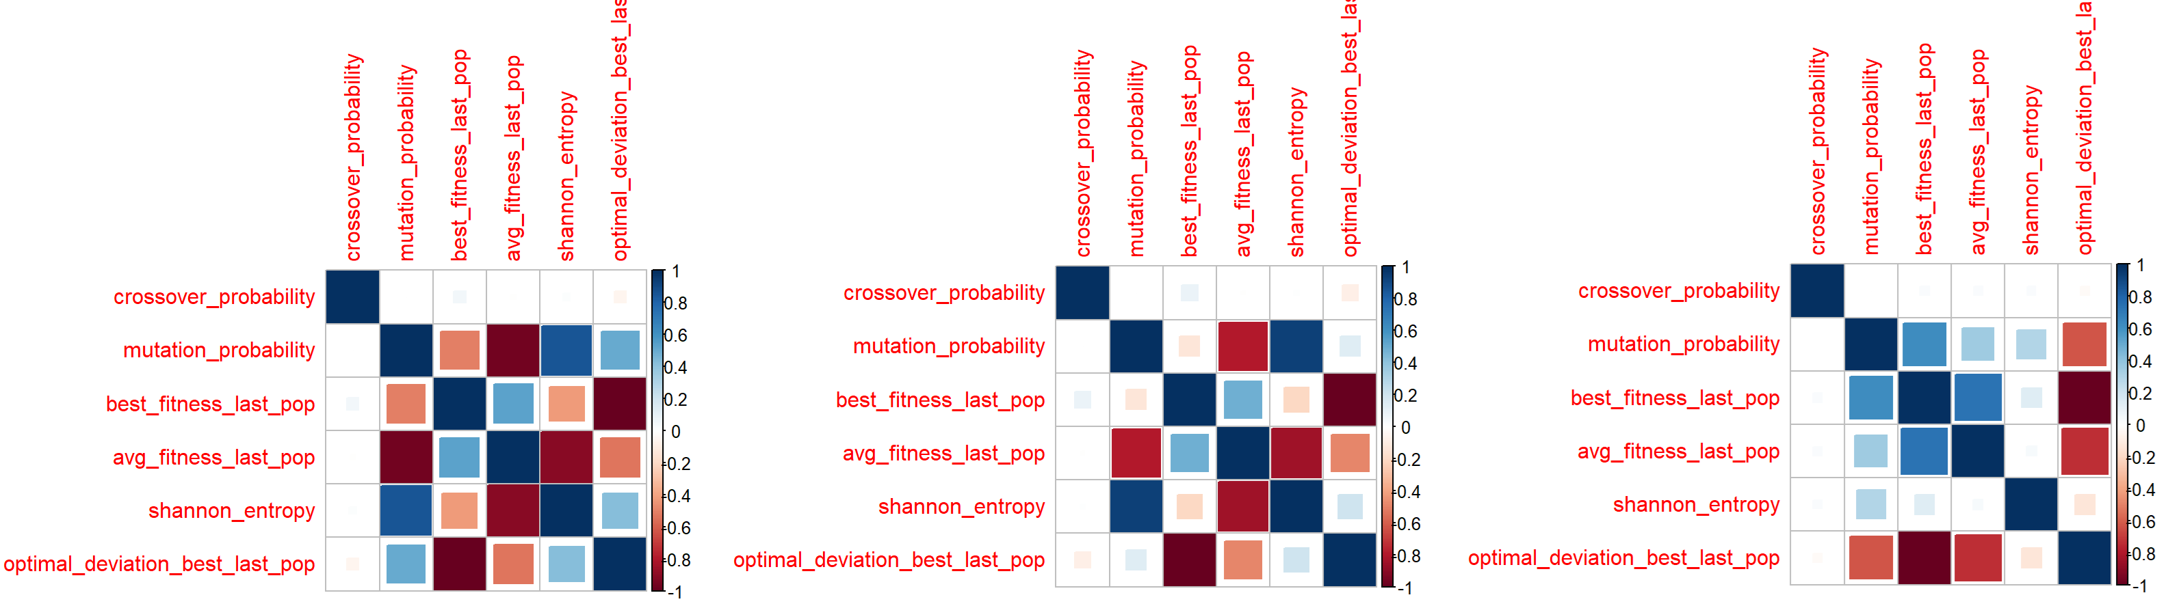
RESULTS: 1st study
Small and medium instances: negative correlation between the average fitness of last population and the entropy
Large instange: (almost) no correlation between the aforementioned variables
→ Greater num_items/knapsacks may increase the diversity in the genotype?

Slide 20
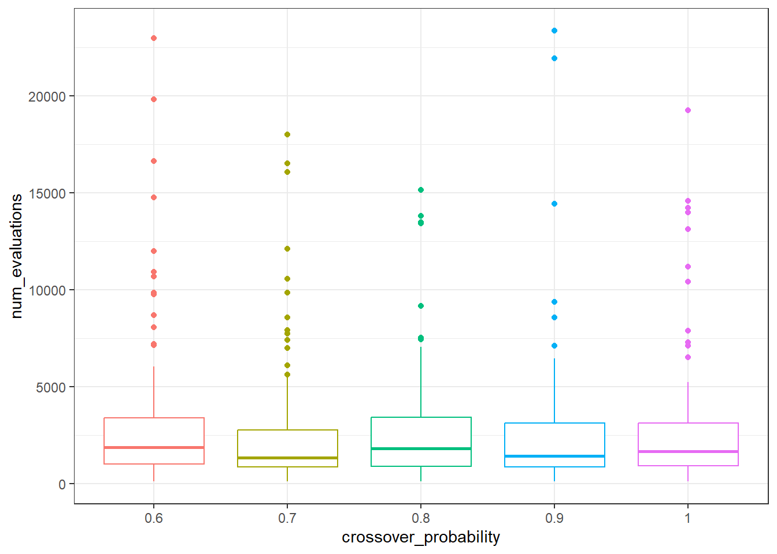
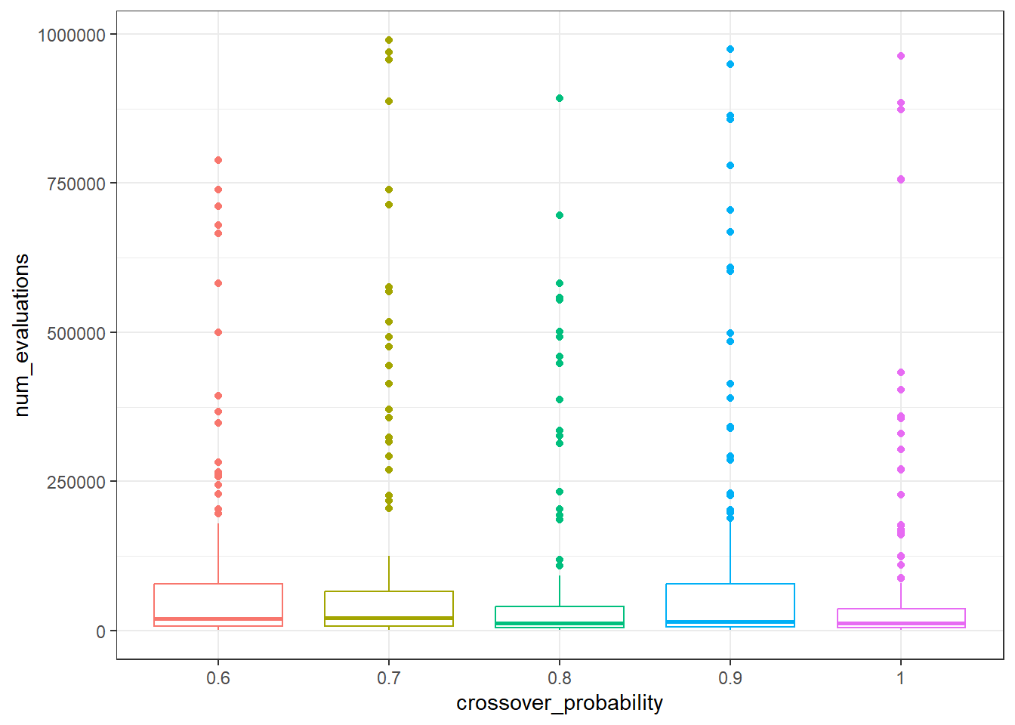
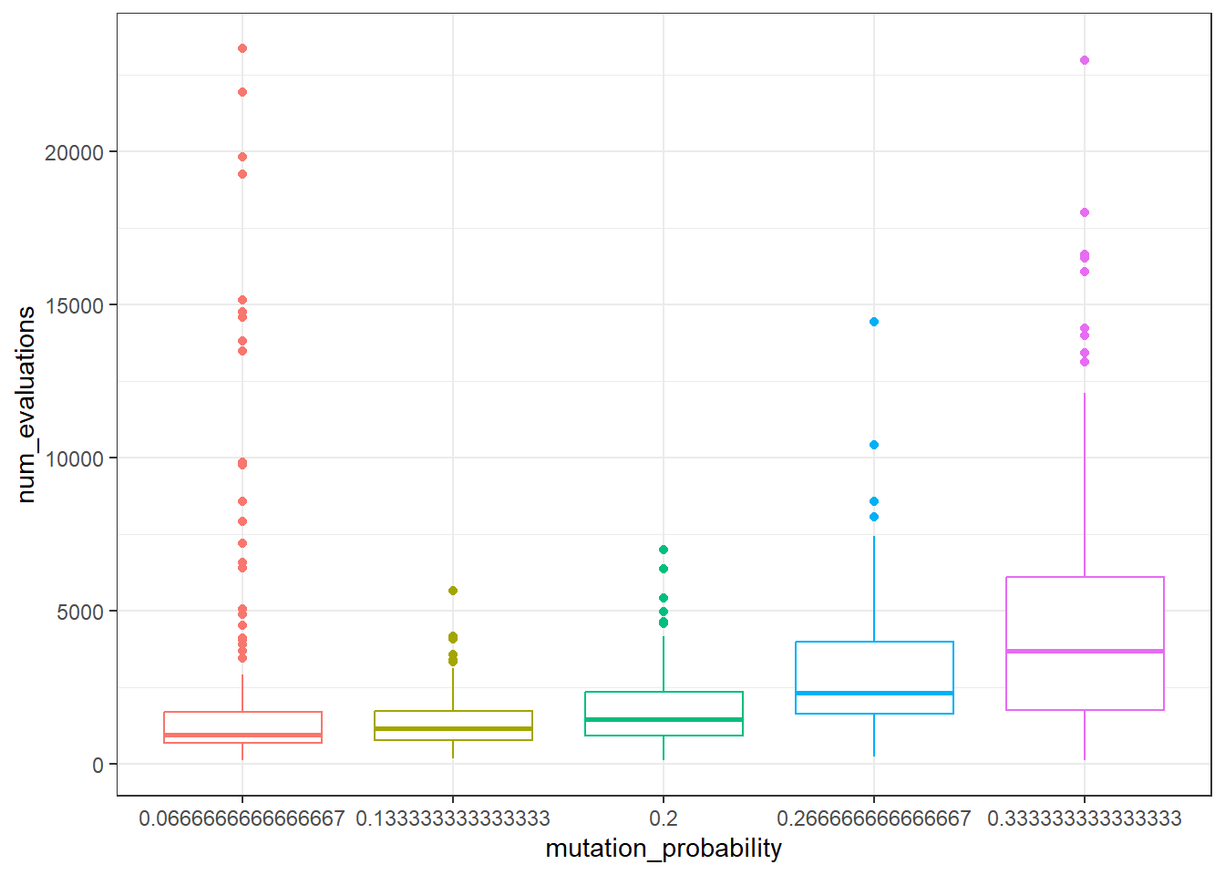
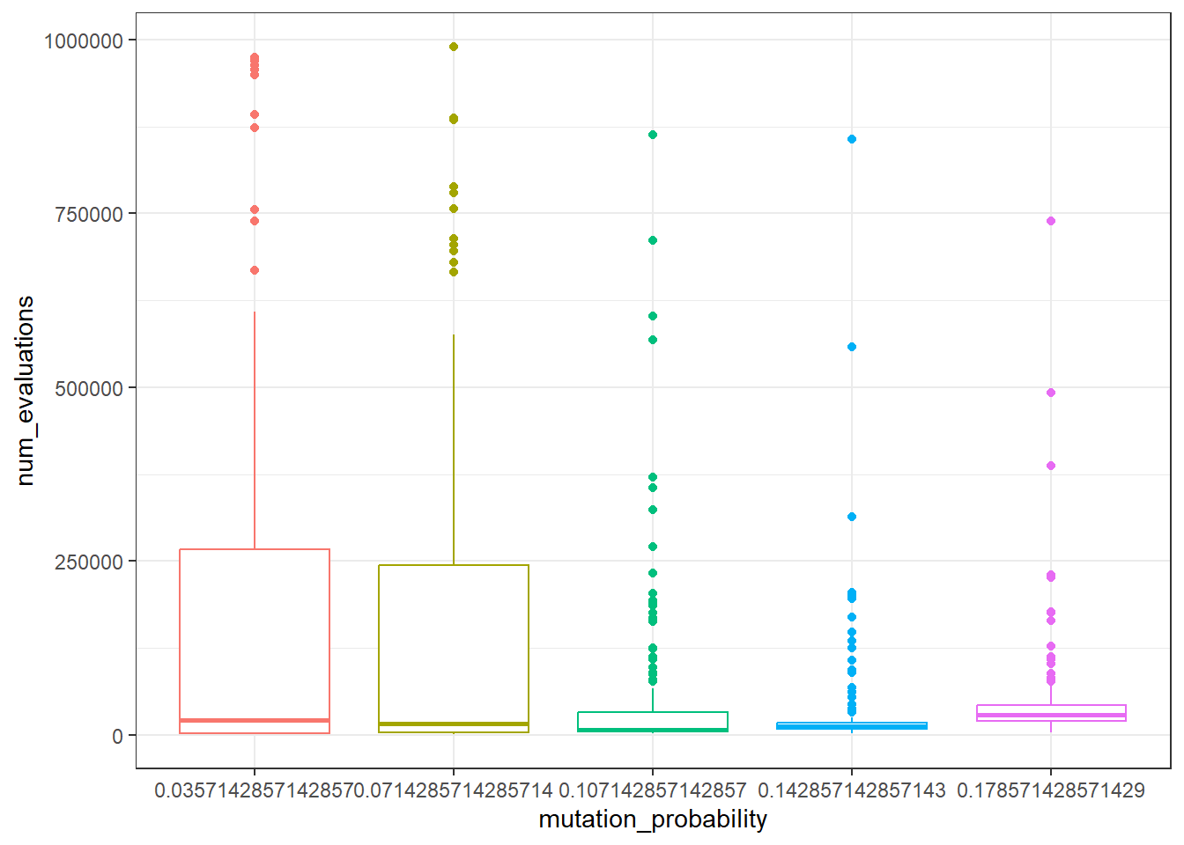
RESULTS: 2nd study
Small and medium problem instances: same results than 1st study
Different crossover probabilities yield similar number of evaluations
Different mutation probabilities yield statistically significant differences in the number of evaluations
For a smaller instance, a smaller number of expected mutated genes on avg. yields less evaluations
Analogously for the medium-sized instance (medium number in the tested set of values)
(tested again with Kruskal-Wallis + Wilcoxon rank-sum tests)

Slide 21
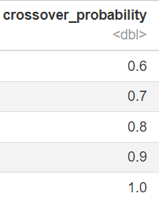
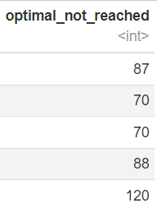
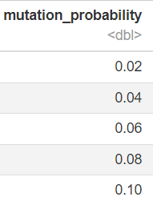
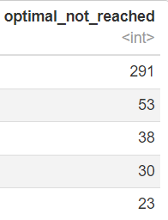
RESULTS: 2nd study
Large instance: several peculiarities
Optimal fitness was not always reached (‘unfinished’ execution)
Modification: max limit of 50000000 evaluations when targeting a fitness value
If not reached, metrics on current state written as result and execution is reset
Reset until obtaining a ‘finished’ execution
We cannot use the unfinished executions for the study (435)
‘Stripped’ results for tests, but number of such executions checked:
Crossover probability: evenly distributed, except for one value
Smaller mutation probability, greater number of unfinished executions

Slide 22
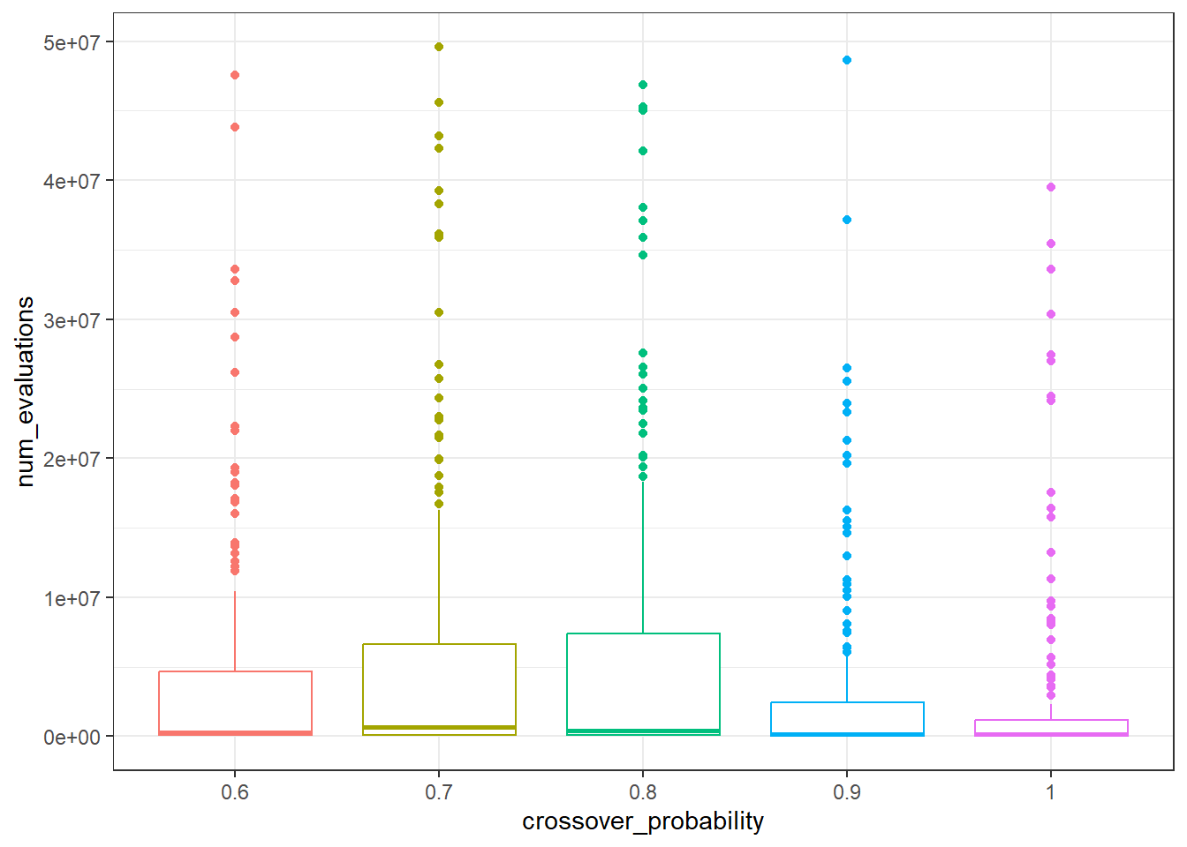
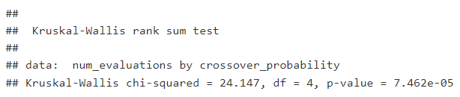
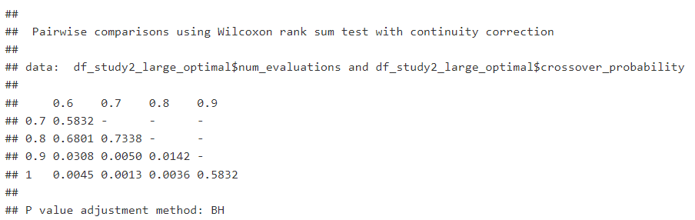
RESULTS: 2nd study
Large instance: several peculiarities
‘Stripped’ results:
Different crossover probabilities yield a different number of evaluations

Slide 23
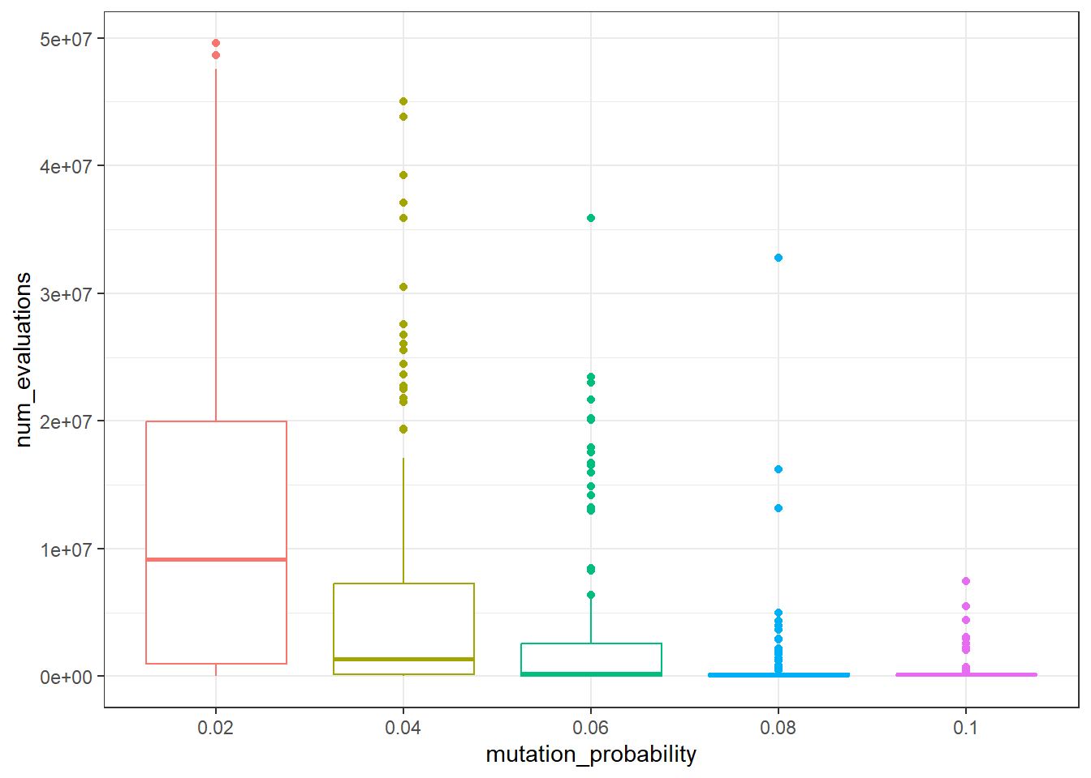
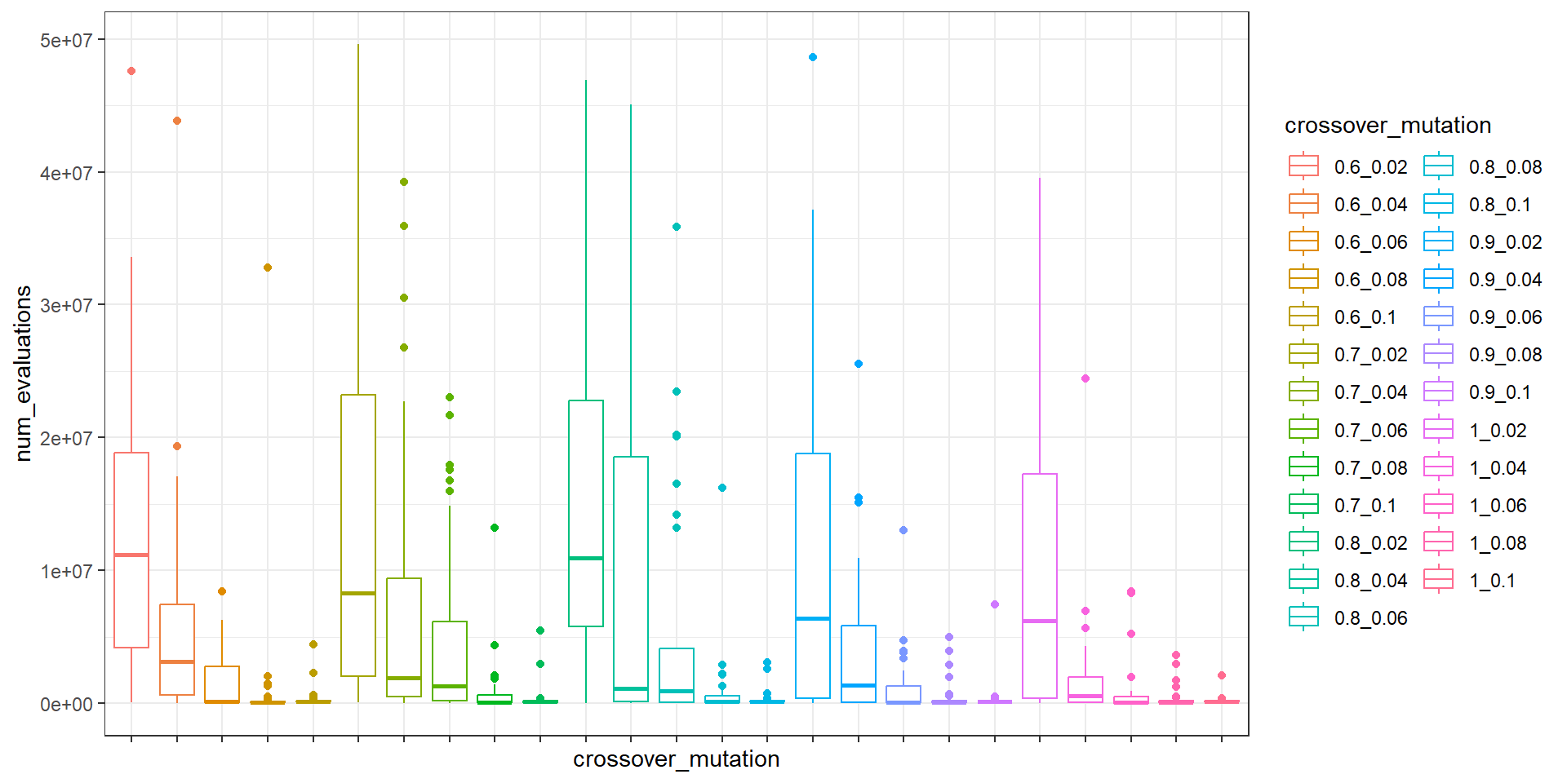
RESULTS: 2nd study
Large instance: several peculiarities
‘Stripped’ results:
Different mutation probabilities yield a different number of evaluations (already expected)
Thus, as Kruskal-Wallis test for the equality of the number of evaluations of all the crossover+mutation combinations is rejected, given the Wilcoxon test results and the balance between median, mean and variance, best combination is (c=1.0, m=0.08).

Slide 24
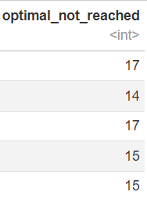
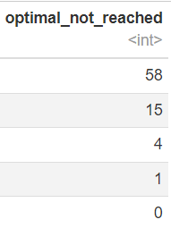
RESULTS: 2nd study
Large instance: fairer study
Relaxation of the problem: trying to get as less unfinished executions as possible
99.5% of the optimal: still many unfinished (77)
99% of the optimal: only 3 unfinished

Slide 25
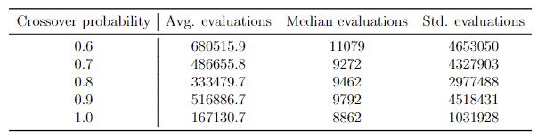
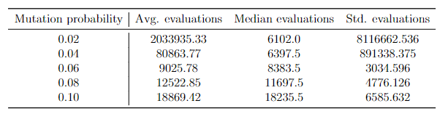
RESULTS: 2nd study
Large instance: fairer study (99%)
‘Back to normal’:
No significant differences among the tested crossover probabilities
Kruskal-Wallis rejected for the results grouped by mutation probabilities, with Wilcoxon test and numerically aggregated results, best result is obtained with 0.06 (3 expected mutated genes per individual on average)
Mutation probability: 0.06 or 3/50 (now) vs 0.1 or 5/50 (then)
May be caused by the problem being a ‘relaxed’ version
The original problem may be tailored to be hard to get close to the optimal (100%)
Thus, it may be easier to escape a local optimum with a smaller probability than before

Slide 26
CONCLUSIONS
Most results are very similar when comparing the two studies → fixed number of evaluations is better, time is guaranteed to be bounded
Overall not significant effect of the (tested) crossover probabilities → nature of the problem and number of existing constraints, easier to solve an unfeasible solution by mutating than by applying the crossover operator
Improvements/future work
Applying a ‘repair’ operator or a heuristic in order not to add unfeasible solutions to the population.
[Chu and Beasley, 1998] approach: greedy algorithm based on a DROP phase and an ADD phase
[Shah, 2020]: Lagrangian multipliers + ‘greedy crossover’

Slide 27
REFERENCES
[Benjamini and Hochberg, 1995] Benjamini, Y. and Hochberg, Y. (1995). Controlling the false discovery rate: A practical and powerful approach to multiple testing. Journal of the Royal Statistical Society. Series B (Methodological), 57(1):289–300.
[Chu and Beasley, 1998] Chu, P. and Beasley, J. (1998). A genetic algorithm for the multidimensional knapsack problem. Journal of Heuristics, 4(1):63–86.
[Petersen, 1967] Petersen, C. C. (1967). Computational experience with variants of the balas algorithm applied to the selection of rd projects. Management Science, 13(9):736–
750.
[Shah, 2020] Shah, S. (2020). Genetic algorithm for the 0/1 multidimensional knapsack problem.

