Slide 1
ANDELA GRADUATE “VIBE CODING” CHALLENGE · PROJECT 2
Enterprise Security
Guardrail Auditor
Shift-left security scanning for Infrastructure-as-Code
Tagle Tag · Connector — Foundation Operator
Damien Gallagher github.com/damogallagher/andela

Slide 2
01
ACT ONE
The mandate
A “Vibe Coding” exercise: I hold the architectural vision, the AI agent writes every line.

Slide 3
THE CHALLENGE
01 · THE MANDATE
I architect, the AI engineers
1
Human-in-the-loop architect
I set vision, constraints and acceptance criteria; the AI agent wrote 100% of the code — no manual edits.
2
Auditable by design
Every instruction is logged in prompts.md — 58 prompts forming a complete trail from scaffold to production-ready.
3
One agent, end-to-end
The same AI tool throughout, preserving architectural consistency across every layer of the stack.
4
Time-boxed delivery
A 4–6 hour MVP target, shipped as a public repo, a full prompt log, and this generated deck.
My value was not syntax — it was directing the system: architecture, interfaces, the quality bar, and the trade-offs.
Guardrail Auditor · 01

Slide 4
WHY IT MATTERS
01 · THE MANDATE
Breaches come from misconfiguration
Most cloud incidents are not zero-days — they are risky settings that ship in Terraform and CloudFormation before anything ever reaches the cloud.
Open SSH ingress
Public S3 buckets
Security groups exposing port 22 to 0.0.0.0/0
Public ACLs and disabled versioning
Wildcard IAM
Hardcoded secrets
Action:* on Resource:* — full privilege
Credentials and AWS keys committed to IaC
The cheapest place to catch them is the pull request — not production.
Unencrypted databases
No backup / retention
Storage encryption switched off
Deletion protection and versioning suspended
Guardrail Auditor · 02

Slide 5
02
ACT TWO
The solution
A Python, API-first guardrail auditor — one scanner core serving humans and pipelines alike.

Slide 6
THE SOLUTION
02 · THE SOLUTION
A guardrail auditor for humans and pipelines
A Python, API-first auditor that scans IaC against a security baseline and presents a visual Risk Score.
Scans
Terraform (.tf) + JSON / CloudFormation
◆
Local-first by design
Detects
100+ AWS / Azure signatures, 9 control families
Runs entirely on Docker Compose — no cloud credentials needed to develop or review.
AWS infrastructure is fully authored in Terraform but never auto-provisions, honoring the challenge’s no-resources rule.
Scores
Normalized 0–100 risk health, color-coded
Persists
Postgres-backed scan history & audit trail
Surfaces
Dashboard · REST API · CLI gate · SARIF
Guardrail Auditor · 03

Slide 7
WHO USES IT
02 · THE SOLUTION
Five use cases
1
PR / pre-merge gate
python -m app.cli scan --fail-on critical blocks risky infra in CI before merge.
2
Developer self-service
Engineers upload a .tf / .json file and see findings plus fixes instantly in the dashboard.
3
GitHub Code Scanning
SARIF export lights up the Security tab and inline pull-request annotations.
4
Compliance audit trail
Every scan is persisted in Postgres with timestamps, providing durable evidence.
5
Regression detection
Compare two scans to prove a change introduced — or resolved — risk.
Guardrail Auditor · 04

Slide 8
ARCHITECTURE
02 · THE SOLUTION
One scanner core, four interfaces
React Dashboard
upload · filter · trend · SARIF
FastAPI app
Postgres
REST scans, upload,
compare, SARIF, health
scan runs + findings
(audit trail)
Pipeline CLI
python -m app.cli scan
Scanner core
IaC sources
GitHub Actions
Terraform rules + JSON rules
sample_iac / uploads
lint · test · SARIF · gate
Rule logic lives once in app.scanner.RULES — reused by dashboard, API, CLI, tests and SARIF. Five trade-offs recorded as ADRs in docs/adr/.
Guardrail Auditor · 05

Slide 9
03
ACT THREE
The product
A polished React dashboard that makes infrastructure risk legible at a glance.

Slide 10
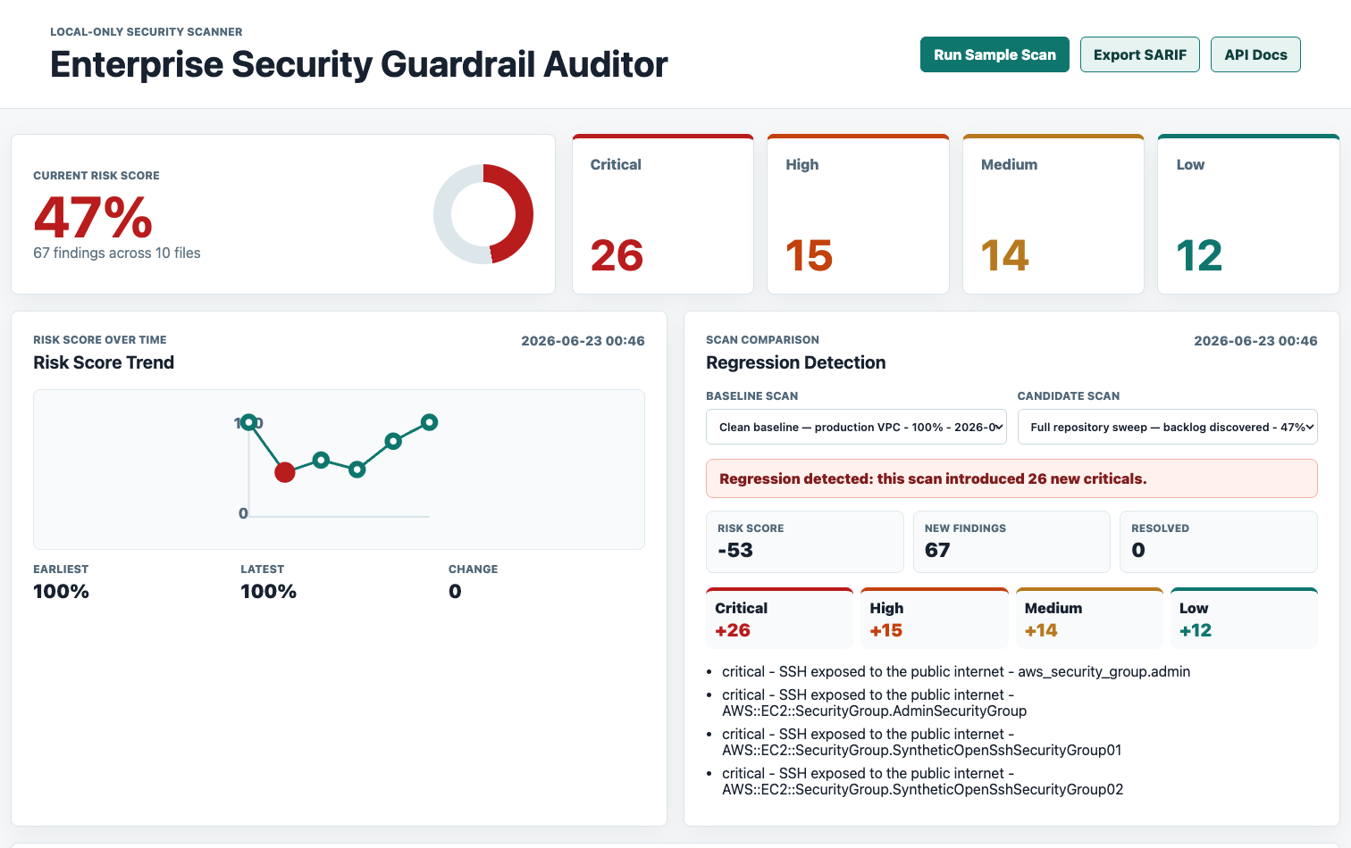
LIVE APPLICATION
03 · THE PRODUCT
The Risk Score, color-coded
Thresholds make risk legible instantly: green > 90 · amber 70–90 · red < 70
A high-risk scan: 47%, 67 findings across 10 files — severity breakdown and a regression alert in one view.
Guardrail Auditor · 06

Slide 11
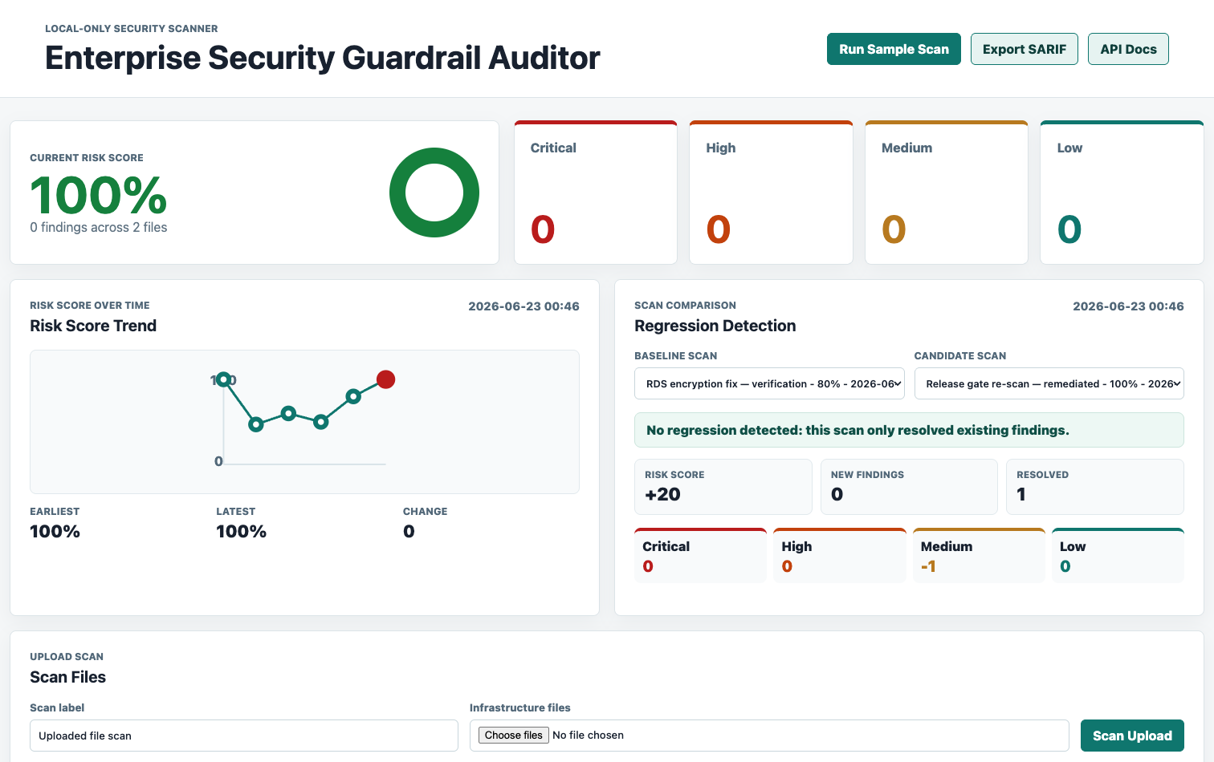
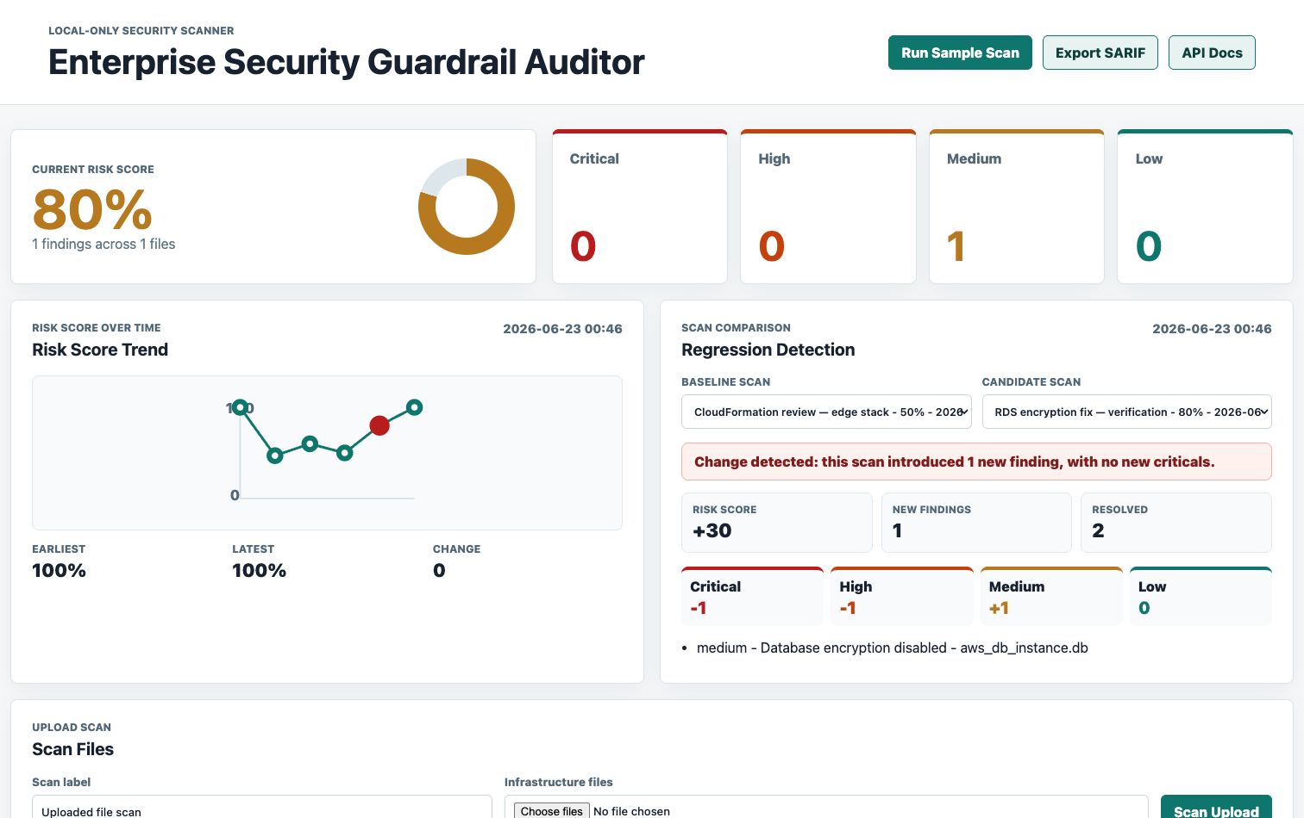
LIVE APPLICATION
03 · THE PRODUCT
Green & amber score states
100% — green. A clean baseline with zero findings.
80% — amber. One medium finding; the normalized model never collapses to zero on small scans.
Guardrail Auditor · 07

Slide 12
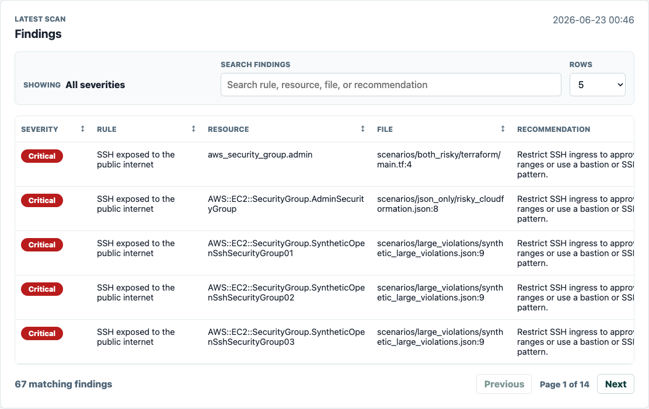
LIVE APPLICATION
03 · THE PRODUCT
Findings management
Every finding carries
Rule + severity
Affected resource
File : line location
Remediation advice
Search, sortable columns, configurable rows and pagination handle large result sets — 67 findings across 14 pages.
Guardrail Auditor · 08

Slide 13
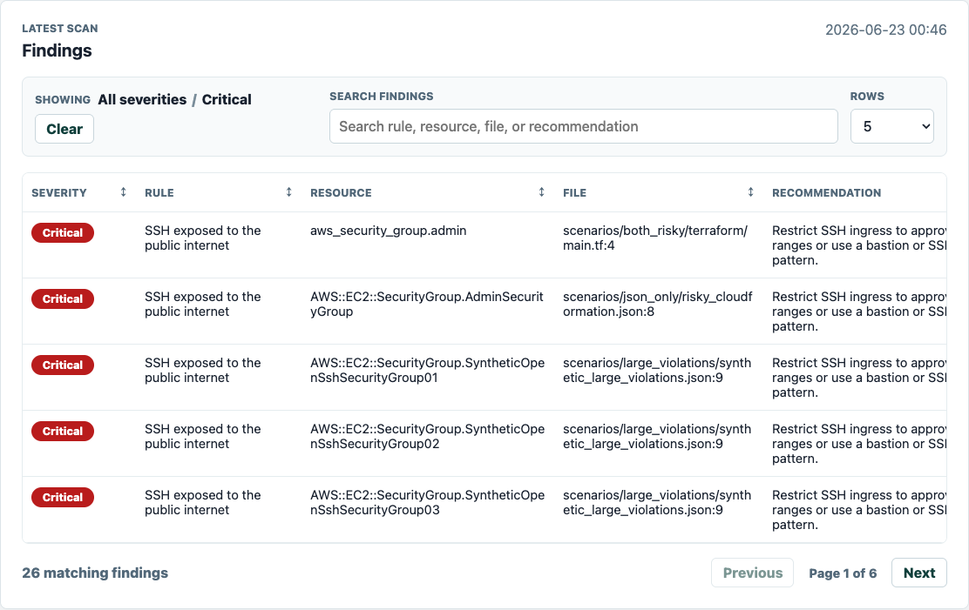
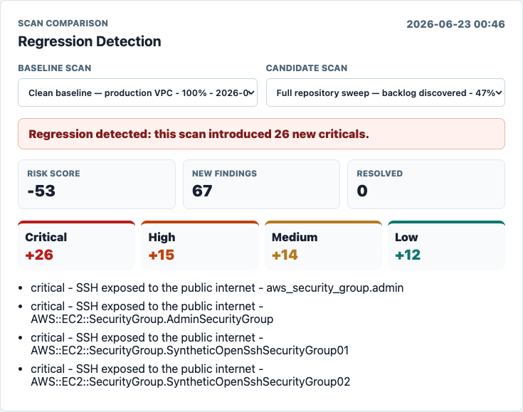
LIVE APPLICATION
03 · THE PRODUCT
Filtering & regression detection
Click a severity card to filter, with breadcrumb and a clear action.
Comparison flags “introduced 26 new criticals.”
Guardrail Auditor · 09

Slide 14
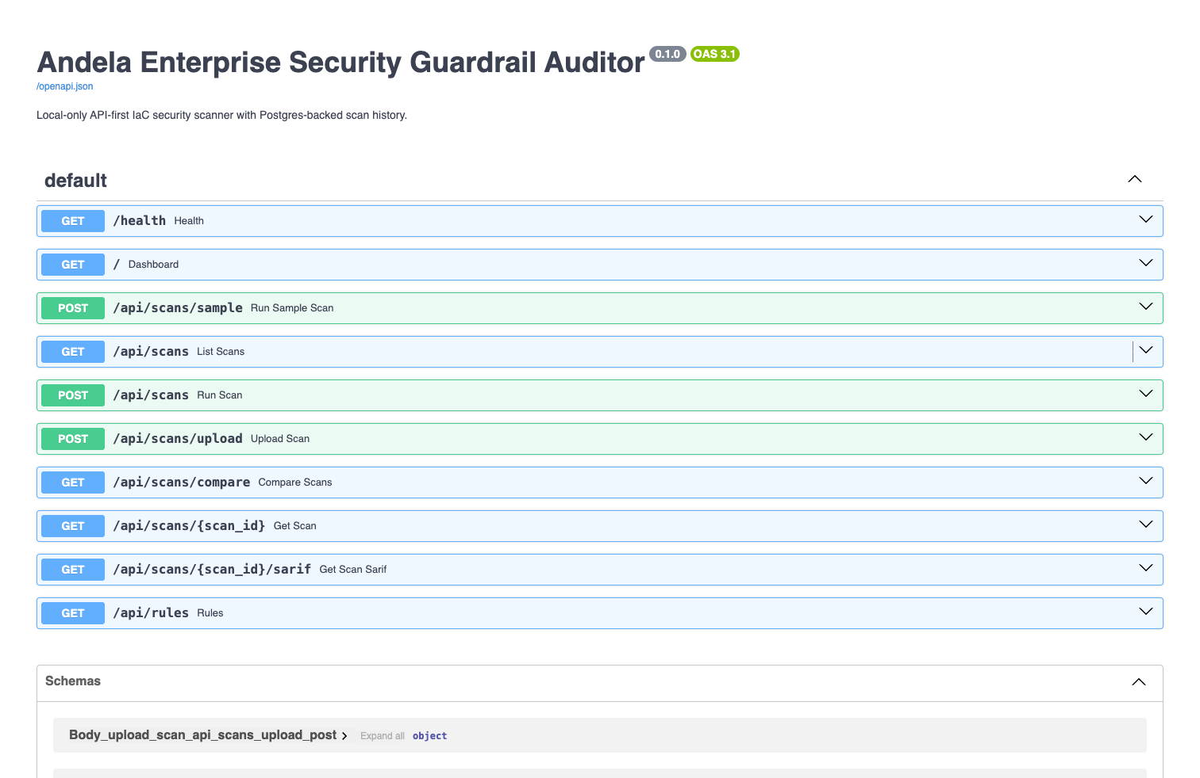
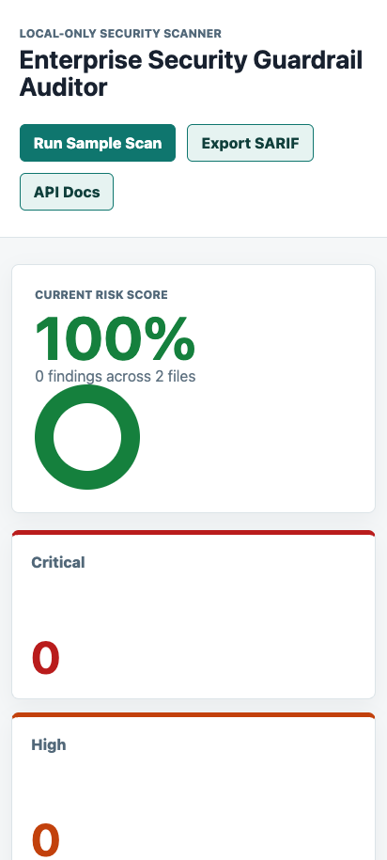
LIVE APPLICATION
03 · THE PRODUCT
API-first & responsive
Auto-generated OpenAPI 3.1 docs for every endpoint: scans, upload, compare, SARIF, rules, health.
Verified on mobile Chromium.
Guardrail Auditor · 10

Slide 15
CAPABILITIES
03 · THE PRODUCT
Feature catalogue
Scanning
Dashboard
Interfaces
100+ AWS / Azure signatures across 9 control families
Color-coded score, severity cards and filtering, breadcrumbs
React dashboard for review
Single rule registry feeds scanner, /api/rules and SARIF — zero drift
Search, sortable headers, pagination
REST API (OpenAPI 3.1)
Secret redaction before persistence, display, CLI and SARIF
Clickable history, trend chart, regression compare, uploads
CLI gate for CI pipelines
SARIF 2.1.0 for Code Scanning
Guardrail Auditor · 11

Slide 16
04
ACT FOUR
The engineering
Documented decisions, an automated pipeline, and a tool that is itself fully guarded.

Slide 17
KEY DECISION · ADR 0005
04 · THE ENGINEERING
An honest risk-scoring model
The original 100 − flat_penalty score saturated at 0 (4 vs 10 criticals looked identical) and ignored scan scope.
Normalized, severity-weighted density
Asymptotic, not subtractive
More findings keep lowering the score — there is no hard floor.
Any scan with findings caps at 99; only a clean scan shows 100.
Aligns exactly with the green / amber / red thresholds.
Severity weights
critical 10 · high 6 · medium 3 · low 1
Scope units
(files × 2) + distinct affected resources
Score
ceil( 100 · 4·units / (4·units + Σweights) )
Guardrail Auditor · 12

Slide 18
ENGINEERING JUDGMENT
04 · THE ENGINEERING
Architecture decisions (ADRs)
Every significant trade-off is documented and version-controlled.
0001
Local-only dev & verification
No cloud cost or credential risk; reviewers run it free
0002
Postgres over SQLite
Mirrors the RDS deployment shape; durable audit trail
0003
Focused text / JSON scan, no full HCL parser
Small, testable, MVP-appropriate — trade-off documented
0004
Expose via API + CLI + Dashboard + SARIF
One core, four audiences; CI fails without a web server
0005
Normalized weighted risk score
Honest density that respects scope and severity
Guardrail Auditor · 13

Slide 19
AUTOMATION
04 · THE ENGINEERING
A seven-stage CI/CD pipeline
.github/workflows/ci-cd.yml runs on every pull request and push to dev.
1
Backend
5
Terraform
Ruff lint + Python unit & functional tests on a Postgres service
fmt -check + init + validate
2
Code scanning
6
Docker build
Generate SARIF → upload to GitHub Code Scanning
Image built only after every gate passes
3
Guardrail CLI
7
Deploy (gated)
Risky fixtures must fail, clean fixtures pass on --fail-on critical
OIDC → Terraform S3 backend → ECS / RDS / ALB
4
Frontend
Plus Dependabot (grouped weekly PR) and a pre-commit gate mirroring CI.
ESLint + Vite build + Playwright (desktop & mobile)
Guardrail Auditor · 14

Slide 20
QUALITY
04 · THE ENGINEERING
The guardrail tool is itself guarded
71
100%
36
58
Python tests passing
Statement coverage
Playwright runs
Logged prompts
scanner · API · CLI · SARIF · migrations · observability
841 / 841 lines — gated in CI at --fail-under=100
18 specs across desktop & mobile Chromium
every instruction captured in prompts.md
$ ./scripts/test-coverage.sh
TOTAL 841 stmts 0 missed 100%
71 passed in 2.55s
Coverage spans scanner, API, CLI, SARIF, migrations, observability and config — a 100% gate keeps it there.
Guardrail Auditor · 15

Slide 21
CLOUD POSTURE
04 · THE ENGINEERING
Deploy-ready, never auto-applied
Full Terraform under terraform/ provisions a realistic production stack — but the agent workspace never provisions cloud.
✓
Cloud judgment without cloud cost
Deployment runs only when explicit repository variables and credentials are configured.
This honors the challenge’s “delete all cloud resources” rule by default — the stack is demonstrable on paper and one config away from live, with zero standing spend.
ECS Fargate behind an Application Load Balancer
RDS Postgres for scan history · ECR for images
Secrets Manager, IAM roles, CloudWatch logging
State in S3 + DynamoDB lock; GitHub OIDC — no long-lived keys
Guardrail Auditor · 16

Slide 22
05
ACT FIVE
The horizon
Where the architecture goes next — each enhancement already has a clear seam.

Slide 23
FUTURE ENHANCEMENTS
05 · THE HORIZON
A roadmap with clear seams
→
Deeper Terraform
→
LLM fallback
Swap focused text rules for a real HCL parser — modules, variables, dynamic blocks.
Call a model only when deterministic rules find nothing; off by default for free, predictable CI.
→
Policy-as-code
→
Alerting
OPA / Rego custom org baselines; rule severities as configuration.
Slack / webhook notifications on regression or critical findings.
→
Multi-tenant + authz
→
Scheduled scans
Teams, projects and role-based access control.
Track risk posture across repositories over time.
Guardrail Auditor · 17

Slide 24
IN SUMMARY
A production-shaped guardrail
auditor, delivered by directing
an AI agent end-to-end.
✓
Tagle Tag — Connector, Foundation Operator
✓
Public GitHub repository — all source code
✓
prompts.md — full 58-prompt audit log
✓
This AI-generated deck — PPTX + Markdown
✓
Cloud cleanup — local-only; nothing provisioned
Python · API-first · Postgres · 100% coverage · CI/CD · SARIF · Terraform

