Slide 1
Assessment
Port!

Slide 2

Concept art for buildings
Well concept art
Library building concept art

Slide 3
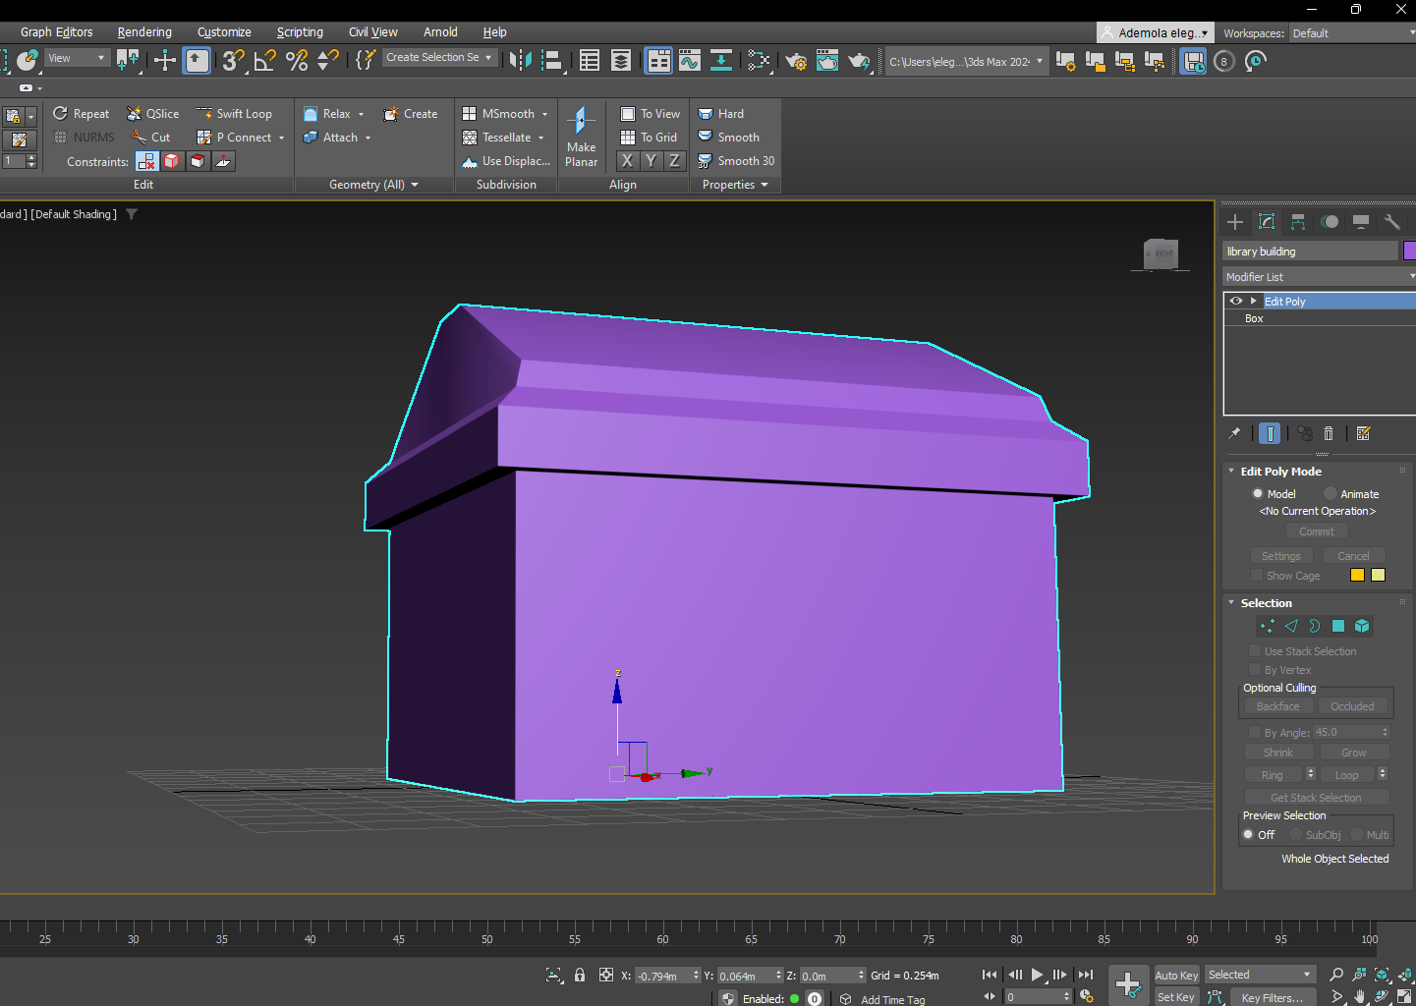
3D modelling
This is 3d base model for the level one library, this model was achieved using the insert and extrude tool.
The chamfer tool was also used to get the flat point of the roof

Slide 4
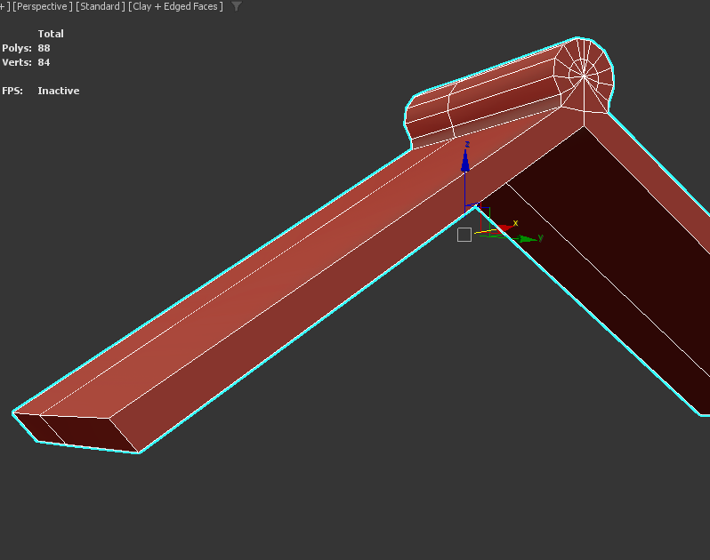
Roof model
This is the 3d model of the arch way roof
This shape was achieved using four modifiers, edit poly, symmetry and the Boolean modifier.

Slide 5
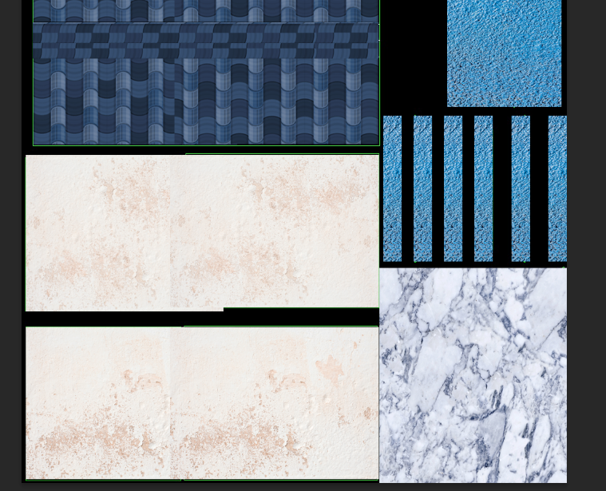
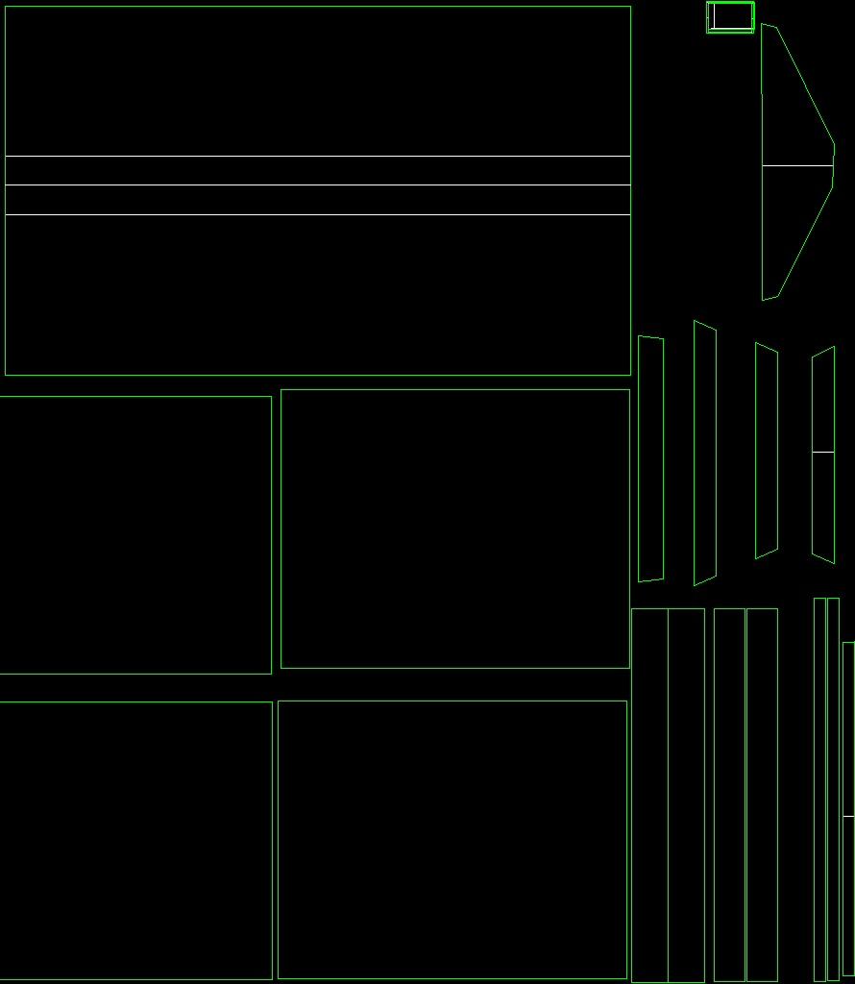
Uv unwrap normal map and texturing
Here ill be showing the uv maps and texture maps used int the producrion of my modes

Slide 6
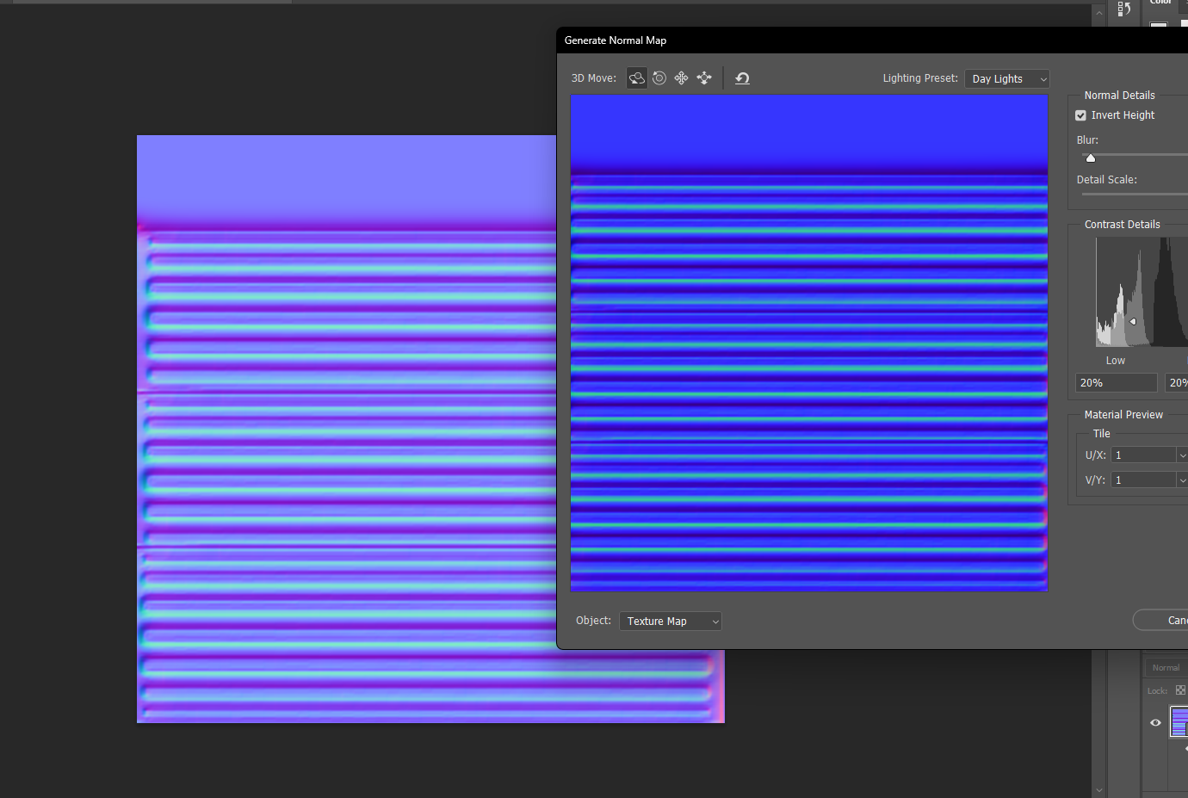
This notmal map was used in the production of the pillars to guve them a sense of dept, it was generated in adobe photoshop. (it is the only normal map used in my assessment.

Slide 7
Animation.
The process involved in the animation would be talked about in the youtube demo.s

