Slide 1
Docker - Benefits & Use cases
Petr Vlasatík
Notes:
1/5/17
1

Slide 2
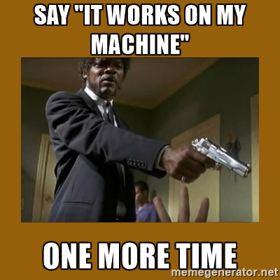
Standardized environment for your product
“Hmmm, but it works on my machine”
Notes:
2
1/5/17

Slide 3
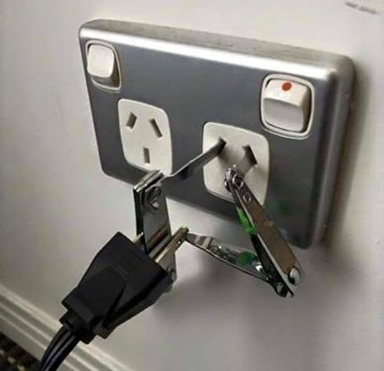
Standardized interface between OS and container
Just install docker and everything will work
Notes:
3
1/5/17

Slide 4
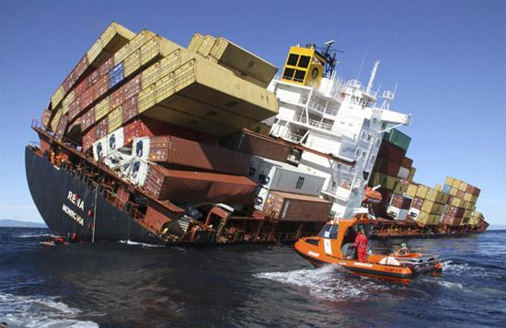
Porting images among developers is easy
Just pack it into an image and send anywhere – it will work the same everywhere
Notes:
4
1/5/17

Slide 5
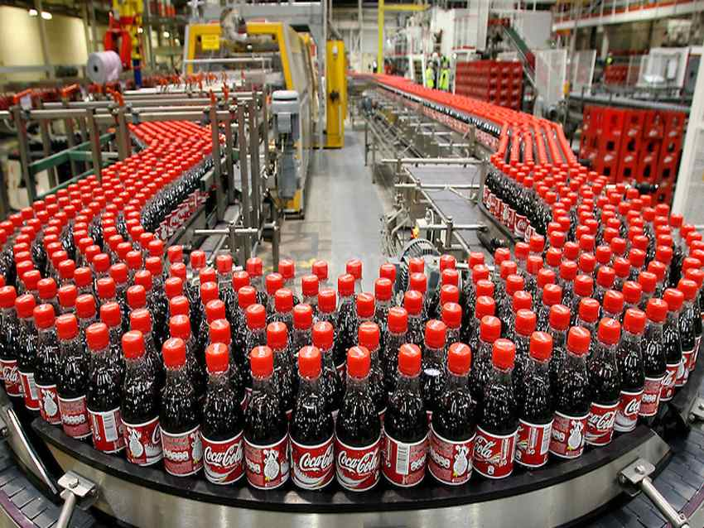
Fast and repeatable deployment
Create as many instances as you want
Notes:
5
1/5/17

Slide 6
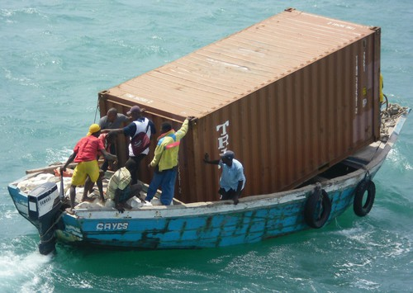
Containers are lightweight
Only application processes consume resources
Notes:
6
1/5/17

Slide 7

Minimal upgrade downtime
Suitable application architecture allows minimize downtime
Notes:
7
1/5/17

Slide 8
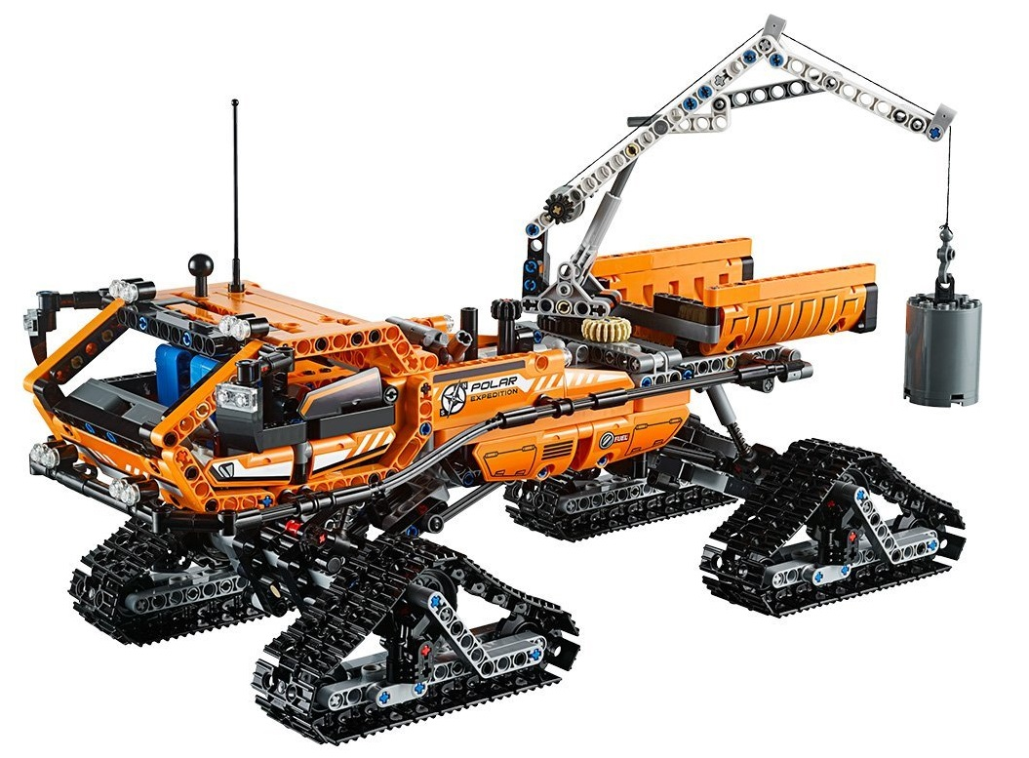
Supports microservices and modular design
One process per one container
Notes:
8
1/5/17

Slide 9

Orchestrators for containers
Automated elasticity and load balancing
Notes:
9
1/5/17

Slide 10
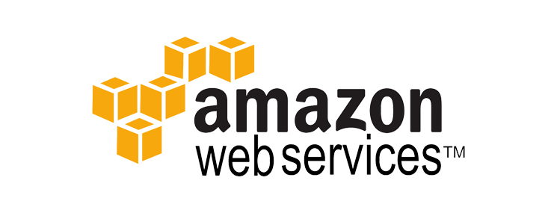
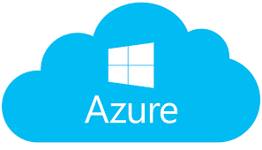
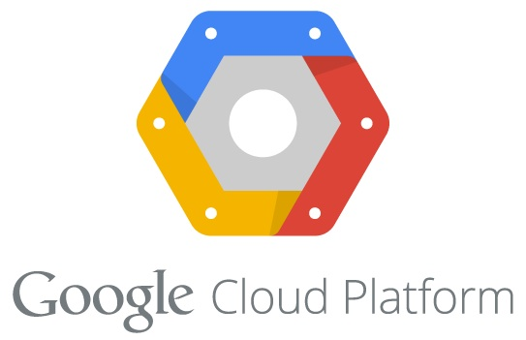
3rd party *aaS providers
Allows easy hosting of infrastructure and platform at 3rd party providers
Notes:
10
1/5/17

Slide 11
Questions ???
Q & A
Notes:
11
1/5/17

