Slide 1

REST & GRPC
NAVISPHERE PLATFORM TEAM
REST & GRPC

Slide 2
High Level Comparison
REST & GRPC
This comparison assumes the “default” usage of both:
REST - JSON over HTTP
gRPC – Protocol Buffers over HTTP
NAVISPHERE PLATFORM TEAM
Factor | REST / JSON | gRPC
Popularity | Ubiquitous – default API format | Somewhat niche
Ecosystem | Strong platform support – authentication, caching, proxy, | Benefits from HTTP
Tooling | Excellent (postman, chrome), JSON the native language for JS, Mongo, many others | Not as strong (binary protocol, not human readable)
Interface Definition | Dynamic, human readable HTTP verbs | Strongly typed, binary RPC style – named messages
Performance | Good for common use cases, working with Javascript | Very fast, compact, efficient. Up to 5x more efficient when dealing with non-JS platforms (Java -> Java)
Debugging | Simple – human readable | Somewhat more difficult, may require additional tooling

Slide 3
REST
REST & gRPC
Ubiquitous
Default API format
Universal programming language support for JSON / HTTP
Well understood architectural pattern
Well supported tooling ecosystem
Postman
Chrome
JSON tooling (linters, formatters, IDE support)
Verbose
JSON is verbose. Compression can help, but still not as efficient as gRPC
Dynamically typed
Can require boilerplate serialization / deserialization – potential for bugs
NAVISPHERE PLATFORM TEAM

Slide 4
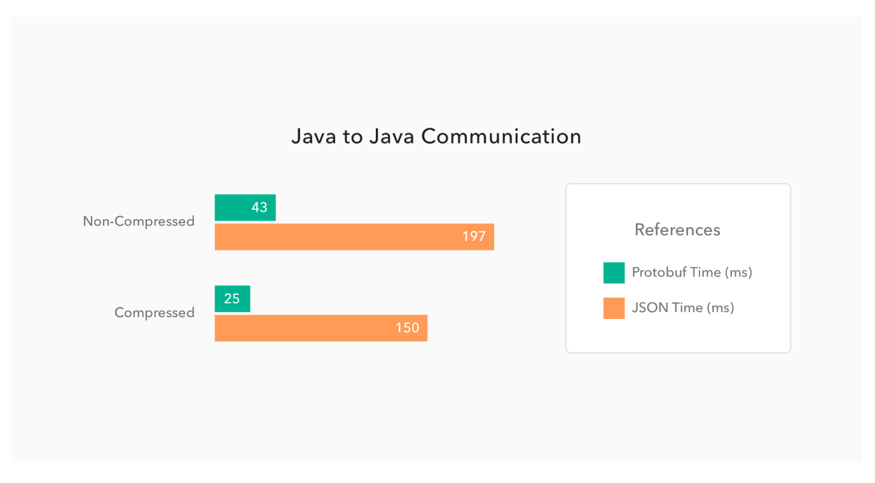
gRPC
REST & gRPC
Efficient
Serialization / deserialization is very fast
Auth0 found up to 5x faster
Messages are compact
~10% smaller w/ compression
~30% smaller w/o compression
Strong typing
Well documented interfaces
Reduces ambiguity across teams / systems
Generated code == less boilerplate serialization code
Tooling support
Most popular languages offer 1st party support – some 3rd party support
Extra build / compilation / process required
NAVISPHERE PLATFORM TEAM
Source: Auth0
Notes:
https://auth0.com/blog/beating-json-performance-with-protobuf/

Slide 5
gRPC
REST & gRPC
What to watch out for
Documentation / ecosystem not as plentiful
Language support – most supported, some by third party libraries
Check your languages
Debugging can be more complicated – messages are binary
NAVISPHERE PLATFORM TEAM
Notes:
https://auth0.com/blog/beating-json-performance-with-protobuf/

Slide 6
Recommendations
REST & gRPC
Prefer REST / JSON when
Providing APIs for 3rd parties
Working with Javascript and JS native tooling like MongoDB, Elastic
High performance is not critical
Prefer gRPC when
High performance is critical (server communication)
Bandwidth is limited (perhaps IoT)
You prefer strong typing, well defined message schemas and are
NAVISPHERE PLATFORM TEAM
Notes:
https://auth0.com/blog/beating-json-performance-with-protobuf/

Slide 7

NAVISPHERE PLATFORM TEAM

