Slide 1
The Process of Preparing for and Passing the Exam

Slide 2
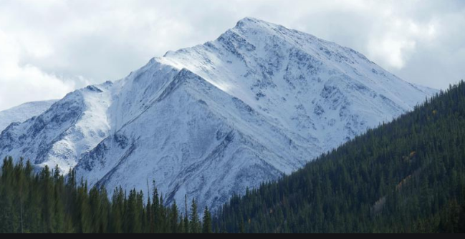
What is a Certification, really?

Slide 3
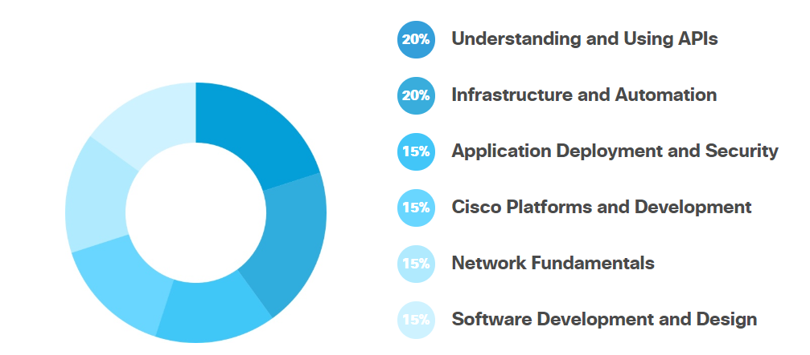
Understand your Objectives and target
https://developer.cisco.com/certification/devnet-associate/

Slide 4
Understand your Resources
https://developer.cisco.com/video/net-prog-basics/
Devasc course
Books (now available)
Quizlet (available)
Third party training
Development environment

Slide 5

Devnet Certification Study Group
A League of Extraordinary Engineers
High pass rate

Slide 6

Purpose
Create a cohort of interested engineers to blaze the trail to certification success
Leverage herd mentality
Drive engagement, encourage accountability
Foster team growth

Slide 7
Syllabus/Logistics
Date | Topic | Presenter/moderator
2/28 | Kickoff – Dev environment, Github | Wnellis
3/20 | Module 1 – 1.1-1.8 | TBD
3/27 | Module 2 : 2.1-2.9
4/3 | Module 3.1 – 3.5
4/10 | Mod 3.6+
4/17 | Mod 4.1-4.5
4/24 | 4.7 – 4.12
5/1 | 5.X
5/8 | 5.x2
5/15 | TEST DAY
Tools:
Teams room (to be created)
Quizlet (wnellis to create class)
Friday meeting
Devnet Curriculum

Slide 8
Quizlet
https://quizlet.com/join/jHjt92pgt - join my class

Slide 9
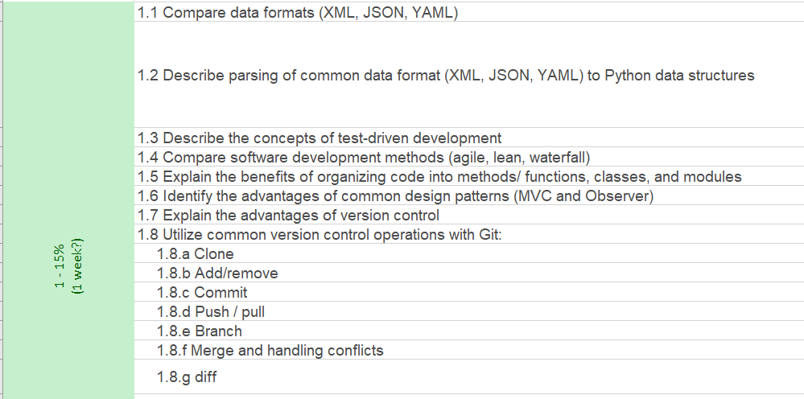
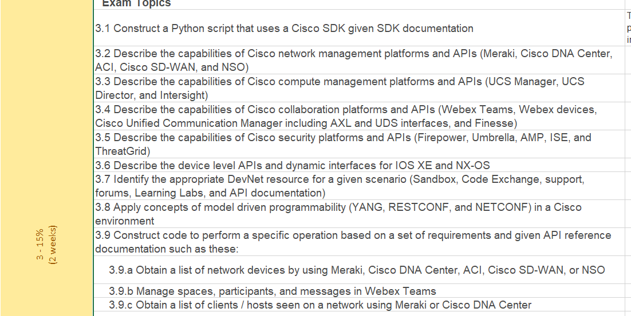
Scoping time and effort : Mod 1 vs Mod 3
5 hours, 15% of grade.
>500 hours, 15% of grade.

Slide 10


Slide 11
Where do you begin? Modular building blocks and Mnemonics…
“URAH”
For every technology, using every rest access mechanism (Postman, Python, etc.). You will have 4 required things,
URL
Request (in python requests library)
Authentication
Headers
With that, and Any Api documentation, you can start figure what to do.

Slide 12
API Documentation
Webex teams
https://developer.webex.com/docs/api/v1/teams
Meraki
https://developer.cisco.com/meraki/api/#/rest/getting-started
DNA-C
https://developer.cisco.com/docs/dna-center/api/1-3-3-x/
Or just google : “webex teams” api, or meraki api, etc.

Slide 13

Hands on Examples
Created Hands on Examples that are easy enough to get right
But you’ll probably get some of it wrong.
And then you learn,

Slide 14
Example
YOU NEED A GOOGLE ACCOUNT
AND THEN
BE SIGNED IN
http://cs.co/devnetcert0304
Go here, then click “File, save to drive” to save a RW copy. Then, go CRAZY

Slide 15
First part of training
What is a Development Environment and why do you need one?
A brief introduction to Git
Intro to Python Part 1
Intro to Python Part 2
Coding 202: Parsing JSON using Python
Introduction to XML
Introduction to the Guest Shell

Slide 16
What would I do Different
Material exists now, that is concise, and good. Devasc course.

