Slide 1

Self-Driving DAMON/S:
Controlled and Automated
Access-aware Efficient Systems
SeongJae Park (SJ)
<sj@kernel.org> <sjpark@meta.com>

Slide 2

TL; DR
Please try DAMON again with intervals auto-tuning, if you were not convinced with its monitoring accuracy and overhead

Slide 3
DAMON: Kernel Subsystem for Data Access Monitoring and Access-aware System Operations

Slide 4
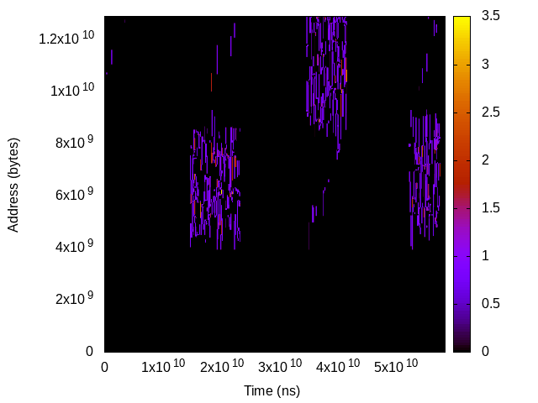
Data Accesses: Events on Space/Time of Memory
Time
Address

Slide 5
Data Access Monitoring: Hope, Real and DAMON
Hope: Precise (every bit), Complete (every moment), Light (prod online)
Real: Expensive, YAGNI without tradeoff
DAMON: Controlled and auto-tuned tradeoff for reasonable and practical monitoring

Slide 6
Space-Controlled Monitoring

Slide 7
Region: Access Monitoring Unit for DAMON
Defined as
  A sub-area of the memory’s space-time
  A collection of adjacent elements that having similar access pattern
Access check of one element per region is enough
e.g., “This page is accessed within last 1 second; a cacheline is checked”
$ cat wonder_region_1
We’re all mad [un]accessed here

Slide 8
Fixed Space/Time Granularity, <=1 Access Frequency
Sort of periodic fixed granularity idleness monitoring
Time overhead: “memory size / space granularity”
Space overhead: “time overhead * monitoring time / time granularity”
Reduced and controllable, but still ruled by memory size and total monitoring time
Time
We’re all mad accessed here
Address
Region
We’re all mad unaccessed here
Sampling interval

Slide 9
Fixed Space/Time Granularity, <=N Access Frequency
Accumulate (sampled) access check results via per-region counter
Now
Time
1
0
0
1
Address
Region
Aggregate interval
Sampling interval

Slide 10
Fixed Space/Time Granularity, <=N Access Frequency
Accumulate (sampled) access check results via per-region counter
Now
Time
1 | 2
0 | 1
0 | 0
1 | 2
Address
Region
Aggregate interval
Sampling interval

Slide 11
Fixed Space/Time Granularity, <=N Access Frequency
Accumulate (sampled) access check results via per-region counter
Now
Time
1 | 2 | 3
0 | 1 | 1
0 | 0 | 1
1 | 2 | 2
Address
Region
Aggregate interval
Sampling interval

Slide 12
Fixed Space/Time Granularity, <=N Access Frequency
Accumulate (sampled) access check results via per-region counter
Now
Time
1 | 2 | 3 | 0
0 | 1 | 1 | 0
0 | 0 | 1 | 0
1 | 2 | 2 | 0
Address
Region
Aggregate interval
Sampling interval

Slide 13
Fixed Space/Time Granularity, <=N Access Frequency
Accumulate (sampled) access check results via per-region counter
Now
Time
1 | 2 | 3 | 0 1 | 2 | 3
0 | 1 | 1 | 0 1 | 1 | 1
0 | 0 | 1 | 0 0 | 0 | 0
1 | 2 | 2 | 0 1 | 2 | 3
Address
Region
Aggregate interval
Sampling interval

Slide 14
Fixed Space/Time Granularity, <=N Access Frequency
Accumulate (sampled) access check results via per-region counter
Now
Time
1 | 2 | 3 | 0 1 | 2 | 3 | 0 1 | 2 | 2
0 | 1 | 1 | 0 1 | 1 | 1 | 0 1 | 1 | 2
0 | 0 | 1 | 0 0 | 0 | 0 | 0 1 | 1 | 1
1 | 2 | 2 | 0 1 | 2 | 3 | 0 1 | 1 | 2
Address
Region
Aggregate interval
Sampling interval

Slide 15
Fixed Space/Time Granularity, <=N Access Frequency
Accumulate access checks via per-region counter
Reduce space overhead to “1/N”
Still, O(memory size * total monitoring time)
Time
3 | 3 | 2
1 | 1 | 2
1 | 0 | 1
2 | 3 | 2
Address
Region
Aggregate interval

Slide 16
Space-Auto-Tuned Monitoring

Slide 17
Problems of Fixed Space Granularity
Adjacent regions of similar hotness are wastes
Impossible to do fine-grained space monitoring
Time
3 | 3 | 2
1 | 1 | 2
1 | 0 | 1
2 | 3 | 2
Address
Region
Aggregate interval

Slide 18
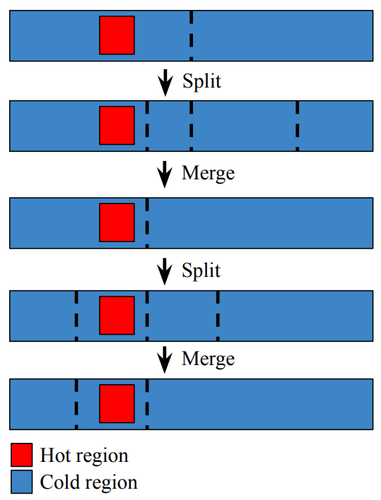
Auto-tuned Dynamic Space Granularity: Mechanisms
Repeat merging the wasteful regions and randomly splitting regions
  The number of region == number of different access patterns
Let user set min/max number of total regions
Time
3 | 3 | 2
1 | 1
 | 0 | 1
2 | 3 | 2
Address
Region
Aggregate interval

Slide 19
Auto-tuned Dynamic Space Granularity: Mechanisms
Repeat merging the wasteful regions and randomly splitting regions
  The number of region == number of different access patterns
Let user set min/max number of regions
Time
3 | 3 | 2
1 | 1
 | 0 | 1
2 | 3 | 2
Address
Region
Aggregate interval

Slide 20
Auto-tuned Dynamic Space Granularity: Overhead/Accuracy
Time overhead: min(different access patterns, max number of regions)
  No more ruled by memory size, fully controlled and auto-tuned
Accuracy: best-effort high
  Auto-tuned dynamic granularity can find even bit level accesses
Time
3 | 3 | 2
1 | 1
 | 0 | 1
2 | 3 | 2
Address
Region
Aggregate interval

Slide 21
Time-Controlled Monitoring

Slide 22
Problems of Fixed Time Granularity Regions (1/2)
The definition of regions is not only about space, but also about time
Time
Address
Region
Aggregate interval

Slide 23
Inefficiency of Fixed Time Granularity Regions (2/2)
The definition of regions is not only about space, but also about time
Multiple time-adjacent regions of similar hotness: only waste
Time
Address
Region
Aggregate interval

Slide 24
Dynamic Time Granularity (1/3)
Count how long the hotness has kept
Snapshot contains history of useful length
Now
Time
1
1
1
1
Address
Region
Aggregate interval

Slide 25
Dynamic Time Granularity (2/3)
Count how long the hotness has kept
Snapshot contains history of useful length
This snapshot can be discarded
Now
Time
1 | 2
1 | 2
1 | 1
1 | 1
Address
Region
Aggregate interval

Slide 26
Dynamic Time Granularity (3/3)
Count how long the hotness has kept
Snapshot contains history of useful length
This snapshot can be discarded
This snapshot can be discarded
Now
Time
1 | 2 | 1
1 | 2 | 3
1 | 1 | 1
1 | 1 | 1
Address
Region
Aggregate interval

Slide 27
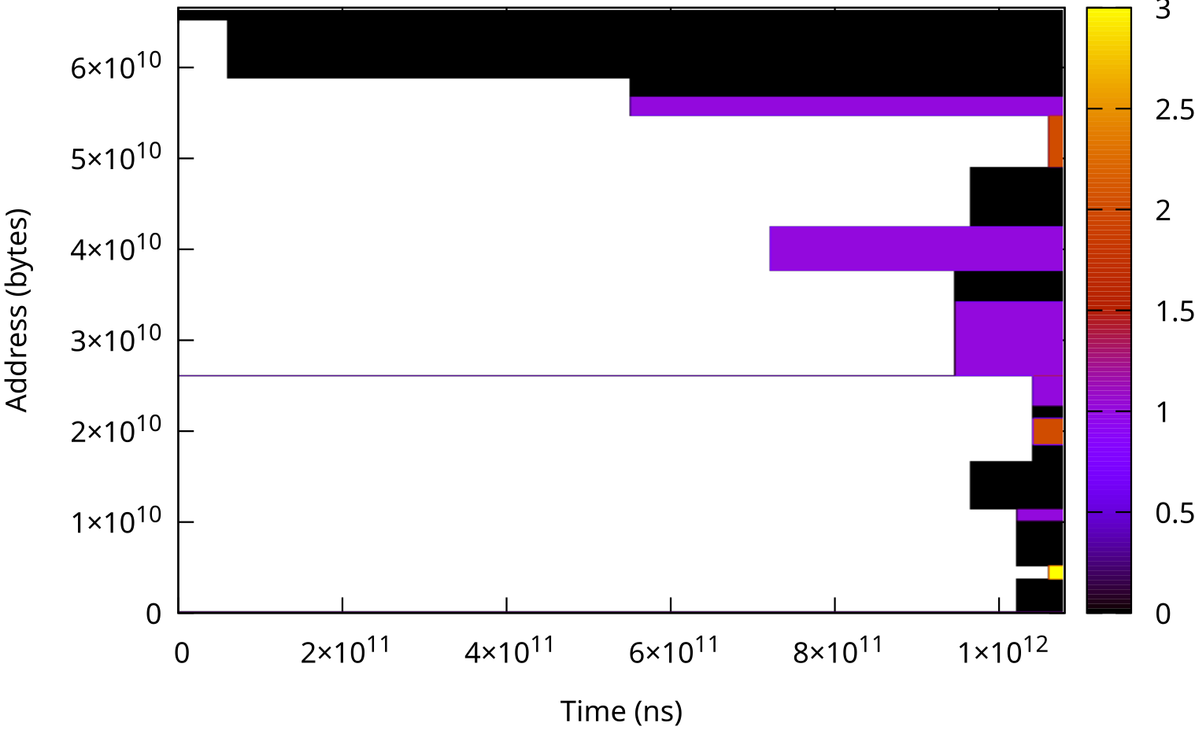
Snapshot: The Output of DAMON
O(max_nr_regions) time/space overhead
Both time/space overheads are not ruled by memory size/monitoring time

Slide 28
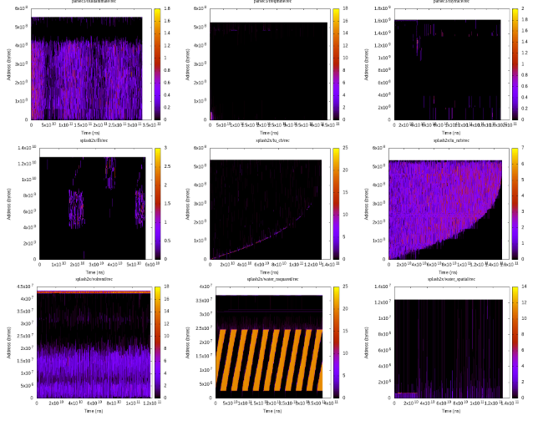
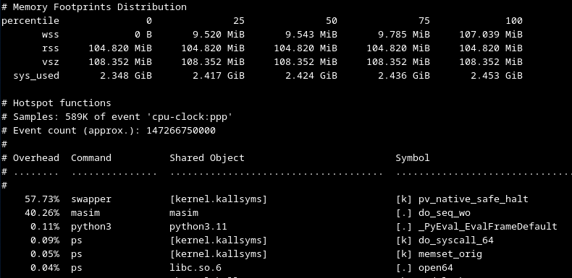
Potential, or Aimed Usages
Profiling (e.g., GIF demo link)
  Help better understand and find rooms for improvements
Profiling-guided Optimizations
  Could be done on both offline and online
Why not let kernel just (transparently) works?

Slide 29
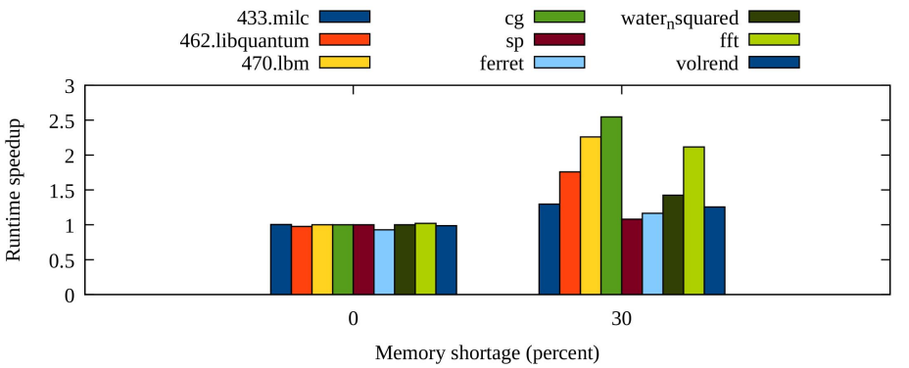
Potential, or Aimed Usages
Profiling (e.g., GIF demo link)
  Help better understand and find rooms for improvements
Profiling-guided Optimizations
  Could be done on both offline and online
Why not let kernel just (transparently) works?

Slide 30
Potential, or Aimed Usages
Profiling (e.g., GIF demo link)
  Help better understand and find rooms for improvements
Profiling-guided Optimizations
  Could be done on both offline and online
Why not let kernel just (transparently) works?

Slide 31
DAMON: Kernel Subsystem for Data Access Monitoring and Access-aware System Operations

Slide 32
DAMOS: Data Access Monitoring-based Operation Schemes
Another side of DAMON
Let users define schemes
  Memory operation actions to apply to regions of specific access pattern
Once per user-defined time interval
  find the regions of the condition from the snapshot and apply the action
Finding optimum “access pattern” on dynamic environments is challenging
  Uncontrolled DAMOS could byte you!
# # pageout memory regions that not accessed for >=5 seconds
# damo start --damos_action pageout --damos_access_rate 0% 0% --damos_age 5s max

Slide 33
DAMOS Filter: Fine-Control Access-aware System Operation Targets
Define target memory with non-access-pattern information
  Page level filters: anon, owned cgroup, hugepage, LRU-activeness
  Non-page level filters: address
  “pageout cold pages of NUMA node 1 that associated with cgroup A and file-backed”
  Can be useful for fine-grained monitoring, too
    (“stat”, instead of “pageout”)

Slide 34
DAMOS Quota: Control Access-aware System Operation Aggressiveness
Six fixed thresholds (min/max size, access frequency, age) are unnecessary in many cases
Setting thresholds flexibly and controlling aggressiveness works in many cases
  Single control knob
Quota set the aggressiveness limit as amount of memory to apply action per a time interval
Access pattern based prioritization is applied under the quota
“pageout cold pages up to 100 MiB per second using <2% CPU time, coldest ones first”

Slide 35
Quota Auto-tuning: Auto-tuned Access-aware System Operations
Quota tuning is manual and repetitive
Change the question for user: How to do (mechanism) → What to achieve (final goal)
Let users specify goal of the quota as a value of a metrics
  Metrics: PSI level, NUMA node memory utilization, workload’s latency, bandwidth, TPS, …
  e.g., “reclaim cold pages aiming 0.5% memory PSI”
DAMOS adjusts quota using feedback loop, for current value of the metric
  e.g., If memory PSI is 0.1% increase quota for reclaiming cold pages (reclaim more warm pages)

Slide 36
Controlled and Auto-tuned Access-aware System Operation Performance
Parsec3/splash2x.fft
Page out regions that not accessed for >=5 seconds, up to 1GiB/sec, using up to 100ms/sec, aiming 10ms/sec memory pressure stall
 | Runtime | RSS
Baseline | 50.489s | 10.005 GiB
+DAMOS-reclaim | 120s | 4.955 GiB
+Quota | 51.772s | 8.527 GiB
+Goal | 49.741s | 9.721 GiB

Slide 37
Those were effectively a recap of OSSNA’24 DAMON talk
https://ossna2024.sched.com/event/1aBOg
Next is for a new auto-tuning feature of DAMON

Slide 38
Auto-Tuning Time
(Monitoring Intervals)

Slide 39
FAQ: DAMON output looks only cold, only hot, or just random
Frequent Answer: Have you turned DAMON off and on tuned the monitoring intervals?
  IOW, the default intervals (5ms sampling, 100ms aggregation) are not really suggested ones

Slide 40
If Intervals Are Appropriate: Meaningful Hot/Cold Regions
Meaningful enough to make some memory management decisions
Time
1 | 2 | 3 | 1 | 2 | 3 | 1 | 2 | 2
0 | 1 | 1 | 1 | 1 | 1 | 1 | 1 | 2
0 | 0 | 1 | 0 | 0 | 0 | 1 | 1 | 1
1 | 2 | 2 | 1 | 2 | 3 | 1 | 1 | 2
Address
Region
Sampling interval
Aggregation interval

Slide 41
If Intervals Are Too Short: Everything Looks Cold
Time
1 | 1 | 1 | 0 | 1 | 1 | 0 | 1 | 1
0 | 0 | 0 | 0 | 0 | 0 | 0 | 0 | 0
0 | 0 | 0 | 0 | 0 | 0 | 0 | 0 | 0
1 | 1 | 1 | 0 | 0 | 0 | 0 | 0 | 0
Address
Region
Sampling interval
Aggregation interval

Slide 42
If Intervals Are Too Long: Everything Looks Hot
1 | 2 | 3 | 1 | 2 | 3 | 1 | 2 | 3
1 | 2 | 3 | 1 | 2 | 3 | 1 | 2 | 3
1 | 2 | 3 | 1 | 1 | 2 | 1 | 2 | 3
1 | 2 | 3 | 1 | 2 | 3 | 1 | 2 | 3
Address
Region
Sampling interval
Aggregation interval

Slide 43
If Intervals Are Too Long: Everything Looks Hot
1 | 2 | 3 | 1 | 2 | 3 | 1 | 2 | 3
1 | 2 | 3 | 1 | 2 | 3 | 1 | 2 | 3
1 | 2 | 3 | 1 | 1 | 2 | 1 | 2 | 3
1 | 2 | 3 | 1 | 2 | 3 | 1 | 2 | 3
Address
Region
Sampling interval
Aggregation interval

Slide 44
If Sampling:Aggregation Interval ratio is Too Low: Meaningless Samples
Most sampling returns “negative”: unnecessary CPU cycle waste
On large systems, sampling quality can also degrade
  Not enough time for workloads to leave footprints
Address
Region
Sampling interval
Aggregation interval

Slide 45
Intervals Tuning Guideline
If it looks too cold, increase intervals
If it loos too hot, decrease intervals
Change both sampling and aggregation intervals in same ratio
Continue until meaningful snapshot is made
Time consuming and repetitive for different workloads
Guideline was added more than 3.5 years after DAMON be merged upstream!
Could be automated?

Slide 46
Monitoring Intervals Auto-tuning (Motivated by Quotas Auto-tuning)
Change Question: How to do? (mechanism) → What to achieve? (final goal, policy)
Let users specify
  Desired amount of access events to capture in each snapshot
  Minimum and maximum sampling intervals
Find proper sampling/aggregation intervals for the desire using feedback loop
  If less than desired events are captured in current snapshot, increase intervals
  If more than desired events are captured in current snapshot, decrease intervals
  Min/max sampling intervals ensure auto-tune goes no too long
Available on mainline from v6.15

Slide 47
Monitoring Intervals Auto-tuning Parameters
Parameters for parameters auto-tuning, but easy to set
Suggestion
  Desired access events per snapshot: 4%
    Applies pareto principle (80:20 rule) twice, assume to capture 80% * 80% = 64% real access
  Min/max sampling intervals: 5ms and 10s
  Sampling:aggregation intervals ratio: 1:20
    Only a few different actions are required, 20 is high enough

Slide 48
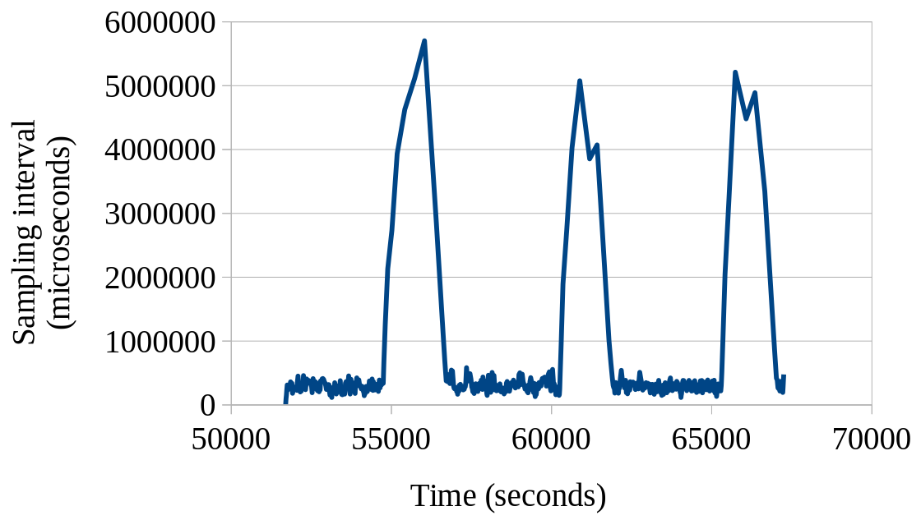
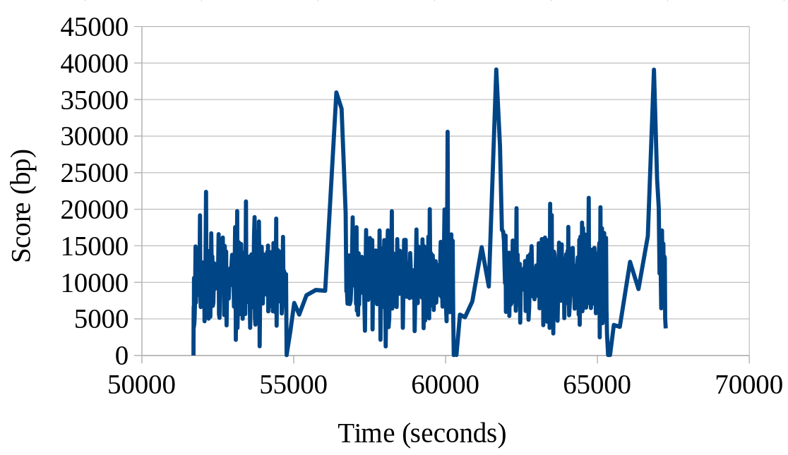
Intervals Auto-tuning on a Real-world Server Workload
Sampling interval and tuning score continuously change, and converge for given situation
  Sampling interval converges to 370ms under usual load, ~4-5 seconds under light load
  Tuning score converges to the goal (10,000 bp)

Slide 49
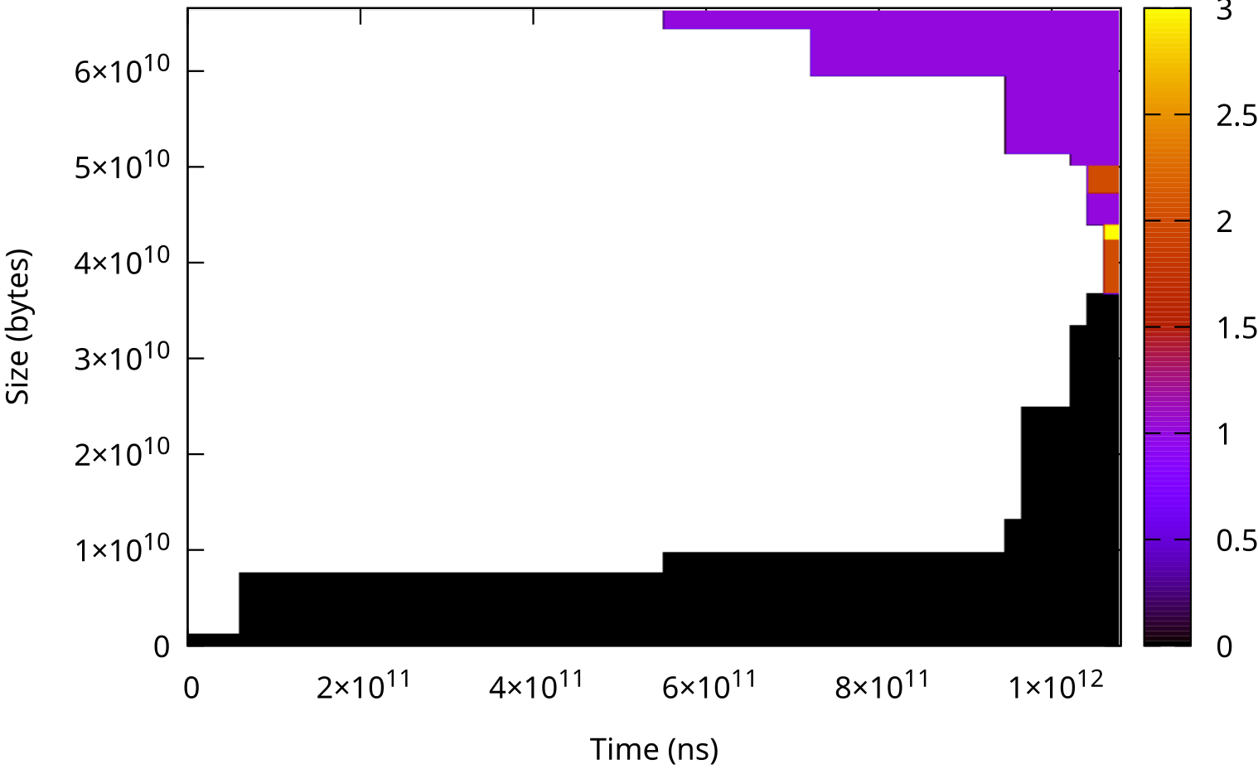
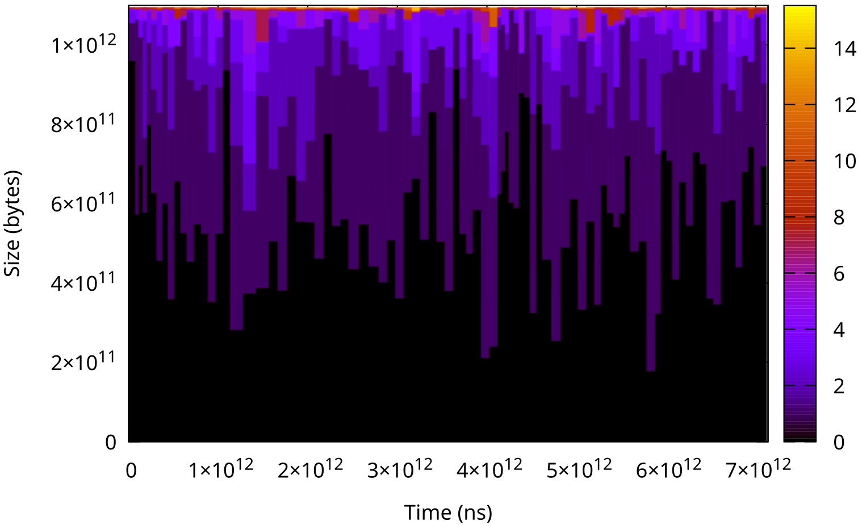
Intervals Auto-Tuning on Real World Server Workloads
Meaningful access patterns found on three different workloads including 1 TiB memory size workload
0.0% CPU time consumed for the monitoring

Slide 50
DAMON_STAT: Recommended Way For System-wide Access Monitoring
Kernel module running DAMON for the entire physical address space
Use intervals auto-tuning with the suggested auto-tune parameters
Extract Idle time percentile
  distribution of per-byte memory idle times (time the byte was not accessed)
  P75 idle time 2minutes: 75 percent of the memory was accessed at least once in last 2 minutes; rest 25 percent of memory was not accessed at all for last 2 minutes
Extract estimated memory bandwidth
  Memory bandwidth estimated based on last snapshot
Recommended way for system-wide access monitoring
  Easy to enable (CONFIG_DAMON_STAT_DEFAULT_ENABLED=y), aggregate, compare
  Can be enabled/disabled at build, boot time and runtime

Slide 51
Idle Time Percentiles
Idle time: How long the region kept being not accessed (access frequency 0)
Idle time percentiles: Percentiles of sorted per-byte idle times
Unsorted snapshot

Slide 52
Idle Time Percentiles
Idle time: How long the region kept being not accessed (access frequency 0)
Idle time percentiles: Percentiles of sorted per-byte idle times
Unsorted snapshot
Sorted by access frequency

Slide 53
Idle Time Percentiles
Idle time: How long the region kept being not accessed (access frequency 0)
Idle time percentiles: Percentiles of sorted per-byte idle times
Unsorted snapshot
Sorted by access frequency
P50 idle time

Slide 54
Idle Time Percentiles
Idle time: How long the region kept being not accessed (access frequency 0)
Idle time percentiles: Percentiles of sorted per-byte idle times
Unsorted snapshot
Sorted by access frequency
P50 idle time
P75 idle time

Slide 55
Idle Time Percentiles
Idle time: How long the region kept being not accessed (access frequency 0)
Idle time percentiles: Percentiles of sorted per-byte idle times
Unsorted snapshot
Sorted by access frequency
P50 idle time
P75 idle time
P99 idle time

Slide 56
DAMON_STAT: Recommended Way For System-wide Access Monitoring
Kernel module running DAMON for the entire physical address space
Use intervals auto-tuning with the suggested auto-tune parameters
Extract Idle time percentile
  distribution of per-byte memory idle times (time the byte was not accessed)
  P75 idle time 2minutes: 75 percent of the memory was accessed at least once in last 2 minutes; rest 25 percent of memory was not accessed at all for last 2 minutes
Extract estimated memory bandwidth
  Memory bandwidth estimated based on last snapshot
Recommended way for system-wide access monitoring
  Easy to enable (CONFIG_DAMON_STAT_DEFAULT_ENABLED=y), aggregate, compare
  Can be enabled/disabled at build, boot time and runtime

Slide 57
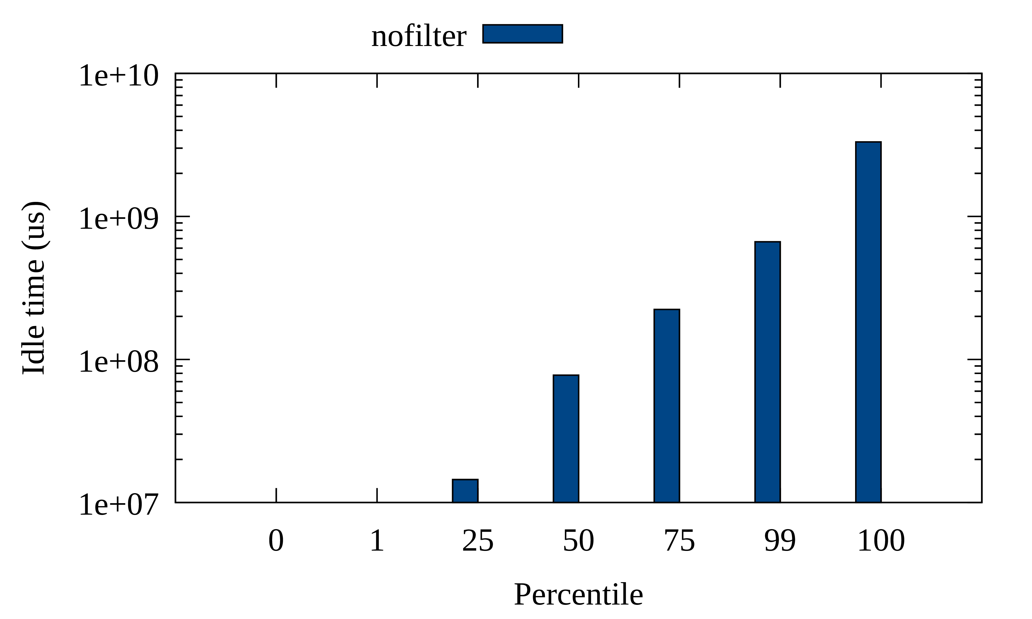
Putting it Altogether: Auto-tuned Total Memory Idle Time Percentiles
Small hot memory, exponentially increasing idle time (long tail of cold pages)

Slide 58
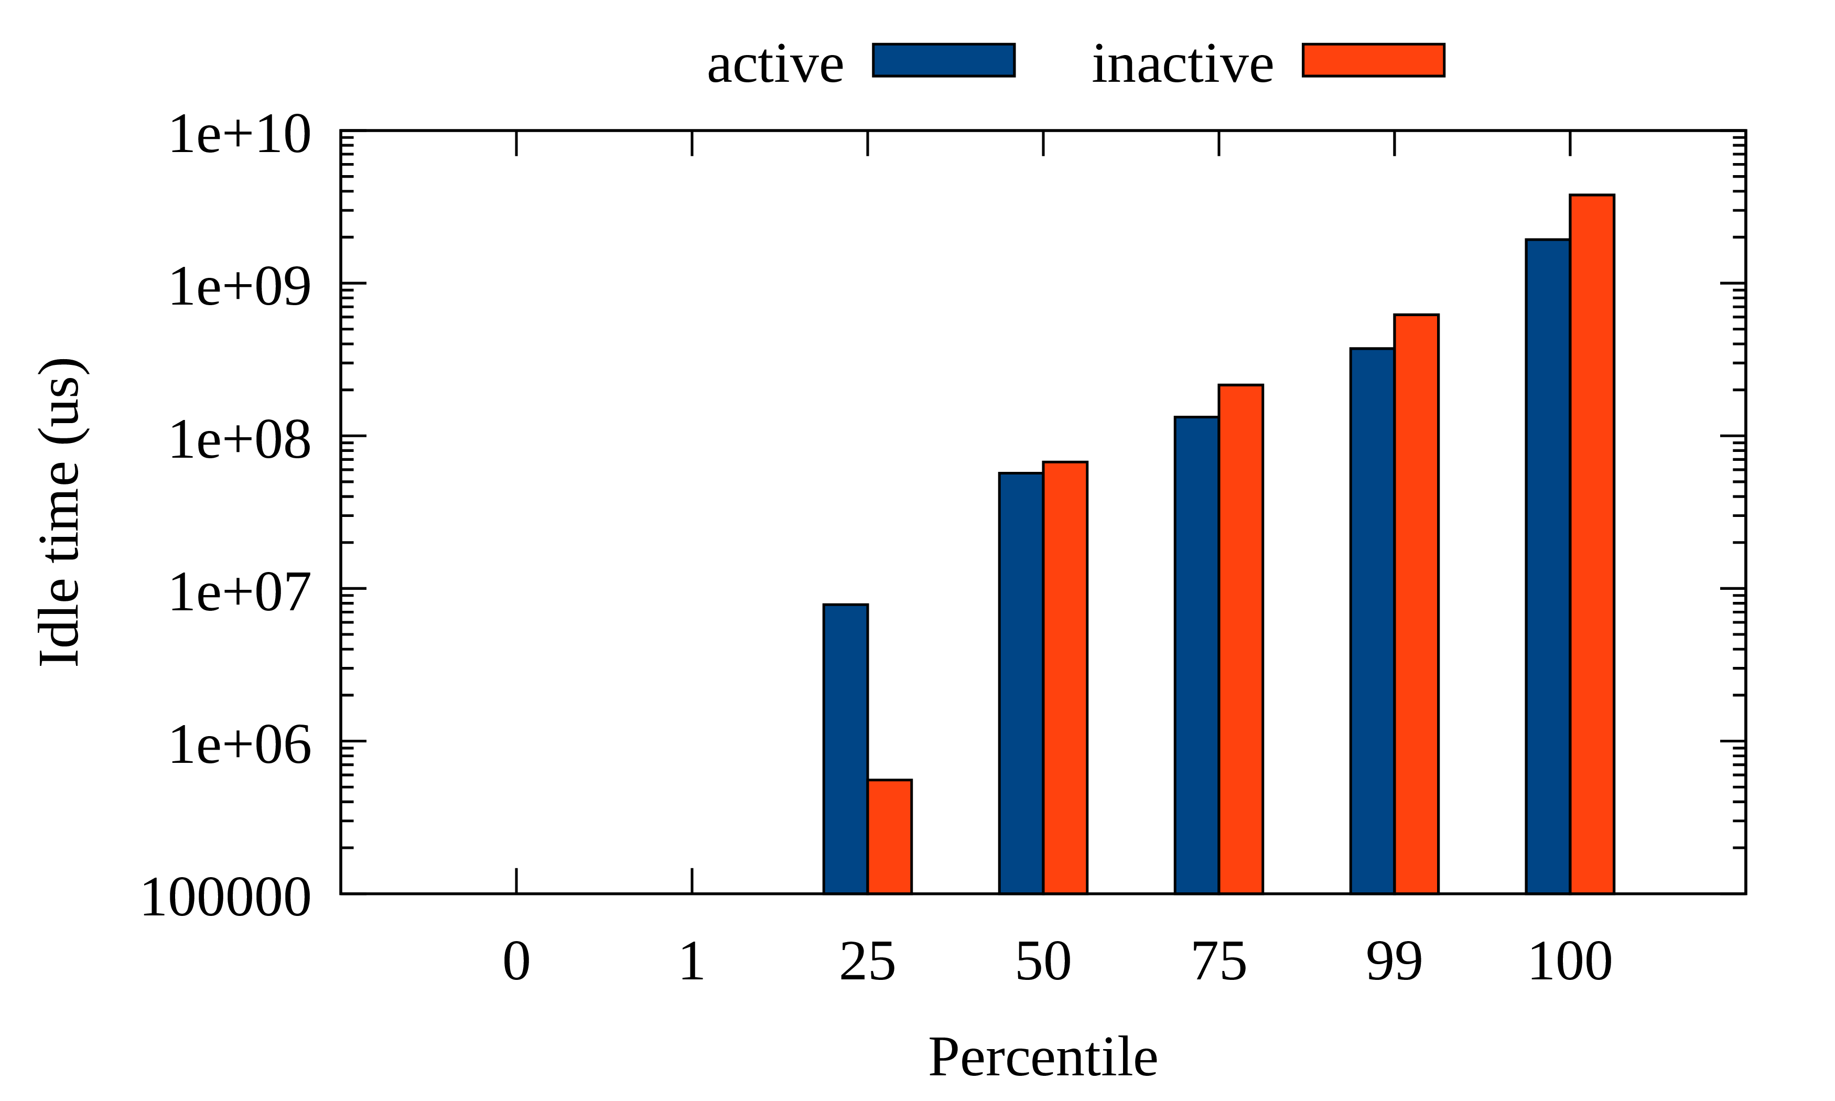
Putting it Altogether: Active vs Inactive Pages Idle Time Breakdown
Active pages have rooms to be more hot than inactive
(ideally, p100 of active should < p0 of inactive)

Slide 59
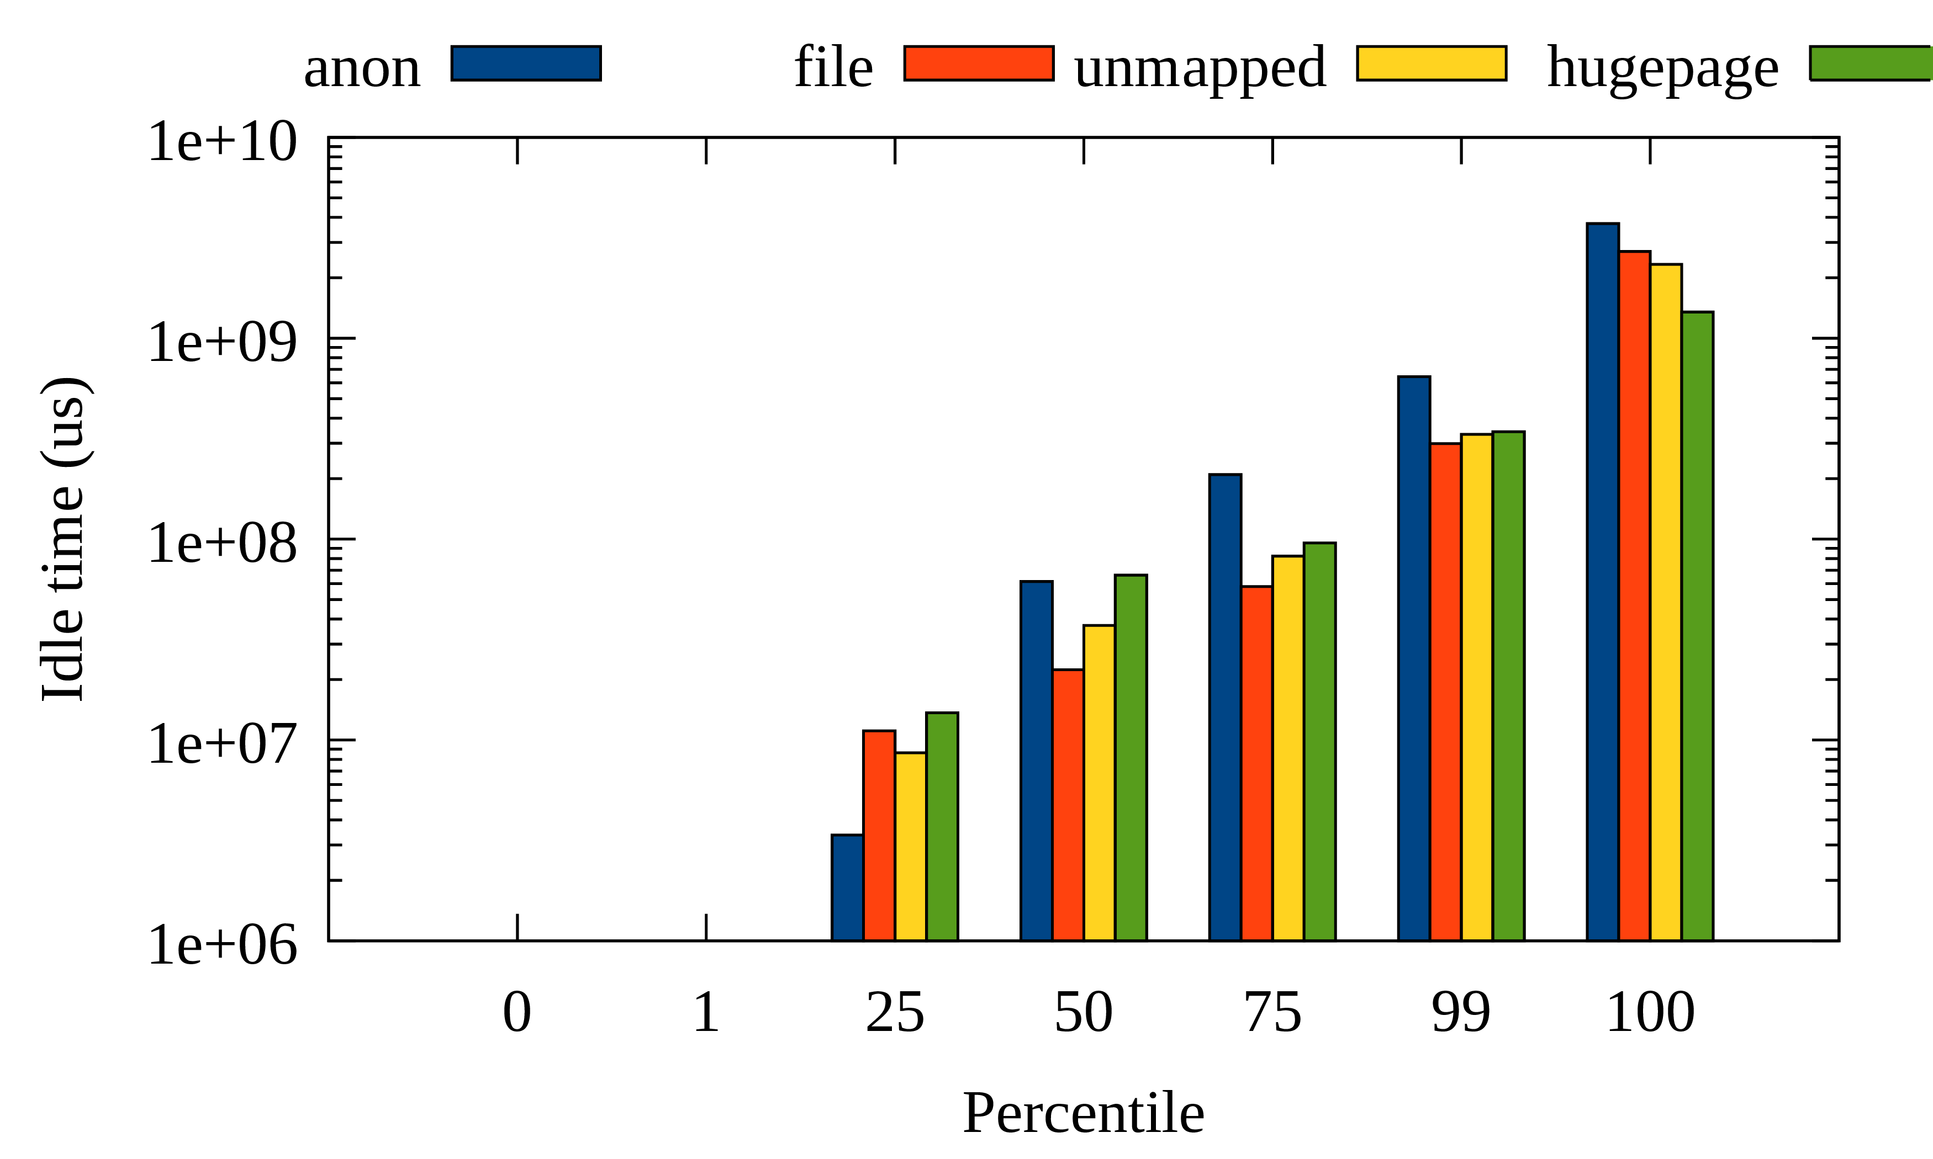
Putting it Altogether: Per Page Type Idle Time Breakdown
You can check if your workload has expected access pattern

Slide 60
Getting Started

Slide 61
Availability
Merged into the mainline from v5.15
Backported and enabled on major Linux distro kernels
  Major distros: Alma, Amazon, Android, Arch, CentOS, Debian, Fedora, Oracle, …
DAMON user-space tool (damo) is available on major packaging systems
  Arch, Debian, Fedora, PyPi, ...

Slide 62
Interfaces
Kernel API: Recommended for kernel programmers
DAMON sysfs interface: Recommended for user-space program development
DAMON user-space tool: Recommended for general usages from user-space
DAMON modules: Recommended for specific usages

Slide 63
Community: For Questions, Help, Patch Reviews
Public mailing list (https://lore.kernel.org/damon)
Bi-weekly virtual meetup
  Occasional/regular private meetings on demand
Project website (https://damonitor.github.io)
  Starting point for DAMON users and developers
The future of DAMON is open and up to you
  “Prefer random evolution over intelligent design”

Slide 64
Summary: That’s DAMON
DAMON is a kernel subsystem
  For data access monitoring and access-aware system operations
DAMON can be safely controlled and self-tunable
  Try again with new features if you didn’t get fun before,
  particularly for monitoring intervals auto-tuning
The future is open and up to the community
  Make your selfish voice

Slide 65
Questions?
You can also ask questions anytime to
  sj@kernel.org
  Public mailing list (https://lore.kernel.org/damon)
  Bi-weekly virtual meetup
  Occasional/regular private meetings on demand
  Project website (https://damonitor.github.io)

Slide 66
Backup Slides

Slide 67
Real-world DAMON Use Cases:
Proactive Reclamation and
CXL Memory Tiering

Slide 68
Proactive Reclamation
Reactive reclamation: Reclaim cold memory when memory pressure happens
Proactively reclamation: Reclaim cold memory before memory pressure
Benefit 1: Reduce memory footprint without performance degradation
Benefit 2: Minimize degradation from direct reclamation
Known usages: Google, Meta, and Amazon
  Each company uses its own implementation for its usage
AWS uses DAMOS-based implementation since 2022

Slide 69
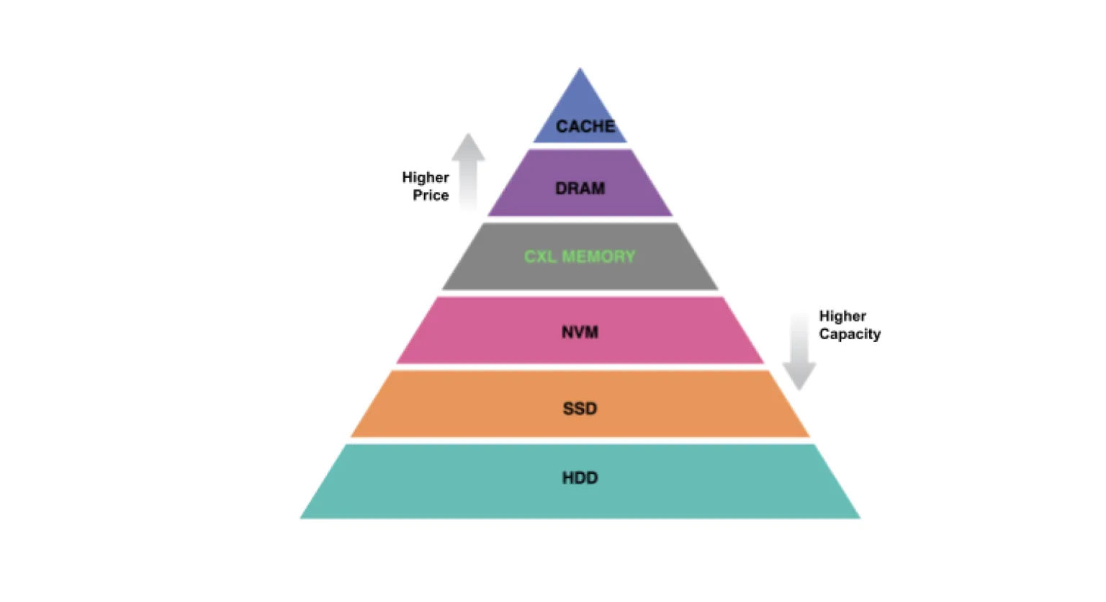
CXL Memory Tiering
CXL-tiered memory: Put CXL memory between DRAM and NVM
  Pros: Higher capacity with lower price (higher efficiency)
Challenge: Dynamic placement of pages (CXL mem is slower than DRAM)
DAMON-based approach: Place hot pages on DRAM node, Place cold pages on CXL node
SK hynix developed their CXL memory SDK (HMSDK) using DAMOS
  Reports ~12.9% speed up

Slide 70
Architectures

Slide 71
Execution Model: Kernel Thread per Requests
“struct damon_ctx”: Data structure for DAMON user input/output containing
  User requests: target address space, address range, intervals, DAMOS schemes
  Operation results: access snapshot, DAMOS stats
“kdamond”: DAMON worker thread
  Create one kdamond per “damon_ctx”
    In future, could support multiple “damon_ctx” per kdamond
    In future, could separate DAMOS to another thread (maybe useful for cgroup charging)
  Allows async DAMON execution and multiple kdamonds (CPUs) scaling

Slide 72
Extensible Layers
User-space
Tools
DAMO
datop
DAMON API User
Kernel Modules
General-purpose User ABI
Special-purpose Modules
DAMON_SYSFS
DAMON_DBGFS
DAMON_RECLAIM
DAMON_LRU_SORT
DAMON_WSS
DAMON Application Programming Interface
DAMON
DAMOS
Adaptive Regions Adjustment
Action and Pattern
Core Logic
Region-based Sampling
Quotas and Prioritization
Access Frequency Monitoring
Feedback-based auto-tuning
Advanced Regions Adjustment
Watermarks
Parameters Auto-tuning
Filters
DAMON Operations Set Registration Interface
Operations Set
paddr
vaddr
Read/write-only
NUMA-cpus-only
Primitives
that DAMON
depends on
PTE/VMA/rmap, ...
AMD IBS
LRU State

Slide 73
Extensible Layers
User-space
Tools
DAMO
datop
DAMON API User
Kernel Modules
General-purpose User ABI
Special-purpose Modules
DAMON_SYSFS
DAMON_DBGFS
DAMON_RECLAIM
DAMON_LRU_SORT
DAMON_WSS
DAMON Application Programming Interface
DAMON
DAMOS
Adaptive Regions Adjustment
Action and Pattern
Core Logic
Region-based Sampling
Quotas and Prioritization
Access Frequency Monitoring
Feedback-based auto-tuning
Advanced Regions Adjustment
Watermarks
Parameters Auto-tuning
Filters
DAMON Operations Set Registration Interface
Operations Set
paddr
vaddr
Read/write-only
NUMA-cpus-only
Primitives
that DAMON
depends on
PTE/VMA/rmap, ...
AMD IBS
LRU State

Slide 74
Extensible Layers
User-space
Tools
DAMO
datop
DAMON API User
Kernel Modules
General-purpose User ABI
Special-purpose Modules
DAMON_SYSFS
DAMON_DBGFS
DAMON_RECLAIM
DAMON_LRU_SORT
DAMON_WSS
DAMON Application Programming Interface
DAMON
DAMOS
Adaptive Regions Adjustment
Action and Pattern
Core Logic
Region-based Sampling
Quotas and Prioritization
Access Frequency Monitoring
Feedback-based auto-tuning
Advanced Regions Adjustment
Watermarks
Parameters Auto-tuning
Filters
DAMON Operations Set Registration Interface
Operations Set
paddr
vaddr
Read/write-only
NUMA-cpus-only
Primitives
that DAMON
depends on
PTE/VMA/rmap, ...
AMD IBS
LRU State

Slide 75
DAMOS Quotas: Intuitive Aggressiveness Control
Before applying DAMOS schemes
  Set temperature-based priority score of each region
  Build “priority score”: “total size of regions of the priority” histogram
  Find lowest priority threshold for the scheme meeting the quota
  Skip applying action to regions having lower-than-threshold priority scores
Single snapshot and histogram iteration: O(<=user-defined-N)
Quota auto-tuning: A simple proportional feedback algorithm
  Reward metrics: Arbitrary user-input or self-retrievable metrics like memory PSI

Slide 76
DAMOS Filters: Fine-grained Target Selection
Before applying DAMOS action, check the properties of region and skip action if needed
Non-page granular (high level) filters
  Filtered out before applying actions
  Address ranges (e.g., NUMA nodes or Zone)
  DAMON-defined monitoring target (e.g., process)
Page granular (low level) filters
  Filtered out in the middle of actions in page level
  Anon/File-backed
  Belonging memory cgroup
  page_idle()

Slide 77
Pseudo-code of DAMON v5.15
While True:
for region in regions:
if region.accessed():
region.nr_accesses += 1
sleep(sampling_interval)
if now() % aggregation_interval:
merge(regions)
user_callback(regions)
for region in regions:
region.nr_accesses = 0
split(regions)

Slide 78
DAMON accuracy on Low-locality Space/Workloads
It is proven to work on real world products for years
Pareto principle and unconcious bias will make the pattern
  Entropy-full situation is when the data center is doom-ed
“age” avoid immature decision
More works for accuracy improvement will be continued
DAMON could be decoupled with the region-based mechanisms in future
Let’s collect data and continue discussions together

Slide 79
Can DAMON Extended for Non-snapshot Access Patterns?
TL; DR: Yes, why not?
DAMON is for any access information; Snapshot is one of the representations
If the information/representation is useful for users, DAMON can add support
We started discussion for Memory bandwidth visibility

Slide 80
Can DAMON Use features Other than PTE Accessed bits?
The extensible layer allows it
AMD IBS and page fault-based appaoraches (e.g., PTE_NONE) are on the table
In future, if GPU provides access check feature, we can extend to use it
Such extension would allow
  More lightweight and precise monitoring
  Access source, read/write-aware monitroing
  Kernel memory access monitoring

Slide 81
DAMOS for Efficient and Fine-grained Data Access Monitoring
DAMOS_STAT
  Special action making no system change but expose the scheme-internal information
  Let user knows which of the memory are eligible for the scheme
With DAMOS filters, can do page level properties-based monitoring
  “How much of >2 minutes unaccessed memory are in hugepages and belong to cgroup A?”
With DAMOS quotas, can do overhead-controlled monitoring

