Slide 1
DAMON Recipes:
Ways to Save Memory Using a Linux Kernel Subsystem in the Real World
SeongJae Park <sj@kernel.org>
Honggyu Kim <honggyu.kim@sk.com>
#linux #kernel #damon

Slide 2
Notices
The views expressed herein are those of the speakers;
They do not reflect the views of their employers
This talk is for DAMON recipes (usages);
detailed internals of DAMON are out of the focus

Slide 3
Overview
DAMON in Nutshell (5 mins)
DAMON Recipes
  Profiling and profiling-guided optimizations (5 mins)
  Memory auto-scaling in AWS Aurora Serverless v2 (7 mins)
  Tiered memory management in SK hynix HMSDK (15 mins)
DAMON Community (2 mins)
Summary (1 mins)
QnA (5 mins)

Slide 4
DAMON in Nutshell

Slide 5
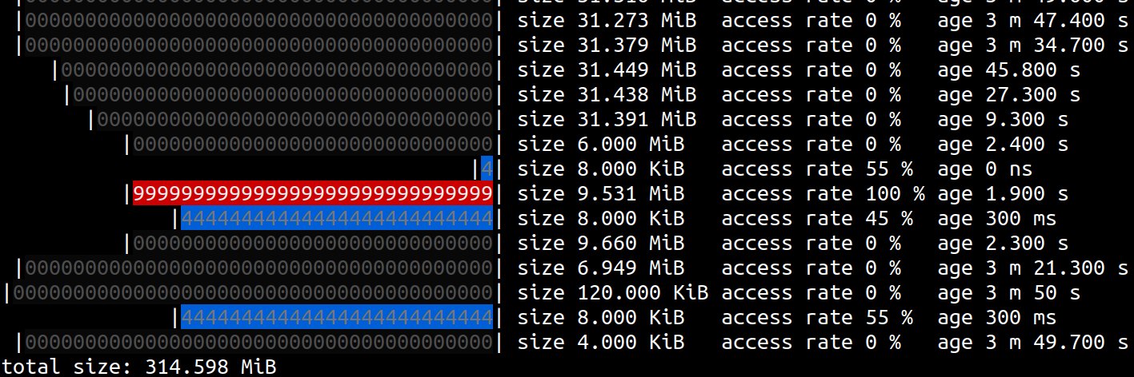
DAMON: Data Access Pattern Snapshot Generator
Informs which address range is how frequently accessed for how long time
Supports virtual/physical address spaces (could be expanded)

Slide 6
DAMON: Data Access Pattern Snapshot Generator
Informs which address range is how frequently accessed for how long time
Supports virtual/physical address spaces (could be expanded)
Cold!
Hot!
Warm!

Slide 7
Best-effort Overhead-Accuracy Tradeoff
Let users control upper-bound monitoring overhead limit
Under the limit, provides its best accuracy using adaptive mechanisms
From real world production usages, 3-4% CPU usage is commonly reported
More details available at the design doc

Slide 8
Extensible Design
DAMON supports virtual address spaces and the physical address space
The core logic and address space/access check-specific logic are separated
Can be extended for different address spaces and access check primitives
E.g., CPU (AMD IBS, Intel PEBS, …) or devices (e.g., GPU, CXL, …) providing access check primitives for special address spaces
(e.g., CPU cache, unified memory, low-tier memory, …)
More details are available at design doc

Slide 9
Extensible Design
Extensible Design
DAMON supports virtual address spaces and the physical address space
The core logic and address space/access check-specific logic are separated
Can be extended for different address spaces and access check primitives
E.g., CPU (AMD IBS, Intel PEBS, …) or devices (e.g., GPU, CXL, …) providing access check primitives for special address spaces
(e.g., CPU cache, unified memory, low-tier memory, …)
More details are available at design doc

Slide 10
DAMOS: DAMon-based Operation Schemes
A feature of DAMON
Apply memory operation actions to regions of interesting access pattern
More details are available at design doc
# # pageout memory regions that not accessed for >=5 seconds
# damo start --damos_action pageout --damos_access_rate 0% 0% --damos_age 5s max
Pageout!

Slide 11
DAMOS: DAMon-based Operation Schemes
A feature of DAMON
Apply memory operation actions to regions of interesting access pattern
More details are available at design doc
# # pageout memory regions that not accessed for >=5 seconds
# damo start --damos_action pageout --damos_access_rate 0% 0% --damos_age 5s max
Pageout!

Slide 12
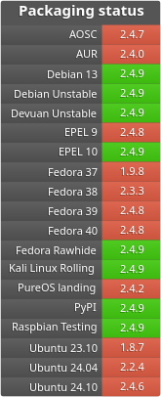
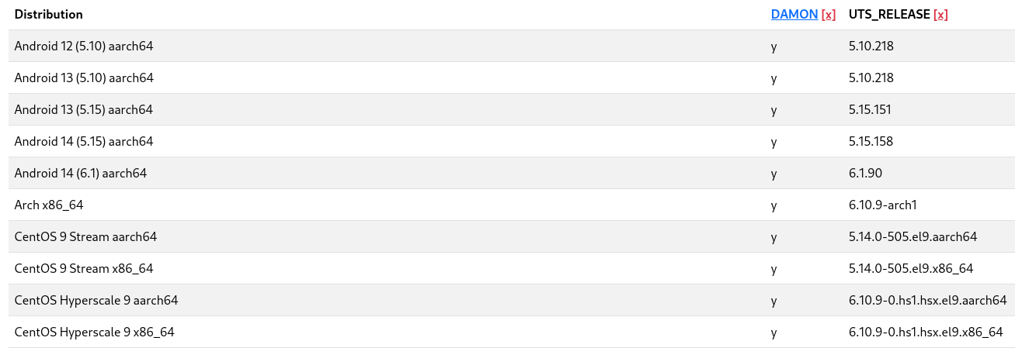
Availability
DAMON is enabled on kernels of major Linux distros
including Amazon Linux, Android, Debian, Fedora, Oracle Linux
DAMON user-space tool is packaged for multiple packaging systems including Arch, Debian, Fedora, PyPi, Raspbian

Slide 13
That’s It About DAMON Itself
Internal mechanism of DAMON is out of the scope of this talk
This talk is for how {others are using,you can use} DAMON for fun and profit
For more details of the internal mechanism, refer to the design doc

Slide 14
Three DAMON Recipes

Slide 15
Introducing (Only) Three DAMON Recipes
No one knows entire and optimum DAMON usages
Following three recipes are only speakers’ best knowledge
We are waiting to learn more recipes from you

Slide 16
Accesses Profiling (-guided Optimization)

Slide 17
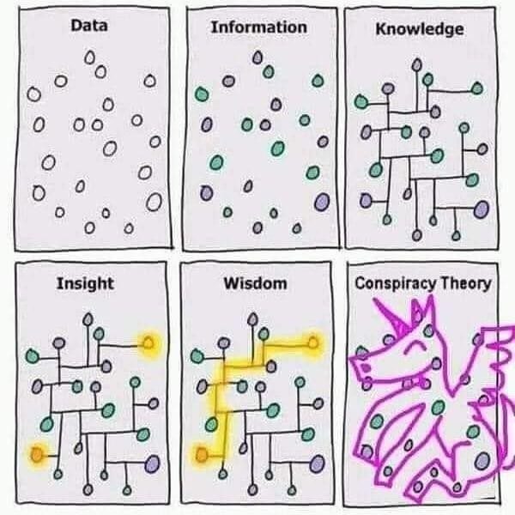
DAMON for Profiling (and Optimizations)
Record, or snapshot data access pattern of workloads using DAMON
Record/snapshot additional information together
Visualize the data points (e.g., heatmap, flamegraphs, workingset size)
Get insights from data for better understanding workloads and systems
Make profiling-guided optimizations
Image is retrieved from internet

Slide 18
General DAMON-based Profiling-Guided Optimization
Find hot/cold regions and matching data/variables in the code
Protect/promote hot data using mlock() or madvise(MADV_HUGEPAGES)
Evict/demote cold data using madvise(PAGEOUT,NOHUGEPAGES)
Any creative optimizations would be possible
Hot page protection achieves 2.3x speedup under memory pressure
More detailed blog article

Slide 19

DAMON user-space tool supports for PGO
DAMON user-space tool, damo, is for easy usages of DAMON
We are adding features for easy DAMON-based PGO to damo
As of this talk, some profiling parts are added, more works to go
Quick start: damo monitor --report_type holistic
Generated from https://qr.io

Slide 20
Proactive Reclamation

Slide 21
Proactive Reclamation
Reactive reclamation: Reclaim cold memory when memory pressure happens
Proactively reclamation: Reclaim cold memory before memory pressure
Benefit 1: Reduce memory footprint without performance degradation
Benefit 2: Minimize degradation from direct reclamation
Known usages: Google, Meta, and Amazon
Each company uses its own implementation for its usage
Amazon uses DAMON-based implementation for memory auto-scaling

Slide 22
Memory Auto-scaling Business Model
User: Specify workload and min/max memory requirements
Service provider: Run it somewhere, charge as they go
Achieving high performance and low price is the provider’s duty
User Service Provider
┌─────────────────┐
workload, min/max memory ──────> │ │
│ ??? │
workload output, bill <────── │ │
└─────────────────┘

Slide 23
Designs of Collaborative Memory Auto-scaling
Non-collab approach: Host reclaims/reallocs guests’ memory
Collab approach: Host reallocs guests-reported free pages
Minimize perf degradation from host’s mistakes
Question: What if guests are not memory frugal?
┌─────────────────────────────┐ ┌─────────┐
│ Guest 1 │ │ Guest 2 │
│ ┌─────────────────────────┐ │ │ │
│ │ Free pages reporting │ │ │ │
│ └────────────┬────────────┘ │ │ │
│ │ │ │ │
└──────────────┼──────────────┘ └─────────┘
│ Report reclaimed ^
V (free) pages │ Alloc Guest 1
┌───────────────────────────────┐ │ freed memory
│ Host ├─────────┘
└───────────────────────────────┘

Slide 24
Design of AWS’ Collaborative Memory Auto-scaling
Guests report free pages to host; the host re-alloc reported pages
Guests run DAMOS-based proactive reclamation for increasing free pages
┌─────────────────────────────┐ ┌─────────┐
│ Guest 1 │ │ Guest 2 │
│ ┌─────────────────────────┐ │ │ │
│ │ DAMON-based ReClamation │ │ │ │
│ └────────────┬────────────┘ │ │ │
│ │ Reclaim │ │ │
│ V │ │ │
│ ┌─────────────────────────┐ │ │ │
│ │ Free pages reporting │ │ │ │
│ └────────────┬────────────┘ │ │ │
│ │ │ │ │
└──────────────┼──────────────┘ └─────────┘
│ Report reclaimed ^
V (free) pages │ Alloc Guest 1
┌───────────────────────────────┐ │ freed memory
│ Host ├─────────┘
└───────────────────────────────┘

Slide 25
AWS’ DAMON-based Proactive Reclamation
AWS Aurora Serverless v2 is an officially known user of the memory scaling
Holistic re:Invent of the entire memory auto-scaling with DAMON is ongoing
[RFC IDEA v2 0/6] mm/damon: introduce Access/Contiguity-aware Memory Auto-scaling (ACMA)
Reclaim
│
┌──────────┴────────────┐
│ │
│ scale-down │
│
┌───────┴────────┐
│ │
0 min-mem max-mem end (memory address)
│ │
└──────┬───────┘
│
Scale-up

Slide 26
CXL Memory Tiering

Slide 27
Moving Mic to Honggyu Kim
Hongguu Kim from SK hynix will introduce this recipe
If you are reading these slides after the talk, refer to Honggyu’s slides (damon_recipes_osseu_hmsdk.pdf)

Slide 28
DAMON Community

Slide 29
DAMON Owner: Community
DAMON is a community-driven development project
Not owned by individual or companies (e.g., SJ, Amazon, Meta)
Owned by the community
A number of DAMON features are results of community discussions

Slide 30
Mailing List
Primary and official place for the community
For any question, discussion, reports, and patches
A tool (hkml) for mailing list-unfamiliar people is supported: https://github.com/sjp38/hackermail
Mailing address: damon@lists.linuxdev
Archive: https://lore.kernel.org/damon
Don’t hesitate sending personal mails/DMs to the maintainer (SJ)

Slide 31


Community Meetups: Beer/Coffee/Tea Chats
For any informal chats
Regular bi-weekly open/registration-based discussions
Occasional/regular private meetings on demand
Feel free to join existing meeting series, or ask one for yours
Multiple individuals and companies are using these
Google doc and calendar for schedules are available
Generated from https://qr.io

Slide 32
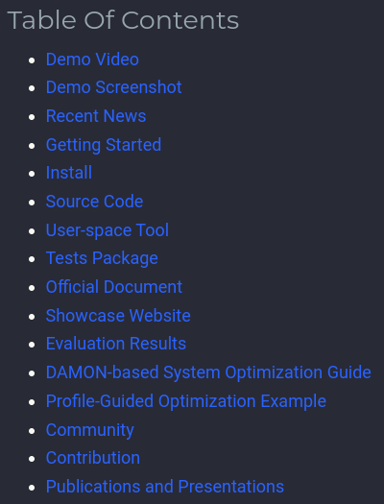

Project Website
https://damonitor.github.io
Provides all information for DAMON starters including
news, demo, usage guides
Generated from https://qr.io

Slide 33
Call For Your Voices
We prefer random evolution over intellectual design
Put your voice on the evolution path for your purposes
Report your use case, test results, and challenges you gone through
Ask questions and request features/documents
Show your interest to known TODO items
Send patches
The maintainer is committed to help the community, you

Slide 34
Summary

Slide 35
Summary
DAMON is an efficient data access pattern snapshot generator
People can optimize system memory usage using DAMON
AWS Aurora Serverless v2 and SK hynix HMSDK are using DAMON for memory auto-scalaing and CXL memory tiering, respectively
DAMON community is waiting for your voices
If you want to start, visit the project site: https://damonitor.github.io
Generated from https://qr.io

Slide 36
Questions?
If your question is not answered by the session, use below
The maintainer: sj@kernel.org
Project webpage: https://damonitor.github.io
Kernel docs for admin and kernel programmers
DAMON mailing list: damon@lists.linux.dev
DAMON Beer/Coffee/Tea Chat
Today’s in-person DAMON meetup (4:55 pm, room 444)
Generated
from https://qr.io

