Slide 1
Beyond Weighted Interleaving:
Bandwidth-Driven Memory Tiering with DAMON
Ravi Jonnalagadda <ravis.opensrc@gmail.com>

Slide 2
Each Policy Solves Half
WEIGHTED INTERLEAVING · fixed split
HOTNESS TIERING · promote what is hot
DRAM
DRAM
CXL
CXL
✓ drives both memory paths at once
✓ right about heat
✗ blind to which pages are hot
✗ keeps filling DRAM after it stops helping
Wanted: place by hotness, split by the bandwidth the machine actually delivers

Slide 3
The Knobs Are Already Upstream
v6.9
v6.17
v7.2
Weighted interleaving
MPOL_WEIGHTED_INTERLEAVE: a per-node weighted page split (co-developed)
DAMOS destination weights
migrate_hot / migrate_cold to several nodes, by weight: a split per process
node_eligible_mem_bp
a DAMOS quota goal: the share of eligible memory on a node, machine-wide
Missing: something that turns these knobs from a live bandwidth reading

Slide 4
Closing the Loop
DAMON: which pages are hot
PEBS / IBS samples through the perf substrate
damo auto_tier
hill climb
move the split one step;
keep it if bandwidth rose,
step back if it fell
no target ratio given
actuator
VA: DAMOS destination weights
PA: node_eligible_mem_bp goal
resctrl MBM: delivered bandwidth
per monitored process, or the whole machine
DAMOS migrates hot pages → bandwidth changes → measured again
Hill climb from our ISMM 2026 paper, “Bandwidth Speaks, We Listen: Dynamic Memory Interleaving for Tiering” · code: damo auto_tier branch

Slide 5
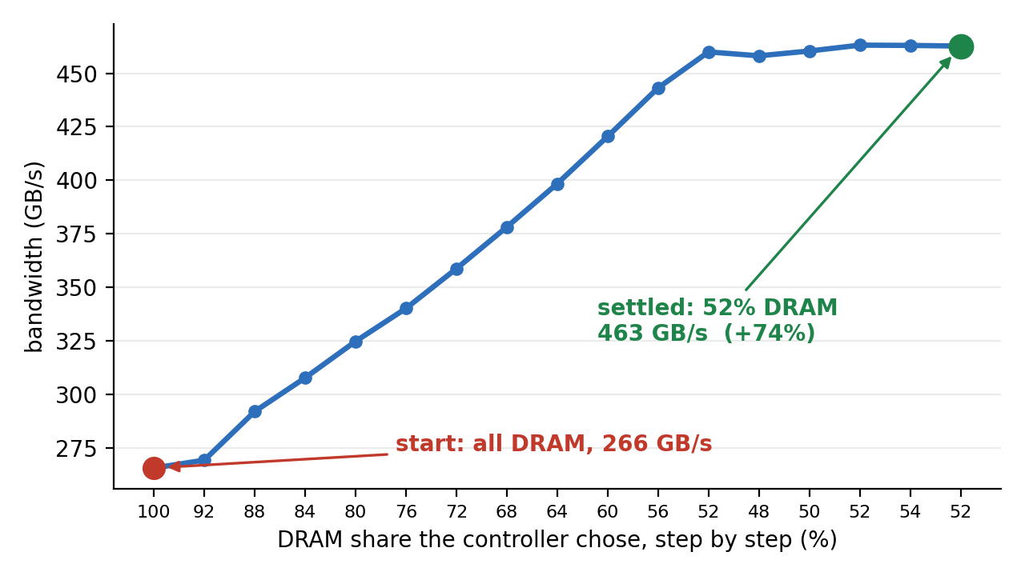
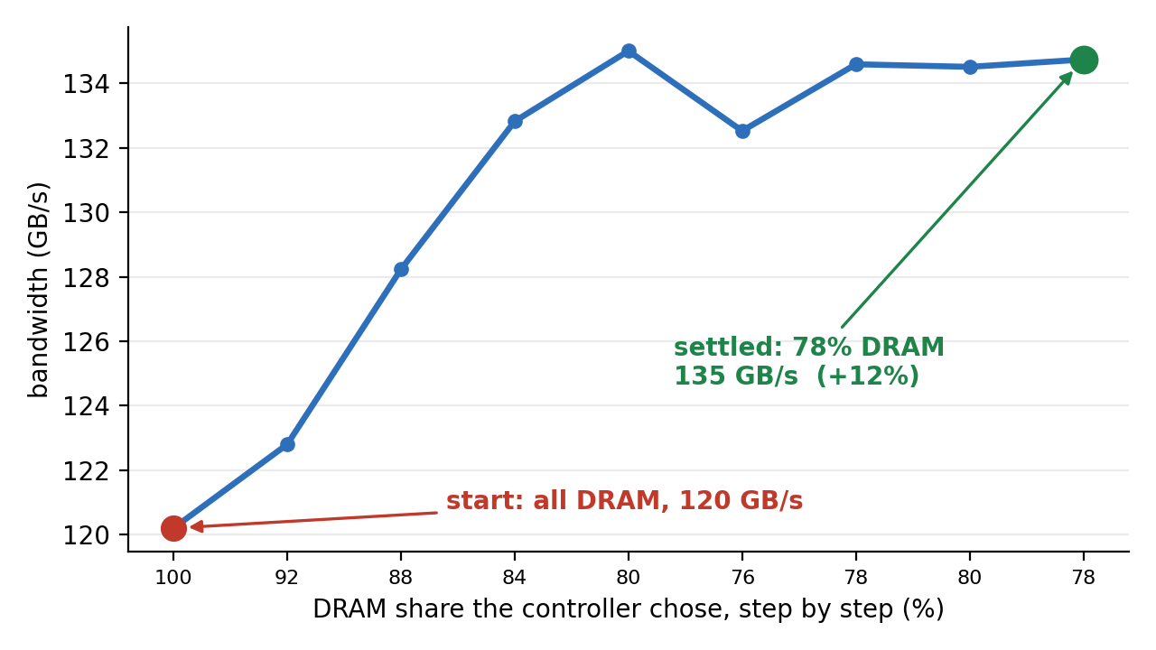
It Finds the Best Split on Its Own
Intel PEBS · virtual addresses · named processes
266 → 463 GB/s, settled at 52% DRAM
AMD IBS · physical addresses · whole machine
120 → 135 GB/s, settled at 78% DRAM
Both start all-DRAM, with no target and no model of the machine

Slide 6
Why Hardware Samples Settle
ACCESSED-BIT SCAN · a delayed view
HARDWARE SAMPLES · a current view
pages move, but the scan reports it
several aggregation intervals later
so the controller corrects an error already fixed
the next samples land where
the pages are now
so the goal is measured against real placement
target
target
time →
time →
✗ overshoots, then hunts around the target
✓ reaches the target and holds
Measured, accessed-bit scan
even with a cache workaround: in band only 15-22% of the time
Measured, IBS samples
the climb reached its peak in 4 steps (previous slide)
Traces are illustrative.

Slide 7
What Next: for Discussion
Upstream path
RFC v4 on damon/next; fold into milestone 2's report path with Akinobu
Where the controller lives
userspace damo today; which parts belong in DAMOS goal tuning?
More hotness sources
sampling PMUs feed the overflow path; trace PMUs such as Arm SPE via Kunwu's AUX backend
Observability
damos_node_eligible_mem_bp tracepoint, posted for mm-new
Kernel: RFC v4 cover letter · tracepoint patch
Userspace: damo auto_tier branch

