Slide 1
KernelSummit @ LinuxPlumbersConf, August 2020
D A M O N:
Data Access MONitoring Framework for Fun and Memory Management Optimizations
SeongJae Park <sjpark@amazon.de>

Slide 2
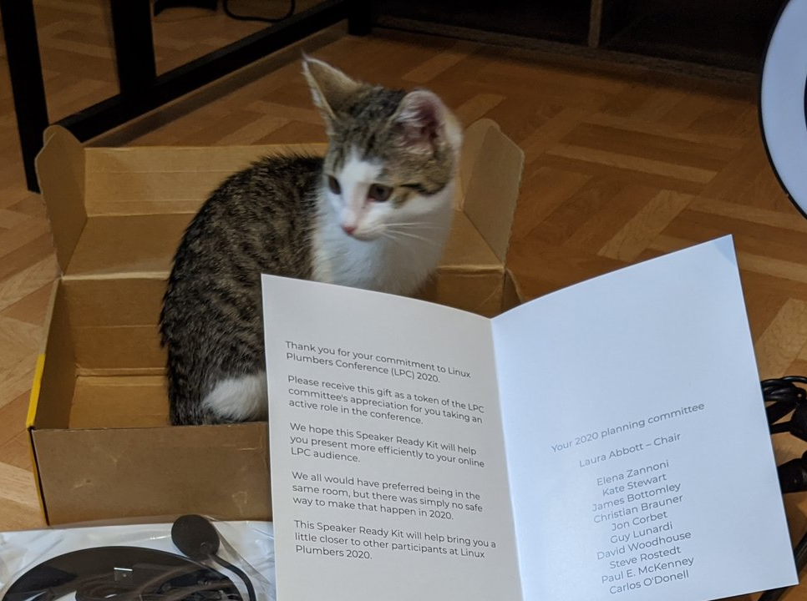
Disclaimer
The views expressed herein are those of the speaker;
they do not reflect the views of his employers
My cat might come up on the screen. The cat has no ‘--silent’ option.
Sorry, please don’t surprise; keep calm and blame COVID19 :P
https://twitter.com/sjpark0x00/status/1295387149018300419/photo/1

Slide 3
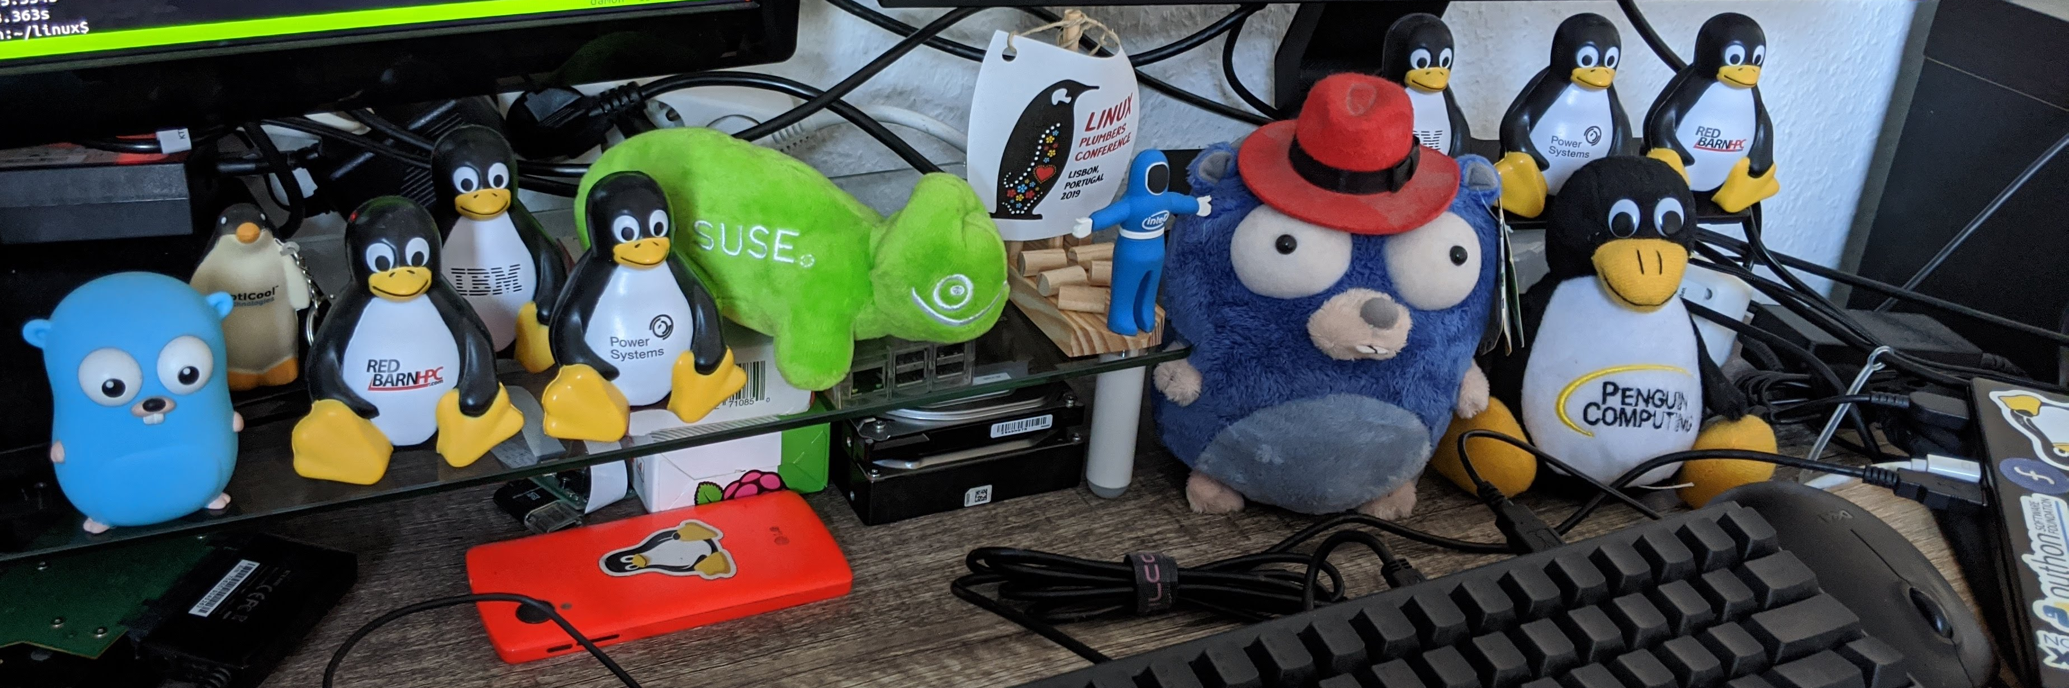
I, SeongJae Park <sjpark@amazon.de>
Kernel / Hypervisor Engineer at Amazon Web Services
Interested in the memory management and the parallel programming
  Before joining Amazon, developed
  Guaranteed Contiguous Memory Allocator and
  HTM-based update-side synchronization for RCU on NUMA systems

Slide 4
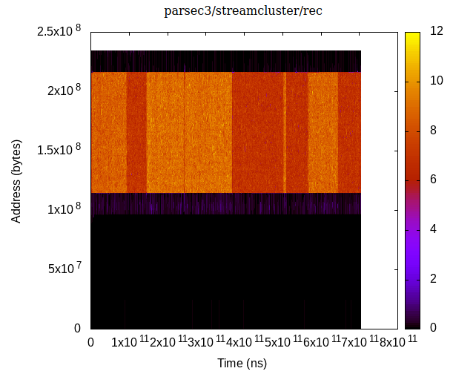
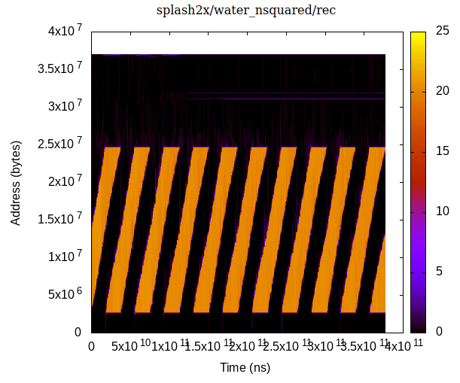
TL; DR
When: Now
Who: Sysdmins and kernel subsystems
Where: On CONFIG_DAMON=y kernel
What: Can monitor the data accesses
Why: For fun and better MM
How (for sysadmins):
# damo record $(pidof my_workload)
# damo report heats –heatmap a.png;
# eog a.png
Review the patches, please!

Slide 5
Overview
Motivation
DAMON
Live Demo
Evaluation
Plans
Conclusion

Slide 6
Overview
Motivation
DAMON
Live Demo
Evaluation
Plans
Conclusion

Slide 7
Data Access Patterns and The Memory Management
For a good memory managements, access patterns are needed
(e.g., to keep warm data close and hot data closer to CPU)
Linux kernel memory management (MM) gets the information with
  PTE ‘Accessed’ bits manipulation, fundamentally
Cons: Coarse
  Only accessed or not, between some events such as memory pressures
  2 LRU lists and heuristics help this a lot
  (The heuristics makes MM more complicated, though)
Pros: Low overhead
  Extracting finer information will result in higher overhead
So, it’s a trade-off that carefully taken. But, wait... is it still the best?

Slide 8
Is MM Happy In This Modern World
Recent trends might changed some things
  Working sets are continuously growing
  DRAM is relatively reducing due to the price and energy consumption
  New memory devices that slower but cheaper and larger than DRAM evolving
Based on the trend, a number of optimizations made
  The works optimize MM in creative ways using finer data access patterns
  Most of the works show impressive improvements;
  Even my simple approach also showed up to 2.55x performance
But, most of the works had only small interest in the pattern extraction
  Only naive approaches incurring high/unscalable overhead are used
  This made most of the works not acceptable in the mainline
  So, MM needs a subsystem for the fine information, first

Slide 9
Overview
Motivation
DAMON
Live Demo
Evaluation
Plans
Conclusion

Slide 10
Overview
Motivation
DAMON
  What it is and what you can get from it
  How to use it
  How it works
  Misc (how it can be used from user space, how it is tested)
Live Demo
Evaluation
Plans
Conclusion

Slide 11
Overview
Motivation
DAMON
  What it is and what you can get from it
  How to use it
  How it works
  Misc (how it can be used from user space, how it is tested)
Live Demo
Evaluation
Plans
Conclusion

Slide 12
DAMON: Data Access MONitor
Data access monitoring framework for the Linux kernel
  Provides access frequency of each address range
perf
DAMO
User
space
tracepoints
debugfs
Data Accesses
Recording
DAMON-based
Operation Schemes
Kernel
space
DAMON
The framework
For vaddr
For phys addr
vma
PTE
rmap

Slide 13
DAMON: Data Access MONitor
Data access monitoring framework for the Linux kernel
  Provides access frequency of each address range
  Both kernel space and user space can use it for
  analysis, memory management optimizations, and fun ;)
perf
DAMO
User space applications
User
space
tracepoints
debugfs
Data Accesses
Recording
DAMON-based
Operation Schemes
Kernel space applications
Kernel
space
DAMON
The framework
For vaddr
For phys addr
vma
PTE
rmap

Slide 14
Main Design Requirements
DAMON is desgined to mitigate the overhead-accuracy problem
For the goal, it fulfills below 4 requirements
  Accuracy: The monitoring result should be useful for DRAM level MM
  Overhead: Should light-weight enough for online monitoring
  Scalability: The upper-bound overhead should be controllable regardless of the size of the monitoring target systems and workloads
  Generality: The mechanism should be applicable for wide use-cases (e.g., virtual address, physical address, cache-line granularity, ...)

Slide 15
Overview
Motivation
DAMON
  What it is and what you can get from it
  How to use it
  How it works
  Misc (how it can be used from user space, how it is tested)
Live Demo
Evaluation
Plans
Conclusion

Slide 16
The Usage: Programming Interface
Step 1: Set the requests in ‘struct damon_ctx’ instances
  How, what memory regions should be monitored
    The upper-bound monitoring overhead is included here (how)
  What function should be periodically called back with the results
    Users can read the monitoring results inside the function
Step 2: Pass the requests to DAMON via ‘damon_start()’
  Then, a kernel thread for the monitoring is created for each request
  The thread does monitoring and calls the notification callback
Unless ‘damon_start()’ is called, the system gets no change at all
  No overhead incurred by just installing DAMON=y kernel
  IOW, No harm in DAMON=y ;)

Slide 17
The Usage: In a Pseudo-Code
void on_notification(struct damon_ctx *c);
static int __init demo(void)
{
struct damon_ctx ctx = {
.aggr_interval = 100,
.aggregate_cb = on_notification,
[...]
};
damon_start(&ctx, 1);
msleep(1000*60);
damon_stop(&ctx, 1);
return 0;
}
void on_notification(struct damon_ctx *c);
{
struct damon_region *r;
damon_for_each_region(r, c)
pr_info(“%lu-%lu accessed %u times during last 100ms\n”,
r->start, r->end, r->nr_accesses);
}
Notify me and reset
‘->nr_accesses’ every 100ms
Call ‘on_notification’
for the notification

Slide 18
Overview
[...]
DAMON
  What it is and what you can get from it
  How to use it
  How it works
    control of the overhead and accuracy
    Support of Various Address Spaces
    DAMON-based MM optimizations
  Misc (how it can be used from user space, how it is tested)
[...]

Slide 19
Overview
[...]
DAMON
  What it is and what you can get from it
  How to use it
  How it works
    control of the overhead and accuracy
    Support of Various Address Spaces
    DAMON-based MM optimizations
  Misc (how it can be used from user space, how it is tested)
[...]

Slide 20
Control of Overheads and Monitoring Accuracy
DAMON becomes DAMON in below steps
  Straightforward Access Monitoring (Fixed granularity)
  Region-based Sampling (Elastic granularity)
  Adaptive Regions Adjustment (Best-effort accuracy)

Slide 21
Straightforward Access Monitoring (Fixed Granularity)
Periodically check if each monitoring target page is accessed
  Let’s call the period as ‘sampling interval’
Aggregate the observations into access frequencies
  Count number of observed accesses and periodically reset the counter
  Let’s call the period as ‘aggregation interval’
By notifying the users just before the reset of the counter, we can provide the access frequency of the pages to the users
Pros: Fine-grained (page size) monitoring
  Might not strictly required in some performance-centric optimizations
Cons: High and unscalable monitoring overhead
  The overhead arbitrarily increases as the target size grows

Slide 22
Region-based Sampling (Elastic Granularity)
Let’s define data objects in access pattern oriented way
  “A data object is a memory region that all page frames in the region have similar access frequencies”
  By the definition, if a page in a region is accessed, other pages of the region has probably accessed, and vice versa
  Thus, checks for the other pages can be skipped
By limiting the number of regions, we can control the monitoring overhead regardless of the target size
However, the accuracy will degrade if the regions are not properly set
(Will result in poor accuracy)
(Will result in reasonable accuracy)
Hot region
Target region
Cold region

Slide 23
Adaptive Regions Adjustment (Best-effort Accuracy)
Merge
Starts with minimal number of regions covering entire target memory areas
For each aggregation interval,
  merge adjacent regions having similar access frequencies to one region
  Split each region into two (or three, depend on state) randomly sized regions
  Avoid merge/split if the number of regions might be out of the user-defined range
If a split was meaningless, next merge process will revert it (vice versa)
In this way, we can let users limit the upper bound overhead while preserving best-effort accuracy
Split
AF: 0.5 0 0 0
Merge
Split
AF: 0 0.9 0 0
Merge
AF: (Observed) Access Frequency
Hot region (AF 1.0)
Cold region (AF 0)
Target region

Slide 24
Overview
[...]
DAMON
  What it is and what you can get from it
  How to use it
  How it works
    control of the overhead and accuracy
    Support of Various Address Spaces
    DAMON-based MM optimizations
  Misc (how it can be used from user space, how it is tested)
[...]

Slide 25
Primitives for Fundamental Access Monitoring
The previous descriptions (intentionally) didn’t explain
  How the monitoring target regions identified, and
  How each page is checked whether it has accessed or not
These two unexplained tasks are
  Dependent on the detailed use-cases
    Virtual address space VS physical address space
    Super high accuracy VS only reasonable accuracy
    (suppose some arch provides dedicated super light access check primitives)
  Independent with the overhead-accuracy handling core logic

Slide 26
Many Use Cases Are Imaginable
There are many realistic use cases including
  Full or parts (e.g., stack) of virtual address spaces of specific processes
  Full or parts (e.g., NUMA) of physical address spaces of the machine
  Memory regions backed by specific file or device
  PTE Accessed bit or LRU position as the access check primitive
  Dedicated h/w feature of special arch as the access check primitive
Implementing those in DAMON makes it only complex and inflexible

Slide 27
The Core Logics Are Highly Simple and Flexible
The minimal access check granularity could be anything
  The description mentioned page size, but it doesn’t have to be
  Page size, cache line size, 42 bytes, or even one byte is OK
  if the regions are addressable and access check is possible
‘Adaptive regions adjustment' can be turned off
  Setting the min # of regions same to the max # of regions will turn off the mechanism, as any split and merge will violate the condition
  Setting the two values same to ``target_size / PAGE_SIZE`` will result in the straightforward page granularity monitoring
Even multiple CPUs can be used if necessary
  If you could afford multiple CPUs for super high accuracy, you could
  1) partition the target region into multiple requests and
  2) send those to `damon_start()` at once

Slide 28
Separation of The Primitives and The Core Logic
The core logic uses the primitives via only cleanly defined interfaces
The interface is 4 function pointers in the ‘struct damon_ctx’
  init_regions(): Initialize the monitoring target regions
  update_regions(): Update the monitoring target regions if there were some changes (e.g., mmap() or hot-plug)
  prepare_access_check():
  Set next sampling target address and mark it not accessed
  access_check(): Check if the sampling target address is accessed
Any primitives following the interface can be configured to be used

Slide 29
DAMON is Extensible
DAMON users can extend DAMON for their specific usages
  Implement own primitives and configure damon_ctx to use it
By default, reference implementations of the primitives for the virtual address spaces and the physical address space are provided
perf
DAMO
User
space
tracepoints
debugfs
Data Accesses
Recording
DAMON-based
Operation Schemes
kernel space
DAMON
Framework (core logics)
For vaddr
For phys addr
Low level primitives
vma
PTE
rmap

Slide 30
Overview
[...]
DAMON
  What it is and what you can get from it
  How to use it
  How it works
    control of the overhead and accuracy
    Support of Various Address Spaces
    DAMON-based MM optimizations
  Misc (how it can be used from user space, how it is tested)
[...]

Slide 31
The DAMON-based Optimizations
Now DAMON-based optimizations are available
  Both the kernel space and the user space can make the optimization by:
    Step 1: Run DAMON
    Step 2: Analyze the monitoring results offline or online
    Step 3: Make some changes based on the analysis
  The works unaccepted due to the problem could revisited
I will optimize the kernel in this way, once DAMON is merged in
  So the upstream kernels will just work (nearly) optimal someday
  However, downstream kernel / user space optimizations will still required
    Because special cases always exist

Slide 32
Risks of Non-upstream DAMON-based Optimizations
It could be difficult, dangerous, dirty, or restrictive
Optimizations in the kernel space could be difficult and dangerous
  Not every sysadmin is experienced kernel programmer
  Kernel bugs are dangerous
Optimizations in the user space could be dirty and restrictive
  Receiving and analyzing the results require some lines of code
    No library for now; To be honest, I want to do everything on the shell
  Actions to monitored memory regions are restricted
  (madvise_process() might solve most of this problem)

Slide 33
DAMOS: DAMON-based Operation Schemes
Yet another kernel feature for easy MM optimizations built on DAMON
Receives ‘schemes’, each constructed with
  3 conditions: Size, access frequency, and age of memory regions
  1 memory management action
    Currently supported actions include:
    MADV_(WILLNEED|COLD|PAGEOUT|HUGEPAGE|NOHUGEPAGE)
DAMON automatically finds the memory region of the condition and applies the action to the region
Now users can make DAMON-based optimizations without code
# format is:
# <min/max size> <min/max frequency (0-100)> <min/max age> <action>
#
# if a region of size >=4KB didn’t accessed for >=2mins, page out
4K max 0 0 2m max pageout

Slide 34
DAMOS Stats
Special DAMOS action, ‘stat’ does nothing but count
  Total number of regions matched in the condition
  Total size of regions matched in the condition
Users can directly get only meaningful numbers such as
  Size and number of regions of varying access frequencies and ages
  No need to get the full results and manually analyze it
# format is:
# <min/max size> <min/max frequency (0-100)> <min/max age> <action>
#
min max 0 49 2mins max stat
min max 50 100 2mins max stat
min max 0 49 4mins max stat
min max 50 100 4mins max stat

Slide 35
Overview
Motivation
DAMON
  What it is and what you can get from it
  How to use it
  How it works
  Misc (how it can be used from user space, how it is tested)
Live Demo
Evaluation
Plans
Conclusion

Slide 36
Interfaces for The User Space
Tracepoint
  Provide the monitoring results
  The monitoring should be manually turned on/off
DAMON debugfs interface
  Receive monitoring requests and provide monitoring records
  Support both the virtual address and physical address
  The ABI for development of other user space tools
User space tool: DAMON Operator (DAMO)
  A reference implementation of user space tool built on the debugfs
  Provide human friendly interfaces and monitoring results visualization

Slide 37
Tests
DAMON has several automated tests for it
Inside the patchset (should be merged together)
  User space tests: Test debugfs interface based on kselftest
  Unit tests: Test internal code based on kunit
Outside the patchset (would not be merged in the mainline)
  Correctness tests: Time consuming tests including build/accuracy tests
  Performance tests: Constructed with 25 realistic workloads
Outside-the-patchset tests might be open-sourced eventually
  Hope to be also used as a getting started guide

Slide 38
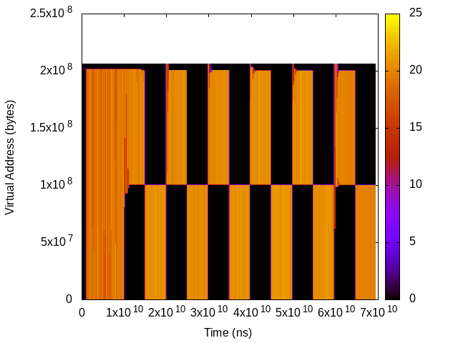
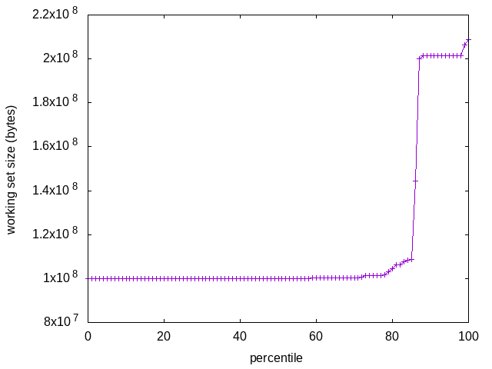
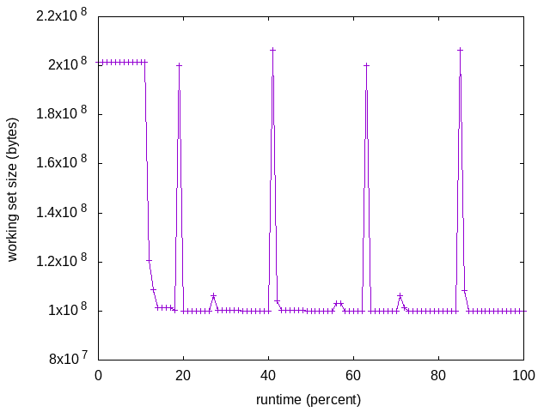
Live Demo using DAMO
$ git clone https://github.com/sjp38/masim
$ cd masim; make; ./masim ./configs/zigzag.cfg &
$ sudo damo record $(pidof masim)
$ damo report raw
$ damo report heats --heatmap access_pattern_heatmap.png
$ damo report wss --range 0 101 1 --plot wss_dist.png
$ damo report wss --range 0 101 1 –sortby time –plot wss_time.png
A demo video is also available: https://youtu.be/l63eqbVBZRY

Slide 39
Overview
Motivation
DAMON
Live Demo
Evaluation
Plans
Conclusion

Slide 40
Evaluation Questions
How lightweight DAMON is?
How accurate DAMON is?
How useful DAMON-based optimizations are?

Slide 41
Evaluation Environment
Test machine
  QEMU/KVM virtual machine on AWS EC2 i3.metal instance
  36 vCPUs, 128 GB memory, 4 GB zram swap device
  Ubuntu 18.04, THP enabled policy madvise
  Linux v5.8 + DAMON patchsets (The source tree is available)
Workloads: 25 realistic benchmark workloads
  13 workloads from PARSEC3
  12 workloads from SPLASH-2X
DAMON monitoring attributes: The default values
  5ms sampling, 100ms aggregation, and 1s regions update intervals
  Number of regions: [10, 1000]

Slide 42
Evaluation Targets
Variants
  orig: DAMON turned off (same to vanilla v5.8)
  rec: DAMON for virtual address of the workload turned on
  prec: DAMON for entire physical address of the system turned on
  thp: THP enabled policy set always (to be compared with ethp)
  ethp: ethp DAMON-based operation scheme is applied
  prcl: prcl DAMON-based operation scheme is applied
$ cat ethp.damos
# for regions having 5/100 access frequency, apply MADV_HUGEPAGE
min max 5 max min max hugepage
# for regions >=2MB and not accessed for >=7 seconds, apply MADV_NOHUGEPAGE
2M max min min 7s max nohugepage
$ cat prcl.damos
# for regions >=4KB and not accessed for >=10 seconds, apply MADV_PAGEOUT
4K max 0 0 10s max pageout

Slide 43
Evaluation Methodology
Measurement
  Runtime of the workload
  System memory usage (MemTotal – MemFree)
  Residential Set Size (RSS) of the workload
  For each of the workload x variant combinations (25 x 6 = 150)
  Memory usages are periodically measured and averaged
Every data is average of 5 different runs (150 x 5 = 750)
  Run each evaluation on 5 different QEMU VMs on different i3.metal instance
  Effects from weird outliers might be minimized (still fluctuates, though)
The test automation code might be open-sourced at last
Detailed results are available online

Slide 44
Runtime
runtime orig rec (overhead) prec (overhead) thp (overhead) ethp (overhead) prcl (overhead)
parsec3/blackscholes 137.688 139.910 (1.61) 138.226 (0.39) 138.524 (0.61) 138.548 (0.62) 150.562 (9.35)
parsec3/bodytrack 124.496 123.294 (-0.97) 124.482 (-0.01) 124.874 (0.30) 123.514 (-0.79) 126.380 (1.51)
parsec3/canneal 196.513 209.465 (6.59) 223.213 (13.59) 189.302 (-3.67) 199.453 (1.50) 242.217 (23.26)
parsec3/dedup 18.060 18.128 (0.38) 18.378 (1.76) 18.210 (0.83) 18.397 (1.87) 20.545 (13.76)
parsec3/facesim 343.697 344.917 (0.36) 341.367 (-0.68) 337.696 (-1.75) 344.805 (0.32) 361.169 (5.08)
parsec3/ferret 288.868 286.110 (-0.95) 292.308 (1.19) 287.814 (-0.36) 284.243 (-1.60) 284.200 (-1.62)
parsec3/fluidanimate 342.267 337.743 (-1.32) 330.680 (-3.39) 337.356 (-1.43) 340.604 (-0.49) 343.565 (0.38)
parsec3/freqmine 437.385 436.854 (-0.12) 437.641 (0.06) 435.008 (-0.54) 436.998 (-0.09) 444.276 (1.58)
parsec3/raytrace 183.036 182.039 (-0.54) 184.859 (1.00) 187.330 (2.35) 185.660 (1.43) 209.707 (14.57)
parsec3/streamcluster 611.075 675.108 (10.48) 656.373 (7.41) 541.711 (-11.35) 473.679 (-22.48) 815.450 (33.45)
parsec3/swaptions 220.338 220.948 (0.28) 220.891 (0.25) 220.387 (0.02) 219.986 (-0.16) -100.000 (0.00)
parsec3/vips 87.710 88.581 (0.99) 88.423 (0.81) 88.460 (0.86) 88.471 (0.87) 89.661 (2.22)
parsec3/x264 114.927 117.774 (2.48) 116.630 (1.48) 112.237 (-2.34) 110.709 (-3.67) 124.560 (8.38)
splash2x/barnes 131.034 130.895 (-0.11) 129.088 (-1.48) 118.213 (-9.78) 124.497 (-4.99) 167.966 (28.19)
splash2x/fft 59.805 60.237 (0.72) 59.895 (0.15) 47.008 (-21.40) 57.962 (-3.08) 87.183 (45.78)
splash2x/lu_cb 132.353 132.157 (-0.15) 132.473 (0.09) 131.561 (-0.60) 135.541 (2.41) 141.720 (7.08)
splash2x/lu_ncb 149.050 150.496 (0.97) 151.912 (1.92) 150.974 (1.29) 148.329 (-0.48) 152.227 (2.13)
splash2x/ocean_cp 82.189 77.735 (-5.42) 84.466 (2.77) 77.498 (-5.71) 82.586 (0.48) 113.737 (38.38)
splash2x/ocean_ncp 154.934 154.656 (-0.18) 164.204 (5.98) 101.861 (-34.26) 142.600 (-7.96) 281.650 (81.79)
splash2x/radiosity 142.710 141.643 (-0.75) 143.940 (0.86) 141.982 (-0.51) 142.017 (-0.49) 152.116 (6.59)
splash2x/radix 50.357 50.331 (-0.05) 50.717 (0.72) 45.664 (-9.32) 50.222 (-0.27) 73.981 (46.91)
splash2x/raytrace 134.039 132.650 (-1.04) 134.583 (0.41) 131.570 (-1.84) 133.050 (-0.74) 141.463 (5.54)
splash2x/volrend 120.769 120.220 (-0.45) 119.895 (-0.72) 120.159 (-0.50) 119.311 (-1.21) 119.581 (-0.98)
splash2x/water_nsquared 376.599 373.411 (-0.85) 382.601 (1.59) 348.701 (-7.41) 357.033 (-5.20) 397.427 (5.53)
splash2x/water_spatial 132.619 133.432 (0.61) 135.505 (2.18) 134.865 (1.69) 133.940 (1.00) 148.196 (11.75)
total 4772.510 4838.740 (1.39) 4862.740 (1.89) 4568.970 (-4.26) 4592.160 (-3.78) 5189.560 (8.74)
This is also available online.
Summarized analysis is in following slide, so you don’t need to read this now.

Slide 45
System Memory Usage (MemTotal - MemFree)
memused.avg orig rec (overhead) prec (overhead) thp (overhead) ethp (overhead) prcl (overhead)
parsec3/blackscholes 1825022.800 1863815.200 (2.13) 1830082.000 (0.28) 1800999.800 (-1.32) 1807743.800 (-0.95) 1580027.800 (-13.42)
parsec3/bodytrack 1425506.800 1438323.400 (0.90) 1439260.600 (0.96) 1400505.600 (-1.75) 1412295.200 (-0.93) 1412759.600 (-0.89)
parsec3/canneal 1040902.600 1050404.000 (0.91) 1053535.200 (1.21) 1027175.800 (-1.32) 1035229.400 (-0.55) 1039159.400 (-0.17)
parsec3/dedup 2526700.400 2540671.600 (0.55) 2503689.800 (-0.91) 2544440.200 (0.70) 2510519.000 (-0.64) 2503148.200 (-0.93)
parsec3/facesim 545844.600 550680.000 (0.89) 543658.600 (-0.40) 532320.200 (-2.48) 539429.600 (-1.18) 470836.800 (-13.74)
parsec3/ferret 352118.600 326782.600 (-7.20) 322645.600 (-8.37) 304054.800 (-13.65) 317259.000 (-9.90) 313532.400 (-10.96)
parsec3/fluidanimate 651597.600 580045.200 (-10.98) 578297.400 (-11.25) 569431.600 (-12.61) 577322.800 (-11.40) 482061.600 (-26.02)
parsec3/freqmine 989212.000 996291.200 (0.72) 989405.000 (0.02) 970891.000 (-1.85) 981122.000 (-0.82) 736030.000 (-25.59)
parsec3/raytrace 1749470.400 1751183.200 (0.10) 1740937.600 (-0.49) 1717138.800 (-1.85) 1731298.200 (-1.04) 1528069.000 (-12.66)
parsec3/streamcluster 123425.400 151548.200 (22.79) 144024.800 (16.69) 118379.000 (-4.09) 124845.400 (1.15) 118629.800 (-3.89)
parsec3/swaptions 4150.600 25679.200 (518.69) 19914.800 (379.80) 8577.000 (106.64) 17348.200 (317.97) -100.000 (0.00)
parsec3/vips 2989801.200 3003285.400 (0.45) 3012055.400 (0.74) 2958369.000 (-1.05) 2970897.800 (-0.63) 2962063.000 (-0.93)
parsec3/x264 3242663.400 3256091.000 (0.41) 3248949.400 (0.19) 3195605.400 (-1.45) 3206571.600 (-1.11) 3219046.333 (-0.73)
splash2x/barnes 1208017.600 1212702.600 (0.39) 1194143.600 (-1.15) 1208450.200 (0.04) 1212607.600 (0.38) 878554.667 (-27.27)
splash2x/fft 9786259.000 9705563.600 (-0.82) 9391006.800 (-4.04) 9967230.600 (1.85) 9657639.400 (-1.31) 10215759.333 (4.39)
splash2x/lu_cb 512130.400 521431.800 (1.82) 513051.400 (0.18) 508534.200 (-0.70) 512643.600 (0.10) 328017.333 (-35.95)
splash2x/lu_ncb 511156.200 526566.400 (3.01) 513230.400 (0.41) 509823.800 (-0.26) 516302.000 (1.01) 418078.333 (-18.21)
splash2x/ocean_cp 3353269.200 3319496.000 (-1.01) 3251575.000 (-3.03) 3379639.800 (0.79) 3326416.600 (-0.80) 3143859.667 (-6.24)
splash2x/ocean_ncp 3905538.200 3914929.600 (0.24) 3877493.200 (-0.72) 7053949.400 (80.61) 4633035.000 (18.63) 3527482.667 (-9.68)
splash2x/radiosity 1462030.400 1468050.000 (0.41) 1454997.600 (-0.48) 1466985.400 (0.34) 1461777.400 (-0.02) 441332.000 (-69.81)
splash2x/radix 2367200.800 2363995.000 (-0.14) 2251124.600 (-4.90) 2417603.800 (2.13) 2317804.000 (-2.09) 2495581.667 (5.42)
splash2x/raytrace 42356.200 56270.200 (32.85) 49419.000 (16.67) 86408.400 (104.00) 50547.600 (19.34) 40341.000 (-4.76)
splash2x/volrend 148631.600 162954.600 (9.64) 153305.200 (3.14) 140089.200 (-5.75) 149831.200 (0.81) 150232.000 (1.08)
splash2x/water_nsquared 39835.800 54268.000 (36.23) 53659.400 (34.70) 41073.600 (3.11) 85322.600 (114.19) 49463.667 (24.17)
splash2x/water_spatial 669746.600 679634.200 (1.48) 667518.600 (-0.33) 664383.800 (-0.80) 684470.200 (2.20) 401946.000 (-39.99)
total 41472600.000 41520700.000 (0.12) 40796900.000 (-1.63) 44592000.000 (7.52) 41840100.000 (0.89) 38456146.000 (-7.27)
This is also available online.
Summarized analysis is in following slide, so you don’t need to read this now.

Slide 46
Residential Set Size (RSS)
rss.avg orig rec (overhead) prec (overhead) thp (overhead) ethp (overhead) prcl (overhead)
parsec3/blackscholes 587078.800 586930.400 (-0.03) 586355.200 (-0.12) 586147.400 (-0.16) 585203.400 (-0.32) 243110.800 (-58.59)
parsec3/bodytrack 32470.800 32488.400 (0.05) 32351.000 (-0.37) 32433.400 (-0.12) 32429.000 (-0.13) 18804.800 (-42.09)
parsec3/canneal 842418.600 842442.800 (0.00) 844396.000 (0.23) 840756.400 (-0.20) 841242.000 (-0.14) 825296.200 (-2.03)
parsec3/dedup 1180100.000 1179309.200 (-0.07) 1160477.800 (-1.66) 1198789.200 (1.58) 1171802.600 (-0.70) 595531.600 (-49.54)
parsec3/facesim 312056.000 312109.200 (0.02) 312044.400 (-0.00) 318102.200 (1.94) 316239.600 (1.34) 192002.600 (-38.47)
parsec3/ferret 99792.200 99641.800 (-0.15) 99044.800 (-0.75) 102041.800 (2.25) 100854.000 (1.06) 83628.200 (-16.20)
parsec3/fluidanimate 530735.400 530759.000 (0.00) 530865.200 (0.02) 532440.800 (0.32) 522778.600 (-1.50) 433547.400 (-18.31)
parsec3/freqmine 552951.000 552788.000 (-0.03) 552761.800 (-0.03) 556004.400 (0.55) 554001.200 (0.19) 47881.200 (-91.34)
parsec3/raytrace 883966.600 880061.400 (-0.44) 883144.800 (-0.09) 871786.400 (-1.38) 881000.200 (-0.34) 267210.800 (-69.77)
parsec3/streamcluster 110901.600 110863.400 (-0.03) 110893.600 (-0.01) 115612.600 (4.25) 114976.800 (3.67) 109728.600 (-1.06)
parsec3/swaptions 5708.800 5712.400 (0.06) 5681.400 (-0.48) 5720.400 (0.20) 5726.000 (0.30) -100.000 (0.00)
parsec3/vips 32272.200 32427.400 (0.48) 31959.800 (-0.97) 34177.800 (5.90) 33306.400 (3.20) 28869.000 (-10.55)
parsec3/x264 81878.000 81914.200 (0.04) 81823.600 (-0.07) 83579.400 (2.08) 83236.800 (1.66) 81220.667 (-0.80)
splash2x/barnes 1211917.400 1211328.200 (-0.05) 1212450.400 (0.04) 1221951.000 (0.83) 1218924.600 (0.58) 489430.333 (-59.62)
splash2x/fft 9874359.000 9934912.400 (0.61) 9843789.600 (-0.31) 10204484.600 (3.34) 9980640.400 (1.08) 7003881.000 (-29.07)
splash2x/lu_cb 509066.200 509222.600 (0.03) 509059.600 (-0.00) 509594.600 (0.10) 509479.000 (0.08) 315538.667 (-38.02)
splash2x/lu_ncb 509192.200 508437.000 (-0.15) 509331.000 (0.03) 509606.000 (0.08) 509578.200 (0.08) 412065.667 (-19.07)
splash2x/ocean_cp 3380283.800 3380301.000 (0.00) 3377617.200 (-0.08) 3416531.200 (1.07) 3389845.200 (0.28) 2398084.000 (-29.06)
splash2x/ocean_ncp 3917913.600 3924529.200 (0.17) 3934911.800 (0.43) 7123907.400 (81.83) 4703623.600 (20.05) 2428288.000 (-38.02)
splash2x/radiosity 1467978.600 1468655.400 (0.05) 1467534.000 (-0.03) 1477722.600 (0.66) 1471036.000 (0.21) 148573.333 (-89.88)
splash2x/radix 2413933.400 2408367.600 (-0.23) 2381122.400 (-1.36) 2480169.400 (2.74) 2367118.800 (-1.94) 1848857.000 (-23.41)
splash2x/raytrace 23280.000 23272.800 (-0.03) 23259.000 (-0.09) 28715.600 (23.35) 28354.400 (21.80) 13302.333 (-42.86)
splash2x/volrend 44079.400 44091.600 (0.03) 44022.200 (-0.13) 44547.200 (1.06) 44615.600 (1.22) 29833.000 (-32.32)
splash2x/water_nsquared 29392.800 29425.600 (0.11) 29422.400 (0.10) 30317.800 (3.15) 30602.200 (4.11) 21769.000 (-25.94)
splash2x/water_spatial 658604.400 660276.800 (0.25) 660334.000 (0.26) 660491.000 (0.29) 660636.400 (0.31) 304246.667 (-53.80)
total 29292400.000 29350400.000 (0.20) 29224634.000 (-0.23) 32985491.000 (12.61) 30157300.000 (2.95) 18340700.000 (-37.39)
This is also available online.
Summarized analysis is in following slide, so you don’t need to read this now.

Slide 47
Overhead is Modest
Normally only 0.3 %CPU is used by the monitoring thread
In total, virtual/physical address monitoring respectively incur
  1.39% / 1.89% target workload slowdown
  0.12% / -1.63% memory usage overhead
  0.20% / -0.23% RSS overhead
  Note the small diff between two, despite of the big target size difference
    128GB for physical, 6MB-9GB for virtual address space
    The target size doesn’t affect the overhead, as promised

Slide 48
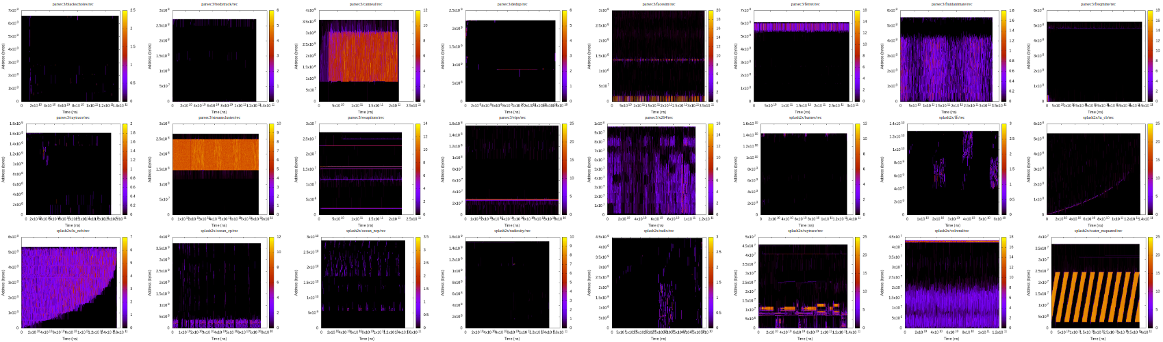
Monitoring Results Seems Reasonably Accurate
Various visualizations of the monitoring results including
  Heatmap
  Working set size distribution based on size and time
  Number of (adaptively constructed) monitoring target regions
All cleanly show reasonable access patterns and distributions
This is also available online.

Slide 49
DAMOS: Access-aware THP Hints (ethp)
‘ethp’ preserves the speedup while reducing the memory bloat
Interesting case: splash2x/ocean_ncp
  thp achieves 34.26% speedup but 80.61% system memory waste
  (best speedup and worst memory waste among the 25 workloads)
  ethp achieves 7.96% speedup but only 18.63% system memory waste
  Hence, ethp removes 76.90% of memory waster while preserving 23.23% of speedup for the workload
Removes 88.16% of thp’s system memory waste in total
Preserves 88.73% of thp’s speedup in total
NOTE: ethp is only for proof-of-concept and thus not optimized
  The ethp speedup could be higher if khugepaged promote pages marked with MADV_HUGEPAGE more aggressively

Slide 50
DAMOS: Proactive Reclamation (prcl)
‘prcl’ reduces working sets while making only modest slowdown
Incurs 8.74% speed down in total
Reduces 37.39% RSS in total
Best case: parsec3/freqmine
  Recuces 91.34% of RSS while incurring only 1.58% speed down
NOTE: prcl is only for proof of concept and thus not optimized
  Paging out 10sec inactive pages might be too aggressive
  (Google’s proactive reclamation waits 2 minutes)
  With faster swap devices, the speed down could further reduced

Slide 51
Evaluation Wrap-up: DAMON Is...
Lightweight
Accurate
Useful for MM optimizations

Slide 52
Overview
Motivation
DAMON
Live Demo
Evaluation
Plans
Conclusion

Slide 53
History of DAMON Project
2019.03: A prototype research project, DAPTRACE kicked-off
2019.09: Renamed into DAMON, Presented at Kernel Summit’2019
2019.12: The development resumed in Amazon
2020.01: Posted the RFC v1 patchset
The work was also introduced in several conferences and medias
  Kernel Summit’19, MIDDLEWARE Industry’19, Phoronix, LWN,
  Google Linux Kernel Exchange’20, and Kernel Summit’20

Slide 54
Now: DAMON patchsets series
V20 DAMON patchset
  The core of DAMON (framework part)
  Provide a DAMON primitives for the virtual address spaces
Two RFC patchsets for future changes are in below order
  Only to show how DAMON could be evolved
  Might not ready-to-be-merged level quality
  RFC v14 of DAMON-based Operation Schemes (DAMOS)
    Support only virtual addresses
  RFC v7 of Physical Memory Address Space Support
    Implement another DAMON primitives for the physical address space
    Support only mapped LRU pages

Slide 55
Before DAMON
perf
User
space
kernel space
vma
PTE
rmap

Slide 56
DAMON Patchset 1-4/15
perf
User
space
kernel space
DAMON
Framework
vma
PTE
rmap

Slide 57
DAMON Patchset 5-6/15
perf
User
space
kernel space
DAMON
Framework
For vaddr
Low level primitives
vma
PTE
rmap

Slide 58
DAMON Patchset 7/15
perf
User
space
Data Accesses
Recording
Kernel space applications
kernel space
DAMON
Framework
For vaddr
Low level primitives
vma
PTE
rmap

Slide 59
DAMON Patchset 8-10/15
perf
User
space
tracepoints
debugfs
User space interfaces
Data Accesses
Recording
Kernel space applications
kernel space
DAMON
Framework
For vaddr
Low level primitives
vma
PTE
rmap

Slide 60
DAMON Patchset 11/15
12-15 are for documentations and tests
perf
DAMO
User space tools
User
space
tracepoints
debugfs
User space interfaces
Data Accesses
Recording
Kernel space applications
kernel space
DAMON
Framework
For vaddr
Low level primitives
vma
PTE
rmap

Slide 61
DAMOS Patchset
perf
DAMO
User space tools
User
space
tracepoints
debugfs
User space interfaces
Data Accesses
Recording
DAMON-based
Operation Schemes
Kernel space applications
kernel space
DAMON
Framework
For vaddr
Low level primitives
vma
PTE
rmap

Slide 62
Physical Address Support Patchset
perf
DAMO
User space tools
User
space
tracepoints
debugfs
User space interfaces
Data Accesses
Recording
DAMON-based
Operation Schemes
Kernel space applications
kernel space
DAMON
Framework
For vaddr
For phys addr
Low level primitives
vma
PTE
rmap

Slide 63
TODOs
Make current DAMON patchsets series merged in the mainline
Support more address spaces
  Cgroup, cached pages, specific file-backed pages, swap slots, …
  Physical address support from DAMOS
Improve the user space interface
  Multiple contexts, CPU usage charge, …
Optimize for special use-cases
  Page granularity monitoring, accessed-or-not monitoring, ...
DAMON-based MM Optimizations
  Page reclaim, THP, compaction, NUMA balancing, …

Slide 64
Need Your Opinions
Are there tasks you want to…
  Put in the current DAMON patchsets before those be merged in,
  Put in the future DAMON patchsets, or
  Assign higher/lower prioritize?

Slide 65
VOTE: What Task Should Have Highest Priority?
A. Make current DAMON patchsets series merged in the mainline
B. Support more address spaces
  Cgroup, cached pages, specific file-backed pages, swap slots, …
  Physical address support from DAMOS
C. Improve the user space interface
  Multiple contexts, CPU usage charge, …
D. Optimize for special use-cases
  Page granularity monitoring, accessed-or-not monitoring, ...
E. DAMON-based MM Optimizations
  Page reclaim, THP, compaction, NUMA balancing, …
F. Something other? Reply to the patchset, please

Slide 66
Summary
DAMON is a kernel subsystem providing data access monitoring with
  Reasonable best-effort accuracy
  Lightweight overhead and scalable control of it
Both kernel space and user space could use DAMON for
  Analysis, MM optimizations, and fun
Evaluations with 25 realistic workloads say the benefit could be big
The patchset and two RFC patchsets for future features are available
  V20 DAMON, RFC v14 DAMOS, RFC v7 Physical address support
  Review, please!

Slide 67
More Resources: https://damonitor.github.io
Source Tree: https://github.com/sjp38/linux/tree/damon/next
Patchsets:
V20 DAMON, RFC v14 DAMOS, RFC v7 Physical address support
Document: https://damonitor.github.io/doc/html/next/index.html
Visualized monitoring results
  https://damonitor.github.io/test/result/visual/next/rec.heatmap.1.png.html
  https://damonitor.github.io/test/result/visual/next/rec.wss_sz.png.html
  https://damonitor.github.io/test/result/visual/next/rec.wss_time.png.html
Hidden index page: https://damonitor.github.io/_index

Slide 68

Questions?
https://kids.nationalgeographic.com/content/dam/kids/photos/animals/Birds/A-G/adelie-penguin-jumping-ocean.ngsversion.1396530997321.adapt.1900.1.jpg

