Slide 1
KernelSummit @ LinuxPlumbersConf, September 2021
DAMON and DAMOS:
Writing a fine-grained access pattern oriented lightweight kernel module
using DAMON/DAMOS in 10 minutes
SeongJae Park <sj@kernel.org>

Slide 2
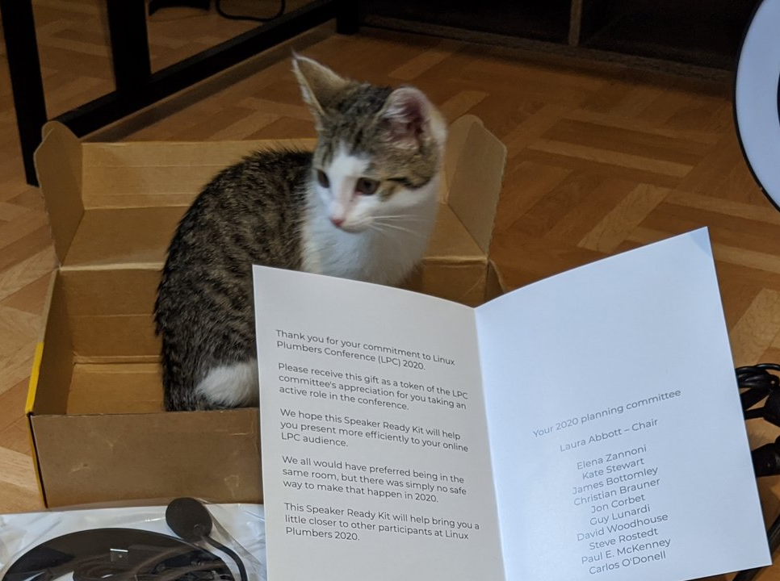
Disclaimer
The views expressed herein are those of the speaker;
they do not reflect the views of his employers
My cat might come up on the screen. The cat has no ‘--silent’ option.
Sorry, please don’t be scared; keep calm and blame COVID19 :P
https://twitter.com/sjpark0x00/status/1295387149018300419/photo/1

Slide 3
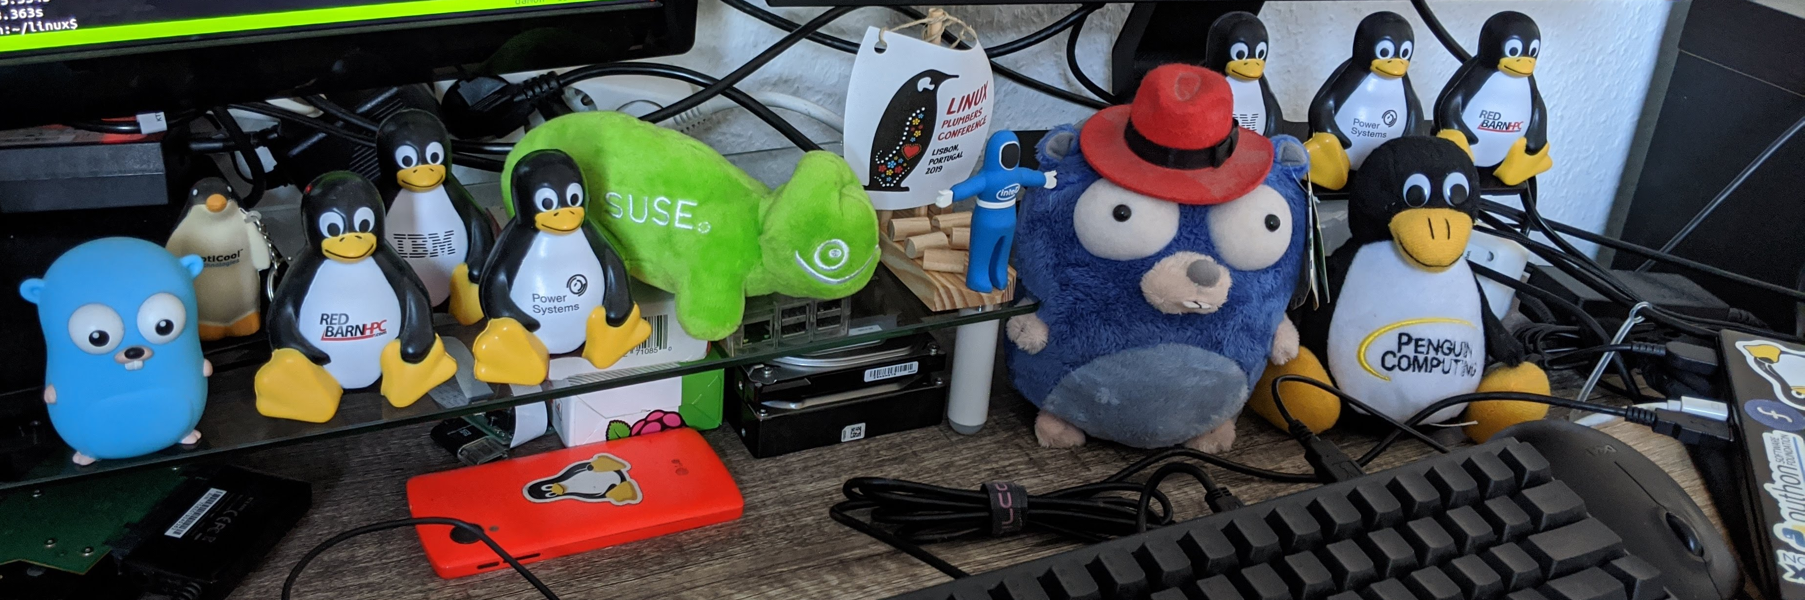
I, SeongJae Park <sj@kernel.org>
Kernel / Hypervisor Engineer at Amazon Web Services
Interested in the memory management and the parallel programming
Developing DAMON

Slide 4
This Talk...
Will not explain how DAMON works internally
  For that, you can refer to
    other resources in the project site (https://damonitor.github.io) or
    the code (https://git.kernel.org/sj/h/damon/next)
Will explain
  How, and what kernel hackers (or their kernel subsystems) can get from DAMON (and its not-yet-mainlined features)
  Things for user-space will not be explained, as this is the Kernel Summit
Will also discuss about future plans on
  Extending DAMON for more usages,
  Improving DAMON itself, and
  Enhancing MM with DAMON

Slide 5
Overview
Motivation
DAMON
DAMOS
DAMON_RECLAIM
Future Plans
Summary

Slide 6
Overview
Motivation
DAMON
DAMOS
DAMON_RECLAIM
Future Plans
Summary

Slide 7
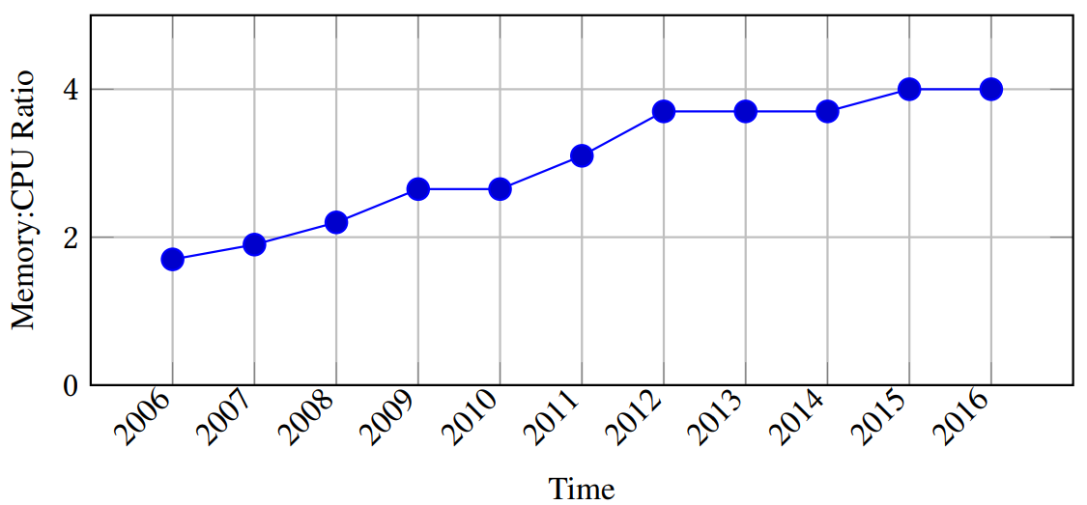
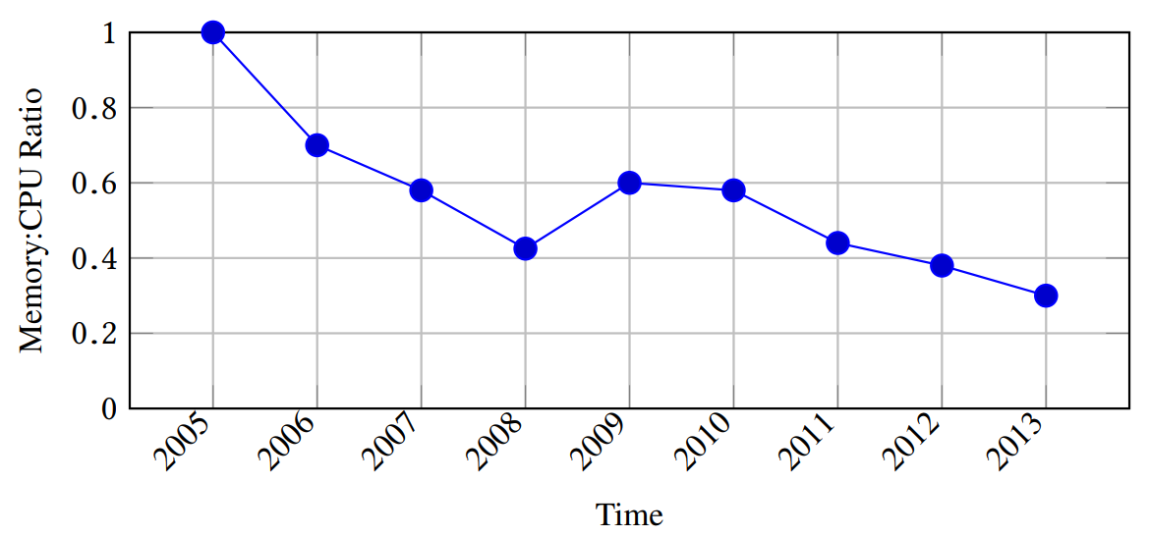
Motivation
Demand for memory is increasing but DRAM supply is not
  Memory management efficiency is becoming even more important
Linux MM works with not-so-fine data access information
  The monitoring overhead is one of the biggest reason
For AWS instances of m* types
(virtual machines: demand)
For multiple server generations
(physical machines: supply)
(Images retrieved from https://oatao.univ-toulouse.fr/24818/1/nitu_24818.pdf)

Slide 8
Overview
Motivation
DAMON
  Intro
  DAMON Programming Interface
  Live-coding a Working Set Size Estimation Module
  DAMON Evaluation
DAMOS
DAMON_RECLAIM
Future Plans
Summary

Slide 9
DAMON: Data Access MONitor
A framework for general Data Access MONitoring
  Provides access frequency of each memory region
  Allows users practically trade monitoring accuracy for less overhead
    Provides best-effort accuracy under the condition
    Users can set upper-bound overhead regardless of the memory size
    Conceptually scans memory for every 5ms with < 2% CPU utilization
The source code is available in
  Development tree (several not-yet-mainlined features are also here)
  Back-ports of the development tree for upstream v5.10.y and v5.4.y
  Amazon Linux kernels (v5.10.y and v5.4.y)
  The mainline from v5.15-rc1
A user-space tool and a tests suite are available under GPL v2

Slide 10
How to Use DAMON Programming Interface
Step 1: Set the requests in ‘struct damon_ctx’ instances
  How, what memory regions of which address spaces should be monitored
  Where monitoring event notifications should be delivered (callbacks)
    Users can read the monitoring results or cleanup things inside the function
Step 2: Start DAMON with the request via ‘damon_start()’
  Then, a kernel thread for the monitoring is created for each request
Step 3: Do your work in the notification callbacks
  Monitoring results can be read via ‘damon_region’s in the ‘damon_ctx’
Step 4: Finish the monitoring by calling ‘damon_stop()’

Slide 11
Live-coding a Working Set Size Estimation Module
Let’s write a kernel module that
  Receives pid of a process as a parameter
  Calculates working set size of the process and log it every 100ms

Slide 12
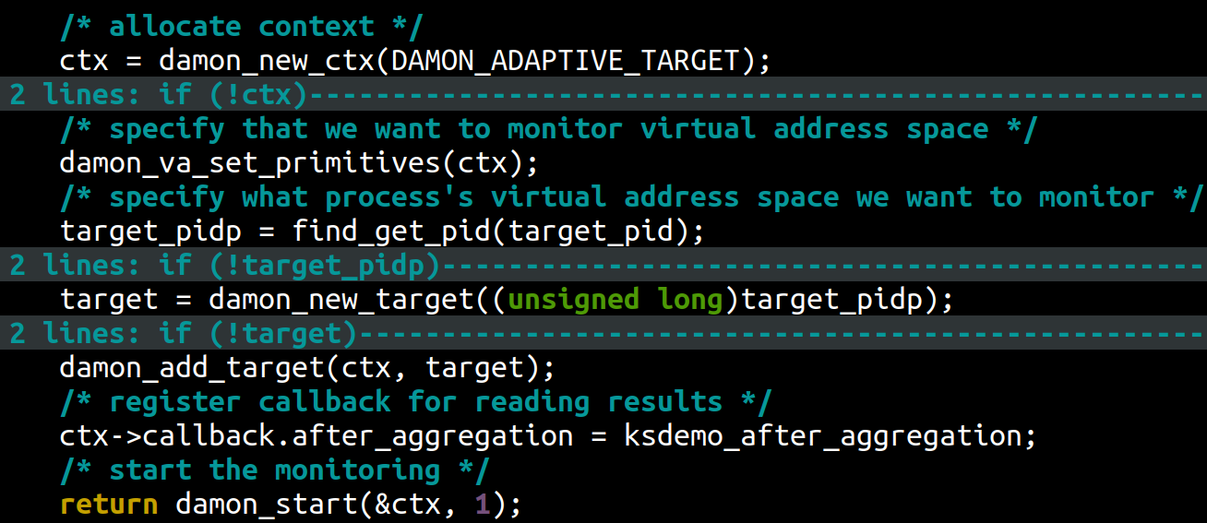
Live-coding a Working Set Size Estimation Module
Let’s write a kernel module that
  Receives pid of a process as a parameter
  Calculates working set size of the process and log it every 100ms
  Live-coded one will be available here
  Seven lines of code in essence for starting DAMON

Slide 13
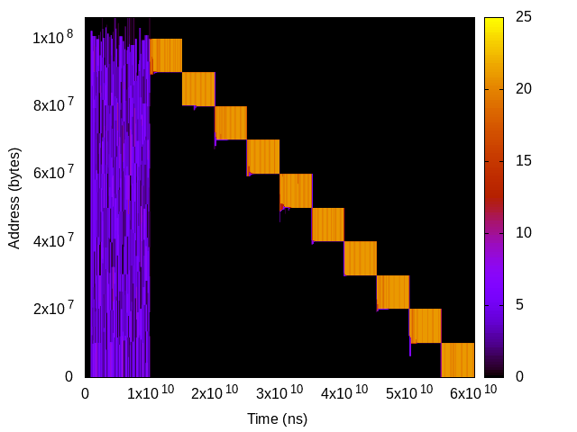
Testing The Module
We will test that against
  Artificial access pattern generator (‘$ ./masim ./configs/stairs.cfg’)
    Allocates ten 10 MiB objects, accesses all objects for first 10 secs, then accesses the first object for 5 secs, then the second object for 5 secs, …
We can expect the process will have 100 MiB RSS, while
the module reports 10 MiB working set size, after first 10 seconds
Heatmap-format access pattern of the workload. Shows when (x-axis) which memory region (y-axis) is how frequently accessed (color)

Slide 14
Evaluation: How Light-weight DAMON Is?
For virtual address and physical address monitoring, DAMON...
  makes the workload 0.62% and 1.53% slower, and
  Uses 1.76% and 0.96% of single CPU time, respectively
The overhead is quite low
  Note: DAMON conceptually scans the memory every 5ms in this case
  Users can tweak its parameters for less overhead
    e.g., increasing the memory scan time interval (5ms)
 | orig | rec | prec
Runtime (seconds) | 191.184 | 191.563 (+0.62% to orig) | 191.928 (+1.53% to orig)
DAMON CPU Usage (%) | 0 | 1.762 | 0.964

Slide 15
Evaluation: How Light-weight DAMON Is?
For virtual address and physical address monitoring, DAMON...
  makes the workload 0.62% and 1.53% slower, and
  Uses 1.76% and 0.96% of single CPU time, respectively
The overhead is quite low
  Note: DAMON conceptually scans the memory every 5ms in this case
  Users can tweak its parameters for less overhead
    e.g., increasing the memory scan time interval (5ms)
 | orig | rec | prec
Runtime (seconds) | 191.184 | 191.563 (+0.62% to orig) | 191.928 (+1.53% to orig)
DAMON CPU Usage (%) | 0 | 1.762 | 0.964

Slide 16
Evaluation: How Light-weight DAMON Is?
For virtual address and physical address monitoring, DAMON...
  makes the workload 0.62% and 1.53% slower, and
  Uses 1.76% and 0.96% of single CPU time, respectively
The overhead is quite low
  Note: DAMON conceptually scans the memory every 5ms in this case
  Users can tweak its parameters for less overhead
    e.g., increasing the memory scan time interval (5ms)
 | orig | rec | prec
Runtime (seconds) | 191.184 | 191.563 (+0.62% to orig) | 191.928 (+1.53% to orig)
DAMON CPU Usage (%) | 0 | 1.762 | 0.964

Slide 17
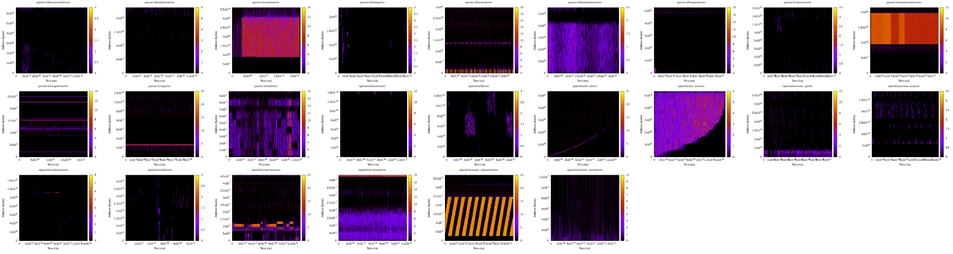
Evaluation: How Accurate DAMON is?
No good/easy way for strictly quantize the accuracy, but we can say
  Visualized monitoring results look reasonable
  The pattern for ‘masim’ shows expected ones with high accuracy
  Note that we can adjust the tradeoff for higher accuracy
More evidence on DAMON accuracy will be introduced in later slides

Slide 18
Overview
Motivation
DAMON
DAMOS
  Intro
  DAMOS Programming Interface
  Live-coding a Proactive Reclamation Kernel Module
  DAMOS Evaluation
DAMON_RECLAIM
Future Plans
Summary

Slide 19
DAMOS: DAMON-based Operation Schemes
Imaginable usual DAMON-based MM optimization procedure
  Monitor data access pattern of some memory range via DAMON,
  Find regions of interest (e.g., hot or cold) from the results, and
  Apply some memory management actions to the regions
    e.g., reclaim cold memory regions, use THP for hot memory regions
DAMOS is a feature of DAMON; it does above works instead of you
  Users only need to specify
    To what specific access pattern (how big, warm, and old) of memory regions
    What MM action (e.g., reclaim, use THP, ...) they wan to be applied
Merged in Amazon Linux but mainline, yet
  Will post the patchset soon

Slide 20
How To Use DAMOS Programming Interface
Put the monitoring request in ‘struct damon_ctx’, as above explained
Create ‘struct damos’ objects and specify the schemes in there
Specification of each scheme consists with
  Ranges of size, access frequency, and age of the interest
    ‘age’ means how long current access pattern has maintained
  Memory management action that need to be applied to the found regions
Put the ‘struct damos’ objects in the ‘struct damon_ctx’ instance
Then, ‘damon_start()’ with the context
  DAMON starts monitoring as requested in the context, finds the memory regions of the specified pattern, and applies the action

Slide 21
Live-coding a Proactive Reclamation Kernel Module
Let’s modify the previously written kernel module to
  Reclaim memory regions of >=4K size that not accessed for >=3 secs

Slide 22
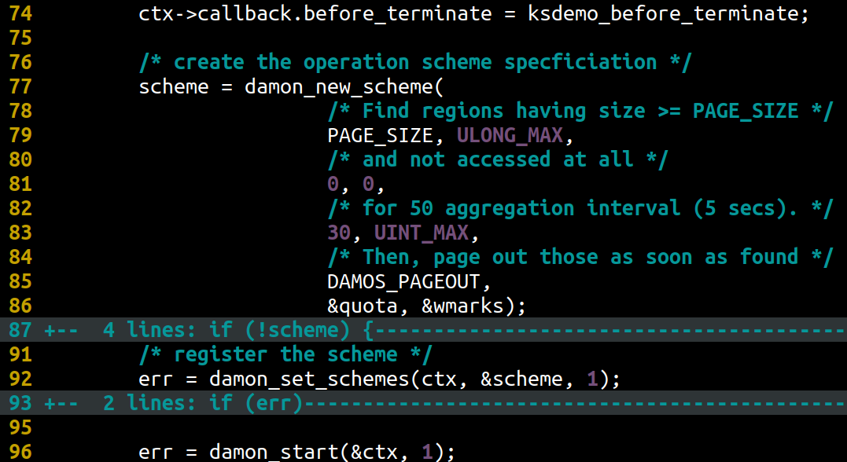
Live-coding a Proactive Reclamation Kernel Module
Let’s modify the previously written kernel module to
  Reclaim memory regions of >=4K size that not accessed for >=3 secs
  An example implementation is available here
  Only two more lines of code in essential

Slide 23
Testing The Proactive Reclamation Module
We will test that against the stairs access pattern, again
  Allocates ten 10 MiB objects, accesses all for first 10 secs, then accesses the first object for 5 secs, then the second object for 5 secs, …
The module is expected to
  Shrink the process’s RSS to 10 MiB after the first 13 seconds
Heatmap-format access pattern of the workload. Shows when (x-axis) which memory region (y-axis) is how frequently accessed (color)

Slide 24
Example Schemes For Evaluation of DAMOS
ethp: Enhanced THP
  MADV_THP for memory regions that real access is monitored
  MADV_NOTHP for >=2MB memory regions that not accessed >=7 secs
  Expected to reduce THP’s internal fragmentation caused memory bloats
prcl: Proactive Reclamation
  Reclaim memory regions that not accessed >= 10secs
  Expected to reduce memory footage with minimal performance drops
$ cat ethp.damos
# for regions having 5/100 access frequency, apply MADV_HUGEPAGE
min max 5 max min max hugepage
# for regions >=2MB and not accessed for >=7 seconds, apply MADV_NOHUGEPAGE
2M max min min 7s max nohugepage
$ cat prcl.damos
# for regions >=4KB and not accessed for >=10 seconds, apply MADV_PAGEOUT
4K max 0 0 10s max pageout

Slide 25
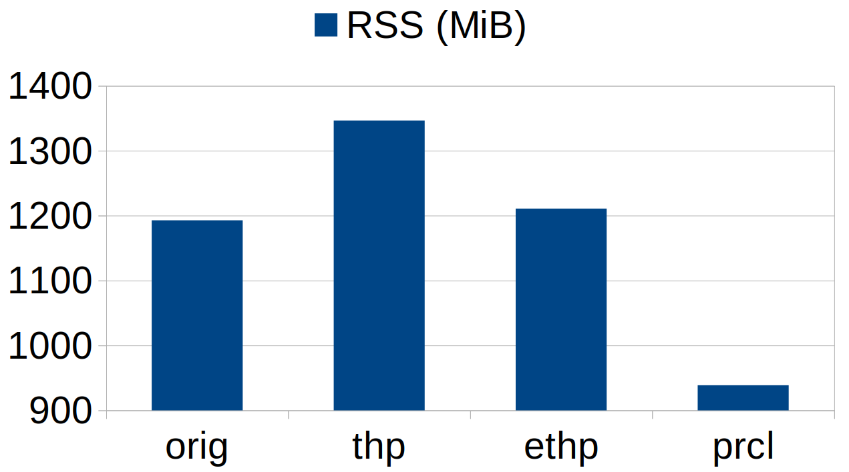
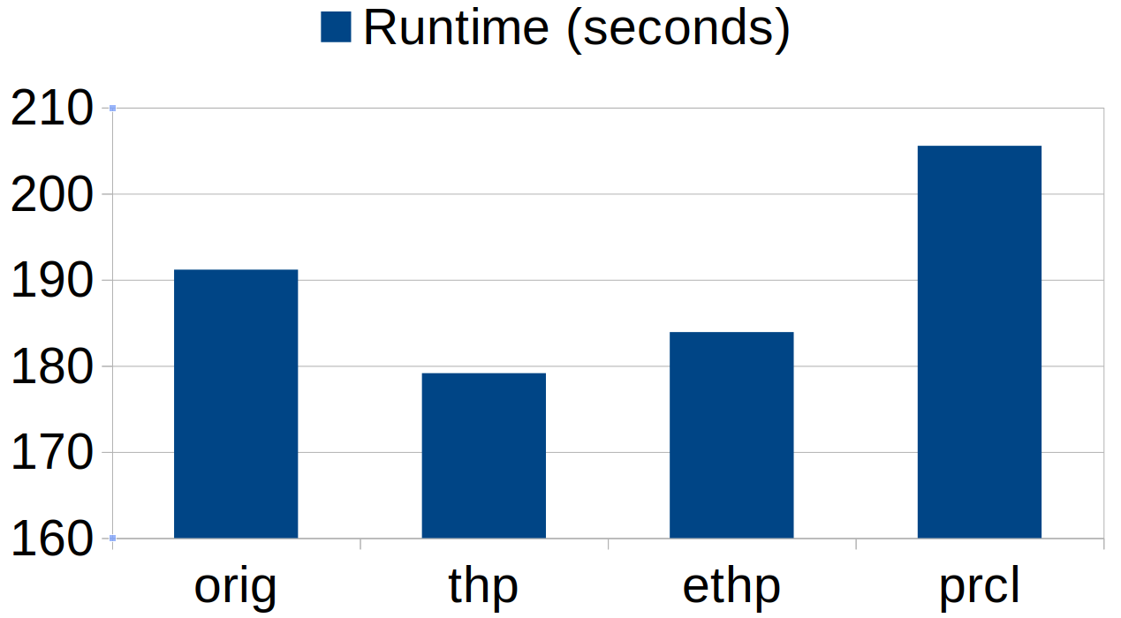
How Effective DAMOS Is? (How Accurate DAMON Is?)
‘ethp’ reduces 76% of ‘thp’ (‘always’ THP policy) memory overhead while preserving 25% of ‘thp’ performance improvement
‘prcl’ saves 38.46% memory with 8.26% runtime slowdown
Working as expected and seems effective (DAMON is accurate)
But… 8.26% slowdown?

Slide 26
How Effective DAMOS Is? (How Accurate DAMON Is?)
‘ethp’ reduces 76% of ‘thp’ (‘always’ THP policy) memory overhead while preserving 25% of ‘thp’ performance improvement
‘prcl’ saves 38.46% memory with 8.26% runtime slowdown
Working as expected and seems effective (DAMON is accurate)
But… 8.26% slowdown?

Slide 27
How Effective DAMOS Is? (How Accurate DAMON Is?)
‘ethp’ reduces 76% of ‘thp’ (‘always’ THP policy) memory overhead while preserving 25% of ‘thp’ performance improvement
‘prcl’ saves 38.46% memory with 8.26% runtime slowdown
Working as expected and seems effective (DAMON is accurate)
But… 8.26% slowdown?

Slide 28
How Effective DAMOS Is? (How Accurate DAMON Is?)
‘ethp’ reduces 76% of ‘thp’ (‘always’ THP policy) memory overhead while preserving 25% of ‘thp’ performance improvement
‘prcl’ saves 38.46% memory with 8.26% runtime slowdown
Working as expected and seems effective (DAMON is accurate)
But… 8.26% slowdown?

Slide 29
DAMOS Challenges for Production Usage
8.26% slowdown of ‘prcl’ seems too huge for the production
  Might be reasonable depending on the specific requirement, though
  Can mitigate by tuning the scheme to be less aggressive
DAMOS schemes tuning is challenging
  Tuning is needed for for each workload and system
  The thresholds are not intuitive for sysadmins
Auto-tuning programs can be a solution
  Our simple auto-tuner makes ‘prcl’ achieve
    24.97% memory saving with 0.91% runtime slowdown
    (Untuned PRCL: 38.46% memory saving with 8.26% runtime slowdown)
But, couldn’t the kernel just work without such user-space help?

Slide 30
Overview
Motivation
DAMON
DAMOS
DAMON_RECLAIM
  DAMOS Safety Guarantees
  DAMON_RECLAIM Intro
Future Plans
Summary

Slide 31
DAMOS Safety Guarantees
For productions that prefer safety, DAMOS provides additional features
Time/space quota per a given time interval
  DAMOS uses CPU time no more than the given time quota
  DAMOS applies the action to memory no more than the space quota
Regions prioritization
  Under the quota, DAMOS applies the action to prioritized regions first
  Prioritization logic can be customized for different DAMOS actions
    In case of RECLAIM, older and colder pages are prioritized by default
Three watermarks (high, mid, low) with user-specified metric (e.g., freemem)
  Deactivate if the metric > high_watermark or metric < low_watermark
  Activate if the metric < mid_watermark and metric > low_watermark
  Avoid DAMOS using any resource under a peaceful or a catastrophic situation

Slide 32
Evaluation of DAMOS Safety Guarantees
‘prcl’ for the physical address space with different safety guarantees
Smaller time quota reduces DAMON’s CPU usage and slowdown
  Note that it also reduces the memory saving, as being less aggressive
Enabling prioritization further reduces slowdown
Still need tuning, but the knobs would be intuitive for sysadmins
time quota | prioritization | memory_saving | cpu_util | slowdown
N | N | 47.16% | 11.62% | 5.40%
200ms/s | N | 48.42% | 10.92% | 4.69%
50ms/s | N | 40.84% | 5.70% | 4.53%
10ms/s | N | 4.55% | 1.78% | 2.51%
200ms/s | Y | 47.99% | 10.41% | 5.10%
50ms/s | Y | 40.34% | 5.16% | 3.38%
10ms/s | Y | 0.77% | 1.37% | 1.84%

Slide 33
Evaluation of DAMOS Safety Guarantees
‘prcl’ for the physical address space with different safety guarantees
Smaller time quota reduces DAMON’s CPU usage and slowdown
  Note that it also reduces the memory saving, as being less aggressive
Enabling prioritization further reduces slowdown
Still need tuning, but the knobs would be intuitive for sysadmins
time quota | prioritization | memory_saving | cpu_util | slowdown
N | N | 47.16% | 11.62% | 5.40%
200ms/s | N | 48.42% | 10.92% | 4.69%
50ms/s | N | 40.84% | 5.70% | 4.53%
10ms/s | N | 4.55% | 1.78% | 2.51%
200ms/s | Y | 47.99% | 10.41% | 5.10%
50ms/s | Y | 40.34% | 5.16% | 3.38%
10ms/s | Y | 0.77% | 1.37% | 1.84%

Slide 34
Evaluation of DAMOS Safety Guarantees
‘prcl’ for the physical address space with different safety guarantees
Smaller time quota reduces DAMON’s CPU usage and slowdown
  Note that it also reduces the memory saving, as being less aggressive
Enabling prioritization further reduces slowdown
Still need tuning, but the knobs would be intuitive for sysadmins
time quota | prioritization | memory_saving | cpu_util | slowdown
N | N | 47.16% | 11.62% | 5.40%
200ms/s | N | 48.42% | 10.92% | 4.69%
50ms/s | N | 40.84% | 5.70% | 4.53%
10ms/s | N | 4.55% | 1.78% | 2.51%
200ms/s | Y | 47.99% | 10.41% | 5.10%
50ms/s | Y | 40.34% | 5.16% | 3.38%
10ms/s | Y | 0.77% | 1.37% | 1.84%

Slide 35
DAMON_RECLAIM
DAMON-based proactive reclamation kernel module
Written using DAMOS
  Excepting the code for module parameters, only 188 lines of code
Aims to be used on production
  Ensure the safety using the quotas and watermarks
  The quotas ans watermarks can be tweaked via module parameters

Slide 36
Overview
Motivation
DAMON
DAMOS
DAMON_RECLAIM
Future Plans
  Extending DAMON
  Improving DAMON
  Improving MM with DAMON
Summary

Slide 37
Extending DAMON (only brainstorming)
DAMON can be extended for various address spaces and use cases
  Need to implement new monitoring primitives for the use case
Currently, monitoring primitives for only virtual address spaces, the physical address space, and page-granularity system monitoring are available
Imaginable extensions include
  More efficient page-granularity system monitoring
    Current page-granularity monitoring is only for proof of concepts
    MGLRU’s page table-based scanning might be able to be used for this
  for specific cgroups,
  for only specific file-backed memory,
  for read-only or write-only

Slide 38
Improving DAMON (only brainstorming)
DAMON’s accuracy and overhead could be more optimized
  Adaptive monitoring attributes adjustment and regions splitting
    Find too stable or too unstable regions and do more aggressive monitoring
  Remapping regions based on monitoring results, to sorted by hotness
    The spatial locality assumption of memory regions will be more reasonable
    DAMON-internal address space would be needed for usual cases
User-provided address space (page-gran management)
Hot
Cool
Warm
Cold
DAMON address space
(DAMON region-based management)
User-provided address space (page-gran management)
Hot
Warm
Cool
Cold
DAMON address space
(DAMON region-based management)

Slide 39
Improving MM with DAMON (only brainstorming)
DAMON might be able to be used to help
  THP promotion/demotion
  Page migration target (for compaction or CMA) selection
  LRU pages prioritization
  Tiered-memory management
The works could fundamentally be done in two ways
  Implementing new subsystems
  Modifying existing subsystems
  Any opinion or preference among these?
    I guess it should be depend on each specific case, though…

Slide 40
Overview
Motivation
DAMON
DAMOS
DAMON_RECLAIM
Future Plans
Summary

Slide 41
Summary
DAMON/DAMOS helps you write fine-grained data access pattern-oriented light-weight kernel modules
Such modules could be useful for enhancing memory efficiency
There are many more things to do; Looking forward your contributions
For more information
  please visit https://damonitor.github.io, or
  reach out to sj@kernel.org

Slide 42
Special Thanks To (Alphabetical order)
I might missed someone’s name, please forgive me...
Alexander Shishkin
Amit Shah
Andrew Morton
Brendan Higgins
David Hildenbrand
David Rientjes
David Woodhouse
Fan Du
Fernand Sieber
Greg Kroah-Hartman
Greg Thelen
Jonathan Cameron
Jonathan Corbet
Leonard Foerster
Marco Elver
Markus Boehme
Maximilian Heyne
Minchan Kim
Paul E. McKenney
Shakeel Butt
Stefan Nuernberger
Steven Rostedt
Varad Gautam
Yunjae Lee

Slide 43

Questions?
You can also
  visit https://damonitor.github.io, or
  reach out to sj@kernel.org
https://kids.nationalgeographic.com/content/dam/kids/photos/animals/Birds/A-G/adelie-penguin-jumping-ocean.ngsversion.1396530997321.adapt.1900.1.jpg

Slide 44
Backup Slides

Slide 45
boilerplate
// SPDX-License-Identifier: GPL-2.0
#define pr_fmt(fmt) "ksdemo: " fmt
#include <linux/init.h>
#include <linux/kernel.h>
#include <linux/module.h>
static int __init ksdemo_init(void)
{
pr_info("Hello Kernel Summit 2021\n");
return 0;
}
static void __exit ksdemo_exit(void)
{
pr_info("Goodbye Kernel Summit 2021\n");
}
module_init(ksdemo_init);
module_exit(ksdemo_exit);
MODULE_LICENSE("GPL");
MODULE_AUTHOR("SeongJae Park");
MODULE_DESCRIPTION("Kernel Summit 2021 live coding demo");

Slide 46
diff -u boilerplate wsse (1/4)
@@ -2,18 +2,69 @@
#define pr_fmt(fmt) "ksdemo: " fmt
+#include <linux/damon.h>
#include <linux/init.h>
#include <linux/kernel.h>
#include <linux/module.h>
+#include <linux/pid.h>
+
+static int target_pid __read_mostly;
+module_param(target_pid, int, 0600);
+
+struct damon_ctx *ctx;
+struct pid *target_pidp;
[...]

Slide 47
diff -u boilerplate wsse (2/4)
[...]
+
+static int ksdemo_after_aggregation(struct damon_ctx *c)
+{
+ struct damon_target *t;
+
+ damon_for_each_target(t, c) {
+ struct damon_region *r;
+ unsigned long wss = 0;
+
+ damon_for_each_region(r, t) {
+ if (r->nr_accesses > 0)
+ wss += r->ar.end - r->ar.start;
+ }
+ pr_info("wss: %lu\n", wss);
+ }
+ return 0;
+}
[...]

Slide 48
diff -u boilerplate wsse (3/4)
[...]
static int __init ksdemo_init(void)
{
+ struct damon_target *target;
+
pr_info("Hello Kernel Summit 2021\n");
- return 0;
+
+ /* allocate context */
+ ctx = damon_new_ctx(DAMON_ADAPTIVE_TARGET);
+ if (!ctx)
+ return -ENOMEM;
+ /* specify that we want to monitor virtual address space */
+ damon_va_set_primitives(ctx);
+ /* specify what process's virtual address space we want to monitor */
+ target_pidp = find_get_pid(target_pid);
+ if (!target_pidp)
+ return -EINVAL;
+ target = damon_new_target((unsigned long)target_pidp);
+ if (!target)
+ return -ENOMEM;
+ damon_add_target(ctx, target);
+ /* register callback for reading results */
+ ctx->callback.after_aggregation = ksdemo_after_aggregation;
+ /* start the monitoring */
+ return damon_start(&ctx, 1);
}
[...]

Slide 49
diff -u boilerplate wsse (4/4)
[…]
static void __exit ksdemo_exit(void)
{
+ if (ctx) {
+ damon_stop(&ctx, 1);
+ damon_destroy_ctx(ctx);
+ }
+ if (target_pidp)
+ put_pid(target_pidp);
pr_info("Goodbye Kernel Summit 2021\n");
}

Slide 50
diff -u wsse prcl (1/2)
@@ -34,6 +34,9 @@
static int __init ksdemo_init(void)
{
struct damon_target *target;
+ struct damos *scheme;
+ struct damos_quota quota = {};
+ struct damos_watermarks wmarks = {};
pr_info("Hello Kernel Summit 2021\n");
[...]

Slide 51
diff -u wsse prcl (2/2)
[...]
@@ -53,6 +56,22 @@
damon_add_target(ctx, target);
/* register callback for reading results */
ctx->callback.after_aggregation = ksdemo_after_aggregation;
+
+ /* create the operation scheme specification */
+ scheme = damon_new_scheme(
+ /* find regions having size >= PAGE_SIZE */
+ PAGE_SIZE, ULONG_MAX,
+ /* and not accessed at all */
+ 0, 0,
+ /* for 30 aggregation interval (3 secs) */
+ 30, UINT_MAX,
+ /* and page out those */
+ DAMOS_PAGEOUT,
+ &quota, &wmarks);
+ if (!scheme)
+ return -ENOMEM;
+ damon_set_schemes(ctx, &scheme, 1);
+
/* start the monitoring */
return damon_start(&ctx, 1);
}

Slide 52
Evaluation Environment
Test machine
  QEMU/KVM virtual machine on AWS EC2 i3.metal instance
  36 vCPUs, 128 GB memory, 4 GB zram swap device
  Ubuntu 18.04, THP enabled policy madvise
  Linux v5.15-rc1 based DAMON dev tree (The source tree is available)
Workloads: 25 realistic benchmark workloads
  13 workloads from PARSEC3
  12 workloads from SPLASH-2X
DAMON monitoring attributes: The default values
  5ms sampling, 100ms aggregation, and 1s regions update intervals
  Number of regions: [10, 1000]

Slide 53
Evaluation Setup: DAMON
Questions to Answer
  How lightweight DAMON is?
  How accurate DAMON is?
Run 25 workloads from PARSEC3 and SPLASH-2X one by one on three different systems
  orig: v5.15-rc1, thp for only ‘madvise’
  rec: orig + DAMON running for the workload’s virtual address space
  prec: orig + DAMON running for the entire physical address space
Measure the workload’s runtime and DAMON’s CPU usage
For more details in the setup, refer to backup slides

Slide 54
Evaluation Setup: DAMOS
Questions to answer
  How effective DAMOS is?
    This also answers ‘How accurate DAMON is?’
Basically similar to that for DAMON
  Run the 25 workloads and measure some metrics
  Apply some DAMON-based operation schemes to the workloads

