Slide 1



The International ACM Symposium on High-Performance Parallel and Distributed Computing (HPDC), Minneapolis, Minnesota, United States, June 27 – July 1, 2022
DAOS:
Data Access-aware Operating System
SeongJae Park
Madhuparna Bhowmik
Alexandru Uta

Slide 2
Disclaimer
The views expressed herein are those of the speaker;
they do not reflect the views of his employers

Slide 3
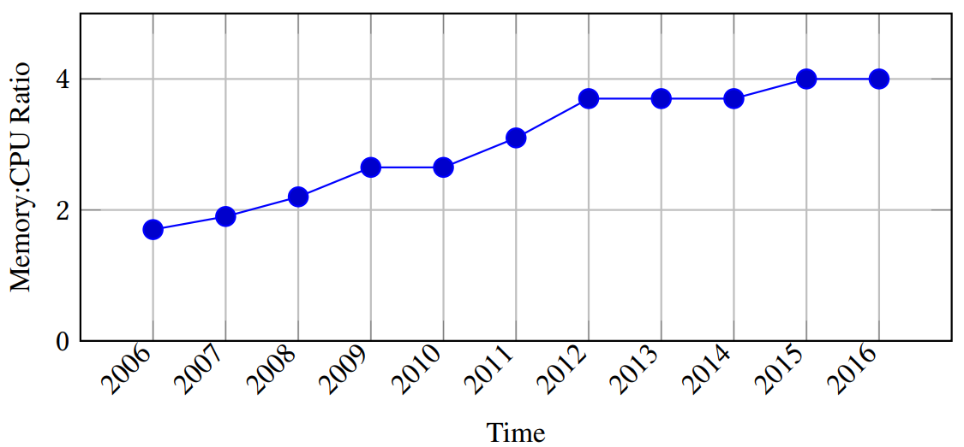
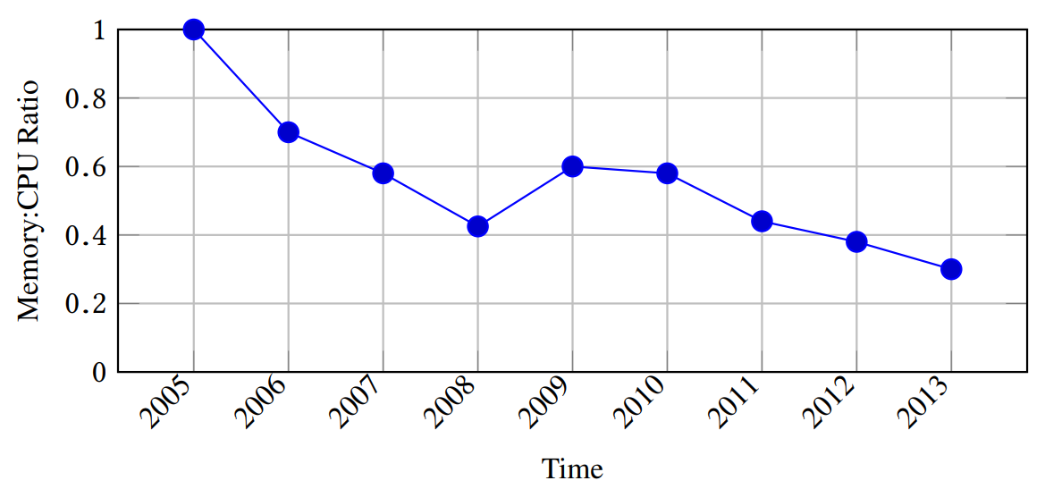
The Trends
Demands for memory is increasing
  Modern workloads (e.g., cloud, big data, ML, …) use larger working set
Size of DRAM in each machine is growing slower than that
  Due to issues including heat/power/cost/supply
  Tiered memory is available
DRAM over-committed systems becoming prevalent
For AWS instances of m* types
(virtual machines: demand)
For multiple server generations
(physical machines: supply)
(Images retrieved from https://oatao.univ-toulouse.fr/24818/1/nitu_24818.pdf)

Slide 4
We Need Data Access-aware Operating System (DAOS)
Because DAOS can predict future memory usage better
Because it helps making better data management decision
Because it can improve memory efficiency and performance
Because DRAM is a major infrastructure expense

Slide 5
DAOS: Three Simple Pieces
User
Space
Workload
Spawn
Read performance
Runtime
Automated tuner
Read system memory utilization,
Write pattern-based operation schemes
Pseudo File Systems
Kernel
Space
Read utilization
Operation schemes
Memory Schemes Engine
Request monitoring
Control management
(Swap, LRU, THP)
Data Access Monitor
Check access
System Memory

Slide 6
DAOS: Three Simple Pieces
User
Space
Workload
Spawn
Read performance
Runtime
Automated tuner
Read system memory utilization,
Write pattern-based operation schemes
Pseudo File Systems
Kernel
Space
Read utilization
Operation schemes
Memory Schemes Engine
Request monitoring
Control management
(Swap, LRU, THP)
1
Data Access Monitor
Check access
System Memory

Slide 7
DAOS: Three Simple Pieces
User
Space
Workload
Spawn
Read performance
Runtime
Automated tuner
Read system memory utilization,
Write pattern-based operation schemes
Pseudo File Systems
Kernel
Space
Read utilization
Operation schemes
2
Memory Schemes Engine
Request monitoring
Control management
(Swap, LRU, THP)
1
Data Access Monitor
Check access
System Memory

Slide 8
DAOS: Three Simple Pieces
User
Space
Workload
Spawn
Read performance
3
Runtime
Automated tuner
Read system memory utilization,
Write pattern-based operation schemes
Pseudo File Systems
Kernel
Space
Read utilization
Operation schemes
2
Memory Schemes Engine
Request monitoring
Control management
(Swap, LRU, THP)
1
Data Access Monitor
Check access
System Memory

Slide 9
DAMON: Data Access MONitor
Data access monitoring component for DAOS
  Provides access frequency of each address range
  DAOS gets data access patterns of the system online using this component
Address
Time

Slide 10
Existing Data Access Monitoring Techniques
Instrumentation-based
  Hook/trace every memory access
  Incur unacceptably high overhead for unnecessarily precise information
  Some static analysis based technique reduces the overhead but recompiling is required
Page table access bit tracking
  Repeatedly clear and read page table entries’ accessed bits
  The overhead is not negligible and arbitrarily grows as the size of the target memory increases
None of them would fit well for DAOS

Slide 11
The Design Requirements for DAMON
To be used for DAOS, DAMON needs to fulfill below requirements
  Accuracy: The monitoring result should be useful for DRAM level MM
  Overhead: Should light-weight enough for online monitoring
  Scalability: The upper-bound overhead should be controllable regardless of the size of the monitoring target systems and workloads
DAMON fulfills the requirements in below steps
  Straightforward Access Monitoring (collect basic information)
  Region-based Sampling (optimize overhead)
  Adaptive Regions Adjustment (make best-effort accuracy)

Slide 12
Straightforward Access Monitoring
Periodically checks if each monitoring target page is accessed
  The period is called ‘sampling interval’
Aggregates the observations into access frequencies
  Count number of observed accesses and periodically reset the counter
  The period is called ‘aggregation interval’
By notifying the users just before the reset of the counter, we can provide the access frequency of the pages to the users
Pros: Fine-grained (page size) monitoring
  Might not strictly required in some performance-centric optimizations
Cons: High and unscalable monitoring overhead
  The overhead arbitrarily increases as the target size grows

Slide 13
Region-based Sampling
Defines data objects in access pattern oriented way
  “A data object is a contiguous memory region that all page frames in the region have similar access frequencies”
  By the definition, if a page in a region is accessed, other pages of the region has probably accessed, and vice versa
  Thus, checks for the other pages can be skipped
By limiting the number of regions, we can control the monitoring overhead regardless of the target size
However, the accuracy will degrade if the regions are not properly set
(Will result in poor accuracy)
(Will result in reasonable accuracy)
Hot region
Target region
Cold region

Slide 14
Adaptive Regions Adjustment
Merge
Starts with minimum number of regions covering entire target memory areas
For each aggregation interval,
  merges adjacent regions having similar access frequencies to one region
  Splits each region into two (or three, depend on state) randomly sized smaller regions
  Avoid merge/split if the number of regions might be out of the user-defined range
If a split was meaningless, next merge process will revert it (vice versa)
In this way, we can let users control the upper bound overhead while preserving minimum and best-effort accuracy
Split
AF: 0.5 0 0 0
Merge
Split
AF: 0 0.9 0 0
Merge
AF: (Observed) Access Frequency
Hot region (AF 1.0)
Cold region (AF 0)
Target region

Slide 15
DAMON-based Manual Memory Management Schemes
Now DAMON-based optimizations are available in below steps
  Step 1: Run DAMON
  Step 2: Analyze the monitoring results offline or online
  Step 3: Make some changes in the kernel or the app
    e.g., page out cold regions, THP-collapse hot regions, …
  Could be done inside kernel or from user space
  Could be effective, but has some risks

Slide 16
Risks of Manual DAMON-based Optimizations
It could be difficult, dangerous, dirty, and/or restrictive
Optimizations in the kernel space could be difficult and dangerous
  No every sysadmin is an experienced kernel programmer
  Every kernel bug is dangerous
Optimizations in the user space could be dirty and restrictive
  Receiving and analyzing the results require some lines of code
    It also incur overheads for context switches
  User space apps can do only limited memory management actions
Most of the basic works would be repetitive

Slide 17
DAMOS: DAMON-based Operation Schemes
DAMON-based memory management schemes engine for DAOS
Receives ‘schemes’; each scheme is constructed with
  Target access pattern: ranges of size, access frequency, and age
  1 memory management action
    Currently supported actions include:
    WILLNEED, COLD, PAGEOUT, HUGEPAGE, NOHUGEPAGE
DAMOS automatically finds the memory region of the target pattern from DAMON results and applies the action to the region
Now users can make DAMON-based optimizations with no-code
# format is:
# <min/max size> <min/max frequency (0-100)> <min/max age> <action>
#
# if a region of size >=4KB didn’t accessed for >=2mins, page out
4K max 0 0 2m max pageout

Slide 18
DAMOS: Example Schemes
Core concepts of some state-of-the-art works can be implemented using DAMOS again as simple as below
Proactive reclamation (software-defined far memory, ASPLOS’19)
Data Access-aware THP (Ingens, OSDI’16)
$ cat prcl.damos
# page out memory regions that not accessed >=2 minutes
4K max 0 0 2m max page_out
$ cat ethp.damos
# Use THP for >=2MiB regions having >=80% frequency ratio for >=1 minute
2MB max 80% max min max thp
# Don’t use THP for regions having <=5% frequency ratio for >=1 minute
min max min 5% 1m max nothp

Slide 19
Evaluation Questions for DAMON/DAMOS
How lightweight DAMON is?
How accurate DAMON is?
How useful DAMOS-based optimizations are?

Slide 20
Evaluation Environment
Test machine
  QEMU/KVM virtual machine on AWS EC2 i3.metal instance
  3.0 GHz x 36 vCPUs, 128 GB memory, 4 GB zram swap device
  Ubuntu 18.04, THP turned off by default
  Linux v5.10 + DAOS changes
Workloads: 25 realistic benchmark workloads
  13 workloads from PARSEC3
  12 workloads from SPLASH-2X
DAMON monitoring attributes: The default values
  sampling interval: 5ms, aggregation interval: 100ms
  Number of regions: [10, 1000]

Slide 21
Evaluation Targets
Six variants
  orig: All DAOS features turned off (same to vanilla v5.10 Linux)
  rec: orig + DAMON for virtual address of the workload turned on
  prec: orig + DAMON for entire physical address of the system turned on
  thp: orig + THP enabled with always policy (to be compared with ethp)
  ethp: orig + ethp DAMON-based operation scheme is applied
  prcl: orig + prcl DAMON-based operation scheme is applied
$ cat ethp.damos
# for regions having 5/100 access frequency, apply MADV_HUGEPAGE
min max 5 max min max hugepage
# for regions >=2MB and not accessed for >=7 seconds, apply MADV_NOHUGEPAGE
2M max min min 7s max nohugepage
$ cat prcl.damos
# for regions >=4KB and not accessed for >=5 seconds, apply MADV_PAGEOUT
4K max 0 0 5s max pageout

Slide 22
Evaluation Methodology
Measurement
  DAMON/DAMOS’ CPU consumption
  Runtime speedup compared to the ‘orig’
  Memory efficiency compared to the ‘orig’
    System entire memory usage for ‘prec’, RSS of the workload for others
  For each of the workload x variant combinations
Every following data is average of 5 different runs

Slide 23
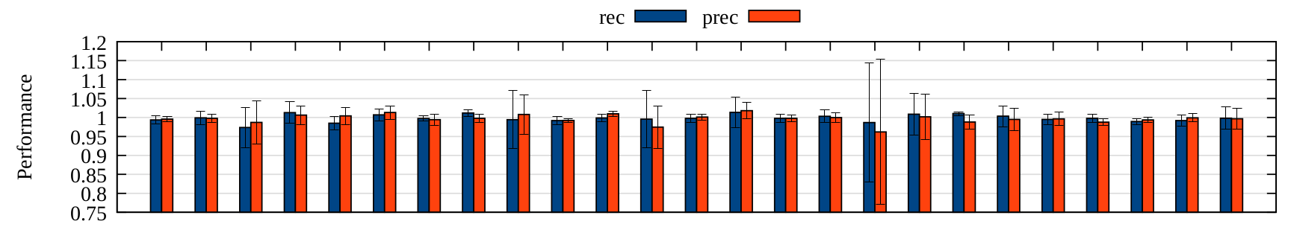
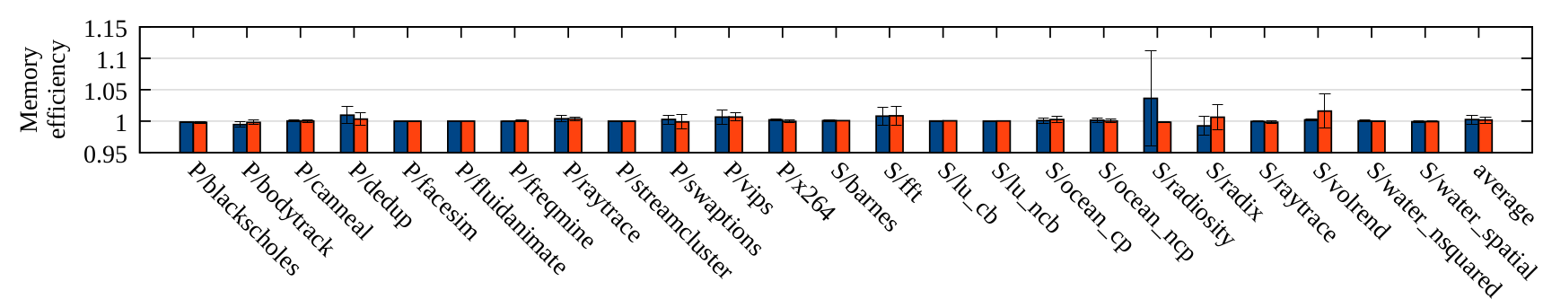
DAMON Overhead
For both ‘rec’ and ‘prec’ (note: ‘prec’ covers entire system memory)
  Consumes <2% of a single CPU time
  Incurs about 1% on average and up to 4% slowdown to the workload
  Memory overhead is also negligible
DAMON keeps upper-limit of the overhead regardless of target size

Slide 24
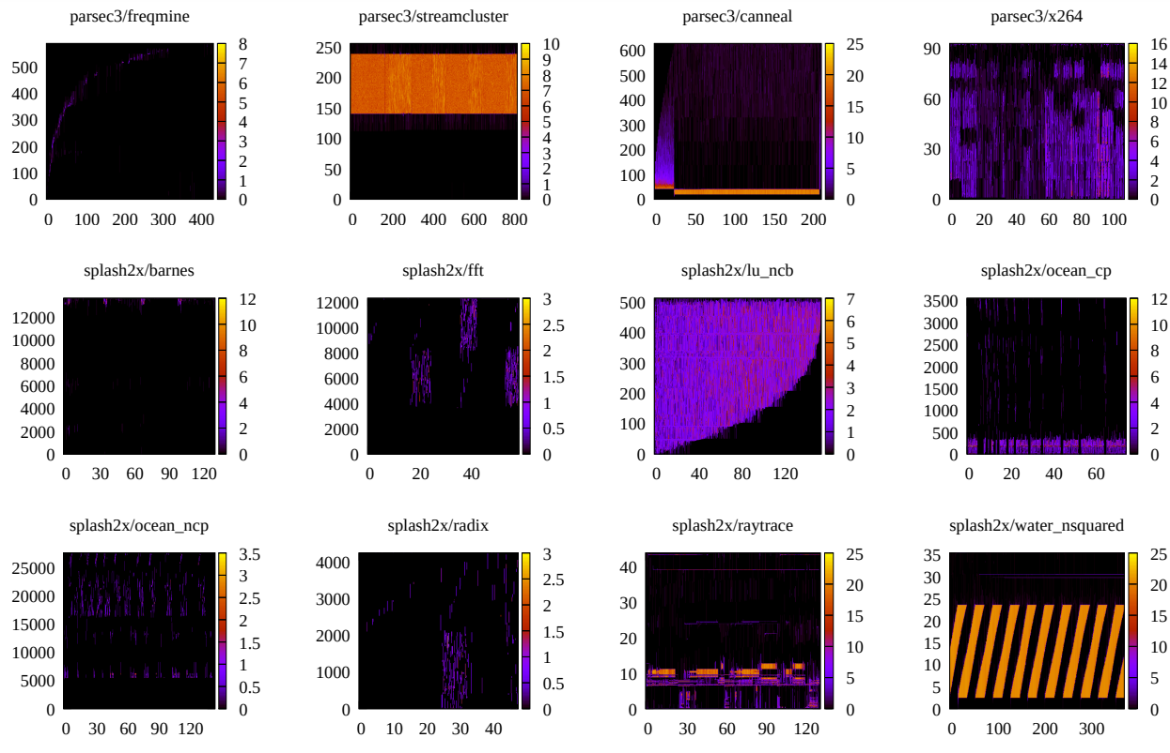
DAMON Accuracy
DAMON results in heatmap visualization shows reasonable results
Data access patterns of the workloads in heatmap format. Each heatmap shows when (x-axis, in seconds) what memory regions of specific address (y-axis, in MiB) is how frequently (color) accessed.

Slide 25
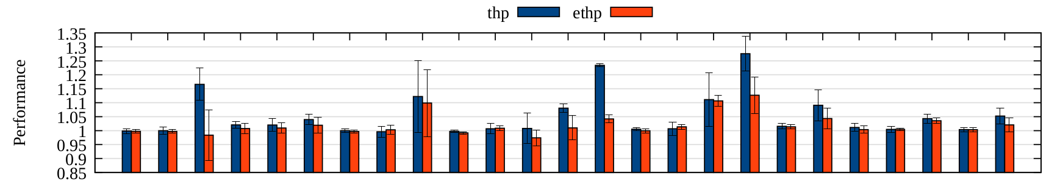
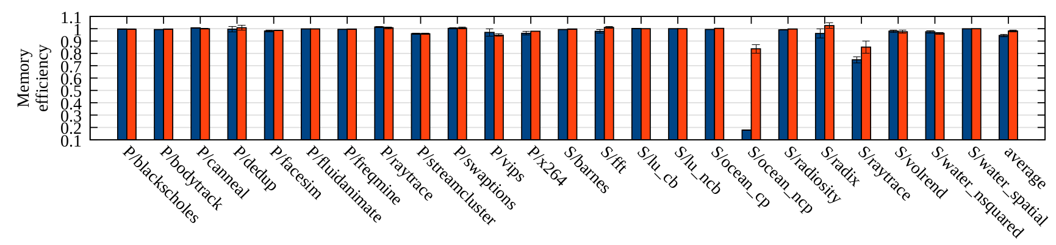
DAMON Accuracy and DAMOS ‘ethp’ Effectiveness
On average, ‘ethp’ preserves 39% of ‘thp’ speedup while removing 64.28% of ‘thp’ memory overhead
For splash-2x/ocean_ncp
  ‘thp’ shows up to 27.54% speedup with 82.18% memory overhead
  ‘ethp’ provides 12.67% speedup with only 16.3% memory overhead

Slide 26
DAMON Accuracy and DAMOS ‘ethp’ Effectiveness
On average, ‘ethp’ preserves 39% of ‘thp’ speedup while removing 64.28% of ‘thp’ memory overhead
For splash-2x/ocean_ncp
  ‘thp’ shows up to 27.54% speedup with 82.18% memory overhead
  ‘ethp’ provides 12.67% speedup with only 16.3% memory overhead

Slide 27
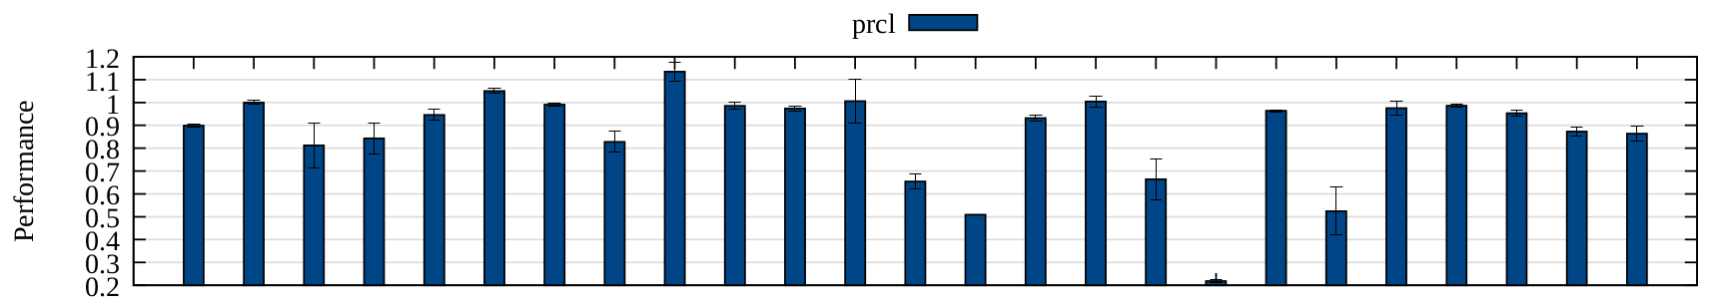
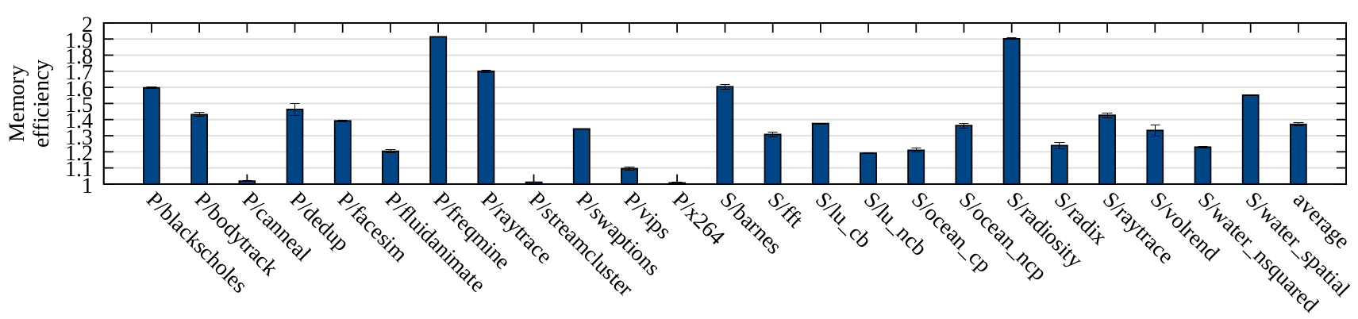
DAMON Accuracy and DAMOS ‘prcl’ Effectiveness
On average, ‘prcl’ saves 37.10% memory with 13.66% slowdown
  On the best case (‘parsec3/freqmine’), 91.34% memory saving with 0.91% slowdown
  On the worst case (‘splash-2x/ocean_ncp’), 36.29% memory saving with 78.16% slowdown; coldness threshold would need to be longer

Slide 28
DAMON Accuracy and DAMOS ‘prcl’ Effectiveness
On average, ‘prcl’ saves 37.10% memory with 13.66% slowdown
  On the best case (‘parsec3/freqmine’), 91.34% memory saving with 0.91% slowdown
  On the worst case (‘splash-2x/ocean_ncp’), 36.29% memory saving with 78.16% slowdown; coldness threshold would need to be longer

Slide 29
DAMON Accuracy and DAMOS ‘prcl’ Effectiveness
On average, ‘prcl’ saves 37.10% memory with 13.66% slowdown
  On the best case (‘parsec3/freqmine’), 91.34% memory saving with 0.91% slowdown
  On the worst case (‘splash-2x/ocean_ncp’), 36.29% memory saving with 78.16% slowdown; coldness threshold would need to be longer

Slide 30
Conclusion from DAMON/DAMOS Evaluation
DAMON is lightweight, scalable, and accurate for DRAM level optimization
DAMOS is effective, but needs fine tuning for each workload
  This would be not trivial works; Should we do that every time?

Slide 31
Why Searching Optimal Operation Schemes Is Difficult
Depends on both h/w and s/w characteristics
  Need to tune for each application on each system
Many parameters to consider and tune
  TLB miss, pgmajfaults, CPU usage, swap i/o, PSI, …
    Target access pattern itself is constructed with six data points
  Essentially this problem is multi-dimensional search problem

Slide 32
Simplifying The Problem
We care only memory efficiency and performance at last
  These can be consolidated into one metric (score) with different priorities
  Giving the metrics and priorities could be easy for users (like SLO)
The target access pattern is only the aggressiveness of the scheme
The multi-dimension search space can be reduced to 2-dimension
  Aggressiveness as X-axis, Score as Y-axis
We can further expect six simple patterns in common cases
1
2
4
Performance
Memory efficiency
Score
3
5
6
Aggressiveness
Aggressiveness
Aggressiveness

Slide 33
DAMOOS: Auto-tuning Runtime for DAOS
Receives
  A workload to run
  Methods for measuring the performance and memory efficiency
  The score function for the workload
  Unit work time of the workload
    The time to wait before getting performance and memory efficiency
  Time limit for the tuning
Finds the best DAMOS scheme for the score function in the time limit and starts the workload with the scheme

Slide 34
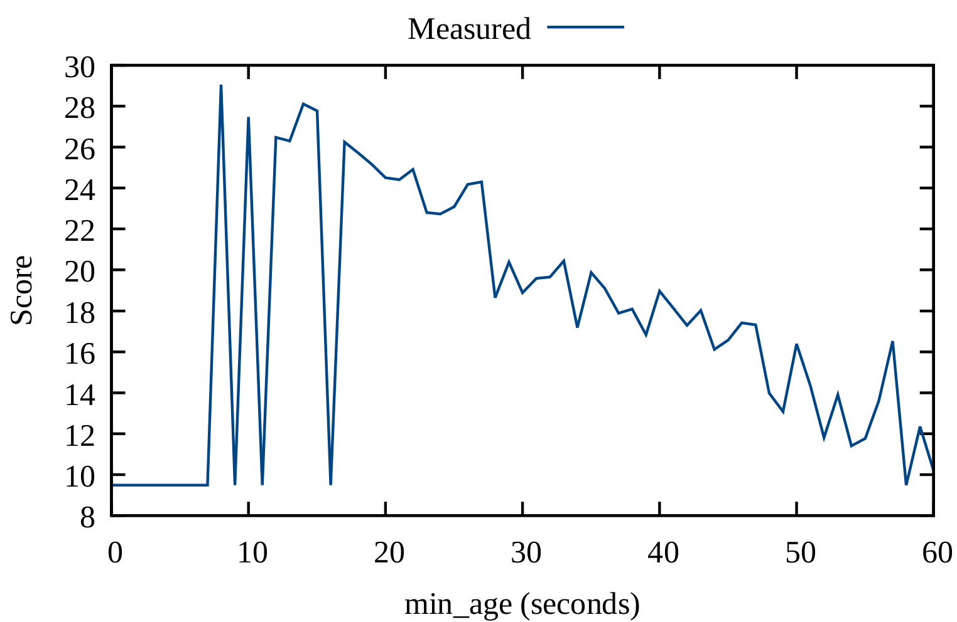
DAMOOS: Sampling (Example: ‘prcl’)
Calculate how many times we can measure the score for different aggressiveness (‘nr_samples’)
  The user-specified tuning time limit divided by the unit work time
Run the workload with 60% of ‘nr_samples’ schemes having random aggressiveness and measure one score for each scheme
Run the workload with 40% of ‘nr_samples’ schemes having random but near to the best of the 60% sample results aggressiveness
‘prcl’ example. Measured line is what we measured later (DAMOOS don’t know it)

Slide 35
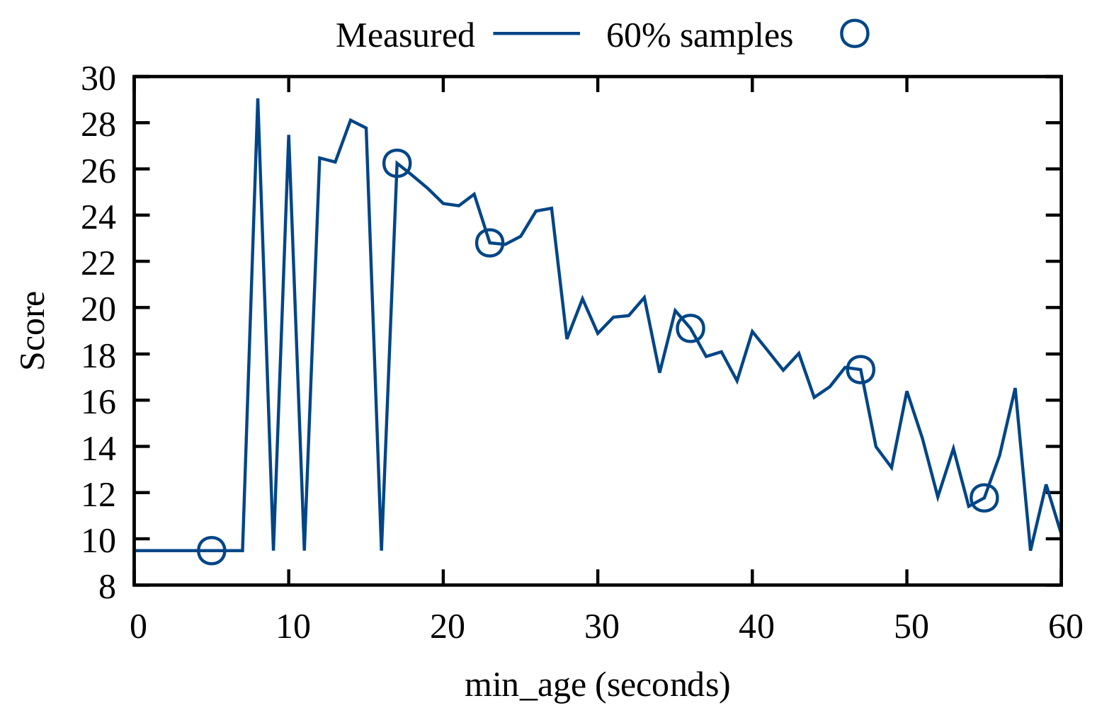
DAMOOS: Sampling (Example: ‘prcl’)
Calculate how many times we can measure the score for different aggressiveness (‘nr_samples’)
  The user-specified tuning time limit divided by the unit work time
Run the workload with 60% of ‘nr_samples’ schemes having random aggressiveness and measure one score for each scheme
Run the workload with 40% of ‘nr_samples’ schemes having random but near to the best of the 60% sample results aggressiveness
‘prcl’ example. Measured line is what we measured later (DAMOOS don’t know it)

Slide 36
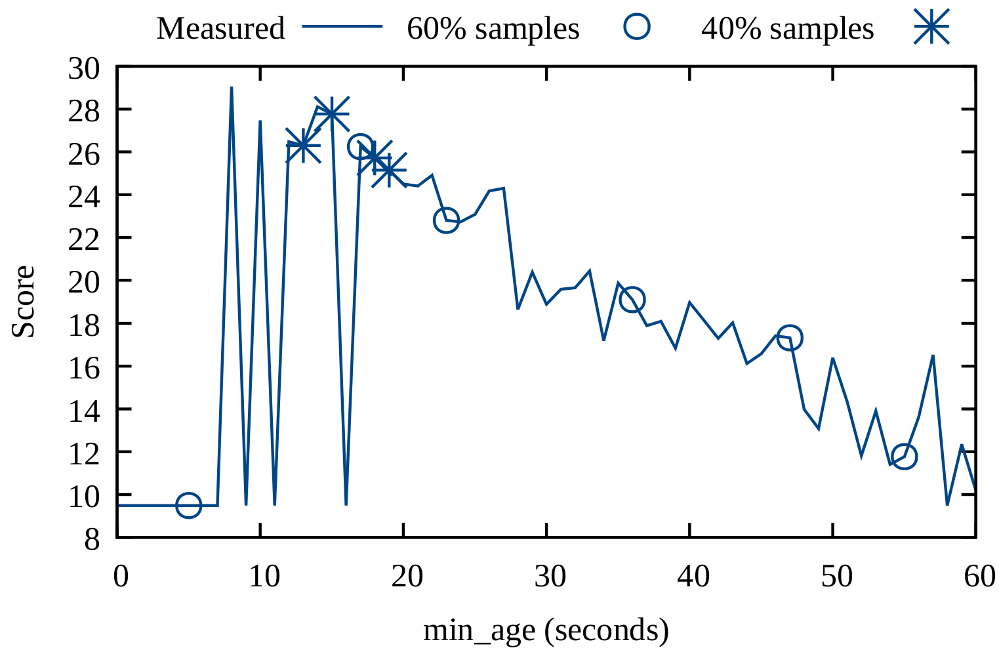
DAMOOS: Sampling (Example: ‘prcl’)
Calculate how many times we can measure the score for different aggressiveness (‘nr_samples’)
  The user-specified tuning time limit divided by the unit work time
Run the workload with 60% of ‘nr_samples’ schemes having random aggressiveness and measure one score for each scheme
Run the workload with 40% of ‘nr_samples’ schemes having random but near to the best of the 60% sample results aggressiveness
‘prcl’ example. Measured line is what we measured later (DAMOOS don’t know it)

Slide 37
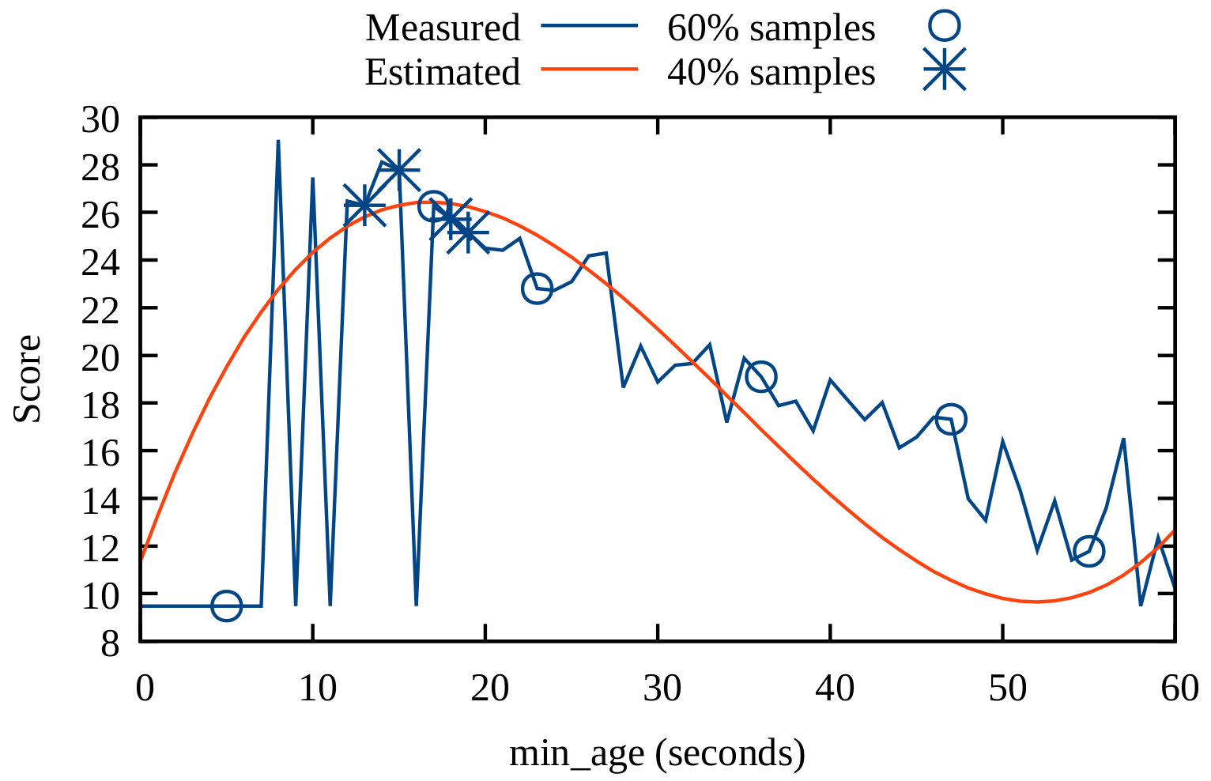
DAMOOS: Estimation and Best Scheme Selection
Find the relationship between the aggressiveness and score by applying Polynomial curve fitting to the ‘nr_samples’ data points
On the curve, we find an aggressiveness value that generates maximum score and use it as the best scheme aggressiveness
‘prcl’ example. Measured line is what we measured later (DAMOOS don’t know it)

Slide 38
DAMOOS Evaluation Setup
Basically same to the DAMON/DAMOS evaluation setup
Adds two more AWS EC2 instance types to show if DAMOOS works for different hardware types
In total, three types of hardware are used
  I3.metal: 3 GHz x 36 vCPUs, 128 GiB DRAM (i/o optimized)
  M5d.metal: 3.1 GHz x 48 vCPUs, 96 GiB DRAM (general purpose optimized)
  Z1d.metal: 4.0 GHz x 24 vCPUs, 96 GiB DRAM (computing optimized)
Use ‘prcl’ only
The score function is focused on avoiding >10% performance drop
  For detail, please read the paper

Slide 39
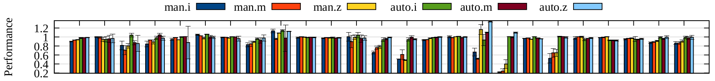
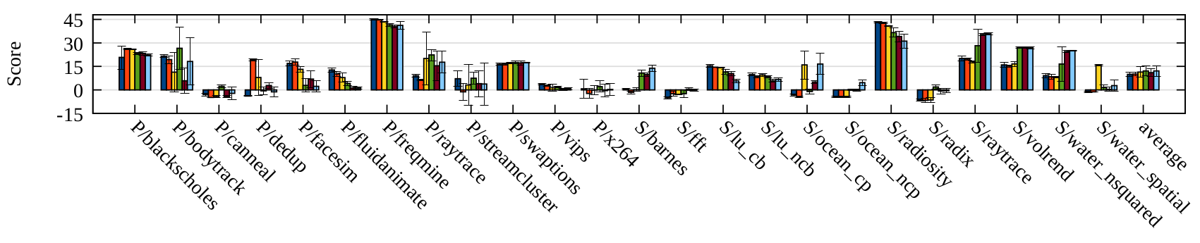
DAMOOS Evaluation Results for ‘prcl’: Performance
Average performance drops on the three h/w
  Manual-tuned: 13.65%, 13.45%, 9.54%
  Auto-tuned: 0.91%, 2.04%, 0.59%
DAOS’s auto-tuning removes 93.33%, 84.83%, and 93.81% of the slowdown of manual version on the three h/w, respectively
  The 10% performance drop SLO is almost always kept

Slide 40
DAMOOS Evaluation Results for ‘prcl’: Performance
Average performance drops on the three h/w
  Manual-tuned: 13.65%, 13.45%, 9.54%
  Auto-tuned: 0.91%, 2.04%, 0.59%
DAOS’s auto-tuning removes 93.33%, 84.83%, and 93.81% of the slowdown of manual version on the three h/w, respectively
  The 10% performance drop SLO is almost always kept
10% performance drop limit

Slide 41
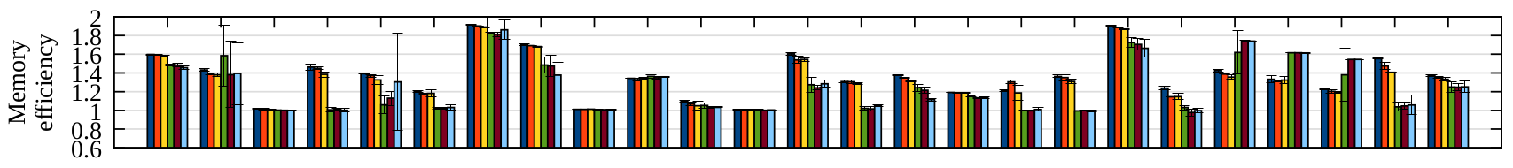
DAMOOS Evaluation Results for ‘prcl’: Memory Saving
Average memory saving on the three h/w types
  Manually-tuned: 37.10%, 35.21%, 33.22%
  Auto-tuned: 24.97%, 24.73%, 25.10%
Auto-tuned version’s memory saving is lower than those of manual version
  Because the score function gives more priority to performance
  Memory saving could increase if we adjust the priorities

Slide 42
DAMOOS Evaluation Results for ‘prcl’: Score
Average score on the three h/w types
  Manually-tuned: 9.99, 10.09, 11.35
  Auto-tuned: 12.08, 11.01, 12.06
Auto-tuning runtime obtains score improvements of 20.02%, 6.16%, and 6.25%

Slide 43


Conclusion
DAOS is a data access-aware operating system that constructed with three simple pieces
  DAMON provides best-effort accurate access patterns with lightweight and upper-bound-limited overhead
  DAMOS allows general access-aware memory management with no difficult, danger, dirty code
  DAMOOS provides a runtime that provides auto-tuned data access-aware memory management scheme within a finite time
All parts of DAOS are opensource
  DAMON and DAMOS are merged in the mainline Linux kernel
  DAMOOS is available at github
  Visit https://github.com/damonitor for quick start

Slide 44

Questions?
You can also
  Visit https://damonitor.github.io,
  Send mails to damon@lists.linux.dev, or
  sj@kernel.org
  We will also participate to the poster session
https://kids.nationalgeographic.com/content/dam/kids/photos/animals/Birds/A-G/adelie-penguin-jumping-ocean.ngsversion.1396530997321.adapt.1900.1.jpg

Slide 45
Backup Slides

Slide 46
DAMON: Resulting Architecture
Core logic and monitoring operations layer are separated
  Multiple address spaces and usages can easily supported
  Current version of DAMON supports virtual address spaces and the physical address space
Client
Monitoring Request
Data Access Monitor
Adaptive Regions Adjustment
Aging
Region-based Access Check
Monitoring Primitives
For virtual addr
For physical addr
Kernel Data Structures and Features
vma
PTE
PG_idle
rmap

