Slide 1

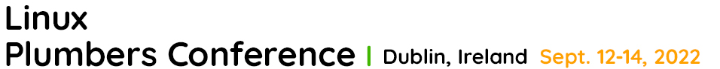
Kernel Summit @
DAMON:
Current Status and Future Plans
SeongJae Park <sj@kernel.org>

Slide 2
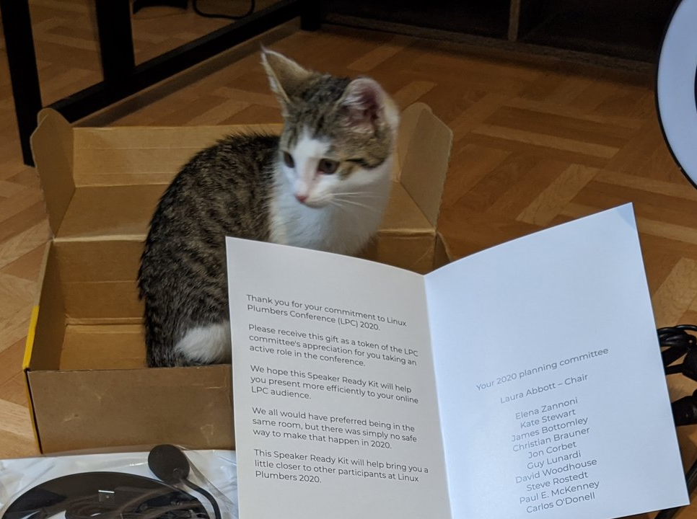
Disclaimer
The views expressed herein are those of the speaker;
they do not reflect the views of his employers
https://twitter.com/sjpark0x00/status/1295387149018300419/photo/1

Slide 3
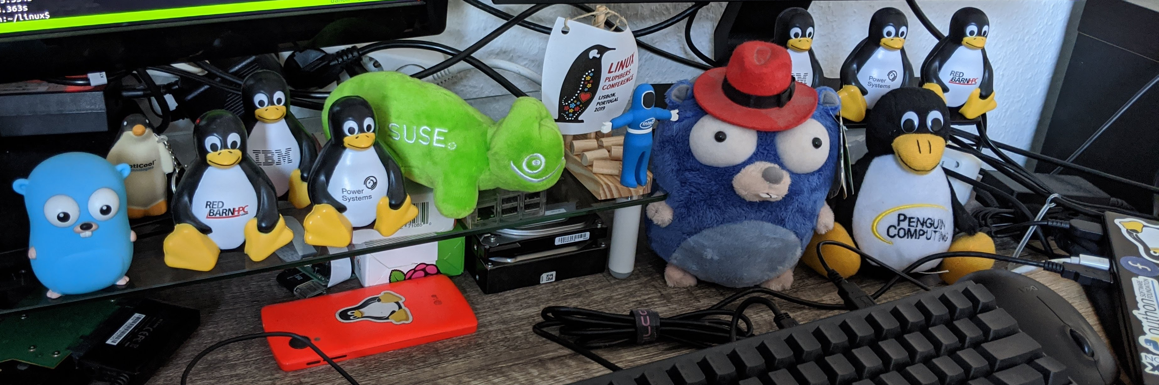
I, SeongJae Park <sj@kernel.org>
Just call me SJ, or whatever better for you to pronounce
Kernel Development Engineer at Amazon Web Services
Interested in the memory management and the parallel programming
Maintaining DAMON

Slide 4
Overall Motivation: Access-aware Linux Kernel
DRAM is a major infrastructure expense
We can reduce the expense by improving memory efficiency
We can do that if we can make better data management decision
We can do that if we can estimate data access patterns
We can do that if we can aware of current access patterns, and operate the system with the information
Linux is an Access-aware OS kernel, but apparently could do better
And, we could make it highly user-space-controllable while just works

Slide 5
Overview
Current Status
  DAMON
  DAMOS
  DAMON Modules
  User-space, Testing, and Community
Future Plans
  DAMON/DAMOS Extension and Improvements
  DAMON Auto-tuning and Modules Unification
  Misc Kernel-side TODOs
  More User-space Components and Testing
Conclusion

Slide 6
DAMON: Motivation
Data access monitoring overhead is high and unbounded
  High overhead can also affect monitoring results accuracy
    Maybe the uncertainty principle can be applied here
  Unbounded overhead is inherent in fixed granularity monitoring
    As the amount of data to monitor increases, overhead grows
High overhead is inevitable for precise large amount of information
  Do we really paying for only what we need? No one price plan fits all
No simple and centralized interface for data access monitoring

Slide 7
DAMON: Data Access MONitor
A data access monitoring framework of Linux kernel
  Aims to be the simple and centralized access monitoring interface
Allows users to know which memory area is how frequently accessed
  Let users set the min accuracy and max overhead
  DAMON makes the best-effort accuracy / overhead trade-off
    Multiple mechanisms could be used for this
    At the moment, Adaptive access pattern-oriented regions adjustment mechanism is the default and single mechanism for this
    (For details, refer to the doc or ksummit’20 DAMON talk)
    The default mechanism allows bounded overhead regardless of the monitoring target memory size
    Experimental efficient page granularity monitoring mechanism was already implemented; Not merged in due to the absence of real use case so far
Allows easy extension and flexible customization

Slide 8
DAMON: Evaluation
DAMON is lightweight
  On a production setup, DAMON was able to check accesses to entire system memory (68.60 GB) every 5 msecs with <1% single CPU time (scans 68.6GB / (5ms * 1%) = 1,372 TB/s)
    Note: DAMON overhead does not increase as the memory size increases
DAMON is accurate
  Shows sane monitoring results with realistic benchmark workloads and production workloads (found 7GB working set and 4KB hottest region)
  Identifying hot memory regions from DAMON results with human eyes and modifying the program to do `mlock()` the regions achieves up to 2.55x speedup under memory pressure[1,2]

Slide 9
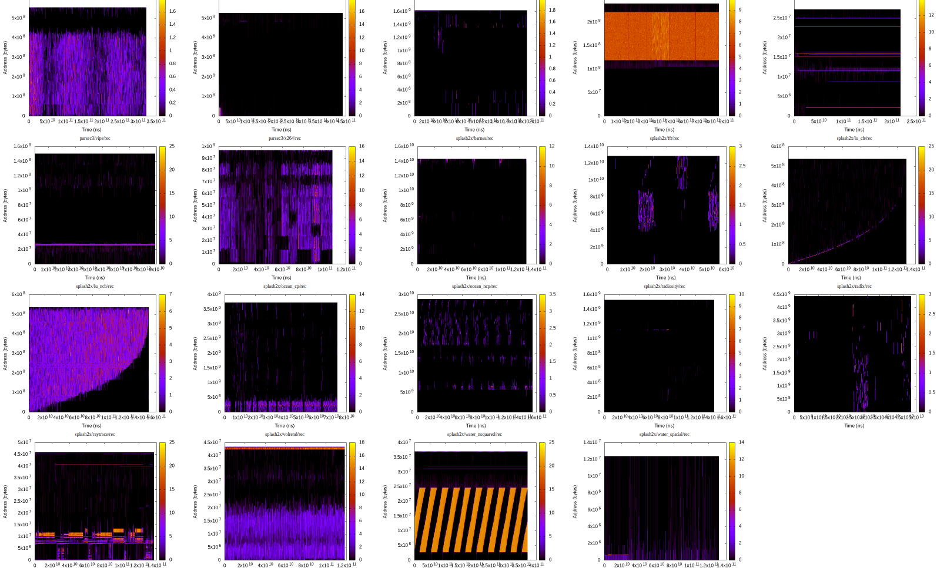
DAMON: Evaluation
DAMON is lightweight
  On a production setup, DAMON was able to check accesses to entire system memory (68.60 GB) every 5 msecs with <1% single CPU time (scans 68.6GB / (5ms * 1%) = 1,372 TB/s)
    Note: DAMON overhead does not increase as the memory size increases
DAMON is accurate
  Shows sane monitoring results with realistic benchmark workloads and production workloads (found 7GB working set and 4KB hottest region)
  Identifying hot memory regions from DAMON results with human eyes and modifying the program to do `mlock()` the regions achieves up to 2.55x speedup under memory pressure[1,2]

Slide 10
DAMON: Evaluation
DAMON is lightweight
  On a production setup, DAMON was able to check accesses to entire system memory (68.60 GB) every 5 msecs with <1% single CPU time (scans 68.6GB / (5ms * 1%) = 1,372 TB/s)
    Note: DAMON overhead does not increase as the memory size increases
DAMON is accurate
  Shows sane monitoring results with realistic benchmark workloads and production workloads (found 7GB working set and 4KB hottest region)
  Identifying hot memory regions from DAMON results with human eyes and modifying the program to do `mlock()` the regions achieves up to 2.55x speedup under memory pressure[1,2]

Slide 11
DAMON: History and Status
2020-01: RFC v1 posted
2021-05: Merged in Amazon Linux 2 >=5.4 Kernels
2021-09: Merged in v5.15-rc1
2022-04: Enabled in Android GKI

Slide 12
Overview
Current Status
  DAMON
  DAMOS
  DAMON Modules
  User-space, Testing, and Community
Future Plans
  DAMON/DAMOS Extension and Improvements
  DAMON Auto-tuning and Modules Unification
  Misc Kernel-side TODOs
  More User-space Components and Testing
Conclusion

Slide 13
DAMOS: Motivation
Now DAMON-based optimizations are available (by both kernel and user)
  Common steps for the optimizations would be…
  Run DAMON, get/analyze monitoring results, and make some memory management decisions (e.g., reclaim cold pages, use THP for hot pages, …)
Not so ideal because
  Steps could be repetitive
  User-space approach could be inefficient due to kernel-user context switches
    BPF-like approaches would be available, though
Couldn’t we offload the works to DAMON in the kernel?
  Don’t repeat yourself
  Use the information directly from where it generated

Slide 14
DAMOS: DAMON-based Operation Schemes
A core feature of DAMON for reducing the repetitive works
Receives ‘schemes’; each scheme is constructed with
  Target access pattern
    Ranges of size, access frequency, and age of memory regions
  Memory management action, e.g., PAGEOUT, HUGEPAGE, ...
DAMOS automatically finds the memory region of the target pattern using DAMON and applies the action to the region
Now users can make DAMON-based optimizations with no-code
# format is:
# <min/max size> <min/max frequency (0-100)> <min/max age> <action>
#
# if a region of size >=4KB didn’t accessed for >=2mins, page out
4K max 0 0 2m max pageout

Slide 15
DAMOS: Evaluation
Implemented main ideas of two state-of-the-arts works with DAMOS
  Access-aware THP collapse/split
    The original work was accepted to a top-tier conf (OSDI’16)
    Re-implemented with two lines of DAMOS config
    Our version removes 76.15% of THP memory bloats
    while preserving 51.25% of THP speedup
  Proactive reclamation
    The original work was accepted to another top-tier conf (ASPLOS’19) and being used for Google fleets
    Re-implemented with one line of DAMOS config
    reduces 93.38% of residential sets and 23.63% of system memory footprint
    while incurring only 1.22% runtime overhead in the best case.
  For more details, please read the report

Slide 16
DAMOS: More Features For Production
For productions that safety-critical, DAMOS provides additional features
Time/space quota per a given time interval
  DAMOS try to use CPU time no more than the given time quota
  DAMOS try to apply the action to memory no more than the space quota
Regions prioritization
  Under the quota, DAMOS applies the action to prioritized regions first
  Prioritization logic can be customized for different DAMOS actions
    In case of RECLAIM, older and colder pages are prioritized by default
Three watermarks (high, mid, low) with user-specified metric (e.g., freemem)
  Deactivate if the metric > high_watermark or metric < low_watermark
  Activate if the metric < mid_watermark and metric > low_watermark
  Avoid DAMOS using any resource under a peaceful or a catastrophic situation
With online tuning, these opens some interesting capabilities

Slide 17
DAMOS: History and Status
2020-02: RFC v1 posted
2021-05: Merged in Amazon Linux 2 >=5.4 Kernels
2021-11: Merged in v5.16-rc1
2022-04: Enabled in Android GKI

Slide 18
Overview
Current Status
  DAMON
  DAMOS
  DAMON Modules
  User-space, Testing, and Community
Future Plans
  DAMON/DAMOS Extension and Improvements
  DAMON Auto-tuning and Modules Unification
  Misc Kernel-side TODOs
  More User-space Components and Testing
Conclusion

Slide 19
DAMON Modules: Motivation
A common question: Policy in user-space or kernel-space?
  Only user-space policies could make ultimate result
    True for some cases, might not be true for some other cases
    Requires non-trivial user-space efforts investment, though
  Kernel-space policies could be worthy to try
    Useful for someone who cannot get help from the user-space ultimate policy
    Kernel just works at least reasonably
DAMON aims to convince both; It hence provides
  Highly tunable and flexible user interface via sysfs, and
  DAMOS application static kernel modules for general use cases
    Supposed to be useful in general without complex tuning
    Can still be highly tuned via parameters, but the default values are supposed to make no fantastic benefits but some, or at least no harm

Slide 20
DAMON_RECLAIM
DAMON-based proactive reclamation kernel module
  Basically same to the previously shown DAMOS schemes
Written using DAMOS’ simple kernel API
  Excepting the code for module parameters, only 188 lines of code
  SJ live-coded almost similar one in 10 minutes at ksummit’21
Aims to be used on the production
  Ensure the safety using the quotas and watermarks
  The quotas and watermarks are conservatively tuned
    Aims to make no fantastic benefits but some with no harm
    Can be tweaked via module parameters

Slide 21
DAMON_LRU_SORT
Yet another DAMON module
Sorts pages in LRU lists for better performance
  Can be used for proactive reclamation improper situations
    E.g., Having slow or restrictive storage devices
  `mark_page_accessed()` hot pages and `deactivate_page()` cold pages
    We could do more fine-grained LRU lists-adjustment in a future
Reduces 10-20% memory pressure stall time (memory PSI, some) under artificial memory pressure

Slide 22
DAMON Modules: History and Status
2021-06: DAMON_RECLAIM RFC v1 posted
2021-10: DAMON_RECLAIM merged in Amazon Linux 2 >=5.10 kernel
2022-01: DAMON_RECLAIM merged in v5.16-rc1
2022-04: DAMON_RECLAIM Enabled in Android GKI
2022-05: DAMON_LRU_SORT RFC v1 posted
2022-08: DAMON_LRU_SORT merged in v6.0-rc1

Slide 23
Overview
Current Status
  DAMON
  DAMOS
  DAMON Modules
  User-space, Testing, and Community
Future Plans
  DAMON/DAMOS Extension and Improvements
  DAMON Auto-tuning and Modules Unification
  Misc Kernel-side TODOs
  More User-space Components and Testing
Conclusion

Slide 24
DAMON User-space Applications
DAMON provides two user interfaces based on debugfs and sysfs
  Those are for user space tools implementation, not for manual use
  The debugfs interface will be deprecated after next LTS is released
SJ develops and maintains his own user space tool
  Available at Github (https://github.com/awslab/damo) and PyPI (https://pypi.org/project/damo/)
  Provides all DAMON features with human-friendly interface
Alibaba developed their own DAMON user-space tool: https://github.com/aliyun/data-profile-tools

Slide 25
Testing DAMON
Maintains open source tests suite for DAMON: https://github.com/awslabs/damon-tests
  Provides functionality tests and performance tests
    Functionality tests are based on selftests and kunit tests
    Performance tests use PARSEC3/SPLASH-2X workloads
  We run
    Functionality tests for every update of SJ’s hacking tree, >=v5.15.y, mm-unstable, and the mainline
    Performance tests for latest SJ’s hacking tree every day
Did some fuzzing tests
  Made DAMON debugfs interface syzkaller description and upstreamed
  No DAMON sysfs interface syzkaller description yet, though

Slide 26
DAMON Community
DAMON is developed by its open and (hopefully) inclusive community
Several people, institutes, and companies are participating
Dedicated open mailing list: damon@lists.linux.dev
Open, regular, and informal virtual bi-weekly meeting series
  https://lore.kernel.org/damon/20220810225102.124459-1-sj@kernel.org/
  We will have an in-person instance of it 17:00 today at Meeting Room 9
  Aims to be used for aligning participants’ conflicting goals and prioritizing TODO items

Slide 27
Overview
Current Status
  DAMON
  DAMOS
  DAMON Modules
  User-space, Testing, and Community
Future Plans
  DAMON/DAMOS Extension and Improvements
  DAMON Auto-tuning and Modules Unification
  Misc Kernel-side TODOs
  More User-space Components and Testing
Conclusion

Slide 28
Extending DAMON
Can easily extend for various address spaces and use cases
  Need to implement new monitoring operations set for the use case
Currently, monitoring operations for virtual address spaces and the physical address space are available
Imaginable extensions include
  More efficient page-granularity system monitoring
    Current page-granularity monitoring is only for proof of concepts
    We already implemented an experimental version of this
  Monitoring operations using IBS or LRU-position
  Read-only, write-only, cgroups, for only specific file-backed memory, ...

Slide 29
Improving DAMON Accuracy/Overhead
Adaptive monitoring attributes adjustment and regions splitting
  Find struggling regions and apply aggressive adaptation
  Page-gran monitoring will be re-implemented to be used for comparison
Remapping regions based on monitoring results, to sorted by hotness
  The spatial locality assumption of memory regions will be more reasonable
  DAMON-internal address space would be needed for usual cases
User-provided address space (page-gran management)
Hot
Cool
Warm
Cold
DAMON address space
(DAMON region-based management)
User-provided address space (page-gran management)
Hot
Warm
Cool
Cold
DAMON address space
(DAMON region-based management)

Slide 30
DAMOS Allow/Deny-list
DAMON is simple
  No special care of anon, file-backed, cgroups, but only access pattern
Users know some important memory areas that shouldn’t be distracted by DAMOS
  Users could do `madvise()` or `mlock()` or somewhat
  DAMOS could have allow-list and deny-list for such regions
    E.g., “do the access-aware proactive reclamation for system memory but these processes, these files, and these cgroups”

Slide 31
More DAMOS Actions and Modules
DAMON might be able to be used to help
  Efficient but performant THP promotion/demotion
  Page migration target (for compaction or CMA) selection
    Cold pages might be not pinned
  Tiered-memory management

Slide 32
Overview
Current Status
  DAMON
  DAMOS
  DAMON Modules
  User-space, Testing, and Community
Future Plans
  DAMON/DAMOS Extension and Improvements
  DAMON Auto-tuning and Modules Unification
  Misc Kernel-side TODOs
  More User-space Components and Testing
Conclusion

Slide 33
DAMON Modules Unification
DAMON modules are exclusive at the moment
Would be better to unify all the modules
  So that all modules can be enabled in one step: Just working kernel
    Say, CONFIG_ACCESS_AWARE_MM?
  But, should still be able to be used separately (no behavior/interface change)
  Support of multiple DAMON contexts on single kdamond is required

Slide 34
DAMON Auto-tuning
DAMON provides not small number of knobs, tuning is not so trivial
  Adding yet other more intuitive knobs for auto-tuning other knobs could help
  E.g., a monitoring time quota for `nr_{min,max}_regions` auto-tuning
Transparent Memory Offloading (TMO) like Auto-tuning of DAMON_RECLAIM would be possible and seems promising
  Monitor PSI and adjusts DAMOS quota
  Running (too-)simplified and aggressive TMO implementation with DAMON_LRU_SORT reduces PSI 10-20%
Might be able to be generalized for general DAMOS
  Already available via online tuning, but why not make kernel just work?
  Provides feedback interface, let users put metric like PSI that really matters to them; DAMON does the auto-tuning based on the metric value
  Allow special keywords for kernel-better-collecting metrics like PSI

Slide 35
Overview
Current Status
  DAMON
  DAMOS
  DAMON Modules
  User-space, Testing, and Community
Future Plans
  DAMON/DAMOS Extension and Improvements
  DAMON Auto-tuning and Modules Unification
  Misc Kernel-side TODOs
  More User-space Components and Testing
Conclusion

Slide 36
Misc Kernel-side TODO Items
Non-root user DAMON interface
DAMON running on no kdamond but a user-process
Efficient DAMON monitoring results exposing
Querying regions of specific access pattern

Slide 37
More User-space Components
Out of SJ’s hand; waiting for user space experts’ contributions
User-space library, say, libdamon
  While preparing for DAMON system call, let’s hide the gap
Hand over of the official DAMON user-space tool
  SJ is bad at user space programming
  Alibaba’s datop might be the one candidate?
More tools
  Showing access pattern with callstack will give us interesting profiling cap
  User-space optimizer/auto-tuner? RSS/WSS based OOM killer?
More services
  DAMON/DAMOS as-a Service
    Working set size monitoring/alarming/auto scaling/...

Slide 38
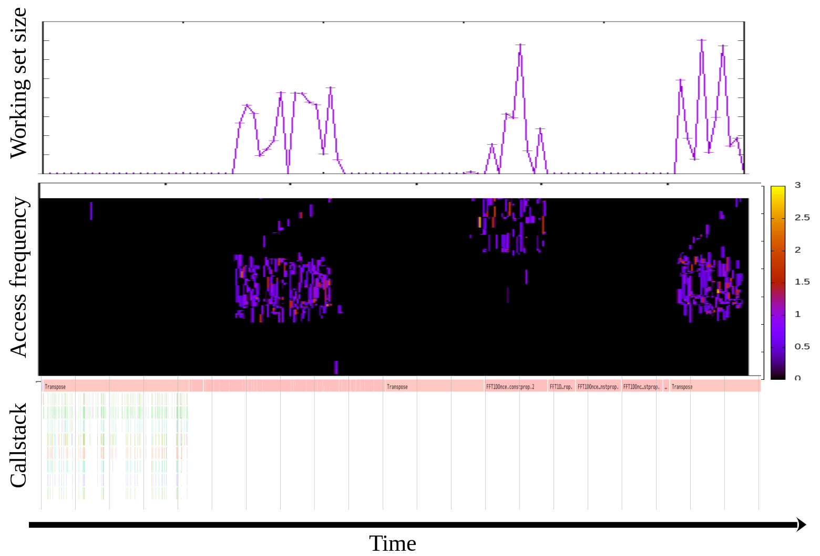
More User-space Components: Imaginable Profiler
Out of SJ’s hand; waiting for user space experts’ contributions
User-space library, say, libdamon
  While preparing for DAMON system call, let’s hide the gap
Hand over of the official DAMON user-space tool
  SJ is bad at user space programming
  Alibaba’s datop might be the one candidate?
More tools
  Showing access pattern with callstack will give us interesting profiling cap
  User-space optimizer/auto-tuner? RSS/WSS based OOM killer?
More services
  DAMON/DAMOS as-a Service
    Working set size monitoring/alarming/auto scaling/...

Slide 39
More User-space Components
Out of SJ’s hand; waiting for user space experts’ contributions
User-space library, say, libdamon
  While preparing for DAMON system call, let’s hide the gap
Hand over of the official DAMON user-space tool
  SJ is bad at user space programming
  Alibaba’s datop might be the one candidate?
More tools
  Showing access pattern with callstack will give us interesting profiling cap
  User-space optimizer/auto-tuner? RSS/WSS based OOM killer?
More services
  DAMON/DAMOS as-a Service
    Working set size monitoring/alarming/auto scaling/...

Slide 40
Testing
DAMON tests suite
  Use of more workloads
  More functionality tests case
  More unit tests
  Integrating in the kernel CI systems
Fuzzing Support
  DAMON sysfs syzkaller description should be made

Slide 41
Summary
Current Status
  In the kernel: DAMON, DAMOS, DAMON Modules
  In userspace: >=2 Tools
  In community: open and (hopefully) inclusive culture and chat series
Future Plans
  Extended and improved DAMON/DAMOS/DAMON Modules
  Convenient and intuitive semi-auto tuning of DAMON/DAMOS
  Unified DAMON Modules: Access-aware LInuX Assistant
  More user-space libraries, tools, and services
  The community!

Slide 42

Questions?
You can also use below
  Project page: https://damonitor.github.io
  Kernel docs for admin and programmers
  DAMON mailing list: damon@lists.linux.dev
  DAMON Beer/Coffee/Tea Chat
  The maintainer: sj@kernel.org
https://kids.nationalgeographic.com/content/dam/kids/photos/animals/Birds/A-G/adelie-penguin-jumping-ocean.ngsversion.1396530997321.adapt.1900.1.jpg

