Slide 1


DAMON:
Current Status and Future Plans
SeongJae Park <sj@kernel.org>
https://damonitor.github.io
Kernel Summit @

Slide 2
Notices
The views expressed herein are those of the speaker;
they do not reflect the views of his employers

Slide 3
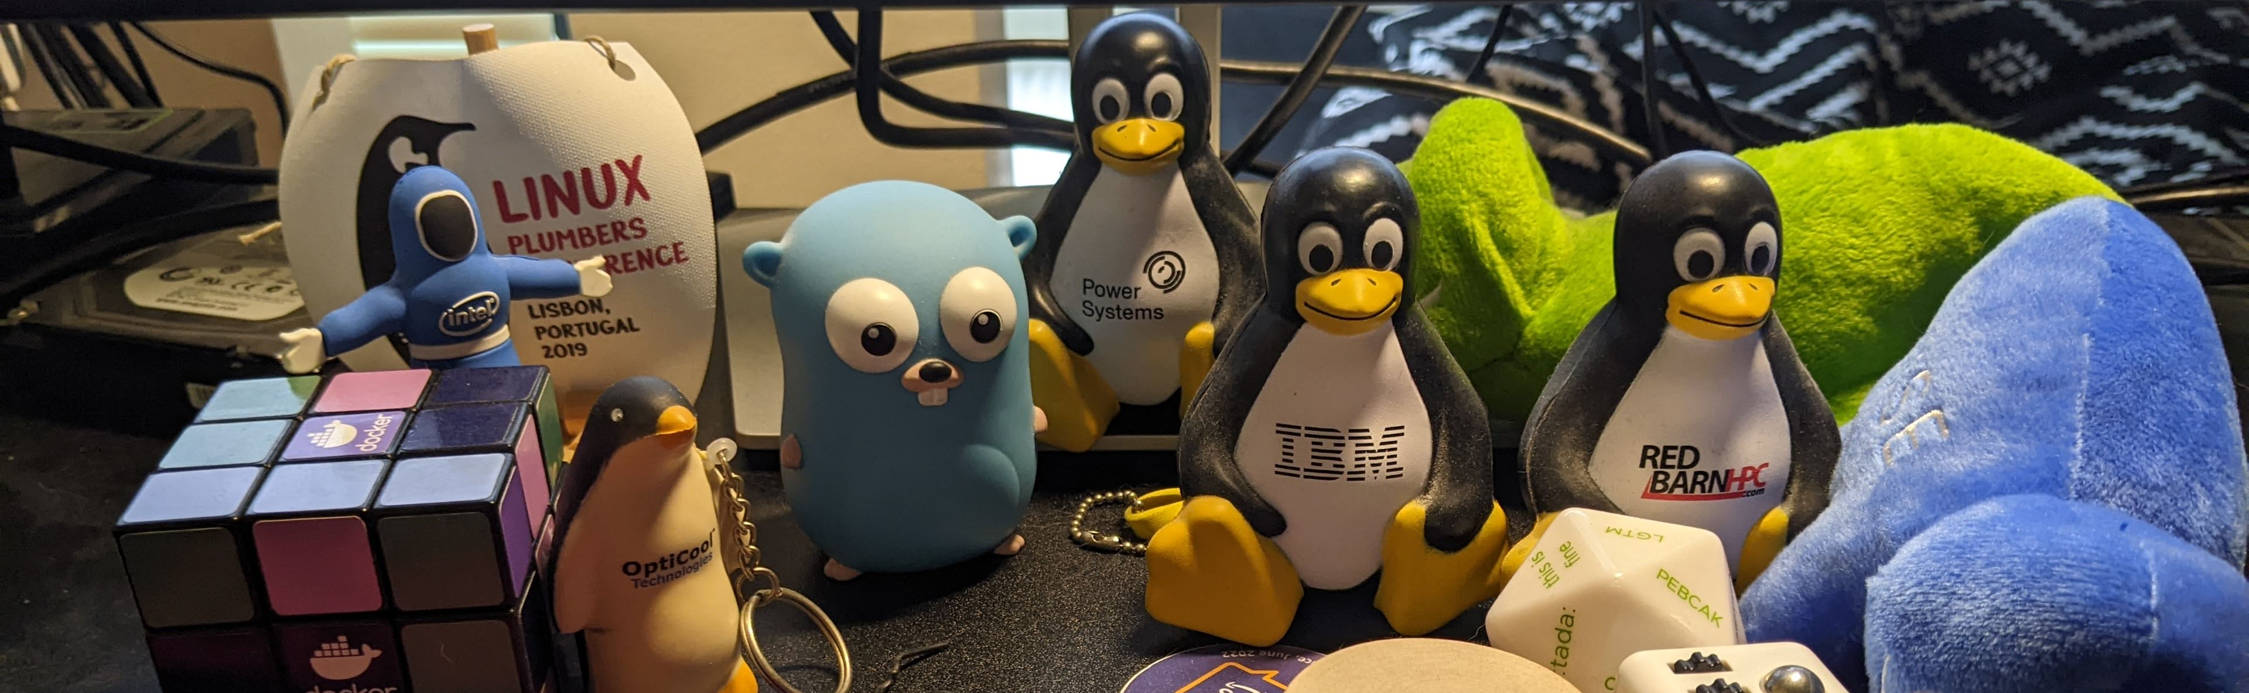
I, SeongJae Park (SJ)
Working on AWS
Maintaining Linux kernel DAMON subsystem and its user-space tool, DAMO

Slide 4
Overview
DAMON in a Nutshell (10 mins)
Updates Since Kernel Summit 2022 (10 mins)
Future Plans (15 mins)
DAMON Community (5 mins)
Conclusion and Remaining QnA
Each time-specified topic will get its own QnA

Slide 5
DAMON in a Nutshell

Slide 6
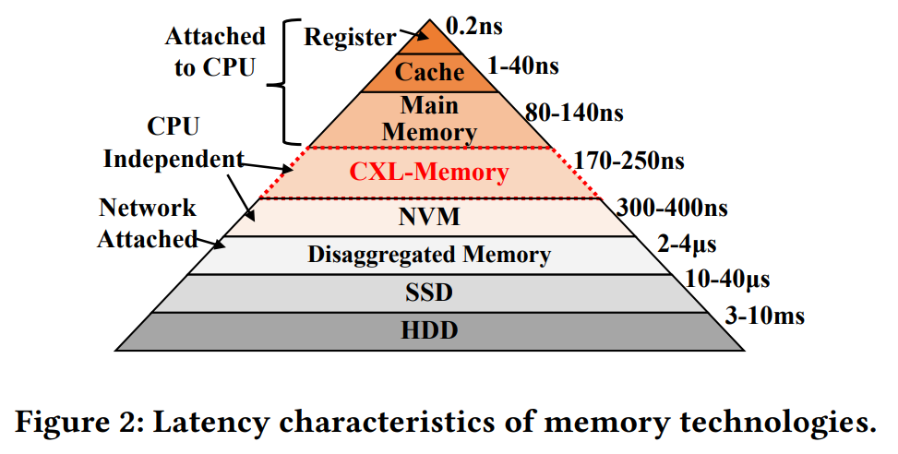
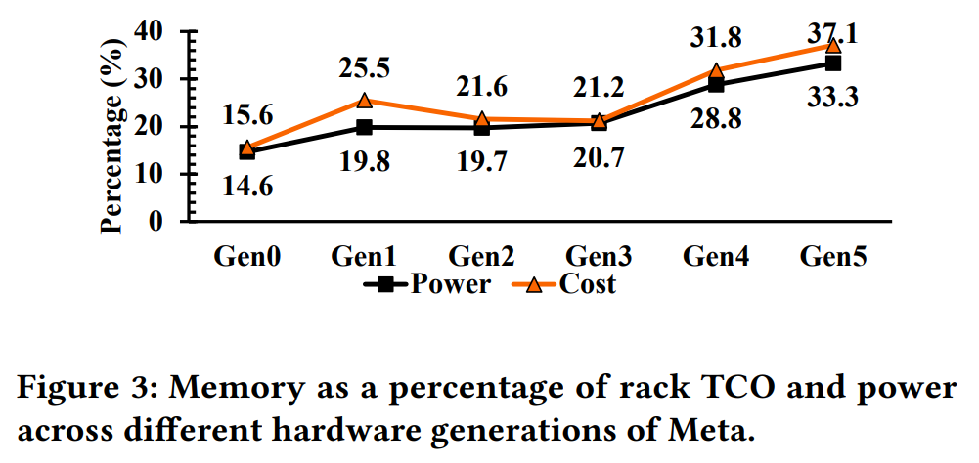
Why? Increasing Demands/Costs and No-free-lunch H/W Solution
Memory demands increase faster than the price is decreasing
New H/W will arrive, but as a new hierarchy rather than a perfect drop-in replacement
  No free lunch
Need access-aware system operation, but how can we be access-aware?
Retrieved from “TPP: Transparent Page Placement for CXL-Enabled Tiered-Memory”, https://dl.acm.org/doi/pdf/10.1145/3582016.3582063

Slide 7
How Data Access Would Look Like, Over Time
Accesses are made sometime, somewhere
Time
Address

Slide 8
How Data Access Would Look Like, Over Time
Accesses are made sometime, somewhere
Time
Address

Slide 9
How Data Access Would Look Like, Over Time
Accesses are made sometime, somewhere
Time
Address

Slide 10
Ideal Data Access MONitor
Capture all access
Space granularity: bit (or, electron?)
Time granularity: 1 sec / CPU freq / # CPUs (or, speed of light?)
Record from: From the boot (or, since Unix timestamp 0 (1970-01-01)?)
Time
Address

Slide 11
Fixed Granularity Monitoring
Let user define the time/space granularity (‘nr_min_regions’ and ‘sample_interval’)
  10 and 5ms by default for the two parameters
Check access to only one page per region
  Pages in each region is assumed to have similar access frequencies
  ‘nr_min_regions’ could be “monitoring target address space size / PAGE_SZ”
Time
Address
Region
Sampling interval

Slide 12
Sampling Results Aggregation
Introduce new user-specifiable time interval, “aggregate interval” (100ms by default)
  Count number of access-detected sampling intervals per aggregate interval (“nr_accesses”)
Amount of the record is reduced
  A bool per sampling interval → One counter per aggregate interval
  Create snapshot per aggregation interval
Time
1 | 2 | 3 | 1 | 2 | 3 | 1 | 2 | 2
0 | 1 | 1 | 1 | 1 | 1 | 1 | 1 | 2
0 | 0 | 1 | 0 | 0 | 0 | 1 | 1 | 1
1 | 2 | 2 | 1 | 2 | 3 | 1 | 1 | 2
Address
Region
Aggregate interval
Sampling interval

Slide 13
Sampling Results Aggregation
Introduce new user-specifiable time interval, “aggregate interval” (100ms by default)
  Count number of access-detected sampling intervals per aggregate interval (“nr_accesses”)
Amount of the record is reduced
  A bool per sampling interval → One counter per aggregate interval
  Create snapshot per aggregation interval
Time
3 | 3 | 2
1 | 1 | 2
1 | 0 | 1
2 | 3 | 2
Address
Region
Aggregate interval

Slide 14
Merging Regions
Definition of region: address range that having similar access frequencies to pages in it
Time
3
1
1
1
Address
Region
Aggregate interval

Slide 15
Merging Regions
Definition of region: address range that having similar access frequencies to pages in it
Merge adjacent regions of similar access frequency, at the end of the aggregation interval
Time
3
1
Address
Region
Aggregate interval

Slide 16
Split Regions
Access pattern may change over time
Time
3
1
Address
Region
Aggregate interval

Slide 17
Split Regions
Access pattern may change over time
Randomly split regions at the beginning of aggregation interval
Some would be merged at the end of the aggregation interval
Time
3
1
Address
Region
Aggregate interval

Slide 18
Continuous Merge/Split: Adaptive Regions Adjustment
Split reverts unnecessary merge, vice versa
One page per region sampling still reasonable
Users can set ‘nr_{min,max}_regions’
  DAMON stops merge/split if the range can be violated
Users can control accuracy and overhead

Slide 19
Age Counting
Age: Number of last aggregation intervals that similar nr_accesses were kept
Snapshot contains some history
Time
1 | 2 | 1
1 | 2 | 3
1 | 1 | 1
1 | 1 | 1
Address
Region
Aggregate interval

Slide 20
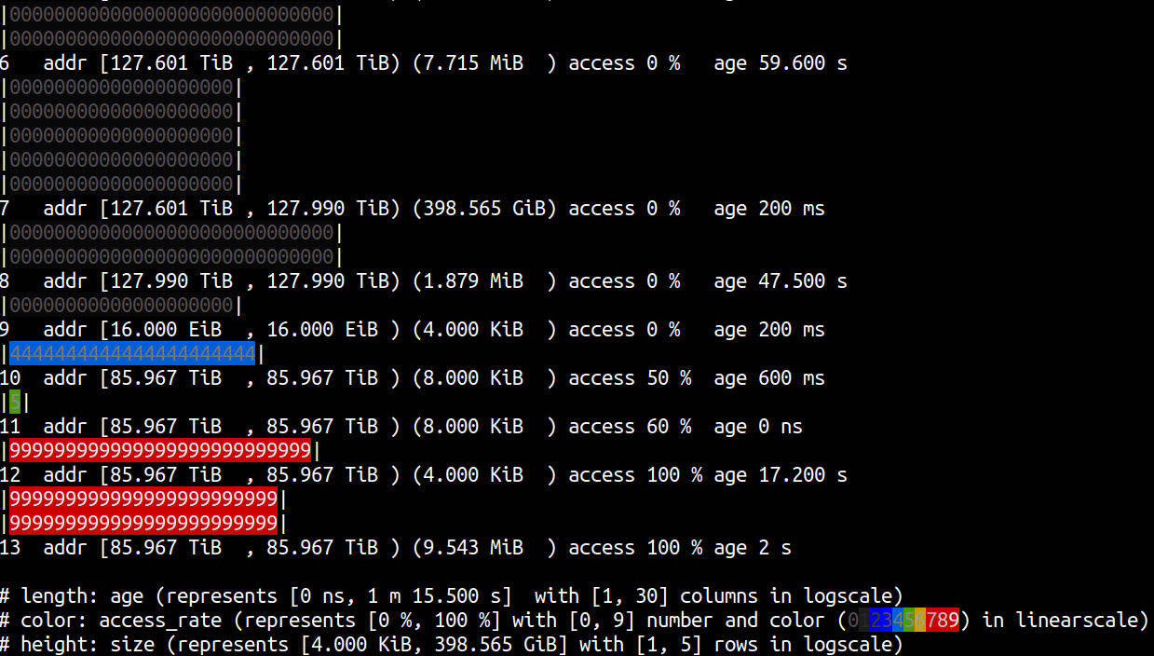
DAMON: Access Monitoring Results Snapshot Generator
Answer to “Which memory region is how frequently accessed for how long time?”
  With controllable overhead and accuracy

Slide 21
DAMON: Access Monitoring Results Snapshot Generator
Answer to “Which memory region is how frequently accessed for how long time?”
  With controllable overhead and accuracy
Wait, isn’t this information enough to make kernel just works?

Slide 22
DAMOS: DAMON-based Operation Schemes
Find regions of interesting access pattern from the snapshot and apply a requested action
  “Page out pages of regions that not accessed for >= 2 mins
  “Use THP for pages of regions that having >= 10% access rate for >= 1 minute”
Multiple requests (called schemes) can be made
# damo start --damos_action pageout --damos_access_rate 0% 0% --damos_age 2m max
# damo start --damos_action thp --damos_access_rate 10% max --damos_age 1m max

Slide 23
DAMOS: Target Access Pattern and Action
Basic ways to specify the request
Target access pattern
  Ranges of size, access rate, and age of the region of the interest
Action
  System action that DAMOS will make to the regions of the pattern
  pageout, thp, nothp, ...

Slide 24
DAMOS Quota
DAMOS target access pattern is hard to tune
  min/max for 3 ranges = 6 parameters
  Optimum tuning depends on the characteristics of the system and workloads
Quota: user-specifiable maximum resource that DAMOS can use for applying the action
  e.g., Apply the action to only up to 100 MiB of regions per second
Under the limit, DAMOS prioritizes regions based on access pattern, following the context
  If the action is pageout, colder pages are prioritized
  If the action is thp, hotter pages are prioritized

Slide 25
QnA for DAMON/DAMOS Basics
Sampling-based access frequency monitoring
Adaptive regions adjustment
DAMOS, w/ access pattern
DAMOS quota

Slide 26
DAMON Updates
Since Kernel Summit 2022

Slide 27
Overview
DAMON in a Nutshell (10 mins)
Updates Since Kernel Summit 2022 (10 mins)
Future Plans (15 mins)
DAMON Community (5 mins)
Conclusion and Remaining QnA
Each time-specified topic will get its own QnA

Slide 28
DAMOS Tried Regions
Expose DAMOS-found target regions
Expected Usages
  Debugging and tuning DAMOS schemes and/or DAMOS itself
  Query-like efficient monitoring results collecting
Provide kernel API, tracepoint, and sysfs interfaces
Merged in v6.2
https://lore.kernel.org/damon/20221101220328.95765-1-sj@kernel.org/

Slide 29
DAMOS Filters
Non-access pattern information based DAMOS target filtering
  Type of backing content of the page (file or anon)
  Belonging memory cgroups
  Address range
  Belonging process
E.g., “Apply this DAMOS scheme to anon pages of these cgroup, if it’s in the address range of NUMA node X, but exclude those of these processes”
Merged in v6.3, later expanded supporting types in v6.6
  https://lore.kernel.org/damon/20221205230830.144349-1-sj@kernel.org/
  https://lore.kernel.org/damon/20230802214312.110532-1-sj@kernel.org/

Slide 30
Psuedo Moving-Average Access Rate-based Snapshot Generation
DAMON snapshot is prepared per aggregation interval (100 ms by default)
Problematic with long aggregation interval (e.g., 20 secs)
  Long aggregation interval for high accuracy and/or lower overhead
Generate a snapshot with pseudo moving average access rate per sampling interval
Merged in v6.7-rc1
https://lore.kernel.org/damon/20230915025251.72816-1-sj@kernel.org/
moving_sum(n) = moving_sum(n – 1) – last_non_moving_sum / len_window + new_value
https://lore.kernel.org/damon/20230915025251.72816-4-sj@kernel.org/

Slide 31
DAMOS Apply Interval
DAMOS applies the action to regions every aggregation interval
  Since the snapshot is complete only at that time
Psuedo-moving access rate allows them be independent
Use a dedicated time interval for DAMOS
Merged in v6.7-rc1
https://lore.kernel.org/damon/20230916020945.47296-1-sj@kernel.org/

Slide 32
DAMO (Data Access Monitoring Operator) v2
DAMO is a DAMON user-space tool
Available on many distros
Initially designed for static offline monitoring usage
re:Designed to support online DAMON usages
Released just before OSSummit EU 2023 (Sep 2023)

Slide 33
QNA for DAMON Updates since KernelSummit 2022
DAMOS Tried Regions
DAMOS Filters
Pseudo moving average access rate based snapshot generation
DAMOS apply interval
DAMO v2

Slide 34
Overview
DAMON in a Nutshell (10 mins)
Updates Since Kernel Summit 2022 (10 mins)
Future Plans (15 mins)
DAMON Community (5 mins)
Conclusion and Remaining QnA
Each time-specified topic will get its own QnA

Slide 35
DAMON Future Plans

Slide 36
Aim-oriented Feedback-driven DAMOS Aggressiveness
Auto-tuning
https://lore.kernel.org/damon/20231112194607.61399-1-sj@kernel.org/

Slide 37
DAMOS Tuning Difficulty
Quota reduces DAMOS tuning complexity by removing number of knobs (6 to 1)
Optimum quota value still depends on systems and workloads
Especially difficult for balancing two conflicting schemes
  Number of knobs still increase with multiple schemes

Slide 38
Aim-oriented Feedback-driven Aggressiveness Auto Tuning
DAMOS quota is good for controlling aggressiveness
  The prioritization mechanism provides a best effort
Idea: Allow users feed and tame DAMOS
  Ask what users want from DAMOS, instead of how DAMOS should work
  Easier to know for users who don’t know DAMOS
  Separate the policy and the mechanism
    DAMOS somehow make it; Users provide feedback
Implementation: A simple feedback loop algorithm
f(n) = max(f(n – 1) * ((target_score - current_score) / target_score + 1), 1)

Slide 39
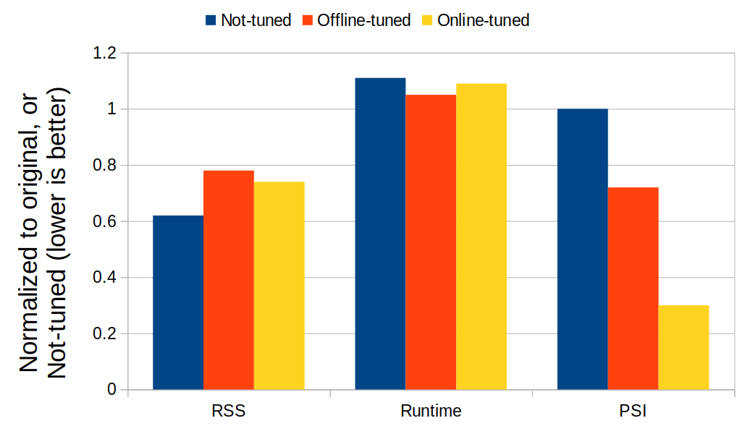
Progress and Test Results
First idea was shared on ksummit 2022; First RFC patchset has sent for ksummit 2023
  Presentation-driven development works
Proactive reclamation aiming last 10 secs 0.5% memory pressure stall has tested
  Memory saving and performance overhead similar to an “offline tuned” ones (DAMOOS)
  Aggressiveness auto-tuning achieves best PSI saving among all

Slide 40
QnA for DAMOS Aggressiveness Auto-tuning
Tuning difficulty
Aim-oriented feedback-driven aggressiveness auto-tuning
Test results

Slide 41
Access/Contiguity-aware
Memory Auto-scaling (ACMA)
https://lore.kernel.org/damon/20231112195114.61474-1-sj@kernel.org/

Slide 42
Collaborative Memory Over-subscribed VM systems
Guest voluntarily reports pages that the host can reuse
  Free pages reporting
The host detects guests’ access to reported pages (page fault) and allocate new one
┌─────────────────────────────┐ ┌─────────┐
│ Guest 1 │ │ Guest 2 │
│ ┌─────────────────────────┐ │ │ │
│ │ Free pages reporting │ │ │ │
│ └────────────┬────────────┘ │ │ │
│ │ │ │ │
└──────────────┼──────────────┘ └─────────┘
│ Report free pages ▲
▼ │ Alloc Guest 1
┌─────────────────────────────┐ │ freed memory
│ MEMO Host ├───────────┘
└─────────────────────────────┘

Slide 43
Guest Requirements
Being memory frugal without performance impact
  To allow higher over-subscription ratio
Report time free pages contiguity
  To minimize reporting overhead
Reported pages contiguity
  If the host uses large page size,
  to avoid returning whole host-page (large) for single guest-page (small) fault
Minimizing metadata for reported pages
  To maximize the over-subscription

Slide 44
Possible Solutions and Challenges
Being memory frugal: DAMON-based proactive reclamation
Report-time contiguity: Proactive compaction
  Compaction could fail due to isolation/migration failures
  More-than-required granularity compaction waste resource
Post-report contiguity: We found no good solution
Minimizing metadata for reported pages: Memory hot-remove
  Memory-block granularity isolation/migration is slow and fails frequently
Orchestrating multiple kernel features that not designed together from user space
  Complex and inefficient

Slide 45
ACMA: Access/Contiguity-aware Memory Autoscaling
A new kernel feature designed for the requirements
Aims
  Provide better solutions for each problem if possible
  Efficiently orchestrate the solutions
  Provide easy-to-use user interface (kernel that just works)

Slide 46
ACMA: New Metric and Operation
New metric: DAMON-working set
  Memory regions that DAMON has shown access to, within a user-specifiable time threshold
New operation: Stealing
  Migrate pages in given physical address range out and take the pages of the range
  Do nothing with the pages but report those pages to the host as free to use
  If an entire memory block is stolen, hot-remove the block, free metadata, report the freed pages
  Maybe similar to virtio-mem’s memory reduction operation

Slide 47
ACMA: Workflow
If DAMON-working set to free memory ratio is higher than a threshold (high, e.g., 200%)
  Steal report-gran-contiguous regions from last available memory block, colder regions first
If the ratio is becomes lower than a threshold (middle, e.g., 100%)
  Stop stealing
  Run DAMON-based proactive reclamation, until the ratio reaches the threshold (middle)
If the ratio is lower than yet another threshold (low, e.g., 50%)
  Start returning stolen pages, stolen pages closer to not-yet-stolen memory block first
  Hot-add previously hot-removed memory block if needed
  Continue until the ratio reaches the threshold (low)

Slide 48
ACMA: Expectations, or Hopes
System gets free memory of a size that relative to working set
  50-100% in above example
Compaction (migration) for only report-granularity contiguity
Less compaction/hot-remove failures, due to colder pages first approach
Easy to use: Set only three thresholds
More hopes, or crazy thoughts
  Useful for general memory auto-scaling (for DRAM’s power consumption saving?)
  Expand to be yet another contiguous memory allocator (Access-aware CMA?)

Slide 49
Progress
No implementation at all
Detailed RFC idea is sent to the mailing list

Slide 50
QnA for ACMA

Slide 51
DAMOS Auto-tuning Based Tiered Memory Management
https://lore.kernel.org/damon/20231112195602.61525-1-sj@kernel.org/

Slide 52
Various DAMOS-based Tiered Memory Management Approaches
DAMOS is not supporting tiered memory management at the moment
  The maintainer willing to, but has no good test setup so far
First DAMOS patch for tiered memory management was sent 2 years ago
  No new revision so far, though
A few various downstream approaches made
  Results also vary
Maybe better to have a public approach or idea to discuss

Slide 53
DAMOS-based Tiered Memory Management
For each CPU-independent NUMA node,
  If the node has a lower node,
    Demote cold pages of the current node to the lower node,
    aiming little fraction (e.g. 5%) of free memory of the current node
  If the node has a upper node,
    Promote hot pages of the current node to the upper node,
    aiming big fraction (e.g., 96%) of used memory of the _upper_ node
node 0 (fast) No lower node, do nothing

Slide 54
DAMOS-based Tiered Memory Management
For each CPU-independent NUMA node,
  If the node has a lower node,
    Demote cold pages of the current node to the lower node,
    aiming little fraction (e.g. 5%) of free memory of the current node
  If the node has a upper node,
    Promote hot pages of the current node to the upper node,
    aiming big fraction (e.g., 96%) of used memory of the _upper_ node
node 0 (fast) Demote cold pages in node 0 aiming 5% free memory of node 0
node 1 (slow) Promote hot pages in node 1 aiming 96% used memory of node 0

Slide 55
DAMOS-based Tiered Memory Management
For each CPU-independent NUMA node,
  If the node has a lower node,
    Demote cold pages of the current node to the lower node,
    aiming little fraction (e.g. 5%) of free memory of the current node
  If the node has a upper node,
    Promote hot pages of the current node to the upper node,
    aiming big fraction (e.g., 96%) of used memory of the _upper_ node
node 0 (fast) Demote cold pages in node 0 aiming 5% free memory of node 0
node 1 (slow) Promote hot pages in node 1 aiming 96% used memory of node 0
Demote cold pages in node 1 aiming 5% free memory of node 1
node 2 (sloow) Promote hot pages in node 2 aiming 96% used memory of node 1

Slide 56
Expectations, or Hopes
High utilization of upper nodes, with hotter pages
Low utilization of lower nodes, with colder pages
Auto-tuning-based speed control and overlapping memory util/free goals
  keep slow but continuous promotion/demotion
Easy to be applied for multiple tiers
Possible future extensions
  General NUMA balancing
    Extend DAMON to capture accesses maker CPU
  Combination with ACMA
    Automatically remove/add tiers depending on real (or, DAMON-) workingset

Slide 57
Progress
No implementation at all
Detailed RFC idea is sent to the mailing list

Slide 58
QnA for DAMOS-based Tiered Memory Management

Slide 59
Overview
DAMON in a Nutshell (10 mins)
Updates Since Kernel Summit 2022 (10 mins)
Future Plans (15 mins)
DAMON Community (5 mins)
Conclusion and Remaining QnA
Each time-specified topic will get its own QnA

Slide 60
DAMON Community

Slide 61
Community Members
DAMON is a community-driven project
Everyone interested in DAMON is a member
  Amazon Linux ported initial version of DAMON in their >=v5.4 kernels
  Android common kernel ported and enabled DAMON_RECLAIM
  Some companies published their research on DAMON
  Some academic papers are addressing DAMON

Slide 62
Collaborations
Collaborating with a number of AWS internal/external people (DAMON community)
In v6.1..v6.7-rc1, 27 Amazon-external people contributed 51/192 patches for DAMON
  For v5.15..v6.1, 39 people, 90/163 patches (DAMON is collapsing, or ... stabilized?)
There were significant contributions to the user space tool (DAMO), too
range AWS non-AWS AWS/non-AWS
v6.1..v6.2 28 6 17.65 %
v6.2..v6.3 32 16 33.33 %
v6.3..v6.4 0 5 100.00 %
v6.4..v6.5 19 8 29.63 %
v6.5..v6.6 20 7 25.93 %
v6.6..v6.7-rc1 42 9 17.65 %
v6.1..v6.7-rc1 141 51 26.56 %

Slide 63
Communication Channels
DAMON-dedicated open mailing list
Bi-weekly community meetup series
  Second in-person version will be held as an LPC BoF, at 4:30 pm, today
Presenting DAMON in conferences since 2019
  Striving to present for both kernel and user space developers
  LSFMM, LinuxCon NA/EU, and Kernel Summit in 2023
Having occasional/regular private meetings on demand

Slide 64
DAMON Community is Waiting For Your Voices
DMAON is evolving
  It might not perfectly fit for your use case
Don’t forgive it or wait for someone to implement it; make your voice
  Report your use case/test results and challenges
  Ask questions and request features
  Show your interest to known future works
  Send patches

Slide 65
Overview
DAMON in a Nutshell (10 mins)
Updates Since Kernel Summit 2022 (10 mins)
Future Plans (15 mins)
DAMON Community (5 mins)
Conclusion and Remaining QnA
Each time-specified topic will get its own QnA

Slide 66
Conclusion
DAMON answers “which memory is how frequently accessed for how long?”
DAMOS makes the kernel just works in an access-aware manner
Continuous development is being made
Please participate in making it better for the community

Slide 67
Questions?
You can also use
  The maintainer: sj@kernel.org
  Project webpage: https://damonitor.github.io
  Kernel docs for admin and programmers
  DAMON mailing list: damon@lists.linux.dev
  DAMON Beer/Coffee/Tea Chat

Slide 68
Backup Slides

Slide 69
DAMON Stack: The Whole Picture of The Stack
User-space
Tools
DAMO
datop
DAMON API User
Kernel Modules
General-purpose User ABI
Special-purpose Modules
DAMON_SYSFS
DAMON_RECLAIM
DAMON_LRU_SORT
DAMON_WSS
DAMON Application Programming Interface
DAMON
DAMOS
Adaptive Regions Adjustment
Action and Pattern
Core Logic
Region-based Sampling
Quotas, Prioritization, Auto-tune
Access Frequency Monitoring
Watermarks
Filters
DAMON Operations Set Registration Interface
Operations Set
paddr
vaddr
Read/write-only
NUMA-cpus-only
Primitives
that DAMON
depends on
PTE/VMA/rmap, ...
AMD IBS
LRU State

