Slide 1
Data Access Monitoring Operator (DAMO):
User-Space Tool/Python Library
for Access-Aware Profiling and Optimization
of Your Linux Systems
SeongJae Park <sj@kernel.org>
https://damonitor.github.io
Slides are also available at: https://github.com/damonitor/talks/tree/master/2023/ossummit_eu
LinuxCon @ Open Source Summit Europe
Bilbao, Spain, 2023-09-19

Slide 2
Notices
The views expressed herein are those of the speaker;
they do not reflect the views of his employers
The talk is based on DAMO v1.9.9 and Linux kernel v6.6-rc2
Some details can be changed in future versions of those
https://twitter.com/sjpark0x00/status/1295387149018300419/photo/1

Slide 3

I, SeongJae Park (sjpark@)
Call me SJ while speaking in English
Working on AWS
Maintaining Linux kernel DAMON subsystem and its user-space tool, DAMO

Slide 4

I, SeongJae Park (sjpark@)
Call me SJ while speaking in English
Working on AWS
Maintaining Linux kernel DAMON subsystem and its user-space tool, DAMO
A certified pilgrim (walked about a 500km preparing this talk)

Slide 5
Overview
Why Access-awareness Matters
DAMO: Data Access Monitoring Operator
DAMO Inputs for Data Access Monitoring
DAMO Inputs for Access Monitoring-based System Operations
DAMON Community: Call For Participate
Conclusion
QnA

Slide 6
Why Access-awareness Matters

Slide 7
Hierarchical Memory
Memory devices of different characteristics
  Devices: Registers, Cache, DRAM, Flash, Disk, Tape, etc
  Characteristics: Capacity, Latency, Bandwidth, Power efficiency, Price, etc
  Faster ones tend to be small, expensive, and power-consuming (emits heat and CO2!)
Hierarchical combination of the devices for efficiency
  L1$ on top, L2$ next, L3$, DRAM, SSD, HDD, Tape, so on
More peculiar memory devices for more complicated but efficient hierarchy are upcoming
  Z{ram,swap}-like S/W-defined memory between DRAM and SSD
  CXL-Memory-like devices between DRAM and SSD
  Fabric-based in-rack devices between somewhere
  Network-based devices somewhere

Slide 8
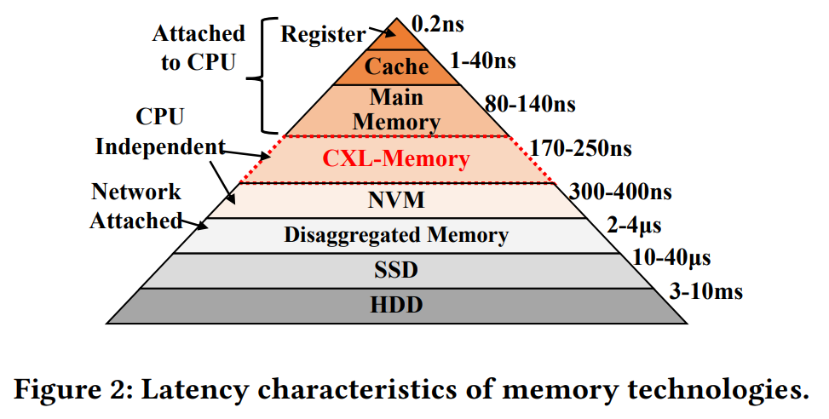
Hierarchical Memory
Memory devices of different characteristics
  Devices: Registers, Cache, DRAM, Flash, Disk, Tape, ...
  Characteristics: Capacity, Latency, Bandwidth, Power efficiency, Cost, ...
  Faster ones tend to be expensive and power-consuming (emits heat and CO2!)
Hierarchical combination of the devices for efficiency
  L1$ on top, L2$ next, L3$, DRAM, SSD, HDD, Tape, so on
More peculiar memory devices are arriving
  Z{ram,swap}-like S/W-defined memory between DRAM and SSD
  CXL-Memory-like devices between DRAM and SSD
  Fabric-based in-rack devices between somewhere
  Network-based devices somewhere
Retrieved from “TPP: Transparent Page Placement for CXL-Enabled Tiered-Memory”, https://dl.acm.org/doi/pdf/10.1145/3582016.3582063

Slide 9
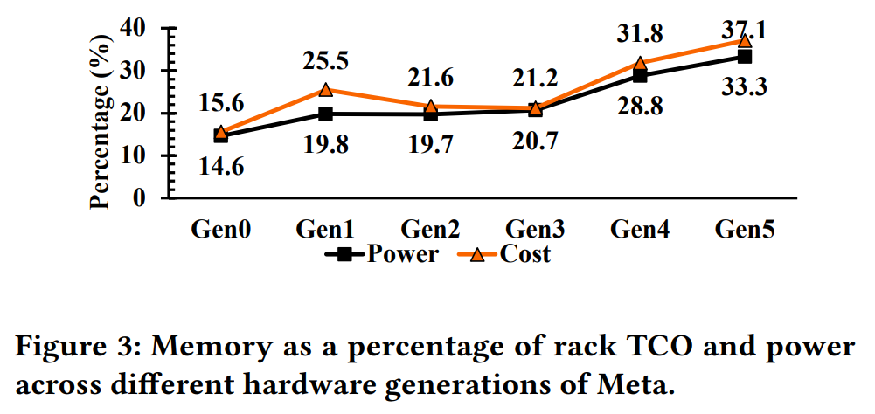
Trend of Cost and Importance of Memory
Modern workloads continuously becoming more data intensive
DRAM price has not dramatically dropped
Meta reports high cost of DRAM on their data centers
  33.3% of cost and 37.1% of power consumption for memory
Cost and importance of memory system is significant, and expected to further increase
Retrieved from “TPP: Transparent Page Placement for CXL-Enabled Tiered-Memory”, https://dl.acm.org/doi/pdf/10.1145/3582016.3582063

Slide 10
Access-aware Efficient System Operations Needed
Given the trends, hierarchical memory system operation is critical for efficiency
Efficient access-aware memory system operation idea: Simple
  Keep important data items close, keep critical data items closer to faster memory devices
Definition of the important data items
  Data item that will be accessed frequently in near future
  Efficient memory management == Access-aware memory management

Slide 11
Examples of Access-aware Memory Management Optimizations
Access-aware Transparent Huge Pages (THP) collapse/split
  THP reduces TLB misses (performance increase), but
  increases huge page-internal fragmentation (memory footprint bloat)
  Idea: Use hugepages for only hot data
  The research work was accepted to a top-tier conf (OSDI)
Proactive reclamation
  Memory pressure-reactive memory reclamation (Linux kernel’s default behavior) incurs unnecessarily big memory footprints and latency spikes
  Idea: Proactively find and reclaim cold pages
  The works from Google and Meta were accepted to a top-tier conf (ASPLOS) twice, and being used on their fleets

Slide 12
Access-aware Memory Management: Challenges and a Solution
Challenges
  Ways to know data item that will be frequently accessed in near future
    Monitoring based prediction is reasonable, but overhead can be significant
  Implementing each optimization from the scratch is difficult, danger, and repetitive
An available solution: DAMO
  A Python-written user-space tool

Slide 13
DAMO:
User-Space Tool/Python Library
for Access-Aware Profiling and Optimization
(a.k.a Data Access Monitor Operator)

Slide 14
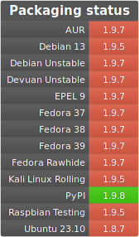
DAMO: Overview
User-space tool for Data Access MONitoring and the monitoring-based system operations
Support all kernels having a required kernel feature
  >=v5.15 upstream kernels
  Distro kernels that backported the feature
    Amazon Linux (AL) >=v5.4 kernels
    The latest version of the feature is backported in AL v5.10 kernel
    Android common v5.10 kernel
    There might be unknown distro kernels that backported the feature
Available at PyPI and a few Linux distros’ package systems
  Check the availability at repolog
  Packaging for Linux distros are done by voluntary contributors
    Huge appreciate to package maintainers (michel@ and kokakiwi@)!

Slide 15
DAMO’s Basic Usage: Sub-commands
DAMO provides sub-commands for four categorized purposes
  DAMON control: ‘start’, ‘tune’, and ‘stop’
  Snapshot of monitoring results and DAMON status: ‘show’ and ‘status’
  Record-based monitoring results profiling: ‘record’ and ‘report’
  For convenient use and debugging of DAMO itself: ‘version’, ‘fmt_json’, and more
For full list of sub-commands: ‘damo --help’
start start DAMON with given parameters
tune update input parameters of ongoing DAMON
stop stop running DAMON
show show monitored access pattern
status show DAMON status
record record data accesses
report report the recorded data accesses in the specified form
version print the version number
fmt_json convert damo-start cmdline option to DAMON json input

Slide 16
DAMO Live Demo: Recording and Visualization-based Offline Profiling
Helps easily understanding access pattern of specific system and workloads
  Even developers could fail at expecting their program’s access pattern
    Due to complexity, design (e.g., depends on random user request and multi-threaded), or bugs
Collection of realistic workloads’ access pattern is available
# git clone https://github.com/sjp38/masim -b osseu2023_demo
# cd masim && make
# damo record "./masim ./osseu2023_demo/complicated_access_pattern"
# damo report heats --heatmap stdout --stdout_heatmap_color flame --resol 12 50 \
--stdout_heatmap_skip_color_example

Slide 17
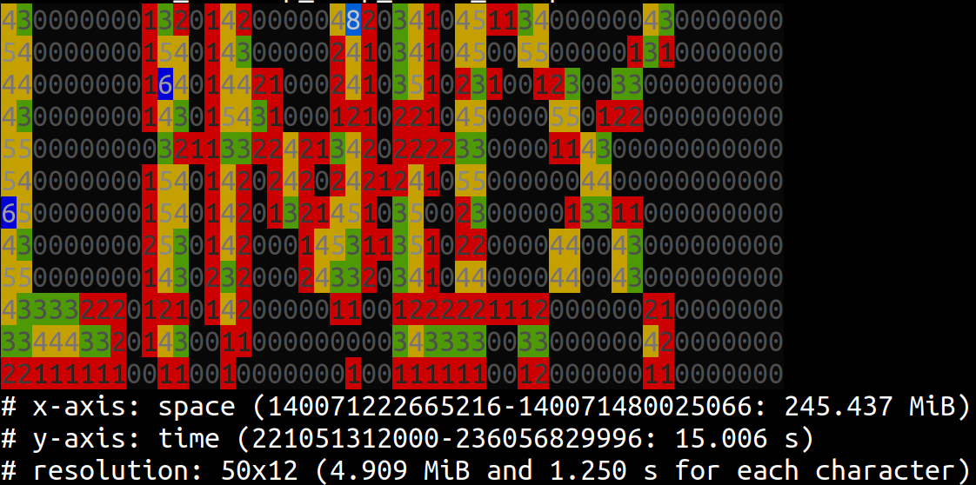
DAMO Live Demo: Recording and Visualization-based Offline Profiling
Helps easily understanding access pattern of specific system and workloads
  Even developers could fail at expecting their program’s access pattern
    Due to complexity, design (e.g., depends on random user request and multi-threaded), or bugs
Collection of realistic workloads’ access pattern is available
# git clone https://github.com/sjp38/masim -b osseu2023_demo
# cd masim && make
# damo record "./masim ./osseu2023_demo/complicated_access_pattern"
# damo report heats --heatmap stdout --stdout_heatmap_color flame --resol 12 50 \
--stdout_heatmap_skip_color_example

Slide 18
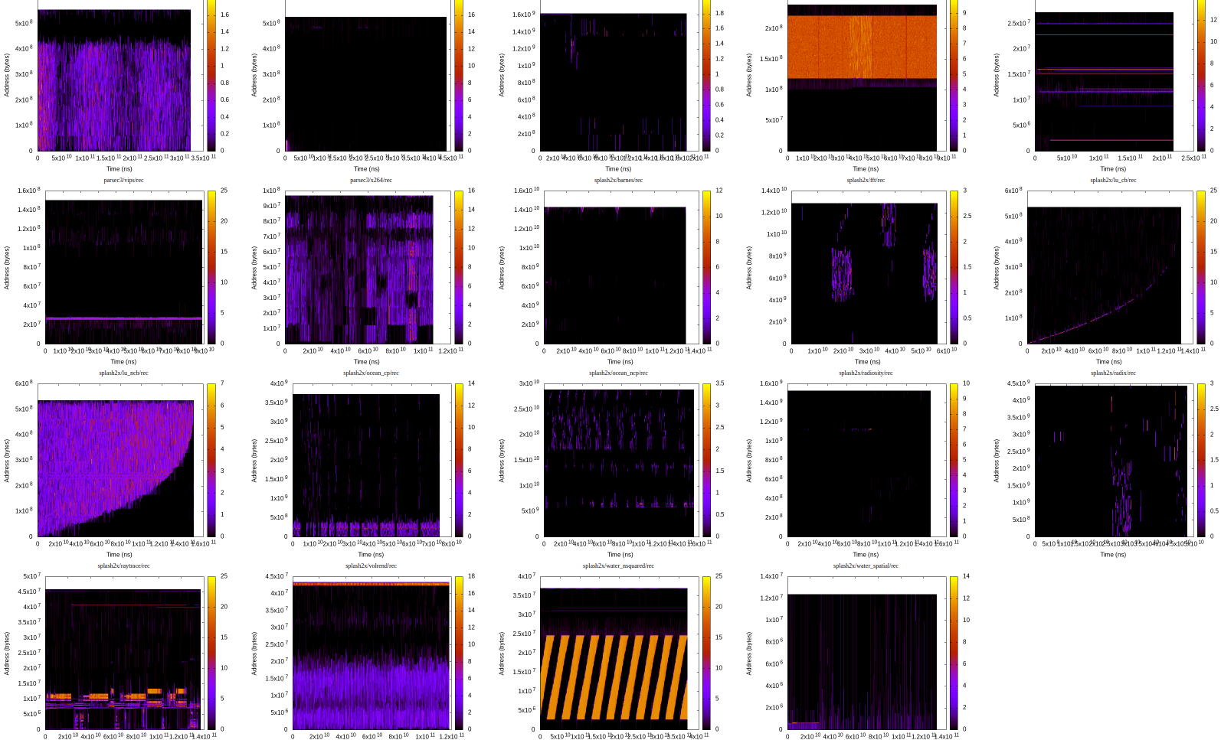
DAMO Live Demo: Recording and Visualization-based Offline Profiling
Helps easily understanding access pattern of specific system and workloads
  Even developers could fail at expecting their program’s access pattern
    Due to complexity, design (e.g., depends on random user request and multi-threaded), or bugs
Collection of realistic workloads’ access pattern is available
# git clone https://github.com/sjp38/masim -b osseu2023_demo
# cd masim && make
# damo record "./masim ./osseu2023_demo/complicated_access_pattern"
# damo report heats --heatmap stdout --stdout_heatmap_color flame --resol 12 50 \
--stdout_heatmap_skip_color_example

Slide 19
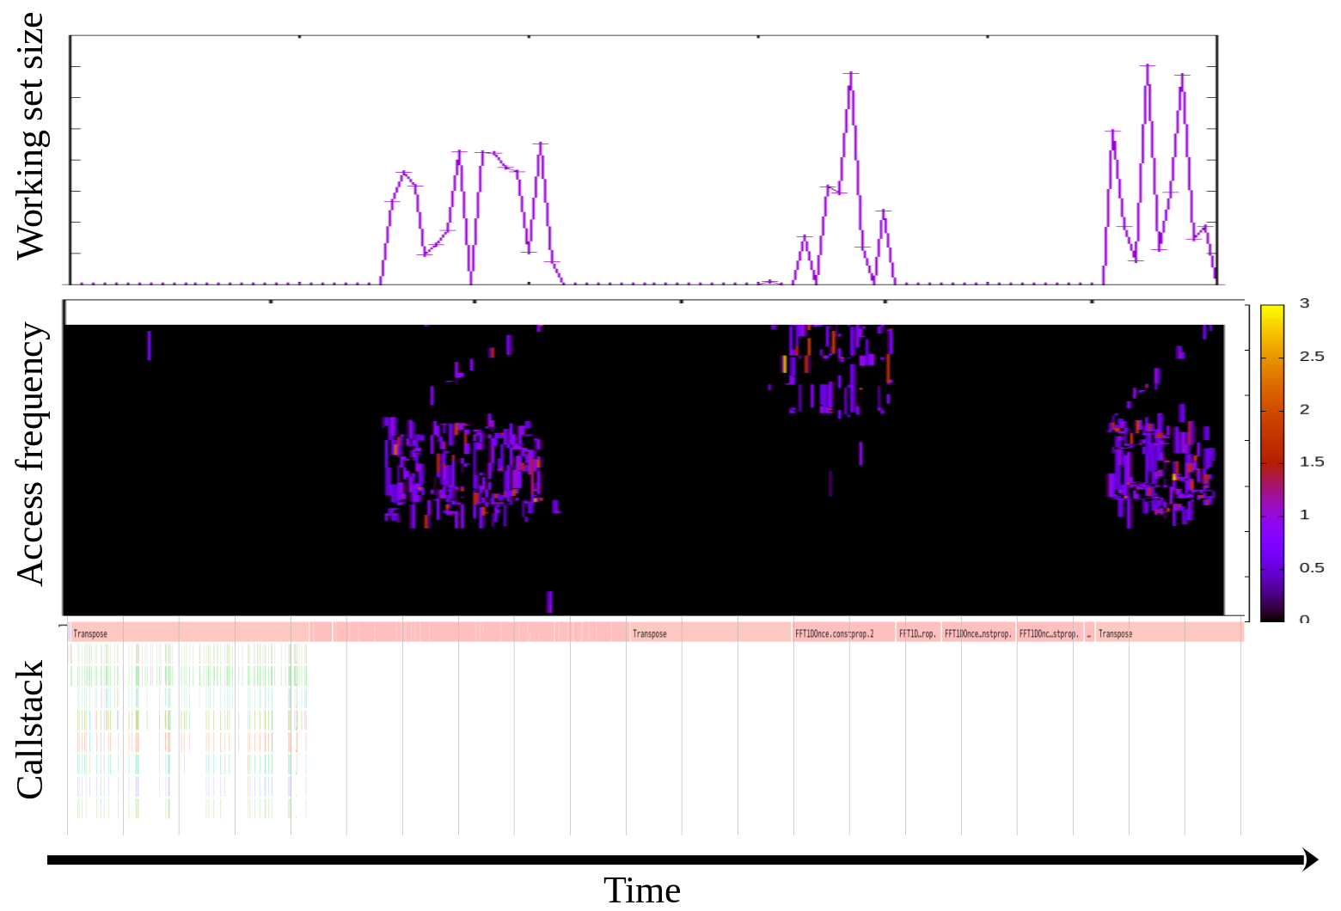
DAMO-based Offline Profiling Example
Record and show callstacks (using perf-like tool) and access patterns (using DAMO) together
https://sjp38.github.io/post/damon_profile_callstack_example/

Slide 20
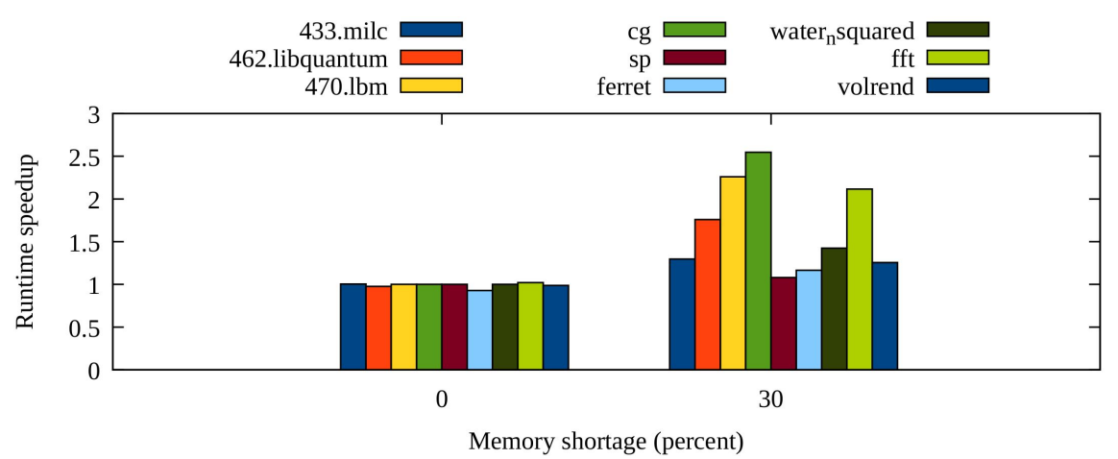
DAMO-based Offline-Profiling-guided Optimization Example
Find hot objects of each workload using DAMO-based offline-profiling and ‘mlock()’
Up to 2.55x speedup under memory pressure
  Shared on ksummit 2019 DAMON talk
  Published via the proceeding of Middleware 2019 Industrial track
Retrieved from ksummit 2019 DAMON talk

Slide 21
DAMO Live Demo: Snapshot of Access Pattern and DAMON Status
Useful for online profiling of access patterns
# damo start "./masim ./configs/stairs.cfg --repeat 5 --quiet"
# damo status
# damo show
# damo show --sort_regions_by age access_rate
# damo show --sort_regions_by age access_rate --region_box \
--region_box_colorset flame
# damo show --access_rate 5% max
# damo stop
# killall masim

Slide 22
DAMO Live Demo: Data Access-aware Optimization
# damo start "./masim ./configs/stairs.cfg --repeat 5 –quiet"
# top | grep -E "RES|masim"
# #
# # Proactively reclaim memory regions that not accessed for >= 3 seconds
#
# damo tune --target_pid $(pidof masim) \
--damos_action pageout --damos_access_rate 0% 0% --damos_age 3s max
# top | grep -E "RES|masim"
# damo stop
# killall masim

Slide 23
DAMON-based Access-aware System Optimization Examples
Proactive reclamation on large serverless production environment
  reduces up to 90% memory overhead with up to 2% CPU usage and negligible performance overhead
  Published to a proceeding of an academic conf (HPDC’22)
Data Access-aware THP collapse/split on realistic benchmark workloads
  reduces up to 76% of THP overhead while keep 51% performance gain
  Detailed results are available

Slide 24
DAMO: Implementation
Delegate low level works to Linux kernel’s Data Access MONitor subsystem (DAMON)
  Data access monitoring
  Data access monitoring-based system operations
  The required kernel feature is DAMON
Implement only DAMON communication, user interface, and visualization
Reference DAMON user-space tool implementation
  Maintained together with DAMON
  Support all DAMON-available Linux kernels
    DAMON was merged in mainline since v5.15
    DAMON was backported to AL kernel >=v5.4, and latest DAMON is ported on AL v5.10 kernel
    DAMON was backported to Android core kernel v5.10

Slide 25
DAMON Stack
User-space
Tools
DAMO
datop
DAMON API User
Kernel Modules
General-purpose User ABI
Special-purpose Modules
DAMON_SYSFS
DAMON_RECLAIM
DAMON_LRU_SORT
DAMON_WSS
DAMON Application Programming Interface
DAMON
DAMOS
Adaptive Regions Adjustment
Action and Pattern
Core Logic
Region-based Sampling
Quotas and Prioritization
Access Frequency Monitoring
Watermarks
Filters
DAMON Operations Set Registration Interface
Operations Set
paddr
vaddr
Read/write-only
NUMA-cpus-only
Primitives
that DAMON
depends on
PTE/VMA/rmap, ...
AMD IBS
LRU State

Slide 26
DAMO-DAMON Communication

Slide 27
DAMO User Interface for DAMON Control
‘start’ and ‘tune’ receive DAMON parameters from users and pass those to DAMON
  The commands share same command line options for DAMON parameters setup
Partial DAMON parameters setup command line options
  Can specify only subset of DAMON parameters
  Provide default parameter values for unspecified parameters
  For beginners; Convenient but restrictive (1 kdamond, 1 DAMON context, 1 monitoring target)
Full DAMON parameters setup command line options
  Receives full DAMON parameters via a json format input
  For experts; Complicated but flexible

Slide 28
DAMON ABI
DAMON core is a framework; Provides API to other kernel modules/subsystems
There is a kernel module named DAMON sysfs interface (mm/damon/sysfs.c)
  Implement a general-purpose DAMON ABI on sysfs (/sys/kernel/mm/damon/)
  Simple enough to be used with shell commands; manual usage is discouraged though
  DAMO passes DAMON parameters via this ABI
DAMON kernel modules implementing special-purpose simpler ABI also available
  DAMON_RECLAIM and DAMON_LRU_SORT
# cd /sys/kernel/mm/damon/admin/
# echo 1 > kdamonds/nr_kdamonds && echo 1 > kdamonds/0/contexts/nr_contexts
# echo vaddr > kdamonds/0/contexts/0/operations
# echo 1 > kdamonds/0/contexts/0/targets/nr_targets
# echo $(pidof <workload>) > kdamonds/0/contexts/0/targets/0/pid_target
# echo on > kdamonds/0/state
Example usage of DAMON sysfs interface

Slide 29
Bring Your Own DAMON User-space Tool
DAMO is just a reference DAMON user-space tool implementation
  Strives to be useful in many general cases and provide full features of DAMON
  Not necessarily the one that fits all needs
  Neither optimal; Written as a naive Python program
Anyone can write their own DAMON user-space tools if needed
  using DAMON ABI: like Alibaba developed DATOP (available at Github)
    Makes sense for faster implementation (e.g., C, Go, or Rust-based tools)
  using DAMO’s core modules (wraps DAMON ABI) as a library
    DAMO’s many features are implemented in this way
    (Refer to damo_start.py, damo_stop.py and damo_record.py for example usage)
    Makes sense for more specialized features
    The interface is unstable; merging your tool into DAMO can be an option (like upstreamed drivers)

Slide 30
DAMON Stack
User-space
Tools
DAMO
datop
DAMON API User
Kernel Modules
General-purpose User ABI
Special-purpose Modules
DAMON_SYSFS
DAMON_RECLAIM
DAMON_LRU_SORT
DAMON_WSS
DAMON Application Programming Interface
DAMON
DAMOS
Adaptive Regions Adjustment
Action and Pattern
Core Logic
Region-based Sampling
Quotas and Prioritization
Access Frequency Monitoring
Watermarks
Filters
DAMON Operations Set Registration Interface
Operations Set
paddr
vaddr
Read/write-only
NUMA-cpus-only
Primitives
that DAMON
depends on
PTE/VMA/rmap, ...
AMD IBS
LRU State

Slide 31
DAMON Parameters for
Access Monitoring (DAMON)

Slide 32
Getting Full Parameter (json) Input
Writing json input from the scratch is boring; helper commands are available
‘damo fmt_json’
  Convert partial DAMON parameters setup input to the full parameters input
‘damo status --json’
  Convert parameters of running DAMON to the full parameters input
Note: Above commands expose not only parameters but also status of DAMON
  fields for the status can be omitted for DAMON full parameters setup input

Slide 33
Kdamonds and DAMON Contexts
Kdamond (item of [“kdamonds”] of the json input)
  DAMON worker thread
DAMON Context (item of [“contexts”] of each kdamond in the json input)
  Data structure for the monitoring requests and running status
Each kdamond should have at least one DAMON context
  Only single context per kdamond is supported for now
Can scale-out with multiple kdamonds
  For more CPU resource or running different monitoring requests
{"kdamonds":
[
{"contexts": [{[…]}]}
]
}

Slide 34
Operations Set
[“ops”] of DAMON context in json input
Data monitoring primitive level operation implementations
Users can select for given use case
  ‘paddr’: for monitoring the physical address space using page table accessed bits
  ‘vaddr’: for monitoring virtual address spaces using page table accessed bits
Selections and extensions are available via “operations set registration interface”
More operations set can be added in future
    e.g., for moitoring the physical address space using AMD IBS
"contexts": [ {"ops": "paddr",

Slide 35
DAMON Stack
User-space
Tools
DAMO
datop
DAMON API User
Kernel Modules
General-purpose User ABI
Special-purpose Modules
DAMON_SYSFS
DAMON_RECLAIM
DAMON_LRU_SORT
DAMON_WSS
DAMON Application Programming Interface
DAMON
DAMOS
Adaptive Regions Adjustment
Action and Pattern
Core Logic
Region-based Sampling
Quotas and Prioritization
Access Frequency Monitoring
Watermarks
Filters
DAMON Operations Set Registration Interface
Operations Set
paddr
vaddr
Read/write-only
NUMA-cpus-only
Primitives
that DAMON
depends on
PTE/VMA/rmap, ...
AMD IBS
LRU State

Slide 36
Monitoring Targets
items of [“targets”] of DAMON context in json input
The target address spaces and address ranges of those to monitor the accesses to it
  ‘pid’ is only for ‘vaddr’ ops (virtual address space of the pid is the monitoring target)
  ‘regions’ specifies address ranges of each address space to monitor
    In case of ‘vaddr’ ops, it periodically resets the target address ranges to cover all mapped regions
"contexts": [
{
"targets": [
{
"pid": null,
"regions": [
{"start": "4,294,967,296", "end": "136,299,151,359"}
]
}
],

Slide 37
Monitoring Intervals (1/3)
[“intervals”] of DAMON context in json input
Every sampling interval (“sample_us”), DAMON does
  Check if there was any access to sub-regions of monitoring targets in last sampling interval
    If so, increase a counter (‘nr_accesses’) of the sub-region
Every aggregation interval (“aggr_us”), DAMON does
  Check if ‘nr_accesses’ significantly changed from that of last aggregation interval
    If not, increase a counter (‘age’) of the region, reset the counter otherwise
  Resets ‘nr_accesses’
    ‘nr_accesses’ / (aggregation interval / sampling interval) is called “access rate” of the region
  Users can read access rate of each region just before the counter reset
This is called “Access Frequency Monitoring”
"contexts": [{"intervals": {"sample_us": "5 ms", "aggr_us": "100 ms", "ops_update_us": "1 s"},

Slide 38
Monitoring Intervals (1/3)
[“intervals”] of DAMON context in json input
Every sampling interval (“sample_us”), DAMON does
  Check if there was any access to sub-regions of monitoring targets in last sampling interval
    If so, increase a counter (‘nr_accesses’) of the sub-region
Every aggregation interval (“aggr_us”), DAMON does
  Check if ‘nr_accesses’ significantly changed from that of last aggregation interval
    If not, increase a counter (‘age’) of the region, reset the counter otherwise
  Resets ‘nr_accesses’
    ‘nr_accesses’ / (aggregation interval / sampling interval) is called “access rate” of the region
  Users can read access rate of each region just before the counter reset
This is called “Access Frequency Monitoring”
Color represents relative access rate
Address
Time
"contexts": [{"intervals": {"sample_us": "5 ms", "aggr_us": "100 ms", "ops_update_us": "1 s"},

Slide 39
Monitoring Intervals (2/3)
Sub-region are defined as address range of pages having similar access rate
  DAMON checks access to only one randomly-picked sample page in each region
  Monitoring overhead gets depend on access pattern (number of regions), not size of memory
  This is called “Regions-based Access Sampling”
Monitoring accuracy depends on if regions are well identified as defined
  Randomly split regions to make those aligned with the definition
    Unnecessary split increases monitoring overhead
  Merge adjacent regions of similar nr_accesses for every aggregation interval
    Revert unnecessary splits
This is called “Adaptive Regions Adjustment”
"contexts": [{"intervals": {"sample_us": "5 ms", "aggr_us": "100 ms", "ops_update_us": "1 s"},

Slide 40
Monitoring Intervals (3/3)
DAMON signals “operations set” every Ops update interval (ops_update_us) for any needed updates of themselves
  ‘vaddr’ ops updates target monitoring address ranges to cover updated mapped regions
  ‘paddr’ do nothing for the signal
"contexts": [{"intervals": {"sample_us": "5 ms", "aggr_us": "100 ms", "ops_update_us": "1 s"},

Slide 41
DAMON Stack
User-space
Tools
DAMO
datop
DAMON API User
Kernel Modules
General-purpose User ABI
Special-purpose Modules
DAMON_SYSFS
DAMON_RECLAIM
DAMON_LRU_SORT
DAMON_WSS
DAMON Application Programming Interface
DAMON
DAMOS
Adaptive Regions Adjustment
Action and Pattern
Core Logic
Region-based Sampling
Quotas and Prioritization
Access Frequency Monitoring
Watermarks
Filters
DAMON Operations Set Registration Interface
Operations Set
paddr
vaddr
Read/write-only
NUMA-cpus-only
Primitives
that DAMON
depends on
PTE/VMA/rmap, ...
AMD IBS
LRU State

Slide 42
Min/Max Number of Regions
‘min’, and ‘max’ field of [‘nr_regions’] of DAMON context in json input
Merge and Split are avoided if it can make the number of regions out of the bound
  Work as accuracy lower-limit (‘min’) and overhead upper-limit (‘max’) of monitoring
This is a part of “Adaptive Regions Adjustment”
Effective limits, but not intuitive knobs; Future improvements are needed

Slide 43
DAMON Stack
User-space
Tools
DAMO
datop
DAMON API User
Kernel Modules
General-purpose User ABI
Special-purpose Modules
DAMON_SYSFS
DAMON_RECLAIM
DAMON_LRU_SORT
DAMON_WSS
DAMON Application Programming Interface
DAMON
DAMOS
Adaptive Regions Adjustment
Action and Pattern
Core Logic
Region-based Sampling
Quotas and Prioritization
Access Frequency Monitoring
Watermarks
Filters
DAMON Operations Set Registration Interface
Operations Set
paddr
vaddr
Read/write-only
NUMA-cpus-only
Primitives
that DAMON
depends on
PTE/VMA/rmap, ...
AMD IBS
LRU State

Slide 44
DAMON Parameters for
Access Monitoring-based Memory Management
(a.k.a DAMOS: DAMon-based Operation Schemes)

Slide 45
DAMOS Schemes
Yet another DAMON core feature for no-code access-aware memory management
  Find memory regions of specific access pattern and apply a user-requested action
Items of [“schemes”] of DAMON context in json input
  No scheme by default
  Can be added with ‘--damos_*’ partial DAMON parameter setup command line options
    e.g., ‘damo fmt_json --damos_action stat’
"contexts": [
{
"schemes": [

Slide 46
DAMOS Action
[“action”] of DAMOS scheme in json input
The system operation that users want to apply to pages in regions of specific access pattern
Supports actions including
  ‘pageout’: Page out the pages
  ‘hugepage’: Hint THP collapse/split deamon to collapse the pages to huge pages
  ‘nohugepage’: Hint THP collapse/split deamon to split the pages to regular pages
  ‘lru_prio’: Make the pages last eviction candidate under future memory pressure
  ‘lru_deprio’: Make the pages first eviction candidate under future memory pressure
  ‘stat’: Do nothing but count statistics
"contexts": [{"schemes": [{"action": "stat",

Slide 47
DAMOS Access Pattern
[“access pattern”] of each scheme in json input
The access pattern of the interest
Constructed with three ranges
  “sz_bytes”: size of the region
  “nr_accesses”: access rate
  “age”: time that the sz_bytes and nr_accesses have maintained
"schemes": [
{
"access_pattern": {
"sz_bytes": {"min": "0 B", "max": "max"},
"nr_accesses": {"min": "0 %", "max": "100 %"},
"age": {"min": "0 ns", "max": "max"}
},

Slide 48
DAMON Stack
User-space
Tools
DAMO
datop
DAMON API User
Kernel Modules
General-purpose User ABI
Special-purpose Modules
DAMON_SYSFS
DAMON_RECLAIM
DAMON_LRU_SORT
DAMON_WSS
DAMON Application Programming Interface
DAMON
DAMOS
Adaptive Regions Adjustment
Action and Pattern
Core Logic
Region-based Sampling
Quotas and Prioritization
Access Frequency Monitoring
Watermarks
Filters
DAMON Operations Set Registration Interface
Operations Set
paddr
vaddr
Read/write-only
NUMA-cpus-only
Primitives
that DAMON
depends on
PTE/VMA/rmap, ...
AMD IBS
LRU State

Slide 49
DAMOS Schemes: Quotas
[“quotas”] of each scheme in json input
Limit maximum CPU usage or amount of memory region for applying DAMOS action
  e.g., 10 ms per 1 s and 1 GiB per 1s for applying the scheme action
Under the quota, regions are prioritized based on access pattern
  The action is applied to more prioritized regions first
  Prioritization mechanism depends on the action: Colder pages are prioritized for pageout action
  Access pattern elements can get different priority weights
"quotas": {
"time_ms": "10 ms", "sz_bytes": "1 GiB", "reset_interval_ms": "1 s",
"weights": {
"sz_permil": "0 %", "nr_accesses_permil": "0 %", "age_permil": "0 %"
}
},

Slide 50
DAMOS Schemes: Quotas
[“quotas”] of each scheme in json input
Limit maximum CPU usage or amount of memory region for applying DAMOS action
  e.g., 10 ms per 1 s and 1 GiB per 1s for applying the scheme action
Under the quota, regions are prioritized based on access pattern
  The action is applied to more prioritized regions first
  Prioritization mechanism depends on the action: Colder pages are prioritized for pageout action
  Access pattern elements can get different priority weights
"quotas": {
"time_ms": "10 ms", "sz_bytes": "1 GiB", "reset_interval_ms": "1 s",
"weights": {
"sz_permil": "0 %", "nr_accesses_permil": "0 %", "age_permil": "0 %"
}
},

Slide 51
DAMOS Schemes: Watermarks
[“watermarks”] of each scheme in json input
[de]activate DAMOS schemes with specific system metric thresholds
  e.g., Activate proactive reclamation if free memory rate becomes lower than 30%,
  Deactivate it if free memory rate becomes higher than 50%
  Global free memory rate is supported as the system metric as of this talk
"watermarks": {
"metric": "free_mem_rate",
"interval_us": "5 s",
"high_permil": "50 %",
"mid_permil": "30 %",
"low_permil": "0 %"
},

Slide 52
DAMOS Schemes: Filters
[“filters”] of each scheme in json input
Let DAMOS actions applied to only pages of specific conditions
  Backing content (anonymous or file-backed), belonging memory cgroup, address ranges, and monitoring target are supported
  e.g., Proactively reclaim only file-backed pages in specific NUMA node of specific cgroups
"filters": [
{
"filter_type": "anon",
"matching": true,
"memcg_path": null,
"address_range": null,
"damon_target_idx": null
}
]

Slide 53
DAMON Stack
User-space
Tools
DAMO
datop
DAMON API User
Kernel Modules
General-purpose User ABI
Special-purpose Modules
DAMON_SYSFS
DAMON_RECLAIM
DAMON_LRU_SORT
DAMON_WSS
DAMON Application Programming Interface
DAMON
DAMOS
Adaptive Regions Adjustment
Action and Pattern
Core Logic
Region-based Sampling
Quotas and Prioritization
Access Frequency Monitoring
Watermarks
Filters
DAMON Operations Set Registration Interface
Operations Set
paddr
vaddr
Read/write-only
NUMA-cpus-only
Primitives
that DAMON
depends on
PTE/VMA/rmap, ...
AMD IBS
LRU State

Slide 54
DAMON Community

Slide 55
Community Members
Anyone interested in DAMON is a member
Some people from companies including Alibaba, AMD, AWS, DigitalOcean, Google, Hocus, Huaweii, IBM, Meta, Oppo, Oracle, etc seems using or experimenting it
  Amazon Linux ported initial version of DAMON in their >=v5.4 kernels
  Latest DAMON is continuously ported in Amazon Linux v5.10 kernel
  Android common kernel ported and enabled DAMON_RECLAIM
  Hocus published their research on DAMON-based proactive reclamation
Some academic/industry folks are researching DAMON-based tiered memory management

Slide 56
Collaborations
Collaborating with a number of AWS internal/external people (DAMON community)
In 2022, 39 Amazon-external people contributed 83 patches for DAMON
Communicating in several ways
  DAMON-dedicated development mailing list
  Virtual bi-weekly community meetup series
  Presenting DAMON in conferences since 2019
    Striving to do those for both kernel and user space application developers
  Having occasional/regular private meetings on demand

Slide 57
DAMON Community is Waiting For Your Voices
DMAON, DAMOS, and DAMO are still rapidly evolving
  It might not perfectly fit for your use case
Don’t forgive it or wait for someone to implement it; make your voice
  Report your use case and challenges
  Ask questions and request features
  Show your interest to known future works
  Test and share the results
  Send patches

Slide 58
Conclusion
More data access-aware system operations are needed
DAMO can be a solution
  DAMO stands on Linux kernel subsystem called DAMON
Some people are getting fun with those
  You can help delivering more fun to the world with those

Slide 59
Questions?
You can also use
  The maintainer: sj@kernel.org
  Project webpage: https://damonitor.github.io
  Kernel docs for admin and programmers
  DAMON mailing list: damon@lists.linux.dev
  DAMON Beer/Coffee/Tea Chat

Slide 60
Backup Slides

Slide 61
Conceptual Psudo-code of DAMON
while monitoring_on:
for page in monitoring_target:
if accessed(page):
nr_accesses[page] += 1
if time() % aggregation_interval == 0:
for callback in user_registered_callbacks:
callback(monitoring_target, nr_accesses)
for page in monitoring_target:
nr_accesses[page] = 0
sleep(sampling interval)

Slide 62
DAMON: Resulting Architecture
Core logic and monitoring operations layer are separated
  Multiple address spaces and usages can easily supported
Client
Monitoring Request
Data Access Monitor
Adaptive Regions Adjustment
Aging
Region-based Access Check
Monitoring Primitives
For virtual addr
For physical addr
Kernel Data Structures and Features
vma
PTE
PG_idle
rmap

Slide 63
Region-based Sampling
Defines data objects in access pattern oriented way
  “A data object is a contiguous memory region that all page frames in the region have similar access frequencies”
  By the definition, if a page in a region is accessed, other pages of the region has probably accessed, and vice versa
  Thus, checks for the other pages can be skipped
By limiting the number of regions, we can control the monitoring overhead regardless of the target size
However, the accuracy will degrade if the regions are not properly set
(Will result in poor accuracy)
(Will result in reasonable accuracy)
Hot region
Target region
Cold region

Slide 64
Adaptive Regions Adjustment
Merge
Starts with minimum number of regions covering entire target memory areas
For each aggregation interval,
  merges adjacent regions having similar access frequencies to one region
  Splits each region into two (or three, depend on state) randomly sized smaller regions
  Avoid merge/split if the number of regions might be out of the user-defined range
If a split was meaningless, next merge process will revert it (vice versa)
In this way, we can let users control the upper bound overhead while preserving minimum and best-effort accuracy
Split
AF: 0.5 0 0 0
Merge
Split
AF: 0 0.9 0 0
Merge
AF: (Observed) Access Frequency
Hot region (AF 1.0)
Cold region (AF 0)
Target region

