Slide 1
DAMON, DAMOS, and DAMO:
Kernel Subsystems and User-Space Tools for Data Access-Aware
System Analysis/Optimizations
SeongJae Park <sj@kernel.org>
https://damonitor.github.io
LinuxCon @ Open Source Summit North America
Vancouver, Canada, 2023-05-12

Slide 2

I, SeongJae Park (sjpark@)
Call me SJ, or whatever better for you to pronounce
Working on AWS
Maintainer of DAMON

Slide 3
Overview
Why Access-awareness Matters
DAMON: Data Access MONitor
DAMOS: DAMON-based Operation Schemes
DAMO: DAMon Operator
Putting It Altogether: Access-aware Linux (AL) System
Collaborations and Use Cases
Conclusion
QnA

Slide 4
Why Access-awareness Matters

Slide 5
Modern Systems Are Using Hierarchical Memory
There are memory devices having different characteristics
  Devices: Registers, Cache, DRAM, Flash, Disk, Tape, ...
  Characteristics: Capacity, Latency, Bandwidth, Power efficiency, Cost, ...
  Faster ones tend to be expensive and power-consuming
Modern systems use those in a hierarchical manner for efficiency
  L1$ on top, L2$ next, L3$, DRAM, SSD, HDD, Tape, so on
The hierarchy will only becomes more complicated with new devices
  Zram-like software-defined memory between DRAM and SSD
  CXL-Memory-like devices between DRAM and SSD
  Fabric-based in-rack devices between somewhere
  Network-based devices somewhere

Slide 6
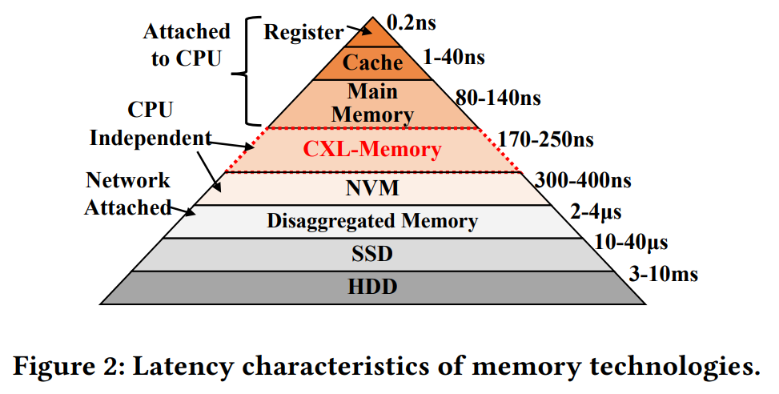
Modern Systems Are Using Hierarchical Memory
The hierarchy will only becomes more complicated
https://dl.acm.org/doi/pdf/10.1145/3582016.3582063

Slide 7
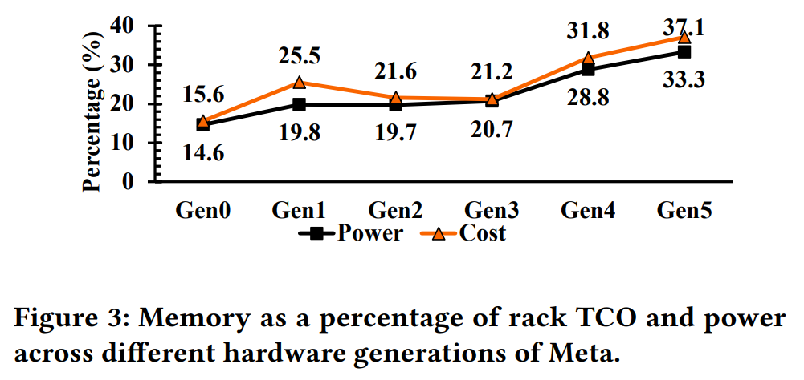
Cost and Importance of Memory is Increasing
Modern workloads are becoming more and more data intensive
  Machine learning, cloud, bigdata, …
DRAM Price is not dramatically dropped
Meta reports high cost of DRAM on their data centers
  33.3% of cost and 37.1% of power consumption
https://dl.acm.org/doi/pdf/10.1145/3582016.3582063

Slide 8
Access-awareness is Critical for Efficiency
Given the trend, efficient memory management is critical for the cost
  “The year of efficiency” might not end by 2023
Efficient memory management would be simple
  Keep important data close, keep critical data closer to fastest memory device
What data is important?
  Data that will (or assumed to) be accessed frequently in near future
How to know those?
  Fortune-teller or ChatGPT could be irresponsible, better to make data-driven decisions
  Monitor current data access pattern and predict future

Slide 9
Examples of Access-aware Efficiency Optimizations
Access-aware Trasnaprent Huge Pages (THP) collapse/split
  Using huge pages increase performance by reducing TLB misses
  But also increase memory footprint due to huge page internal fragmentation
  Using THP for only hot data reduces the memory footprint while preserving the performance
  The work was accepted to a top-tier conf (OSDI)
Proactive reclamation
  Reactive memory reclamation under memory pressure (Linux kernel’s default behavior) incurs latency spikes and keep unnecessarily big memory footprints
  Proactively finding and reclaiming cold pages reduce such spikes and reduce memory footprint
  The works from Google and Meta were accepted to another top-tier conf (ASPLOS) twice, and being used on their fleets
Ideas sound simple, but some DAMON demon is in the detail

Slide 10
DAMON: Data Access MONitor

Slide 11
Monitoring Data Accesses Is Not an Easy Problem
With prior-DAMON normal access monitoring techniques,
  Overhead is high, and arbitrarily grows as the size of memory to monitor increases
  High overhead can also affect monitoring results accuracy
    Maybe uncertainty principle can be applied here
Linux kernel made some tradeoffs for low overhead
  Called LRU, but not real LRU (even real LRU might not be the ideal)
  No fine-grained access tracking but hotness classification
    traditionally only accessed at least once or not, active or inactive
    MGLRU improved this with generation concept
  Access scan happens reactive to memory pressure-like events
    Without periodic and frequent such events, the accuracy could be bad
  Worked well so far, but could be more challenging, given the trend

Slide 12
DAMON: What It Provides?
Conceptually, DAMON does periodic access check of all memory area
Inform users when (x-axis) which memory (y-axis) area has how frequently accessed (color)
Address
Time

Slide 13
DAMON: What Is Special?
Equips a simple but effective best-effort overhead-accuracy tradeoff logic
  Called “regions-based sampling” and “adaptive regions adjustment”
  Let users set the min accuracy and max overhead
  make best-effort for lowest overhead and max accuracy under the constraints
  For detail, please read the doc or the paper
  Important parts of DAMON, but not itself; Could be replaced or unused if needed, in a future
Not a magic, just a trade-off
  May provide a poor result if wrongly tuned
  How well the best-effort works? Only data can say

Slide 14
Evaluation of DAMON’s Overhead and Accuracy
DAMON is lightweight
  A prior-DAMON page-granularity approach (kstaled) consumes 100% single CPU time to scan accesses to 512GB memory every 2 minutes
  (scans 512GB / (2mins * 100% CPU time) = 4.26 GB/s)
    There were great improvements following the first approach, though
  On a production setup, DAMON _conceptually_ scans accesses to 68.60 GB memory
  every 5 msecs with <1% single CPU time (scans 68.6GB / (5ms * 1% CPU time) = 1,372 TB/s)
    Note: DAMON upper-bound overhead can be set regardless of the memory size
DAMON is accurate
  Shows sane monitoring results with realistic benchmarks

Slide 15
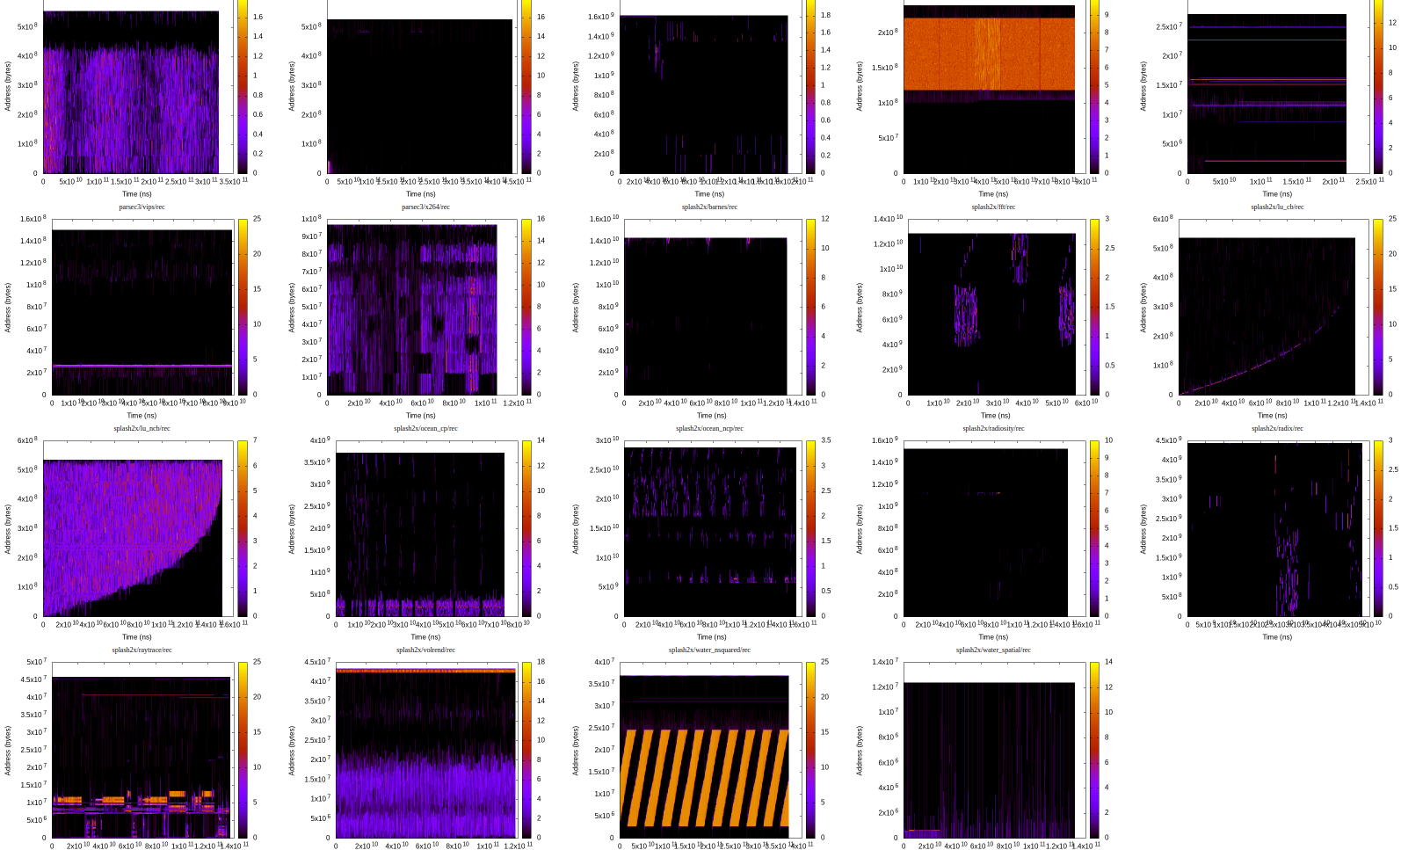
Evaluation of DAMON’s Overhead and Accuracy
DAMON is lightweight
  A prior-DAMON page-granularity approach (kstaled) consumes 100% single CPU time to scan accesses to 512GB memory every 2 minutes
  (scans 512GB / (2mins * 100% CPU time) = 4.26 GB/s)
    There were great improvements following the first approach, though
  On a production setup, DAMON _conceptually_ scans accesses to 68.60 GB memory
  every 5 msecs with <1% single CPU time (scans 68.6GB / (5ms * 1% CPU time) = 1,372 TB/s)
    Note: DAMON upper-bound overhead can be set regardless of the memory size
DAMON is accurate
  Shows sane monitoring results with realistic benchmarks

Slide 16
Evaluation of DAMON’s Overhead and Accuracy
DAMON is lightweight
  A prior-DAMON page-granularity approach (kstaled) consumes 100% single CPU time to scan accesses to 512GB memory every 2 minutes
  (scans 512GB / (2mins * 100% CPU time) = 4.26 GB/s)
    There were great improvements following the first approach, though
  On a production setup, DAMON _conceptually_ scans accesses to 68.60 GB memory
  every 5 msecs with <1% single CPU time (scans 68.6GB / (5ms * 1% CPU time) = 1,372 TB/s)
    Note: DAMON upper-bound overhead can be set regardless of the memory size
DAMON is accurate
  Shows sane monitoring results with realistic benchmarks and a production setup
    found 7GB working set and 4KB hottest region from the production setup
  Identifying hot memory regions from DAMON results with human eyes and modifying the program to do `mlock()` the regions achieves up to 2.55x speedup under memory pressure[1,2]

Slide 17
DAMON Demonstration
https://sjp38.github.io/post/damon/#demo-video
# while :; do ps -o rss=,cmd= --pid $(pidof masim); sleep 1; done # screen 1
# while :; do ps -o rss=,cmd= --pid $(pidof kdamond.0); sleep 1; done # screen 2
# damo monitor “./masim configs/stairs.cfg”
# ./masim –repeat 1024 configs/stairs.cfg
# damo record $(pidof masim)
# damo report raw
# damo report heats –heatmap
# damo report wss

Slide 18
DAMON Allows Access-aware System Operations
A number of access-aware analysis and optimizations of systems are possible
  Providing monitored working set size based system config guideline
  Debugging/optimizing wrongly implemented data access logics

Slide 19
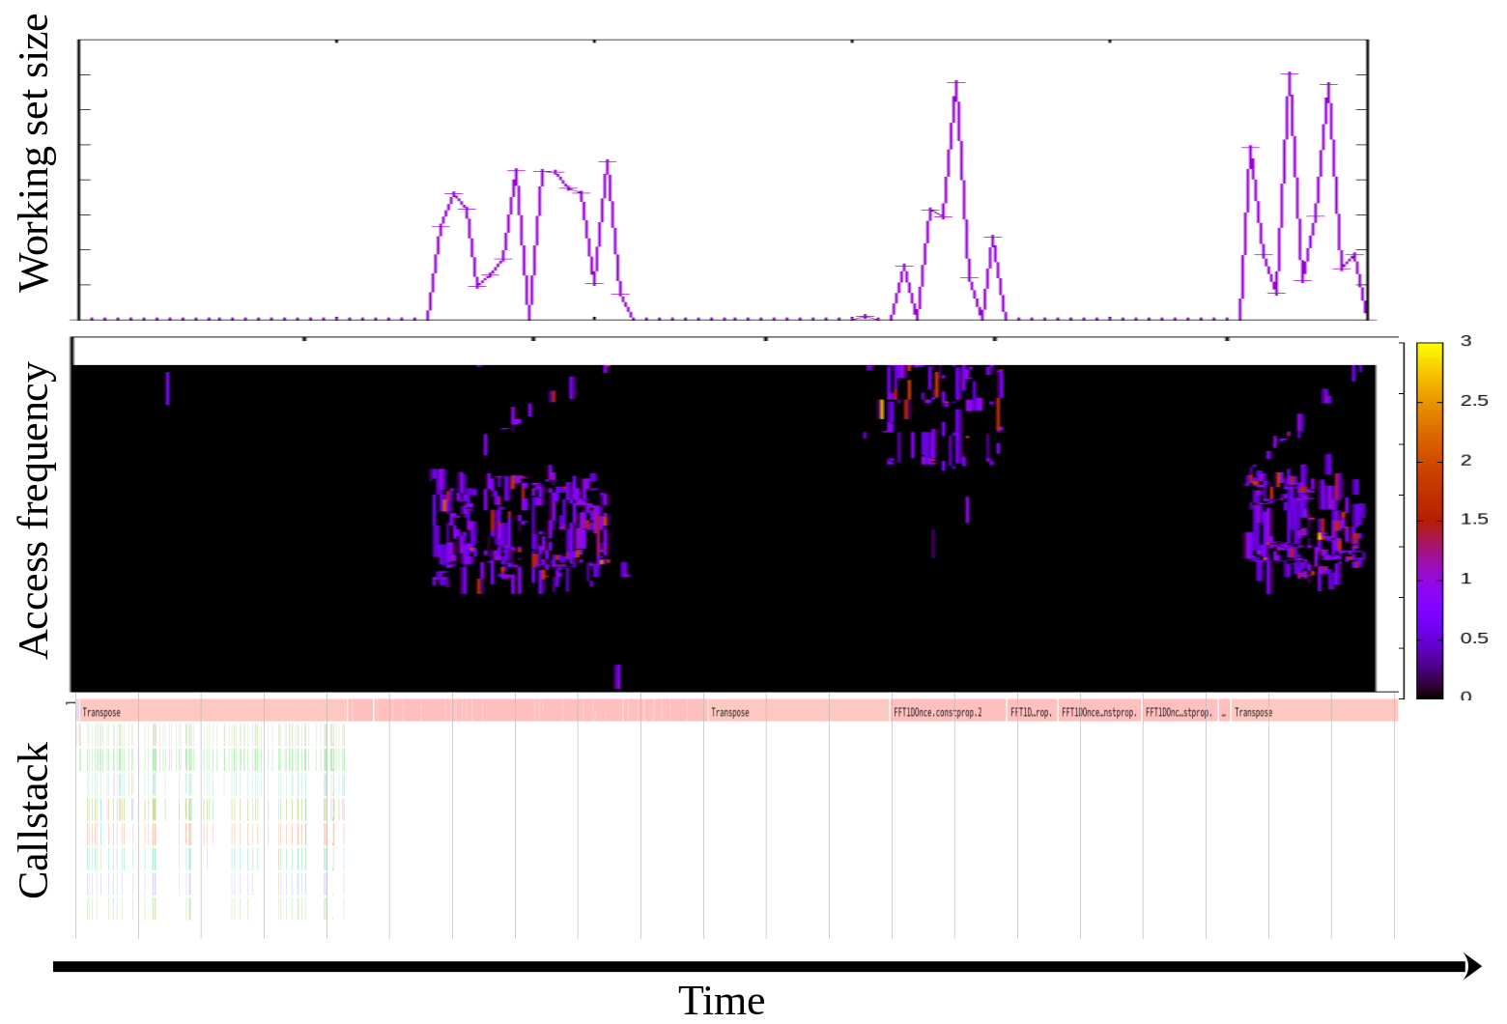
Example DAMON-based Profiling
https://sjp38.github.io/post/damon_profile_callstack_example/

Slide 20
DAMON Allows Access-aware System Operations
A number of access-aware analysis and optimizations of systems are possible
  Providing monitored working set size based system config guideline
  Debugging/optimizing wrongly implemented data access logics
  System level access-aware memory management
    This is something Linux kernel can further help

Slide 21
DAMOS:
DAMON-based Operation Schemes

Slide 22
Yet More Things DAMON Can Help
Common DAMON-based optimizations would be…
  Get/analyze monitoring results and [de]prioritize memory regions based on the analysis
  (e.g., page out cold regions, apply THP to hot regions, …)
  IOW, getting important data close, critical data closer
May contain repetitive and inefficient steps
  The analysis and prioritization could be repetitive
  User-space driven management could be inefficient
    Transfer monitoring results from kernel to user space
    Transfer management decision from user to kernel space
Can’t DAMON do that instead, directly inside the kernel?

Slide 23
DAMOS for Access-aware Optimizations with No Code
DAMOS is a feature of DAMON for offloading the optimizations effort to DAMON
  Users can simply
    specify the access pattern of their interest, and
    the action they want to apply to the regions of the pattern
  Then, DAMON finds regions of the pattern and apply the action
  No code, just request specification
$ damo start --schemes “
[{
"access_pattern": {
"nr_accesses": {"max": "0 %"},
"age": {"min": "2 m"}
},
"action": "pageout"
}]”
A json-format DAMOS scheme asking
“Page out memory regions of >=4K that not accessed at all for >=2 minutes”

Slide 24
Evaluation of DAMOS’ Effectiveness
Implemented main ideas of the two state-of-the-arts works with DAMOS
  Access-aware THP collapse/split
    Our version removes 76.15% of THP memory bloats
    while preserving 51.25% of THP speedup
  Proactive reclamation
    reduces 93.38% of residential sets and 23.63% of system memory footprint
    while incurring only 1.22% runtime overhead in the best case.
  For more details, please read the report
Reasonable DAMOS effectiveness also means reasonable DAMON accuracy

Slide 25
DAMOS Demonstration
https://sjp38.github.io/post/damon/#demo-video
# while :; do ps -o rss=,cmd= --pid $(pidof masim) ; sleep 1; done # screen 1
# while :; do ps -o rss=,cmd= --pid $(pidof kdamond.0); sleep 1; done # screen 2
# ./masim –repeat 1024 configs/stairs.cfg
# damo start --damos_access_rate 0% 0% --damos_age 5s max \
--damos_action page $(pidof masim)
You may show rss of ‘masim’ process is significantly reduced;
DAMON worker thread (kdamond.0) may show a little higher CPU usage for pageout

Slide 26
DAMOS Feature for Production: Quotas
Schemes’ target access patterns should fine tuned to be appropriately aggressive
  If too aggressive, DAMON overhead for applying the action could be significant
  If not aggressive enough, no effective change will be made
  Finding the optimal value might be doable for big companies, but DAMON is for all
DAMOS Quotas allow users set upper-limits of the aggressiveness in an intuitive way
  Limit time for and bytes to apply the action per specific time
  Under the limit, prioritize regions using their access pattern
    Allow users set their personal priority weights for each access pattern element
"quotas": {
"time_ms": "10 ms", "sz_bytes": "100 MB", "reset_interval_ms": "1 s",
"weights": {
"sz_permil": "0 %", "nr_accesses_permil": "50 %", "age_permil": "50 %"
}
},
“Apply the scheme under 10ms and 100 MB per second limit,
treating access frequency and age of regions samely important, while ignoring sizes of the regions”

Slide 27
DAMOS Feature for Finer User Control: Filters
Some users may know some characteristics of their workloads more than kernel
  E.g., list of latency-critical processes, frequent anonymous page usage, …
DAMOS Filters allows users to filter schemes via type of the pages
  Currently support anonymousness and belonging cgroups of pages
  Users can apply a scheme to only [non-]anon pages, pages of specific cgroups, in any combination
"filters": [
{"filter_type": "anon", "matching": true}
{"filter_type": "memcg", "memcg_path": "/latency-critical", "matching": true},
]
“Do not apply the scheme to anonymous pages of ‘latency-critical’ cgroup”

Slide 28
Is DAMON/DAMOS for User-space Control? Or Kernel That Just Works?
Users having capacity could get more information, and need a way for finer control
  DAMOS Filters could be used for them
Users having no such capacity need a kernel that just works
  DAMOS Quotas could be used for them
We’re pursuing to help both parties
  More features for both parties will be developed

Slide 29
DAMO:
Data Access Moniotring Operator
(User-space Tool written in Python)

Slide 30
DAMON User Interfaces: How You Can Use DAMON
DAMON provides only kernel API for other kernel components
There is a Linux kernel module named DAMON sysfs interface
  Create pseudo-files on sysfs, hook I/O to the files
  As a response to the I/O, control DAMON using DAMON API
  Resulting in DAMON ABI, that user-space can use
  Manual use of the files by human fingers is tedious and buggy, so discouraged
  Easy-to-use User-space tools can be developed using the ABI
# cd /sys/kernel/mm/damon/admin/
# echo 1 > kdamonds/nr_kdamonds && echo 1 > kdamonds/0/contexts/nr_contexts
# echo vaddr > kdamonds/0/contexts/0/operations
# echo 1 > kdamonds/0/contexts/0/targets/nr_targets
# echo $(pidof <workload>) > kdamonds/0/contexts/0/targets/0/pid_target
# echo on > kdamonds/0/state
Example usage of DAMON sysfs interface

Slide 31
DAMO: Data Access Monitoring Operator
Human-friendly user-space tool for DAMON
  Developed by DAMON author (maybe we could call this an official tool)
  Provides human-friendly user interface for input access pattern visualization
  Written in Python and available at PyPI
DAMO is not necessarily the only one DAMON user-space tool
  Anyone can write their own DAMON user-space tools using the ABI
    DATOP: developed by Alibaba, available at Github

Slide 32
DAMO as a Library for Your Own DAMON User-space Tool
_damon.py implements core logics for DAMON ABI
DAMO commands are implemented by using _damon.py as a library
  Refer to damo_record.py, damo_start.py, and damo_stop.py for example usage
You could implement DAMON user-space tool for you using it as a library
  The interface is not that stable at the moment, though
    Best approach might be making your tool merged in DAMO and maintaining it on your own
    Or, use it as only a reference implementation

Slide 33
DAMO Demo
https://sjp38.github.io/post/damon/#demo-video
Wait, you already shown the demonstration!

Slide 34
Putting It Altogether:
Access-aware Linux (AL) System

Slide 35
Putting It Altogether: Access-aware Linux (AL) System
DAMON: Data Access MONitor
  Provides practical best-effort quality information with low overhead
DAMOS: DAMON-based Operation Schemes
  Allows common access-aware memory management with no code
DAMO: Data Access Monitoring Operator
  Provides human-friendly user interface for DAMON and DAMOS
Those construct an Access-aware Linux System
  Allow DRAM cost cut and memory intensive performance boosting
  Not an official but a temporal name for making Amazon Linux (AL) people be confused

Slide 36
Availability of Access-aware Linux
All AL system components are open source and upstreamed
  DAMON and DAMOS have merged in Linux mainline v5.15 and v5.16, respectively
  DAMO is available at PyPi
    Might be better to be in the Linux mainline?
There are options for people who cannot use >=5.15 kernels
  Basic DAMON/DAMOS functionalities are backported on Amazon Linux 5.4 kernel
  All new DAMON/DAMOS features are being backported to Amazon Linux 2 5.10 kernel
  Quite amount of DAMON/DAMOS features are backported on Android 5.10 common kernel
  There’s a rumor about some customers’ DAMON backporting request to a distro

Slide 37
Use-cases and Collaborations

Slide 38
Use-cases
Disclaimer: These are just rumors and clues collected from private/public conversations
  There’s no central and well-managed channel and storage for this kind of information
  There could be a lot of false positives/negatives
Some people from companies including Alibaba, AMD, AWS, DigitalOcean, Google, Huaweii, IBM, Meta, Oppo, Oracle, etc seems using or experimenting it
  Android common kernel ported and enabled DAMON_RECLAIM
Some academic/industry folks are researching DAMON-based tiered memory management

Slide 39
Collaborations
Collaborating with a number of AWS internal/external people (DAMON community)
In 2022, 39 Amazon-external people contributed 83 patches for DAMON
Communicating in several ways
  DAMON-dedicated development mailing list
  Virtual bi-weekly community meetup series
  Presenting DAMON in conferences since 2019
    Striving to do those for both kernel and user space application developers
  Having occasional/regular private meetings on demand

Slide 40
DAMON Community is Waiting For Your Voices
DMAON, DAMOS, and DAMO are still under active development; the journey just begun
  The interface may not fit for you
  There could be lacking features for you
  Not meaning unstable; will always be backward compatible and never breaks users
Don’t forgive it or wait for someone to implement it; make your voice
  Report your use case, challenges, and benefits you currently getting
  Ask questions and request features for your use case
  Prioritize some future works by
    Showing your interest, share your expected usage of the feature
    Test and share the results
  Send patches

Slide 41
Conclusion
DAMON: Linux kernel subsystem for efficient data access monitoring
DAMOS: No-code efficient access-aware system optimization engine
DAMO: User-space tool/library for DAMON and DAMOS
Some people are getting fun with those
You can help delivering more fun to the world with those

Slide 42
Questions?
You can also use
  The maintainer: sj@kernel.org
  Project webpage: https://damonitor.github.io
  Kernel docs for admin and programmers
  DAMON mailing list: damon@lists.linux.dev
  DAMON Beer/Coffee/Tea Chat

Slide 43
Backup Slides

Slide 44
Conceptual Psudo-code of DAMON
while monitoring_on:
for page in monitoring_target:
if accessed(page):
nr_accesses[page] += 1
if time() % aggregation_interval == 0:
for callback in user_registered_callbacks:
callback(monitoring_target, nr_accesses)
for page in monitoring_target:
nr_accesses[page] = 0
sleep(sampling interval)

Slide 45
DAMON: Resulting Architecture
Core logic and monitoring operations layer are separated
  Multiple address spaces and usages can easily supported
Client
Monitoring Request
Data Access Monitor
Adaptive Regions Adjustment
Aging
Region-based Access Check
Monitoring Primitives
For virtual addr
For physical addr
Kernel Data Structures and Features
vma
PTE
PG_idle
rmap

Slide 46
Region-based Sampling
Defines data objects in access pattern oriented way
  “A data object is a contiguous memory region that all page frames in the region have similar access frequencies”
  By the definition, if a page in a region is accessed, other pages of the region has probably accessed, and vice versa
  Thus, checks for the other pages can be skipped
By limiting the number of regions, we can control the monitoring overhead regardless of the target size
However, the accuracy will degrade if the regions are not properly set
(Will result in poor accuracy)
(Will result in reasonable accuracy)
Hot region
Target region
Cold region

Slide 47
Adaptive Regions Adjustment
Merge
Starts with minimum number of regions covering entire target memory areas
For each aggregation interval,
  merges adjacent regions having similar access frequencies to one region
  Splits each region into two (or three, depend on state) randomly sized smaller regions
  Avoid merge/split if the number of regions might be out of the user-defined range
If a split was meaningless, next merge process will revert it (vice versa)
In this way, we can let users control the upper bound overhead while preserving minimum and best-effort accuracy
Split
AF: 0.5 0 0 0
Merge
Split
AF: 0 0.9 0 0
Merge
AF: (Observed) Access Frequency
Hot region (AF 1.0)
Cold region (AF 0)
Target region

