Slide 1
DAMO[N,S]?: Implementing
Self-Driven Data Access-Aware Efficient Linux System
SeongJae Park <sj@kernel.org>
#linux #kernel #damon

Slide 2
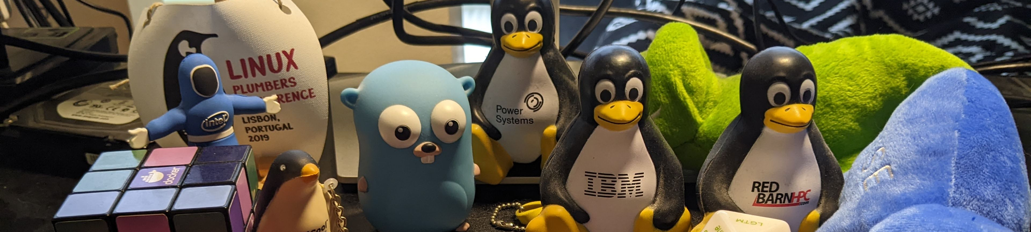
From: SeongJae Park <sj@kernel.org>
Call me SJ
Working on AWS
Maintaining Linux kernel DAMON subsystem and its user-space tool, DAMO

Slide 3
Notices
The views expressed herein are those of the speaker;
they do not reflect the views of his employers
Examples on these slides are made with
DAMO of commit 3a9b8e821bef (v2.3.1+) and Linux kernel v6.9-rc4
This version contains below fixes after the conference presentation
  Fix wrong link to EuroSys24 paper
  s/SK Hynix/SK hynix/

Slide 4
Overview
Importance and Difficulties
Generating Accesses Heatmap
Online Access-aware System Operations
DAMON Community
Summary
QnA

Slide 5
Importance and Difficulties

Slide 6
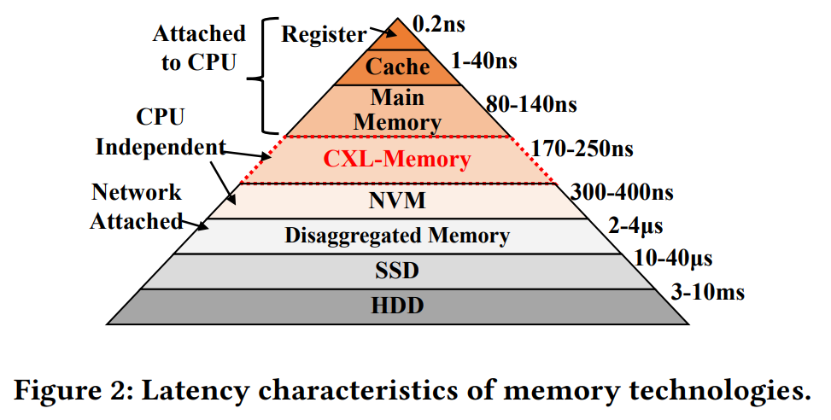
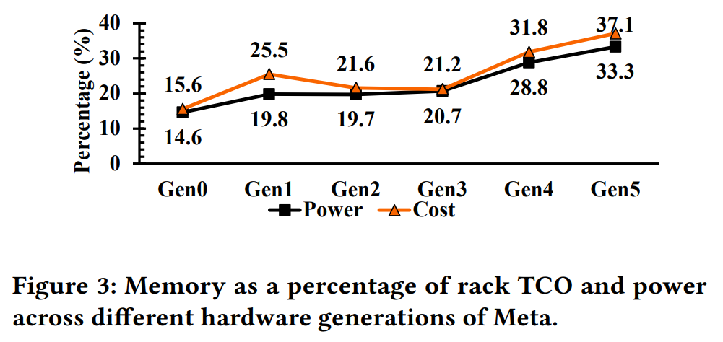
Increasing Demands and Complexity
Memory demands are increasing
New H/W will arrive as a new hierarchy, not a drop-in replacement
Access-aware system operations can be helpful
Retrieved from “TPP: Transparent Page Placement for CXL-Enabled Tiered-Memory”, https://dl.acm.org/doi/pdf/10.1145/3582016.3582063

Slide 7
Data Accesses: Events on Space/Time of Memory
Looks like a sort of a heatmap
Time
Address

Slide 8
Ideal Data Access MONitor: Precise, Complete, Light
Time granularity: CPU cycle / # CPUs (or, speed of light)
Space granularity: bit (or, electron)
Keep complete history (from Bigbang)
Lightweight enough for general system operations

Slide 9
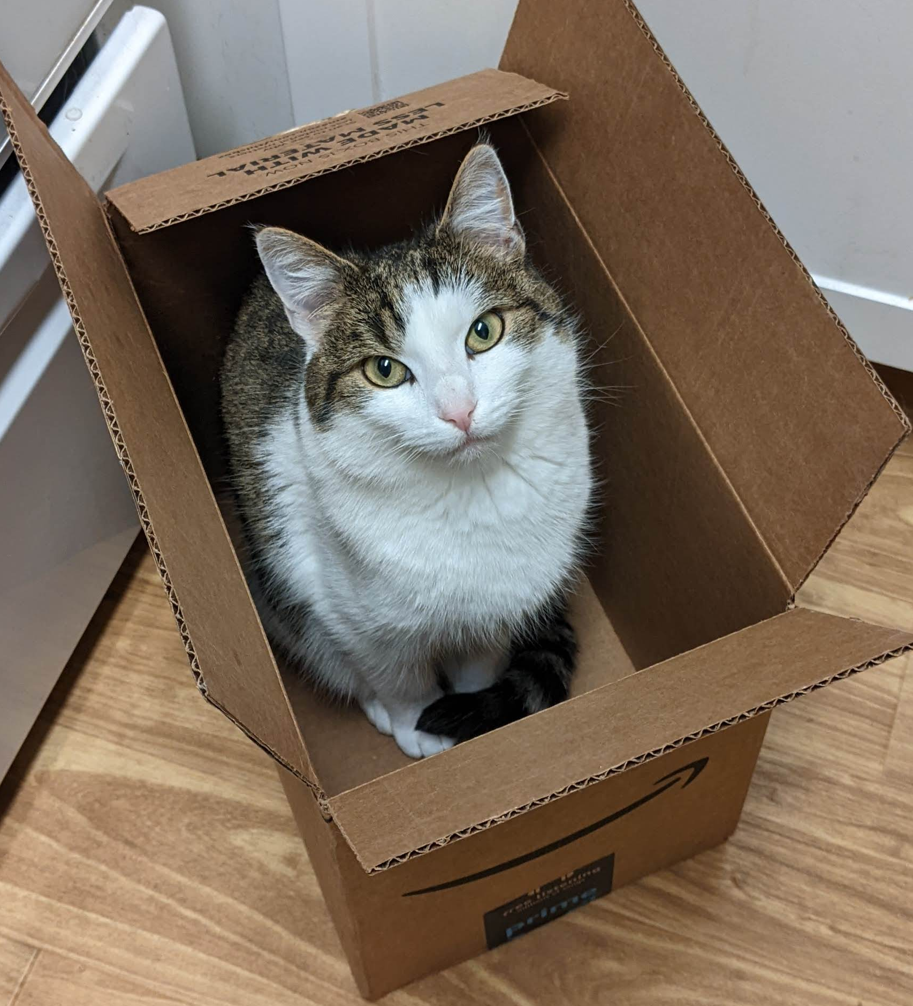
Physics: “It May Not That Easy”
Observing/memorizing memory accesses via memory accesses
Some of observer effects and the uncertainty principal may apply
O(memory size)/O(memory size * total monitoring time) time/space overhead
  Finite speed of light and atomic nature of matter
I was both accessed and unaccessed before you opened the box

Slide 10
Generating Accesses Heatmap

Slide 11
Region: Access Monitoring Unit
Memory region: A sub-area of the memory’s space-time
Collection of elements that having similar access pattern
Access check of one element per region is enough
e.g., “This page is accessed within last 1 second; a cacheline is checked”
$ cat wonder_region_1
We’re all mad [un]accessed here

Slide 12
Fixed Space/Time Granularity, <=1 Access Frequency
Sort of periodic fixed granularity idleness monitoring
Time overhead: “memory size / space granularity”
Space overhead: “memory size * monitoring time / time granularity”
Reduced, but still ruled by memory size and total monitoring time
Time
We’re all mad accessed here
Address
Region
We’re all mad unaccessed here
Sampling interval

Slide 13
Fixed Space/Time Granularity, <=N Access Frequency
Accumulate access checks via per-region counter
Time
1
0
0
1
Address
Region
Aggregate interval
Sampling interval

Slide 14
Fixed Space/Time Granularity, <=N Access Frequency
Accumulate access checks via per-region counter
Time
1 | 2
0 | 1
0 | 0
1 | 2
Address
Region
Aggregate interval
Sampling interval

Slide 15
Fixed Space/Time Granularity, <=N Access Frequency
Accumulate access checks via per-region counter
Time
1 | 2 | 3
0 | 1 | 1
0 | 0 | 1
1 | 2 | 2
Address
Region
Aggregate interval
Sampling interval

Slide 16
Fixed Space/Time Granularity, <=N Access Frequency
Accumulate access checks via per-region counter
Time
1 | 2 | 3 | 1 | 2 | 3
0 | 1 | 1 | 1 | 1 | 1
0 | 0 | 1 | 0 | 0 | 0
1 | 2 | 2 | 1 | 2 | 3
Address
Region
Aggregate interval
Sampling interval

Slide 17
Fixed Space/Time Granularity, <=N Access Frequency
Accumulate access checks via per-region counter
Time
1 | 2 | 3 | 1 | 2 | 3 | 1 | 2 | 2
0 | 1 | 1 | 1 | 1 | 1 | 1 | 1 | 2
0 | 0 | 1 | 0 | 0 | 0 | 1 | 1 | 1
1 | 2 | 2 | 1 | 2 | 3 | 1 | 1 | 2
Address
Region
Aggregate interval
Sampling interval

Slide 18
Fixed Space/Time Granularity, <=N Access Frequency
Accumulate access checks via per-region counter
Reduce space overhead to “1/N”
Still, O(memory size * total monitoring time)
Time
3 | 3 | 2
1 | 1 | 2
1 | 0 | 1
2 | 3 | 2
Address
Region
Aggregate interval

Slide 19
Inefficiency of Fixed Space Granularity
Adjacent regions of similar hotness
Time
3 | 3 | 2
1 | 1 | 2
1 | 0 | 1
2 | 3 | 2
Address
Region
Aggregate interval

Slide 20
Dynamic Space Granularity: Mechanisms
Merge the wasteful regions and randomly split region
  The number of region == number of different access patterns
Let user set min/max number of regions
Time
3 | 3 | 2
1 | 1
 | 0 | 1
2 | 3 | 2
Address
Region
Aggregate interval

Slide 21
Dynamic Space Granularity: Overhead/Accuracy
Time overhead: min(different access patterns, max number of regions)
  No more ruled by arbitrary memory size
Minimum accuracy: min number of regions
  Best-effort, lower-bound accuracy
Time
3 | 3 | 2
1 | 1
 | 0 | 1
2 | 3 | 2
Address
Region
Aggregate interval

Slide 22
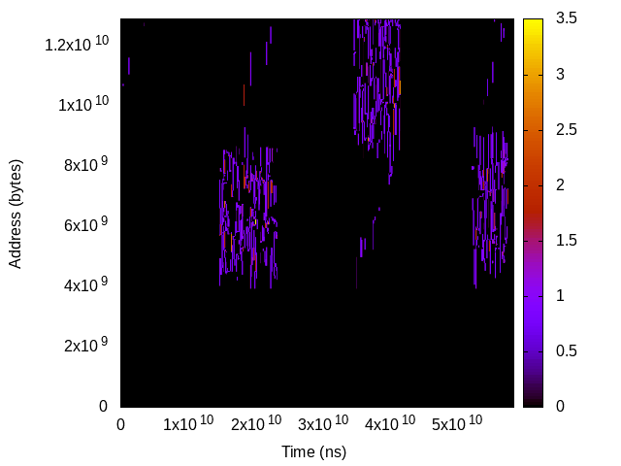
Output: Best-effort Controllable Accesses Heatmap
How we can get it? DAMO
Heatmap of “Splash2x.fft”

Slide 23
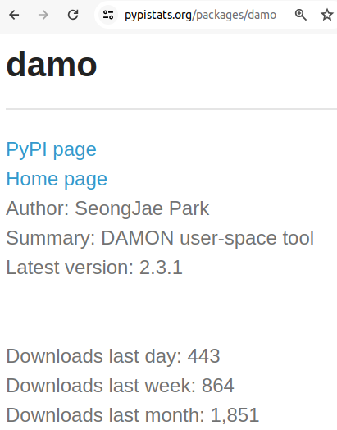
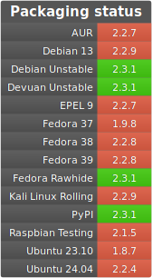
DAMO: Data Access Monitoring Operator
A Python3 program
Provides the heatmap
Packaged for PyPI and various distros
Simple git cloning also works
The images are captured on 2024-04-17

Slide 24
DAMON: Data Access MONitor (1/2)
A Linux kernel subsystem
Implement the heatmap generating mechanism;
DAMO is a DAMON user-space tool
Merged into the mainline from v5.15
Backported and enabled on multiple distros

Slide 25
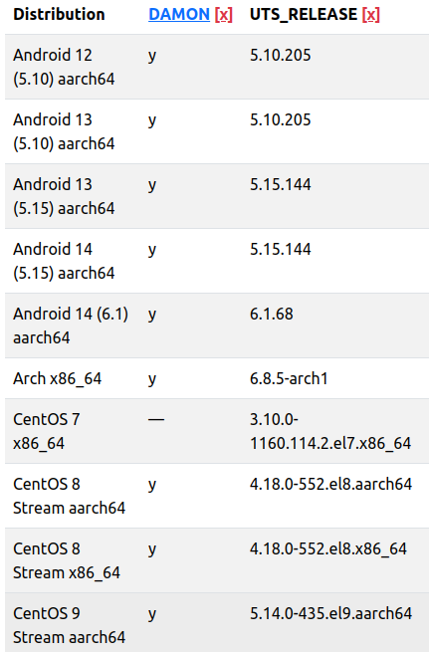
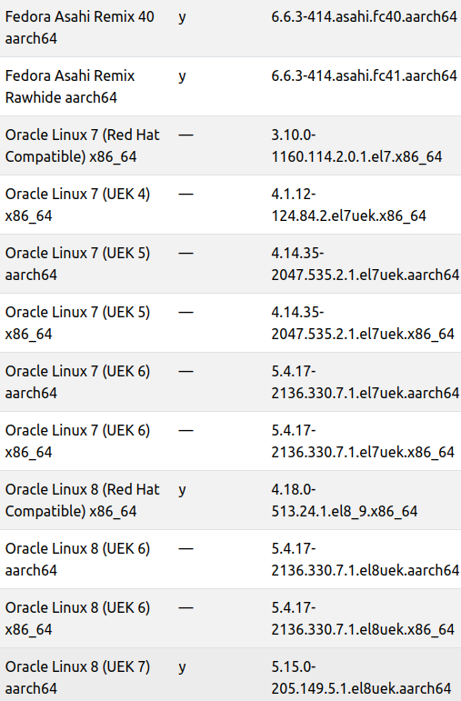
DAMON: Data Access MONitor (2/2)
A Linux kernel subsystem
Implement real monitoring mechanisms;
DAMO is a DAMON user-space tool
Merged into the mainline since v5.15
Backported and enabled on multiple distros
The images are captured on 2024-04-16

Slide 26
DAMO Demo: Generating The Heatmap (1/2)
# damo record "$HOME/parsec3_on_ubuntu/run.sh splash2x.fft" \
--include_child_tasks --profile –footprint
[...]
real 50.489s
[...]
# damo report heats --heatmap stdout

Slide 27
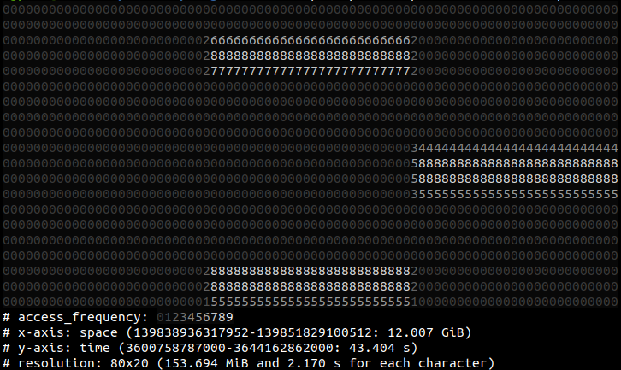
DAMO Demo: Generating The Heatmap (2/2)

Slide 28
DAMO Demo: Profiling Memory Usage/Accesses (1/2)
# damo report footprints rss
[...]
# avr: 10.005 GiB
[...]

Slide 29
DAMO Demo: Profiling Memory Usage/Accesses (2/2)
# damo report footprints rss
[...]
# avr: 10.005 GiB
[...]
# damo report wss --collapse_targets
[...]
# avr: 1.872 GiB
[...]

Slide 30
DAMO Demo: Access-aware Program Profiling (1/2)
# damo report profile --access_rate 50% 100%
Samples: 75K of event 'cpu-clock:pppH', Event count (approx.): 18985500000
Overhead Command Shared Object Symbol
66.08% swapper [kernel.vmlinux] [k] pv_native_safe_halt
29.81% fft fft [.] Transpose
0.18% ps [kernel.vmlinux] [k] do_syscall_64
[...]

Slide 31
DAMO Demo: Access-aware Program Profiling (2/2)
# damo report profile --access_rate 50% 100%
Samples: 75K of event 'cpu-clock:pppH', Event count (approx.): 18985500000
Overhead Command Shared Object Symbol
66.08% swapper [kernel.vmlinux] [k] pv_native_safe_halt
29.81% fft fft [.] Transpose
0.18% ps [kernel.vmlinux] [k] do_syscall_64
[...]
# damo report profile --access_rate 0% 0%
Samples: 578K of event 'cpu-clock:pppH', Event count (approx.): 144693500000
Overhead Command Shared Object Symbol
66.50% swapper [kernel.vmlinux] [k] pv_native_safe_halt
12.81% fft fft [.] FFT1DOnce.constprop.1
12.66% fft fft [.] Transpose
0.95% fft [kernel.vmlinux] [k] clear_page_orig

Slide 32
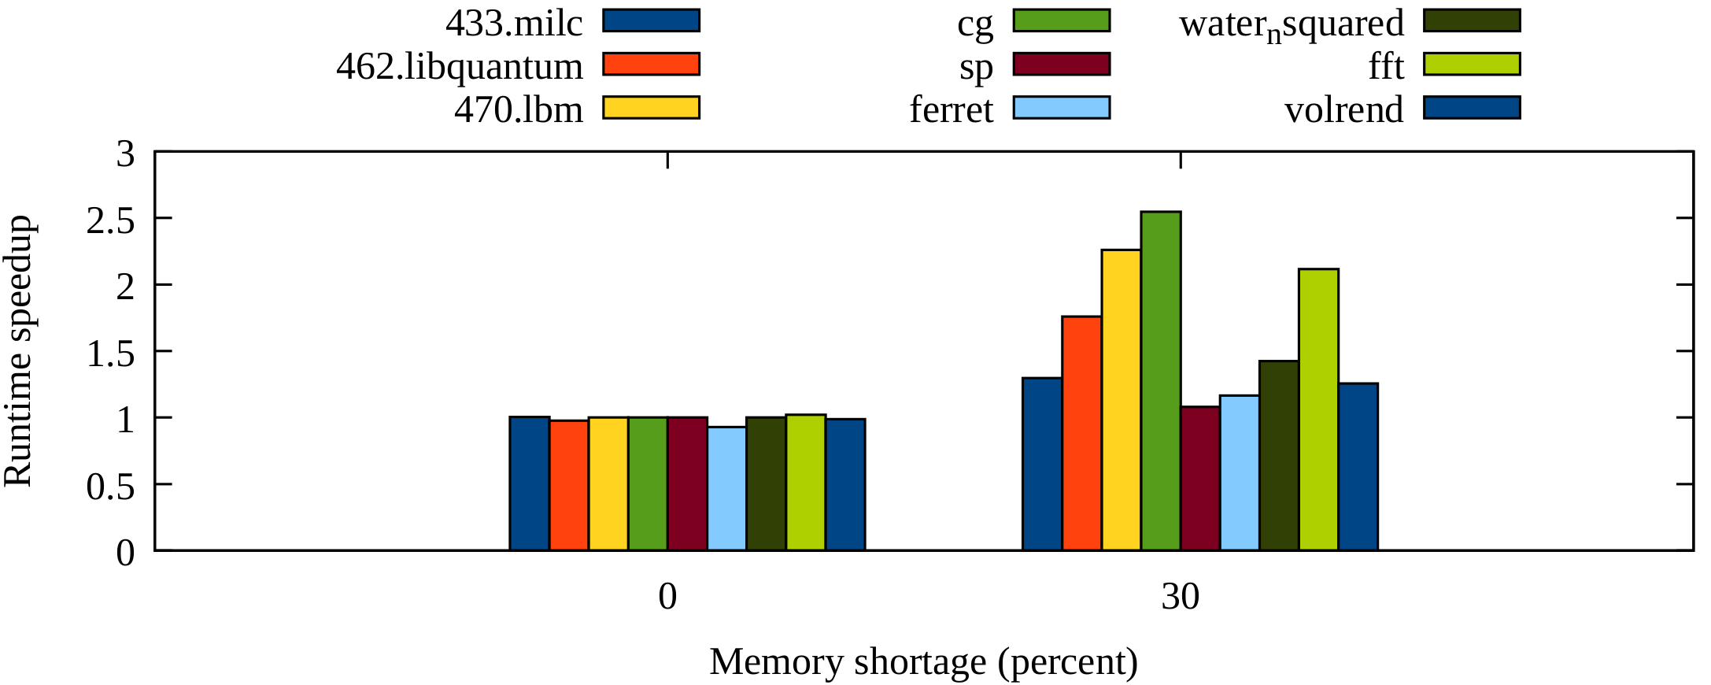
DAMO Demo: Manual Optimization of Program
Optimize the program logic or add system calls such as madvise() or mlock()
Achieved 2x performance improvement under memory pressure
More details are out of the scope of this talk
The image is retrieved from ksummit 19 DAMON talk

Slide 33
Online Access-aware System Operations

Slide 34
Inefficiency of Fixed Time Granularity Regions (1/2)
The definition of regions is not only about space, but also about time
Time
Address
Region
Aggregate interval

Slide 35
Inefficiency of Fixed Time Granularity Regions (2/2)
The definition of regions is not only about space, but also about time
Multiple time-adjacent regions of similar hotness: only waste
Time
Address
Region
Aggregate interval

Slide 36
Dynamic Time Granularity (1/3)
Count how long the hotness has kept
Snapshot contains recent access history
Time
1
1
1
1
Address
Region
Aggregate interval

Slide 37
Dynamic Time Granularity (2/3)
Count how long the hotness has kept
Snapshot contains recent access history
Time
1 | 2
1 | 2
1 | 1
1 | 1
Address
Region
Aggregate interval

Slide 38
Dynamic Time Granularity (3/3)
Count how long the hotness has kept
Snapshot contains recent access history
Time
1 | 2 | 1
1 | 2 | 3
1 | 1 | 1
1 | 1 | 1
Address
Region
Aggregate interval

Slide 39
DAMO Demo: Showing Snapshot (1/3)
# damo start $workload_command
# damo show --format_region \
"<box> size <size> access rate <access rate> age <age>" \
--region_box_min_max_height 1 1 --region_box_min_max_length 1 40 \
--region_box_align right --region_box_colorset emotion

Slide 40
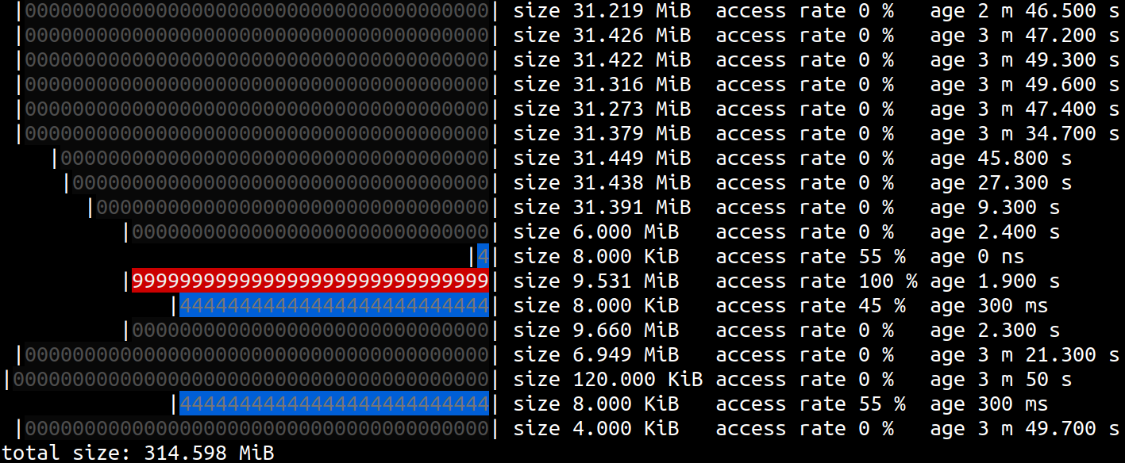
DAMO Demo: Showing Snapshot (2/3)

Slide 41
DAMO Demo: Showing Snapshot (3/3)

Slide 42
Snapshot: Real Output of DAMON
Heatmaps: DAMO-collected snapshots
Both time/space overheads are not ruled by memory size/monitoring time
Informative enough for reasonable online optimizations

Slide 43
DAMOS: DAMon-based Operation Schemes
A core feature of DAMON
Apply specific operation to regions of specific access pattern
  e.g., page out regions that not accessed for >=2 minutes
  Get the latest snapshot from DAMON
  Find regions of the pattern from the snapshot
  Apply the action to the regions
  Repeat
Users specify the pattern and the action

Slide 44
DAMO Demo: Online Access-aware Optimization
Page out regions that not accessed for >=5 seconds
# damo record "$HOME/parsec3_on_ubuntu/run.sh splash2x.fft" \
--include_child_tasks --profile --footprint \
--damos_action pageout --damos_access_rate 0% 0% --damos_age 5s max
[...]
real 2m 0.43s
[...]
# damo report footprints rss
[...]
# avr: 4.955 GiB
[...]

Slide 45
DAMOS Quotas: Safe-guards
Finding optimum access pattern of the interest is challenging
DAMOS resource usage quotas can be set for avoiding extreme misconfigs
Under the limit, actions are applied to regions that prioritized for the action
For pageout, colder memory regions are prioritized (paged out first)

Slide 46
DAMO Demo: DAMOS Quotas
Page out regions that not accessed for >=5 seconds,
up to 1GiB per second, using up to 100ms per second
# damo record "$HOME/parsec3_on_ubuntu/run.sh splash2x.fft" \
--include_child_tasks --profile --footprint \
--damos_action pageout --damos_access_rate 0% 0% --damos_age 5s max \
--damos_quotas 100ms 1G 1s
[...]
51.772s
[...]
# damo report footprints rss
[...]
# avr: 8.527 GiB
[...]

Slide 47
DAMOS Quota Goals: Aggressiveness Auto-tuning
Knowing the optimum quota is still difficult; policy is coupled with mechanism
Users specify aiming system metric values
DAMOS self-tune its quota to achieve the goal using a simple feedback loop

Slide 48
DAMO Demo: DAMOS Quota Goals
Page out regions that not accessed for >=5 seconds, up to 1GiB/sec, using up to 100ms/sec, aiming 10ms/sec memory pressure stall
# damo record "$HOME/parsec3_on_ubuntu/run.sh splash2x.fft" \
--include_child_tasks --profile --footprint \
--damos_action pageout --damos_access_rate 0% 0% --damos_age 5s max \
--damos_quotas 100ms 1G 1s \
--damos_quota_goal some_mem_psi_us 10000
[...]
real 49.741s
[...]
# damo report footprints rss
[...]
# avr: 9.721 GiB

Slide 49
DAMOS Results At a Glance
DAMOS improves system efficiency
Quota: Safe-guard
Quota goal: Aim-driven self-driver
Daily DAMOS performance test results are available online
 | Runtime | RSS
Baseline | 50.489s | 10.005 GiB
+DAMOS-reclaim | 120s | 4.955 GiB
+Quota | 51.772s | 8.527 GiB
+Goal | 49.741s | 9.721 GiB

Slide 50
DAMON Community

Slide 51
DAMON Is Developed-By: The Community
Jie Li et al. wrote EuroSys’24 paper exploring DAMON in depth
Intel wrote a paper and posted patches for DAMON accuracy improvement
SK hynix developed their tiered memory management kit using DAMON; collaborating with the community on upstreaming
A number of DAMON features are results of community discussions

Slide 52
Communication Channels
DAMON-dedicated open mailing list: https://lore.kernel.org/damon/
Bi-weekly community meetup series
  An in-person version of it will be held Today 4:55 pm, Room 444
Having occasional/regular private meetings on demand

Slide 53
Call For Your Voices
We prefer random evolution over intellectual design
Put your voice on the evolution path for your purpose
  Report your use case/test results and challenges
  Ask questions and request features
  Show your interest to known future works
  Send patches

Slide 54
Summary

Slide 55
Summary
Access-aware system operation is required for modern memory systems
DAMON: best-effort access monitoring kernel subsystem
DAMOS: Access-aware system operation engine
DAMO: User-space tool for DAMON/DAMOS
DAMON is evolving under the community’s efforts

Slide 56
Questions?
If your question is not answered by the session, use below
  The maintainer: sj@kernel.org
  Project webpage: https://damonitor.github.io
  Kernel docs for admin and programmers
  DAMON mailing list: damon@lists.linux.dev
  DAMON Beer/Coffee/Tea Chat
  Today’s in-person DAMON meetup (4:55 pm, room 444)

