Slide 1
hkml: Mailing Tool for Simple Linux Kernel Development
SeongJae Park (SJ)
<sj@kernel.org>
<sjpark@crusoe.ai>

Slide 2

About The Speaker: SJ
Kernel Programmer, maintaining DAMON
Working for crusoe.ai (we’re hiring!)
Was working for Meta when this talk was submitted
  And don’t know how to update talk intro on the webpage
  (sorry if it confused you)
  All opinions are speaker’s own, though
crusoe.ai

Slide 3
Table of Contents
hkml: Mailing Tool for Simple Linux Kernel Development (40 minutes)
  Linux Kernel Development Process and Pain Points (7 minutes)
  hkml: Hackers’ mailing tool (3 minutes)
  hkml live demo (20 minutes)
  QnA (10 minutes)

Slide 4
Linux Kernel Development Process and Its Pain Points

Slide 5
Linux Kernel Development Statistics
Survived from the test of time, since 1991
Being used nearly everywhere
Keeping and even accelerating development speed
  ~2,000 developers, ~15,000 commits, per ~9 weeks
Most successful and active open source software

Slide 6
Kernel Development Process, 1000 ft View
Kernel: A set of (recursive) subsystems
One maintainer team per subsystem
Contributors send changes to maintainers
Maintainers send changes to upper level maintainer
Distributed, scalable, simple
Linus Torvalds
Changes
Changes
mm/ Maintainer
net/ Maintainer
Changes
Changes
mm/damon/ Maintainer
Contributor B
Changes
Contributor A

Slide 7
Individual Code Change Process, 100 ft View
Make local changes
Convert changes into human-readable form
Send it to the relevant people
Discuss about the proposal with the people
Repeat until accept/reject
Straightforward
Linus Torvalds
Changes
Changes
mm/ Maintainer
net/ Maintainer
Changes
Changes
mm/damon/ Maintainer
Contributor B
Changes
Contributor A

Slide 8
Making Change Request, 10 ft View
Standardized tool (‘git’) and resources available
Make local changes
  ‘git commit’
Convert changes into human-readable form
  ‘git format-patch’ or ‘git request-pull’
Make local changes
Convert changes into human-readable form
Send it to the relevant people
Discuss about the proposal with the people
Repeat until accept/reject
Straightforward

Slide 9
Sending Change Request, 10 ft View
Send it as a plain text email
Standardized tool (‘git’) makes this semi-automated and doable
Finding relevant people
  Maintainers, reviewers, and mailing list of the subsystem
  MAINTAINERS file and get_maintainer.pl can be used
Sending the patch or pull request
  ‘git send-email’
Make local changes
Convert changes into human-readable form
Send it to the relevant people
Discuss about the proposal with the people
Repeat until accept/reject
Straightforward

Slide 10
Change Request Discussion, 10 ft View
How to reply?
  Bring your own mailing tool (Note: Gmail is sub-optimum)
How to read others’ mails?
  Subscribe to mailing list, or
  Search mailing list archives
How to convince others?
  Out of the scope of this talk
Make local changes
Convert changes into human-readable form
Send it to the relevant people
Discuss about the proposal with the people
Repeat until accept/reject
Straightforward

Slide 11
Change Request Discussion Pain Points
Finding proper email client
  There are more than two ways to do that
    Kernel official documentation introduces 15 tools
Reading other’s email
  Subscribing doesn’t work for busy subsystems
  (hundreds of mails per day)
  Public archives (lore.kernel.org) lack comfy of private inbox
    No reply button, difficult personalization
Pain points for some people including beginners

Slide 12
hkml: Hackers’ Mailing Tool

Slide 13
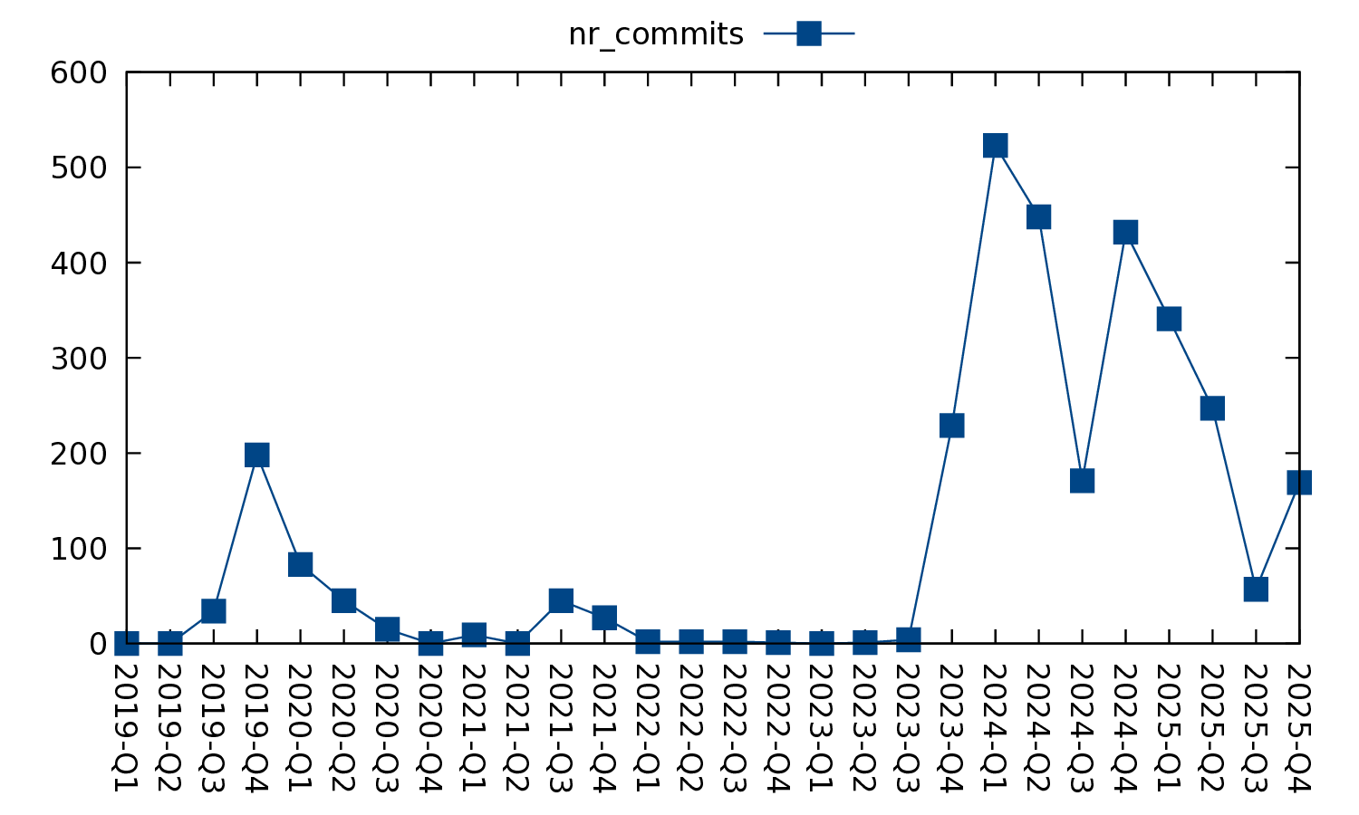
Evolution Story of hkml
2019: Public-inbox based hack
  Supported only listing and reading mails
  Only for scratching the developer’s itch
2021: DAMON maintenance mailing tool
  Extended for formatting and sending mails
  Still a hack for personal usages
  Was unable to recommend to others
2024: Linux kernel developers mailing tool
  Extended for mbox support, interactive UI, and more
  Officially committed to support any Linux kernel developers including DAMON community

Slide 14

hkml: Mailing tool for Mails-driven development
Design goals: minimum setup and resources
Support reading public-inbox archives and mbox files
Highly optimized for Linux kernel development
Known users: DAMON maintainer and a few cool folks
Available at
https://github.com/sjp38/hackermail
This QR code is generated from
https://www.qr-code-generator.com

Slide 15
hkml Demo Time

Slide 16
Setup
git clone https://github.com/sjp38/hackermail
That’s it!

Slide 17
Reading Mails from Mailing Lists
hkml list <list name, e.g., damon>
Show the mails of the list with an interactive UI
The interactive UI supports most works
  Replying, Finding patches to review, etc
  Press ‘?’ for shortcut keys
  Press ‘m’ for menus

Slide 18
Reading Mails of a Thread on Mailing List
hkml list <msgid or lore.kernel.org link>
  e.g.,
  ‘html list \
  https://lore.kernel.org/20251125015841.76180-1-sj@kernel.org’, or
  ‘hkml list 20251125015841.76180-1-sj@kernel.org’

Slide 19
Reading Mails Not Sent to Mailing Lists
Save the mail[s] as an mbox file
  Modern email clients including Gmail support this
hkml list <mbox file>

Slide 20
Tagging Mails
From the list, open menu (press ‘m’) → ‘manage tags’
To read mails of a tag,
  hkml list <tag name>

Slide 21
Replying to Mails
From the list, open menu (press ‘m’) → ‘reply’
  ‘hkml’ will open a text editor for writing/sending the reply
  The mail will be tagged as ‘drafts’ or ‘sent’ depend on your following action
  ‘hkml’ find previous draft and let you continue writing it

Slide 22
Writing and Sending a Mail
‘hkml write’ from the terminal
  Works similar to replying feature

Slide 23
Downloading Patches
From the list, open menu → ‘handle as patches’
  → ‘export patch[es]’
Save the patches on the user-specified path
Collect {Reviewed,Acked,Tested}-by: tags in replies
Merge cover letter into first patch’s commit message (mm style) if requested

Slide 24
Testing Patches
From the list, open menu → ‘handle as patches’
  → ‘check patch[es]’
  Download the patches and run checkpatch.pl

Slide 25
Applying Patches
From the list, open menu → ‘handle as patches’
  → ‘apply patch[es]’
Download the patches and apply on the current tree
Make a merge commit having cover letter’s description as its commit message, if requested

Slide 26
Formatting and Sending Patches
From terminal, ‘hkml patch format <commits>’
  Setup CV with commit message of
    first commit’s parent, or merge commit of given commits
  Add recipients based on get_maintainer.pl
    Only coverletter gets all recipients
  Run checkpatch.pl for each patch
  Give user a moment to review subjects and reviewers
  Finally send the patches
  User can abort the process at each step

Slide 27
hkml Advanced Features Demo
(Depending on time, this might be skipped)

Slide 28
Remote tags synchronization
hkml sync --remote <your private git repo>

Slide 29
Mails Monitoring
hkml monitor add ...
hkml monitor start
  Periodically run ‘hkml list’ with specified filter/decoration options
    Only new mails are git-fetched; no overhead to lore.kernel.org
  Send the output as an email to user

Slide 30
And more hidden features
Flexible mails filtering
Flexible mails display options
Refer to USAGE.md
Suggest/contribute your features

Slide 31
QnA
Feel free to use
  sj@kernel.org
  https://github.com/sjp38/hackermail/issues
This QR code is generated from
https://www.qr-code-generator.com

