Slide 1
DAMON: Long-term Plans for
Kernel That
{Just Works,Extensible}
Kernel
Memory Management MicroConference @
SeongJae Park <sj@kernel.org>

Slide 2
Notices
- The views expressed herein are those of the speakers;
They do not reflect the views of their employers
- This is for long-term plan discussions rather than presentations

Slide 3
DAMON in One minute
- DAMON is a data access pattern snapshot generator informing
- which address range is how frequently accessed for how long time
- Supports virtual address spaces and physical address space
- Designed for low/controllable overhead and easy extensions
- DAMOS: access-aware system optimizations engine
- e.g., reclaim memory regions that not accessed for >=2 minutes
- Being used in real-world products including Aurora Serverless v2

Slide 4
For Kernel That Is Extensible
- For a sort of user-space control plane
- Kernel knows many things but not everything
- Expose DAMON functionality via sysfs as much as possible
- For new features, add files and/or directories
- Aim to be a long-term stable ABI
- Humans should use a user-space tool instead of ABI
- damo aims to be a long-term stable user-space tool
- Open to BPF integration (damon_ext?)

Slide 5
For Kernel That Just Works
- For reasonable benefits without additional efforts
- Users know many things but not necessarily everything
- Not necessarily optimum for all case
- Add DAMON modules for common usages with simple interface
- DAMON_RECLAIM, DAMON_LRU_SORT, …
- Aim to assist rather than replace
- Continue simplifying UI by adding more auto-tuning features/knobs
- Manual driving handle will continue be provided
- Eventually, a single knob, say, CONFIG_DAMON_X=y
- Run all auto-tuned DAMON modules by default

Slide 6
What I’m [not] gonna do
I’m gonna do (unless you stop me)
- Make DAMON extensible and just works
- Add more sysfs files under /sys/kernel/mm/damon/
I’m not gonna do (unless you ask me to)
- Introduce regressions (by purposes)
- Add intrusive changes to places other than mm/damon/

Slide 7
Discussion Time!
- Is pursuing two goals a bad idea?
- Is sysfs interface a bad idea?
- Will this disturb other kernel developers?
- Should DAMON modules be replacements rather than assistance?
- How to determine DAMON is ready for CONFIG_DAMON_X=y?
- Should the verbal promises be documented somewhere?

Slide 8
Backup Slides
Kernel
Memory Management MicroConference @

Slide 9
DAMON Stack, In a Future
User-space
Tools
DAMO
datop
DAMON API User
Kernel Modules
General-purpose User ABI
Special-purpose Modules
DAMON_SYSFS
DAMON_DBGFS
DAMON_RECLAIM
DAMON_LRU_SORT
DAMON_WSS
DAMON Application Programming Interface
DAMON
DAMOS
Adaptive Regions Adjustment
Action and Pattern
Core Logic
Region-based Sampling
Quotas and Prioritization
Access Frequency Monitoring
Feedback-based auto-tuning
Advanced Regions Adjustment
Watermarks
Parameters Auto-tuning
Filters
DAMON Operations Set Registration Interface
Operations Set
paddr
vaddr
Read/write-only
NUMA-cpus-only
Primitives
that DAMON
depends on
PTE/VMA/rmap, ...
AMD IBS
LRU State

Slide 10
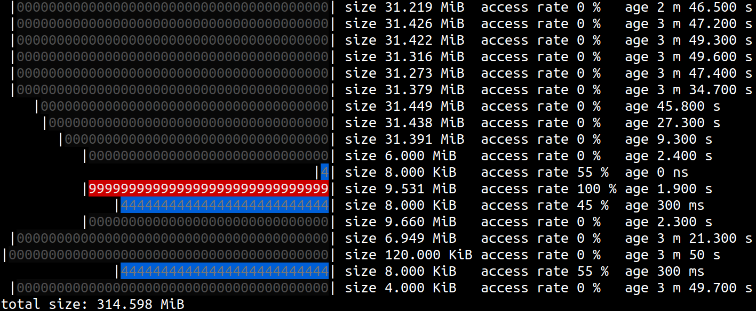
Example Access Pattern Snapshot
# damo show

Slide 11
/sys/kernel/mm/damon/admin
│ kdamonds/nr_kdamonds
│ │ 0/state,pid
│ │ │ contexts/nr_contexts
│ │ │ │ 0/avail_operations,operations
│ │ │ │ │ monitoring_attrs/
│ │ │ │ │ │ intervals/sample_us,aggr_us,update_us
│ │ │ │ │ │ nr_regions/min,max
│ │ │ │ │ targets/nr_targets
│ │ │ │ │ │ 0/pid_target
│ │ │ │ │ │ │ regions/nr_regions
│ │ │ │ │ │ │ │ 0/start,end
│ │ │ │ │ │ │ │ ...
│ │ │ │ │ │ ...
│ │ │ │ │ schemes/nr_schemes
│ │ │ │ │ │ 0/action,target_nid,apply_interval_us
│ │ │ │ │ │ │ access_pattern/
│ │ │ │ │ │ │ │ sz/min,max
│ │ │ │ │ │ │ │ nr_accesses/min,max
│ │ │ │ │ │ │ │ age/min,max
│ │ │ │ │ │ │ quotas/ms,bytes,reset_interval_ms,effective_bytes
│ │ │ │ │ │ │ │ weights/sz_permil,nr_accesses_permil,age_permil
│ │ │ │ │ │ │ │ goals/nr_goals
│ │ │ │ │ │ │ │ │ 0/target_metric,target_value,current_value
│ │ │ │ │ │ │ watermarks/metric,interval_us,high,mid,low
│ │ │ │ │ │ │ filters/nr_filters
│ │ │ │ │ │ │ │ 0/type,matching,memcg_id
│ │ │ │ │ │ │ stats/nr_tried,sz_tried,nr_applied,sz_applied,qt_exceeds
│ │ │ │ │ │ │ tried_regions/total_bytes
│ │ │ │ │ │ │ │ 0/start,end,nr_accesses,age
│ │ │ │ │ │ │ │ ...
│ │ │ │ │ │ ...
│ │ │ │ ...
│ │ ...
DAMON sysfs interface
- Following sysfs philosophy
- Extensible
- Strive to be long-term stable
https://www.kernel.org/doc/html/latest/admin-guide/mm/damon/usage.html#files-hierarchy

