Slide 1
You're Measuring Memory Wrong: The Right Ways With DAMON
SJ Park <sj@kernel.org> <sjpark@crusoe.ai>

Slide 2
TL; DR
Measure memory usage using DAMON
  Enable Auto-tune
  Record on labs, Snapshot on products
Or, just ask DAMON to save memory
Community is here to help

Slide 3
Table of Contents (40 mins)
Background (5 mins)
Tools (5 mins)
Config (7 mins)
Monitoring/Visualization (10 mins)
One more thing (5 mins)
QnA (8 mins)

Slide 4
Memory Efficiency:
Expectation and Real

Slide 5
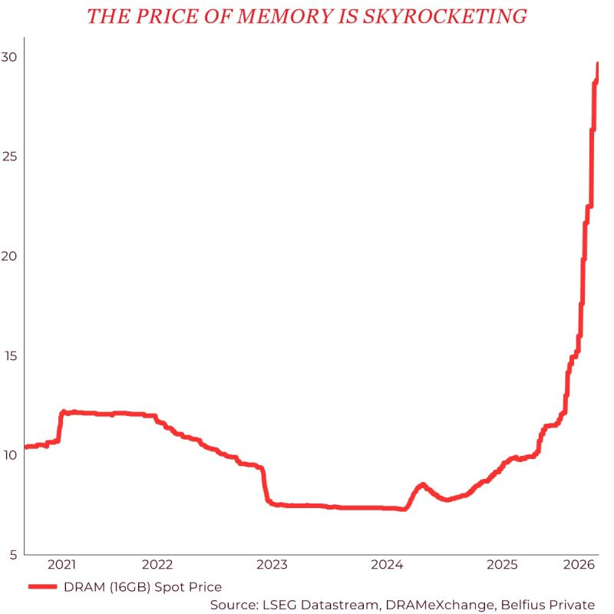
Quiz: What This Is?
Image source: https://media.licdn.com/dms/image/v2/D4D22AQEGuu4U82nddg/feedshare-shrink_800/B4DZ38iDPgHkAc-/0/1778058278141?e=2147483647&v=beta&t=1ZRbFrejThXU6Lqt7AGuBq_zwtJXhvzIrDgazCp1Ep0

Slide 6
Quiz: What This Is?
Hint: Not # of CVEs
Image source: https://media.licdn.com/dms/image/v2/D4D22AQEGuu4U82nddg/feedshare-shrink_800/B4DZ38iDPgHkAc-/0/1778058278141?e=2147483647&v=beta&t=1ZRbFrejThXU6Lqt7AGuBq_zwtJXhvzIrDgazCp1Ep0

Slide 7
Quiz: What This Is?
Hint: Not # of CVEs
Answer: DRAM price
Image source: https://media.licdn.com/dms/image/v2/D4D22AQEGuu4U82nddg/feedshare-shrink_800/B4DZ38iDPgHkAc-/0/1778058278141?e=2147483647&v=beta&t=1ZRbFrejThXU6Lqt7AGuBq_zwtJXhvzIrDgazCp1Ep0

Slide 8
Don’t Panic, Overcommit
Long time researched problem
Equip RAM to only fit working set
Kernel should do everything else

Slide 9
Thrashing, OOM Kills, Panic
Having support != well supported
Long time researched != Solved
“Everyone Has a Plan Until They Get Punched in the Mouth”,
Mike Tyson

Slide 10
Working Set
Not necessarily all allocated memory
Frequently accessed (hot) data
How to monitor access?
One of long-time unsolved issues

Slide 11
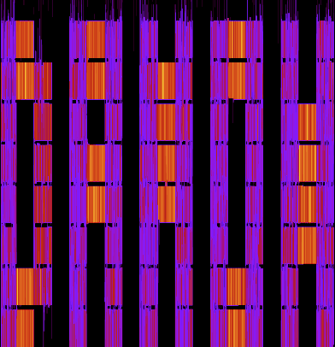
DAMON: Yet Another Solution
“DAMON is a Linux kernel subsystem for efficient data access monitoring and
access-aware system operations.”
Image is generated by DAMON

Slide 12
DAMON in Nutshell

Slide 13
High Level Implementation
Spawn a kernel thread that does
See if each page is accessed, every 5ms
Inform users the findings, every 100ms
Time intervals can be [auto-]tuned

Slide 14

Output: Access Information
Location
Frequency
Stability
Recency
Access pattern heatmap of
Splash2x/Raytrace

Slide 15
Design
Goal: Accurate, light, tunable, automated
Mechanisms: Sampling, Adaptive regions, Sysfs interface, Feedback loops
Result: <0.1% CPU overhead on products
Out of the scope of this talk

Slide 16
Availability and Usages
Available on >=5.15 upstream kernels
Enabled on most distro kernels
Being used for products and researches

Slide 17
Community
Public channels
  Mailing list: damon@lists.linux.dev
  Project website: https://damonitor.github.io/
Private channels
  Maintainer email: sj@kernel.org
  DAMON Beer/Coffee/Tea Meetup

Slide 18
Pain: Poor User Guides
The evolution ain’t be documentized
Code changes faster than docs
Users leave with misunderstandings
  Don’t be gentle...

Slide 19
The Guides Arrived
This talk is the DAMON user guide
  v2026.10.06; One version before another
Ain’t be complete; please report bugs
Point is, placeholder for yelling

Slide 20
Table of Contents (40 mins)
Background (5 mins)
Tools (5 mins)
Config (7 mins)
Monitoring/Visualization (10 mins)
One more thing (5 mins)
QnA (8 mins)

Slide 21
How To Use

Slide 22
DAMON User-space Tool (damo)
https://github.com/damonitor/damo
Easy to use, flexible, not highly optimized

Slide 23
DAMON Sysfs Interface
/sys/kernel/mm/damon/
Machine-friendly, flexible
Optimized for “Build Your Own Tool”

Slide 24
DAMON Modules
CONFIG_DAMON_{STAT,RECLAIM,LRU_SORT}
Optimized for specific use cases
More improvements (DAMON-X) will arrive

Slide 25
Tools: damo, sysfs, and AI
Start from damo for simple usages
Build your optimized tool using sysfs
AI could make it easy (or worse)
  Let AI refer to damo and avail resources
  Request help to community if needed

Slide 26
Table of Contents (40 mins)
Background (5 mins)
Tools (5 mins)
Config (7 mins)
Monitoring/Visualization (10 mins)
One more thing (5 mins)
QnA (8 mins)

Slide 27
DAMON Configuration

Slide 28
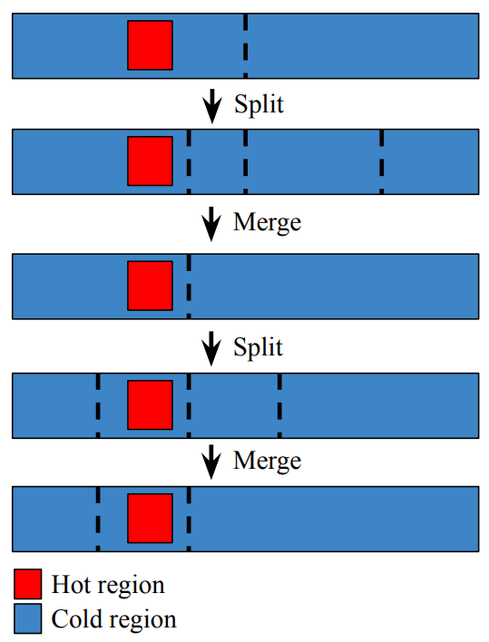
DAMON Region
Address range of similar access frequency
  Dynamic size, merge/split
User sets # regions limits
  Same to min/max accuracy/overhead

Slide 29
# Regions Range Setup Guide
Start from [10, 1000]
  Proven to work on a few products
Set min == max for fixed-gran monitoring

Slide 30
Monitoring Intervals
Sampling interval (5ms by default)
  Time between each page access check
Aggregation interval (100ms by default)
  Sampling results aggregation window
  Time between monitoring results snapshot

Slide 31
Supposed DAMON Snapshot
Captures actionable amount of diversity
Time
1 | 2 | 3 | 1 | 2 | 3 | 1 | 2 | 2
0 | 1 | 1 | 1 | 1 | 1 | 1 | 1 | 2
0 | 0 | 1 | 0 | 0 | 0 | 1 | 1 | 1
1 | 2 | 2 | 1 | 2 | 3 | 1 | 1 | 2
Address
Region
Sampling interval
Aggregation interval

Slide 32
Short Intervals: Nothing Special
Time
1 | 1 | 1 | 0 | 1 | 1 | 0 | 1 | 1
0 | 0 | 0 | 0 | 0 | 0 | 0 | 0 | 0
0 | 0 | 0 | 0 | 0 | 0 | 0 | 0 | 0
1 | 1 | 1 | 0 | 0 | 0 | 0 | 0 | 0
Address
Region
Sampling interval
Aggregation interval

Slide 33
Long Intervals: All Special
1 | 2 | 3 | 1 | 2 | 3 | 1 | 2 | 3
1 | 2 | 3 | 1 | 2 | 3 | 1 | 2 | 3
1 | 2 | 3 | 1 | 1 | 2 | 1 | 2 | 3
1 | 2 | 3 | 1 | 2 | 3 | 1 | 2 | 3
Address
Region
Sampling interval
Aggregation interval

Slide 34
Intervals Tuning Difficulty
Nothing Special ~= All Special
  Not actionable
Optimum tuning depends on workload
  Time consuming and repetitive
DAMON provides intervals auto-tuning

Slide 35
Intervals Tuning Guide
Start from auto-tuning
  Aim 4% access event in each snapshot
  Keep 1:20 sample:aggregation interval
  Span sample interval in [5ms, 10s]
Reach out to community for optimizations

Slide 36
Table of Contents (40 mins)
Background (5 mins)
Tools (5 mins)
Config (7 mins)
Monitoring/Visualization (10 mins)
One more thing (5 mins)
QnA (8 mins)

Slide 37
Capturing and Visualizing Monitoring Results

Slide 38
Monitoring Results Delivery
Single snapshot built in kernel memory
Exposed to user space via 2 ways
  Tracepoint, every snapshot per aggregation
  DAMON sysfs, one snapshot on demand

Slide 39
Record on Lab Envs
Save all tracepoint output
Interval auto-tuning doesn’t matter
  5ms/100ms intervals can work
Cost: space to save record
Best for lab environments

Slide 40
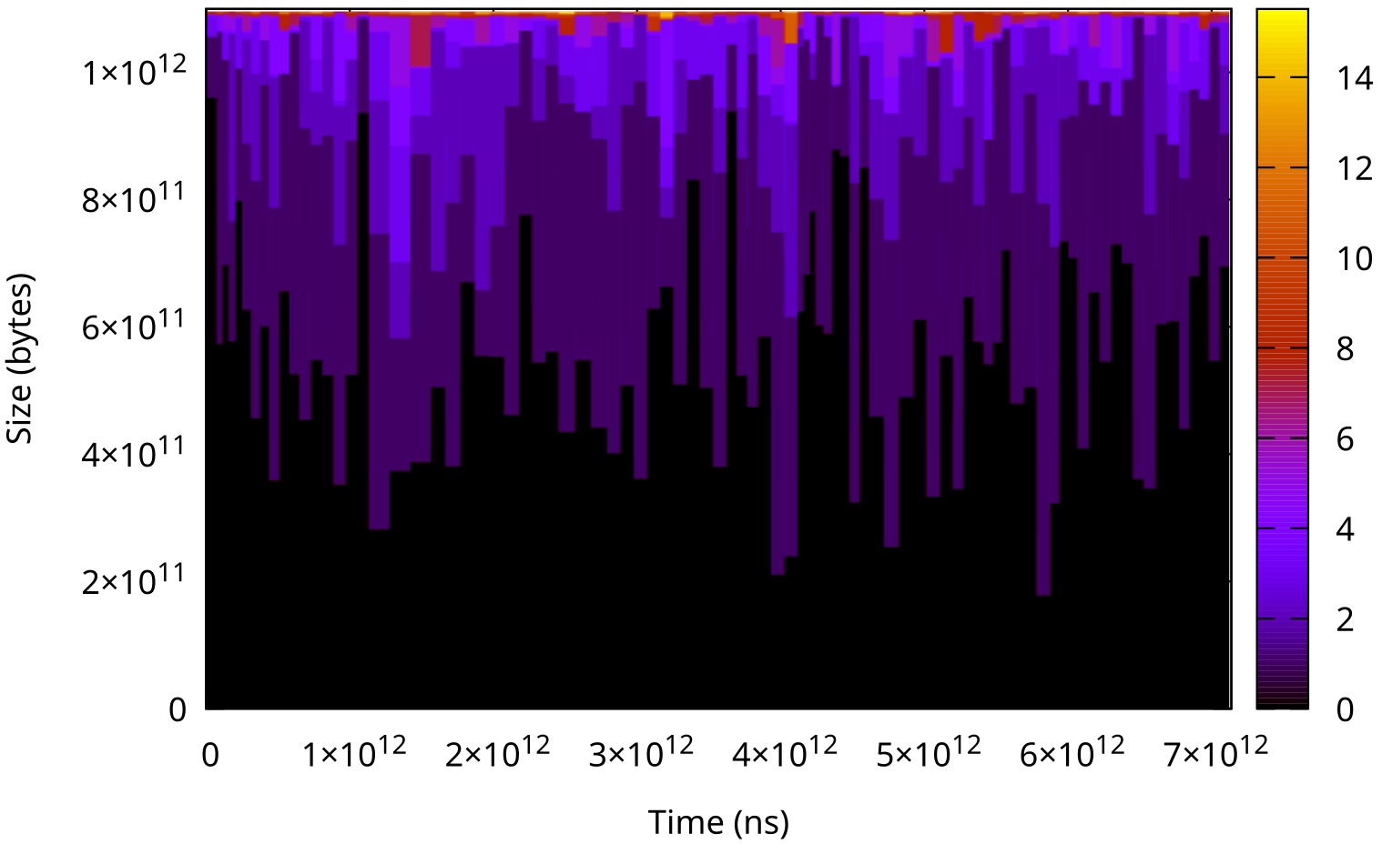
Show Heatmap of Records
Best for records
Time-space zoom in/out is required
  Otherwise, only a blue dot in the void
Heatmap shows ~750 GiB workingset

Slide 41
Record/Heatmap Demo
$ sudo damo record $(workload_pid)
$ sudo damo report heatmap

Slide 42
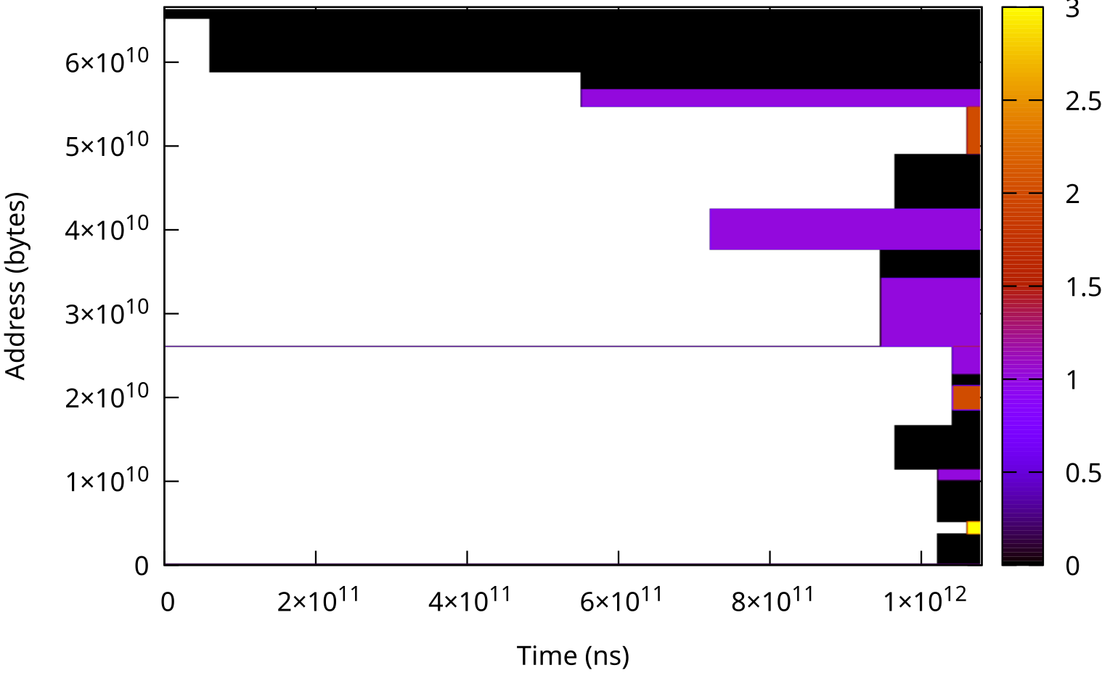
Snapshot on Prod Envs
Snapshot contains practical history
  Access stability per region
Light enough for prod envs: <0.1% CPU

Slide 43
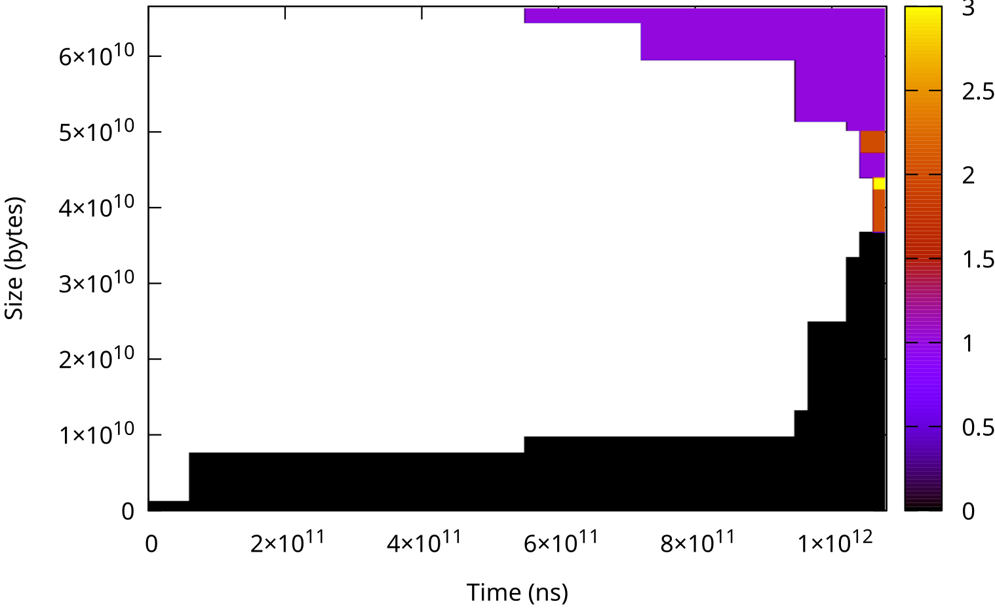
Idle Time Percentiles: Concept
Idle time: how long it was not accessed
Percentile: that of the statistics
Unsorted snapshot
Sorted by access frequency

Slide 44
Idle Time Percentiles: Concept
Idle time: how long it was not accessed
Percentile: that of the statistics
Unsorted snapshot
Sorted by access frequency
P50 idle time

Slide 45
Idle Time Percentiles: Concept
Idle time: how long it was not accessed
Percentile: that of the statistics
Unsorted snapshot
Sorted by access frequency
P50 idle time
P75 idle time

Slide 46
Idle Time Percentiles: Concept
Idle time: how long it was not accessed
Percentile: that of the statistics
Unsorted snapshot
Sorted by access frequency
P50 idle time
P75 idle time
P99 idle time

Slide 47
Idle Times for Snapshot
Easy to aggregate fleet-wide snapshots
  E.g., Fleet-average p{25,50,75} idle time
Integrate well into Grafana-like systems

Slide 48
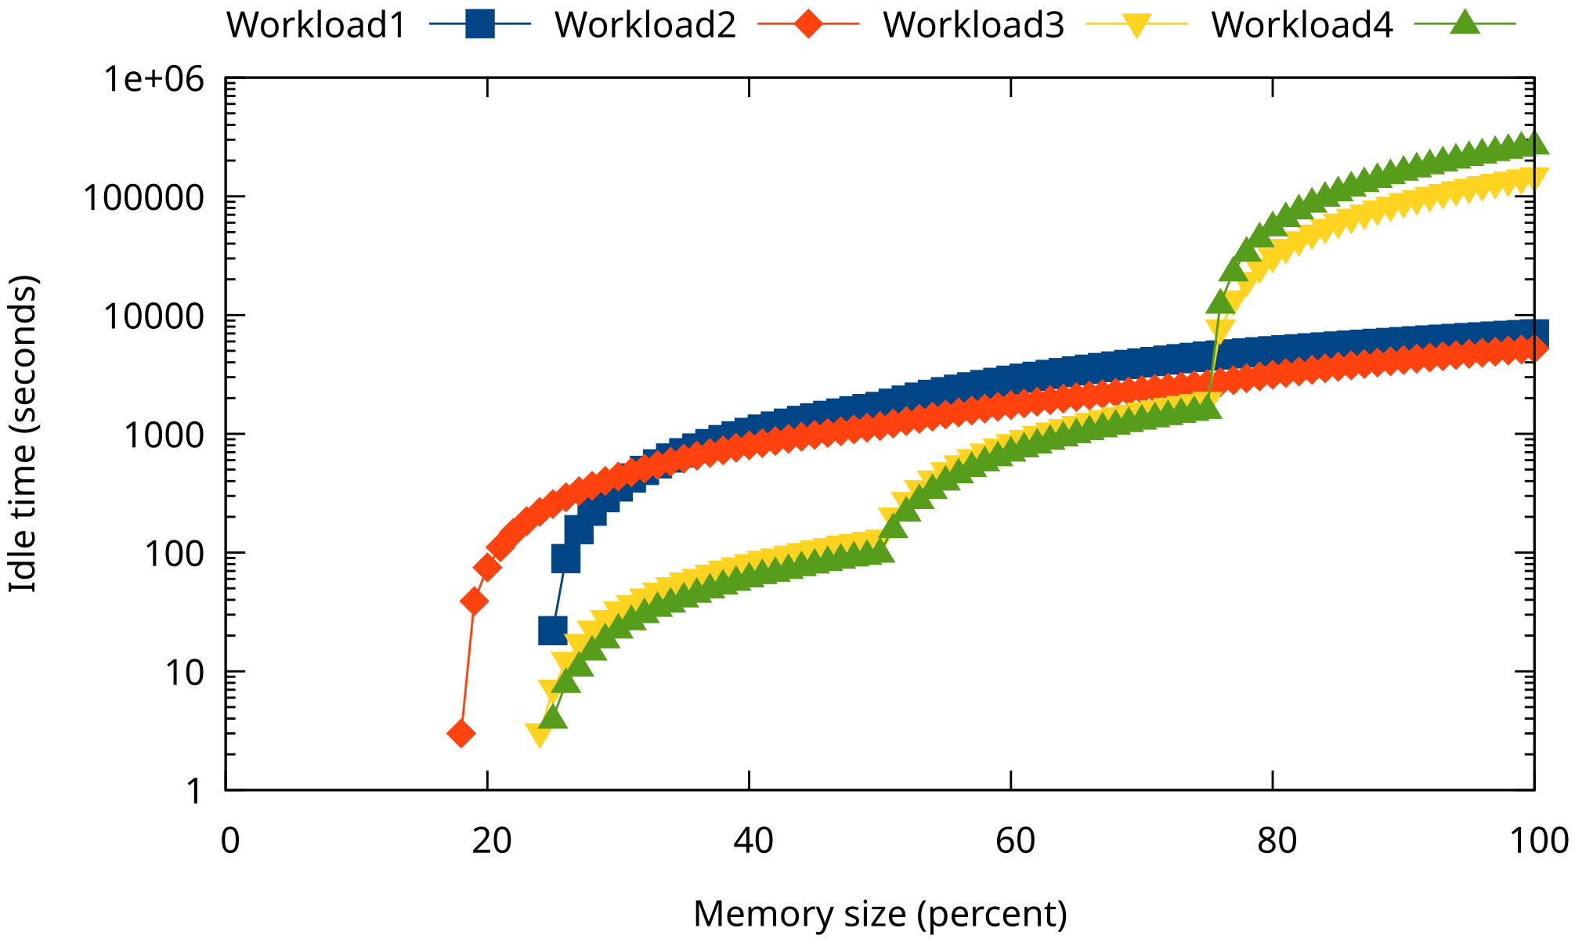
Idle Time Percentiles in Real
Note: Y-axis in logscale
Show common and different patterns of workloads

Slide 49
Snapshot/Idle Times Demo
$ sudo damo start $(workload_pid)
$ sudo ./damo report access --style idle-time-percentiles

Slide 50
Memory Monitoring Wrapup
Config DAMON as community suggests
Record and show heatmap on lab
Snapshot and show idle time on prod/fleet

Slide 51
Table of Contents (40 mins)
Background (5 mins)
Tools (5 mins)
Config (7 mins)
Monitoring/Visualization (10 mins)
One more thing (5 mins)
QnA (8 mins)

Slide 52
One More Thing: DAMOS

Slide 53
Monitoring: Only One of Issues
How hot data is workingset?
How kernel finds the workingset?
  User sends hint to kernel?
DAMON is a part of kernel; Can’t it do all?

Slide 54
DAMOS: Second Face of DAMON
DAMon-based Operation Schemes
  “Page out cold memory”
  “Migrate hot/cold pages to DRAM/CXL node”
Turn DAMON into access-aware memory management system operations engine

Slide 55
DAMOS First
DRAM price is already increased
No time to observe first
Can we save memory first?
Running proven DAMOS schemes is a way

Slide 56
Proactive Reclaim
Proactively reclaim cold memory
Users: Google, Meta, AWS, DeepSeek
  Commonly reports ~20% memory saving
  AWS and DeepSeek uses DAMOS-based one
One well proven overcommit approach

Slide 57
DAMOS for Proactive Reclaim
$ sudo ./damo start --monitoring_intervals_autotune \
--damos_action pageout --damos_access_rate 0% 0% \
--damos_age 2m max \
--damos_quota_space 128M --damos_quota_interval 1s \
--damos_quota_goal some_mem_psi_us 5000

Slide 58
DAMOS for Proactive Reclaim
Hey damo, start DAMON for monitoring
entire physical address space
$ sudo ./damo start --monitoring_intervals_autotune \
--damos_action pageout --damos_access_rate 0% 0% \
--damos_age 2m max \
--damos_quota_space 128M --damos_quota_interval 1s \
--damos_quota_goal some_mem_psi_us 5000

Slide 59
DAMOS for Proactive Reclaim
I don’t know optimum sampling/aggregation intervals,
so just auto-tune the intervals.
$ sudo ./damo start --monitoring_intervals_autotune \
--damos_action pageout --damos_access_rate 0% 0% \
--damos_age 2m max \
--damos_quota_space 128M --damos_quota_interval 1s \
--damos_quota_goal some_mem_psi_us 5000

Slide 60
DAMOS for Proactive Reclaim
Pageout memory that not accessed for >=2 minutes
$ sudo ./damo start --monitoring_intervals_autotune \
--damos_action pageout --damos_access_rate 0% 0% \
--damos_age 2m max \
--damos_quota_space 128M --damos_quota_interval 1s \
--damos_quota_goal some_mem_psi_us 5000

Slide 61
DAMOS for Proactive Reclaim
But only up to 128 MiB/second. I don’t want too rapid reclaim.
$ sudo ./damo start --monitoring_intervals_autotune \
--damos_action pageout --damos_access_rate 0% 0% \
--damos_age 2m max \
--damos_quota_space 128M --damos_quota_interval 1s \
--damos_quota_goal some_mem_psi_us 5000

Slide 62
DAMOS for Proactive Reclaim
Under the hard speed limit, adjust the real speed
aiming 5ms/second (0.05%) memory pressure
$ sudo ./damo start --monitoring_intervals_autotune \
--damos_action pageout --damos_access_rate 0% 0% \
--damos_age 2m max \
--damos_quota_space 128M --damos_quota_interval 1s \
--damos_quota_goal some_mem_psi_us 5000

Slide 63
Just Run Proactive Reclaim
Test first, of course
It should save ~20% memory for you
If not, the community is there to help

Slide 64
Disclaimer

Slide 65
No Satisfaction Guaranteed
Only recommendation
Test and deploy under your charge

Slide 66
Community Exists for Reasons
Place to report issues and cowork
Possible services
  Advanced tuning guides
  Investigations
  Feature backports

Slide 67
Wrapup
Don’t panic, use DAMON
Start from recommended configs
Measure real memory usage
  Recording/heatmap on lab
  Snapshot/idle time percentiles on prod
Start from DAMOS if it works

Slide 68
QnA
Feel free to use
  Hallway track
  damon@lists.linux.dev
  DAMON Beer/Coffee/Tea Chat
  sj@kernel.org

