Slide 1

MARCH 24-26, 2025
MONTREAL, CANADA
#LSFMMBPF
DAMON Updates and Future Plans: Monitoring Parameters Auto-tuning and Memory Tiering
SeongJae (SJ) Park <sj@kernel.org>
https://damonitor.github.io

Slide 2
From: SJ, speaking instead of thankful DAMON community
Authors of DAMON commits merged after LSFMM+BPF’24
Usama Arif <usamaarif642@gmail.com> Andrew Morton <akpm@linux-foundation.org>
Honggyu Kim <honggyu.kim@sk.com>
Linus Torvalds <torvalds@linux-foundation.org> Nhat Pham <nphamcs@gmail.com> David Hildenbrand <david@redhat.com>
Zheng Yejian <zhengyejian@huaweicloud.com>
Anna-Maria Behnsen <anna-maria@linutronix.de>
Hyeongtak Ji <hyeongtak.ji@sk.com> Taotao Chen <chentaotao@didiglobal.com> Marcelo Moreira <marcelomoreira1905@gmail.com>
Thorsten Blum <thorsten.blum@linux.dev> Joshua Hahn <joshua.hahnjy@gmail.com>
Maximilian Heyne <mheyne@amazon.de> Andrew Paniakin <apanyaki@amazon.com>
James Houghton <jthoughton@google.com> Ba Jing <bajing@cmss.chinamobile.com>
Leo Stone <leocstone@gmail.com> Jinjie Ruan <ruanjinjie@huawei.com>
Diederik de Haas <didi.debian@cknow.org>
Liam R. Howlett <Liam.Howlett@oracle.com> Peng Hao <flyingpeng@tencent.com>
Christophe Leroy <christophe.leroy@csgroup.eu>
Alex Rusuf <yorha.op@gmail.com>

Slide 3
DAMON in a Nutshell
DAMON: a kernel subsystem for Data Access MONitoring
  “DAMON-region” abstraction for
    Access pattern information (which address range is how frequently accessed for how long time)
    Overhead-accuracy best-effort tradeoff
DAMOS: another side of DAMON for access-aware system operations
  Executes monitoring results-based memory management operations
    e.g., reclaim regions that not accessed for >=2 minutes
  Allows fine control of resource consumption and behavior: quotas and filters
Publicly known industry usages: Proactive reclaim (AWS) and CXL memory tiering (SK hynix)

Slide 4
Major DAMON Changes Since LSFMM+BPF’24 in a Glance
Shared in LSFMM+BPF’24 and merged into mainline
  DAMOS young page filter (6.10-rc1)
  memory tiering support (migrate_{hot,cold} DAMOS actions) (6.11-rc1)
Developed after LSFMM+BPF’24 and merged into mm-stable so far
  Monitoring intervals tuning guide documentation (6.14-rc1)
  Page level monitoring support (6.14-rc1)
  Monitoring intervals auto-tune (mm-stable as of this talk)
Followup of LSFMM+BPF’24-shared one
  Self-tuned memory tiering prototype and evaluation results are recently shared
(Important and significant amount of cleanups and documentations are also made)

Slide 5
Page Level Monitoring

Slide 6
Page Level Monitoring, a.k.a sz_ops_filter_passed
Motivation: “I want to know access pattern of huge pages only”
DAMOS filters feature provides the information
  Supplement DAMON region’s best-effort quality
  PG_young, anonymous, memcg, hugepage_size, unmapped, active, etc
  Not exposed to monitoring results, though
Idea: Expose it via API and ABI
Implementation: Count and expose ‘->sz_filter_passed’ per-region, per-scheme

Slide 7
Page Level Monitoring Example: Detailed Information
Shows how much of the region of a specific access pattern have passed the given filter
$ sudo ./damo report access --snapshot_damos_filter allow active --sort_regions_by temperature
heatmap: 98888888888888888633333332222222100000000000000000000000000000000000000000000000
# min/max temperatures: -50,872,986,756, 905,086,383, column size: 766.312 MiB
# damos filters (df): allow active
df-pass: 998888888888888888888888888888887777777777777777777777778[...]800000000006[...]40000000000004
# min/max temperatures: -49,530,000,000, 2,570,000,500, column size: 236.492 MiB
0 addr 63.165 GiB size 719.684 MiB access 0 % age 8 m 29.600 s df-passed 0 B
1 addr 57.185 GiB size 2.990 GiB access 0 % age 8 m 15.300 s df-passed 0 B
2 addr 60.175 GiB size 2.990 GiB access 0 % age 8 m 15.300 s df-passed 3.324 MiB
[...]
302 addr 5.013 GiB size 4.000 KiB access 35 % age 400 ms df-passed 4.000 KiB
303 addr 5.013 GiB size 8.000 KiB access 50 % age 400 ms df-passed 8.000 KiB
304 addr 5.012 GiB size 12.000 KiB access 95 % age 400 ms df-passed 12.000 KiB
305 addr 5.013 GiB size 8.000 KiB access 95 % age 400 ms df-passed 8.000 KiB
[...]
447 addr 5.363 GiB size 52.000 KiB access 100 % age 25.500 s df-passed 52.000 KiB
448 addr 5.363 GiB size 36.000 KiB access 100 % age 25.500 s df-passed 36.000 KiB
449 addr 4.000 GiB size 518.094 MiB access 5 % age 25.700 s df-passed 156.574 MiB
memory bw estimate: 5.650 GiB per second df-passed: 2.117 GiB per second
total size: 59.868 GiB df-passed 1.305 GiB

Slide 8
Page Level Monitoring Example: Recency Histogram
Page level information can be accumulated in multiple visualization
$ sudo ./damo report access --snapshot_damos_filter allow active \
--style recency-sz-hist
<last accessed time (us)> <df-passed size>
[0 ns, 7.380 s) 180.168 MiB |***** |
[7.380 s, 14.760 s) 891.234 MiB |********************|
[14.760 s, 22.140 s) 234.203 MiB |****** |
[22.140 s, 29.520 s) 17.480 MiB |* |
[...]
[1 m 6.420 s, 1 m 13.800 s) 9.250 MiB |* |
<last accessed time (us)> <total size>
[0 ns, 7.380 s) 531.879 MiB |* |
[7.380 s, 14.760 s) 5.989 GiB |*** |
[14.760 s, 22.140 s) 732.332 MiB |* |
[22.140 s, 29.520 s) 5.631 GiB |*** |
[...]
[1 m 6.420 s, 1 m 13.800 s) 41.073 GiB |********************|
memory bw estimate: 10.645 GiB per second df-passed: 3.787 GiB per second
total size: 59.868 GiB df-passed 1.301 GiB

Slide 9
Page Level Monitoring: Continu{ed,ing} Developments
More DAMOS filter types are added for page level monitoring purpose:
  Usama Arif (THP shrinker developer) contributed ‘hugepage_size’ DAMOS filter type
  Nhat Pham (zswap developer) contributed ‘active’ LRU pages DAMOS filter type
Future Work: Reducing overhead
  Overhead is controllable, but still high
    Controlled usage: apply page level monitoring to only interesting regions
    e.g., damo report access --address 7.2G 7.4G --snapshot_damos_filter hugeapge_size 2M max
  Sampling approaches might help

Slide 10
Monitoring Intervals Auto-tuning

Slide 11
Monitoring Intervals Tuning
Aggregation interval need to be tuned
  If it is too short, everything looks cold
  If it is too long, everything looks hot
  The default value (100 ms) is far from a magic value
The tuning is required for different systems and workloads (repetitive and time consuming)
  Every known DAMON production users did the tuning on their own ways
Tuning guide is finally documented on v6.14
  Readable one is good, executable (automated) one is better

Slide 12
Monitoring Intervals Tuning Automation
Change question: “how much access events each snapshot should capture?”
  Metric: access events ratio (DAMON-observed : DAMON-could-observe-in-max)
Run feedback loop for the target value, feeding access events ratio of current snapshot
Let users set how frequently adaptation should happen, and min/max sampling interval
Still questions exist, but easier to answer
  Target access events ratio depend on users’ interest: higher target to find more hot regions
    4 % maybe a good default value (by 20:80 rule, can capture 64% meaningful accesses)
  Min/max sampling interval can naively set
    [5ms, 10s] maybe a good default range
Hopefully will be merged in v6.15-rc1

Slide 13
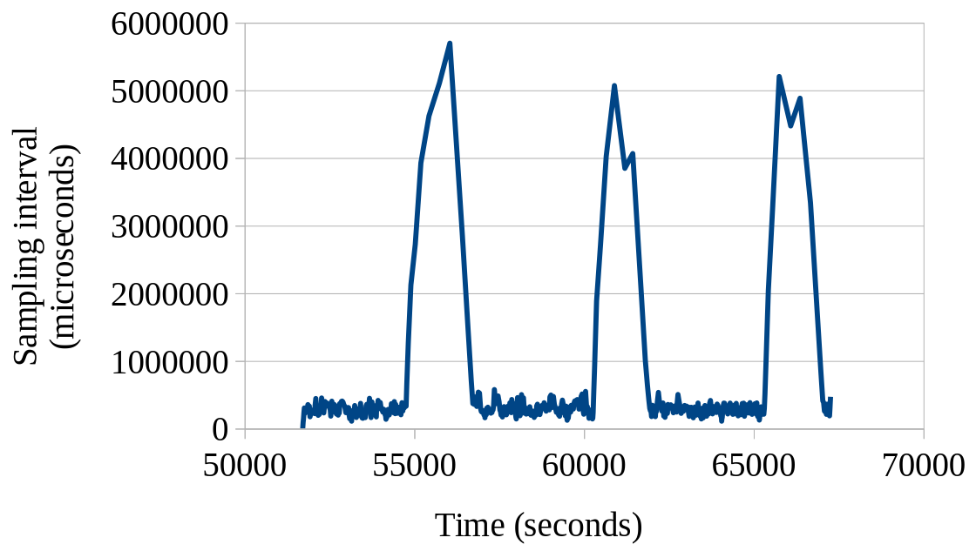
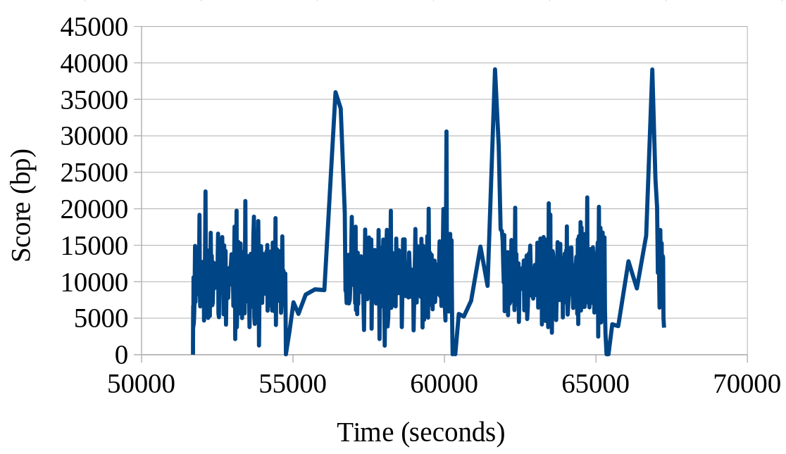
Intervals Auto-tuning on a Real-world Server Workload
Sampling interval continuously change, and be converged for given access pattern
  370ms under usual load, ~4-5 seconds under light load
Tuning score converges to the goal (10,000 bp)

Slide 14
Results and Next Steps
Results: Always colorful snapshot with 0.1% single CPU usage
Next step: CONFIG_DAMON_ALWAYS_ON?

Slide 15
Self-tuned Memory Tiering

Slide 16
Recap of LSFMM+BPF 24 Discussion for DAMON-based Memory Tiering
A few DAMON-based memory tiering approaches were introduced
  SK hynix’ patch series for that was under review
  The patch series has merged into 6.11-rc1 after LSFMM+BPF
A design of another approach for general environments has proposed
  Detailed RFC idea has sent to the mailing list

Slide 17
DAMOS Auto-tuning Based Memory Tiering Policy
For each CPU-independent NUMA node,
  If the node has a lower node,
    Demote cold pages of the current node to the lower node,
    aiming little fraction (e.g. 5%) of free memory of the current node
  If the node has an upper node,
    Promote hot pages of the current node to the upper node,
    aiming big fraction (e.g., 96%) of used memory of the _upper_ node
Use upper tier as much as possible for hotter data with controlled aggressiveness
Support N tiers
node 0 (fast): Demote cold pages in node 0 aiming 5% free memory of node 0
node 1 (slow): Promote hot pages in node 1 aiming 96% used memory of node 0
Demote cold pages in node 1 aiming 5% free memory of node 1
node 2 (slowoo): Promote hot pages in node 2 aiming 96% used memory of node 1

Slide 18
Self-tuned DAMON-based Memory Tiering Development
‘migrate_{hot,cold}’ DAMOS actions are merged into v6.11-rc1
Developed NUMA nodes utilization/free space ratio DAMOS tuning goal
Implemented a DAMON module for self-tuned memory tiering
  With auto-tuned intervals, promote/demote hot/cold pages up to 200 MiB/s quota that auto-tuned aiming 99.7%/0.5% utilization/free ratio of upper tier memory
RFC implementation: https://lore.kernel.org/20250320053937.57734-1-sj@kernel.org

Slide 19
Evaluation Setup
Machine: 250 GiB DIMM-connected node 0 and 55 GiB CXL-connected node 1
Workload
  Taobench/DCPerf, 340 GiB memsize (~270 GiB RSS), 2,500 s warmup_time, 1,440 s test_time
Configs
  Baseline: Occasionally promote cold and demote hot pages, to simulate dynamic access pattern
  Numab_tiering: Enable NUMAB-2 promotion and LRU-based demotion on Baseline
  DAMON_tiering: Enable DAMON-based memory tiering on Baseline

Slide 20
Evaluation Result: Performance
DAMON_tiering improves performance by 4.4 %
  Shows effectiveness of DAMOS-based operation and DAMON’s monitoring accuracy
Numab_tiering degrades performance by 7.3 %
  More investigation is needed, but current suspects are:
    Direct migration has blocked Taobench’s progress
    Took long time to find hot pages scattered in large area
Disclaimer: Artificial frequent access pattern change
Config Score Stdev (%) Normalized
Baseline 1.6165 0.0319 1.9764 1.0000
Numab_tiering 1.4976 0.0452 3.0209 0.9264
DAMON_tiering 1.6881 0.0249 1.4767 1.0443

Slide 21
Next Steps
Land NUMA nodes utilization / free space ratios DAMOS goal metrics
Implement DAMON module for general memory tiering that just works
  Automated tiers and promotion/demotion path identification
General heterogeneous (NUMA-abstract) memory management
Bandwidth-aware migrations

Slide 22
Discussion Time

Slide 23
Discussion Points
Page Level Monitoring
Monitoring Intervals Auto-tuning
Self-tuned Memory Tiering

Slide 24
Backup Slides

Slide 25
Self-tuned DAMON-based Memory Tiering vs NUMAB-2 and LRU-based Demotion

Slide 26
DAMON/S vs NUMAB-2 promotion
Advantages
  Migrate in async thread
  Handle unmapped pages
  Adapt promotion aggressiveness; minimize unnecessary demotion-promotion ping-pong
  Can detect hot pages in any location
Disadvantages
  Fairness: DAMON loves hot threads!
  Could take longer time to find small hot pages

Slide 27
DAMON/S vs LRU-based Demotion
Advantages
  Balance better with DAMOS auto-tuning based promotion; minimize unnecessary ping-pong
  Can find colder pages faster, if memory pressure happens only occasionally
Disadvantage
  DAMOS maybe slower than LRU-based one at handling significant memory pressure
Running LRU-based direct demotion and DAMON/S-based proactive one together may be good team work

Slide 28
Memory Tiering Evaluation for Static Access Pattern

Slide 29
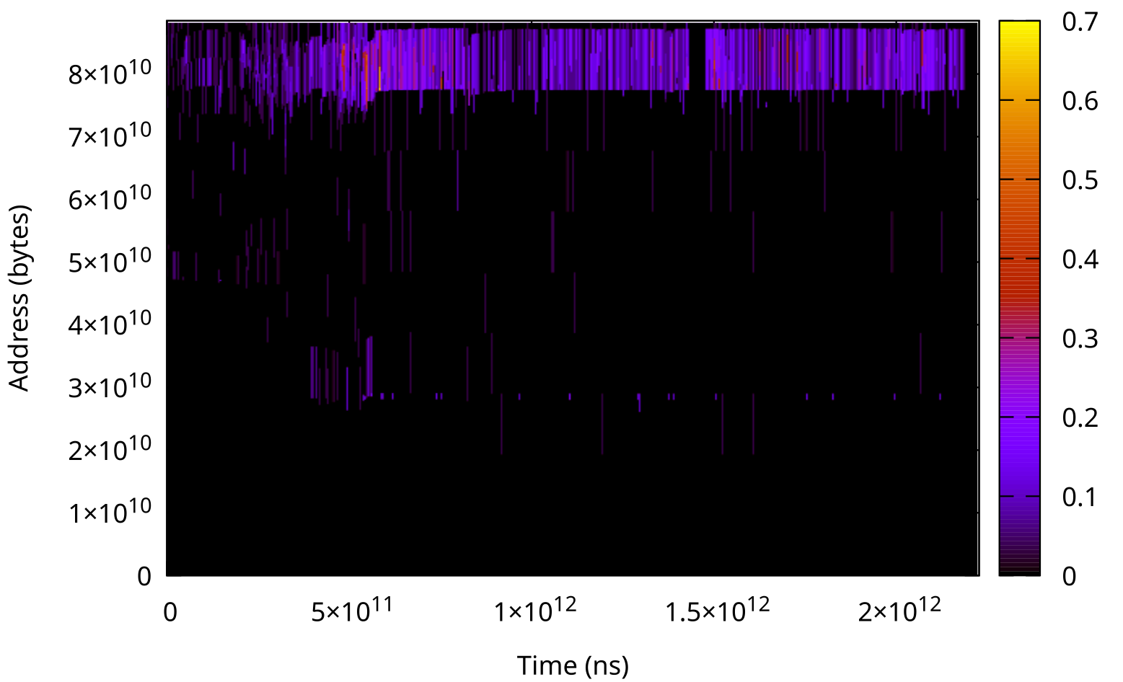
Taobench (64GiB memsize) Access Pattern
Only small amount of memory is continue being hot
Only demotion benefit this access pattern

Slide 30
Evaluation Result: Performance
Baseline_0: Taobench without artificial access pattern changes (hot pages demotion and cold pages promotion)
Config Score Stdev (%) Normalized
Baseline_0 1.5989 0.0131 0.8193 0.9891
Baseline 1.6165 0.0319 1.9764 1.0000
Numab_tiering 1.4976 0.0452 3.0209 0.9264
DAMON_tiering 1.6881 0.0249 1.4767 1.0443

Slide 31
Taobench_static Performance Results
Why damon_tiering degrade?
  DAMON-demotion is too slow (200 MiB/second) to handle the memory pressure
  Since LRU-demotion is turned off, reclaim happened
Why {numab,damon}-promotion doesn’t improve?
  Static access pattern: No value to promote anything
Config Score Stdev (%) Normalized
Baseline_0 1.6175 0.0131 0.8112 1.0000
demote_only 1.7178 0.0166 0.9635 1.0620
numab_tiering 1.7126 0.0298 1.7399 1.0588
damon_tiering 1.5754 0.0134 0.8509 0.9994
demote+damon_tiering 1.6939 0.0102 0.5998 1.0472

Slide 32
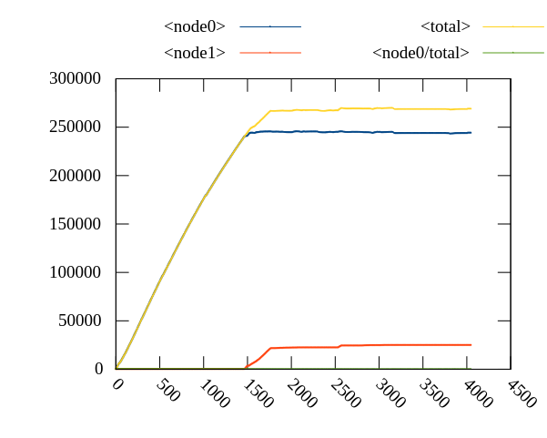
Taobench Memory Usage: Baseline0

Slide 33
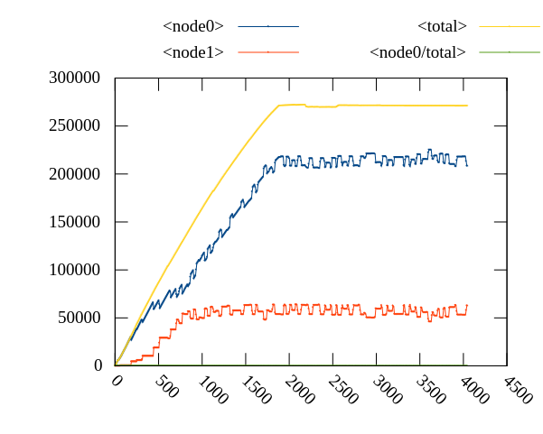
Taobench Memory Usage: Baseline

Slide 34
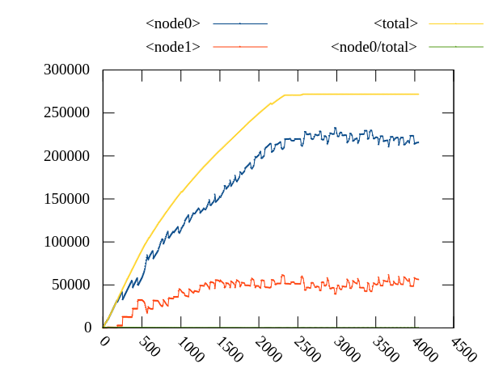
Taobench Memory Usage: Numab2

Slide 35
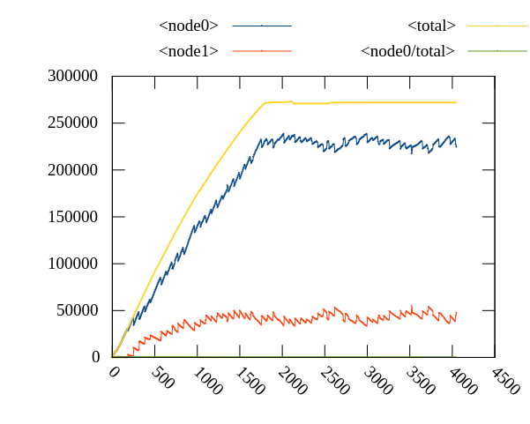
Taobench Memory Usage: DAMON-tiering

Slide 36
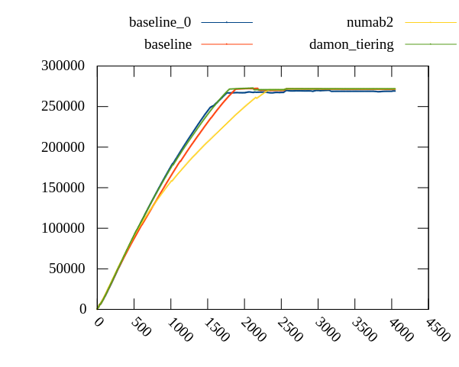
DAMON-Tiering: Memory Usage: Total

Slide 37
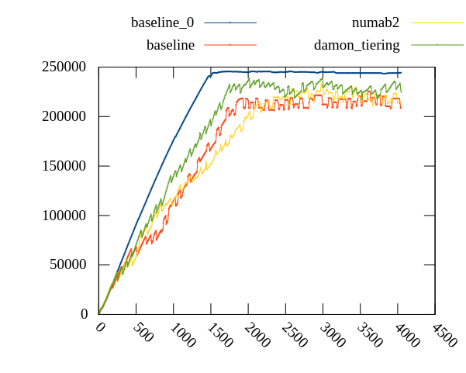
DAMON-Tiering: Memory Usage: Node 0

Slide 38
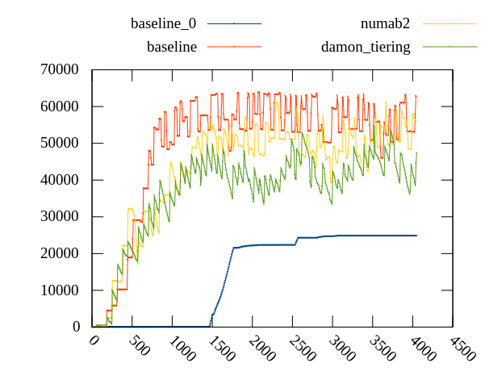
DAMON-Tiering: Memory Usage: Node 1

Slide 39
Updates to LSFMM+BPF’24 Shared Projects
DAMOS Auto-tuning based Tiered Memory Management
  A prototype is implemented and evaluated: 4.4% performance improvement achieved
Access/Contiguity-aware Memory Auto-scaling
  No progress at all, sorry; It’s unclear if it will be prioritized
Monitoring improvements
  Auto-tuning: Intervals auto-tuning is actually for this
  higher accuracy: A plan for regions adjustment improvement is shared
Write-only monitoring: Beyond Accessed bits is for this
LRU-sort auto-tuning: No progress yet; stay tuned
Access-aware THP assistant: THP access monitoring is for preparation of this
CPU-aware monitoring and NUMA-balancing: Beyond Accessed bits is for this

Slide 40
More Plans

Slide 41
Keep The Monitoring On
DAMON ABI users (user-space) and API callers (kernel-space) should start DAMON for them
  Difficult to “just” use DAMON
Planning to be able to “just” be used
  Start DAMON for physical address space with intervals auto-tuning at boot, keep it on always
    CONFIG_DAMON_ALWAYS ?
  Let users and kernel components use the system-started DAMON
    struct damon_ctx *damon_get_always_on_ctx(void);
    Read monitoring results from it
    Add and remove (stacking) DAMOS schemes to it
    Report observed access to it

Slide 42
Beyond Accessed Bits
Page accessed bits and PG_Idle are the main source of DAMON today
Desired Usages of DAMON
  Per-CPU access for cache-aware scheduling
  Write-only monitoring for live migration VM target selection
  Memory bandwidth monitoring for process/jobs scheduling
Planning to expand with more source of information
  Page faults
  AMD IBS and similar h/w features
  Memory bandwidth PMU

Slide 43
DAMON in a Nutshell

Slide 44
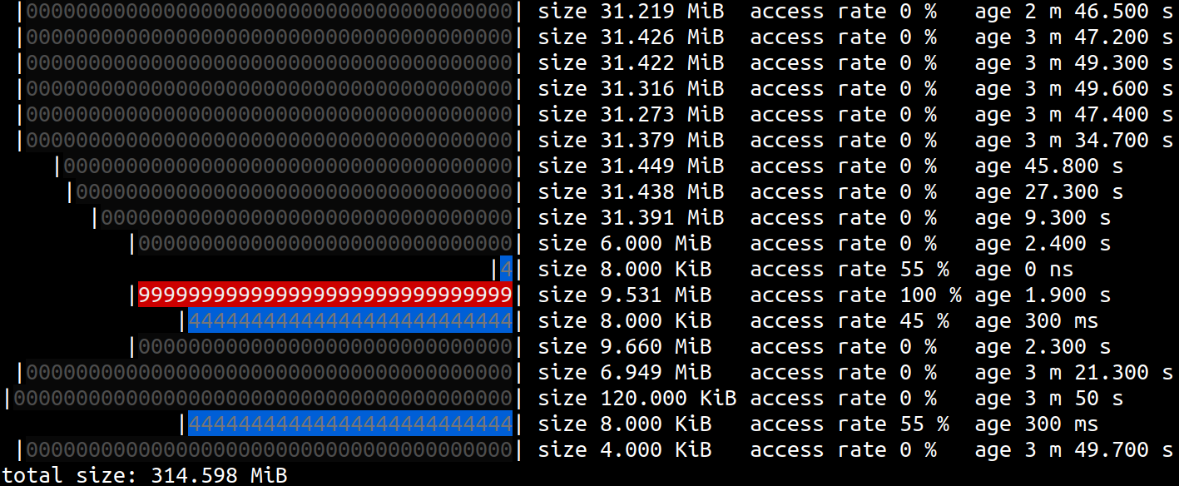
DAMON: Access Pattern Snapshot Generator
Inform which address range is how frequently accessed for how long time
Support virtual address spaces and the physical address space

Slide 45
DAMON: Access Pattern Snapshot Generator
Inform which address range is how frequently accessed for how long time
Support virtual address spaces and the physical address space
Cold!
Hot!
Warm!

Slide 46
DAMOS: DAMON-based Operation Scheme
Apply memory operation actions to regions of interesting access pattern
# # pageout memory regions that not accessed for >=5 seconds
# damo start --damos_action pageout --damos_access_rate 0% 0% --damos_age 5s max
Pageout!

Slide 47
DAMON Stack, In a Future
User-space
Tools
DAMO
datop
DAMON API User
Kernel Modules
General-purpose User ABI
Special-purpose Modules
DAMON_SYSFS
DAMON_DBGFS
DAMON_RECLAIM
DAMON_LRU_SORT
DAMON_WSS
DAMON Application Programming Interface
DAMON
DAMOS
Adaptive Regions Adjustment
Action and Pattern
Core Logic
Region-based Sampling
Quotas and Prioritization
Access Frequency Monitoring
Feedback-based auto-tuning
Advanced Regions Adjustment
Watermarks
Parameters Auto-tuning
Filters
DAMON Operations Set Registration Interface
Operations Set
paddr
vaddr
Read/write-only
NUMA-cpus-only
Primitives
that DAMON
depends on
PTE/VMA/rmap, ...
AMD IBS
LRU State

Slide 48
DAMON: Kernel Subsystem for Data Access Monitoring and Access-aware System Operations

Slide 49
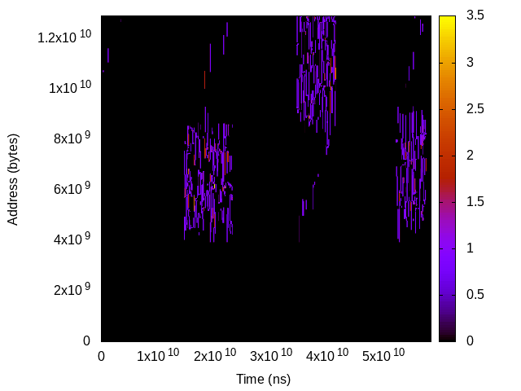
Data Accesses: Events on Space/Time of Memory
Time
Address

Slide 50
Data Access Monitoring: Hope, Real, and DAMON
Hope: Precise, Complete, Light
  Time granularity: CPU cycle / # CPUs (or, speed of light)
  Space granularity: bit (or, electron)
  Keep complete history (from Bigbang)
  Lightweight enough to run on production systems
Real: Expensive, YAGNI without tradeoff
  O(memory size) time, O(memory size * total monitoring time) space overhead
  Do you really care if a bit was accessed five years ago?
DAMON: accuracy vs overhead tradeoff
  Scalable, best-effort, aim real-world products usage

Slide 51
Region-based Space Handling

Slide 52
Region: Access Monitoring Unit
Defined as
  A sub-area of the memory’s space-time
  A collection of adjacent elements that having similar access pattern
Access check of one element per region is enough
e.g., “This page is accessed within last 1 second; a cacheline is checked”
$ cat wonder_region_1
We’re all mad [un]accessed here

Slide 53
Fixed Space/Time Granularity, <=1 Access Frequency
Sort of periodic fixed granularity idleness monitoring
Time overhead: “memory size / space granularity”
Space overhead: “time overhead * monitoring time / time granularity”
Reduced, but still ruled by memory size and total monitoring time
Time
We’re all mad accessed here
Address
Region
We’re all mad unaccessed here
Sampling interval

Slide 54
Fixed Space/Time Granularity, <=N Access Frequency
Accumulate access checks via per-region counter
Now
Time
1
0
0
1
Address
Region
Aggregate interval
Sampling interval

Slide 55
Fixed Space/Time Granularity, <=N Access Frequency
Accumulate access checks via per-region counter
Now
Time
1 | 2
0 | 1
0 | 0
1 | 2
Address
Region
Aggregate interval
Sampling interval

Slide 56
Fixed Space/Time Granularity, <=N Access Frequency
Accumulate access checks via per-region counter
Now
Time
1 | 2 | 3
0 | 1 | 1
0 | 0 | 1
1 | 2 | 2
Address
Region
Aggregate interval
Sampling interval

Slide 57
Fixed Space/Time Granularity, <=N Access Frequency
Accumulate access checks via per-region counter
Now
Time
1 | 2 | 3 | 0
0 | 1 | 1 | 0
0 | 0 | 1 | 0
1 | 2 | 2 | 0
Address
Region
Aggregate interval
Sampling interval

Slide 58
Fixed Space/Time Granularity, <=N Access Frequency
Accumulate access checks via per-region counter
Now
Time
1 | 2 | 3 | 0 1 | 2 | 3
0 | 1 | 1 | 0 1 | 1 | 1
0 | 0 | 1 | 0 0 | 0 | 0
1 | 2 | 2 | 0 1 | 2 | 3
Address
Region
Aggregate interval
Sampling interval

Slide 59
Fixed Space/Time Granularity, <=N Access Frequency
Accumulate access checks via per-region counter
Now
Time
1 | 2 | 3 | 0 1 | 2 | 3 | 0 1 | 2 | 2
0 | 1 | 1 | 0 1 | 1 | 1 | 0 1 | 1 | 2
0 | 0 | 1 | 0 0 | 0 | 0 | 0 1 | 1 | 1
1 | 2 | 2 | 0 1 | 2 | 3 | 0 1 | 1 | 2
Address
Region
Aggregate interval
Sampling interval

Slide 60
Fixed Space/Time Granularity, <=N Access Frequency
Accumulate access checks via per-region counter
Reduce space overhead to “1/N”
Still, O(memory size * total monitoring time)
Time
3 | 3 | 2
1 | 1 | 2
1 | 0 | 1
2 | 3 | 2
Address
Region
Aggregate interval

Slide 61
Inefficiency of Fixed Space Granularity
Adjacent regions of similar hotness
Time
3 | 3 | 2
1 | 1 | 2
1 | 0 | 1
2 | 3 | 2
Address
Region
Aggregate interval

Slide 62
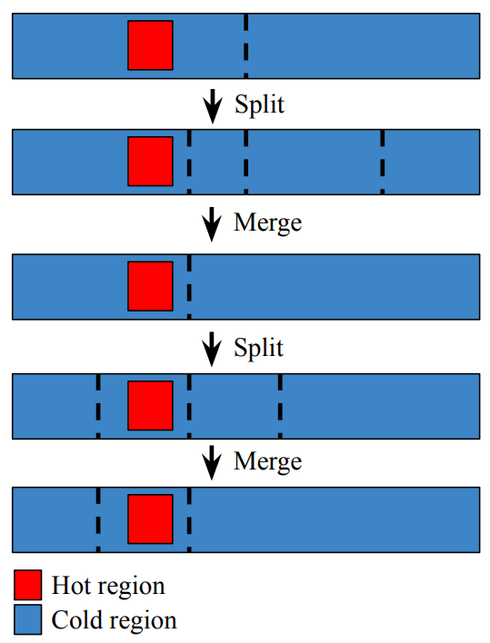
Dynamic Space Granularity: Mechanisms
Repeat merging the wasteful regions and randomly splitting regions
  The number of region == number of different access patterns
Let user set min/max number of total regions
Time
3 | 3 | 2
1 | 1
 | 0 | 1
2 | 3 | 2
Address
Region
Aggregate interval

Slide 63
Dynamic Space Granularity: Mechanisms
Merge the wasteful regions and randomly split region
  The number of region == number of different access patterns
Let user set min/max number of regions
Time
3 | 3 | 2
1 | 1
 | 0 | 1
2 | 3 | 2
Address
Region
Aggregate interval

Slide 64
Dynamic Space Granularity: Overhead/Accuracy
Time overhead: min(different access patterns, max number of regions)
  No more ruled by arbitrary memory size
Accuracy: best-effort high
  Lower-bound accuracy can be set via min_nr_regions
Time
3 | 3 | 2
1 | 1
 | 0 | 1
2 | 3 | 2
Address
Region
Aggregate interval

Slide 65
Age Counting for History Handling

Slide 66
Inefficiency of Fixed Time Granularity Regions (1/2)
The definition of regions is not only about space, but also about time
Time
Address
Region
Aggregate interval

Slide 67
Inefficiency of Fixed Time Granularity Regions (2/2)
The definition of regions is not only about space, but also about time
Multiple time-adjacent regions of similar hotness: only waste
Time
Address
Region
Aggregate interval

Slide 68
Dynamic Time Granularity (1/3)
Count how long the hotness has kept
Snapshot contains history of useful length
Now
Time
1
1
1
1
Address
Region
Aggregate interval

Slide 69
Dynamic Time Granularity (2/3)
Count how long the hotness has kept
Snapshot contains history of useful length
This snapshot can be discarded
Now
Time
1 | 2
1 | 2
1 | 1
1 | 1
Address
Region
Aggregate interval

Slide 70
Dynamic Time Granularity (3/3)
Count how long the hotness has kept
Snapshot contains history of useful length
This snapshot can be discarded
This snapshot can be discarded
Now
Time
1 | 2 | 1
1 | 2 | 3
1 | 1 | 1
1 | 1 | 1
Address
Region
Aggregate interval

Slide 71
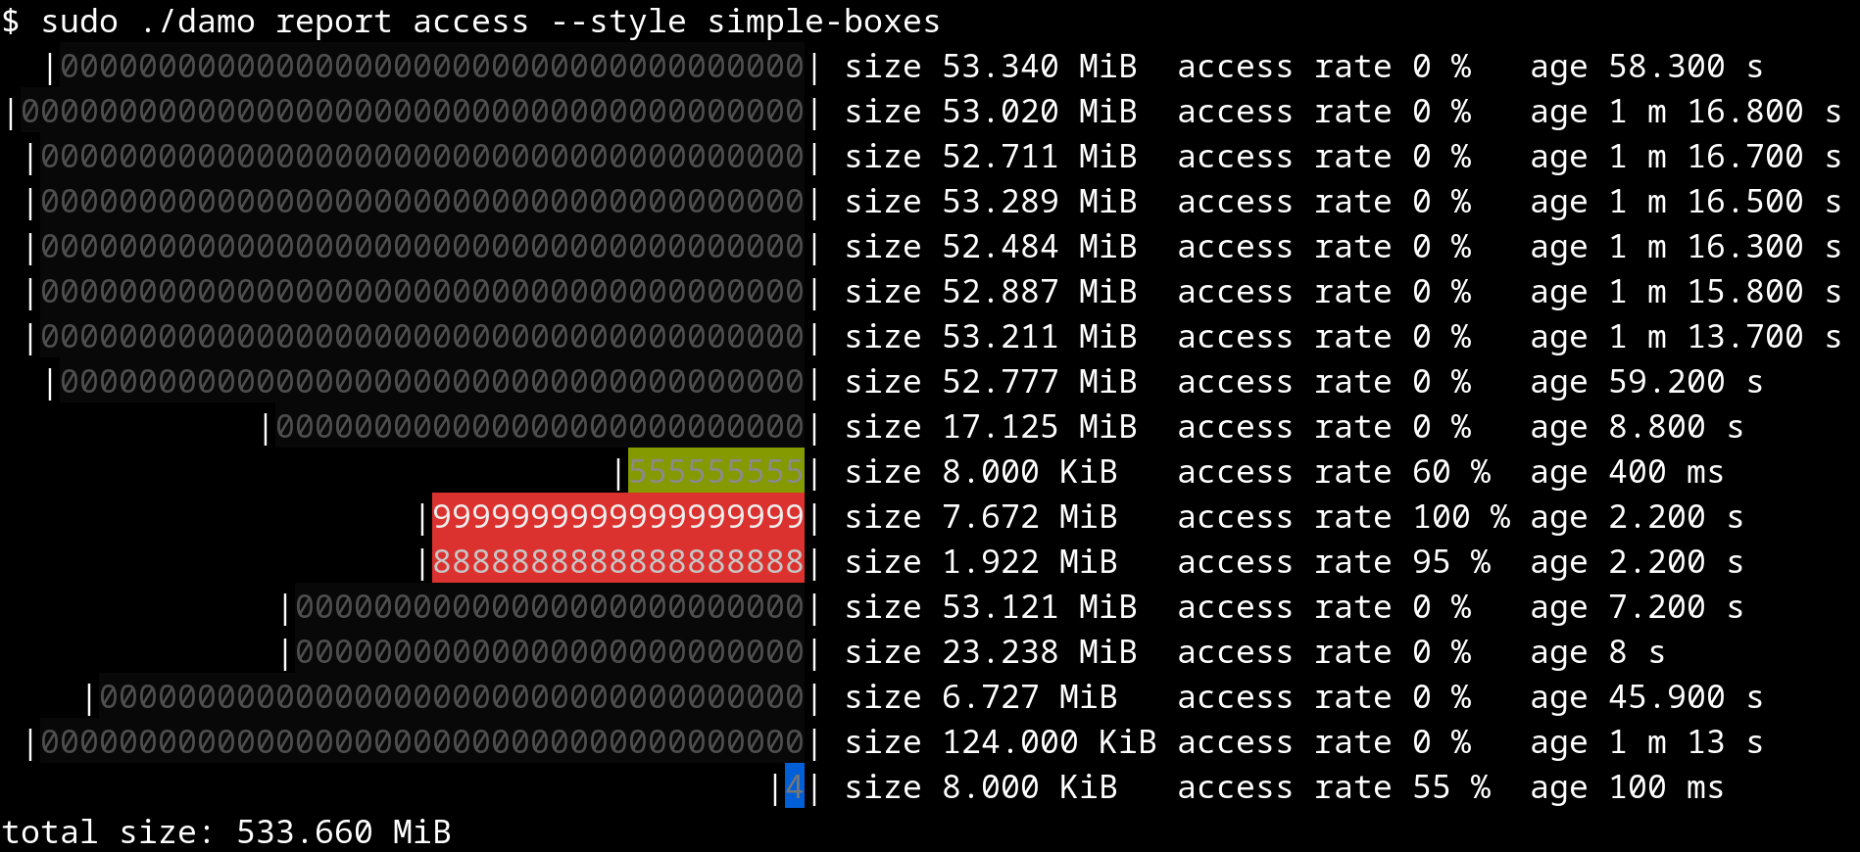
Snapshot: The Output of DAMON
O(max_nr_regions) time/space overhead
Both time/space overheads are not ruled by memory size/monitoring time

