Slide 1
Breaking through
Accessed Bit Limits of DAMON
SJ Park <sj@kernel.org> <sjpark@crusoe.ai>
Ravi Jonnalagadda <ravis.opensrc@gmail.com>
Akinobu Mita <akinobu.mita@gmail.com>

Slide 2
DAMON in One Slide
Spawn a kernel thread that does
See if each page is accessed, every 5ms
Inform users the findings, every 100ms
Time intervals can be [auto-]tuned

Slide 3

Providing Access Information
Location
Frequency
Stability
Recency
Access pattern heatmap of
Splash2x/Raytrace

Slide 4
Page Table Accessed Bit (A-bit)
DAMON’s access check primitive
H/W sets the bit when it access the page
S/W (DAMON) can clear the bit

Slide 5
A-bit Limits
Lack of info
  No accessor (which CPU/proc/cgroup)
  No access type (read/write)
Page table (reverse) walk overhead
(Huge) Page granularity

Slide 6
Idea to Break-through Limits
Extend DAMON for Data Attributes
Attribute Examples
  Memory is backed by cgroup X
  A-bit of the data is set
  AMD IBS found access to the data
  (with accessor and access type info)

Slide 7
Roadmap
Extend DAMON for Data Attributes
  Milestone 1, by LPC’26
Support perf event based access attribute
  Milestone 2, by LSFMMBPF’27
Support AMD IBS, Intel PEBS, ARM SPE, …

Slide 8
Milestone 1: Complete
DAMON is (almost) renamed to DAMON
  Data Access/Attribute Monitoring and Operations eNgine
DAMOS update is in progress

Slide 9
Milestone 2: In Progress
Perf cycle event based access monitoring
  Akinobu suggested initial form
  Ravi suggested cross-vendor perf substrate
  SJ is revisioning
Decode perf sample load/store instruction

Slide 10
Milestone 3: Prototypes Ready
Ravi: AMD IBS, Intel PEBS Support
Kunwu: Arm SPE Support

Slide 11
Milestones 2&3, More Details

Slide 12
Milestone 2: NMI-Safe Delivery
PMU overflow runs in NMI; damon_report_access() takes a mutex, so delivery is deferred
PMU overflow
NMI, one CPU
per-CPU ring
one per context
kdamond drain
each sampling interval
region credited
probe hits, once per interval
write entry
smp_wmb()
publish head
read head
smp_rmb()
read entries
binary search
paddr or vaddr,
per context
re-entrant NMI
dropped and counted by a per-CPU busy guard
one owner per PMU type
a second context gets -EBUSY
CPU hotplug
per-CPU events armed and released with it
per-process targets
matched by thread group id
Next, with Akinobu: fold into milestone 2's report path · damon_report_access() made lock-free
Details in the RFC v4 cover letter

Slide 13
Milestone 3: IBS, PEBS, SPE
TODAY · ACCESSED-BIT SCAN
THIS WORK · PERF EVENTS
page-table walk
reads and clears the Accessed bit
Intel PEBS
virtual address
AMD IBS
physical address
Arm SPE
Kunwu Chan's backend
one look per sampling interval
accessed or not, no more
perf overflow handler · NMI context
turns each sample into an access report
AUX trace buffer
kdamond parses it, no NMI
per-context, per-CPU ring
lockless, NMI-safe
kdamond drain
each sampling interval
access rate (scan) · per-probe hits (perf, once per interval)
access pattern + probe_hits_wsum → DAMOS: promote · demote
Probe weight 0: the scan sets the access rate; perf samples are probe hits. Weights set: scan off, weighted hits decide.
Built on Akinobu Mita's perf-event access check and co-developed with him · RFC v4, October 2026

Slide 14
QnA

Slide 15
Beyond Weighted Interleaving:
Bandwidth-Driven Memory Tiering with DAMON
Ravi Jonnalagadda <ravis.opensrc@gmail.com>

Slide 16
Each Policy Solves Half
WEIGHTED INTERLEAVING · fixed split
HOTNESS TIERING · promote what is hot
DRAM
DRAM
CXL
CXL
✓ drives both memory paths at once
✓ right about heat
✗ blind to which pages are hot
✗ keeps filling DRAM after it stops helping
Wanted: place by hotness, split by the bandwidth the machine actually delivers

Slide 17
The Knobs Are Already Upstream
v6.9
v6.17
v7.2
Weighted interleaving
MPOL_WEIGHTED_INTERLEAVE: a per-node weighted page split (co-developed)
DAMOS destination weights
migrate_hot / migrate_cold to several nodes, by weight: a split per process
node_eligible_mem_bp
a DAMOS quota goal: the share of eligible memory on a node, machine-wide
Missing: something that turns these knobs from a live bandwidth reading

Slide 18
Closing the Loop
DAMON: which pages are hot
PEBS / IBS samples through the perf substrate
damo auto_tier
hill climb
move the split one step;
keep it if bandwidth rose,
step back if it fell
no target ratio given
actuator
VA: DAMOS destination weights
PA: node_eligible_mem_bp goal
resctrl MBM: delivered bandwidth
per monitored process, or the whole machine
DAMOS migrates hot pages → bandwidth changes → measured again
Hill climb from our ISMM 2026 paper, “Bandwidth Speaks, We Listen: Dynamic Memory Interleaving for Tiering” · code: damo auto_tier branch

Slide 19
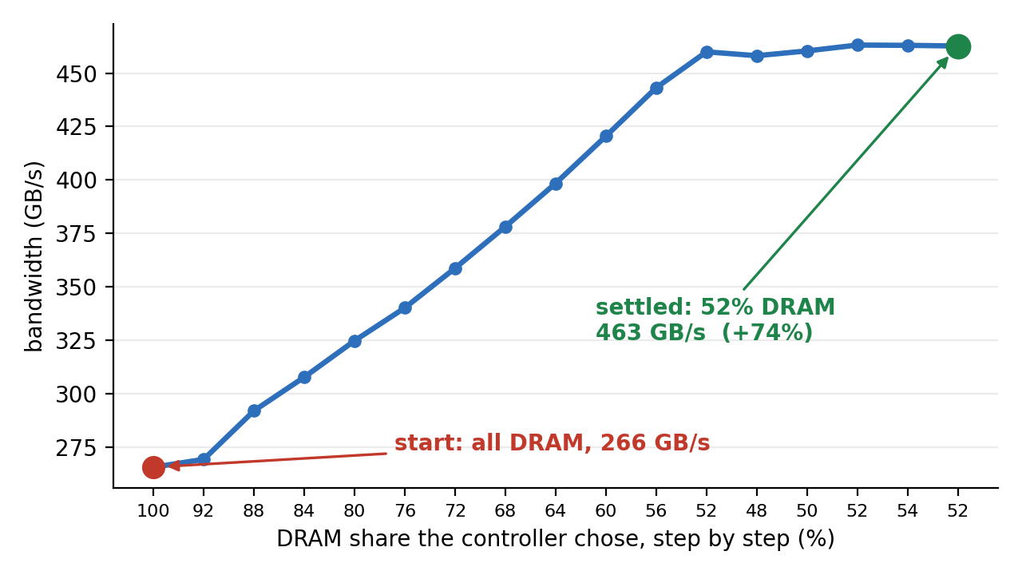
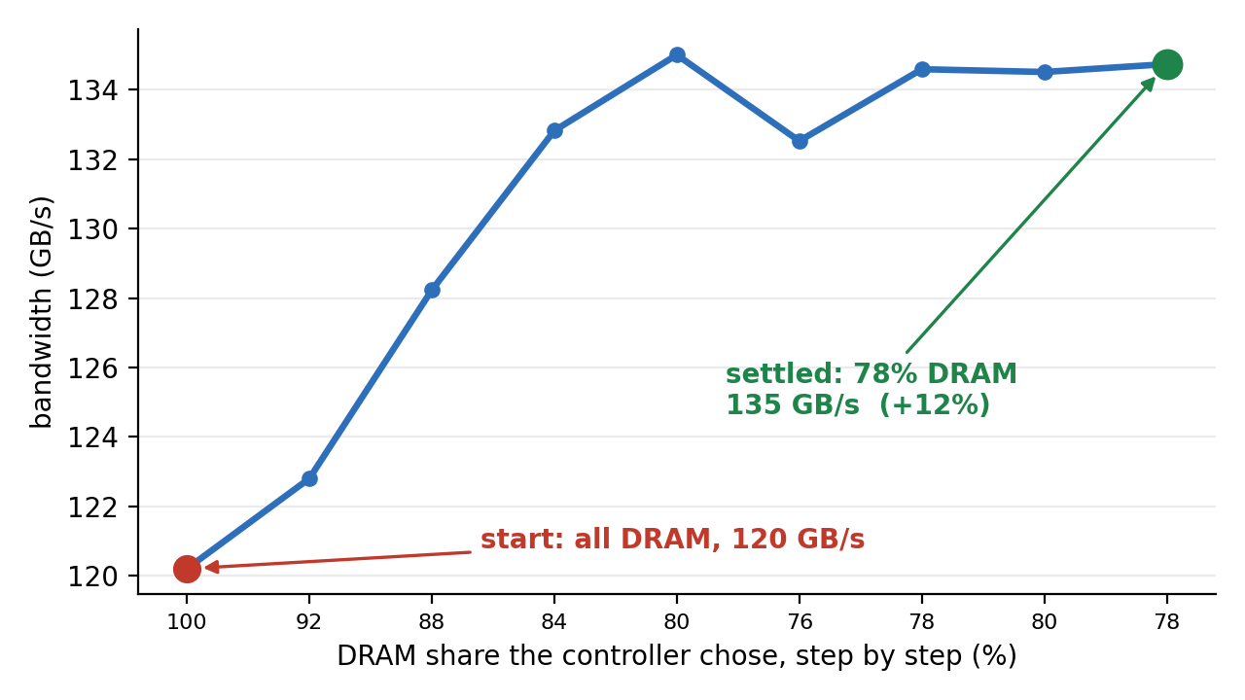
It Finds the Best Split on Its Own
Intel PEBS · virtual addresses · named processes
266 → 463 GB/s, settled at 52% DRAM
AMD IBS · physical addresses · whole machine
120 → 135 GB/s, settled at 78% DRAM
Both start all-DRAM, with no target and no model of the machine

Slide 20
Why Hardware Samples Settle
ACCESSED-BIT SCAN · a delayed view
HARDWARE SAMPLES · a current view
pages move, but the scan reports it
several aggregation intervals later
so the controller corrects an error already fixed
the next samples land where
the pages are now
so the goal is measured against real placement
target
target
time →
time →
✗ overshoots, then hunts around the target
✓ reaches the target and holds
Measured, accessed-bit scan
even with a cache workaround: in band only 15-22% of the time
Measured, IBS samples
the climb reached its peak in 4 steps (previous slide)
Traces are illustrative.

Slide 21
What Next: for Discussion
Upstream path
RFC v4 on damon/next; fold into milestone 2's report path with Akinobu
Where the controller lives
userspace damo today; which parts belong in DAMOS goal tuning?
More hotness sources
sampling PMUs feed the overflow path; trace PMUs such as Arm SPE via Kunwu's AUX backend
Observability
damos_node_eligible_mem_bp tracepoint, posted for mm-new
Kernel: RFC v4 cover letter · tracepoint patch
Userspace: damo auto_tier branch

