Slide 1

Sep 23, 2025
Kernel Recipes’25, Paris
Overcoming Observer Effects in Memory Management with DAMON
SeongJae Park (SJ) <sj@kernel.org> <sjpark@meta.com>
QR code
generated from https://qr.io
https://damonitor.github.io

Slide 2
Table of Contents
A User Story: A Memory Auto-scaling Service Development – 5 mins
Observer Effects in Memory Management – 5 mins
How DAMON Overcomes the Observer Effect – 20 mins
DAMON Use Cases – 5 mins
Getting Started – 2 mins
QnA – 8 mins

Slide 3
A Story:
Once Upon a Time,
In a Cloud Provider
Far, Far Away

Slide 4
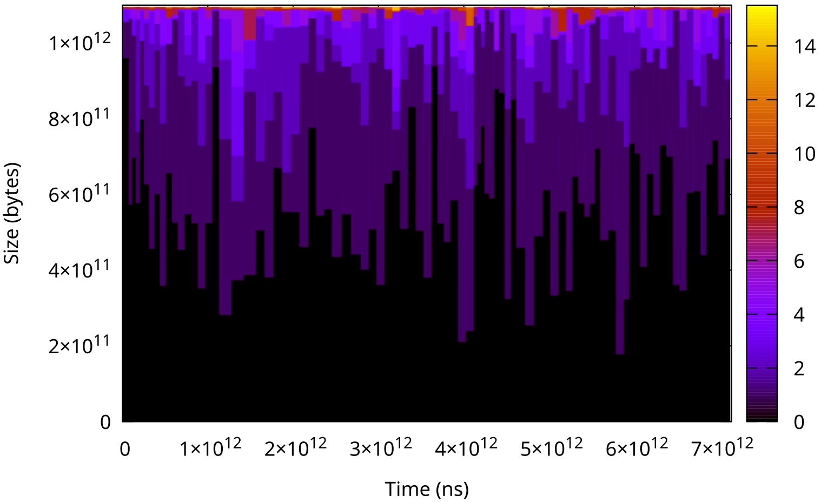
An AWSome Team Started an Adventure for a Memory Auto-Scaling Service
Motivation: Real memory requirement < given VM (virtual machine) memory (usual)
Idea: Dynamic VM memory size for only the real memory requirement
Provider benefit: Higher physical resource efficiency (room to cut user price)
User benefit: Less cost, no performance degradation

Slide 5
An AWSome Team Started an Adventure for a Memory Auto-Scaling Service
Motivation: Real memory requirement < given VM (virtual machine) memory (usual)
Idea: Dynamic VM memory size for only the real memory requirement
Provider benefit: Higher physical resource efficiency (room to cut user price)
User benefit: Less cost, no performance degradation
User Service Provider
┌─────────────────┐
workload, min/max memory ──────> │ Fixed total ram,│
workload output, bill <────── │ Flexible # VMs │
└─────────────────┘

Slide 6
An AWSome Team Started an Adventure for a Memory Auto-Scaling Service
Motivation: Real memory requirement < given VM (virtual machine) memory (usual)
Idea: Dynamic VM memory size for only the real memory requirement
Provider benefit: Higher physical resource efficiency (room to cut user price)
User benefit: Less cost, no performance degradation
User Service Provider
┌─────────────────┐
workload, min/max memory ──────> │ Fixed total ram,│
workload output, bill <────── │ Flexible # VMs │
└─────────────────┘

Slide 7
The Quest: Knowing Real Memory Requirement
Allocated memory != Real (or, critical) memory requirements
Major challenge: Overhead and Accuracy
No good solution was available back then (<Linux 5.15 era)
$ sudo damo monitor --report_type holistic $(pidof $MY_WORKLOAD)
[...]
# Memory Footprints Distribution
percentile 0 25 50 75 100
wss 13.539 MiB 13.754 MiB 15.293 MiB 16.605 MiB 16.605 MiB
rss 105.102 MiB 105.102 MiB 105.102 MiB 105.102 MiB 105.102 MiB
vsz 108.277 MiB 108.277 MiB 108.277 MiB 108.277 MiB 108.277 MiB
sys_used 943.090 MiB 943.090 MiB 943.090 MiB 943.090 MiB 943.090 MiB
[...]

Slide 8
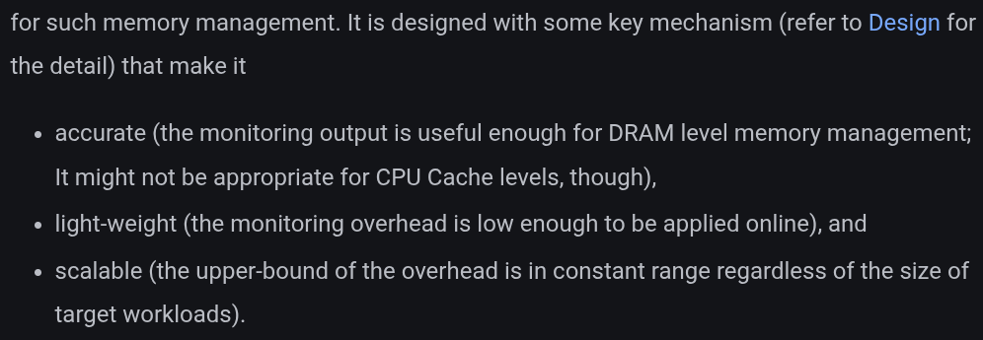
User Meets Kernel
A kernel programmer in Dresden was looking for users of their new kernel feature
The feature was advertised as what the service team was looking for
They eventually met and co-developed the service with the kernel feature
<Image captured from the feature’s project website>

Slide 9

They Lived Happily Ever After (So Far)
Amazon Aurora Serverless v2
The service has successfully launched:
Amazon Aurora Serverless v2
The subsystem has merged into Linux 5.15: DAMON
DAMON continues its revolution for more users
DRESDEN
STARTED
2019
Retrieved and modified from https://xkcd.com/2347/

Slide 10
Table of Contents
A User Story: A Memory Auto-scaling Service Development – 5 mins
Observer Effects in Memory Management – 5 mins
How DAMON Overcomes the Observer Effect – 20 mins
DAMON Use Cases – 4 mins
Getting Started – 3 mins
QnA – 8 mins

Slide 11
Observer Effects in
Memory Management

Slide 12
Memory: What It Is, and Why Limited?
Goal of Computers: processing data
Memory: Medium for storing/loading data
Consistent Trend: Exploding size of data (Otherwise, why those machines are needed?)
Turing Machine Idea: Infinite memory
Limitations of Physics (E = mc²; m: mass of electrons on modern computers)
  Speed of processor > Speed of memory
  Physical memory cost ∝Access speed and capacity of memory
“Everyone Has a Plan Until They Get Punched in the Mouth”, Mike Tyson

Slide 13
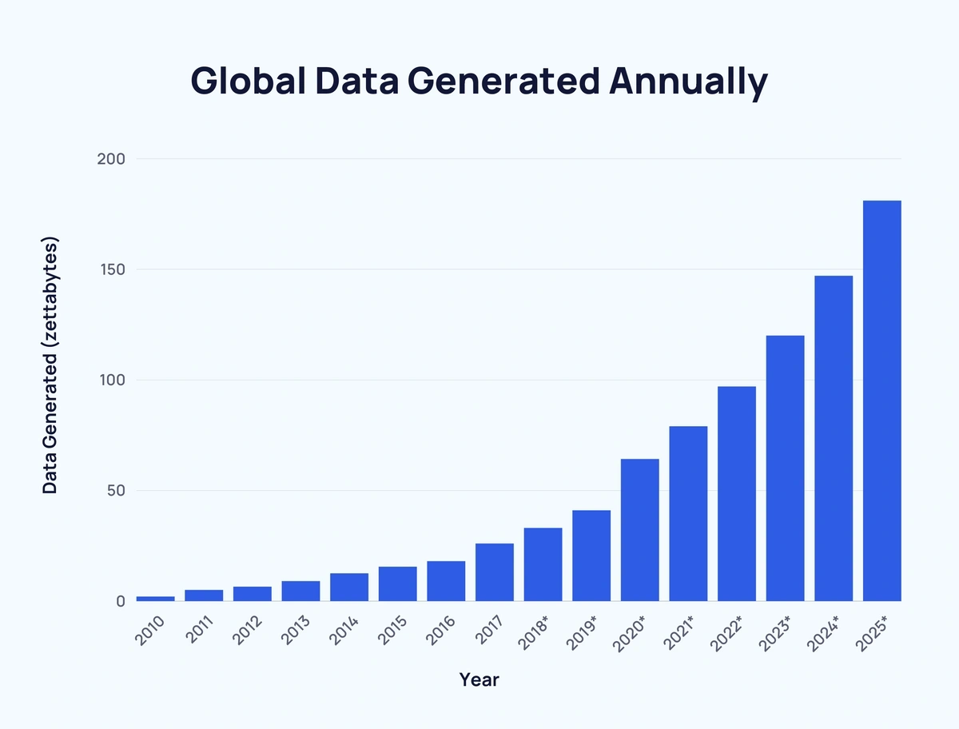
Memory: What It Is, and Why Limited?
Goal of Computers: processing data
Memory: Medium for storing/loading data
Consistent Trend: Exploding size of data (Otherwise, why those machines are needed?)
Turing Machine Idea: Infinite memory
Limitations of Physics (E = mc²; m: mass of electrons on modern computers)
Speed of processor > Speed of memory
Physical memory cost ∝Access speed and capacity of memory
“Everyone Has a Plan Until They Get Punched in the Mouth”, Mike Tyson
Image was retrieved from https://explodingtopics.com/blog/data-generated-per-day

Slide 14
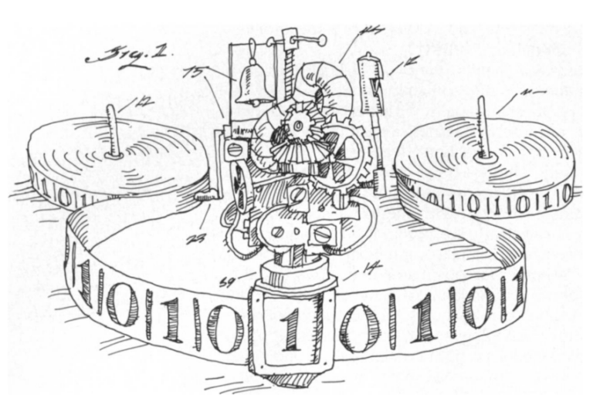
Memory: What It Is, and Why Limited?
Goal of Computers: processing data
Memory: Medium for storing/loading data
Consistent Trend: Exploding size of data
Turing Machine Idea: Infinite memory
Limitations of Physics (E = mc²; m: mass of electrons on modern computers)
  Speed of processor > Speed of memory
  Physical memory cost ∝Access speed and capacity of memory
x
“Everyone Has a Plan Until They Get Punched in the Mouth”, Mike Tyson
Image was retrieved from https://lifeiscomputation.com/can-a-finite-physical-device-be-turing-equivalent/

Slide 15
Memory: What It Is, and Why Limited?
Goal of Computers: processing data
Memory: Medium for storing/loading data
Consistent Trend: Exploding size of data
Turing Machine Idea: Infinite memory
Limitations of Physics (E = mc²; m: mass of electrons on modern computers)
  Speed of processor > Speed of memory
  Physical memory cost ∝Access speed and capacity of memory
“Everyone Has a Plan Until They Get Punched in the Mouth”, Mike Tyson

Slide 16
H/W Solution for Memory Limitation: Hierarchical Memory System
Hierarchical memory: construct memory with different cost/performance devices
  Fastest (smallest) device on uppermost layer (nearest to the processor)
  More frequently accessed (hot) data on upper layer
  H/W cannot save the world alone! (many too complicated, large scale cases)
Cache
Hot Data
DRAM
Warm Data
SSD
Cold Data
HDD
Frozen Data

Slide 17
S/W for Optimized Hierarchical Memory Management
Goal: Keep hottest memory in uppermost layer of hierarchical memory
How
  Evict cold data to lower layer (a.k.a reclaim, tiered-memory demotion)
  Migrate hot data to upper layer (a.k.a NUMA balancing, tiered-memory promotion)
  Eviction and migrations (mapping magics): Out of the scope of this talk
  Finding cold and hot data: The topic of this talk

Slide 18
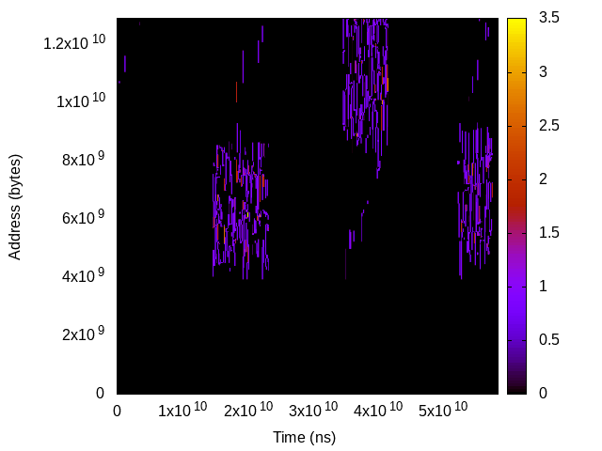
Data Accesses: Microscope Events on Space-Time of Memory
Can be visualized as a space-time access events map
Time
Address

Slide 19
Observer Effects in Data Access Monitoring
Ideal goal: Precise (every bit), Complete (every moment), Light (prod online)
Promising Idea: Record every access whenever it is made
Bad reality: Inevitable observer effects
  Add monitoring-purpose memory accesses and assignments for each memory access
Good reality: We’re open to negotiate
  For practical memory management, a high level view can be enough
“any data within the system representing state in the real world outside of the system is always and forever outdated”
- Paul E. McKenney, Chapter 9.5,
“Is Parallel Programming Hard, And, If So, What Can You Do About It?”

Slide 20


Access Monitoring Approaches of Linux Kernel
Use non-ideal but practical mechanisms of two categories
Developed/optimized for individual management mechanism
  E.g., Pseudo-LRU and artificial page faults for reclamation and NUMA balancing
  Optimized and time-tested, but obscure, heuristic-based, difficult to extend/generalize
Developed for observable and general memory managements: DAMON
Images retrieved from https://visla.kr/article/etc/119021/ and https://x.com/DeepinJapanPod/status/1819569233124376815

Slide 21
Access Monitoring Approaches of Linux Kernel
Use non-ideal but practical mechanisms of two categories
Developed/optimized for individual management mechanism
  E.g., Pseudo-LRU and artificial page faults for reclamation and NUMA balancing
  Optimized and time-tested, but obscure, heuristic-based, difficult to extend/generalize
Developed for observable and general memory managements: DAMON
Close your eyes and use the force!
Images retrieved from https://visla.kr/article/etc/119021/ and https://x.com/DeepinJapanPod/status/1819569233124376815

Slide 22
Access Monitoring Approaches of Linux Kernel
Use non-ideal but practical mechanisms of two categories
Developed/optimized for individual management mechanism
  E.g., Pseudo-LRU and artificial page faults for reclamation and NUMA balancing
  Optimized and time-tested, but obscure, heuristic-based, difficult to extend/generalize
Developed for observable and general memory managements: DAMON
Close your eyes and use the force!
But I’d like to see it!
Images retrieved from https://visla.kr/article/etc/119021/ and https://x.com/DeepinJapanPod/status/1819569233124376815

Slide 23
Access Monitoring Approaches of Linux Kernel
Use non-ideal but practical mechanisms of two categories
Developed/optimized for individual management mechanism
  E.g., Pseudo-LRU and artificial page faults for reclamation and NUMA balancing
  Optimized and time-tested, but obscure, heuristic-based, difficult to extend/generalize
Developed for observable and general memory managements: DAMON
The topic of this talk
Close your eyes and use the force!
But I’d like to see it!
Images retrieved from https://visla.kr/article/etc/119021/ and https://x.com/DeepinJapanPod/status/1819569233124376815

Slide 24
How DAMON Handles
The Observer Effects:
0. Goal and Challenges

Slide 25
DAMON Goal: Access Observability for Holistic Memory Management
Space-time access events map or practically same information
Time
Address

Slide 26
DAMON Challenges: Overhead
Time Overhead
  For generating each snapshot of the map
  O(memory size)
Space Overhead
  For saving the entire access events map
  O(memory size * total monitoring time)
Memory size and monitoring time: arbitrarily huge (unscalable)

Slide 27
How DAMON Handles
The Observer Effects:
1. Region-based Sampling

Slide 28
Region: Access Monitoring Unit for DAMON
Defined as a reasonably-atomic unit of data access
  A sub-area of the space-time access events map
  A collection of adjacent elements that having similar access pattern
By the definition, access check of one element per region is enough
e.g., “This page is accessed within last 1 second; I saw a cacheline in it is accessed!”
$ cat wonder_region_1
We’re all mad [un]accessed here

Slide 29
Fixed Space/Time Granularity, Boolean Access Frequency
Time overhead: “memory size / space granularity”
Space overhead: “time overhead * monitoring time / time granularity”
Overhead is reducible and controllable
Still ruled by memory size and monitoring time
Time
We’re all mad accessed here
Address
Region
We’re all mad unaccessed here
Sampling interval

Slide 30
Fixed Space/Time Granularity, <=N Access Frequency
Accumulate (sampled) access check results via per-region counter
Now
Time
1
0
0
1
Address
Region
Aggregate interval
Sampling interval

Slide 31
Fixed Space/Time Granularity, <=N Access Frequency
Accumulate (sampled) access check results via per-region counter
Now
Time
1 | 2
0 | 1
0 | 0
1 | 2
Address
Region
Aggregate interval
Sampling interval

Slide 32
Fixed Space/Time Granularity, <=N Access Frequency
Accumulate (sampled) access check results via per-region counter
Now
Time
1 | 2 | 3
0 | 1 | 1
0 | 0 | 1
1 | 2 | 2
Address
Region
Aggregate interval
Sampling interval

Slide 33
Fixed Space/Time Granularity, <=N Access Frequency
Accumulate (sampled) access check results via per-region counter
Now
Time
1 | 2 | 3 | 0
0 | 1 | 1 | 0
0 | 0 | 1 | 0
1 | 2 | 2 | 0
Address
Region
Aggregate interval
Sampling interval

Slide 34
Fixed Space/Time Granularity, <=N Access Frequency
Accumulate (sampled) access check results via per-region counter
Now
Time
1 | 2 | 3 | 0 1 | 2 | 3
0 | 1 | 1 | 0 1 | 1 | 1
0 | 0 | 1 | 0 0 | 0 | 0
1 | 2 | 2 | 0 1 | 2 | 3
Address
Region
Aggregate interval
Sampling interval

Slide 35
Fixed Space/Time Granularity, <=N Access Frequency
Accumulate (sampled) access check results via per-region counter
Now
Time
1 | 2 | 3 | 0 1 | 2 | 3 | 0 1 | 2 | 2
0 | 1 | 1 | 0 1 | 1 | 1 | 0 1 | 1 | 2
0 | 0 | 1 | 0 0 | 0 | 0 | 0 1 | 1 | 1
1 | 2 | 2 | 0 1 | 2 | 3 | 0 1 | 1 | 2
Address
Region
Aggregate interval
Sampling interval

Slide 36
Fixed Space/Time Granularity, <=N Access Frequency
Accumulate access checks via per-region counter
Reduce space overhead to “1/N”
Still, O(memory size * total monitoring time)
Time
3 | 3 | 2
1 | 1 | 2
1 | 0 | 1
2 | 3 | 2
Address
Region
Aggregate interval

Slide 37
How DAMON Handles
The Observer Effects:
2. Self-tuned Region Space

Slide 38
Problems of Fixed Space Granularity
Wasteful adjacent regions of similar hotness
Restrict fine-grained space monitoring
Time
3 | 3 | 2
1 | 1 | 2
1 | 0 | 1
2 | 3 | 2
Address
Region
Aggregate interval

Slide 39
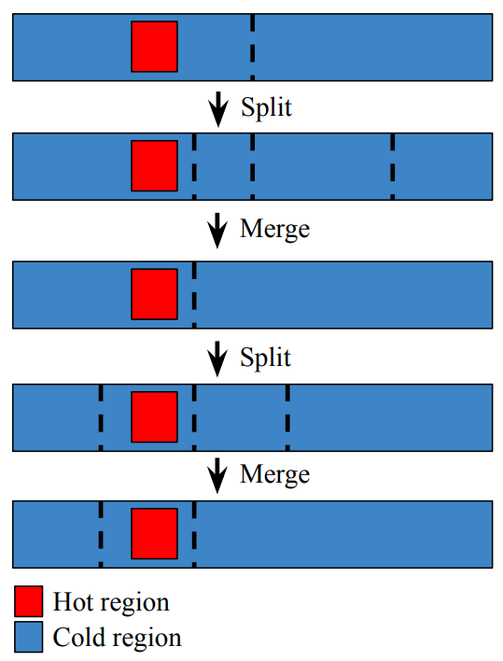
Auto-tuned Dynamic Space Granularity: Mechanisms (1/2)
Repeat merging the wasteful regions and randomly splitting regions
  The number of region == number of different access patterns
Let user set min/max number of total regions (10 and 1000 are defaults and recommended)
Time
3 | 3 | 2
1 | 1
 | 0 | 1
2 | 3 | 2
Address
Region
Aggregate interval

Slide 40
Auto-tuned Dynamic Space Granularity: Mechanisms (2/2)
Repeat merging the wasteful regions and randomly splitting regions
  The number of region == number of different access patterns
Let user set min/max number of total regions (10 and 1000 are defaults and recommended)
Time
3 | 3 | 2
1 | 1
 | 0 | 1
2 | 3 | 2
Address
Region
Aggregate interval

Slide 41
Auto-tuned Dynamic Space Granularity: Overhead/Accuracy
Time overhead: min(different access patterns, max number of regions)
  No more ruled by memory size, fully controlled and auto-tuned
Accuracy: best-effort high
  Auto-tuned dynamic granularity can find accesses to small memory area
Time
3 | 3 | 2
1 | 1
 | 0 | 1
2 | 3 | 2
Address
Region
Aggregate interval

Slide 42
How DAMON Handles
The Observer Effects:
3. Mortal Region Time

Slide 43
Problems of Fixed Time Granularity Regions (1/2)
The definition of regions: about not only space, but also time
Time
Address
Region
Aggregate interval

Slide 44
Inefficiency of Fixed Time Granularity Regions (2/2)
The definition of regions: about not only space, but also time
Multiple time-adjacent regions of similar hotness: only waste
Time
Address
Region
Aggregate interval

Slide 45
Dynamic Time Granularity (1/3)
Count how long the hotness has kept
Snapshot contains history of useful length
Now
Time
1
1
1
1
Address
Region
Aggregate interval

Slide 46
Dynamic Time Granularity (2/3)
Count how long the hotness has kept
Snapshot contains history of useful length
This snapshot can be discarded
Now
Time
1 | 2
1 | 2
1 | 1
1 | 1
Address
Region
Aggregate interval

Slide 47
Dynamic Time Granularity (3/3)
Count how long the hotness has kept
Snapshot contains history of useful length
This snapshot can be discarded
This snapshot can be discarded
Now
Time
1 | 2 | 1
1 | 2 | 3
1 | 1 | 1
1 | 1 | 1
Address
Region
Aggregate interval

Slide 48
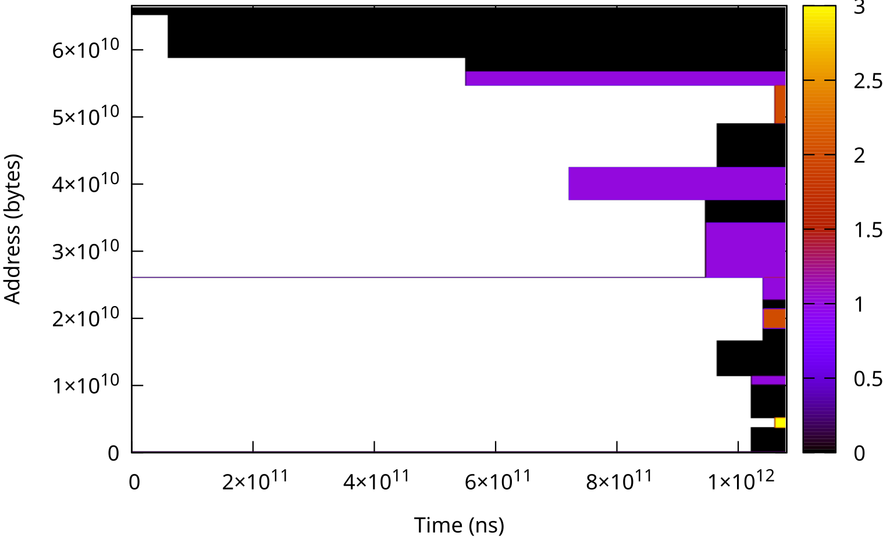
Snapshot: The Output of DAMON
O(max_nr_regions) time/space overhead
Both time/space overheads are not ruled by memory size/monitoring time

Slide 49
How DAMON Handles
The Observer Effects:
4. Monitoring Intervals
Auto-tuning

Slide 50
If Intervals Are Appropriate: Meaningful Hot/Cold Regions
Meaningful enough to make some memory management decisions
Time
1 | 2 | 3 | 1 | 2 | 3 | 1 | 2 | 2
0 | 1 | 1 | 1 | 1 | 1 | 1 | 1 | 2
0 | 0 | 1 | 0 | 0 | 0 | 1 | 1 | 1
1 | 2 | 2 | 1 | 2 | 3 | 1 | 1 | 2
Address
Region
Sampling interval
Aggregation interval

Slide 51
If Intervals Are Too Short: Everything Looks Cold
Time
1 | 1 | 1 | 0 | 1 | 1 | 0 | 1 | 1
0 | 0 | 0 | 0 | 0 | 0 | 0 | 0 | 0
0 | 0 | 0 | 0 | 0 | 0 | 0 | 0 | 0
1 | 1 | 1 | 0 | 0 | 0 | 0 | 0 | 0
Address
Region
Sampling interval
Aggregation interval

Slide 52
If Intervals Are Too Long: Everything Looks Hot
1 | 2 | 3 | 1 | 2 | 3 | 1 | 2 | 3
1 | 2 | 3 | 1 | 2 | 3 | 1 | 2 | 3
1 | 2 | 3 | 1 | 1 | 2 | 1 | 2 | 3
1 | 2 | 3 | 1 | 2 | 3 | 1 | 2 | 3
Address
Region
Sampling interval
Aggregation interval

Slide 53
If Sampling:Aggregation Interval ratio is Too Low: Meaningless Samples
Most sampling returns “negative”: unnecessary CPU cycle waste
Address
Region
Sampling interval
Aggregation interval

Slide 54
Aimed Monitoring Output-oriented Intervals Auto-tuning
Change Question: How to do? (mechanism) → What to achieve? (final goal, policy)
Let users specify
  Desired amount of access events to capture in each snapshot
  Minimum and maximum sampling intervals
Find sampling/aggregation intervals for the desire using a feedback loop
  Increase intervals if less than desired events are captured in current snapshot
  Decrease intervals if more than desired events are captured in current snapshot

Slide 55
Monitoring Intervals Auto-tuning Parameters
Parameters for parameters auto-tuning, but easy to set
Suggestion
  Desired access events per snapshot: 4% of per-snapshot maximum capturable events
  Min/max sampling intervals: 5ms and 10s
  Sampling:aggregation intervals ratio: 1:20
  Proven to be useful on multiple real-world production workloads
  Isn’t this another heuristic? Yes, but the maintainer will be there to support this

Slide 56
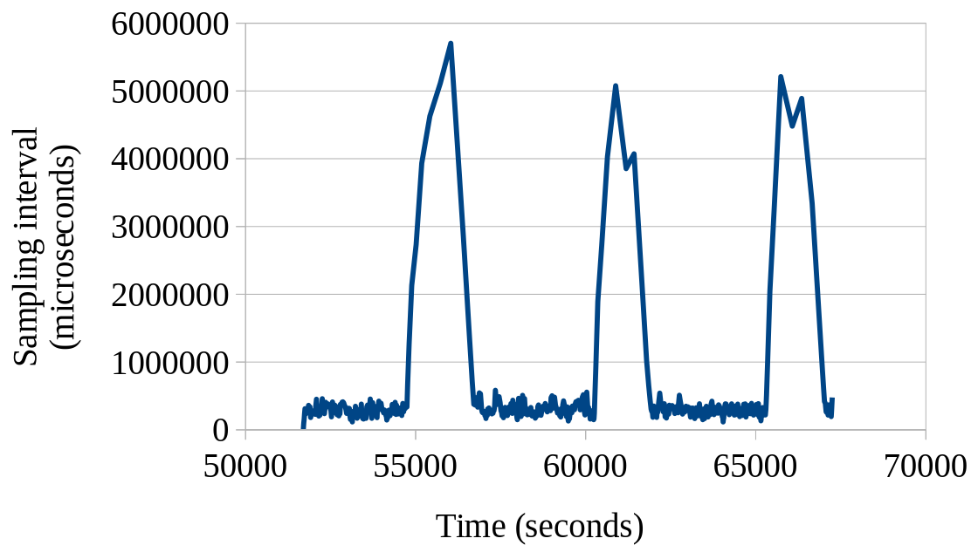
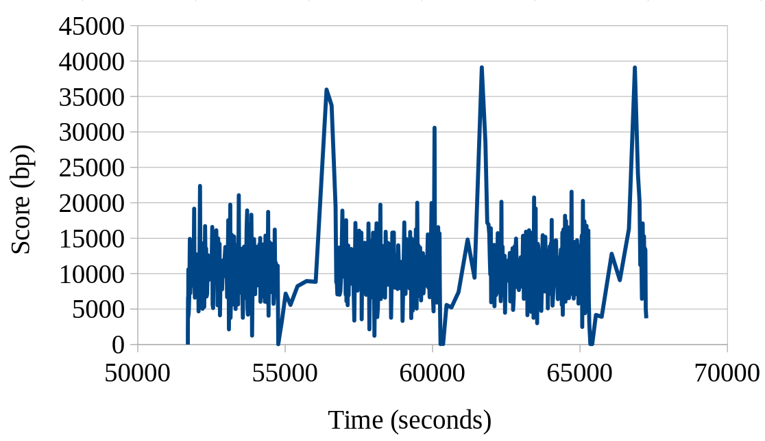
Intervals Auto-tuning on a Real-world Server Workload
Sampling interval and tuning score continuously change, and converge for given situation
  Sampling interval converges to 370ms under usual load, ~4-5 seconds under light load
  Tuning score converges to the goal (10,000 bp)

Slide 57
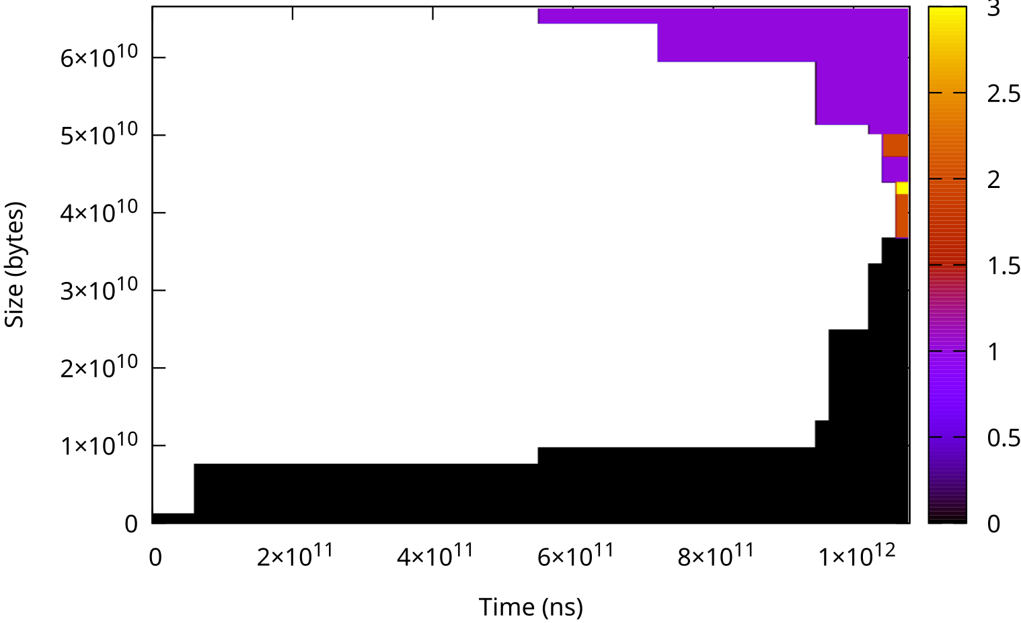
Intervals Auto-Tuning on Real World Server Workloads
Meaningful access patterns found on three different workloads including 1 TiB memory size workload
0.0% CPU time consumed for the monitoring

Slide 58
How DAMON Handles
The Observer Effects:
5. Access-aware
Memory Management

Slide 59
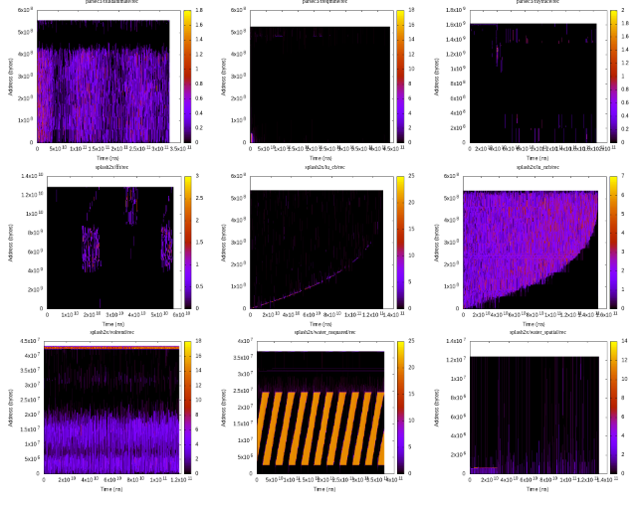
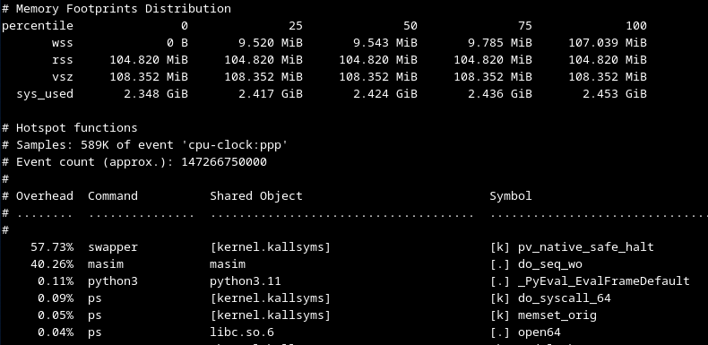
Utilizing DAMON for Access-aware Memory Management
Profiling (e.g., GIF demo link)
  For finding rooms to improve, e.g., capacity planning
Profiling-guided Optimizations
  Could be done on both offline and online
Why not let kernel just (transparently) works?

Slide 60
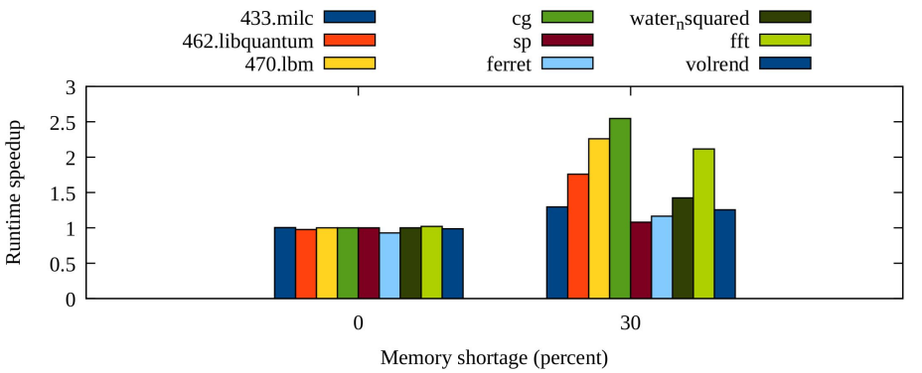
Utilizing DAMON for Access-aware Memory Management
Profiling (e.g., GIF demo link)
  For finding rooms to improve, e.g., capacity planning
Profiling-guided Optimizations
  Could be done on both offline and online
Why not let kernel just (transparently) works?

Slide 61
Utilizing DAMON for Access-aware Memory Management
Profiling (e.g., GIF demo link)
  For finding rooms to improve, e.g., capacity planning
Profiling-guided Optimizations
  Could be done on both offline and online
Why not let kernel just (transparently) works?

Slide 62
DAMOS: Data Access Monitoring-based Operation Schemes
The other face of DAMON
Let users define schemes
  Interested access patterns and memory operation actions to apply to the regions of interests
DAMOS: execution engine of such schemes
For more interesting details about DAMOS, refer to other resources or future DAMOS talks
# # pageout memory regions that not accessed for >=5 seconds
# damo start --damos_action pageout --damos_access_rate 0% 0% --damos_age 5s max

Slide 63
Use Cases

Slide 64
Proactive Cold Memory Reclamation
Proactively find and reclaim cold pages
Reduce memory footprint without performance degradation
Reduce memory pressure occurrences and help (automated) capacity planning
AWS Aurora Serverless v2 uses this for memory auto-scaling

Slide 65
Memory Tiering
Migrate hot data in slower NUMA nodes to faster nodes, cold data in opposite direction
  e.g., CXL and DRAM nodes
SK Hynix developed and utilizing this for their Heterogeneous Memory SDK
Meta’s self-tuned version shows ~7.34% performance improvement on a test workload (Taobench)
Cgroup fairness-aware extension is also available in RFC
Supporting {C,G,X}PU-attached NUMA nodes: WIP

Slide 66
Access-aware Dynamic Memory Interleaving
Memory interleaving: interleave placement on allocation time for bandwidth control
Runtime-interleave (migrate) data for dynamic access pattern in access-aware order
Micron developed for their internal project; shows 25% performance improvement

Slide 67
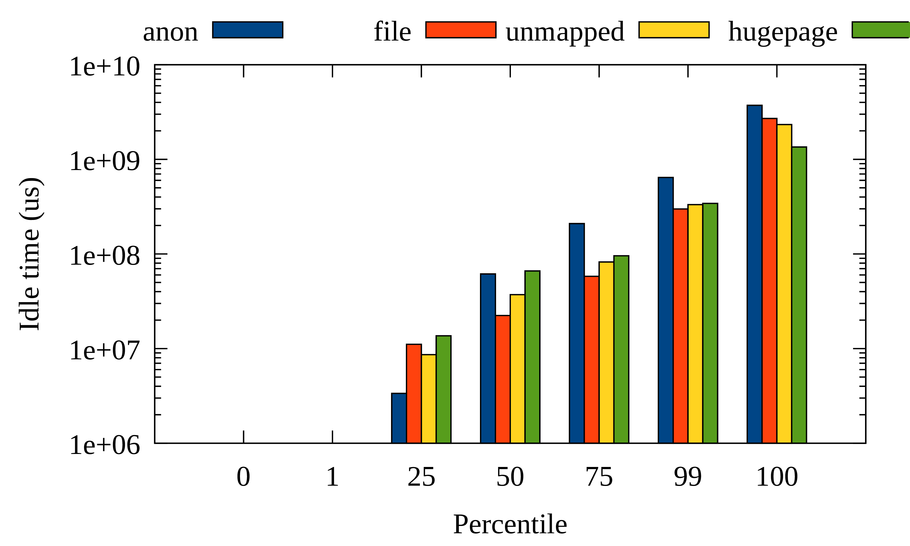
Page Level Data Access Monitoring
Different types of pages have different management mechanisms
Breakdown data access pattern for specific types of pages
Developed by Meta for hugepage and LRU-active pages access pattern profiling
Per-page type access pattern of a production workload

Slide 68
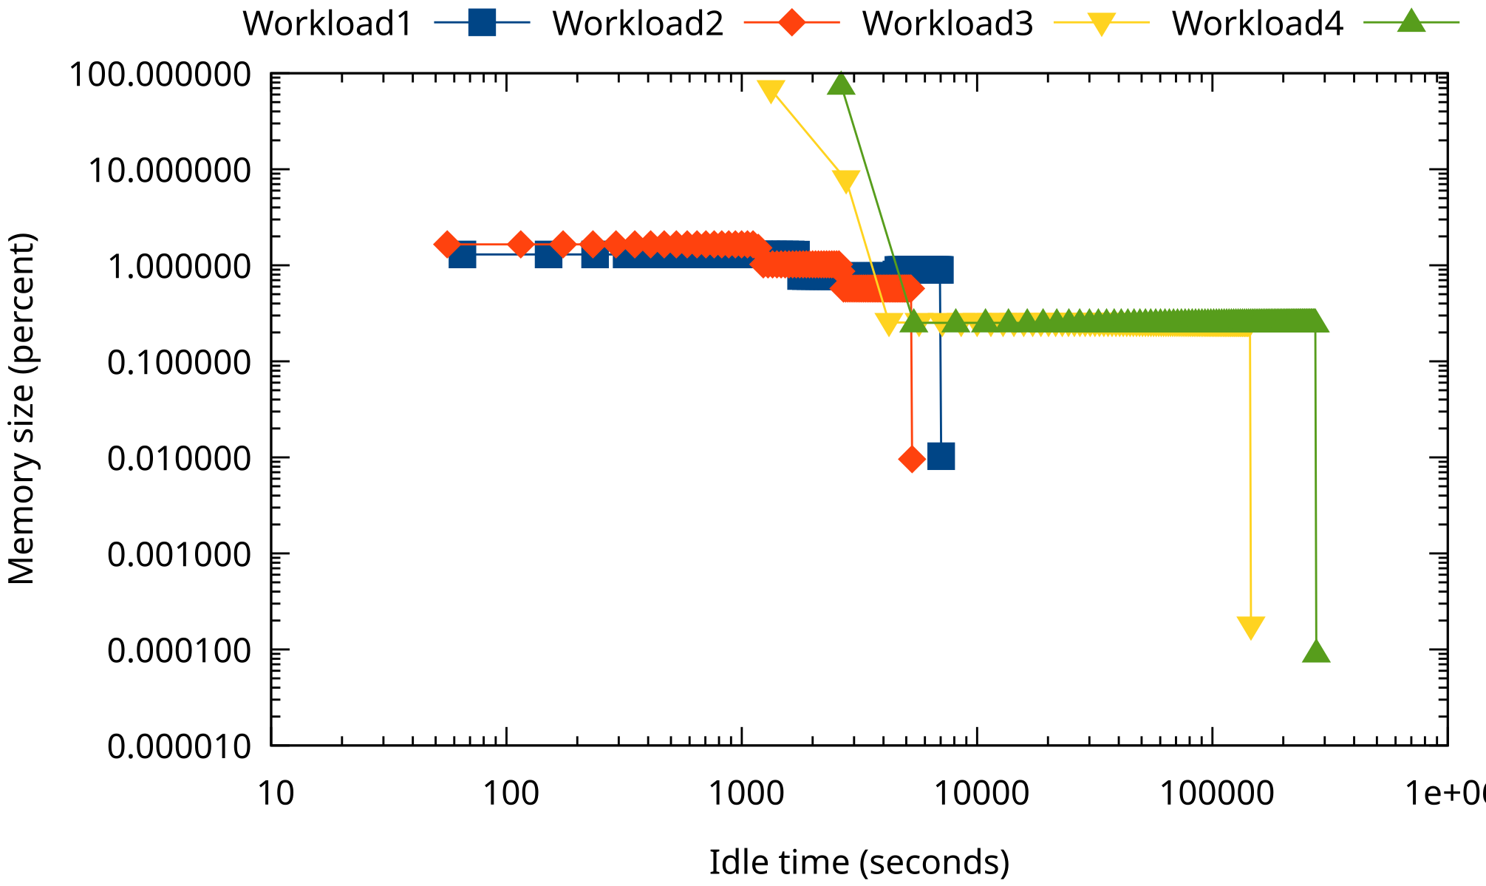
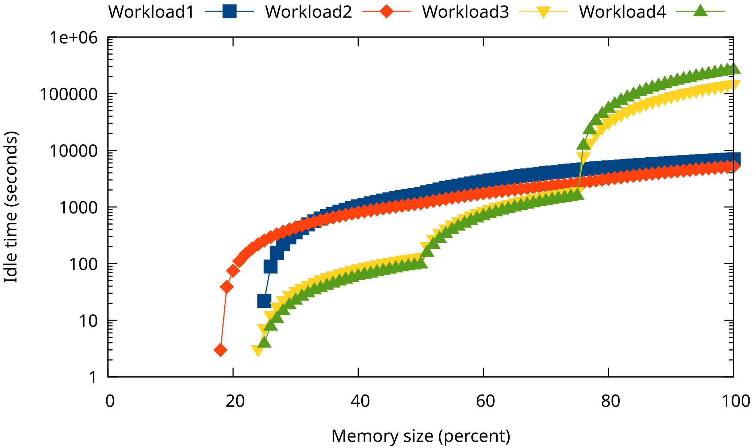
Fleet-wide Data Access Monitoring
Transform DAMON snapshot into hotness distribution
Easy to aggregate and intuitively understand (idle time percentiles or cold memory tails)
Developed by Meta for fleet-wide real workloads access pattern profiling
Cold memory tails (left) and idle memory time percentiles (right) of real workloads

Slide 69
And Any Future Opportunities Are Open
DAMON of Today != DAMON of Tomorrow
Aim to randomly evolve for selfish users
Make your voice

Slide 70
Getting Started

Slide 71
Where to Get Started: https://damonitor.github.io
Project website
Contains getting started guides and all resources for users and developers
Should have all you need to get started
  If not, report it please

Slide 72
Availability
Merged into the mainline from v5.15
Recommended to use latest kernel; Feel free to ask backporting
Backported and enabled on major Linux distro kernels
  Alma, Amazon, Android, Arch, CentOS, Debian, Fedora, OpenSuse, Oracle, …
DAMON user-space tool (damo) is available on major packaging systems
  Arch, Debian, Fedora, PyPi, ...

Slide 73
Interfaces
DAMON user-space tool: Recommended for general usages from user-space
DAMON modules: Recommended for specific usages
DAMON sysfs interface: Recommended for user-space program development
Kernel API: Recommended for kernel programmers

Slide 74
Community: For Questions, Help, Patch Reviews
Public mailing list (https://lore.kernel.org/damon)
Bi-weekly virtual meetup
  Occasional/regular private meetings on demand
Not used to mail-based development? Try hkml
  Developed and maintained for DAMON and Linux kernel developers
The future of DAMON is open and up to you
  “Prefer random evolution over intelligent design”

Slide 75
Summary: That’s DAMON of Today
DAMON: a Linux kernel subsystem
  For practical access monitoring based holistic and observable memory managements
Being used in real-world
The future is open and up to the community
  Make your selfish voice!

Slide 76
Questions?
You can also ask questions anytime to
  Maintainer: sj@kernel.org
  Public mailing list (https://lore.kernel.org/damon)
  Bi-weekly virtual meetup
  Occasional/regular private meetings on demand
  Project website (https://damonitor.github.io)

Slide 77
Backup Slides

Slide 78
DAMON_STAT: Recommended Way For System-wide Access Monitoring
Kernel module running DAMON for the entire physical address space
Use intervals auto-tuning with the suggested auto-tune parameters
Extract Idle time percentile
  distribution of per-byte memory idle times (time the byte was not accessed)
  P75 idle time 2minutes: 75 percent of the memory was accessed at least once in last 2 minutes; rest 25 percent of memory was not accessed at all for last 2 minutes
Extract estimated memory bandwidth
  Memory bandwidth estimated based on access events that captured in the last snapshot
Recommended way for system-wide access monitoring
  Easy to enable (CONFIG_DAMON_STAT_DEFAULT_ENABLED=y), aggregate, compare
  Can be enabled/disabled at build, boot time and runtime

Slide 79
Idle Time Percentiles
Idle time: How long the region kept being not accessed (access frequency 0)
Idle time percentiles: Percentiles of sorted per-byte idle times
Unsorted snapshot

Slide 80
Idle Time Percentiles
Idle time: How long the region kept being not accessed (access frequency 0)
Idle time percentiles: Percentiles of sorted per-byte idle times
Unsorted snapshot
Sorted by access frequency

Slide 81
Idle Time Percentiles
Idle time: How long the region kept being not accessed (access frequency 0)
Idle time percentiles: Percentiles of sorted per-byte idle times
Unsorted snapshot
Sorted by access frequency
P50 idle time

Slide 82
Idle Time Percentiles
Idle time: How long the region kept being not accessed (access frequency 0)
Idle time percentiles: Percentiles of sorted per-byte idle times
Unsorted snapshot
Sorted by access frequency
P50 idle time
P75 idle time

Slide 83
Idle Time Percentiles
Idle time: How long the region kept being not accessed (access frequency 0)
Idle time percentiles: Percentiles of sorted per-byte idle times
Unsorted snapshot
Sorted by access frequency
P50 idle time
P75 idle time
P99 idle time

Slide 84
DAMON_STAT: Recommended Way For System-wide Access Monitoring
Kernel module running DAMON for the entire physical address space
Use intervals auto-tuning with the suggested auto-tune parameters
Extract Idle time percentile
  distribution of per-byte memory idle times (time the byte was not accessed)
  P75 idle time 2minutes: 75 percent of the memory was accessed at least once in last 2 minutes; rest 25 percent of memory was not accessed at all for last 2 minutes
Extract estimated memory bandwidth
  Memory bandwidth estimated based on access events that captured in the last snapshot
Recommended way for system-wide access monitoring
  Easy to enable (CONFIG_DAMON_STAT_DEFAULT_ENABLED=y), aggregate, compare
  Can be enabled/disabled at build, boot time and runtime

Slide 85
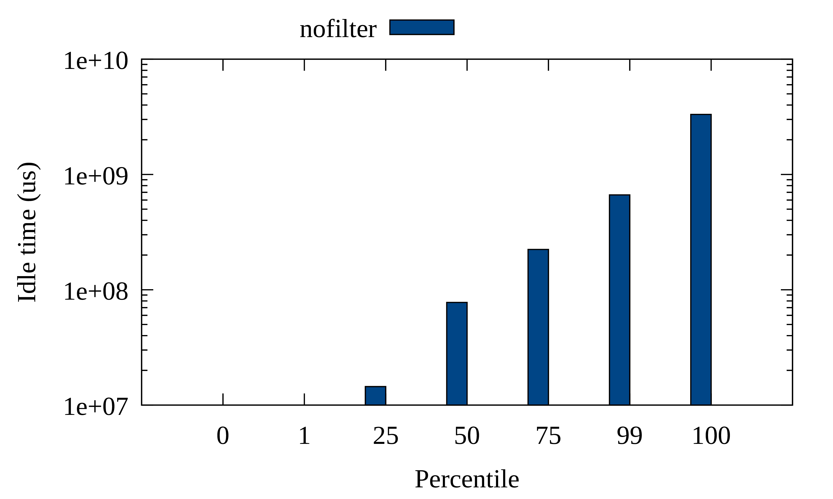
Results on a Real Workload: Auto-tuned Total Memory Idle Time Percentiles
Small hot memory, exponentially increasing idle time (long tail of cold pages)

Slide 86
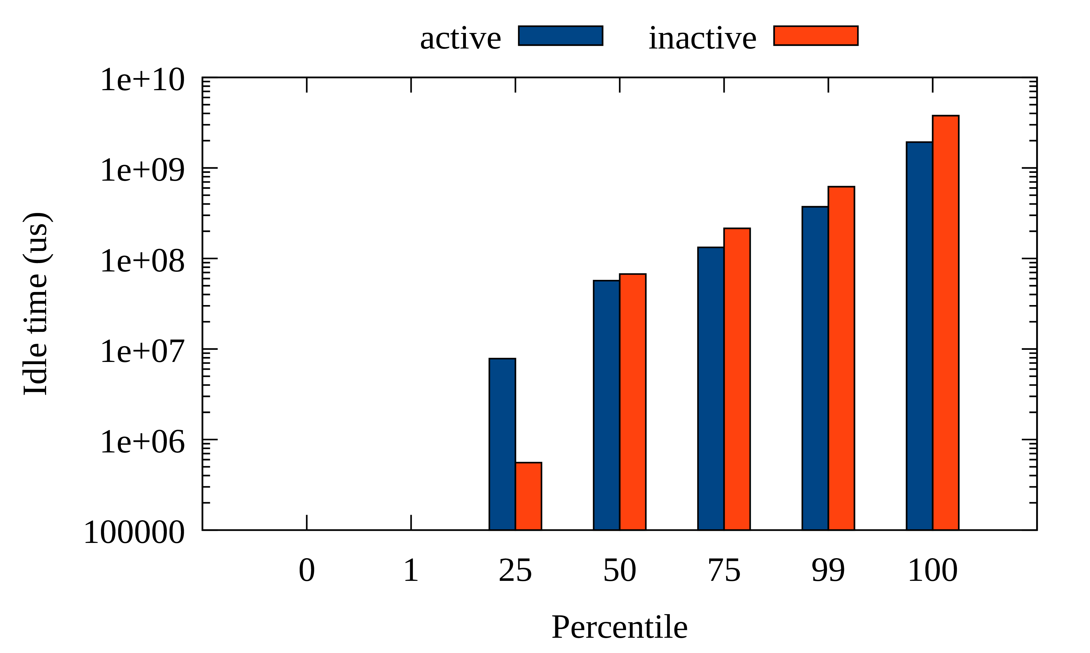
Results on a Real Workload: Active vs Inactive Pages Idle Time Breakdown
Active pages have rooms to be more hot than inactive
(ideally, p100 of active should < p0 of inactive)

Slide 87
Results on a Real Workload: Per Page Type Idle Time Breakdown
You can check if your workload has expected access pattern

Slide 88
DAMOS Filter: Fine-Control Access-aware System Operation Targets
Define target memory with non-access-pattern information
  Page level filters: anon, owned cgroup, hugepage, LRU-activeness
  Non-page level filters: address
  “pageout cold pages of NUMA node 1 that associated with cgroup A and file-backed”
  Can be useful for fine-grained monitoring, too
    (“stat”, instead of “pageout”)

Slide 89
DAMOS Quota: Control Access-aware System Operation Aggressiveness
Six fixed thresholds (min/max size, access frequency, age) are unnecessary in many cases
Setting thresholds flexibly and controlling aggressiveness works in many cases
  Single control knob
Quota set the aggressiveness limit as amount of memory to apply action per a time interval
Access pattern based prioritization is applied under the quota
“pageout cold pages up to 100 MiB per second using <2% CPU time, coldest ones first”

Slide 90
Quota Auto-tuning: Auto-tuned Access-aware System Operations
Quota tuning is manual and repetitive
Change the question for user: How to do (mechanism) → What to achieve (final goal)
Let users specify goal of the quota as a value of a metrics
  Metrics: PSI level, NUMA node memory utilization, workload’s latency, bandwidth, TPS, …
  e.g., “reclaim cold pages aiming 0.5% memory PSI”
DAMOS adjusts quota using feedback loop, for current value of the metric
  e.g., If memory PSI is 0.1% increase quota for reclaiming cold pages (reclaim more warm pages)

Slide 91
Controlled and Auto-tuned Access-aware System Operation Performance
Parsec3/splash2x.fft
Page out regions that not accessed for >=5 seconds, up to 1GiB/sec, using up to 100ms/sec, aiming 10ms/sec memory pressure stall
 | Runtime | RSS
Baseline | 50.489s | 10.005 GiB
+DAMOS-reclaim | 120s | 4.955 GiB
+Quota | 51.772s | 8.527 GiB
+Goal | 49.741s | 9.721 GiB

Slide 92
Real-world DAMON Use Cases:
Proactive Reclamation and
CXL Memory Tiering

Slide 93
Proactive Reclamation
Reactive reclamation: Reclaim cold memory when memory pressure happens
Proactively reclamation: Reclaim cold memory before memory pressure
Benefit 1: Reduce memory footprint without performance degradation
Benefit 2: Minimize degradation from direct reclamation
Known usages: Google, Meta, and Amazon
  Each company uses its own implementation for its usage
AWS uses DAMOS-based implementation since 2022

Slide 94
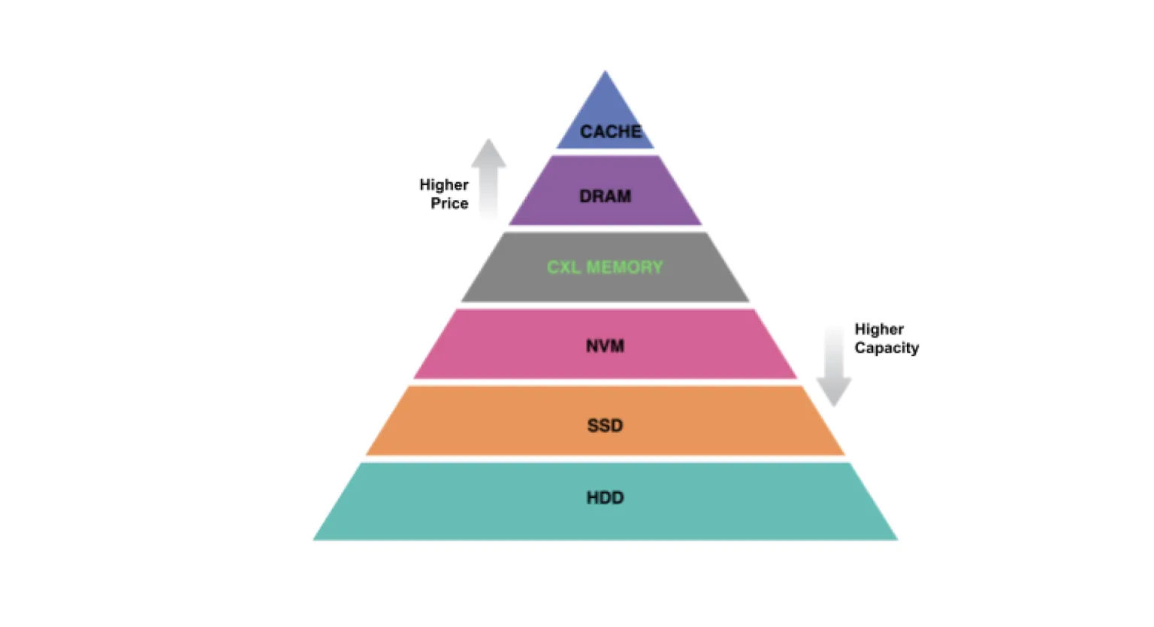
CXL Memory Tiering
CXL-tiered memory: Put CXL memory between DRAM and NVM
  Pros: Higher capacity with lower price (higher efficiency)
Challenge: Dynamic placement of pages (CXL mem is slower than DRAM)
DAMON-based approach: Place hot pages on DRAM node, Place cold pages on CXL node
SK hynix developed their CXL memory SDK (HMSDK) using DAMOS
  Reports ~12.9% speed up

Slide 95
Architectures

Slide 96
Execution Model: Kernel Thread per Requests
“struct damon_ctx”: Data structure for DAMON user input/output containing
  User requests: target address space, address range, intervals, DAMOS schemes
  Operation results: access snapshot, DAMOS stats
“kdamond”: DAMON worker thread
  Create one kdamond per “damon_ctx”
    In future, could support multiple “damon_ctx” per kdamond
    In future, could separate DAMOS to another thread (maybe useful for cgroup charging)
  Allows async DAMON execution and multiple kdamonds (CPUs) scaling

Slide 97
Extensible Layers
User-space
Tools
DAMO
datop
DAMON API User
Kernel Modules
General-purpose User ABI
Special-purpose Modules
DAMON_SYSFS
DAMON_DBGFS
DAMON_RECLAIM
DAMON_LRU_SORT
DAMON_WSS
DAMON Application Programming Interface
DAMON
DAMOS
Adaptive Regions Adjustment
Action and Pattern
Core Logic
Region-based Sampling
Quotas and Prioritization
Access Frequency Monitoring
Feedback-based auto-tuning
Advanced Regions Adjustment
Watermarks
Parameters Auto-tuning
Filters
DAMON Operations Set Registration Interface
Operations Set
paddr
vaddr
Read/write-only
NUMA-cpus-only
Primitives
that DAMON
depends on
PTE/VMA/rmap, ...
AMD IBS
LRU State

Slide 98
Extensible Layers
User-space
Tools
DAMO
datop
DAMON API User
Kernel Modules
General-purpose User ABI
Special-purpose Modules
DAMON_SYSFS
DAMON_DBGFS
DAMON_RECLAIM
DAMON_LRU_SORT
DAMON_WSS
DAMON Application Programming Interface
DAMON
DAMOS
Adaptive Regions Adjustment
Action and Pattern
Core Logic
Region-based Sampling
Quotas and Prioritization
Access Frequency Monitoring
Feedback-based auto-tuning
Advanced Regions Adjustment
Watermarks
Parameters Auto-tuning
Filters
DAMON Operations Set Registration Interface
Operations Set
paddr
vaddr
Read/write-only
NUMA-cpus-only
Primitives
that DAMON
depends on
PTE/VMA/rmap, ...
AMD IBS
LRU State

Slide 99
Extensible Layers
User-space
Tools
DAMO
datop
DAMON API User
Kernel Modules
General-purpose User ABI
Special-purpose Modules
DAMON_SYSFS
DAMON_DBGFS
DAMON_RECLAIM
DAMON_LRU_SORT
DAMON_WSS
DAMON Application Programming Interface
DAMON
DAMOS
Adaptive Regions Adjustment
Action and Pattern
Core Logic
Region-based Sampling
Quotas and Prioritization
Access Frequency Monitoring
Feedback-based auto-tuning
Advanced Regions Adjustment
Watermarks
Parameters Auto-tuning
Filters
DAMON Operations Set Registration Interface
Operations Set
paddr
vaddr
Read/write-only
NUMA-cpus-only
Primitives
that DAMON
depends on
PTE/VMA/rmap, ...
AMD IBS
LRU State

Slide 100
DAMOS Quotas: Intuitive Aggressiveness Control
Before applying DAMOS schemes
  Set temperature-based priority score of each region
  Build “priority score”: “total size of regions of the priority” histogram
  Find lowest priority threshold for the scheme meeting the quota
  Skip applying action to regions having lower-than-threshold priority scores
Single snapshot and histogram iteration: O(<=user-defined-N)
Quota auto-tuning: A simple proportional feedback algorithm
  Reward metrics: Arbitrary user-input or self-retrievable metrics like memory PSI

Slide 101
DAMOS Filters: Fine-grained Target Selection
Before applying DAMOS action, check the properties of region and skip action if needed
Non-page granular (high level) filters
  Filtered out before applying actions
  Address ranges (e.g., NUMA nodes or Zone)
  DAMON-defined monitoring target (e.g., process)
Page granular (low level) filters
  Filtered out in the middle of actions in page level
  Anon/File-backed
  Belonging memory cgroup
  page_idle()

Slide 102
Pseudo-code of DAMON v5.15
While True:
for region in regions:
if region.accessed():
region.nr_accesses += 1
sleep(sampling_interval)
if now() % aggregation_interval:
merge(regions)
user_callback(regions)
for region in regions:
region.nr_accesses = 0
split(regions)

Slide 103
DAMON accuracy on Low-locality Space/Workloads
It is proven to work on real world products for years
Pareto principle and unconcious bias will make the pattern
  Entropy-full situation is when the data center is doom-ed
“age” avoid immature decision
More works for accuracy improvement will be continued
DAMON could be decoupled with the region-based mechanisms in future
Let’s collect data and continue discussions together

Slide 104
Can DAMON Extended for Non-snapshot Access Patterns?
TL; DR: Yes, why not?
DAMON is for any access information; Snapshot is one of the representations
If the information/representation is useful for users, DAMON can add support
We started discussion for Memory bandwidth visibility

Slide 105
Can DAMON Use features Other than PTE Accessed bits?
The extensible layer allows it
AMD IBS and page fault-based appaoraches (e.g., PTE_NONE) are on the table
In future, if GPU provides access check feature, we can extend to use it
Such extension would allow
  More lightweight and precise monitoring
  Access source, read/write-aware monitroing
  Kernel memory access monitoring

Slide 106
DAMOS for Efficient and Fine-grained Data Access Monitoring
DAMOS_STAT
  Special action making no system change but expose the scheme-internal information
  Let user knows which of the memory are eligible for the scheme
With DAMOS filters, can do page level properties-based monitoring
  “How much of >2 minutes unaccessed memory are in hugepages and belong to cgroup A?”
With DAMOS quotas, can do overhead-controlled monitoring

