Slide 1

Page-level and Fleet-wide Data Access Monitoring for Meta
SeongJae Park (SJ) <sj@kernel.org> <sjpark@crusoe.ai>
Device and Specific Purpose Memory MC

Slide 2
About Speaker
Name: SJ
Maintain a kernel subsystem, DAMON
Working for crusoe.ai (We’re hiring!)
  Was Meta worker when this talk is submitted
  Everything is open source and upstreamed
  All opinions are speaker’s own

Slide 3
Table of Contents
Why access pattern observability (1 mins)
DAMON in Nutshell (4 mins)
Page Level Monitoring (13 mins)
Fleet-wide monitoring (17 mins)
QnA (10 mins)

Slide 4
TL; DR
Set DAMON_STAT_ENABLED_DEFAULT=y
And be happy observer :)

Slide 5
Why Meta (and You) Need
Access Pattern Observability

Slide 6
We Love Data, Hate Memory
Data: Our precious (money generator)
  Source of $$
Memory: The Place for Data
  Sinkhole of $$
Diverse types of data and memory exist
Efficient memory management saves $$

Slide 7
Access Pattern for Efficient MM
Efficient MM
  More Precious Data in Less Memory
Data Access Pattern
  To make action on [non-]precious data
  To self-aware and assess
  To repeat

Slide 8
DAMON in Nutshell

Slide 9
What It Does
Spawn a kernel thread that
See if each page is accessed, every 5ms
Inform users the findings, every 100ms
Time intervals can be [auto-]tuned

Slide 10

Providing Access Information
Location
Frequency
Stability
Recency
Access pattern heatmap of
Splash2x/Raytrace

Slide 11
Lightweight and Accurate
Utilizes adaptive sampling/aggregation
The upper-limit overhead is tunable
  Regardless of the memory size (scalable)
0.0x% single CPU use on real workloads
  It’s up to user; multiple CPUs use is also ok

Slide 12
Availability and Usages
Available on >=5.15 upstream kernels
Enabled on most distro kernels
Being used by products and researches

Slide 13
DAMOS: Second Face of DAMON
DAMon-based Operation Schemes
  “Page out cold memory”
  “Use huge pages for hot memory”
Turn DAMON into access-aware memory management system operations engine

Slide 14
DAMON in One Sentence
“DAMON is a Linux kernel subsystem for efficient access monitoring and
access-aware system operations.”

Slide 15
Community
Waiting for any *selfish* discussion
Public channels
  Mailing list: damon@lists.linux.dev
  Project website: https://damonitor.github.io/
Private channels
  Maintainer email: sj@kernel.org
  DAMON Beer/Coffee/Tea Meetup

Slide 16
Page Level Monitoring

Slide 17
Motivation: Huge Pages Hotness
Meta knows huge pages matter
$ ./damo/damo report access
heatmap: 65555555555555555555555444444445444566663333333455555558999998100000002444446631
# min/max temperatures: -92,557,696,000, 60,740,989,500, column size: 793.600 MiB
intervals: sample 723.107 ms aggr 14.462 s (max access hz 1.383)
0 addr 4.000 GiB size 20.000 MiB access 0 hz age 2 m 53.546 s
1 addr 4.020 GiB size 2.000 MiB access 1.383 hz age 3 h 4 m 37.999 s
2 addr 4.021 GiB size 6.046 GiB access 0.069 hz age 1 m 26.773 s
[...]
18 addr 64.780 GiB size 1.220 GiB access 0 hz age 10 m 7.410 s
memory bw estimate: 3.889 GiB per second
total size: 62.000 GiB
record DAMON intervals: sample 723.107 ms, aggr 14.462 s
# target 4 % accesses per 3 aggrs, [5 ms, 10 s] sampling interval

Slide 18
Motivation: Huge Pages Hotness
Meta knows huge pages matter
$ ./damo/damo report access
heatmap: 65555555555555555555555444444445444566663333333455555558999998100000002444446631
# min/max temperatures: -92,557,696,000, 60,740,989,500, column size: 793.600 MiB
intervals: sample 723.107 ms aggr 14.462 s (max access hz 1.383)
0 addr 4.000 GiB size 20.000 MiB access 0 hz age 2 m 53.546 s
1 addr 4.020 GiB size 2.000 MiB access 1.383 hz age 3 h 4 m 37.999 s
2 addr 4.021 GiB size 6.046 GiB access 0.069 hz age 1 m 26.773 s
[...]
18 addr 64.780 GiB size 1.220 GiB access 0 hz age 10 m 7.410 s
memory bw estimate: 3.889 GiB per second
total size: 62.000 GiB
record DAMON intervals: sample 723.107 ms, aggr 14.462 s
# target 4 % accesses per 3 aggrs, [5 ms, 10 s] sampling interval
Is this a huge page?

Slide 19
Avail but Uncollected Info
DAMON lacks the info
  works on regions, not pages
DAMOS has the info
  Works on pages
  Supports page type-based action filtering

Slide 20
Page Level Monitoring Support
DAMOS provides the info to DAMON
DAMON exposes it to users
User-space tool
  runs DAMOS with STAT action and filter
  Visualize the DAMON-exposed info

Slide 21
Page Level Monitoring Output
Df-passed: DAMOS filter passed bytes
$ sudo damo report access –damos_filter allow hugepage_size 2M max
[...]
0 addr 4.000 GiB size 8.000 MiB access 0.069 hz age 2 m 53.546 s df-passed 0 B
1 addr 4.008 GiB size 12.000 MiB access 0 hz age 2 m 53.546 s df-passed 0 B
2 addr 4.020 GiB size 816.000 KiB access 1.383 hz age 3 h 4 m 37.999 s df-passed 2.000 MiB
[...]
11 addr 25.053 GiB size 3.023 GiB access 0 hz age 3 m 8.008 s df-passed 20.000 MiB
12 addr 28.075 GiB size 123.578 MiB access 0.069 hz age 3 m 8.008 s df-passed 0 B
13 addr 28.196 GiB size 185.367 MiB access 0.069 hz age 3 m 8.008 s df-passed 2.000 MiB
[...]
24 addr 64.780 GiB size 1.220 GiB access 0 hz age 10 m 7.410 s df-passed 0 B
memory bw estimate: 3.079 GiB per second df-passed: 10.787 MiB per second
total size: 62.000 GiB df-passed 86.000 MiB

Slide 22
Page Level Monitoring Output
Df-passed: DAMOS filter passed bytes
$ sudo damo report access –damos_filter allow hugepage_size 2M max
[...]
0 addr 4.000 GiB size 8.000 MiB access 0.069 hz age 2 m 53.546 s df-passed 0 B
1 addr 4.008 GiB size 12.000 MiB access 0 hz age 2 m 53.546 s df-passed 0 B
2 addr 4.020 GiB size 816.000 KiB access 1.383 hz age 3 h 4 m 37.999 s df-passed 2.000 MiB
[...]
11 addr 25.053 GiB size 3.023 GiB access 0 hz age 3 m 8.008 s df-passed 20.000 MiB
12 addr 28.075 GiB size 123.578 MiB access 0.069 hz age 3 m 8.008 s df-passed 0 B
13 addr 28.196 GiB size 185.367 MiB access 0.069 hz age 3 m 8.008 s df-passed 2.000 MiB
[...]
24 addr 64.780 GiB size 1.220 GiB access 0 hz age 10 m 7.410 s df-passed 0 B
memory bw estimate: 3.079 GiB per second df-passed: 10.787 MiB per second
total size: 62.000 GiB df-passed 86.000 MiB
This is quite consistently being accessed
And it is using a 2MiB-size huge page
(we are doing ... GOOD?)

Slide 23
Page Level Monitoring Output
Df-passed: DAMOS filter passed bytes
$ sudo damo report access –damos_filter allow hugepage_size 2M max
[...]
0 addr 4.000 GiB size 8.000 MiB access 0.069 hz age 2 m 53.546 s df-passed 0 B
1 addr 4.008 GiB size 12.000 MiB access 0 hz age 2 m 53.546 s df-passed 0 B
2 addr 4.020 GiB size 816.000 KiB access 1.383 hz age 3 h 4 m 37.999 s df-passed 2.000 MiB
[...]
11 addr 25.053 GiB size 3.023 GiB access 0 hz age 3 m 8.008 s df-passed 20.000 MiB
12 addr 28.075 GiB size 123.578 MiB access 0.069 hz age 3 m 8.008 s df-passed 0 B
13 addr 28.196 GiB size 185.367 MiB access 0.069 hz age 3 m 8.008 s df-passed 2.000 MiB
[...]
24 addr 64.780 GiB size 1.220 GiB access 0 hz age 10 m 7.410 s df-passed 0 B
memory bw estimate: 3.079 GiB per second df-passed: 10.787 MiB per second
total size: 62.000 GiB df-passed 86.000 MiB
This is not accessed
for last 3 minutes
And it is using a 10 2MiB-size huge pages
(we are doing ... BAD?)

Slide 24
Meta Contributions
‘hugepage_size’ filter: Usama Arif
‘active’ filter: Nhat Pham
Virtual address space page level monitoring support: Yueyang Pan

Slide 25
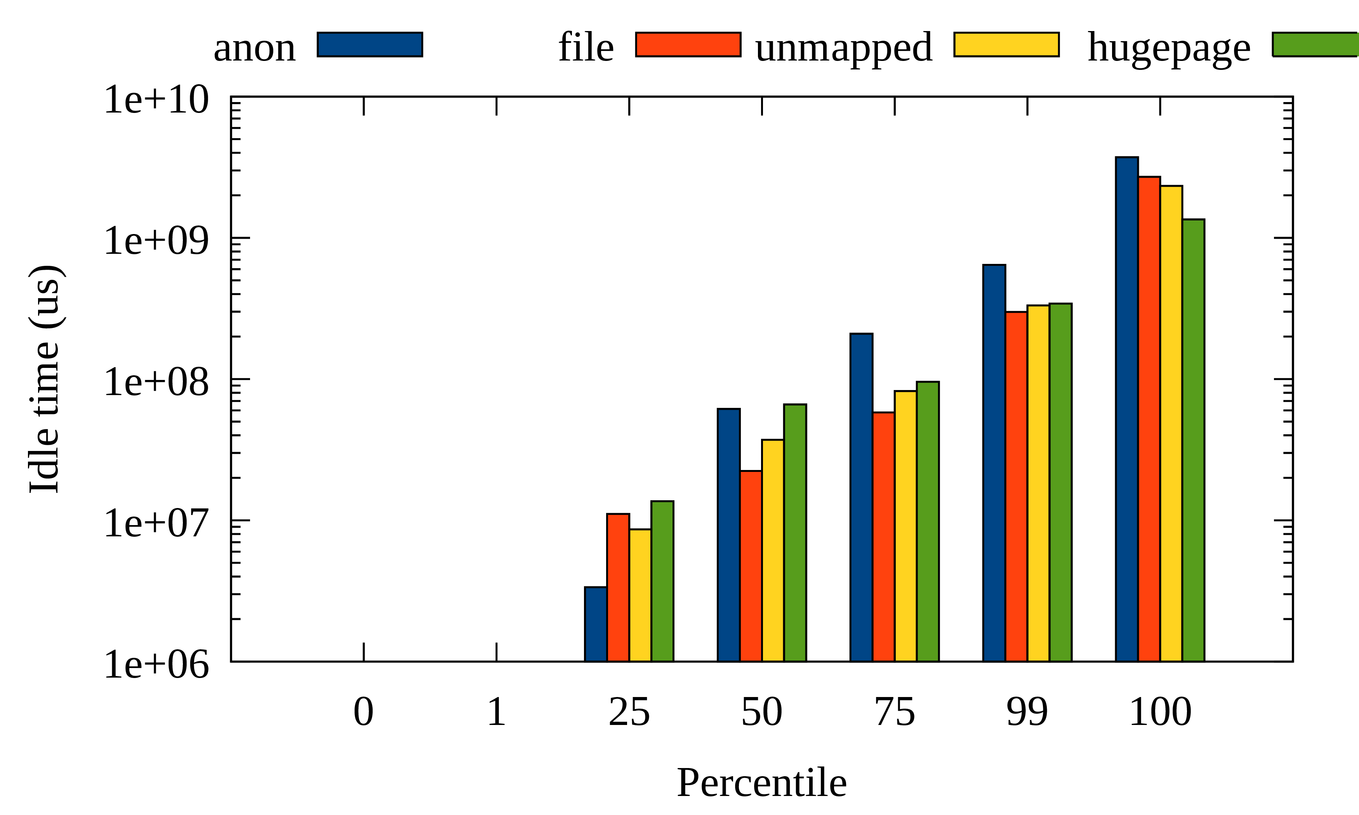
Page Level Access in Real
Files are hotter than anon
Huge pages are hotter in general
Per-page type access pattern of a production workload

Slide 26
Supported Filter Types
Backing content (file or anon)
Belonging Cgroup
PG_Young
Folio size
Whether on active LRU list

Slide 27
Future Works: Optimization
Page level filter: expensive, unscalable
  Not applicable in fleet level
Workaround: Machine-level sampling
Idea: page sampling, timeline TBD
  Show your interest for prioritization
  Or, send patches!

Slide 28
Fleet Wide Monitoring

Slide 29
Fleet Wide Monitoring TOC
Monitoring intervals auto-tuning
Format for Fleet-wide aggregation
DAMON_STAT

Slide 30
Monitoring Intervals
Auto-tuning

Slide 31
Motivation: Why So Inaccurate?
DAMON parameters need tuning
  For each workload/system
  Without tuning it looks only chaotic or boring
Meta runs more than one workloads
  No more tuning!

Slide 32
Supposed DAMON Snapshot
Captures actionable amount of diversity
Time
1 | 2 | 3 | 1 | 2 | 3 | 1 | 2 | 2
0 | 1 | 1 | 1 | 1 | 1 | 1 | 1 | 2
0 | 0 | 1 | 0 | 0 | 0 | 1 | 1 | 1
1 | 2 | 2 | 1 | 2 | 3 | 1 | 1 | 2
Address
Region
Sampling interval
Aggregation interval

Slide 33
If Intervals Are Too Short
Frozen, but boring (no Elsa)
Time
1 | 1 | 1 | 0 | 1 | 1 | 0 | 1 | 1
0 | 0 | 0 | 0 | 0 | 0 | 0 | 0 | 0
0 | 0 | 0 | 0 | 0 | 0 | 0 | 0 | 0
1 | 1 | 1 | 0 | 0 | 0 | 0 | 0 | 0
Address
Region
Sampling interval
Aggregation interval

Slide 34
If Intervals Are Too Long
Muspelheim, but boring (no Thor)
1 | 2 | 3 | 1 | 2 | 3 | 1 | 2 | 3
1 | 2 | 3 | 1 | 2 | 3 | 1 | 2 | 3
1 | 2 | 3 | 1 | 1 | 2 | 1 | 2 | 3
1 | 2 | 3 | 1 | 2 | 3 | 1 | 2 | 3
Address
Region
Sampling interval
Aggregation interval

Slide 35
Too Short Sampling Interval
Most sampling returns “negative”: unnecessary CPU cycle waste
Address
Region
Sampling interval
Aggregation interval

Slide 36
Too Short Intervals in Real 1/2
5ms sampling, 100ms aggregation
Frozen, without Elsa
# damo report access --sort_regions_by temperature
0 addr 16.052 GiB size 5.985 GiB access 0 % age 5.900 s # coldest
1 addr 22.037 GiB size 6.029 GiB access 0 % age 5.300 s
2 addr 28.065 GiB size 6.045 GiB access 0 % age 5.200 s
3 addr 10.069 GiB size 5.983 GiB access 0 % age 4.500 s
4 addr 4.000 GiB size 6.069 GiB access 0 % age 4.400 s
5 addr 62.008 GiB size 3.992 GiB access 0 % age 3.700 s
6 addr 56.795 GiB size 5.213 GiB access 0 % age 3.300 s
7 addr 39.393 GiB size 6.096 GiB access 0 % age 2.800 s
8 addr 50.782 GiB size 6.012 GiB access 0 % age 2.800 s
9 addr 34.111 GiB size 5.282 GiB access 0 % age 2.300 s
10 addr 45.489 GiB size 5.293 GiB access 0 % age 1.800 s # hottest
total size: 62.000 GiB

Slide 37
Too Short Intervals in Real 2/2
5ms sampling, 100ms aggregation
Frozen, without Elsa
# damo report access --style temperature-sz-hist
<temperature> <total size>
[-,590,000,000, -,549,000,000) 5.985 GiB |********** |
[-,549,000,000, -,508,000,000) 12.074 GiB |********************|
[-,508,000,000, -,467,000,000) 0 B | |
[-,467,000,000, -,426,000,000) 12.052 GiB |********************|
[-,426,000,000, -,385,000,000) 0 B | |
[-,385,000,000, -,344,000,000) 3.992 GiB |******* |
[-,344,000,000, -,303,000,000) 5.213 GiB |********* |
[-,303,000,000, -,262,000,000) 12.109 GiB |********************|
[-,262,000,000, -,221,000,000) 5.282 GiB |********* |
[-,221,000,000, -,180,000,000) 0 B | |
[-,180,000,000, -,139,000,000) 5.293 GiB |********* |

Slide 38
Tuned Intervals in Real 1/2
400ms sampling, 8s aggregation
“Look” actionable
# damo report access --sort_regions_by temperature
0 addr 64.492 GiB size 1.508 GiB access 0 % age 6 m 48 s # coldest
1 addr 21.749 GiB size 5.674 GiB access 0 % age 6 m 8 s
2 addr 27.422 GiB size 5.801 GiB access 0 % age 6 m
[...]
25 addr 6.615 GiB size 297.531 MiB access 15 % age 0 ns
26 addr 9.513 GiB size 12.000 KiB access 20 % age 0 ns
27 addr 9.511 GiB size 108.000 KiB access 25 % age 0 ns
[...]
43 addr 58.321 GiB size 4.000 KiB access 100 % age 6 m 24 s
44 addr 9.512 GiB size 4.000 KiB access 100 % age 6 m 48 s
45 addr 58.106 GiB size 4.000 KiB access 100 % age 6 m 48 s # hottest
total size: 62.000 GiB

Slide 39
Tuned Intervals in Real 2/2
400ms sampling, 8s aggregation
“Look” actionable
# damo report access --style temperature-sz-hist
<temperature> <total size>
[-42,800,000,000, -33,479,999,000) 22.018 GiB |***************** |
[-33,479,999,000, -24,159,998,000) 27.090 GiB |********************|
[-24,159,998,000, -14,839,997,000) 6.836 GiB |****** |
[-14,839,997,000, -5,519,996,000) 6.056 GiB |***** |
[-5,519,996,000, 3,800,005,000) 4.000 KiB |* |
[3,800,005,000, 13,120,006,000) 0 B | |
[13,120,006,000, 22,440,007,000) 0 B | |
[22,440,007,000, 31,760,008,000) 0 B | |
[31,760,008,000, 41,080,009,000) 0 B | |
[41,080,009,000, 50,400,010,000) 0 B | |
[50,400,010,000, 59,720,011,000) 4.000 KiB |* |

Slide 40
Intervals Auto-tuning
Change Question
  How to do? (mechanism) → What to achieve? (final goal, policy)
Users specify
  Desired amount of access events in each snapshot
  Minimum and maximum sampling intervals
Tune intervals for the desire using a feedback loop
  Increase intervals if events in current snapshot < goal
  Decrease intervals if events in current snapshot > goal

Slide 41
Parameters for Auto-tune
Parameters for parameters auto-tuning
  Ironic, but inevitable
  Arguably easier to tune
Default suggestion is available
  Proven on real-world production workloads
  Should be good enough to at least start

Slide 42
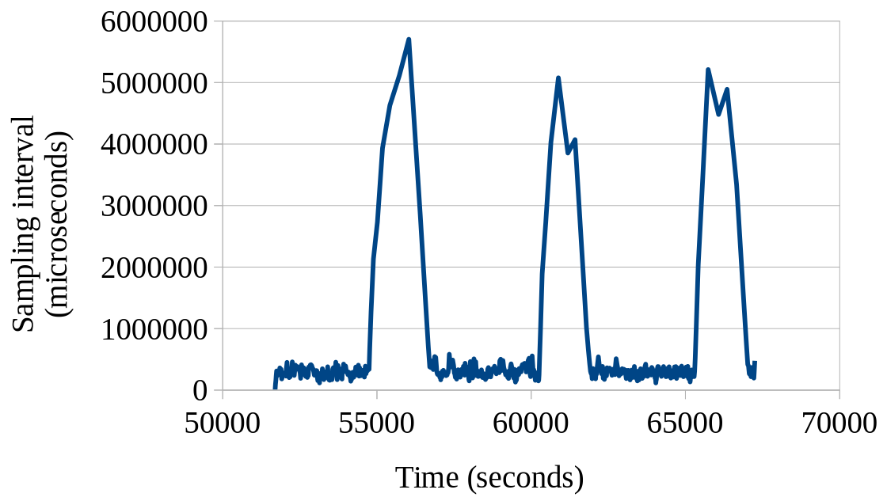
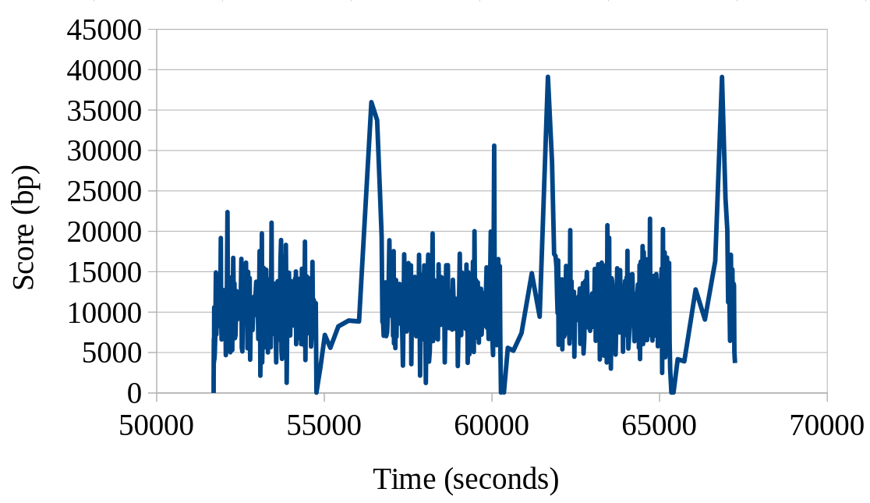
Auto-tuning in Real World
Dynamically change and converge
  As expected

Slide 43
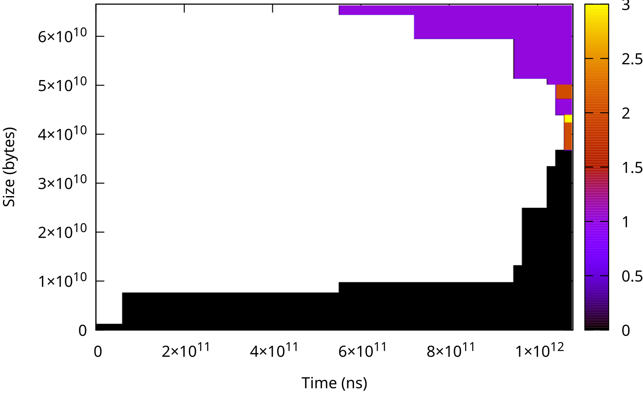
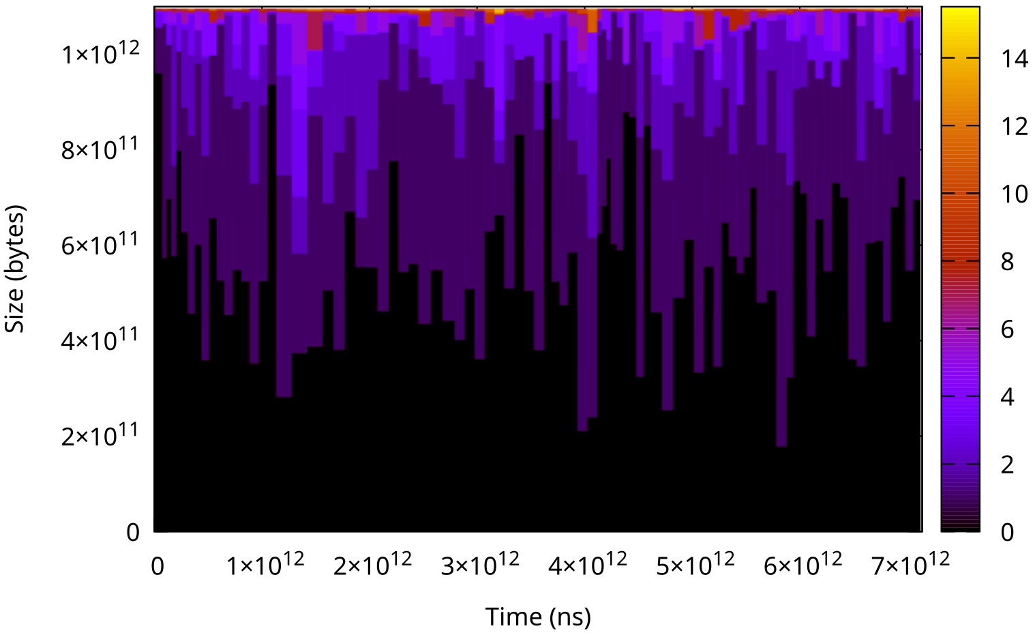
Auto-tuned Snapshots
Meaningful access patterns on multiple workloads
<0.1% single CPU time consumption

Slide 44
Format for Fleet-wide Aggregation

Slide 45
Motivation: Finer != Always Fine
Data from machines need aggregation
DAMON provides
location, frequency, stability, recency
  Location only disturbs aggregation
$ sudo damo report access
[...]
0 addr 4.000 GiB size 20.000 MiB access 0 hz age 2 m 53.546 s
1 addr 4.020 GiB size 2.000 MiB access 1.383 hz age 3 h 4 m 37.999 s
2 addr 4.021 GiB size 6.046 GiB access 0.069 hz age 1 m 26.773 s
[...]

Slide 46
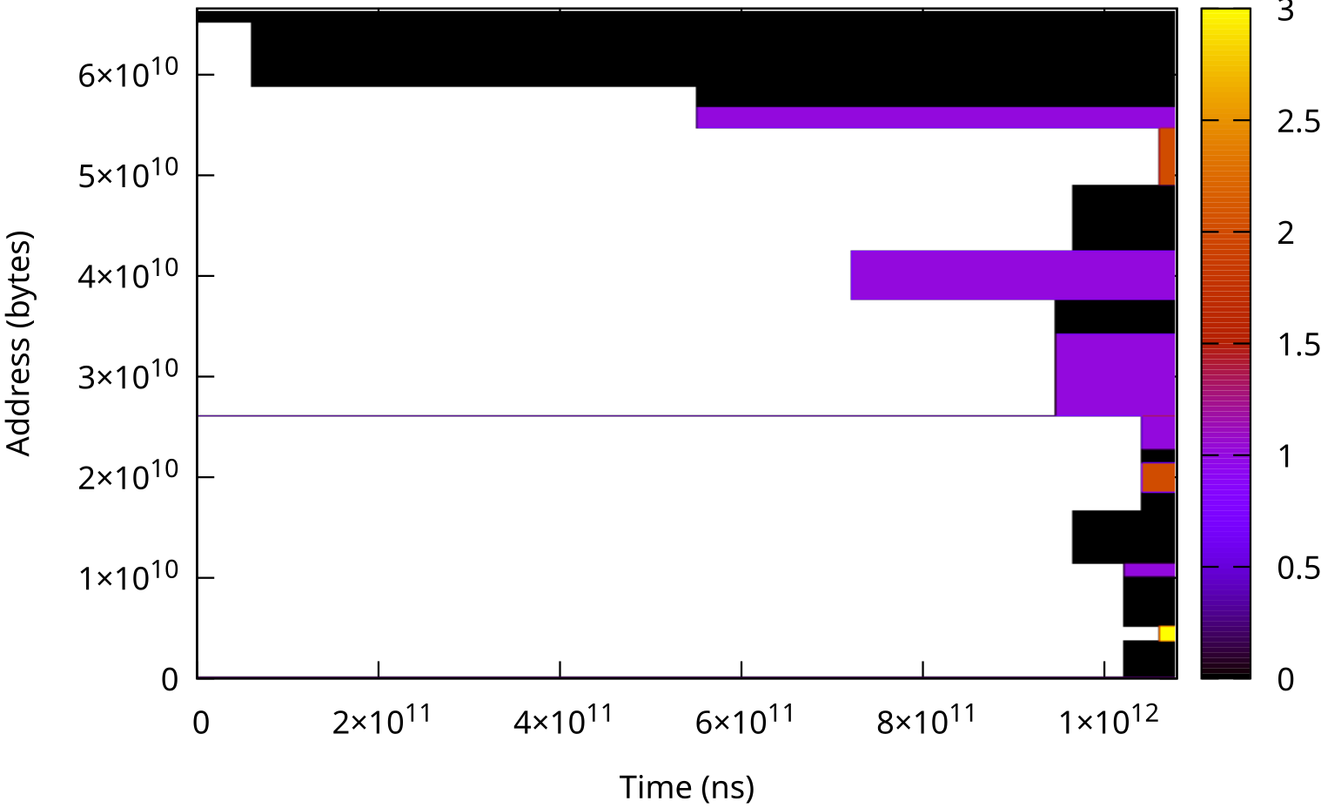
Idle Time Percentiles: Concept
Idle time: how long it was not accessed
Percentile: that of the statistics
Unsorted snapshot
Sorted by access frequency

Slide 47
Idle Time Percentiles: Concept
Idle time: how long it was not accessed
Percentile: that of the statistics
Unsorted snapshot
Sorted by access frequency
P50 idle time

Slide 48
Idle Time Percentiles: Concept
Idle time: how long it was not accessed
Percentile: that of the statistics
Unsorted snapshot
Sorted by access frequency
P50 idle time
P75 idle time

Slide 49
Idle Time Percentiles: Concept
Idle time: how long it was not accessed
Percentile: that of the statistics
Unsorted snapshot
Sorted by access frequency
P50 idle time
P75 idle time
P99 idle time

Slide 50
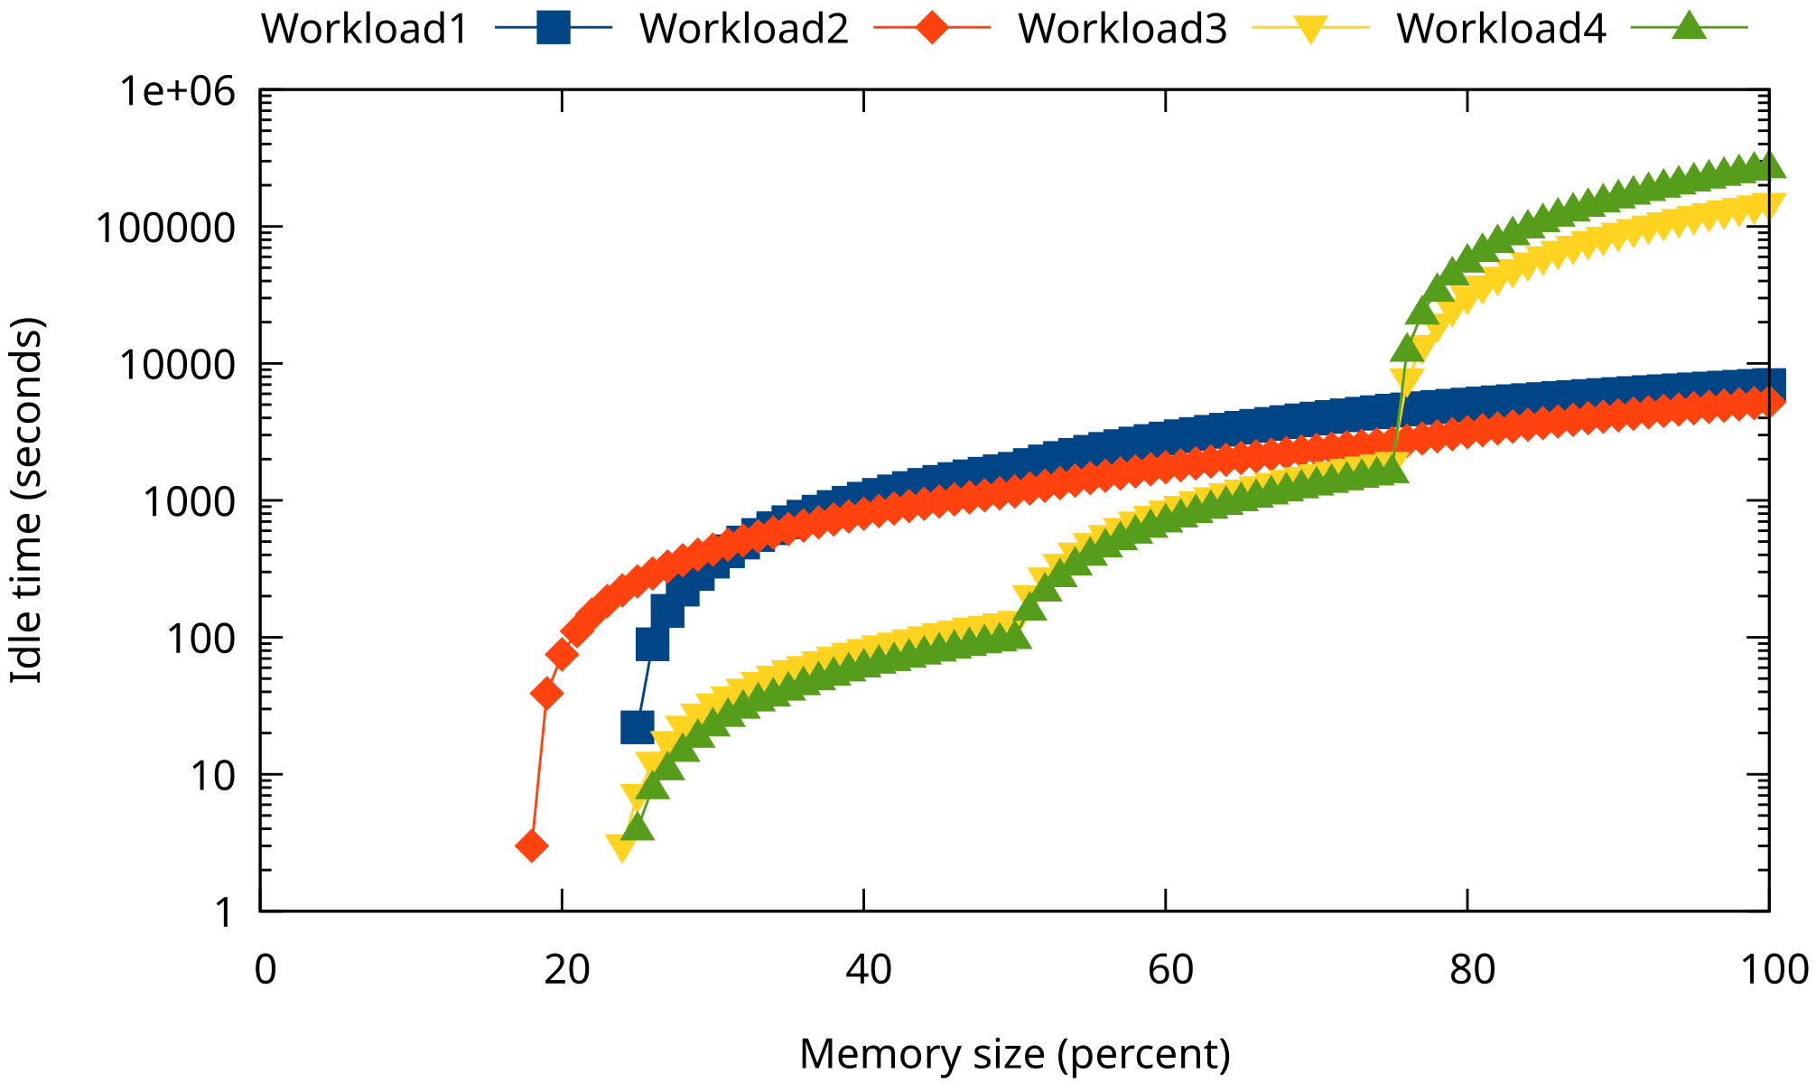
Idle Time Percentiles in Real
Note: Y-axis in logscale
Show common and different patterns of workloads

Slide 51
Cold Memory Tail
X/Y-axis inversion of idle time percentiles
X axis: Idle time
Y axis: Size of memory of the idle time

Slide 52
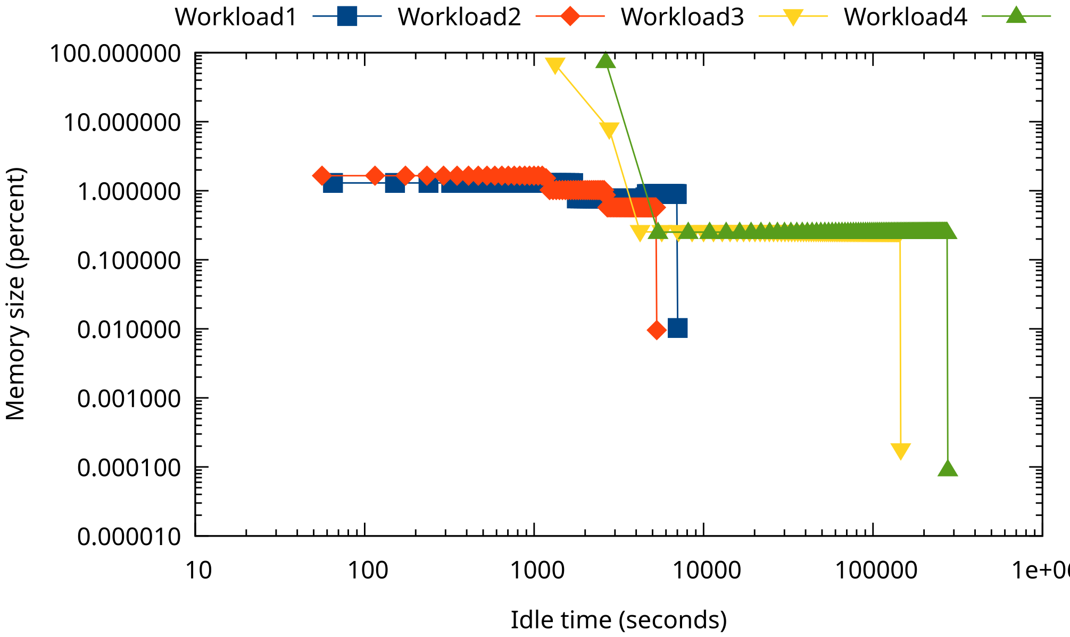
Cold Memory Tail in Real
Note: Both X/Y-axis in logscale

Slide 53
DAMON_STAT

Slide 54
Motivation: Usability
DAMON is in Kernel
Need a user-space agent
  Run DAMON with the features
  Collect the monitoring outputs
  Send the outputs to a server

Slide 55
DAMON_STAT: A kernel module
Run auto-tuned DAMON
Expose idle time percentiles and estimated memory bandwidth with files
Can enabled at runtime, boot time, build time
Upstream-ed v6.17

Slide 56
Interface: Module Params
DAMON_STAT_ENABLED_DEFAULT for build time enable
$ cd /sys/module/damon_stat/parameters/
$ ls
aggr_interval_us enabled estimated_memory_bandwidth memory_idle_ms_percentiles
$ sudo cat estimated_memory_bandwidth
3860000
$ sudo cat memory_idle_ms_percentiles
-25600,25600,25600,25600,25600,[...]128000,128000

Slide 57
How To Do Fleet Wide Monitor
Set DAMON_STAT_ENABLED_DEFAULT=y
Modify your monitoring agent
  Read idle_time_percdentiles file
  Send the content to the server

Slide 58
Wrapup
Meta developed and upstreamed DAMON features for
  page level and fleet wide access monitoring
Feel free to use and
please feedback DAMON

Slide 59
Questions?
Community is there for you, too
  Mailing list: damon@lists.linux.dev
  Project website: https://damonitor.github.io/
  Maintainer email: sj@kernel.org
  DAMON Beer/Coffee/Tea Meetup

