Slide 1

Feb 2, 2025
FOSDEM’25, Brussels
DAMON: Kernel Subsystem for Data Access Monitoring and Access-aware System Operations
SeongJae Park (SJ) <sj@kernel.org> <sjpark@meta.com>
QR code
generated from https://qr.io
https://damonitor.github.io

Slide 2
DAMON: Kernel Subsystem for Data Access Monitoring and Access-aware System Operations

Slide 3
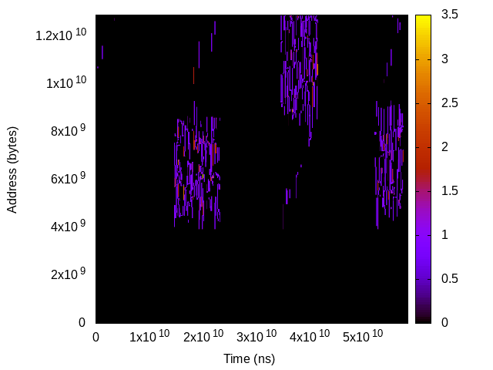
Data Accesses: Events on Space/Time of Memory
Time
Address

Slide 4
Data Access Monitoring: Hope, Real, and DAMON
Hope: Precise, Complete, Light
  Time granularity: CPU cycle / # CPUs (or, speed of light)
  Space granularity: bit (or, electron)
  Keep complete history (from Bigbang)
  Lightweight enough to run on production systems
Real: Expensive, YAGNI without tradeoff
  O(memory size) time, O(memory size * total monitoring time) space overhead
  Do you really care if a bit was accessed five years ago?
DAMON: accuracy vs overhead tradeoff
  Scalable, best-effort, aim real-world products usage

Slide 5
Region-based Space Handling

Slide 6
Region: Access Monitoring Unit
Defined as
  A sub-area of the memory’s space-time
  A collection of adjacent elements that having similar access pattern
Access check of one element per region is enough
e.g., “This page is accessed within last 1 second; a cacheline is checked”
$ cat wonder_region_1
We’re all mad [un]accessed here

Slide 7
Fixed Space/Time Granularity, <=1 Access Frequency
Sort of periodic fixed granularity idleness monitoring
Time overhead: “memory size / space granularity”
Space overhead: “time overhead * monitoring time / time granularity”
Reduced, but still ruled by memory size and total monitoring time
Time
We’re all mad accessed here
Address
Region
We’re all mad unaccessed here
Sampling interval

Slide 8
Fixed Space/Time Granularity, <=N Access Frequency
Accumulate access checks via per-region counter
Now
Time
1
0
0
1
Address
Region
Aggregate interval
Sampling interval

Slide 9
Fixed Space/Time Granularity, <=N Access Frequency
Accumulate access checks via per-region counter
Now
Time
1 | 2
0 | 1
0 | 0
1 | 2
Address
Region
Aggregate interval
Sampling interval

Slide 10
Fixed Space/Time Granularity, <=N Access Frequency
Accumulate access checks via per-region counter
Now
Time
1 | 2 | 3
0 | 1 | 1
0 | 0 | 1
1 | 2 | 2
Address
Region
Aggregate interval
Sampling interval

Slide 11
Fixed Space/Time Granularity, <=N Access Frequency
Accumulate access checks via per-region counter
Now
Time
1 | 2 | 3 | 0
0 | 1 | 1 | 0
0 | 0 | 1 | 0
1 | 2 | 2 | 0
Address
Region
Aggregate interval
Sampling interval

Slide 12
Fixed Space/Time Granularity, <=N Access Frequency
Accumulate access checks via per-region counter
Now
Time
1 | 2 | 3 | 0 1 | 2 | 3
0 | 1 | 1 | 0 1 | 1 | 1
0 | 0 | 1 | 0 0 | 0 | 0
1 | 2 | 2 | 0 1 | 2 | 3
Address
Region
Aggregate interval
Sampling interval

Slide 13
Fixed Space/Time Granularity, <=N Access Frequency
Accumulate access checks via per-region counter
Now
Time
1 | 2 | 3 | 0 1 | 2 | 3 | 0 1 | 2 | 2
0 | 1 | 1 | 0 1 | 1 | 1 | 0 1 | 1 | 2
0 | 0 | 1 | 0 0 | 0 | 0 | 0 1 | 1 | 1
1 | 2 | 2 | 0 1 | 2 | 3 | 0 1 | 1 | 2
Address
Region
Aggregate interval
Sampling interval

Slide 14
Fixed Space/Time Granularity, <=N Access Frequency
Accumulate access checks via per-region counter
Reduce space overhead to “1/N”
Still, O(memory size * total monitoring time)
Time
3 | 3 | 2
1 | 1 | 2
1 | 0 | 1
2 | 3 | 2
Address
Region
Aggregate interval

Slide 15
Inefficiency of Fixed Space Granularity
Adjacent regions of similar hotness
Time
3 | 3 | 2
1 | 1 | 2
1 | 0 | 1
2 | 3 | 2
Address
Region
Aggregate interval

Slide 16
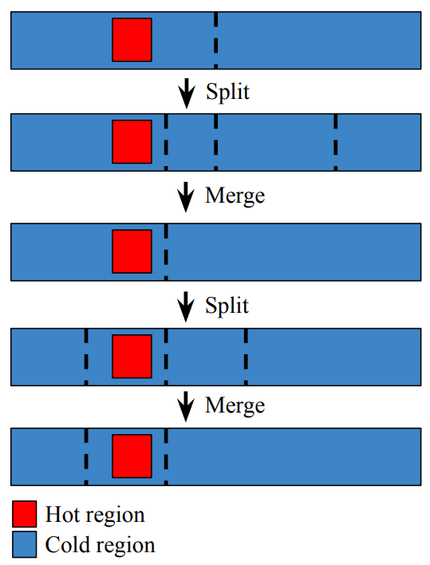
Dynamic Space Granularity: Mechanisms
Repeat merging the wasteful regions and randomly splitting regions
  The number of region == number of different access patterns
Let user set min/max number of total regions
Time
3 | 3 | 2
1 | 1
 | 0 | 1
2 | 3 | 2
Address
Region
Aggregate interval

Slide 17
Dynamic Space Granularity: Mechanisms
Merge the wasteful regions and randomly split region
  The number of region == number of different access patterns
Let user set min/max number of regions
Time
3 | 3 | 2
1 | 1
 | 0 | 1
2 | 3 | 2
Address
Region
Aggregate interval

Slide 18
Dynamic Space Granularity: Overhead/Accuracy
Time overhead: min(different access patterns, max number of regions)
  No more ruled by arbitrary memory size
Accuracy: best-effort high
  Lower-bound accuracy can be set via min_nr_regions
Time
3 | 3 | 2
1 | 1
 | 0 | 1
2 | 3 | 2
Address
Region
Aggregate interval

Slide 19
Age Counting for History Handling

Slide 20
Inefficiency of Fixed Time Granularity Regions (1/2)
The definition of regions is not only about space, but also about time
Time
Address
Region
Aggregate interval

Slide 21
Inefficiency of Fixed Time Granularity Regions (2/2)
The definition of regions is not only about space, but also about time
Multiple time-adjacent regions of similar hotness: only waste
Time
Address
Region
Aggregate interval

Slide 22
Dynamic Time Granularity (1/3)
Count how long the hotness has kept
Snapshot contains history of useful length
Now
Time
1
1
1
1
Address
Region
Aggregate interval

Slide 23
Dynamic Time Granularity (2/3)
Count how long the hotness has kept
Snapshot contains history of useful length
This snapshot can be discarded
Now
Time
1 | 2
1 | 2
1 | 1
1 | 1
Address
Region
Aggregate interval

Slide 24
Dynamic Time Granularity (3/3)
Count how long the hotness has kept
Snapshot contains history of useful length
This snapshot can be discarded
This snapshot can be discarded
Now
Time
1 | 2 | 1
1 | 2 | 3
1 | 1 | 1
1 | 1 | 1
Address
Region
Aggregate interval

Slide 25
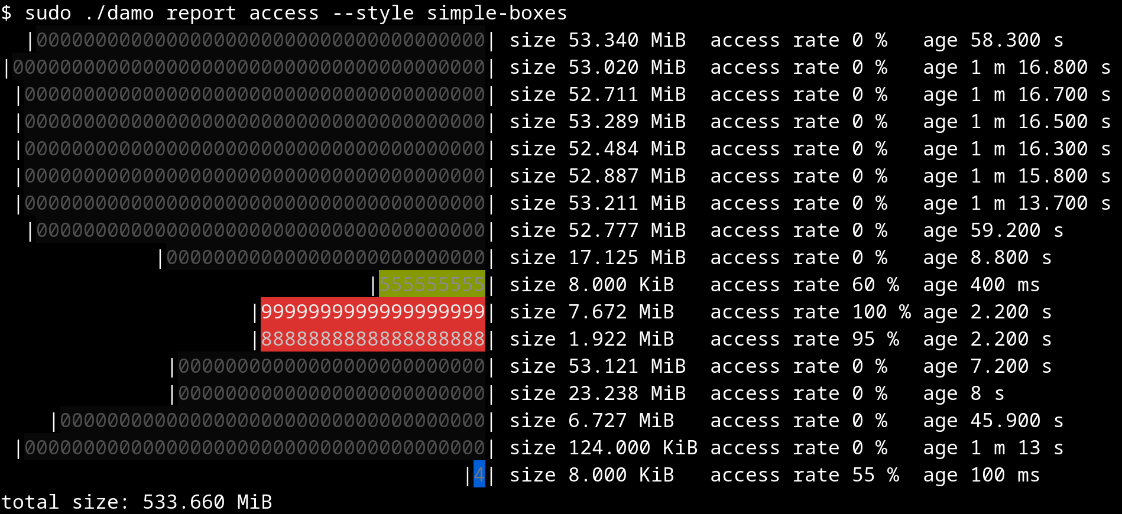
Snapshot: The Output of DAMON
O(max_nr_regions) time/space overhead
Both time/space overheads are not ruled by memory size/monitoring time

Slide 26
How Accurate, How Heavy?
Up to you: Under the control, best effort (highest accuracy, lowest overhead)
Being successfully used on real world products for years
3-4% single CPU usage is commonly reported from real world products
  Many rooms to improve: the goal is turning it on by default everywhere

Slide 27
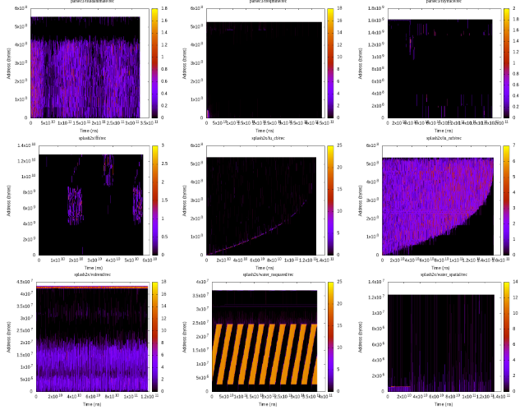
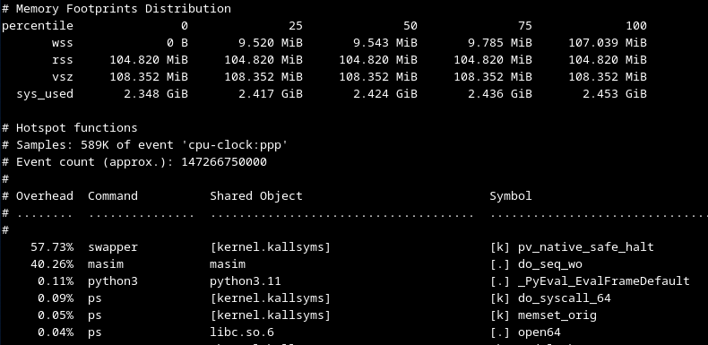
Potential, or Aimed Usages
Profiling (e.g., GIF demo link)
  Help better understand and find rooms for improvements
Profiling-guided Optimizations
  Could be done on both offline and online
Why not let kernel just (transparently) works?

Slide 28
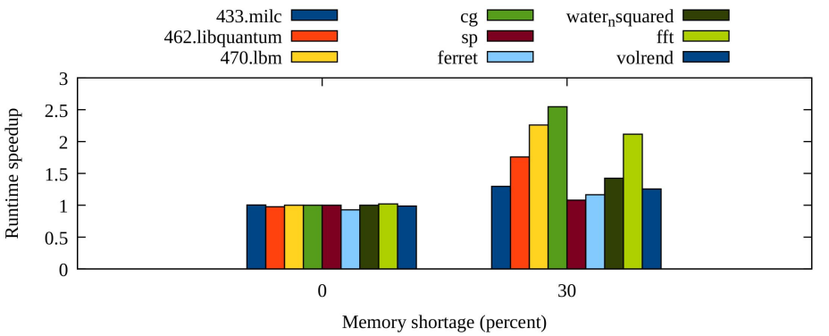
Potential, or Aimed Usages
Profiling (e.g., GIF demo link)
  Help better understand and find rooms for improvements
Profiling-guided Optimizations
  Could be done on both offline and online
Why not let kernel just (transparently) works?

Slide 29
Potential, or Aimed Usages
Profiling (e.g., GIF demo link)
  Help better understand and find rooms for improvements
Profiling-guided Optimizations
  Could be done on both offline and online
Why not let kernel just (transparently) works?

Slide 30
DAMON: Kernel Subsystem for Data Access Monitoring and Access-aware System Operations

Slide 31
DAMOS: Data Access Monitoring-based Operation Schemes
Another side of DAMON
Let users define schemes
  Memory operation actions to apply to regions of specific access pattern
Once per user-defined time interval
  find the regions of the condition from the snapshot and apply the action
Additional features for production level control are provided
  Finding optimum “access pattern” on dynamic environments is challenging
# # pageout memory regions that not accessed for >=5 seconds
# damo start --damos_action pageout --damos_access_rate 0% 0% --damos_age 5s max

Slide 32
Features for Production Quality DAMOS Control
Filters: define target memory with non-access-pattern information
  “pageout cold pages of NUMA node 1 that associated with cgroup A and file-backed”
Quota: set aggressiveness of DAMOS
  Access pattern based prioritization is applied under the quota
  “pageout cold pages up to 100 MiB per second using <2% CPU time, coldest ones first”
Quota auto-tuning: auto-tune quota for user-defined target metric
  “pageout cold pages aiming 0.05% of memory pressure (coldest ones first)”

Slide 33
DAMOS for Efficient and Fine-grained Data Access Monitoring
DAMOS_STAT
  Special action making no system change but expose the scheme-internal information
  Let user knows which of the memory are eligible for the scheme
With DAMOS filters, can do page level properties-based monitoring
  “How much of >2 minutes unaccessed memory are in hugepages and belong to cgroup A?”
With DAMOS quotas, can do overhead-controlled monitoring

Slide 34
Getting Started

Slide 35
Availability
Merged into the mainline from v5.15
Backported and enabled on major Linux distro kernels
  Major distros: Amazon, Android, Arch, Debian, Fedora, Oracle, …
DAMON user-space tool (damo) is available on major packaging systems
  Arch, Debian, Fedora, PyPi, ...

Slide 36
How can I Use DAMON?
Kernel API: Recommended for kernel programmers
DAMON sysfs interface: Recommended for user-space program development
DAMON user-space tool: Recommended for general usages from user-space
DAMON modules: Recommended for specific usages
If you don’t know what to do first, DAMON tests suite

Slide 37
Community: For Questions, Help, Patch Reviews
Public mailing list (https://lore.kernel.org/damon)
Bi-weekly virtual meetup
  Occasional/regular private meetings on demand
Project website (https://damonitor.github.io)
  Starting point for DAMON users and developers
The future of DAMON is open and up to you
  “Prefer random evolution over intelligent design”

Slide 38
Summary: That’s DAMON
DAMON is a kernel subsystem
  For data access monitoring and access-aware system operations
The future is open and up to the community
  Make your selfish voice

Slide 39
Questions?
You can also ask questions anytime to
  sj@kernel.org
  Public mailing list (https://lore.kernel.org/damon)
  Bi-weekly virtual meetup
  Occasional/regular private meetings on demand
  Project website (https://damonitor.github.io)
These slides are also available at
  https://github.com/damonitor/talks/blob/master/2025/fosdem/damon_fosdem25.pdf

Slide 40
Backup Slides

Slide 41
Real-world DAMON Use Cases:
Proactive Reclamation and
CXL Memory Tiering

Slide 42
Proactive Reclamation
Reactive reclamation: Reclaim cold memory when memory pressure happens
Proactively reclamation: Reclaim cold memory before memory pressure
Benefit 1: Reduce memory footprint without performance degradation
Benefit 2: Minimize degradation from direct reclamation
Known usages: Google, Meta, and Amazon
  Each company uses its own implementation for its usage
AWS uses DAMOS-based implementation since 2022

Slide 43
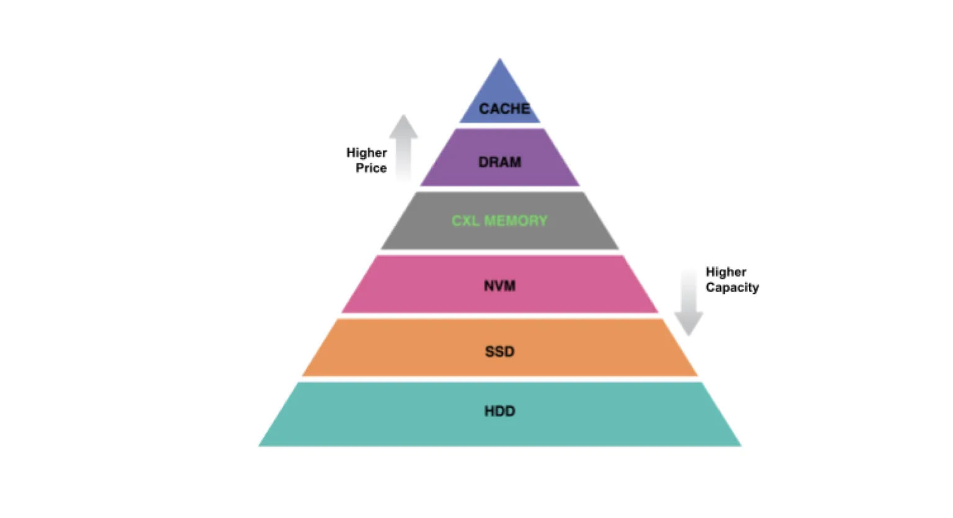
CXL Memory Tiering
CXL-tiered memory: Put CXL memory between DRAM and NVM
  Pros: Higher capacity with lower price (higher efficiency)
Challenge: Dynamic placement of pages (CXL mem is slower than DRAM)
DAMON-based approach: Place hot pages on DRAM node, Place cold pages on CXL node
SK hynix developed their CXL memory SDK (HMSDK) using DAMOS
  Reports ~12.9% speed up

Slide 44
Architectures

Slide 45
Execution Model: Kernel Thread per Requests
“struct damon_ctx”: Data structure for DAMON user input/output containing
  User requests: target address space, address range, intervals, DAMOS schemes
  Operation results: access snapshot, DAMOS stats
“kdamond”: DAMON worker thread
  Create one kdamond per “damon_ctx”
    In future, could support multiple “damon_ctx” per kdamond
    In future, could separate DAMOS to another thread (maybe useful for cgroup charging)
  Allows async DAMON execution and multiple kdamonds (CPUs) scaling

Slide 46
Extensible Layers
User-space
Tools
DAMO
datop
DAMON API User
Kernel Modules
General-purpose User ABI
Special-purpose Modules
DAMON_SYSFS
DAMON_DBGFS
DAMON_RECLAIM
DAMON_LRU_SORT
DAMON_WSS
DAMON Application Programming Interface
DAMON
DAMOS
Adaptive Regions Adjustment
Action and Pattern
Core Logic
Region-based Sampling
Quotas and Prioritization
Access Frequency Monitoring
Feedback-based auto-tuning
Advanced Regions Adjustment
Watermarks
Parameters Auto-tuning
Filters
DAMON Operations Set Registration Interface
Operations Set
paddr
vaddr
Read/write-only
NUMA-cpus-only
Primitives
that DAMON
depends on
PTE/VMA/rmap, ...
AMD IBS
LRU State

Slide 47
Extensible Layers
User-space
Tools
DAMO
datop
DAMON API User
Kernel Modules
General-purpose User ABI
Special-purpose Modules
DAMON_SYSFS
DAMON_DBGFS
DAMON_RECLAIM
DAMON_LRU_SORT
DAMON_WSS
DAMON Application Programming Interface
DAMON
DAMOS
Adaptive Regions Adjustment
Action and Pattern
Core Logic
Region-based Sampling
Quotas and Prioritization
Access Frequency Monitoring
Feedback-based auto-tuning
Advanced Regions Adjustment
Watermarks
Parameters Auto-tuning
Filters
DAMON Operations Set Registration Interface
Operations Set
paddr
vaddr
Read/write-only
NUMA-cpus-only
Primitives
that DAMON
depends on
PTE/VMA/rmap, ...
AMD IBS
LRU State

Slide 48
Extensible Layers
User-space
Tools
DAMO
datop
DAMON API User
Kernel Modules
General-purpose User ABI
Special-purpose Modules
DAMON_SYSFS
DAMON_DBGFS
DAMON_RECLAIM
DAMON_LRU_SORT
DAMON_WSS
DAMON Application Programming Interface
DAMON
DAMOS
Adaptive Regions Adjustment
Action and Pattern
Core Logic
Region-based Sampling
Quotas and Prioritization
Access Frequency Monitoring
Feedback-based auto-tuning
Advanced Regions Adjustment
Watermarks
Parameters Auto-tuning
Filters
DAMON Operations Set Registration Interface
Operations Set
paddr
vaddr
Read/write-only
NUMA-cpus-only
Primitives
that DAMON
depends on
PTE/VMA/rmap, ...
AMD IBS
LRU State

Slide 49
DAMOS Quotas: Intuitive Aggressiveness Control
Before applying DAMOS schemes
  Set temperature-based priority score of each region
  Build “priority score”: “total size of regions of the priority” histogram
  Find lowest priority threshold for the scheme meeting the quota
  Skip applying action to regions having lower-than-threshold priority scores
Single snapshot and histogram iteration: O(<=user-defined-N)
Quota auto-tuning: A simple proportional feedback algorithm
  Reward metrics: Arbitrary user-input or self-retrievable metrics like memory PSI

Slide 50
DAMOS Filters: Fine-grained Target Selection
Before applying DAMOS action, check the properties of region and skip action if needed
Non-page granular (high level) filters
  Filtered out before applying actions
  Address ranges (e.g., NUMA nodes or Zone)
  DAMON-defined monitoring target (e.g., process)
Page granular (low level) filters
  Filtered out in the middle of actions in page level
  Anon/File-backed
  Belonging memory cgroup
  page_idle()

Slide 51
Pseudo-code of DAMON v5.15
While True:
for region in regions:
if region.accessed():
region.nr_accesses += 1
sleep(sampling_interval)
if now() % aggregation_interval:
merge(regions)
user_callback(regions)
for region in regions:
region.nr_accesses = 0
split(regions)

Slide 52
DAMON accuracy on Low-locality Space/Workloads
It is proven to work on real world products for years
Pareto principle and unconcious bias will make the pattern
  Entropy-full situation is when the data center is doom-ed
“age” avoid immature decision
More works for accuracy improvement will be continued
DAMON could be decoupled with the region-based mechanisms in future
Let’s collect data and continue discussions together

Slide 53
Can DAMON Extended for Non-snapshot Access Patterns?
TL; DR: Yes, why not?
DAMON is for any access information; Snapshot is one of the representations
If the information/representation is useful for users, DAMON can add support
We started discussion for Memory bandwidth visibility

Slide 54
Can DAMON Use features Other than PTE Accessed bits?
The extensible layer allows it
AMD IBS and page fault-based appaoraches (e.g., PTE_NONE) are on the table
In future, if GPU provides access check feature, we can extend to use it
Such extension would allow
  More lightweight and precise monitoring
  Access source, read/write-aware monitroing
  Kernel memory access monitoring

Slide 55
DAMON Monitoring Auto-tuning
Aggregation interval tuning is mandatory for real-world DAMON usages
Auto-tuning for the user-desired amount of access samples is under development
Auto-tuning of max_nr_regions for user-desired CPU usage is a TODO

