Slide 1

DAMOS:
The Smart Cruise Control for RAM
SJ Park <sj@kernel.org> <sjpark@crusoe.ai>
21 SEPTEMBER 2026
PARIS, FRANCE

Slide 2

TL; DR
DAMOS is a Linux kernel feature for automated access-aware system operations
Image is retrieved from https://pollackgroup.com/wp-content/uploads/2023/07/62bcd9b81b5cfd7bf26cb65d_self-driving-cars-1-jpg.webp

Slide 3
Table of Contents
Why Smart Control for RAM (6 minutes)
Begins: Origin to Productizing (10 minutes)
Darknight: DAMOS Auto-tuning (10 minutes)
Rises: DAMOS Usages (2 minutes)
Revolution: Ongoing Changes (2 mins)
QnA (10 mins)

Slide 4
Why Smart Control for RAM

Slide 5

RAM Efficiency Matters
Data: Source of money
  Getting bigger :D
RAM (Memory): Sink of money
  Getting more expensive :’(
Goal: More data with less memory
Images are retrived from https://i.imgflip.com/244jt6.jpg?a497136

Slide 6

Real World Story
In a cloud provider far, far away
CPU: Pay-as-you-go
Memory: Fixed price
Plan: pay-as-you-go for memory
  Charge for only working set
Image is retrieved from https://imgflip.com/i/b1mr1j

Slide 7
Real World Story
In a cloud provider far, far away
CPU: Pay-as-you-go
Memory: Fixed price
Plan: pay-as-you-go for memory
  Charge for only working set
“Everyone Has a Plan Until They Get Punched in the Mouth”,
Mike Tyson
Image is retrieved from https://imgflip.com/i/b1mr1j

Slide 8

Problem: Working Set Detection
Working set != Allocated memory
Much more difficult than it looks like
  Definition of working set
  Monitoring overhead
  Memory-greedy system
Common and essential for memory efficiency
Image is retrieved from https://magicmeme.com/_next/image?url=https%3A%2F%2Fcdn.magicmeme.com%2Ftemplates%2Ficeberg.png&w=1200&q=75

Slide 9

DAMON: A New Hope
A PhD student’s side project
  For the issue in main research
  Developed a kernel subsystem
  as a solution
Named DAMON: Data Access MONitor
Image is retrieved from https://media.makeameme.org/created/jedi-master-why.jpg

Slide 10
DAMON in Nutshell

Slide 11
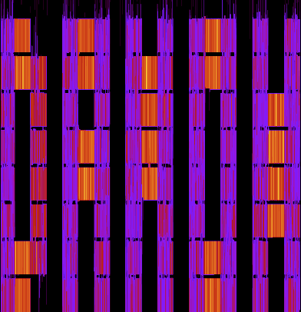
DAMON in One Sentence
“DAMON is a Linux kernel subsystem for efficient access monitoring and
access-aware system operations.”
Image is generated by DAMON

Slide 12
High Level Implementation
Spawn a kernel thread that does below
See if each page is accessed, every 5ms
Inform users the findings, every 100ms
Time intervals can be [auto-]tuned
$ ls mm/damon/
acma.c Makefile ops-common.h sysfs.c sysfs-schemes.c
core.c modules-common.c paddr.c sysfs-common.c tests
Kconfig modules-common.h reclaim.c sysfs-common.h vaddr.c
lru_sort.c ops-common.c stat.c sysfs-sample.c
$ wc -l mm/damon/*.c | tail -n 1
16000 total

Slide 13

Providing Access Information
Location
Frequency
Stability
Recency
Access pattern heatmap of
Splash2x/Raytrace

Slide 14
Design
Goals: Accurate, Lightweight,
Tunable and Automated
Mechanisms: Sampling, Adaptive regions, Sysfs interface, Feedback loops
Results
  <0.1% CPU overhead on products

Slide 15
Availability and Usages
Available on >=5.15 upstream kernels
Enabled on most distro kernels
Being used for products and researches

Slide 16
Community
Public channels
  Mailing list: damon@lists.linux.dev
  Project website: https://damonitor.github.io/
Private channels
  Maintainer email: sj@kernel.org
  DAMON Beer/Coffee/Tea Meetup

Slide 17

But This is Not About DAMON
DAMON was presented in detail at Kernel Recipes’25

Slide 18
Table of Contents
Why Smart Control for RAM (6 minutes)
Begins: Origin to Productizing (10 minutes)
Darknight: DAMOS Auto-tuning (10 minutes)
Rises: DAMOS Usages (2 minutes)
Revolution: Ongoing Changes (2 mins)
QnA (10 mins)

Slide 19
DAMOS Begins

Slide 20

Developer’s Expectation
DAMON only provides
Access Pattern
Users do hard lifts
  Decide optimum system memory size
  Optimize programs for access pattern
Image is retrieved from https://encrypted-tbn0.gstatic.com/images?q=tbn:ANd9GcSOuahkkiJvsAe56zRaoB0KSAqMdowUS5XB36ULDvioD0HGmRe2d4GJYILc&s=10

Slide 21
DAMON User Reaction in Real
Users are busy, even in hyper-scalers
No time to run a tool
for no direct wins
FAQ: Can DAMON provide wins itself?
Image is retrieved from https://encrypted-tbn0.gstatic.com/images?q=tbn:ANd9GcSOuahkkiJvsAe56zRaoB0KSAqMdowUS5XB36ULDvioD0HGmRe2d4GJYILc&s=10

Slide 22

madvise()
System call
Gives memory advice to kernel
Supported actions
  MADV_PAGEOUT, MADV_HUGEPAGE, MADV_WILLNEED, ...
Image is retrieved from https://i.imgflip.com/1itm1d.jpg?a495600

Slide 23

DAMON+madvise()
Let DAMON do madvise() calls
For memory of a given pattern
  Pattern: Access frequency & stability
Target pattern+madvise() action:
DAMon-based Operation Scheme (DAMOS)
Image is retrieved from https://static0.hotcarsimages.com/wordpress/wp-content/uploads/2018/05/6138666188_f86c3cdc67_b.jpg?q=50&fit=crop&w=825&dpr=1.5

Slide 24
DAMON+madvise() Example
Proactive cold memory reclaim
  ‘damo’ is DAMON user-space tool
$ sudo ./damo start $(pidof my_workload) \
--damos_action pageout \
--damos_access_rate 0% 0% --damos_age 2m max

Slide 25
DAMON+madvise() Example
Proactive cold memory reclaim
$ sudo ./damo start $(pidof my_workload) \
--damos_action pageout \
--damos_access_rate 0% 0% --damos_age 2m max
Start DAMON, monitor access pattern of ‘my_workload’ process

Slide 26
DAMON+madvise() Example
Proactive cold memory reclaim
$ sudo ./damo start $(pidof my_workload) \
--damos_action pageout \
--damos_access_rate 0% 0% --damos_age 2m max
Page out memory that not accessed for >=2 minutes
according to the monitoring results, as soon as found.

Slide 27
More than madvise()
No reason to support only madvise() actions
DAMOS is later extended for general system operations
  Moving folio inactive → active LRU list
  Migrate folio to a given node

Slide 28
DAMOS for Products

Slide 29

What If DAMOS Out Of Control
Access pattern is dynamic
  Target memory can suddenly increase
  DAMOS can consume huge system resource
  Critical in real-world products
Image is retrieved from
https://inews.co.uk/wp-content/uploads/2022/01/JGD_1214107.jpg?w=1200&h=675&crop=1

Slide 30

DAMOS Quota
Max speed of DAMOS actions
  E.g., reclaim cold memory up to 128 MiB/s
Regions for action under quota
  Selected via access pattern
  Hottest or coldest memory, depend on action
Image is retrieved from https://i.pinimg.com/736x/ba/31/88/ba3188f5a6f7a1b6227262a14d9841ae.jpg

Slide 31
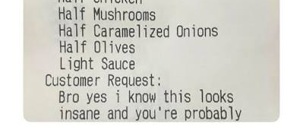
Special Requests
Special products have unique requests
  Access pattern is useful but not everything
  Example requests
    Reclaim cold page cache but anon pages
    Reclaim cold memory of cgroup X but Y
Image is retrieved from https://encrypted-tbn0.gstatic.com/images?q=tbn:ANd9GcRuwoXpDo3YjK9u8JQ8r0VVP5YWcNENt9NaxBS2uicKEH4nG-ef_YAIUo4&s=10

Slide 32
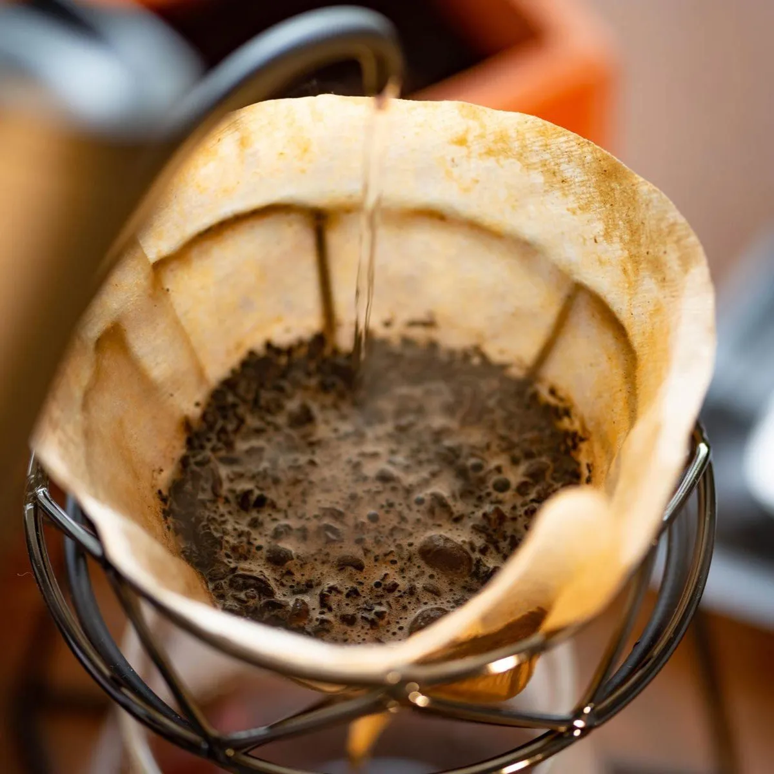
DAMOS Filter
Non-access pattern target spec
Allow/reject memory
of given types
Support multiple filters combination
  “Reclaim anon pages of cgroup A”
Image is retrieved from https://coffeeculture.asia/wp-content/uploads/2020/12/Coffee-Culture-Coffee-Filter-Papers-Buy-Coffee-equipment-online-in-thailand.jpg

Slide 33
DAMOS Quota,Filters Example
Speed-bounded, Targeted proactive cold memory reclaim
$ sudo ./damo start \
--damos_action pageout \
--damos_access_rate 0% 0% --damos_age 2m max \
--damos_quota_space 128M --damos_quota_interval 1s \
--damos_filter reject anon \
--damos_filter reject memcg /workload_latency_sensitive

Slide 34
DAMOS Quota,Filters Example
Speed-bounded, Targeted proactive cold memory reclaim
$ sudo ./damo start \
--damos_action pageout \
--damos_access_rate 0% 0% --damos_age 2m max \
--damos_quota_space 128M --damos_quota_interval 1s \
--damos_filter reject anon \
--damos_filter reject memcg /workload_latency_sensitive
Start DAMON,
monitor access pattern of entire physical address space.

Slide 35
DAMOS Quota,Filters Example
Speed-bounded, Targeted proactive cold memory reclaim
$ sudo ./damo start \
--damos_action pageout \
--damos_access_rate 0% 0% --damos_age 2m max \
--damos_quota_space 128M --damos_quota_interval 1s \
--damos_filter reject anon \
--damos_filter reject memcg /workload_latency_sensitive
Pageout memory that not accessed for >=2 minutes
according to the monitoring output, as soon as found.

Slide 36
DAMOS Quota,Filters Example
Speed-bounded, Targeted proactive cold memory reclaim
$ sudo ./damo start \
--damos_action pageout \
--damos_access_rate 0% 0% --damos_age 2m max \
--damos_quota_space 128M --damos_quota_interval 1s \
--damos_filter reject anon \
--damos_filter reject memcg /workload_latency_sensitive
However, limit the pageout to be tried only up to 128 MiB per second. If there are more than 128 MiB cold memory,
do reclaim coldest 128 MiB memory.

Slide 37
DAMOS Quota,Filters Example
Speed-bounded, Targeted proactive cold memory reclaim
Also, skip the reclaim for anonymous pages.
$ sudo ./damo start \
--damos_action pageout \
--damos_access_rate 0% 0% --damos_age 2m max \
--damos_quota_space 128M --damos_quota_interval 1s \
--damos_filter reject anon \
--damos_filter reject memcg /workload_latency_sensitive

Slide 38
DAMOS Quota,Filters Example
Speed-bounded, Targeted proactive cold memory reclaim
$ sudo ./damo start \
--damos_action pageout \
--damos_access_rate 0% 0% --damos_age 2m max \
--damos_quota_space 128M --damos_quota_interval 1s \
--damos_filter reject anon \
--damos_filter reject memcg /workload_latency_sensitive
Skip the reclaim for memory that belongs to ‘workload_latency_sensitive’ memory cgroup, too.

Slide 39
Table of Contents
Why Smart Control for RAM (6 minutes)
Begins: Origin to Productizing (10 minutes)
Darknight: DAMOS Auto-tuning (10 minutes)
Rises: DAMOS Usages (2 minutes)
Revolution: Ongoing Changes (2 mins)
QnA (10 mins)

Slide 40
Dark Knight:
DAMOS Auto-tuning

Slide 41

Problem: Tuning Difficulties
DAMOS users should...
  Understand DAMON/DAMOS internal
  Understand their workload access pattern
  Setup optimum scheme for the workload
Complicated, repetitive for each workload
Image is retrieved from https://media.makeameme.org/created/whats-that-sounds.jpg

Slide 42
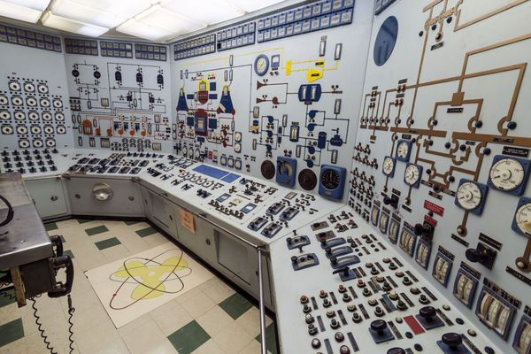
Why So Difficult? It’s Question!
DAMOS asks users “how” (mechanism)
Effectively programming request
Flexible but difficult
Image is retrieved from https://i.pinimg.com/736x/4c/25/6f/4c256f103aca4785544b78e430c079aa.jpg

Slide 43
Change The Question
Idea: Ask users “what” (policy, or vibe)
  What they want to achieve
    E.g., 5% free memory, 0.05% memory pressure
  Intuitive for service owners
DAMOS works in darkness
  Auto-tune parameters to achieve the goal

Slide 44

Knobs to tune: Access Pattern?
Min/max access frequency and stability
Four parameters; too complicated
Image is retrieved from https://subsonic.com/img/p/1/0/7/4/1074.jpg

Slide 45
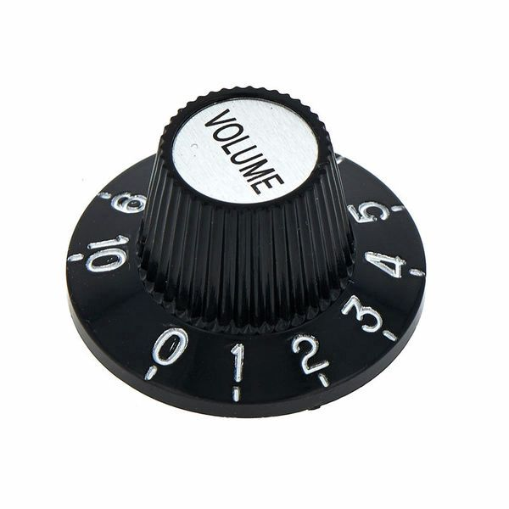
Knobs to Tune: Quota!
Single parameter; much simple
Effectively auto-tune access pattern parameters
Image is retrieved from https://thumbs.static-thomann.de/thumb/padthumb600x600/pics/bdb/_28/284224/10785205_800.jpg

Slide 46
DAMOS quota auto-tuning
Users set goals of the quota
  Goal: a target value of a system metric
Auto-tune quota using a feedback loop
  Increase/decrease quota
  when the goal is under/over-achieved
  Multiple tuning algorithms available

Slide 47
Auto-tuned DAMOS Example
$ sudo ./damo start \
--damos_action pageout \
--damos_access_rate 0% 0% --damos_age 2m max \
--damos_quota_space 128M --damos_quota_interval 1s \
--damos_filter reject anon \
--damos_filter reject memcg /workload_latency_sensitive
--damos_quota_goal some_mem_psi_us 5ms

Slide 48
Auto-tuned DAMOS Example
$ sudo ./damo start \
--damos_action pageout \
--damos_access_rate 0% 0% --damos_age 2m max \
--damos_quota_space 128M --damos_quota_interval 1s \
--damos_filter reject anon \
--damos_filter reject memcg /workload_latency_sensitive
--damos_quota_goal some_mem_psi_us 5ms
Start DAMON, monitor entire physical memory, reclaim memory that not accessed for >= 2 minutes, up to 128 MiB/s,
skipping anonymous pages and pages of latecy sensitive workload cgroup

Slide 49
Auto-tuned DAMOS Example
$ sudo ./damo start \
--damos_action pageout \
--damos_access_rate 0% 0% --damos_age 2m max \
--damos_quota_space 128M --damos_quota_interval 1s \
--damos_filter reject anon \
--damos_filter reject memcg /workload_latency_sensitive
--damos_quota_goal some_mem_psi_us 5ms
Tune the quota to achive 5ms/1s (0.05%) memory pressure stall.
If <0.05% memory pressure, reclaim more cold page, and vice versa.
Little pressure is good for health :)

Slide 50

DAMOS for Hot Memory
DAMOS is not only for cold memory
Memory tiering: one of DAMOS use cases
Image is retrieved from https://i.pinimg.com/736x/51/8f/09/518f09467228e2ac87c0f2d299d02fc5.jpg

Slide 51
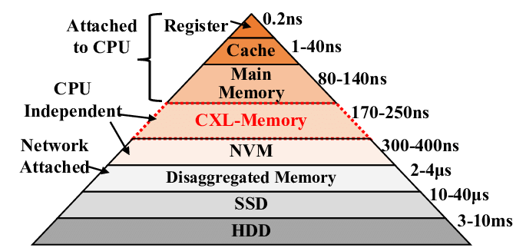
Memory Tiering 101
Two tiers: DRAM and CXL memory
  DRAM: Fast, small
  CXL: Slow, large
Goal: Hot data on DRAM, cold data on CXL
Image is retrieved from https://www.researchgate.net/publication/361162182/figure/fig1/AS:1164536778358786@1654658612492/Different-tiers-has-different-characteristics-with-varied-memory-access-latency-in-a.png

Slide 52
Transparent Page Placement
Utilize DRAM as much as possible
  It is more powerful, no reason to under utilize
Keep headroom free memory in DRAM
TPP-DAMON: DAMOS-based TPP implementation

Slide 53
TPP-DAMON
damo start \
--numa_node 0 --monitoring_intervals_goal 4% 3 5ms 10s \
--damos_action migrate_cold 1 --damos_access_rate 0% 0% \
--damos_apply_interval 1s \
--damos_quota_interval 1s --damos_quota_space 200MB \
--damos_quota_goal node_mem_free_bp 0.5% 0 \
--damos_filter reject young \
--numa_node 1 --monitoring_intervals_goal 4% 3 5ms 10s \
--damos_action migrate_hot 0 --damos_access_rate 5% max \
--damos_apply_interval 1s \
--damos_quota_interval 1s --damos_quota_space 200MB \
--damos_quota_goal node_mem_used_bp 99.7% 0 \
--damos_filter allow young \
--damos_nr_quota_goals 1 1 --damos_nr_filters 1 1 \
--nr_targets 1 1 --nr_schemes 1 1 --nr_ctxs 1 1

Slide 54
TPP-DAMON
Start DAMON in kernel.
damo start \
--numa_node 0 --monitoring_intervals_goal 4% 3 5ms 10s \
--damos_action migrate_cold 1 --damos_access_rate 0% 0% \
--damos_apply_interval 1s \
--damos_quota_interval 1s --damos_quota_space 200MB \
--damos_quota_goal node_mem_free_bp 0.5% 0 \
--damos_filter reject young \
--numa_node 1 --monitoring_intervals_goal 4% 3 5ms 10s \
--damos_action migrate_hot 0 --damos_access_rate 5% max \
--damos_apply_interval 1s \
--damos_quota_interval 1s --damos_quota_space 200MB \
--damos_quota_goal node_mem_used_bp 99.7% 0 \
--damos_filter allow young \
--damos_nr_quota_goals 1 1 --damos_nr_filters 1 1 \
--nr_targets 1 1 --nr_schemes 1 1 --nr_ctxs 1 1
Dear DAMON user-space tool,

Slide 55
TPP-DAMON
damo start \
--numa_node 0 --monitoring_intervals_goal 4% 3 5ms 10s \
--damos_action migrate_cold 1 --damos_access_rate 0% 0% \
--damos_apply_interval 1s \
--damos_quota_interval 1s --damos_quota_space 200MB \
--damos_quota_goal node_mem_free_bp 0.5% 0 \
--damos_filter reject young \
--numa_node 1 --monitoring_intervals_goal 4% 3 5ms 10s \
--damos_action migrate_hot 0 --damos_access_rate 5% max \
--damos_apply_interval 1s \
--damos_quota_interval 1s --damos_quota_space 200MB \
--damos_quota_goal node_mem_used_bp 99.7% 0 \
--damos_filter allow young \
--damos_nr_quota_goals 1 1 --damos_nr_filters 1 1 \
--nr_targets 1 1 --nr_schemes 1 1 --nr_ctxs 1 1
Create one DAMON worker thread, monitoring for node 0 (upper tier)
With auto-tuned monitoring intervals.

Slide 56
TPP-DAMON
damo start \
--numa_node 0 --monitoring_intervals_goal 4% 3 5ms 10s \
--damos_action migrate_cold 1 --damos_access_rate 0% 0% \
--damos_apply_interval 1s \
--damos_quota_interval 1s --damos_quota_space 200MB \
--damos_quota_goal node_mem_free_bp 0.5% 0 \
--damos_filter reject young \
--numa_node 1 --monitoring_intervals_goal 4% 3 5ms 10s \
--damos_action migrate_hot 0 --damos_access_rate 5% max \
--damos_apply_interval 1s \
--damos_quota_interval 1s --damos_quota_space 200MB \
--damos_quota_goal node_mem_used_bp 99.7% 0 \
--damos_filter allow young \
--damos_nr_quota_goals 1 1 --damos_nr_filters 1 1 \
--nr_targets 1 1 --nr_schemes 1 1 --nr_ctxs 1 1
And ask it to migrate un-accessed (access_rate 0%) memory to node 1 (lower tier), coldest one first.
IOW, demote cold memory.

Slide 57
TPP-DAMON
damo start \
--numa_node 0 --monitoring_intervals_goal 4% 3 5ms 10s \
--damos_action migrate_cold 1 --damos_access_rate 0% 0% \
--damos_apply_interval 1s \
--damos_quota_interval 1s --damos_quota_space 200MB \
--damos_quota_goal node_mem_free_bp 0.5% 0 \
--damos_filter reject young \
--numa_node 1 --monitoring_intervals_goal 4% 3 5ms 10s \
--damos_action migrate_hot 0 --damos_access_rate 5% max \
--damos_apply_interval 1s \
--damos_quota_interval 1s --damos_quota_space 200MB \
--damos_quota_goal node_mem_used_bp 99.7% 0 \
--damos_filter allow young \
--damos_nr_quota_goals 1 1 --damos_nr_filters 1 1 \
--nr_targets 1 1 --nr_schemes 1 1 --nr_ctxs 1 1
And do that once per second.

Slide 58
TPP-DAMON
damo start \
--numa_node 0 --monitoring_intervals_goal 4% 3 5ms 10s \
--damos_action migrate_cold 1 --damos_access_rate 0% 0% \
--damos_apply_interval 1s \
--damos_quota_interval 1s --damos_quota_space 200MB \
--damos_quota_goal node_mem_free_bp 0.5% 0 \
--damos_filter reject young \
--numa_node 1 --monitoring_intervals_goal 4% 3 5ms 10s \
--damos_action migrate_hot 0 --damos_access_rate 5% max \
--damos_apply_interval 1s \
--damos_quota_interval 1s --damos_quota_space 200MB \
--damos_quota_goal node_mem_used_bp 99.7% 0 \
--damos_filter allow young \
--damos_nr_quota_goals 1 1 --damos_nr_filters 1 1 \
--nr_targets 1 1 --nr_schemes 1 1 --nr_ctxs 1 1
Within one second, do the migration only up to 200 MiB of memory.

Slide 59
TPP-DAMON
damo start \
--numa_node 0 --monitoring_intervals_goal 4% 3 5ms 10s \
--damos_action migrate_cold 1 --damos_access_rate 0% 0% \
--damos_apply_interval 1s \
--damos_quota_interval 1s --damos_quota_space 200MB \
--damos_quota_goal node_mem_free_bp 0.5% 0 \
--damos_filter reject young \
--numa_node 1 --monitoring_intervals_goal 4% 3 5ms 10s \
--damos_action migrate_hot 0 --damos_access_rate 5% max \
--damos_apply_interval 1s \
--damos_quota_interval 1s --damos_quota_space 200MB \
--damos_quota_goal node_mem_used_bp 99.7% 0 \
--damos_filter allow young \
--damos_nr_quota_goals 1 1 --damos_nr_filters 1 1 \
--nr_targets 1 1 --nr_schemes 1 1 --nr_ctxs 1 1
Under the 200MiB/1s hard limitation, auto-tune the real soft limitation to make node 0’s free memory ratio becomes 0.5% soon.

Slide 60
TPP-DAMON
damo start \
--numa_node 0 --monitoring_intervals_goal 4% 3 5ms 10s \
--damos_action migrate_cold 1 --damos_access_rate 0% 0% \
--damos_apply_interval 1s \
--damos_quota_interval 1s --damos_quota_space 200MB \
--damos_quota_goal node_mem_free_bp 0.5% 0 \
--damos_filter reject young \
--numa_node 1 --monitoring_intervals_goal 4% 3 5ms 10s \
--damos_action migrate_hot 0 --damos_access_rate 5% max \
--damos_apply_interval 1s \
--damos_quota_interval 1s --damos_quota_space 200MB \
--damos_quota_goal node_mem_used_bp 99.7% 0 \
--damos_filter allow young \
--damos_nr_quota_goals 1 1 --damos_nr_filters 1 1 \
--nr_targets 1 1 --nr_schemes 1 1 --nr_ctxs 1 1
Btw, if the page is PG_Young, don’t do the migration.
DAMON might identify young page as not accessed.

Slide 61
TPP-DAMON
Create another DAMON worker thread that monitors node 1 (lower tier) with auto-tuned monitoring intervals.
Ask it to migrate memory shown >=5% access rate to node 0 (upper tier), hottest first. IOW, promote hot pages.
Do the migration once per second, up to 200 MiB of memory.
Under the 200 MiB/s hard limit, adjust the real soft limit aiming node 0 memory utilization ratio 99.7%.
Btw, to that only if the page is PG_Young.
damo start \
--numa_node 0 --monitoring_intervals_goal 4% 3 5ms 10s \
--damos_action migrate_cold 1 --damos_access_rate 0% 0% \
--damos_apply_interval 1s \
--damos_quota_interval 1s --damos_quota_space 200MB \
--damos_quota_goal node_mem_free_bp 0.5% 0 \
--damos_filter reject young \
--numa_node 1 --monitoring_intervals_goal 4% 3 5ms 10s \
--damos_action migrate_hot 0 --damos_access_rate 5% max \
--damos_apply_interval 1s \
--damos_quota_interval 1s --damos_quota_space 200MB \
--damos_quota_goal node_mem_used_bp 99.7% 0 \
--damos_filter allow young \
--damos_nr_quota_goals 1 1 --damos_nr_filters 1 1 \
--nr_targets 1 1 --nr_schemes 1 1 --nr_ctxs 1 1

Slide 62
Table of Contents
Why Smart Control for RAM (6 minutes)
Begins: Origin to Productizing (10 minutes)
Darknight: DAMOS Auto-tuning (10 minutes)
Rises: DAMOS Usages (2 minutes)
Revolution: Ongoing Changes (2 mins)
QnA (10 mins)

Slide 63
Dark Knight Rises:
Publicly Known DAMOS Usages

Slide 64

Proactive Memory Reclaim
AWS Aurora Serverless v2
Proactively reclaim cold memory in VMs
Pay for only remaining non-cold memory
Image is retrieved from https://i.ytimg.com/vi/xKFA6PJgp0o/maxresdefault.jpg

Slide 65


DRAM/CXL Memory Tiering
SK Hynix HMSDK
  Migrate hot/cold data across tiers
Micron dynamic interleaving
  Interleave hot/cold memory for bandwidth
Images retrieved from https://upload.wikimedia.org/wikipedia/fr/c/c1/Sk-hynix_-_Logo.svg and https://upload.wikimedia.org/wikipedia/commons/8/8e/Micron_Logo.png

Slide 66
More Non-public Usages
Real DAMOS usages are unknown
A few more usages are privately shared
Make your own creative usage

Slide 67
Ongoing DAMON/S Revolution

Slide 68
The Classes
Primary class: Access information
Secondary class: Data attributes
  DAMOS filters for page level properties

Slide 69
Is It Fair (and Useful)?
Why access info is always primary?
Other attributes are primary interests for some users

Slide 70

DAMON Revolution
Re-define DAMON
  Data Attributes Monitoring/Operation eNgine
Every attribute including access is equal
DAMOS get revolutionized together
Image is retrieved from https://encrypted-tbn0.gstatic.com/images?q=tbn:ANd9GcShaoxj5LAQw3g2Ed4w83aLruDWdiIAN1TRojKmw49EKQ&s=10

Slide 71
Revolution In Progress
Monitoring framework is extended
More support of attributes is ongoing
  Now: access, Anon page, memcg, hugepage
Minimum support in DAMOS yet

Slide 72
Revolution Never Ends
DAMON evolves for users

Slide 73
Wrapup
DAMOS is a Linux kernel feature for automated access-aware system operations
Being used for products
A revolution for making it for every attribute is ongoing

Slide 74
QnA
Don’t forget
  sj@kernel.org
  damon@lists.linux.dev
  https://damonitor.github.io
  Just poke me in hallway

