Slide 1

Actionable Data Access Monitoring
Output Data and Format
SeongJae Park (SJ) <sj@kernel.org> <sjpark@crusoe.ai>
Device and Specific Purpose Memory MC

Slide 2
Table of Contents
Why Data Access Pattern
DAMON in Nutshell
Available Access Pattern Formats
Discussion

Slide 3
Why Data Access Pattern
Restricted seats, various audiences
To see how we are doing
To fore-see what we should do
To get actionable insights and make it

Slide 4
DAMON in Nutshell

Slide 5
What It Does
Spawn a kernel thread that
See if each page is accessed, every 5ms
Inform users the findings, every 100ms
Time intervals can be [auto-]tuned

Slide 6

Providing Access Information
Location
Frequency
Stability
Recency
Access pattern heatmap of
Splash2x/Raytrace

Slide 7
Overhead and Accuracy
Utilizes adaptive sampling/aggregation
The upper-limit overhead is tunable
  Regardless of the memory size
0.0x% single CPU use on real workloads
Light, accurate, scalable, automated

Slide 8
Availability and Usages
Available on >=5.15 upstream kernels
Enabled on most distro kernels
Being used by products and researches

Slide 9
DAMOS: Second Face of DAMON
DAMon-based Operation Schemes
  “Page out cold memory”
  “Use huge pages for hot memory”
Turn DAMON into access-aware memory management system operations engine

Slide 10
DAMON in One Sentence
“DAMON is a Linux kernel subsystem for efficient access monitoring and
access-aware system operations.”

Slide 11
Community
Waiting for any *selfish* discussion
Public channels
  Mailing list: damon@lists.linux.dev
  Project website: https://damonitor.github.io/
Private channels
  Maintainer email: sj@kernel.org
  DAMON Beer/Coffee/Tea Meetup

Slide 12
Available Formats
(Access Pattern Visualizations)

Slide 13
It’s Format, Stupid!
Having data does nothing
Same data causes different insights
Most challenging part
  Convincing “human”, not “machines”
  Anyway I’m keeping trying...

Slide 14
Formats for All DAMON Info
Straightforward (or, lazy) format
  For location, frequency, stability, and recency
Namely, heatmap and snapshot

Slide 15
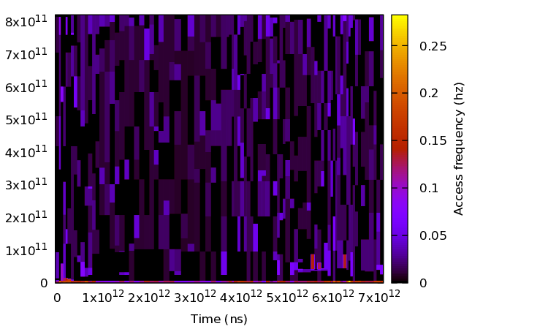
Heatmap
X-axis: time
Y-axis: address
Color: frequency
Scoping is important
(or, challenging)

Slide 16
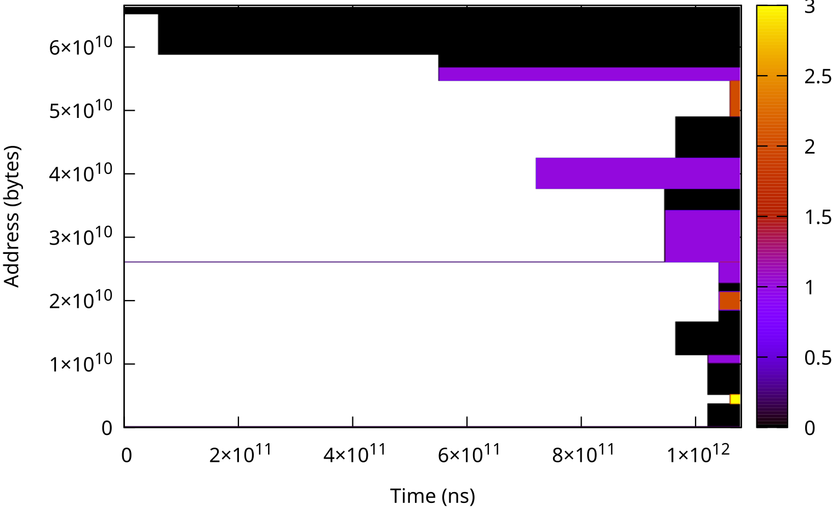
Snapshot
A slice of heatmap
Scoping is still the thing

Slide 17
Formats for DAMON++ Data
DAMON cannot capture the world alone
Use it together with other tools to record
  Memory alloc/free/RSS data
  Hotspot functions
And show all together as time series data

Slide 18
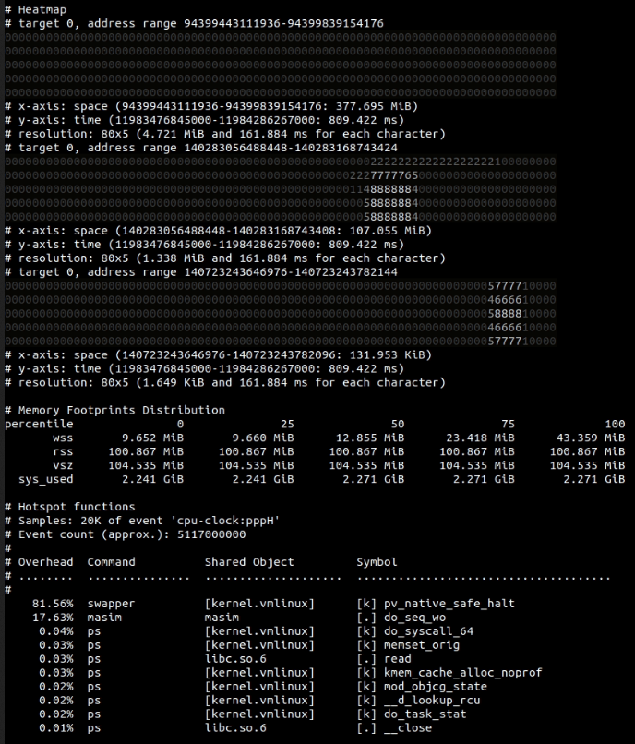
Holistic Snapshot[s]
Ani-GIF

Slide 19
Formats for DAMON-- Data
DAMON data is just right for machines
Too much for human in some cases
Visualize after dropping some information
  Specifically, “location”
Namely, hotness-sorted heatmap and snapshot

Slide 20
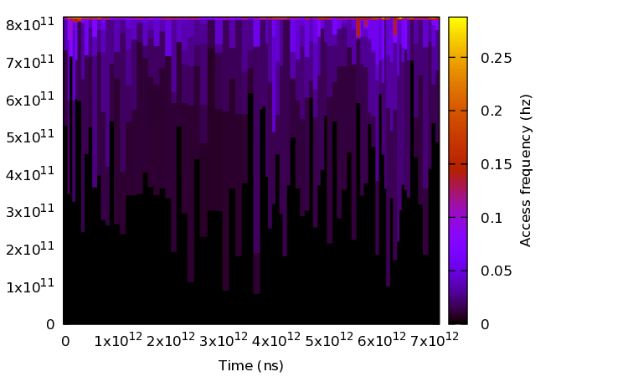
Hotness-sorted Heatmap

Slide 21
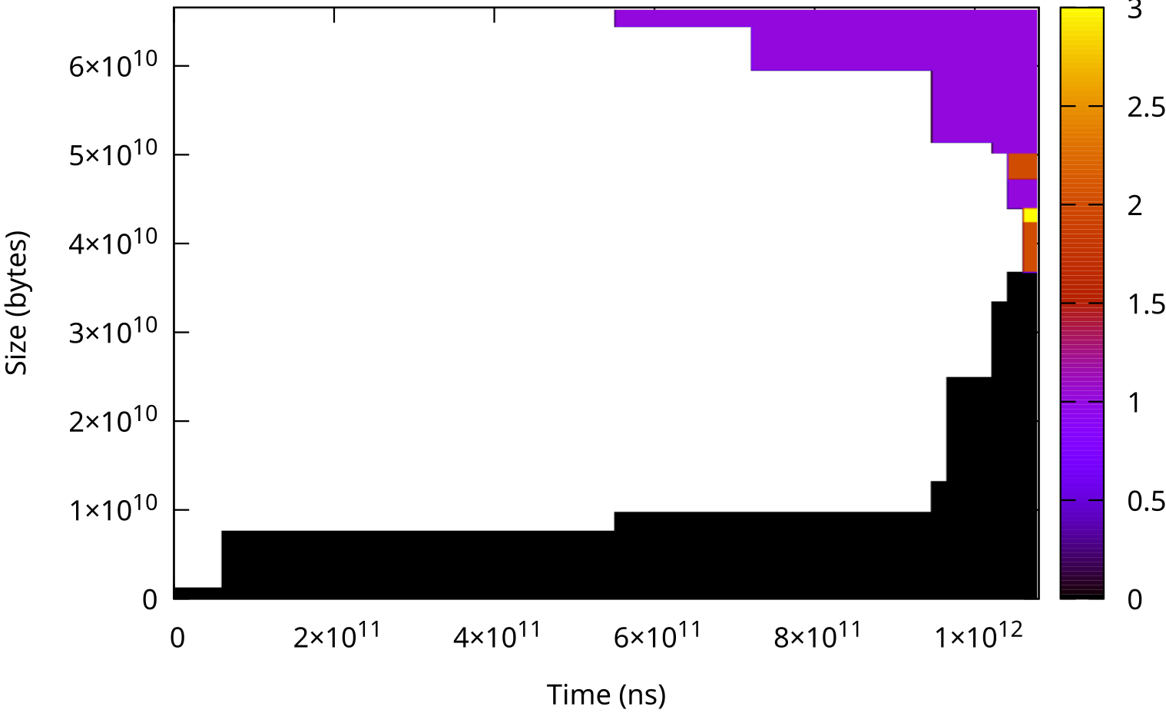
Hotness-sorted Snapshot

Slide 22
For Coarse-grain DAMON-- Data
Lines: informative
  Encourage “creative” interpretation
Discrete numbers are alarm-able
  Better for busy “fleets”

Slide 23
Idle Time Percentiles: Concept
Idle time: how long it was not accessed
Percentile: that of the statistics
Unsorted snapshot
Sorted by access frequency

Slide 24
Idle Time Percentiles: Concept
Idle time: how long it was not accessed
Percentile: that of the statistics
Unsorted snapshot
Sorted by access frequency
P50 idle time

Slide 25
Idle Time Percentiles: Concept
Idle time: how long it was not accessed
Percentile: that of the statistics
Unsorted snapshot
Sorted by access frequency
P50 idle time
P75 idle time

Slide 26
Idle Time Percentiles: Concept
Idle time: how long it was not accessed
Percentile: that of the statistics
Unsorted snapshot
Sorted by access frequency
P50 idle time
P75 idle time
P99 idle time

Slide 27
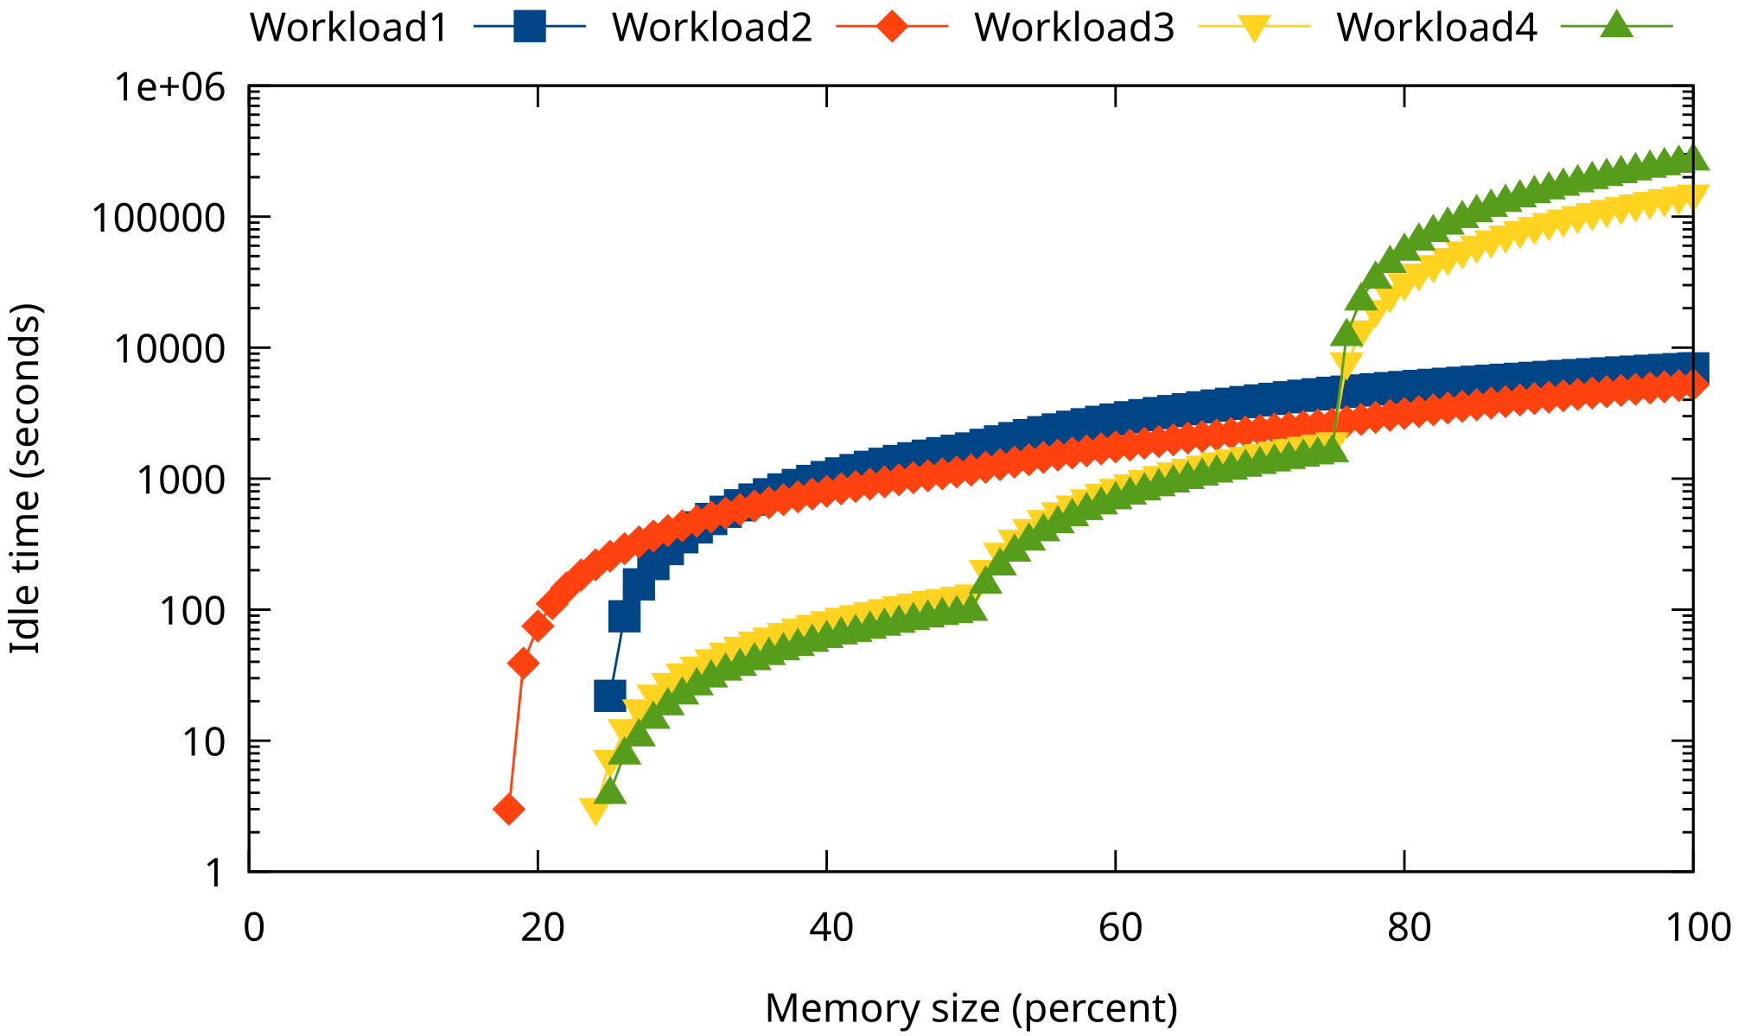
Idle Time Percentiles in Real
Note: Y-axis in logscale
Show common and different patterns of workloads

Slide 28
Cold Memory Tail
X/Y-axis inversion of idle time percentiles
X axis: Idle time
Y axis: Size of memory of the idle time

Slide 29
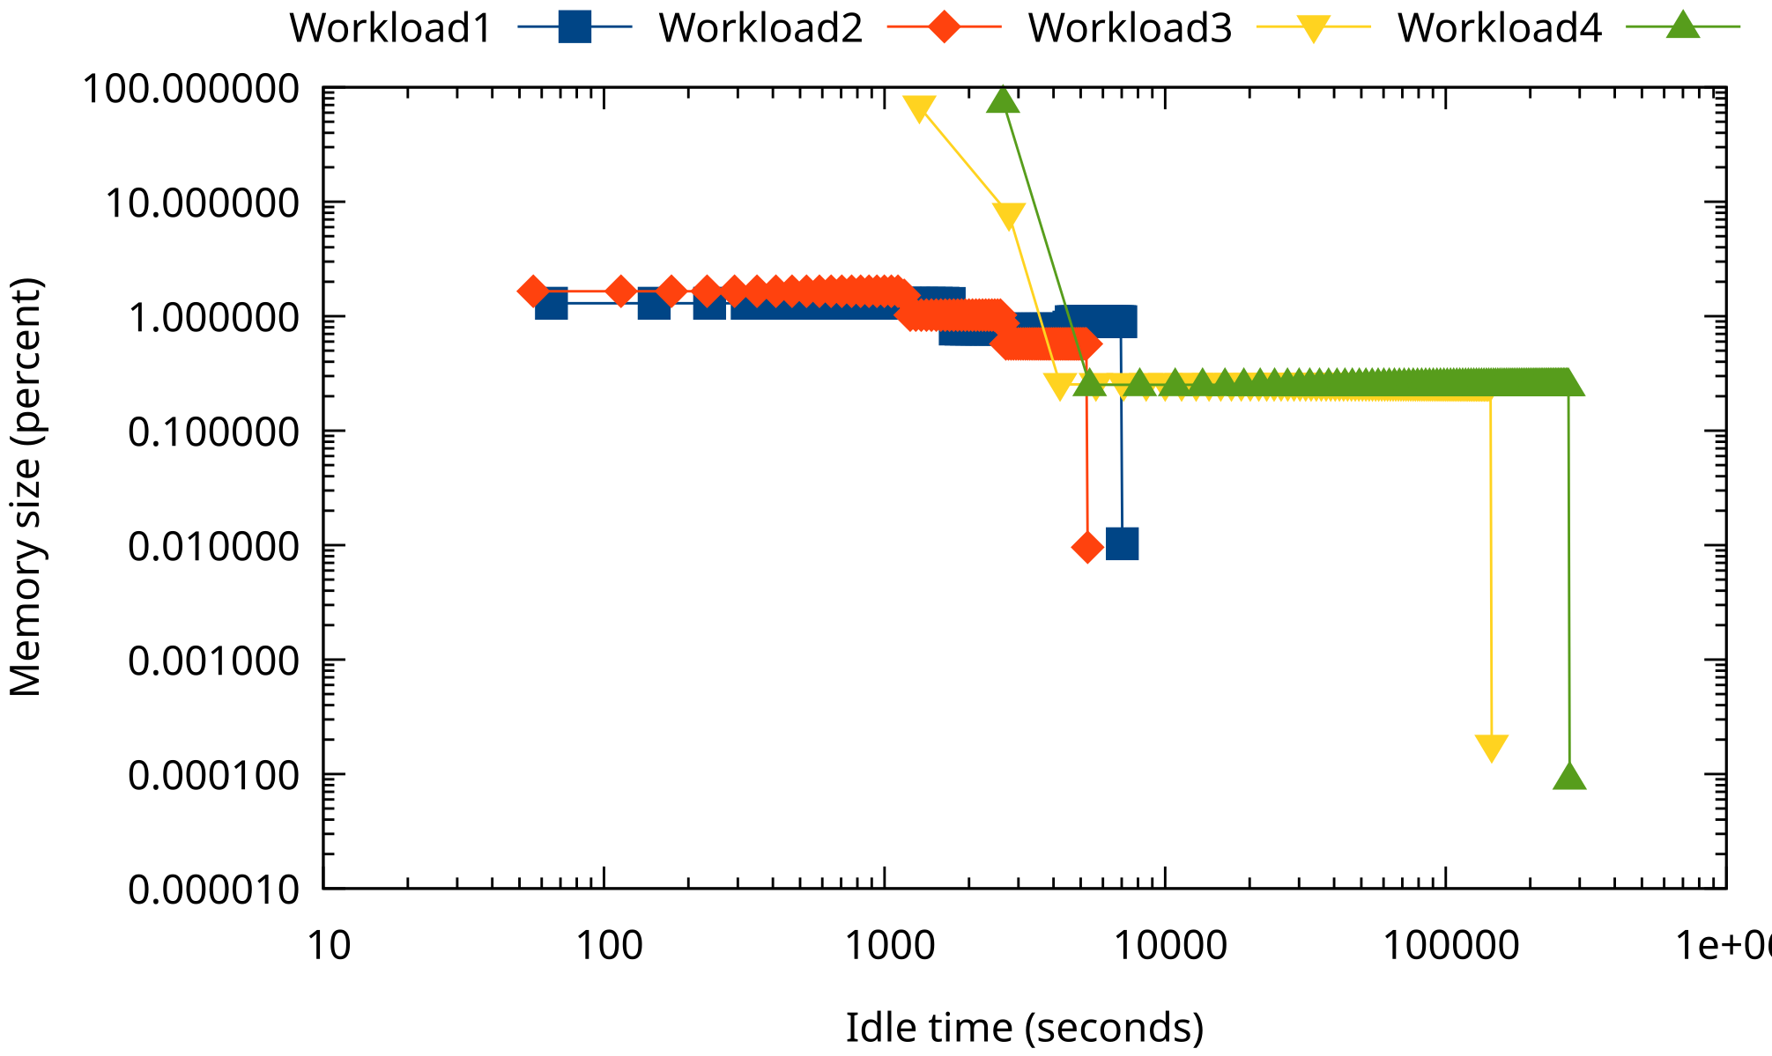
Cold Memory Tail in Real
Note: Both X/Y-axis in logscale

Slide 30
Estimated Memory Bandwidth
A region in DAMON snapshot
  of size 1 GiB
  that was accessed 10 times per second
Estimation: 10 GiB/s bandwidth use
Shouldn’t be accurate but best effort

Slide 31
Formats for Brave People
Turn on DAMOS-based operations
  e.g., proactive reclamation, memory tiering
Hear if someone yells
Surprisingly most successful use case
Here is the help: DAMOS stats

Slide 32
Wrapup
DAMON provides access information
There are 2+ ways to show that
  Maybe good for fans of oysters but snakes

Slide 33
Discussion Time
Any of the formats seems useful? Why?
Any new format suggestions?
More info or less info?
What is reasonable “actionable” goal?

