Slide 1



Static Resolution of Implicit Control Flow for Reflection and Message-Passing
Paulo Barros, René Just, Suzanne Millstein,
Paul Vines, Werner Dietl, Marcelo d’Amorim and Michael D. Ernst

Slide 2
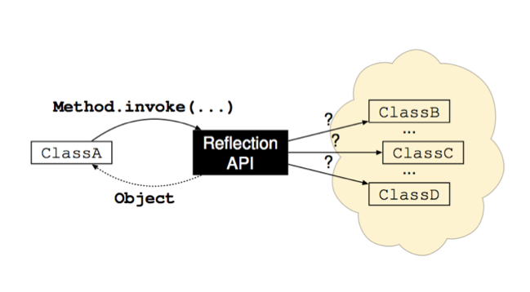
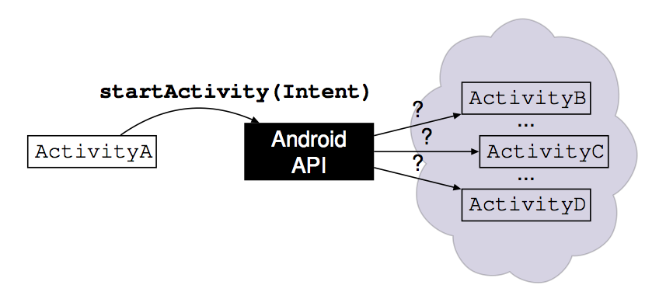
Implicit control flow
Indirect method call
Design pattern that allows coding flexibility
Reflection
Message-Passing (Android Intents)

Slide 3
Problem: imprecise summaries for static analyses
…a.foo(b,c);…
Notes:
Static analysis analyzes method calls, using summaries; with implict control flow, the estimate of possibly-called methods is very large, leading to unacceptable imprecision. Just a bit more context about the problem you are solving would help to bring the audience along.

Slide 4
Problem: imprecise summaries for static analyses
…a.foo(b,c);…
What does foo do?
Notes:
Static analysis analyzes method calls, using summaries; with implict control flow, the estimate of possibly-called methods is very large, leading to unacceptable imprecision. Just a bit more context about the problem you are solving would help to bring the audience along.

Slide 5
Problem: imprecise summaries for static analyses
…a.foo(b,c);…
Use method summary.
What does foo do?
Notes:
Static analysis analyzes method calls, using summaries; with implict control flow, the estimate of possibly-called methods is very large, leading to unacceptable imprecision. Just a bit more context about the problem you are solving would help to bring the audience along.

Slide 6
Problem: imprecise summaries for static analyses
…a.foo(b,c);…
…myMethod.invoke(a,b,c);…
Use method summary.
What does foo do?
Notes:
Static analysis analyzes method calls, using summaries; with implict control flow, the estimate of possibly-called methods is very large, leading to unacceptable imprecision. Just a bit more context about the problem you are solving would help to bring the audience along.

Slide 7
Problem: imprecise summaries for static analyses
…a.foo(b,c);…
…myMethod.invoke(a,b,c);…
Use method summary.
What does foo do?
What does invoke do?
Notes:
Static analysis analyzes method calls, using summaries; with implict control flow, the estimate of possibly-called methods is very large, leading to unacceptable imprecision. Just a bit more context about the problem you are solving would help to bring the audience along.

Slide 8
Problem: imprecise summaries for static analyses
…a.foo(b,c);…
…myMethod.invoke(a,b,c);…
Use method summary.
What does foo do?
Anything!
What does invoke do?
Notes:
Static analysis analyzes method calls, using summaries; with implict control flow, the estimate of possibly-called methods is very large, leading to unacceptable imprecision. Just a bit more context about the problem you are solving would help to bring the audience along.

Slide 9
Problem: imprecise summaries for static analyses
…a.foo(b,c);…
…myMethod.invoke(a,b,c);…
Sound analysis → Imprecise
Use method summary.
What does foo do?
Anything!
What does invoke do?
Notes:
Static analysis analyzes method calls, using summaries; with implict control flow, the estimate of possibly-called methods is very large, leading to unacceptable imprecision. Just a bit more context about the problem you are solving would help to bring the audience along.

Slide 10
Problem: imprecise summaries for static analyses
…a.foo(b,c);…
…myMethod.invoke(a,b,c);…
Sound analysis → Imprecise
Unsound analysis → Precise but unsafe
Use method summary.
What does foo do?
Anything!
What does invoke do?
Notes:
Static analysis analyzes method calls, using summaries; with implict control flow, the estimate of possibly-called methods is very large, leading to unacceptable imprecision. Just a bit more context about the problem you are solving would help to bring the audience along.

Slide 11
Problem: imprecise summaries for static analyses
…a.foo(b,c);…
…myMethod.invoke(a,b,c);…
Sound analysis → Imprecise
Unsound analysis → Precise but unsafe
Goal → Soundness and high precision
Use method summary.
What does foo do?
Anything!
What does invoke do?
Notes:
Static analysis analyzes method calls, using summaries; with implict control flow, the estimate of possibly-called methods is very large, leading to unacceptable imprecision. Just a bit more context about the problem you are solving would help to bring the audience along.

Slide 12

Android
Over 1 billion active users
Over 1.6 million apps
Analyzing apps is important
Example: Malware detection
  Soundness is crucial

Slide 13
Implicit control flow is pervasive in Android
F-Droid is a repository of Android apps
F-Droid apps
  39% use reflection
  69% share data through intents
Conclusion → Static analysis on Android apps must handle implicit control flow

Slide 14
Resolving implicit control flow
Goal → Soundly resolve implicit control flows
Observation → Statically resolvable in F-Droid
  93% of reflective calls
  88% of sent intents
Solution → We developed type systems that model implicit control flows
Results
  Improves the precision by 400x
  Soundness is maintained
  Low developer effort
Notes:
One by one.

Slide 15
Resolving implicit control flow
Goal → Soundly resolve implicit control flows
Observation → Statically resolvable in F-Droid
  93% of reflective calls
  88% of sent intents
Solution → We developed type systems that model implicit control flows
Results
  Improves the precision by 400x
  Soundness is maintained
  Low developer effort
Notes:
One by one.

Slide 16
Reflection and intents in real apps

Slide 17


Non-interference type system
Guarantees that the program does not leak sensitive data
Privacy-types:
  @Secret: Sensitive-data values
  @Public: Non-sensitive-data values
@Public String var;
@Secret String password = getPassword();
var = password;
@Secret
@Public
  @Public ← @Secret
Notes:
Say "This dataflow is illegal".

Slide 18
Non-interference type system
Guarantees that the program does not leak sensitive data
Privacy-types:
  @Secret: Sensitive-data values
  @Public: Non-sensitive-data values
@Public String var;
@Secret String password = getPassword();
var = password;
@Secret
@Public
  @Public ← @Secret

Slide 19
Use of reflection – Aarddict
// Library Annotations:
class Activity {
// In Android SDK ≥ 11.
@Public ActionBar getActionBar() {...}
}
class Method {
@Secret Object invoke(Object obj, Object... args) {...}
}
if (android.os.Build.VERSION.SDK_INT >= 11) {
Class<?> clazz = Activity.class;
Method mtd = clazz.getMethod("getActionBar");
@Public Object actionBar = mtd.invoke(this);
…
}…

Slide 20
Use of reflection – Aarddict
// Library Annotations:
class Activity {
// In Android SDK ≥ 11.
@Public ActionBar getActionBar() {...}
}
class Method {
@Secret Object invoke(Object obj, Object... args) {...}
}
Conservative annotation
if (android.os.Build.VERSION.SDK_INT >= 11) {
Class<?> clazz = Activity.class;
Method mtd = clazz.getMethod("getActionBar");
@Public Object actionBar = mtd.invoke(this);
…
}…

Slide 21
Use of reflection – Aarddict
// Library Annotations:
class Activity {
// In Android SDK ≥ 11.
@Public ActionBar getActionBar() {...}
}
class Method {
@Secret Object invoke(Object obj, Object... args) {...}
}
Conservative annotation
if (android.os.Build.VERSION.SDK_INT >= 11) {
Class<?> clazz = Activity.class;
Method mtd = clazz.getMethod("getActionBar");
@Public Object actionBar = mtd.invoke(this);
…
}…

Slide 22
Use of reflection – Aarddict
// Library Annotations:
class Activity {
// In Android SDK ≥ 11.
@Public ActionBar getActionBar() {...}
}
class Method {
@Secret Object invoke(Object obj, Object... args) {...}
}
Conservative annotation
if (android.os.Build.VERSION.SDK_INT >= 11) {
Class<?> clazz = Activity.class;
Method mtd = clazz.getMethod("getActionBar");
@Public Object actionBar = mtd.invoke(this);
…
}…

Slide 23
Use of reflection – Aarddict
// Library Annotations:
class Activity {
// In Android SDK ≥ 11.
@Public ActionBar getActionBar() {...}
}
class Method {
@Secret Object invoke(Object obj, Object... args) {...}
}
Conservative annotation
if (android.os.Build.VERSION.SDK_INT >= 11) {
Class<?> clazz = Activity.class;
Method mtd = clazz.getMethod("getActionBar");
@Public Object actionBar = mtd.invoke(this);
…
}…

Slide 24
Use of reflection – Aarddict
// Library Annotations:
class Activity {
// In Android SDK ≥ 11.
@Public ActionBar getActionBar() {...}
}
class Method {
@Secret Object invoke(Object obj, Object... args) {...}
}
Conservative annotation
if (android.os.Build.VERSION.SDK_INT >= 11) {
Class<?> clazz = Activity.class;
Method mtd = clazz.getMethod("getActionBar");
@Public Object actionBar = mtd.invoke(this);
…
}…
  @Public ← @Secret
Notes:
←

Slide 25

Use of reflection – Aarddict
// Library Annotations:
class Activity {
// In Android SDK ≥ 11.
@Public ActionBar getActionBar() {...}
}
class Method {
@Secret Object invoke(Object obj, Object... args) {...}
}
Conservative annotation
if (android.os.Build.VERSION.SDK_INT >= 11) {
Class<?> clazz = Activity.class;
Method mtd = clazz.getMethod("getActionBar");
@Public Object actionBar = mtd.invoke(this);
…
}…
  @Public ← @Public

Slide 26
Intent payloads
ComponentA
ComponentB
Intent
Notes:
----- Meeting Notes (11/11/15 18:52) -----
Talk about maps here.
Insert slide here. Showing Activity1 -> Activity2. Put some data on the seta. Say this is the payload, and that this is a map.
Fix text that is not covered.

Slide 27
Intent payloads
ComponentA
ComponentB
Intent
“name” → “Paulo”
“conf” → “ASE”
“id” → 198
Map format
Notes:
----- Meeting Notes (11/11/15 18:52) -----
Talk about maps here.
Insert slide here. Showing Activity1 -> Activity2. Put some data on the seta. Say this is the payload, and that this is a map.
Fix text that is not covered.

Slide 28
Use of intent payloads – Aarddict
class LookupWord extends Activity {
void translateWord(@Public String sentence) {
Intent i = new Intent(this, WordTranslator.class);
i.putExtra("sentence", sentence);
startActivity(i);
}…}
class WordTranslator extends Activity {
void onCreate(Bundle savedInstanceState)
Intent i = getIntent();
@Public String sentence = i.getStringExtra("sentence");
…
}…}
// Library Annotations
class Intent {
@Secret String
getStringExtra(String key) {...}
}
Notes:
----- Meeting Notes (11/11/15 18:52) -----
Talk about maps here.
Insert slide before here. Showing Activity1 -> Activity2. Put some data on the seta. Say this is the payload, and that this is a map.
Fix text that is not covered.

Slide 29
Use of intent payloads – Aarddict
class LookupWord extends Activity {
void translateWord(@Public String sentence) {
Intent i = new Intent(this, WordTranslator.class);
i.putExtra("sentence", sentence);
startActivity(i);
}…}
class WordTranslator extends Activity {
void onCreate(Bundle savedInstanceState)
Intent i = getIntent();
@Public String sentence = i.getStringExtra("sentence");
…
}…}
// Library Annotations
class Intent {
@Secret String
getStringExtra(String key) {...}
}
Conservative annotation
Notes:
----- Meeting Notes (11/11/15 18:52) -----
Talk about maps here.
Insert slide before here. Showing Activity1 -> Activity2. Put some data on the seta. Say this is the payload, and that this is a map.
Fix text that is not covered.

Slide 30
Use of intent payloads – Aarddict
class LookupWord extends Activity {
void translateWord(@Public String sentence) {
Intent i = new Intent(this, WordTranslator.class);
i.putExtra("sentence", sentence);
startActivity(i);
}…}
class WordTranslator extends Activity {
void onCreate(Bundle savedInstanceState)
Intent i = getIntent();
@Public String sentence = i.getStringExtra("sentence");
…
}…}
// Library Annotations
class Intent {
@Secret String
getStringExtra(String key) {...}
}
Conservative annotation

Slide 31
Use of intent payloads – Aarddict
class LookupWord extends Activity {
void translateWord(@Public String sentence) {
Intent i = new Intent(this, WordTranslator.class);
i.putExtra("sentence", sentence);
startActivity(i);
}…}
class WordTranslator extends Activity {
void onCreate(Bundle savedInstanceState)
Intent i = getIntent();
@Public String sentence = i.getStringExtra("sentence");
…
}…}
// Library Annotations
class Intent {
@Secret String
getStringExtra(String key) {...}
}
Conservative annotation

Slide 32
Use of intent payloads – Aarddict
class LookupWord extends Activity {
void translateWord(@Public String sentence) {
Intent i = new Intent(this, WordTranslator.class);
i.putExtra("sentence", sentence);
startActivity(i);
}…}
class WordTranslator extends Activity {
void onCreate(Bundle savedInstanceState)
Intent i = getIntent();
@Public String sentence = i.getStringExtra("sentence");
…
}…}
// Library Annotations
class Intent {
@Secret String
getStringExtra(String key) {...}
}
Conservative annotation

Slide 33
Use of intent payloads – Aarddict
class LookupWord extends Activity {
void translateWord(@Public String sentence) {
Intent i = new Intent(this, WordTranslator.class);
i.putExtra("sentence", sentence);
startActivity(i);
}…}
class WordTranslator extends Activity {
void onCreate(Bundle savedInstanceState)
Intent i = getIntent();
@Public String sentence = i.getStringExtra("sentence");
…
}…}
// Library Annotations
class Intent {
@Secret String
getStringExtra(String key) {...}
}
Conservative annotation

Slide 34
Use of intent payloads – Aarddict
class LookupWord extends Activity {
void translateWord(@Public String sentence) {
Intent i = new Intent(this, WordTranslator.class);
i.putExtra("sentence", sentence);
startActivity(i);
}…}
class WordTranslator extends Activity {
void onCreate(Bundle savedInstanceState)
Intent i = getIntent();
@Public String sentence = i.getStringExtra("sentence");
…
}…}
// Library Annotations
class Intent {
@Secret String
getStringExtra(String key) {...}
}
Conservative annotation

Slide 35
Use of intent payloads – Aarddict
class LookupWord extends Activity {
void translateWord(@Public String sentence) {
Intent i = new Intent(this, WordTranslator.class);
i.putExtra("sentence", sentence);
startActivity(i);
}…}
class WordTranslator extends Activity {
void onCreate(Bundle savedInstanceState)
Intent i = getIntent();
@Public String sentence = i.getStringExtra("sentence");
…
}…}
// Library Annotations
class Intent {
@Secret String
getStringExtra(String key) {...}
}
Conservative annotation

Slide 36
Use of intent payloads – Aarddict
class LookupWord extends Activity {
void translateWord(@Public String sentence) {
Intent i = new Intent(this, WordTranslator.class);
i.putExtra("sentence", sentence);
startActivity(i);
}…}
class WordTranslator extends Activity {
void onCreate(Bundle savedInstanceState)
Intent i = getIntent();
@Public String sentence = i.getStringExtra("sentence");
…
}…}
// Library Annotations
class Intent {
@Secret String
getStringExtra(String key) {...}
}
Conservative annotation
  @Public ← @Secret

Slide 37
Use of intent payloads – Aarddict
class LookupWord extends Activity {
void translateWord(@Public String sentence) {
Intent i = new Intent(this, WordTranslator.class);
i.putExtra("sentence", sentence);
startActivity(i);
}…}
class WordTranslator extends Activity {
void onCreate(Bundle savedInstanceState)
Intent i = getIntent();
@Public String sentence = i.getStringExtra("sentence");
…
}…}
// Library Annotations
class Intent {
@Secret String
getStringExtra(String key) {...}
}
Conservative annotation
  @Public ← @Public

Slide 38
Reflection Analysis

Slide 39
Reflection resolution
if (android.os.Build.VERSION.SDK_INT >= 11) {
Class<?> clazz = Activity.class;
Method mtd = clazz.getMethod("getActionBar");
@Public Object actionBar = mtd.invoke(this);
…
}…

Slide 40
Reflection resolution
if (android.os.Build.VERSION.SDK_INT >= 11) {
Class<?> clazz = Activity.class;
Method mtd = clazz.getMethod("getActionBar");
@Public Object actionBar = mtd.invoke(this);
…
}…
The type of clazz is inferred to represent Activity
Notes:
----- Meeting Notes (11/11/15 18:52) -----
Fix text again.
Remove the term "refined" everywhere, and replace by inferred.

Slide 41
Reflection resolution
if (android.os.Build.VERSION.SDK_INT >= 11) {
Class<?> clazz = Activity.class;
Method mtd = clazz.getMethod("getActionBar");
@Public Object actionBar = mtd.invoke(this);
…
}…
The type of mtd is inferred to represent Activity.getActionBar()

Slide 42
Reflection resolution
if (android.os.Build.VERSION.SDK_INT >= 11) {
Class<?> clazz = Activity.class;
Method mtd = clazz.getMethod("getActionBar");
@Public Object actionBar = mtd.invoke(this);
…
}…
Activity.getActionBar()
*Conceptual replacement

Slide 43
Reflection type system
Refines the Java type system
Indicates an exact class
  Example
    @ClassVal(“java.util.HashMap”)
Indicates an upper bound of a class
  Example
    @ClassBound(“java.util.HashMap”)

Slide 44
Reflection type system
Refines the Java type system
Indicates an exact class
  Example
    @ClassVal(“java.util.HashMap”)
Indicates an upper bound of a class
  Example
    @ClassBound(“java.util.HashMap”)
Notes:
----- Meeting Notes (11/11/15 18:52) -----
Remove bullet points from types.

Slide 45
Reflection type system
Refines the Java type system
Indicates a method
  Example
    @MethodVal("java.util.HashMap.containsKey(Object)”)

Slide 46
Constant value analysis
Constant folding
Constant propagation
Multiple values, not just one
Evaluate side-effect-free methods
    Infer and track length of arrays
    Implemented as a type system and dataflow analysis

Slide 47
Constant value inference
void restrictFileAccess(String path) {
String fileUtilsClassName = "android.os.FileUtils";
Class<?> clazz = Class.forName(fileUtilsClassName);
Method mtd = clazz.getMethod("setPermissions", String.class, int.class);
mtd.invoke(null, path, 0700);
}

Slide 48
Constant value inference
void restrictFileAccess(String path) {
String fileUtilsClassName = "android.os.FileUtils";
Class<?> clazz = Class.forName(fileUtilsClassName);
Method mtd = clazz.getMethod("setPermissions", String.class, int.class);
mtd.invoke(null, path, 0700);
}
@StringVal(“android.os.FileUtils”)

Slide 49
Constant value inference
void restrictFileAccess(String path) {
String fileUtilsClassName = "android.os.FileUtils";
Class<?> clazz = Class.forName(fileUtilsClassName);
Method mtd = clazz.getMethod("setPermissions", String.class, int.class);
mtd.invoke(null, path, 0700);
}
@ClassVal(“android.os.FileUtils”)
Inference of @ClassVal
  C.class
  Class.forName(arg)
  ClassLoader.loadClass(arg)
Notes:
----- Meeting Notes (11/11/15 18:52) -----
Get rid of infers exact class name.
Similar changes in previous slides.
Mention that these examples are inter-procedural, but our type system can express facts to enable inter-procedural analysis.

Slide 50
Constant value inference
void restrictFileAccess(String path) {
String fileUtilsClassName = "android.os.FileUtils";
Class<?> clazz = Class.forName(fileUtilsClassName);
Method mtd = clazz.getMethod("setPermissions", String.class, int.class);
mtd.invoke(null, path, 0700);
}
@MethodVal(“android.os.FileUtils.setPermissions(String,int)”)
Inference of @MethodVal
  Class.getMethod(String n, Class<?> pT)
  Class.getConstructor(String n, Class<?> pT)

Slide 51
Constant value inference
void restrictFileAccess(String path) {
String fileUtilsClassName = "android.os.FileUtils";
Class<?> clazz = Class.forName(fileUtilsClassName);
Method mtd = clazz.getMethod("setPermissions", String.class, int.class);
mtd.invoke(null, path, 0700);
}
@MethodVal(“android.os.FileUtils.setPermissions(String,int)”)
*Conceptual replacement
Notes:
High level diagram to show how all components communicate in our solution.
----- Meeting Notes (11/11/15 18:52) -----
Add another slide.
The android library markes this method as hidden, and this can only be invoked reflectively.

Slide 52
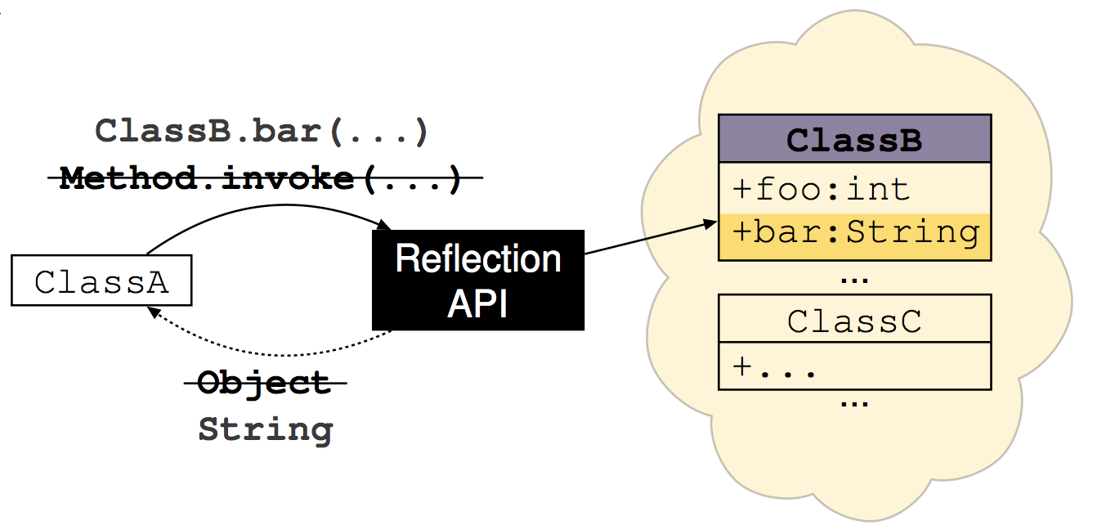
Reflection resolver
Procedure summary is narrowed based on the Reflection type system
Program remains unchanged
Downstream analysis remains unchanged

Slide 53
Message-passing analysis
(Android Intents)

Slide 54
Intent analysis
ComponentA
ComponentB
Intent i = buildIntent();
i.putExtra("key",getPass());
startActivity(i);
Intent i = getIntent();
int val = i.getIntExtra("key");
sendToEverybody(val);
Intents present two challenges to static analyses:
  Control flow
    Component Communication Pattern (CCP)
    [D. Octeau et al. USENIX ’13]
  Data flow analysis
    Intent type system

Slide 55
Intent analysis
ComponentA
ComponentB
Intent i = buildIntent();
i.putExtra("key",getPass());
startActivity(i);
Intent i = getIntent();
int val = i.getIntExtra("key");
sendToEverybody(val);
Intents present two challenges to static analyses:
  Control flow
    Component Communication Pattern (CCP)
    [D. Octeau et al. USENIX ’13]
  Data flow analysis
    Intent type system
Who receives this message?
Who sent this message?

Slide 56
Intent analysis
ComponentA
ComponentB
Intent i = buildIntent();
i.putExtra("key",getPass());
startActivity(i);
Intent i = getIntent();
int val = i.getIntExtra("key");
sendToEverybody(val);
Intents present two challenges to static analyses:
  Control flow
    Component Communication Pattern (CCP)
    [D. Octeau et al. USENIX ’13]
  Data flow analysis
    Intent type system
Who receives this message?
Who sent this message?
Notes:
Mention epicc

Slide 57
Intent analysis
ComponentA
ComponentB
Intent i = buildIntent();
i.putExtra("key",getPass());
startActivity(i);
Intent i = getIntent();
int val = i.getIntExtra("key");
sendToEverybody(val);
Intents present two challenges to static analyses:
  Control flow
    Component Communication Pattern (CCP)
    [D. Octeau et al. USENIX ’13]
  Data flow analysis
    Intent type system

Slide 58
Intent analysis
ComponentA
ComponentB
Intent i = buildIntent();
i.putExtra("key",getPass());
startActivity(i);
Intent i = getIntent();
int val = i.getIntExtra("key");
sendToEverybody(val);
Intents present two challenges to static analyses:
  Control flow
    Component Communication Pattern (CCP)
    [D. Octeau et al. USENIX ’13]
  Data flow analysis
    Intent type system
Our contribution

Slide 59
Intent type system
Syntax
  @Intent("K₁" → t₁, ..., "K_{n}" → t_{n}) Intent i = …;
Semantics
  (C1): Keys accessed in i must be a subset of T’s keys
  (C2): ∀k ∈ domain(T) . i.get*Extra(k) : t[k]
Example
T
@Intent("k" → @C) Intent i = …
@A int e1 = i.getIntExtra("k"); // Legal
i.getIntExtra("otherKey"); // Violates (C1)
@B int e3 = i.getIntExtra("k"); // Violates (C2)
@A
@B
@C

Slide 60
Intent type system
Syntax
  @Intent("K₁" → t₁, ..., "K_{n}" → t_{n}) Intent i = …;
Semantics
  (C1): Keys accessed in i must be a subset of T’s keys
  (C2): ∀k ∈ domain(T) . i.get*Extra(k) : t[k]
Example
T
@Intent("k" → @C) Intent i = …
@A int e1 = i.getIntExtra("k"); // Legal
i.getIntExtra("otherKey"); // Violates (C1)
@B int e3 = i.getIntExtra("k"); // Violates (C2)
@A
@B
@C

Slide 61
Intent type system inference
Intent i = new Intent();
@Secret int secret = …;
i.putExtra("akey", secret);
// i now has type @Intent("akey" → @Secret)
i:T
Calls i.putExtra(key, value) always refine the type of i, except when:
  i has aliases
  or
  The declared type of i has key in its domain and T[key] is a subtype of the refined type

Slide 62
Revisiting example
Aarddict
class LookupWord extends Activity {
void translateWord(@Public String sentence) {
@Intent("sentence" → @Public)
Intent i = new Intent(this, WordTranslator.class);
i.putExtra("sentence", sentence);
startActivity(i);
} … }
class WordTranslator extends Activity {
void onCreate(Bundle savedInstanceState)
@Intent("sentence" → @Public)
Intent i = getIntent();
@Public String sentence = i.getStringExtra("sentence");
…
} … }

Slide 63
Evaluation

Slide 64
Research questions
How much do our reflection and intent analyses improve the precision of a downstream analysis?
What is the annotation overhead for programmers?
Notes:
We wanted to evaluate how much our analyses improved the precision of a downstream analysis. We also wanted to evaluate what was the overhead for programmers.

Slide 65
Experimental setup
10 F-Droid apps
  Each contain uses of reflection and intents
  Average complexity → 5.3K LOC
Downstream analysis
  Information Flow Checker (IFC) https://github.com/typetools/sparta
Metrics
  Recall → 100%
  Precision
    # Real Flows / # Flows Reported
  Programmer overhead → Number of annotations
Notes:
IFC is an analysis that takes as input a list of allowed/permitted information flows (e.g., SMS => EMAIL) and reports warnings that indicate ***potential*** violating flows. We evaluated the benefit of our analyses to improve IFC.
Remind people that recall must be 100% for security analysis. Soundness is crucial, we are willing to give up some precision.
----- Meeting Notes (11/12/15 13:27) -----
modify text

Slide 66
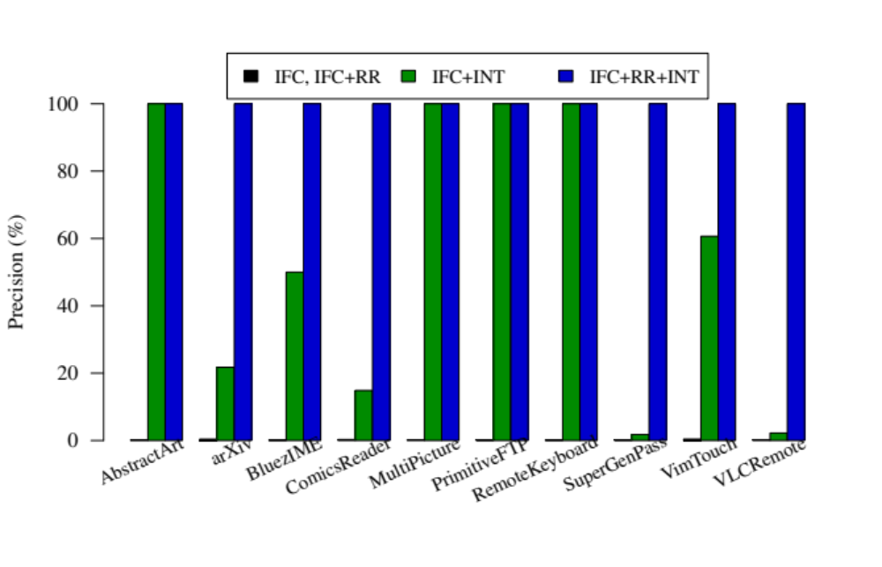
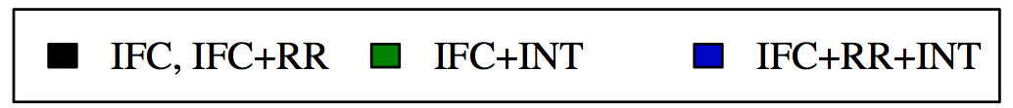
Precision
Average precision: 0.24% 53% 100%
Notes:
On this chart we have precision for the 10 apps for all approaches. IFC and IFC + RR had the same results, which is a very low precision. 0.24% on average. We barely can see the bar. The precision is very low because all apps send intents, which may trigger the use of any permissions, even ones not declared on the app’s manifest file. Reflection resolution alone does not help, including ones not listed in the flow policy.
IFC + INT has higher precision, on average 53%. Differently from intent invocations, reflective calls are only allowed to use permissions listed in the app’s manifest. That means we must assume that all sources declared in the app’s manifest can flow to all sinks declared in the app’s manifest, when there is a reflective call. There are some cases where IFC + INT achieves 100% precision. This happens when the method that is called reflectively receives no arguments and has a void return type, meaning that no information flow will be shared in this call.

Slide 67
Precision
RR by itself never helps, because every app uses intents
Average precision: 0.24% 53% 100%
Notes:
On this chart we have precision for the 10 apps for all approaches. IFC and IFC + RR had the same results, which is a very low precision. 0.24% on average. We barely can see the bar. The precision is very low because all apps send intents, which may trigger the use of any permissions, even ones not declared on the app’s manifest file. Reflection resolution alone does not help, including ones not listed in the flow policy.
IFC + INT has higher precision, on average 53%. Differently from intent invocations, reflective calls are only allowed to use permissions listed in the app’s manifest. That means we must assume that all sources declared in the app’s manifest can flow to all sinks declared in the app’s manifest, when there is a reflective call. There are some cases where IFC + INT achieves 100% precision. This happens when the method that is called reflectively receives no arguments and has a void return type, meaning that no information flow will be shared in this call.
Our analyses does not resolve 100% of refelction and intents, but it made the downstram analyses 100%.Because we soplved all meaningful cases.

Slide 68
Precision
INT and RR are complementary
Average precision: 0.24% 53% 100%
Notes:
On this chart we have precision for the 10 apps for all approaches. IFC and IFC + RR had the same results, which is a very low precision. 0.24% on average. We barely can see the bar. The precision is very low because all apps send intents, which may trigger the use of any permissions, even ones not declared on the app’s manifest file. Reflection resolution alone does not help, including ones not listed in the flow policy.
IFC + INT has higher precision, on average 53%. Differently from intent invocations, reflective calls are only allowed to use permissions listed in the app’s manifest. That means we must assume that all sources declared in the app’s manifest can flow to all sinks declared in the app’s manifest, when there is a reflective call. There are some cases where IFC + INT achieves 100% precision. This happens when the method that is called reflectively receives no arguments and has a void return type, meaning that no information flow will be shared in this call.

Slide 69
Precision
RR by itself never helps, because every app uses intents
INT and RR are complementary
Average precision: 0.24% 53% 100%
Notes:
On this chart we have precision for the 10 apps for all approaches. IFC and IFC + RR had the same results, which is a very low precision. 0.24% on average. We barely can see the bar. The precision is very low because all apps send intents, which may trigger the use of any permissions, even ones not declared on the app’s manifest file. Reflection resolution alone does not help, including ones not listed in the flow policy.
IFC + INT has higher precision, on average 53%. Differently from intent invocations, reflective calls are only allowed to use permissions listed in the app’s manifest. That means we must assume that all sources declared in the app’s manifest can flow to all sinks declared in the app’s manifest, when there is a reflective call. There are some cases where IFC + INT achieves 100% precision. This happens when the method that is called reflectively receives no arguments and has a void return type, meaning that no information flow will be shared in this call.

Slide 70
Annotation overhead
10 Android Apps | LOC | Reflection and Intent uses | # of annotations
 |  |  | IFC | RR+INT
Total | 52,614 | 405 | 5,583 | 98
2% extra annotations
For RR+INT → One annotation every ~2K LOC
Notes:
On this chart we details each subject regarding the number of LOC, reflection uses, intents uses, and number of annotations added.

Slide 71
Related work
Reflection – sound, but limited:
  M. S. Tschantz and M. D. Ernst, OOPSLA’15
  Livshits et al., APLAS ’05
  M. Tatsubori et al., PPL’04
Reflection – unsound:
  Y. Li et al., ECOOP’14
  Bodden et al., ICSE’11
Intents – unsound:
  L. Li et al., ICSE’15

Slide 72

Conclusion
Two sound analyses for implicit control flows
  Reflection
  Message-Passing
High precision for Android apps
  Resolved 93% of reflective calls
  Resolved 88% of sent intents
Can be integrated with any downstream analysis
  Improved precision by 400x
Implementations are available
http://CheckerFramework.org/
Notes:
We performed experiments to answer both rqs.
We selected 10 real apps from the F-droid repository. We started by filtering apps that used both Reflection and Intents.
Out of those, we removed apps with more than 15k LOC and apps with lower than 2k LOC. We also removed apps that
used more than 5 Android permissions (which is the average number of permissions used in the total set of apps).
40 apps met our critirea, and we sampled 10 of them.
The apps average over 5k LOC, 3 reflective calls and 37 calls to putExtra or getExtra. (Make sure that those terms are introduced earlier, or change that)
Just like we used the non-interference type system to introduce the problem earlier in the presentation, we used another static analysis to evaluate our approaches. We used the Information Flow Checker, or IFC.
IFC is an analysis that takes as input a list of allowed/permitted information flows (e.g., SMS => EMAIL) and reports warnings that indicate ***potential*** violating flows. We evaluated the benefit of our analyses to improve IFC.
We considered 4 different approaches:
IFC, which is the Information Flow Checker without any modifications.
IFC + RR, which is the IFC with our Reflection Resolution enabled
IFC + INT, which is the IFC with our Intent analysis enabled.
IFC + INT + RR is the IFC with both our Reflection resolution and Intent analysis enabled.
We confirmed that IFC is sound, just like our analyses. Therefore, we compared them in terms of precision and the number of annotations required.
----- Meeting Notes (11/11/15 18:52) -----
Exaclty, no one would use it. There was there was no sound analysis enable, and now they are.

Slide 73
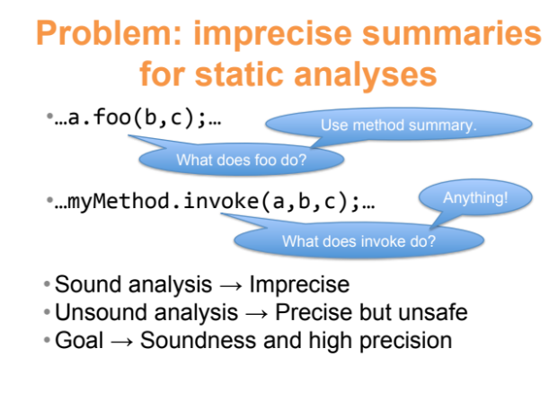
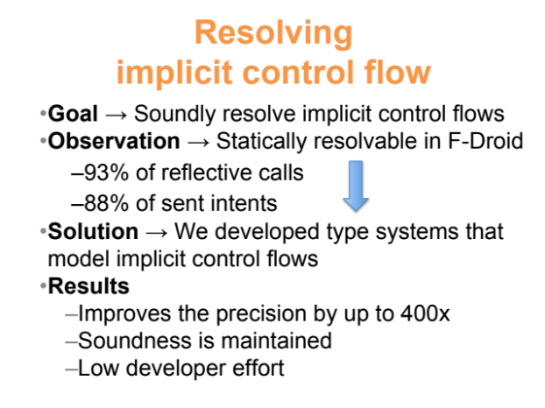
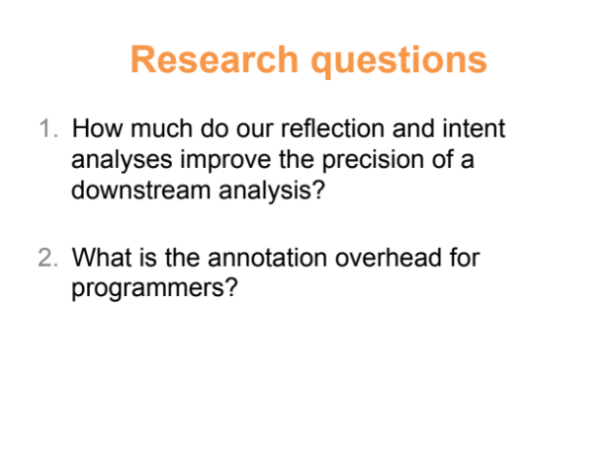
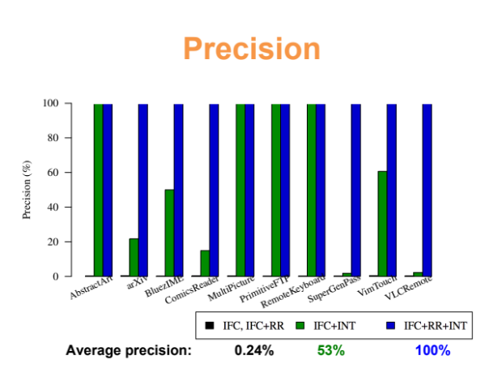
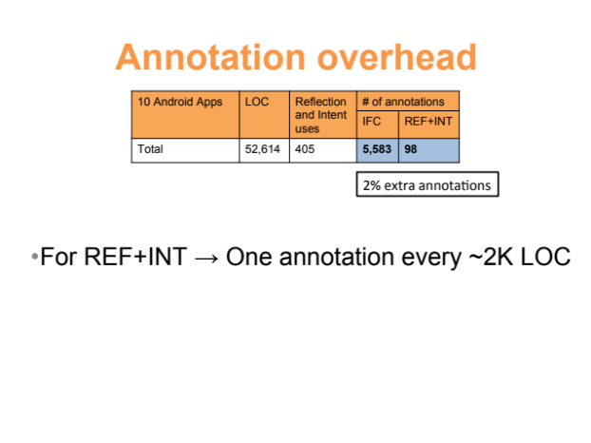
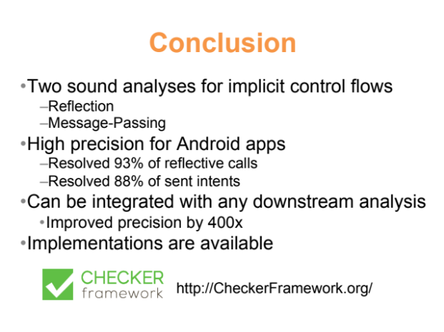
Paulo Barros - pbsf@cin.ufpe.br

Slide 74
Uses of reflection in Android apps
35 F-droid apps were evaluated (10+25)
  Total of 142 reflective invocations
    81% to provide backward compatibility
    6% to access non-public/hidden methods
    13% are for other cases (duck-typing)

Slide 75
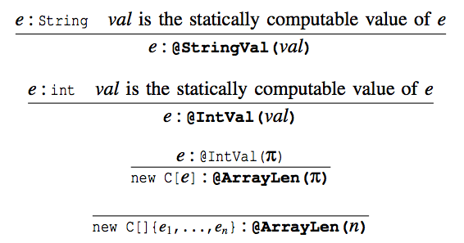
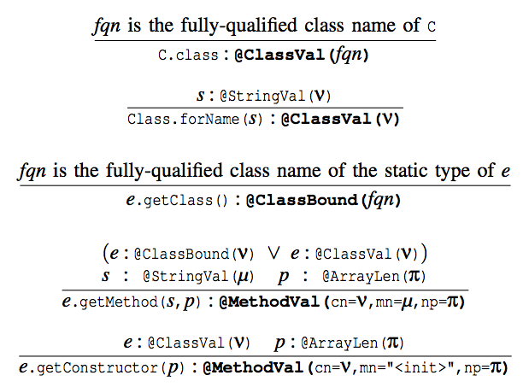
Reflection type inference rules

Slide 76
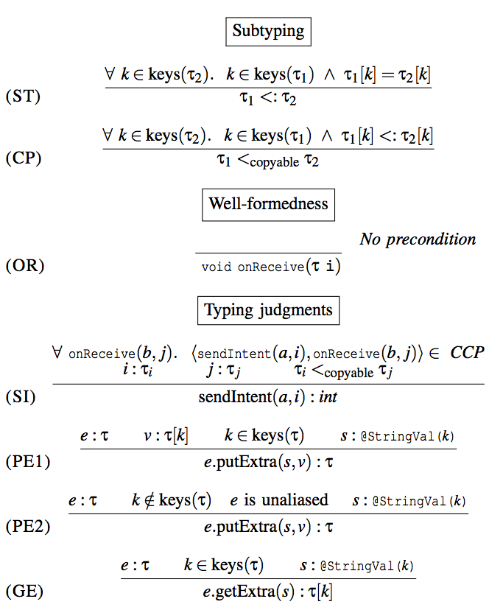
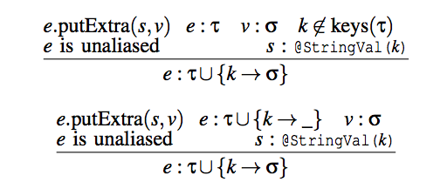
Intent type system rules
Type inference rules

Slide 77
Type inference evaluation
Inference used on reflective calls
  52% required intra-procedural inference
  41% required inter-procedural inference
  7% cannot be resolved by any static analysis
Inference used on send intent calls
  67% required intra-procedural inference
  21% required inter-procedural inference
  12% required a better aliasing analysis

Slide 78
Annotation burden
Annotations are required for two reasons
  The downstream analysis is a modular analysis
  Express facts that no static analysis can infer
The average time to add an annotation was one minute

