Slide 1





Intent-Preserving Test Repair
Xiangyu Li
Alessandro Orso
Marcelo d’Amorim
Notes:
Hello everyone. Welcome to my talk.
Today I will present our intent-preserving test repair technique.

Slide 2






Motivation
P
Δ ( Spec )
Δ ( Interface )
P’
Preserve Test Intent
P’(t’) ≈ P(t)
t
t
t’
Existing approaches
Fix expected values¹
Fix compilation errors caused by pre-defined set of method signature changes²
Repairing many broken tests require more complex changes³
Our approach to handle more complex cases:
Make flexible changes to test code
Model and consider test intent explicitly
1. B. Daniel, T. Gvero, and D. Marinov, “On test repair using symbolic execution”, ISSTA 2010
2. M. Mirzaaghaei, F. Pastore, and M. Pezz`e, “Supporting test suite evolution through test case adaptation”, ICST 2012
3. L. S. Pinto, S. Sinha, and A. Orso, “Understanding myths and realities of test-suite evolution”, FSE 2012
Notes:
Testing is widely used to check that software behaves as expected.
In evolving code bases, people use regression testing to ensure that changes in the software do not break these verified correct behaviors.
Consider the program P that has a passing test suite.
In the next version, P is changed to P’.
The existing test cases are executed against P’ to check whether they still pass.
Regression test failures could be caused by two reasons.
First, the failing test reveals a fault in the changed program. In this case, P’ should be modified to fix the fault.
Second, the failure is because the test itself becomes invalid.
This is typically because either the specification or the interface of the software is changed.
In this case, we say that the test is broken.
Suppose we have a test t that passes on P but breaks on P’.
If it still tests a valid functionality of the program, the test should be repaired.
In real-world software, a single program change could potentially break a large number of test cases.
Manually repairing each of them is time-consuming.
To reduce the manual effort, researchers have proposed automated test repair techniques.
One important requirement for test repair techniques is that a repaired test should preserve the original test intent.
That is, the behavior of P’ verified by t’ should be similar to the behavior of P verified by t.
Existing approaches repair broken tests in a few situations:
If the broken test still compiles, some techniques, for example Re-assert, can fix the expected values to match the runtime behavior.
Other techniques, for example the Test Care Assistant, can repair compilation errors caused by a set of pre-defined types of method signature changes such as parameter addition and removal.
However, a previous empirical study on broken tests shows that a significant proportion of broken tests require more complex changes to repair.
To extend automated test repair techniques to handle more general and complex cases, our approach is to allow more flexible changes to the test code.
In this case, however, preserving the original test intent is challenging.
To solve this problem, our technique explicitly models and considers test intent while repairing tests.

Slide 3

Test Repair Example
1 public void testHtml40Nbsp() {
2 Entities e = new Entities();
3 e.map = new Entities.PrimitiveEntityMap();
4 Entities.fillWithHtml40Entities(e);
5 assertEquals("&nbsp;", e.escape("\u00A0")); }
①
Δ (P, P’)
- Entities.map
Broken test t
1 public void testHtml40Nbsp() {
2 Entities e = new Entities(
3 new Entities.PrimitiveEntityMap());
4 Entities.fillWithHtml40Entities(e);
5 assertEquals("&nbsp;", e.escape("\u00A0")); }
Δ (t, t’)
- Entities constructor
- Field assignment
+Different Entities constructor
②
Repaired test t’
Commons Lang: https://commons.apache.org/proper/commons-lang/
Notes:
Before I present our approach, let me give you an idea of what is a broken test and what it means to repair it.
The broken test is from a widely-used Java library, commons lang.
It is broken because in a new version of the software, the field Entities.map is made inaccessible from the test code.
As a result, the test fails to compile at line 3.
On the bottom is the repaired test provided by the library developers.
Repairing the test requires first removing from the broken test line 2 which creates the Entities object, and line 3 which assigns its map field, and then adding a new statement to create the Entities object by calling a different constructor which achieves the same functionality as the two removed statements.
These modifications are highly specific to the actual change of the program.
It takes more than pre-defined rules to repair the test.

Slide 4

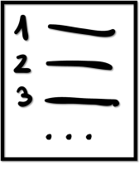
Our Approach
P
P’
TRIP (Test Repair with Intent Preservation)
Repair Candidate
Generator
t
{ t_{i} }
Test Intent
Extractor
P(t)
{ P’(t_{i}) }
Test Intent
Comparator
Ranked List of
Repair Candidates
Notes:
In this work, we propose TRIP, an intent-aware automated test repair technique that repairs broken tests due to compilation errors.
The technique works as follows.
It takes the old version of the program P, the new version P’ and the broken test t as input, and produces a ranked list of repair candidates.
The technique has three main components.
First, the repair candidate generator takes the broken test case t and, based on the changes in P’, generates a set of repair candidates ti that passes on P’.
Second, the test intent extractor takes the original test t and produces a model of its test intent.
To do this, it executes t on the old version of the program P and extracts a set of dynamic information to represent its test intent.
Similarly, it executes each ti on the new version P’ and extracts their test intent models in the same way.
Third, the test intent comparator uses the test intent models to compute a similarity score between the test intent of the original test t and each repair candidate ti.
It ranks the repair candidates by their intent similarity with the original test and outputs the ranked list.

Slide 5
Our Approach
P
P’
TRIP (Test Repair with Intent Preservation)
Repair Candidate
Generator
t
{ t_{i} }
Test Intent
Extractor
P(t)
{ P’(t_{i}) }
Test Intent
Comparator
Ranked List of
Repair Candidates
Notes:
Let me describe how each of the components works.
I’ll start with the repair candidate generator.

Slide 6
Repair Candidate Generator
Compare
P and P’
Analyze
Broken Test
Generate
Candidates
Notes:
It works in three steps.

Slide 7

Repair Candidate Generator
Compare
P and P’
Analyze
Broken Test
Generate
Candidates
Removed PPEs
. . .
Public Program Elements (PPEs)
Entities.map
. . .
Notes:
In the first step, it compares the program versions P and P’.
Our technique sees the program as a set of public program elements, or PPEs for short, which are the methods and fields accessible from the test code.
It models programs in this way because accessing PPEs is how the test code exercises program behavior.
By comparing the PPEs of P and P’, TRIP identifies the set of removed PPEs that are only in P but not in P’.
They are the reason why the test breaks and should be removed from the broken test.
In our example, because the field Entities.map becomes inaccessible, the removed PPEs include this field.

Slide 8
Repair Candidate Generator
Compare
P and P’
Analyze
Broken Test
Generate
Candidates
0: Entities.<init>()
2: PrimitiveEntityMap.<init>()
Parts that fail to compile
Parts that can be re-used
Data Flow Graph (DFG)
1: Entities
3: PrimitiveEntityMap
4: !set-field[Entities, map](Entities, EntityMap)
5: Entities
6: Entities.fillWithHtml40Entities(Entities)
Notes:
In the second step, our technique analyzes the broken test to identify the parts of the code that fail to compile and the parts that are still valid and can be re-used.
To do that, our technique first converts the test code to a data flow graph, or DFG for short.
Let me show the DFG for our broken test example. Because of space limitation, I’ll show a subgraph of the complete DFG.
Conceptually, the DFG represents the data dependencies and type information associated with each expression in the test.
The rectangles with solid borders represent operations performed by the test such as method calls and field accesses.
They are connected through the dashed rectangles which represent the definitions including primitive values and objects.
TRIP uses this representation internally to search for repair candidates.
I do not want you to read the content of each node. Let me use a Jigsaw puzzle as the analogy to explain the idea intuitively.

Slide 9
Repair Candidate Generator
Compare
P and P’
Analyze
Broken Test
Generate
Candidates
0: Entities.<init>()
2: PrimitiveEntityMap.<init>()
Parts that fails to compile
Parts that can be re-used
Data Flow Graph (DFG)
①
②
Input type requirements
1: Entities
3: PrimitiveEntityMap
③
e.map = ...
4: !set-field[Entities, map](Entities, EntityMap)
5: Entities
Output types
④
6: Entities.fillWithHtml40Entities(Entities)
Notes:
(I do not want you to read the content of each node. Let me use a Jigsaw puzzle as the analogy to explain the idea intuitively.)
This Jigsaw puzzle game has four pieces. Each piece represents an operation in the DFG I just showed.
The shapes of the dents on the top of each piece indicate the input type requirements of the operation and the shapes of the bumps on the bottom indicate its output types.
Some pieces do not have dents on the top because their corresponding operations take no parameters.
For the game to be in a good shape, the input requirements of all the pieces have to be fulfilled.
Piece 3 corresponds to the assignment of the field Entities.map, which is a removed PPE.

Slide 10
Repair Candidate Generator
Compare
P and P’
Analyze
Broken Test
Generate
Candidates
0: Entities.<init>()
2: PrimitiveEntityMap.<init>()
Parts that fails to compile
Parts that can be re-used
Data Flow Graph (DFG)
①
②
1: Entities
3: PrimitiveEntityMap
③
e.map = ...
4: !set-field[Entities, map](Entities, EntityMap)
5: Entities
④
6: Entities.fillWithHtml40Entities(Entities)
Notes:
As a result, this piece becomes invalid and should be removed.
Piece 4 is also affected by the program change because its input type requirement becomes unsatisfied.
On the other hand, pieces 1 and 2 are still valid and can be directly re-used.

Slide 11
Repair Candidate Generator
Compare
P and P’
Analyze
Broken Test
Generate
Candidates
①
②
Search-based approach
Type matching
③
e.map = ...
④
Notes:
In the third step, TRIP tries to find pieces from P’ to replace the removed parts and restore the puzzle to a good shape.
The pieces that can be used include both the new PPEs of P’ and the existing PPEs inherited from the old version.
To enable TRIP to generate flexible changes, it uses a search-based approach.
Based on type compatibility, each time TRIP randomly selects a PPE whose input type requirements can be satisfied by the available outputs in the puzzle.
For our example, I’ll show how TRIP generates the actual repair only and ignore the other choices in the search space.
It selects a piece that requires a half-circle as input and outputs a triangle.
To satisfy its input type requirements, the technique connects the new piece with piece 2.
The output of new piece can be used in two ways: 1) it can be used to satisfy the input type requirements of existing pieces and 2) TRIP can use it as input to add more pieces to the puzzle.
In the example, TRIP fits the output of the new piece with the input requirements of piece 4.
This restores the puzzle to a valid state.
On the other hand, piece 1 is no longer needed and should be removed.

Slide 12
Repair Candidate Generator
Compare
P and P’
Analyze
Broken Test
Generate
Candidates
2: PrimitiveEntityMap.<init>()
1 public void testHtml40Nbsp() {
2 Entities e = new Entities(
3 new Entities.PrimitiveEntityMap());
4 Entities.fillWithHtml40Entities(e);
5 assertEquals("&nbsp;", e.escape("\u00A0")); }
3: PrimitiveEntityMap
t1’ (intent-preserving)
7: Entities.<init>(EntityMap)
Add Pieces
8: Entities
Fit Pieces
Together
6: Entities.fillWithHtml40Entities(Entities)
Notes:
This diagram shows the actual DFG after these transformations.
TRIP generates the corresponding test code from the new DFG.
In the general case, the technique repeatedly add pieces into the puzzle and fits things together to generate increasingly complex repair candidates.

Slide 13
Repair Candidate Generator
Compare
P and P’
Analyze
Broken Test
Generate
Candidates
2: PrimitiveEntityMap.<init>()
Prefer PPEs that are more likely needed:
New PPEs in P’
PPEs with higher textual similarity with the ones removed from the test
3: PrimitiveEntityMap
7: Entities.<init>(EntityMap)
8: Entities
6: Entities.fillWithHtml40Entities(Entities)
Notes:
To explore the search space more efficiently, TRIP uses two heuristics to prioritize the PPEs that are more likely to be needed in the actual repair.
First, TRIP give higher priority to the new PPEs in P’.
Second, TRIP prefers the PPEs whose signatures have higher textual similarity with the PPEs removed from the broken test.

Slide 14
Repair Candidate Generator
Compare
P and P’
Analyze
Broken Test
Generate
Candidates
✓
Execute On P’
Repair
Candidates
Generated
Test Code
✗
(Discarded)
Notes:
In the last step, the technique executes the generated test code against P’. The passing ones are retained as the repair candidates.

Slide 15
Test Intent Extractor
P
P’
TRIP (Test Repair with Intent Preservation)
Repair Candidate
Generator
t
{ t_{i} }
Test Intent
Extractor
P(t)
{ P’(t_{i}) }
Test Intent
Comparator
Ranked List of
Repair Candidates
Notes:
The generated repair candidates could have various test intents.
The test intent extractor takes the repair candidates as input and produces models of their test intents.

Slide 16
Test Intent Extractor
Path condition (PC) as model of test intent
1 public int sumAbs(int x, int y) {
2 if (x < 0)
3 x = -x;
4 if (y < 0)
5 y = -y;
6 return x + y;
7 }
1 x = s1, y = s2
2 Path constraint: s1 < 0
3 x = -s1
4 Path constraint:¬(s2 < 0)
6 return = -s1 + s2
11 Path constraint: -s1 + s2 == 5
8 @Test
9 public void testSumAbs() {
10 assertEquals(5, sumAbs(-2, 3));
11 }
s1
s2
Path condition: s1 < 0 Λ ¬(s2 < 0) Λ -s1 + s2 == 5
Notes:
To model the intent of a test, TRIP uses its path condition, which is an abstraction of how the program processes the test inputs.
I’ll show what this means and why we use PC to model test intent on this simple example.
We have to use a different example here because the PC of our previous example is too complex.
The system under test is the method sumAbs, which computes the sum of the absolute values of two integers.
A test case for the method is shown on the bottom.
To generate the PC, TRIP marks the test inputs as symbolic values and evaluates the test by using dynamic symbolic execution, following the same path of the concrete execution.
The test has two input values, -2 and 3, on line 10.
For illustration purpose, we denote their symbolic values as s1 and s2 respectively.
The test first calls the method sumAbs.
The parameters x and y take the values s1 and s2.
The predicate on line 2 takes the true branch based on the fact that s1 is less than 0.
The variable x then gets a new value, negative s1.
The next predicate takes the false branch based on the fact that s2 is not less than 0.
The return value of the method is negative s1 plus s2.
The control returns to the test.
The assertEquals method compares 5 with the return value.
It produces no errors based on the fact that two values are equal.
The PC of this test is the logical conjunction of these three highlighted clauses, which determine the control flow of the execution.
It provides an abstraction of the program behavior for this particular test case.
One reason we use path conditions as the model of test intent is that path conditions generated for the same functionality on different implementations are often extremely similar.
Let me show this intuitively using the example.

Slide 17
Test Intent Extractor
1 public int sum(int x, int y) {
2 return x + y;
3 }
4
5 public int abs(int a) {
6 if (a < 0)
7 return –a;
8 else
9 return a;
10 }
Path condition (PC) as model of test intent
1 public int sumAbs(int x, int y) {
2 if (x < 0)
3 x = -x;
4 if (y < 0)
5 y = -y;
6 return x + y;
7 }
1 x = s1, y = s2
2 Path constraint: s1 < 0
3 x = -s1
4 Path constraint:¬(s2 < 0)
6 return = -s1 + s2
11 Path constraint: -s1 + s2 == 5
s1 < 0
¬(s2 < 0)
11 @Test
12 public void testSumAbs() {
13 assertEquals(5, sum(abs(-2), abs(3)));
14 }
8 @Test
9 public void testSumAbs() {
10 assertEquals(5, sumAbs(-2, 3));
11 }
-s1 + s2 == 5
s1
s2
s1
s2
Path condition: s1 < 0 Λ ¬(s2 < 0) Λ -s1 + s2 == 5
Notes:
Consider that we refactored the method sumAbs, splitting it into two methods that compute the sums and absolute values separately.
To test the same functionality, the test code is changed accordingly.
Despite the implementation differences, the resulting PC of the changed test is exactly the same as the original test.
The method abs() would generate the first two clauses and the comparison in the assertEquals method would generate the third clause.

Slide 18
Test Intent Comparator
P
P’
TRIP (Test Repair with Intent Preservation)
Repair Candidate
Generator
t
{ t_{i} }
Test Intent
Extractor
P(t)
{ P’(t_{i}) }
Test Intent
Comparator
Ranked List of
Repair Candidates
Notes:
The test intent comparator uses the test intent models to calculate the intent similarity between tests.
Now let me explain how it does this in more details.

Slide 19
Test Intent Comparator
Intent similarity of two tests
Degree of similarity to which test executions are dependent on the test inputs
Similarity between path conditions
Structural similarity
Logical reasoning
Equivalence of clauses
Inference relations
Notes:
The intent similarity between two tests represents how similarly their executions are dependent on the test inputs.
TRIP computes the similarity score by using the path condition abstraction.
One straight-forward approach based on path condition is to use logical reasoning to compute the logical equivalence and inference relations between the clauses in the two PCs.
However, this approach is computationally too expensive for our technique because TRIP needs to calculate the similarity of a large number of PC clause pairs.
Instead, we uses a much cheaper approach which is computing the structural similarity between the path conditions.

Slide 20
Test Intent Comparator
Expression tree forest
(s1 = -2, s2 = 3)
c1: (s1 < 0)
Expression tree forest
c3: (- s1 + s2 = 5)
Intent similarity of two tests
Degree of similarity to which test executions are dependent on the test inputs
Structural similarity between path conditions
<
(s1 = 2, s2 = 3)
=
c1’: ¬(s1 < 0)
s1
0
¬
+
5
c2: ¬(s2 < 0)
<
c3’: (s1 + s2 = 5)
¬
-
s2
=
<
s1
0
s1
+
5
c2’: ¬(s2 < 0)
s2
0
¬
s1
s2
<
Compare
Clauses
Compare
Complete PCs
s2
0
Notes:
To do this, TRIP represents a PC as a forest of symbolic expression trees.
This diagram shows the tree representation of the PC in our simple example.
I’ll refer to the three clauses as c1, c2 and c3.
Suppose that we have a different test in which the value of s1 is not negative two, but positive two.
The PC of the second test is different because the program processes s1 differently.
Specifically, in the first clause c1’, the result of the comparison between s1 and 0 is reversed, and in the third clause c3’, the value of s1 is not negated.
The technique performs the structural comparison at two levels.
It first compares the clauses and then, based on the similarity of the clauses, computes the similarity of complete PCs.
Let me first use c3 and c3’ to illustrate how it compares the clauses.

Slide 21
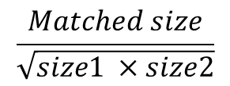
Test Intent Comparator
Intent similarity of two tests
Degree of similarity to which test executions are dependent on the test inputs
Structural similarity between path conditions
c3: (- s1 + s2 = 5)
c3’: (s1 + s2 = 5)
=
=
+
5
+
5
-
s2
s1
s2
Tree alignment algorithm¹
s1
$$\frac{Matched size}{\sqrt{size1 ×size2}}$$
1. T. Jiang, L. Wang, and K. Zhang, “Alignment of trees an alternative to tree edit,” Theoretical Computer Science, vol. 143, no. 1, pp. 137 – 148, 1995.
Notes:
TRIP first applies the tree alignment algorithm to the tree forms of the clauses.
This algorithm allows us to compute the maximum matching between structurally different trees.
After applying the tree alignment, 5 pairs of nodes are matched and 1 node is not matched.
The matched nodes are indicated with green borders.
To compute the similarity score, TRIP uses the cosine similarity formula, which is the matched size of the clauses divided by the geometric mean of their full sizes.

Slide 22
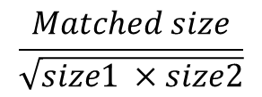
Test Intent Comparator
c1: (s1 < 0)
c2: ¬(s2 < 0)
c3: (- s1 + s2 = 5)
c1’: ¬(s1 < 0)
c2’: ¬(s2 < 0)
c3’:(s1 + s2 = 5)
Intent similarity of two tests
Degree of similarity to which test executions are dependent on the test inputs
Structural similarity between path conditions
0.866
1.00
0.913
Maximum matching of bipartite graphs
$$\frac{Matched size}{\sqrt{size1 ×size2}}$$
Notes:
Next, TRIP computes the similarity of the complete PCs.
For each clause in the first PC, TRIP calculates its similarity score with all the clauses in the second PC.
Then it computes the correspondence of the clauses across the two PCs by computing a matching between these two sets of clauses such that the sum similarities of matched clauses is maximized.
The remaining connections show the maximum matching, and the numbers are the similarities of the matched clauses.
The similarity score of the two complete PCs are calculated by using the same cosine similarity formula.

Slide 23


Test Intent Comparator
1 public void testHtml40Nbsp() {
2 Entities e = new Entities();
3 e.map = new Entities.PrimitiveEntityMap();
4 Entities.fillWithHtml40Entities(e);
5 assertEquals("&nbsp;", e.escape("\u00A0")); }
PC of t has clauses from:
Entities
PrimitiveEntityMap
Intent similarity of two tests
Degree of similarity to which test executions are dependent on the test inputs
Structural similarity between path conditions
t (broken test)
PC of t1 has clauses from:
Entities
PrimitiveEntityMap
1 public void testHtml40Nbsp() {
2 Entities e = new Entities(
3 new Entities.PrimitiveEntityMap());
4 Entities.fillWithHtml40Entities(e);
5 assertEquals("&nbsp;", e.escape("\u00A0")); }
t1 (intent-preserving)
1 public void testHtml40Nbsp() {
2 Entities e = new Entities();
3 Entities.fillWithHtml40Entities(e);
4 assertEquals("&nbsp;", e.escape("\u00A0")); }
PC of t2 has clauses from:
Entities
t2 (non-intent-preserving)
Notes:
Let me show how TRIP uses test intent similarity to rank the repairs in our test repair example.
Here I show only the top two repair candidates – an intent-preserving candidate t1, and a non-preserving one t2.
The difference between the two candidates is at the first statement. They call different constructors to create the Entities object.
The complete path conditions of the tests are too complex to show, but the relevant bit of information is that the path conditions of both t and t1 contain clauses generated in the PrimitiveEntityMap class, while the path condition of t2 does not.
As a result, the intent similarity score between t and t1 is higher than that between t and t2.
In the ranked list of repair candidates, t1 is ranked higher.

Slide 24
Empirical Evaluation
Research questions
RQ1: How effective is TRIP at generating actual test repairs?
RQ2: Are path conditions a good abstraction of test intent?
Notes:
We evaluated TRIP by answering two research questions:
How effective is TRIP at generating actual test repairs?
Are path conditions a good abstraction of test intent?

Slide 25
Empirical Evaluation
Have developer-provided repairs
Require non-trivial changes
Experiment setup
Benchmark
Procedure
Whether TRIP generates actual repair
How well TRIP ranks actual repair
Table I: Benchmark programs.
Identical with developer repairs
Identical through trivial transformations
Program | # Versions | # Classes | # LoC | # Tests
commons-lang | 8 | 67-99 | 36K-52K | 1193-2051
commons-math | 7 | 614-990 | 12K-20K | 2379-4587
gson | 10 | 77-96 | 8K-12K | 204-939
joda-time | 13 | 142-157 | 47K-63K | 2420-3838
Total | 38 | / | / | /
# Broken Tests
14
3
69
5
91
Notes:
We used a benchmark of 4 open-source programs.
For each program, we included multiple versions.
This allows us to identify test cases that are broken between versions and to find the repaired tests provided by the developers.
In total, we found 91 broken test cases that have developer-provided repairs, and require non-trivial changes to fix.
We ran TRIP on each broken test for a time limit of 5 minutes.
To answer RQ1, we manually inspected the top repair candidates to determine whether TRIP generated the actual repairs.
To answer RQ2, we report the rank of these actual repairs in the repair candidate list.
To determine whether a repair candidate is the actual repair, we manually compared the repair candidate with the developer’s repair and require them to be semantically equivalent.
In fact, all the successful repairs in our study are either identical to the developer repairs, or can be made identical through trivial program transformations.

Slide 26

Empirical Evaluation
RQ1: How effective is TRIP at generating actual test repairs?
Out of the 91 broken tests we considered, TRIP was able to generate actual repairs for 72 (≈ 80%) cases.
Notes:
This diagram shows the results to answer RQ1.
The blue bars show the numbers of broken tests in the experiment, and the orange bars show the numbers of tests for which TRIP generated the actual repair.
In total, out of the 91 broken tests we considered, TRIP is able to generate the actual repairs for 72 cases.

Slide 27
Empirical Evaluation
RQ2: Are path conditions a good abstraction of test intent?
Out of the 72 successful repairs, TRIP ranks 63 (>87%) as the first repair recommendation and 68 (>94%) among the top 3 positions
Notes:
For these successfully generated repairs, we look at their rankings in the repair candidate list to answer RQ 2.
This diagram shows the results.
The blue bars show the numbers of successful repairs, which is the same data I just presented on the previous page.
The orange and gray bars show the numbers of actual repairs ranked as the first choice, and among the top 3 choices, respectively.
Out of the 72 successful repairs, our technique ranks more than 87% as the first repair recommendation and over 94% among the top 3 positions.

Slide 28
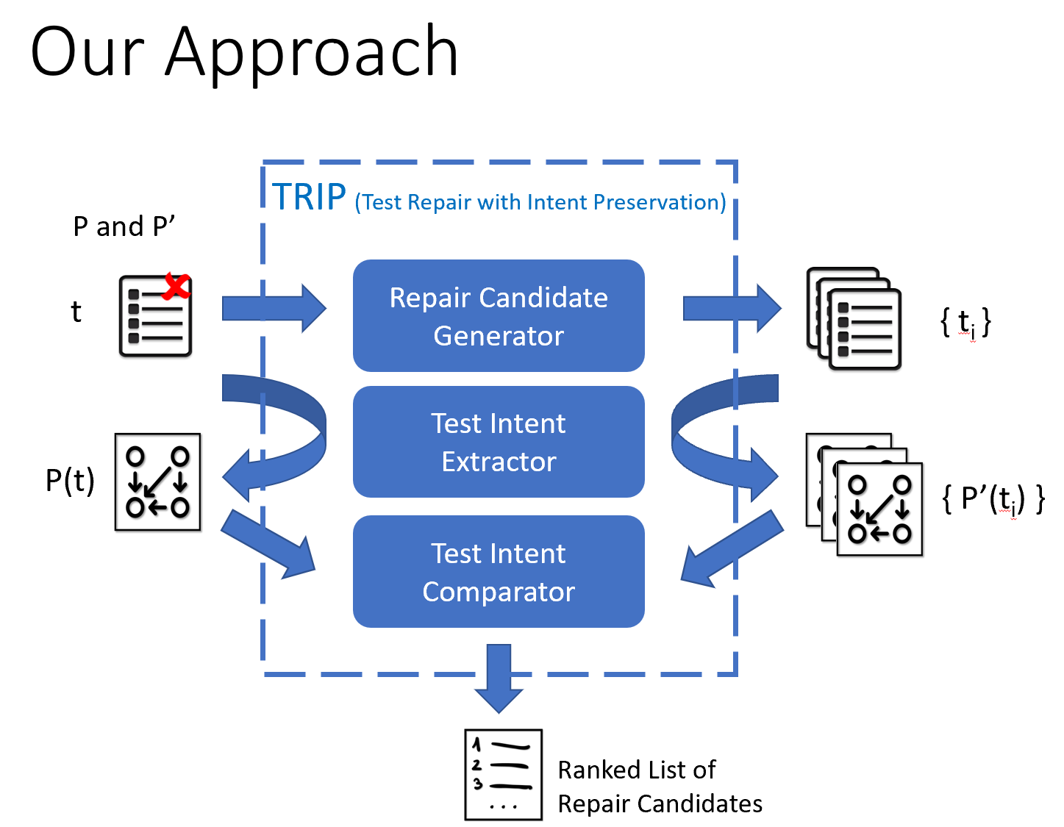
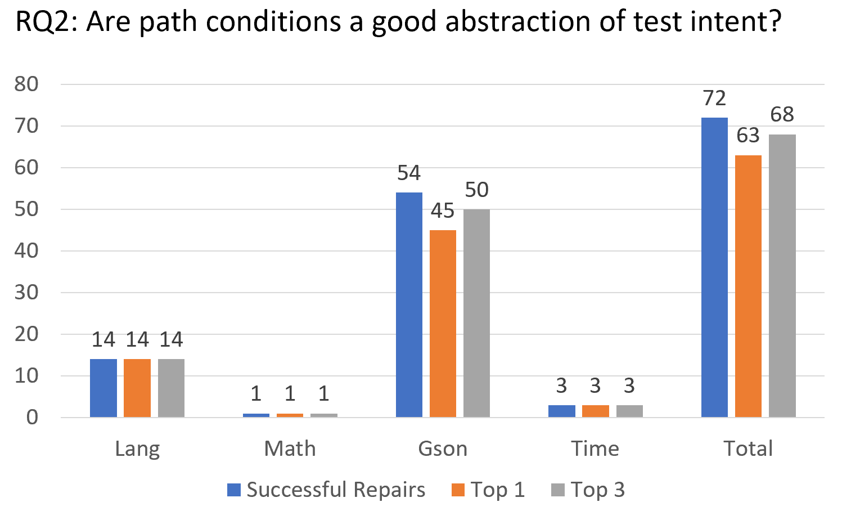
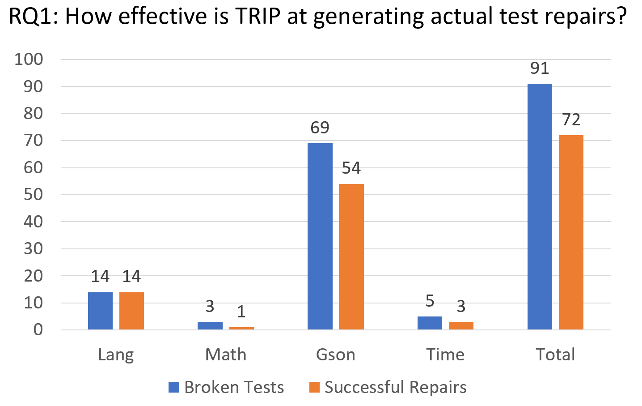
Search-based approach guided by dependency and type information to allow more flexible changes
Explicit test intent models represented by path conditions
Encouraging empirical results
Generate successful repairs for most broken tests
Rank actual repairs at top positions
Notes:
To conclude, I presented TRIP, an intent-aware automated test repair technique.
Different from existing work, our technique uses a search-based approach guided by data dependency and type information to allow more flexible changes.
To produce repair recommendations that are likely to preserve the original test intent, TRIP models and considers test intent explicitly by using path conditions.
We evaluated our technique with a large number of broken tests that require non-trivial changes to fix.
We found that TRIP can generate actual repairs for the majority of the broken tests in the study and that path conditions are a good abstraction of test intent.
Thank you for attending my talk. I’m happy to take questions.

Slide 29
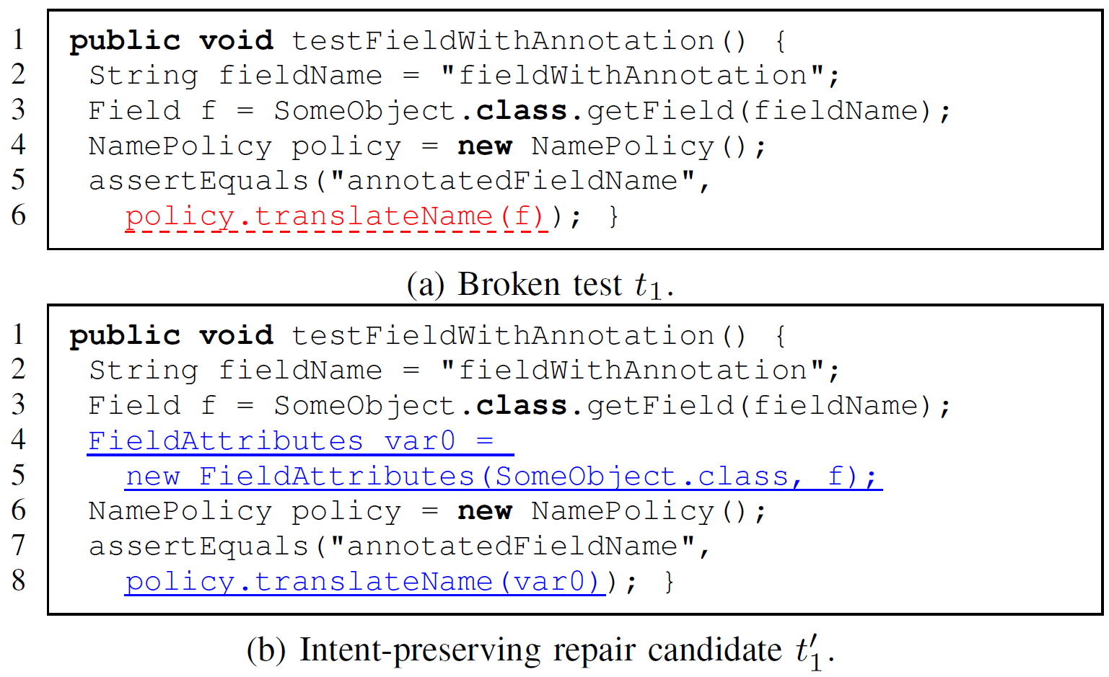
Example Repairs
Notes:
(If we have time…)

Slide 30
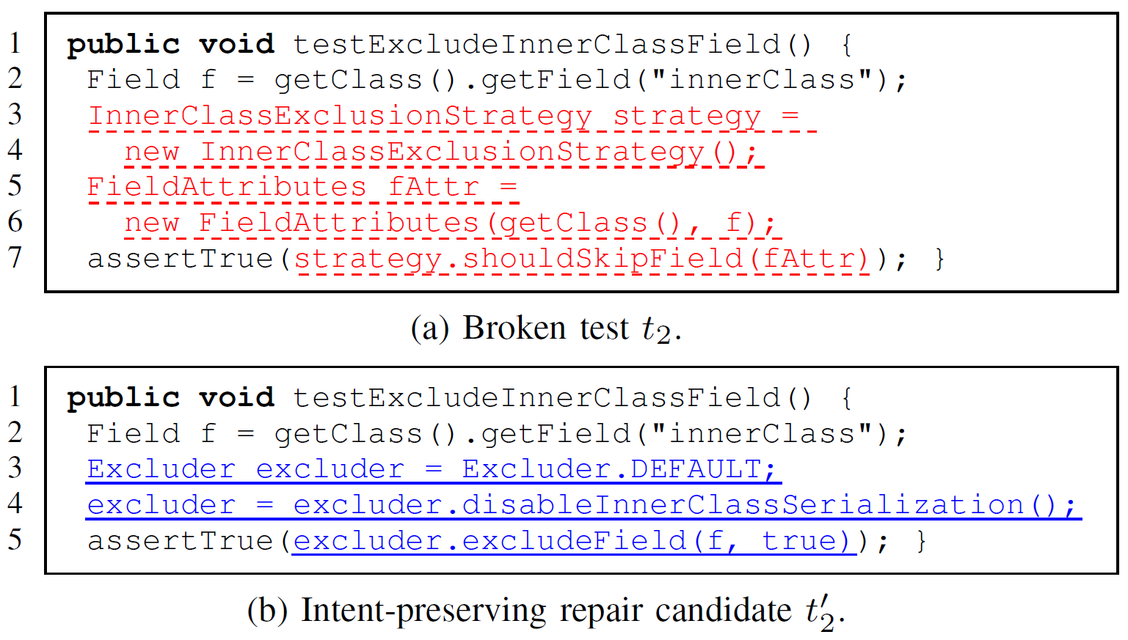
Example Repairs
Notes:
(If we have time…)

