Slide 1
Program Model Checking
Tutorial
Davino Junior Luis Melo Marcelo d'Amorim
Universidade Federal de Pernambuco (UFPE)
SBMF Tutorial, November 21, 2017, Recife-PE, Brazil

Slide 2
Website
https://github.com/davinomjr/model-checking-tutorial

Slide 3
Model Checking (MC)
Method for checking properties in system designs
Extremely popular in hardware verification!
Intuition
Model are encoded as Labeled Transition System (LTS)
Describe properties in some specification language (e.g., LTL, CTL)
Verify properties in LTS

Slide 4
Model Checking (MC)
Method for checking properties in system designs
Extremely popular in hardware verification!
Intuition
Model are encoded as Labeled Transition System (LTS)
Describe properties in some specification language (e.g., LTL, CTL)
Verify properties in LTS
4

Slide 5
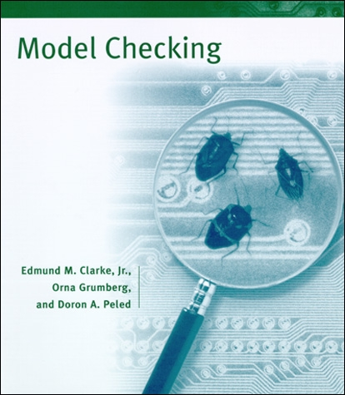

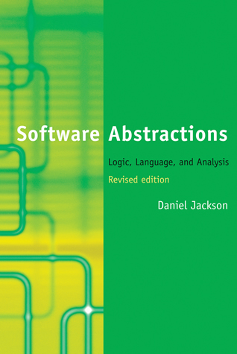
Model Checking (MC)
Method for checking properties in system designs
Extremely popular in hardware verification!
Intuition
Model are encoded as Labeled Transition System (LTS)
Describe properties in some specification language (e.g., LTL, CTL)
Verify properties in LTS
Vast literature!
5

Slide 6
Program Model Checking
Big gap between design and implementation
Correct design does not imply correct implementation
Systematic refinement of models is rare

Slide 7
Program Model Checking
Big gap between design and implementation
Correct design does not imply correct implementation
Systematic refinement of models is rare
This tutorial is about Program Model Checking as opposed to Model Checking of Designs

Slide 8
Design Choices
Programming Language
Can make a huge difference in complexity. Think of pointers, dynamic binding, reflection, native methods, libraries, etc.
State Representation: Explicit or Symbolic
Tradeoff between time and space
Concurrency
Big source of problems. E.g., data races and deadlocks

Slide 9
This Tutorial
 | Language | State Representation | Concurrency
JPF [1] | Java | Explicit | 
SPF [2] | Java | Symbolic | 
CBMC [3] | C ou Java | Symbolic | 
[1] Java Pathfinder website. https://babelfish.arc.nasa.gov/trac/jpf/
[2] Symbolic Pathfinder. https://babelfish.arc.nasa.gov/trac/jpf/wiki/projects/jpf-symbc
[3] CBMC website. https://github.com/diffblue/cbmc/

Slide 10
Java Pathfinder (JPF)

Slide 11
Symbolic Pathfinder (SPF)

Slide 12
CBMC

Slide 13
Bounded Model Checking
…
Similar to SE, inputs are symbolic
But paths are not explored one-at-a-time

Slide 14
Bounded Model Checking of C [1]
x₁ = x₀ + 1
if (x₁ != 1) {
x₂ = 2;
if (z₀) x₃ = x₂ + 1;
x4 = phi(x_{3,} x₂)
}
x5 = phi(x_{4,} x₁)
assert (x₅ <= 3);
x₁ = x₀ + 1
if (x₁ != 1) {
x₂ = 2;
if (z₀) x₃ = x₂ + 1;
x4 = phi(x_{3,} x₂)
}
x5 = phi(x_{4,} x₁)
assert (x₅ <= 3);
x = x + 1
if (x != 1) {
x = 2;
if (z) x++;
}
assert (x <= 3);
goto program
SSA
[1] Clarke et al, DAC’03, Behavioral consistency of C and verilog programs using bounded model checking

Slide 15
Bounded Model Checking of C [1]

C :=
x₁ = x₀ + 1 &
x₂ = 2 &
x₃ = x₂ + 1 &
x₄ = ite(z₀,x₃,x₂) &
x₅ = ite((x₁!=1),x₄,x₁)
P := x₅ <= 3;
C & !P
SAT solver
Bit-Blasting

Logical
Formula

SMT solver

[1] Clarke et al, DAC’03, Behavioral consistency of C and verilog programs using bounded model checking

Slide 16
Bounded Model Checking of C [1]

Challenges
Scalability: Formula can grow big!
Precision: Pointers, reflection, etc.
SAT solver
Bit-Blasting


SMT solver

[1] Clarke et al, DAC’03, Behavioral consistency of C and verilog programs using bounded model checking

Slide 17
Tutorial Website:
https://github.com/davinomjr/model-checking-tutorial

