Slide 1
Program Model Checking
Tutorial
Davino Junior Luis Melo Marcelo d'Amorim
Universidade Federal de Pernambuco (UFPE)
SBMF Tutorial, November 21, 2017, Recife-PE, Brazil

Slide 2
Website
http://davinomjr.github.io/model-checking-tutorial/

Slide 3
Model Checking (MC)
Method for checking properties in system designs
Extremely popular in hardware verification!
Intuition
Model are encoded as Labeled Transition System (LTS)
Describe properties in some specification language (e.g., LTL, CTL)
Verify properties in LTS

Slide 4
Model Checking (MC)
Method for checking properties in system designs
Extremely popular in hardware verification!
Intuition
Model are encoded as Labeled Transition System (LTS)
Describe properties in some specification language (e.g., LTL, CTL)
Verify properties in LTS
4

Slide 5
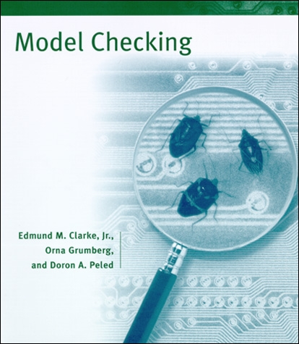
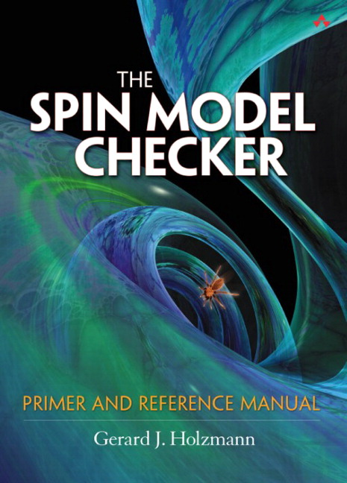
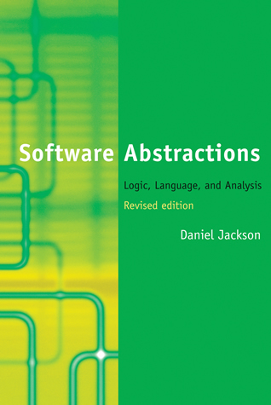
Model Checking (MC)
Method for checking properties in system designs
Extremely popular in hardware verification!
Intuition
Model are encoded as Labeled Transition System (LTS)
Describe properties in some specification language (e.g., LTL, CTL)
Verify properties in LTS
Vast literature!
5

Slide 6
Program Model Checking
Big gap between design and implementation
Correct design does not imply correct implementation
Systematic refinement of models is rare

Slide 7
Program Model Checking
Big gap between design and implementation
Correct design does not imply correct implementation
Systematic refinement of models is rare
This tutorial is about Program Model Checking as opposed to Model Checking of Designs

Slide 8
Design Choices
Programming Language
Can make a huge difference in complexity. Think of pointers, dynamic binding, reflection, native methods, libraries, etc.
State Representation: Explicit or Symbolic
Tradeoff between time and space
Concurrency
Big source of problems. E.g., data races and deadlocks

Slide 9
This Tutorial
 | Language | State Representation | Concurrency
JPF [1] | Java | Explicit | 
SPF [2] | Java | Symbolic | 
CBMC [3] | C ou Java | Symbolic | 
[1] Java Pathfinder website. https://babelfish.arc.nasa.gov/trac/jpf/
[2] Symbolic Pathfinder. https://babelfish.arc.nasa.gov/trac/jpf/wiki/projects/jpf-symbc
[3] CBMC website. https://github.com/diffblue/cbmc/

Slide 10
Java Pathfinder (JPF)

Slide 11
What is JPF?
Virtual Machine for Java with several tweaks;
Theoretically executes a Java program in all possible ways
Checks for concurrency issues (e.g., deadlocks, and race conditions)

Slide 12
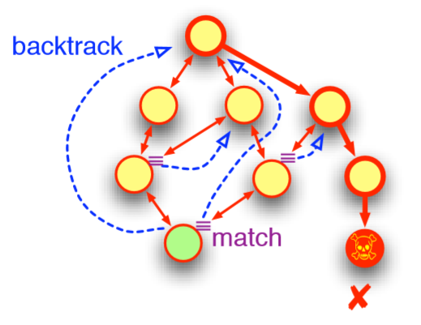
Essential capabilities
Backtracking
JPF can restore previous execution states, to see if there are unexplored choices left.
JPF allows you to create your own ChoiceGenerator.
JPF allows you to explore in a DFS or your own search heuristic.
State matching
JPF checks every new state if it already has been explored, in which case is not explored anymore.

Slide 13
Example Race Condition
public class MyRaceCondition {
private static class Pair {
String x = "x";
String y = "y";
public void update() {
x = x + y + x;
}
}
private static class RC extends Thread {
Pair p;
public void run() {
p.update();
}
}
public static void main(String[] args) {
Pair p = new Pair();
RC rc1 = new RC();
RC rc2 = new RC();
rc1.p = p;
rc2.p = p;
rc1.start();
rc2.start();
rc1.join();
rc2.join();
System.out.println("x: " + p.x);
}
}

Slide 14
Example Race Condition
====================================================== search started:
x: xyxyxyx
x: xyxyxyx
====================================================== error 1
gov.nasa.jpf.listener.PreciseRaceDetector
race for field Racer$Pair@15e.x
Thread-1 at Racer$Pair.update(Racer.java:7)
"x = x + y + x;" WRITE: putfield Racer$Pair.x
Thread-2 at Racer$Pair.update(Racer.java:7)
"x = x + y + x;" READ: getfield Racer$Pair.x

Slide 15
Example Deadlock
private static class RC2 extends Thread {
Pair p;
public void run() {
synchronized(p.y) {
synchronized(p.x) {
p.update(); }}}
}
public static void main(String[] args) {
Pair p = new Pair();
Thread rc1 = new RC1();
Thread rc2 = new RC2();
rc1.p = p;
rc2.p = p;
rc1.start();
rc2.start();
rc1.join();
rc2.join();
System.out.println("x: " + p.x);
}
}
public class MyDeadlock {
private static class Pair {
String x = "x";
String y = "y";
public void update() {
x = x + y + x;
}
}
private static class RC1 extends Thread {
Pair p;
public void run() {
synchronized(p.x) {
synchronized(p.y) {
p.update(); }}}
}

Slide 16
Example Deadlock
====================================================== search started
x: xyxyxyx
x: xyxyxyx
====================================================== error 1
gov.nasa.jpf.vm.NotDeadlockedProperty
deadlock encountered:
thread java.lang.Thread:{id:0,name:main,status:WAITING,priority:5,isDaemon:false,lockCount:0,suspendCount:0}
thread Racer$RC1:{id:1,name:Thread-1,status:BLOCKED,priority:5,isDaemon:false,lockCount:0,suspendCount:0}
thread Racer$RC2:{id:2,name:Thread-2,status:BLOCKED,priority:5,isDaemon:false,lockCount:0,suspendCount:0}

Slide 17
There is no free lunch!
Scalability Issues
Your program will run on top a tweaked JVM on top of the JVM.
Only works on closed systems
JPF cannot I/O and GUI.
You will possibly encounter unimplemented/missing parts
State-relevant native libraries (e.g., java.io and java.net)

Slide 18
Demo
Software Requirements:
Docker >= 17.09-CE
Running:
docker run -it –rm lhsm/jpf-examples

Slide 19
Symbolic Pathfinder (SPF)

Slide 20
Motivation
Automatic Input Generation
Manually generate inputs for testing all paths of a program can be unfeasible

Slide 21
Motivation
Automatic Input Generation
Manually generate inputs for testing all paths of a program can be unfeasible
public void foo(int x){
int z;
if(x >= 10) {
int y = x – 10;
z = x / y;
}
else {
...
}
}

Slide 22
Motivation
Automatic Input Generation
Manually generate inputs for testing all paths of a program can be unfeasible
@Test
public void test1(){
...
foo (1);
...
}
public void foo(int x){
int z;
if(x >= 10) {
int y = x – 10;
z = x / y;
}
else {
...
}
}

Slide 23
Motivation
Automatic Input Generation
Manually generate inputs for testing all paths of a program can be unfeasible
@Test
public void test1(){
...
foo (1);
...
}
public void foo(int x){
int z;
if(x >= 10) {
int y = x – 10;
z = x / y;
}
else {
...
}
}
public void foo(int x){
if(x > 10) {
...
}
else {
...
}
}
@Test
public void test2(){
...
foo (15);
...
}

Slide 24
Motivation
Triggers ArithmeticException (DivisionByZero)
Automatic Input Generation
Manually generate inputs for testing all paths of a program can be unfeasible
@Test
public void test3(){
...
foo (10);
...
}
@Test
public void test1(){
...
foo (1);
...
}
public void foo(int x){
int z;
if(x >= 10) {
int y = x – 10;
z = x / y;
}
else {
...
}
}
@Test
public void test2(){
...
foo (15);
...
}

Slide 25
SPF: Symbolic Execution
Symbolic Execution [1]
Execute the program on symbolic inputs
Symbolic values represent sets of concrete values
Build symbolic tree which encodes many execution paths
For each possible execution path
Build a path condition (PC)
Check condition satisfability with solvers
Model checker backtracks if path becomes infeasible
Uses SMT solvers to get test inputs
[1] King, J.C.: Symbolic execution and program testing. Commun. ACM 19, 385–394 (1976).

Slide 26
Example
Program Counter
x = $A, y = $B
PC: TRUE
1
int x, y
1 if(x > y){
x = x + y;
y = x – y;
x = x – y;
if(x > y){
assert false;
}
print(x, y);

Slide 27
Example
x = $A, y = $B
PC: TRUE
1
int x, y
1 if(x > y){
x = x + y;
y = x – y;
x = x – y;
if(x > y){
assert false;
}
print(x, y);
x = $A, y = $B
PC: $A > $B
2
?
SAT? 

Slide 28
Example
x = $A, y = $B
PC: TRUE
1
int x, y
1 if(x > y){
x = x + y;
y = x – y;
x = x – y;
if(x > y){
assert false;
}
print(x, y);
x = $A, y = $B
PC: $A > $B
2
?
SAT? 
x = $A + $B, y = $B
PC: $A > $B
3
SAT? 

Slide 29
Example
x = $A, y = $B
PC: TRUE
1
int x, y
1 if(x > y){
x = x + y;
y = x – y;
x = x – y;
if(x > y){
assert false;
}
print(x, y);
x = $A, y = $B
PC: $A > $B
2
?
SAT? 
x = $A + $B, y = $B
PC: $A > $B
3
SAT? 
x = $A + $B, y = $A
PC: $A > $B
4
SAT? 

Slide 30
Example
x = $A, y = $B
PC: TRUE
1
int x, y
1 if(x > y){
x = x + y;
y = x – y;
x = x – y;
if(x > y){
assert false;
}
print(x, y);
x = $A, y = $B
PC: $A > $B
2
?
SAT? 
x = $A + $B, y = $B
PC: $A > $B
3
SAT? 
x = $A + $B, y = $A
PC: $A > $B
4
SAT? 
x = $B, y = $A
PC: $A > $B
5
SAT? 

Slide 31
Example
x = $A, y = $B
PC: TRUE
1
int x, y
1 if(x > y){
x = x + y;
y = x – y;
x = x – y;
if(x > y){
assert false;
}
print(x, y);
x = $A, y = $B
PC: $A > $B
2
?
SAT? 
x = $A + $B, y = $B
PC: $A > $B
3
SAT? 
x = $A + $B, y = $A
PC: $A > $B
4
SAT? 
x = $B, y = $A
PC: $A > $B
5
SAT? 
SAT? 
x = $B, y = $A
PC: $A > $B & $B-$A > 0
?
6

Slide 32
Example
x = $A, y = $B
PC: TRUE
1
int x, y
1 if(x > y){
x = x + y;
y = x – y;
x = x – y;
if(x > y){
assert false;
}
print(x, y);
x = $A, y = $B
PC: $A > $B
2
?
SAT? 
x = $A + $B, y = $B
PC: $A > $B
3
SAT? 
x = $A + $B, y = $A
PC: $A > $B
4
SAT? 
x = $B, y = $A
PC: $A > $B
5
SAT? 
SAT? 
x = $B, y = $A
PC: $A > $B & $B-$A > 0
?
6

Slide 33
Example
x = $A, y = $B
PC: TRUE
1
int x, y
1 if(x > y){
x = x + y;
y = x – y;
x = x – y;
if(x > y){
assert false;
}
print(x, y);
x = $A, y = $B
PC: $A > $B
2
?
SAT? 
x = $A + $B, y = $B
PC: $A > $B
3
SAT? 
x = $A + $B, y = $A
PC: $A > $B
4
SAT? 
x = $B, y = $A
PC: $A > $B
5
SAT? 
SAT? 
SAT? 
x = $B, y = $A
PC: $A > $B & $B-$A > 0
x = $B, y = $A
PC: $A > $B & $B-$A <= 0
6
8

Slide 34
Example
x = $A, y = $B
PC: TRUE
1
int x, y
1 if(x > y){
x = x + y;
y = x – y;
x = x – y;
if(x > y){
assert false;
}
print(x, y);
x = $A, y = $B
PC: $A > $B
2
?
SAT? 
x = $A + $B, y = $B
PC: $A > $B
3
SAT? 
x = $A + $B, y = $A
PC: $A > $B
4
SAT? 
x = $B, y = $A
PC: $A > $B
5
SAT? 
SAT? 
SAT? 
x = $B, y = $A
PC: $A > $B & $B-$A > 0
x = $B, y = $A
PC: $A > $B & $B-$A <= 0
6
8

Slide 35
Example
x = $A, y = $B
PC: TRUE
1
int x, y
1 if(x > y){
x = x + y;
y = x – y;
x = x – y;
if(x > y){
assert false;
}
print(x, y);
x = $A, y = $B
PC: $A > $B
2
?
SAT? 
x = $A + $B, y = $B
PC: $A > $B
3
SAT? 
x = $A + $B, y = $A
PC: $A > $B
4
SAT? 
x = $B, y = $A
PC: $A > $B
5
SAT? 
SAT? 
SAT? 
x = $B, y = $A
PC: $A > $B & $B-$A > 0
x = $B, y = $A
PC: $A > $B & $B-$A <= 0
6
8

Slide 36
Example
x = $A, y = $B
PC: TRUE
1
int x, y
1 if(x > y){
x = x + y;
y = x – y;
x = x – y;
if(x > y){
assert false;
}
print(x, y);
x = $A, y = $B
PC: $A > $B
2
?
SAT? 
x = $A + $B, y = $B
PC: $A > $B
3
SAT? 
x = $A + $B, y = $A
PC: $A > $B
4
SAT? 
x = $B, y = $A
PC: $A > $B
5
SAT? 
SAT? 
SAT? 
x = $B, y = $A
PC: $A > $B & $B-$A > 0
x = $B, y = $A
PC: $A > $B & $B-$A <= 0
6
8

Slide 37
Example
x = $A, y = $B
PC: TRUE
1
int x, y
1 if(x > y){
x = x + y;
y = x – y;
x = x – y;
if(x > y){
assert false;
}
print(x, y);
x = $A, y = $B
PC: $A > $B
2
?
SAT? 
x = $A + $B, y = $B
PC: $A > $B
3
SAT? 
x = $A + $B, y = $A
PC: $A > $B
4
SAT? 
x = $B, y = $A
PC: $A > $B
5
SAT? 
SAT? 
SAT? 
x = $B, y = $A
PC: $A > $B & $B-$A > 0
x = $B, y = $A
PC: $A > $B & $B-$A <= 0
6
8

Slide 38
Example
x = $A, y = $B
PC: TRUE
1
int x, y
1 if(x > y){
x = x + y;
y = x – y;
x = x – y;
if(x > y){
assert false;
}
print(x, y);
x = $A, y = $B
PC: $A > $B
2
?
SAT? 
x = $A + $B, y = $B
PC: $A > $B
3
SAT? 
x = $A + $B, y = $A
PC: $A > $B
4
SAT? 
x = $B, y = $A
PC: $A > $B
5
SAT? 
SAT? 
SAT? 
x = $B, y = $A
PC: $A > $B & $B-$A > 0
x = $B, y = $A
PC: $A > $B & $B-$A <= 0
6
8

Slide 39
Example
x = $A, y = $B
PC: TRUE
1
int x, y
1 if(x > y){
x = x + y;
y = x – y;
x = x – y;
if(x > y){
assert false;
}
print(x, y);
x = $A, y = $B
PC: $A > $B
x = $A, y = $B
PC: $A <= $B
8
2
SAT? 
SAT? 
x = $A + $B, y = $B
PC: $A > $B
3
SAT? 
x = $A + $B, y = $A
PC: $A > $B
4
SAT? 
x = $B, y = $A
PC: $A > $B
5
SAT? 
SAT? 
SAT? 
x = $B, y = $A
PC: $A > $B & $B-$A > 0
x = $B, y = $A
PC: $A > $B & $B-$A <= 0
6
8

Slide 40
Example
x = $A, y = $B
PC: TRUE
1
int x, y
1 if(x > y){
x = x + y;
y = x – y;
x = x – y;
if(x > y){
assert false;
}
print(x, y);
x = $A, y = $B
PC: $A > $B
x = $A, y = $B
PC: $A <= $B
8
2
x = $A + $B, y = $B
PC: $A > $B
Final SMT Solver Results
3
Path | PC | Program Input
1, 8 | $A <= $B | $A = 1, $B = 1
1,2,3,4,5,8 | PC: $A > $B & $B-$A <= 0 | $A = 2, $B = 1
1,2,3,4,5,6 | $A > $B & $B-$A > 0 | -
x = $A + $B, y = $A
PC: $A > $B
4
x = $B, y = $A
PC: $A > $B
5
T
F
x = $B, y = $A
PC: $A > $B & $B-$A > 0
x = $B, y = $A
PC: $A > $B & $B-$A <= 0
6
8

Slide 41
Symbolic Pathfinder (SPF)
Performs symbolic execution of Java bytecodes
Built as a JPF module
Search engine used to explore symbolic execution tree
Multiple decision procedures/contraint solvers
Used to check path conditions
Test suites with high coverage
Generates JUnit tests

Slide 42
SPF: Implementation
JPF infrastructure used
Replaces/extend standard concrete with symbolic execution
Attributes associated with program state
Fields, stack operands, variables stored as symbolic information
Allows mixed concrete and symbolic execution
Can change from concrete to symbolic execution on the go
Listeners
Act as monitors for symbolic analysis

Slide 43
SPF
Pros (+)
Cons (-)
Less effort on generating test inputs
Portability (Java)
Availability (Open source)
Path explosion
Scalability
JPF limitations

Slide 44
Demo
Software Requirements:
Docker >= 17.09-CE
Running:
Samples -> docker run -it davinomjr/spf-examples
Modify files -> docker run -it davinomjr/spf-examples bash

Slide 45
CBMC

Slide 46
Bounded Model Checking of C [1]
C :=
x₁ = x₀ + 1 &
x₂ = 2 &
x₃ = x₂ + 1 &
x₄ = ite(z₀,x₃,x₂) &
x₅ = ite((x₁!=1),x₄,x₁)
P := x₃ <= 3;
C & !P
x₁ = x₀ + 1
if (x₁ != 1) {
x₂ = 2;
if (z₀) x₃ = x₂ + 1;
x4 = phi(x_{3,} x₂)
}
x5 = phi(x_{4,} x₁)
assert (x₅ <= 3);
x = x + 1
if (x != 1) {
x = 2;
if (z) x++;
}
assert (x <= 3);
Logical
Formula
SSA
[1] Clarke et al, DAC’03, Behavioral consistency of C and verilog programs using bounded model checking

Slide 47
Bounded Model Checking of C [1]

SAT solver
Bit-Blasting


SMT solver

[1] Clarke et al, DAC’03, Behavioral consistency of C and verilog programs using bounded model checking

Slide 48
Bounded Model Checking of C [1]

Challenges
Scalability: Formula can grow big!
Precision: Loops, pointers, reflection, etc.
SAT solver
Bit-Blasting


SMT solver

[1] Clarke et al, DAC’03, Behavioral consistency of C and verilog programs using bounded model checking

Slide 49
Tutorial Website:
http://davinomjr.github.io/model-checking-tutorial/

