Slide 1
Program Model Checking
Tutorial
Davino Junior Luis Melo Marcelo d'Amorim
Universidade Federal de Pernambuco (UFPE)
SBMF Tutorial, November 21, 2017, Recife-PE, Brazil

Slide 2
Website
http://model-checking.dmtsj.com.br

Slide 3
Model Checking (MC)
Method for checking properties in system designs
Extremely popular in hardware verification!
Intuition
Model is encoded as Labeled Transition System (LTS)
Property is described in some specification language (e.g., LTL, CTL)
Verification translated to graph algo

Slide 4
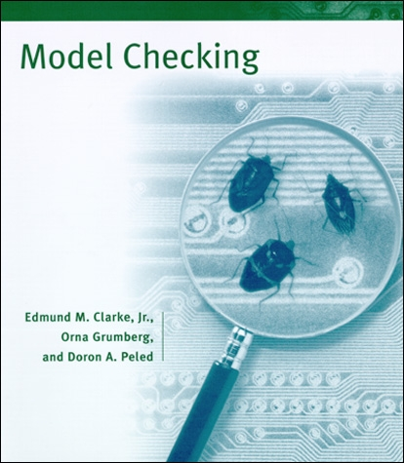
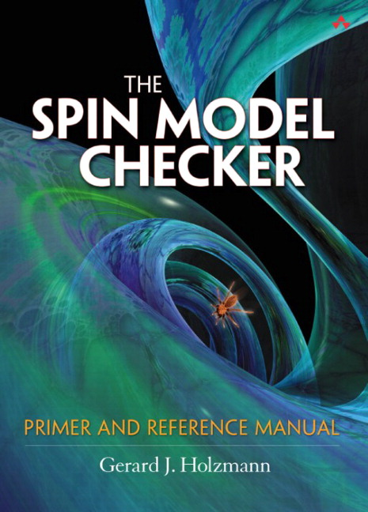
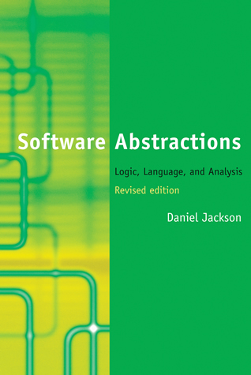
Model Checking (MC)
Method for checking properties in system designs
Extremely popular in hardware verification!
Intuition
Model is encoded as Labeled Transition System (LTS)
Property is described in some specification language (e.g., LTL, CTL)
Verification translated to graph algo
Vast literature!
4

Slide 5
Example
Two symmetric processes with one shared semaphore
Each process (1, 2) has three states:
Non-critical region – N1, N2
Trying to acquire semaphore – T1, T2
Critical region – C1, C2
Semaphore can be available or not – S0 or S1
Initial states: N1 & N2 & S0

Slide 6
Example
Two symmetric processes with one shared semaphore
Each process (1, 2) has three states:
Non-critical region – N1, N2
Trying to acquire semaphore – T1, T2
Critical region – C1, C2
Semaphore can be available or not – S0 or S1
Initial states: N1 & N2 & S0
It should always be possible to eventually get back to the initial state
Model:
Property: AG EF (N1 & N2 & S0)
N1 -> T1
T1 & S0 -> C1 & S1
C1 -> N1 & S0
N2 -> T2
T2 & S0 -> C2 & S1
C2 -> N2 & S0
This property holds for this model. This is verified searching the graph induced by model and property.

Slide 7
Big gap between design and implementation

Slide 8
-> Correct designs do not imply correct implementations
-> Systematic refinement of models is expensive (and rare)
Big gap between design and implementation
This tutorial is about Program Model Checking as opposed to Model Checking of Designs

Slide 9
Design Choices
Path Exploration: Stateful or Stateless
State Representation: Explicit or Symbolic
Handling Concurrency
Often important source of problems. E.g., data races and deadlocks
Programming Language
Can make a huge difference in complexity. Think of pointers, dynamic binding, reflection, native methods, libraries, etc.
Tradeoff between time and space

Slide 10
This Tutorial
 | Language | State Representation | Concurrency
JPF [1] | Java | Explicit | 
SPF [2] | Java | Symbolic | 
CBMC [3] | C ou Java | Symbolic | 
[1] Java Pathfinder website. https://babelfish.arc.nasa.gov/trac/jpf/
[2] Symbolic Pathfinder. https://babelfish.arc.nasa.gov/trac/jpf/wiki/projects/jpf-symbc
[3] CBMC website. https://github.com/diffblue/cbmc/

Slide 11
Java Pathfinder (JPF)

Slide 12
What is JPF?
Virtual Machine for Java with several tweaks;
Theoretically executes a Java program in all possible ways
Checks for concurrency issues (e.g., deadlocks, and race conditions)

Slide 13
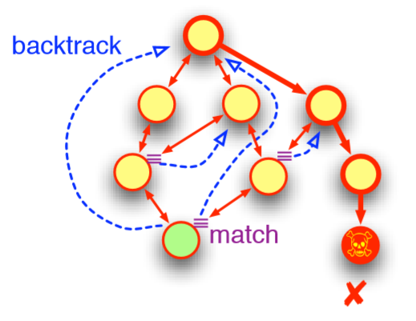
Essential capabilities
Backtracking
JPF can restore previous execution states, to see if there are unexplored choices left.
JPF allows you to create your own ChoiceGenerator.
JPF allows you to explore in a DFS or your own search heuristic.
State matching
JPF checks every new state if it already has been explored, in which case is not explored anymore.

Slide 14
Example Race Condition
public class MyRaceCondition {
private static class Pair {
String x = "x";
String y = "y";
public void update() {
x = x + y + x;
}
}
private static class RC extends Thread {
Pair p;
public void run() {
p.update();
}
}
public static void main(String[] args) {
Pair p = new Pair();
RC rc1 = new RC();
RC rc2 = new RC();
rc1.p = p;
rc2.p = p;
rc1.start();
rc2.start();
rc1.join();
rc2.join();
System.out.println("x: " + p.x);
}
}

Slide 15
Example Race Condition
====================================================== search started:
x: xyxyxyx
x: xyxyxyx
====================================================== error 1
gov.nasa.jpf.listener.PreciseRaceDetector
race for field Racer$Pair@15e.x
Thread-1 at Racer$Pair.update(Racer.java:7)
"x = x + y + x;" WRITE: putfield Racer$Pair.x
Thread-2 at Racer$Pair.update(Racer.java:7)
"x = x + y + x;" READ: getfield Racer$Pair.x

Slide 16
Example Deadlock
private static class RC2 extends Thread {
Pair p;
public void run() {
synchronized(p.y) {
synchronized(p.x) {
p.update(); }}}
}
public static void main(String[] args) {
Pair p = new Pair();
Thread rc1 = new RC1();
Thread rc2 = new RC2();
rc1.p = p;
rc2.p = p;
rc1.start();
rc2.start();
rc1.join();
rc2.join();
System.out.println("x: " + p.x);
}
}
public class MyDeadlock {
private static class Pair {
String x = "x";
String y = "y";
public void update() {
x = x + y + x;
}
}
private static class RC1 extends Thread {
Pair p;
public void run() {
synchronized(p.x) {
synchronized(p.y) {
p.update(); }}}
}

Slide 17
Example Deadlock
====================================================== search started
x: xyxyxyx
x: xyxyxyx
====================================================== error 1
gov.nasa.jpf.vm.NotDeadlockedProperty
deadlock encountered:
thread java.lang.Thread:{id:0,name:main,status:WAITING,priority:5,isDaemon:false,lockCount:0,suspendCount:0}
thread Racer$RC1:{id:1,name:Thread-1,status:BLOCKED,priority:5,isDaemon:false,lockCount:0,suspendCount:0}
thread Racer$RC2:{id:2,name:Thread-2,status:BLOCKED,priority:5,isDaemon:false,lockCount:0,suspendCount:0}

Slide 18
There is no free lunch!
Your program won’t just work
You probably still need to make some modeling
Scalability Issues
Your program will run on top a tweaked JVM on top of the JVM.
Only works on closed systems
JPF cannot I/O and GUI.
You will possibly encounter unimplemented/missing parts
State-relevant native libraries (e.g., java.io and java.net)

Slide 19
Demo
Software Requirements:
Docker >= 17.09-CE
Running:
docker run -it –rm lhsm/jpf-examples

Slide 20
Symbolic Pathfinder (SPF)

Slide 21
Motivation
Automatic Input Generation
Manually generate inputs for testing all paths of a program can be unfeasible

Slide 22
Motivation
Automatic Input Generation
Manually generate inputs for testing all paths of a program can be unfeasible
public void foo(int x){
int z;
if(x >= 10) {
int y = x – 10;
z = x / y;
}
else {
...
}
}

Slide 23
Motivation
Automatic Input Generation
Manually generate inputs for testing all paths of a program can be unfeasible
@Test
public void test1(){
...
foo (1);
...
}
public void foo(int x){
int z;
if(x >= 10) {
int y = x – 10;
z = x / y;
}
else {
...
}
}

Slide 24
Motivation
Automatic Input Generation
Manually generate inputs for testing all paths of a program can be unfeasible
@Test
public void test1(){
...
foo (1);
...
}
public void foo(int x){
int z;
if(x >= 10) {
int y = x – 10;
z = x / y;
}
else {
...
}
}
public void foo(int x){
if(x > 10) {
...
}
else {
...
}
}
@Test
public void test2(){
...
foo (15);
...
}

Slide 25
Motivation
Triggers ArithmeticException (DivisionByZero)
Automatic Input Generation
Manually generate inputs for testing all paths of a program can be unfeasible
@Test
public void test3(){
...
foo (10);
...
}
@Test
public void test1(){
...
foo (1);
...
}
public void foo(int x){
int z;
if(x >= 10) {
int y = x – 10;
z = x / y;
}
else {
...
}
}
@Test
public void test2(){
...
foo (15);
...
}

Slide 26
SPF: Symbolic Execution
Symbolic Execution [1]
Execute the program on symbolic inputs
Symbolic values represent sets of concrete values
Build symbolic tree which encodes many execution paths
For each possible execution path
Build a path condition (PC)
Check condition satisfability with solvers
Model checker backtracks if path becomes infeasible
Uses SMT solvers to get test inputs
[1] King, J.C.: Symbolic execution and program testing. Commun. ACM 19, 385–394 (1976).

Slide 27
Example
Program Counter
x = $A, y = $B
PC: TRUE
1
int x, y
1 if(x > y){
x = x + y;
y = x – y;
x = x – y;
if(x > y){
assert false;
}
print(x, y);

Slide 28
Example
x = $A, y = $B
PC: TRUE
1
int x, y
1 if(x > y){
x = x + y;
y = x – y;
x = x – y;
if(x > y){
assert false;
}
print(x, y);
x = $A, y = $B
PC: $A > $B
2
?
SAT? 

Slide 29
Example
x = $A, y = $B
PC: TRUE
1
int x, y
1 if(x > y){
x = x + y;
y = x – y;
x = x – y;
if(x > y){
assert false;
}
print(x, y);
x = $A, y = $B
PC: $A > $B
2
?
SAT? 
x = $A + $B, y = $B
PC: $A > $B
3
SAT? 

Slide 30
Example
x = $A, y = $B
PC: TRUE
1
int x, y
1 if(x > y){
x = x + y;
y = x – y;
x = x – y;
if(x > y){
assert false;
}
print(x, y);
x = $A, y = $B
PC: $A > $B
2
?
SAT? 
x = $A + $B, y = $B
PC: $A > $B
3
SAT? 
x = $A + $B, y = $A
PC: $A > $B
4
SAT? 

Slide 31
Example
x = $A, y = $B
PC: TRUE
1
int x, y
1 if(x > y){
x = x + y;
y = x – y;
x = x – y;
if(x > y){
assert false;
}
print(x, y);
x = $A, y = $B
PC: $A > $B
2
?
SAT? 
x = $A + $B, y = $B
PC: $A > $B
3
SAT? 
x = $A + $B, y = $A
PC: $A > $B
4
SAT? 
x = $B, y = $A
PC: $A > $B
5
SAT? 

Slide 32
Example
x = $A, y = $B
PC: TRUE
1
int x, y
1 if(x > y){
x = x + y;
y = x – y;
x = x – y;
if(x > y){
assert false;
}
print(x, y);
x = $A, y = $B
PC: $A > $B
2
?
SAT? 
x = $A + $B, y = $B
PC: $A > $B
3
SAT? 
x = $A + $B, y = $A
PC: $A > $B
4
SAT? 
x = $B, y = $A
PC: $A > $B
5
SAT? 
SAT? 
x = $B, y = $A
PC: $A > $B & $B > $A
?
6

Slide 33
Example
x = $A, y = $B
PC: TRUE
1
int x, y
1 if(x > y){
x = x + y;
y = x – y;
x = x – y;
if(x > y){
assert false;
}
print(x, y);
x = $A, y = $B
PC: $A > $B
2
?
SAT? 
x = $A + $B, y = $B
PC: $A > $B
3
SAT? 
x = $A + $B, y = $A
PC: $A > $B
4
SAT? 
x = $B, y = $A
PC: $A > $B
5
SAT? 
SAT? 
x = $B, y = $A
PC: $A > $B & $B > $A
?
6

Slide 34
Example
x = $A, y = $B
PC: TRUE
1
int x, y
1 if(x > y){
x = x + y;
y = x – y;
x = x – y;
if(x > y){
assert false;
}
print(x, y);
x = $A, y = $B
PC: $A > $B
2
?
SAT? 
x = $A + $B, y = $B
PC: $A > $B
3
SAT? 
x = $A + $B, y = $A
PC: $A > $B
4
SAT? 
x = $B, y = $A
PC: $A > $B
5
SAT? 
SAT? 
SAT? 
x = $B, y = $A
PC: $A > $B & $B > $A
x = $B, y = $A
PC: $A > $B & $B <= $A
6
8

Slide 35
Example
x = $A, y = $B
PC: TRUE
1
int x, y
1 if(x > y){
x = x + y;
y = x – y;
x = x – y;
if(x > y){
assert false;
}
print(x, y);
x = $A, y = $B
PC: $A > $B
2
?
SAT? 
x = $A + $B, y = $B
PC: $A > $B
3
SAT? 
x = $A + $B, y = $A
PC: $A > $B
4
SAT? 
x = $B, y = $A
PC: $A > $B
5
SAT? 
SAT? 
SAT? 
x = $B, y = $A
PC: $A > $B & $B > $A
x = $B, y = $A
PC: $A > $B & $B <= $A
6
8

Slide 36
Example
x = $A, y = $B
PC: TRUE
1
int x, y
1 if(x > y){
x = x + y;
y = x – y;
x = x – y;
if(x > y){
assert false;
}
print(x, y);
x = $A, y = $B
PC: $A > $B
2
?
SAT? 
x = $A + $B, y = $B
PC: $A > $B
3
SAT? 
x = $A + $B, y = $A
PC: $A > $B
4
SAT? 
x = $B, y = $A
PC: $A > $B
5
SAT? 
SAT? 
SAT? 
x = $B, y = $A
PC: $A > $B & $B > $A
x = $B, y = $A
PC: $A > $B & $B <= $A
6
8

Slide 37
Example
x = $A, y = $B
PC: TRUE
1
int x, y
1 if(x > y){
x = x + y;
y = x – y;
x = x – y;
if(x > y){
assert false;
}
print(x, y);
x = $A, y = $B
PC: $A > $B
2
?
SAT? 
x = $A + $B, y = $B
PC: $A > $B
3
SAT? 
x = $A + $B, y = $A
PC: $A > $B
4
SAT? 
x = $B, y = $A
PC: $A > $B
5
SAT? 
SAT? 
SAT? 
x = $B, y = $A
PC: $A > $B & $B > $A
x = $B, y = $A
PC: $A > $B & $B <= $A
6
8

Slide 38
Example
x = $A, y = $B
PC: TRUE
1
int x, y
1 if(x > y){
x = x + y;
y = x – y;
x = x – y;
if(x > y){
assert false;
}
print(x, y);
x = $A, y = $B
PC: $A > $B
2
?
SAT? 
x = $A + $B, y = $B
PC: $A > $B
3
SAT? 
x = $A + $B, y = $A
PC: $A > $B
4
SAT? 
x = $B, y = $A
PC: $A > $B
5
SAT? 
SAT? 
SAT? 
x = $B, y = $A
PC: $A > $B & $B > $A
x = $B, y = $A
PC: $A > $B & $B <= $A
6
8

Slide 39
Example
x = $A, y = $B
PC: TRUE
1
int x, y
1 if(x > y){
x = x + y;
y = x – y;
x = x – y;
if(x > y){
assert false;
}
print(x, y);
x = $A, y = $B
PC: $A > $B
2
?
SAT? 
x = $A + $B, y = $B
PC: $A > $B
3
SAT? 
x = $A + $B, y = $A
PC: $A > $B
4
SAT? 
x = $B, y = $A
PC: $A > $B
5
SAT? 
SAT? 
SAT? 
x = $B, y = $A
PC: $A > $B & $B > $A
x = $B, y = $A
PC: $A > $B & $B <= $A
6
8

Slide 40
Example
x = $A, y = $B
PC: TRUE
1
int x, y
1 if(x > y){
x = x + y;
y = x – y;
x = x – y;
if(x > y){
assert false;
}
print(x, y);
x = $A, y = $B
PC: $A > $B
x = $A, y = $B
PC: $A <= $B
8
2
SAT? 
SAT? 
x = $A + $B, y = $B
PC: $A > $B
3
SAT? 
x = $A + $B, y = $A
PC: $A > $B
4
SAT? 
x = $B, y = $A
PC: $A > $B
5
SAT? 
SAT? 
SAT? 
x = $B, y = $A
PC: $A > $B & $B > $A
x = $B, y = $A
PC: $A > $B & $B <= $A
6
8

Slide 41
Example
x = $A, y = $B
PC: TRUE
1
int x, y
1 if(x > y){
x = x + y;
y = x – y;
x = x – y;
if(x > y){
assert false;
}
print(x, y);
x = $A, y = $B
PC: $A > $B
x = $A, y = $B
PC: $A <= $B
8
2
x = $A + $B, y = $B
PC: $A > $B
Final SMT Solver Results
3
Path | PC | Program Input
1, 8 | $A <= $B | $A = 1, $B = 1
1,2,3,4,5,8 | PC: $A > $B & $B <= $A | $A = 2, $B = 1
1,2,3,4,5,6 | $A > $B & $B > $A | -
x = $A + $B, y = $A
PC: $A > $B
4
x = $B, y = $A
PC: $A > $B
5
x = $B, y = $A
PC: $A > $B & $B > $A
x = $B, y = $A
PC: $A > $B & $B <= $A
6
8

Slide 42
Symbolic Pathfinder (SPF)
Performs symbolic execution of Java bytecodes
Built as a JPF module
Search engine used to explore symbolic execution tree
Multiple decision procedures/contraint solvers
Used to check path conditions
Test suites with high coverage
Generates JUnit tests

Slide 43
SPF: Implementation
JPF infrastructure used
Replaces/extend standard concrete with symbolic execution
Attributes associated with program state
Fields, stack operands, variables stored as symbolic information
Allows mixed concrete and symbolic execution
Can change from concrete to symbolic execution on-the-fly
Listeners
Act as monitors for symbolic analysis

Slide 44
SPF
Pros (+)
Cons (-)
Less effort on generating test inputs
Portability (Java)
Availability (Open source)
Path explosion
Scalability
JPF limitations

Slide 45
Demo
Software Requirements:
Docker >= 17.09-CE
Running:
Samples -> docker run -it davinomjr/spf-examples
Modify files -> docker run -it davinomjr/spf-examples bash
http://model-checking.dmtsj.com.br

Slide 46
CBMC

Slide 47
Bounded Model Checking
Translates program into formula (in some decidable theory) and uses a (SAT, SMT) solver to find counter-examples
Compared to Symbolic Execution (SE):
Both BMC and SE: use symbolic inputs and use solvers to find bugs
BMC explores several paths simultaneously; SE explores paths one-at-a-time
Tradeoff between time and space

Slide 48
Bounded Model Checking of C [1]
x = x + 1
if (x != 1) {
x = 2;
if (z) x++;
}
assert (x <= 3);
x₁ = x₀ + 1
if (x₁ != 1) {
x₂ = 2;
if (z₀) x₃ = x₂ + 1;
x4 = phi(x_{3,} x₂)
}
x5 = phi(x_{4,} x₁)
assert (x₅ <= 3);
x = x + 1
if (x != 1) {
x = 2;
if (z) x++;
}
assert (x <= 3);
goto program
SSA
[1] Clarke et al, DAC’03, Behavioral consistency of C and verilog programs using bounded model checking

Slide 49
Bounded Model Checking of C [1]

counterexample
C :=
x₁ = x₀ + 1 &
x₂ = 2 &
x₃ = x₂ + 1 &
x₄ = ite(z₀,x₃,x₂) &
x₅ = ite((x₁!=1),x₄,x₁)
P := x₅ <= 3;
C & !P
SAT solver
Bit-Blasting

Logical
Formula
properties hold up to some bound
SMT solver
[1] Clarke et al, DAC’03, Behavioral consistency of C and verilog programs using bounded model checking

Slide 50
Bounded Model Checking of C [1]

Challenges
Scalability: Formula can grow big!
Precision: Pointers, reflection, etc.
SAT solver
Bit-Blasting


SMT solver

[1] Clarke et al, DAC’03, Behavioral consistency of C and verilog programs using bounded model checking

Slide 51
Tutorial Website:
http://model-checking.dmtsj.com.br

