Slide 1
Program Model Checking
Tutorial
Davino Junior Luis Melo Marcelo d'Amorim
Universidade Federal de Pernambuco (UFPE)
SBMF Tutorial, November 21, 2017, Recife-PE, Brazil

Slide 2
Website
https://github.com/davinomjr/model-checking-tutorial

Slide 3
Model Checking (MC)
Method for checking properties in system designs
Extremely popular in hardware verification!
Intuition
Model your problem as a Labeled Transition System (LTS)
Describe properties in same language (e.g., LTL, CTL)
Verify property on LTS

Slide 4


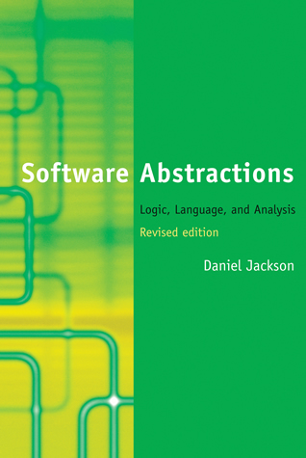
Model Checking (MC)
Method for checking properties in system models
Extremely popular in hardware verification!
Intuition
Model your problem as a Labeled Transition System (LTS)
Describe properties in same language (e.g., LTL, CTL)
Verify property on LTS
Vast literature!

Slide 5
Program Model Checking
Correct design does not imply correct implementation
=> Checking code is important

Slide 6
Program Model Checking
Correct design does not imply correct implementation
=> Checking code is important
This tutorial is about Model Checking code as opposed to designs

Slide 7
Design Choices
Programming Language
Can make a huge difference in complexity. Think of pointers, dynamic binding, reflection, native methods, libraries, etc.
State Representation: Explicit or Symbolic
Tradeoff between time and space
Concurrency
Can be big source of problems such as data races and deadlocks

Slide 8
This Tutorial
 | Language | State Representation | Concurrency
JPF [1] | Java | Explicit | 
SPF [2] | Java | Symbolic | 
CBMC [3] | C ou Java | Symbolic | 
[1] Java Pathfinder website. https://babelfish.arc.nasa.gov/trac/jpf/
[2] Symbolic Pathfinder. https://babelfish.arc.nasa.gov/trac/jpf/wiki/projects/jpf-symbc
[3] CBMC website. https://github.com/diffblue/cbmc/

Slide 9
Java Pathfinder (JPF)

Slide 10
Symbolic Pathfinder (SPF)

Slide 11
CBMC

Slide 12
Bounded Model Checking of C [1]
C :=
x₁ = x₀ + 1 &
x₂ = 2 &
x₃ = x₂ + 1 &
x₄ = ite(z₀,x₃,x₂) &
x₅ = ite((x₁!=1),x₄,x₁)
P := x₃ <= 3;
C & !P
x₁ = x₀ + 1
if (x₁ != 1) {
x₂ = 2;
if (z₀) x₃ = x₂ + 1;
x4 = phi(x_{3,} x₂)
}
x5 = phi(x_{4,} x₁)
assert (x₅ <= 3);
x = x + 1
if (x != 1) {
x = 2;
if (z) x++;
}
assert (x <= 3);
Logical
Formula
SSA
[1] Clarke et al, DAC’03, Behavioral consistency of C and verilog programs using bounded model checking

Slide 13
Bounded Model Checking of C [1]

SAT solver
Bit-Blasting


SMT solver

[1] Clarke et al, DAC’03, Behavioral consistency of C and verilog programs using bounded model checking

Slide 14
Bounded Model Checking of C [1]

Challenges
Scalability: Formula can grow big!
Precision: Loops, pointers, reflection, etc.
SAT solver
Bit-Blasting


SMT solver

[1] Clarke et al, DAC’03, Behavioral consistency of C and verilog programs using bounded model checking

Slide 15
Tutorial Website:
https://github.com/davinomjr/model-checking-tutorial

