Slide 1
PHP
Marcelo d’Amorim

Slide 2
Web application
.php
PHP Interpreter
.php
GET/POST
Server
Browser
File System
HTML+
CSS+
JS

Slide 3
Web application
.php
PHP Interpreter
.php
GET/POST
Server
Browser
File System
HTML+
CSS+
JS
Database
Session

Slide 4
PHP
Acronym for PHP: Hypertext Preprocessor
Language for writing server-side scripts (.php files)
A script runs entirely on the server
The typical use case of a script is to return plain HTML to the browser
Could return JSON, XML, PDF, etc.

Slide 5
Basic Language Elements

Slide 6
Variables
$foo = “bar”;
echo $foo."\n";

Slide 7
Arrays
$array = array("Hello", "World");
echo $array[0]." ".$array[1];

Slide 8
Dictionaries
$name_user = array(
1 => "Bob",
2 => "Alice"
);
echo $name_user[1]."\n";
echo $name_user[2];

Slide 9
Loops with Arrays
$names = array("Bob", "Alice");
$counter = 1;
foreach( $names as $this_name ){
echo $counter.": [ ".$this_name." ]\n";
$counter++;
}

Slide 10
Loops with Dictionaries
$dict = array(
"PHP" => "PHP code tester Sandbox Online",
"foo" => "bar");
foreach( $dict as $key => $value ) {
echo $key."\t : \t".$value."\n";
}

Slide 11
Dynamic Typing
$array = array("1" => "PHP code tester Sandbox Online",
"foo" => "bar",
5 ,
5 => 89009,
"case" => "Random Stuff: " . rand(100,999),
"PHP Version" => phpversion()
);

Slide 12
PHP Online
https://sandbox.onlinephpfunctions.com/

Slide 13
Basic Concepts

Slide 14
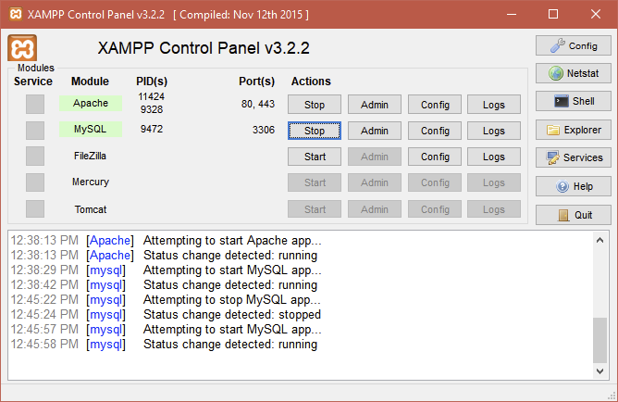
CRUD
Dynamic web apps need a database
Relational databases are the most typical kind of database used in PHP
CRUD = Create + Read + Update + Delete

