Slide 1
Web Frameworks
Marcelo d’Amorim

Slide 2
Problem: Coupling between data, presentation, and business logic
Common problem in web apps, affecting productivity as apps grow
Originally, PHP promoted this coupling
(all three elements within .php files)

Slide 3
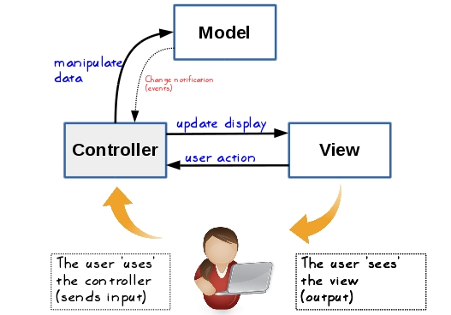
Solution: Model-View Controller (MVC) Architecture
Separation of Concerns

Slide 4
Symfony

Slide 5
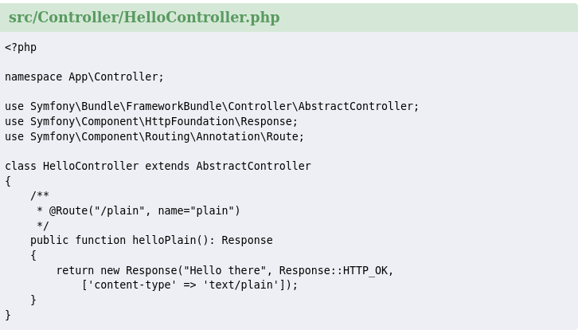
An example controller in Symfony
A route is a map from a URL to a named method/function. Here “/plain” maps to “helloPlain” and the name of this mapping is “plain”
A Response object holds all the information that needs to be sent back to the client from a given request. The constructor takes up to three arguments: the response content, the status code, and an array of HTTP headers. The default status code is Response::HTTP_OK and content type text/html.

