Slide 1
Software and Systems Engineering*
* Slides based on the material published by Paulo Borba (phmb@cin.ufpe.br) under Creative Commons license
Marcelo d’Amorim
Federal University of Pernambuco
www.cin.ufpe.br/~damorim

Slide 2
Overview

Slide 3
Tasks
Defining, maintaining and managing requirements
Managing configurations and changes
Managing software projects
Implementing, maintaining and executing tests
Designing, implementing and maintaining features
Creating or adapting features
Finding and fixing bugs
Refactoring
Finding and fixing reuse and modularity issues

Slide 4
Background
Process and collaboration technologies
git, GitHub, modular development
Software architecture concepts
web architecture, patterns
Programming and testing technologies for SaaS (software as a service)
HTML, Typescript, Angular, Node.js, Cucumber

Slide 5
Thoughtworks core values and practices

Slide 6
Expected Results
Develop quality systems, in a productive way, using techniques and tools
Apply refactoring techniques to increase code reuse and modularity
Critically compare techniques and tools, identifying their advantages, disadvantages, and limitations

Slide 7
Focus on Software as a Service (SaaS), not systems in general

Slide 8
Focus on Agile development, not more rigorous techniques
Notes:
Foco em sistemas exigiria modelagem híbrida, pelo menos para simulação e testes

Slide 9
You will not become a software engineer with this course, but you will find out the way to become one!
Notes:
Traditional engineers are regulated, certified, and subject to apprenticeship and continuing education. Engineering claims an explicit responsibility to public safety and reliability, even if it doesn’t always deliver.https://www.theatlantic.com/amp/article/414271/
First, the pressure to get things right the first time around was relieved, because updates and changes could be applied centrally, as in the mainframe era. Over time, the ease of rapid repair became an excuse for rapid development, and Brooks-style prototyping mutated into the constant software updates we experience today. Facebook has wisely retired its one-time internal-development philosophy, “move fast and break things,” but no business reliant on civil or structural engineering would ever have adopted such a motto in the first place.

Slide 10
Tasks and recommendations

Slide 11
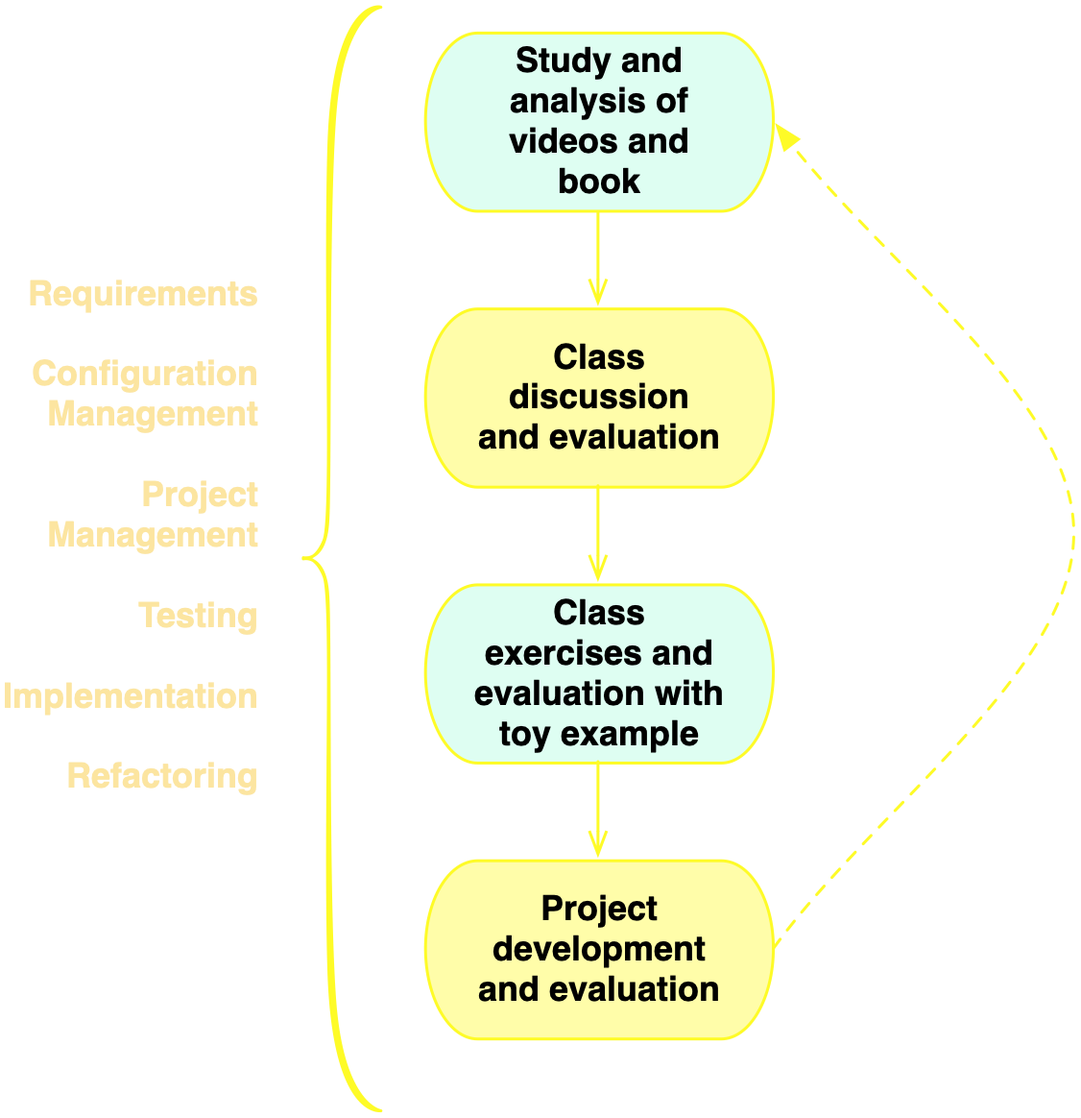
Course structure

Slide 12
Systems
Non trivial system
Frequent access to the stakeholders is mandatory
Developed with the technology used in the example discussed in the course
Existing or new system (and small, in case of new)
Notes:
DEFINIR tecnologia única é importante por questões de instalações de sw no lab, monitores, e, principalmente, para seguir um único roteiro nas monitorias e exemplos em sala.

Slide 13
My expectations
Ethical behavior (fraud implies in failing the course)
Attendance to all classes and evaluation sessions (unless progress is shown before class)
Punctuality
Good time management and minimum dedication of 10-12 hours a week (including classes)
Behave as CS elite

Slide 14
Textbook
Engineering Software as a Service: An Agile Approach Using Cloud Computing
by David Patterson and Armando Fox
http://www.saasbook.info
(Portuguese version is available, but English skills are very important for a software engineer)

Slide 15
You should primarily study by reading the textbook!
Studying by reading the slides and wikipedia is a very bad idea!
Notes:
deixar claro que Muitos assuntos presentes no cap 1 e 7 não foram abordados.

Slide 16
Classes are for discussing the material studied before the class
Do not expect to learn only through classes!
Watch, read and practice!

Slide 17
Manage your time!
Make sure you make the most of this opportunity!

Slide 18
Classroom: l4wnrtf GitHub (slides): damorim/software-engineering-courses
Resources
Notes:
mostrar class code!

Slide 19
Carefully follow the course guidelines!
https://bit.ly/2T9JVNz
Notes:
mostrar class code!

Slide 20
Communication
ess-cc-ufpe.slack.com
#general, #naaula
google classroom
damorim@ (com [ESS] no subject)

Slide 21
Para quem precisa de uma melhor base de leitura e escrita em Inglês, recomendo muito investir agora. Reforço fortemente a importância do domínio do Inglês para a carreira em computação, e a disponibilidade de cursos de Inglês de baixo custo no CAC e no SENAC.

Slide 22
Course evaluation

Slide 23
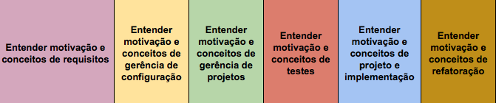
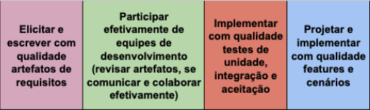
Learning goals

Slide 24
Evaluation items
Project (7)
Class and slack participation (1)
Quizzes (2)
Exercise sets (1 extra points)
includes questions related to the Project (so must be delivered on time)

Slide 25
Project evaluation
requirements (1)
configuration management (1)
project management (1)
tests (2)
design and implementation (3)
refactoring (1)
individual presentation (practical and conceptual questions, auto-evaluation)

Slide 26
Class and slack participation
Asking questions
Discussing topics
Answering questions from other students
Correcting answers from other students

Slide 27
quizzes are answered during classes (check calendar)
no second chance for quizzes
oral final exam

Slide 28
Assignment: Introduce yourself...
Name
What do you expect from this course?
What questions do you have about the course?

Slide 29
Take care of yourself
acolhimento@cin.ufpe.br

