Slide 1









From Data to Discovery Essential Data Science Tools & Techniques
2025 Green Path Summer Camp

Slide 2



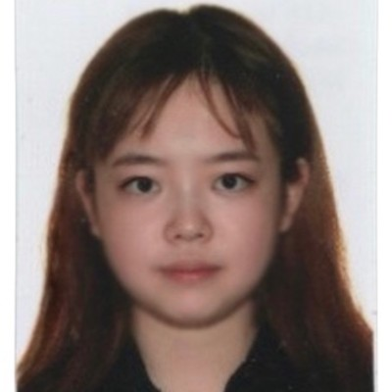
Introductions
Instructor: Prof. Sotirios (Sotos) Damouras
Teaching Probability, Statistics, and Quantitative Finance
Teaching Assistants
Tian Wang YiTong Li Kejing Guo Li Zhang

Slide 3
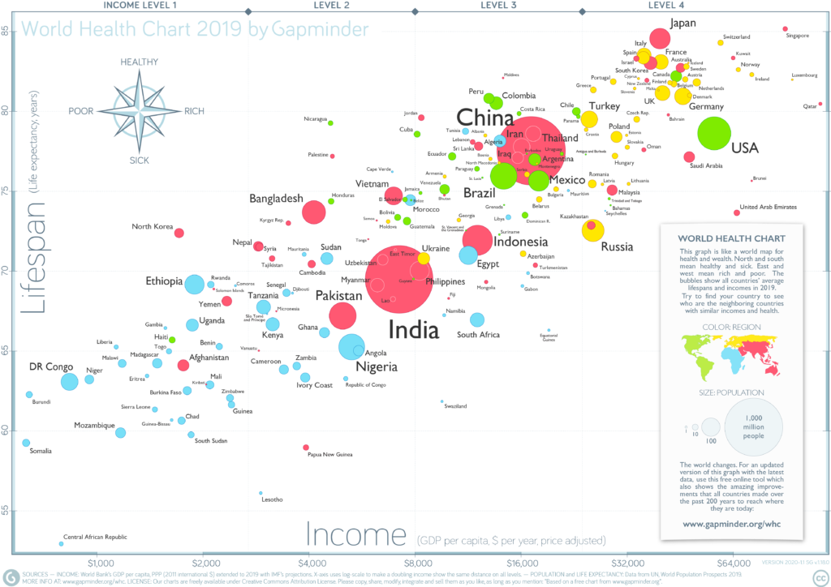
Course Goals
Go from raw data to insightful, publication-grade graphs
Recreate this plot, showing relationship of Health vs Wealth
… & learn cool stuff along the way
https://www.gapminder.org/downloads/updated-gapminder-world-poster-2019/

Slide 4

Gapminder Data
The Gapminder foundation is a non-profit dedicated to promoting a fact-based worldview
Founded by Hans Rosling, famous statistician & public health prof
Meant to upgrade your worldview based on data
Gapminder provides country-level annual data on
GDP/capita (Wealth)
Life Expectancy (Health)
Population
… and many other social/economic/environmental indicators

Slide 5


Sustainable Development Goals (SDGs)
Data related to United Nations’ Sustainable Development Goals

Slide 6
Tools
Work in Python via Jupyter notebooks
Employ two basic frameworks for Data Science:
“Tidy Data” organization for streamlined analysis
“Grammar of Graphics” for describing/constructing plots
These are implemented in Python libraries
Pandas for Data Manipulation
Plotly for Data Visualization

Slide 7
Your Turn!
Log into JupyterHub server & open new notebook
www.utsc.utoronto.ca/webapps/jupyterhub (2/3)
Import pandas (as pd) & plotly.express (as px) libraries
import pandas as pd
import plotly.express as px

Slide 8
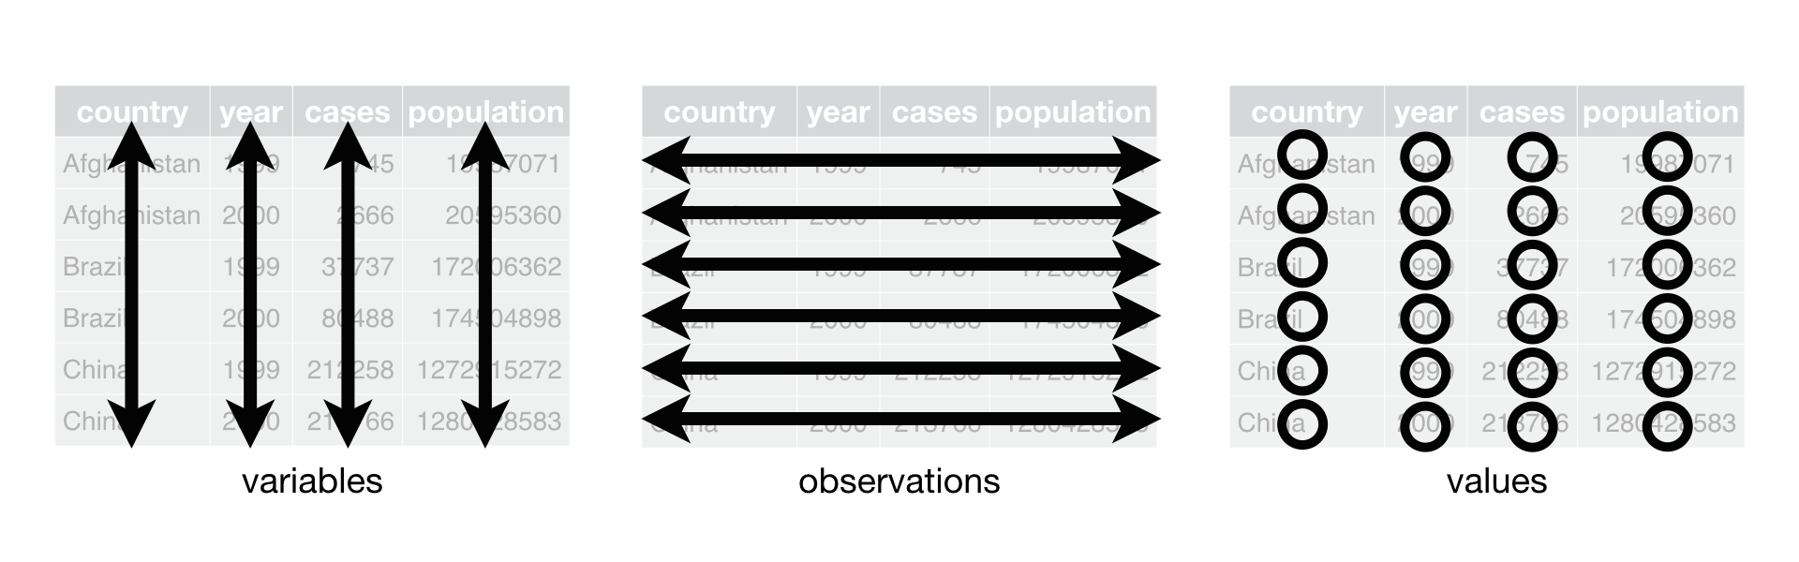
Tidy Data
Standard way of organizing & working w/ data based on 3 rules:
1. Every column is a single variable
2. Every row is a single observation
3. Every cell contains a single value.

Slide 9
Tidy Data
Table B
Which data are “tidy”?
Country | Year | Population
Canada | 1990 | 27.7M
China | 1990 | 1,135.1M
France | 1990 | 56.7M
Canada | 2000 | 30.7M
China | 2000 | 1,262.6M
France | 2000 | 59.1M
Canada | 2010 | 34M
China | 2010 | 1,337.7M
France | 2010 | 62.9M
Table A
(population) | 1990 | 2000 | 2010
Canada | 27.7M | 30.7M | 34M
China | 1,135.1M | 1,262.6M | 1,337.7M
France | 56.7M | 59.1M | 62.9M

Slide 10

Your Turn!
Download “gapminder _data.csv” file from:
https://damouras.github.io/teaching/
Upload on your data on JupyterHub
Create a pandas data frame by running
gapminder_df = pd.read_csv(“gapminder_data.csv”)
View first 20 rows
gapminder_df.head(20)

Slide 11
Filter Data
Select relevant rows by running a query
Running a query (filter rows)
gapminder_df.query(`Year == 1990`)
Combine queries with “&” (logical AND operator)
gapminder_df.query(`Year >= 2000 & Country == “Canada” `)
Country | Year | Population
Canada | 1990 | 27.7M
China | 1990 | 1,135.1M
Canada | 2000 | 30.7M
China | 2000 | 1,262.6M
Canada | 2010 | 34M
China | 2010 | 1,337.7M

Slide 12
Your Turn!
Filter data from China between 1990 to 2020
gapminder_df.query(‘Year >= 1990 &
Year <= 2020 & Country == “China” ’)

Slide 13
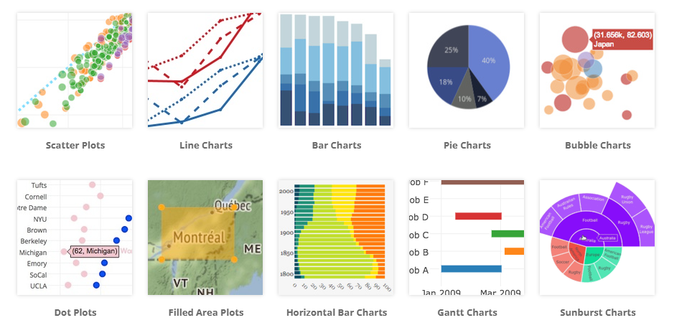
Data Visualization
Communicate information graphically through plots

Slide 14
Plotly Express
Plotly Express provides a concise, high-level interface to create a wide range of interactive Plotly figures with minimal code.
It can generate complex visualizations directly from data frames, making it ideal for quick exploration and analysis.
All charts created with Plotly Express are interactive by default (allow users to zoom, pan, hover for details, and toggle traces)

Slide 15
Anatomy of Plots
High-level description based on layered grammar of graphics
Basic ingredients:
Data (tidy) →
Aesthetics: location (x/y-coord), size, color, etc. →
Geometric objects: lines, points, text, etc.
Main idea: variables are mapped to aesthetics

Slide 16
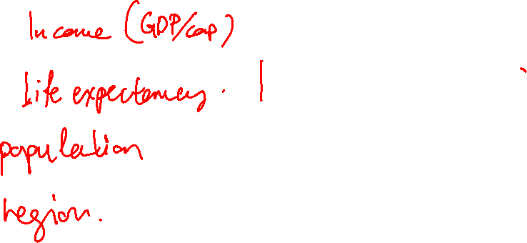
Anatomy of Plots
Identify aesthetics of Gapminder world poster
x-coord:
y-coord:
size:
color:

Slide 17
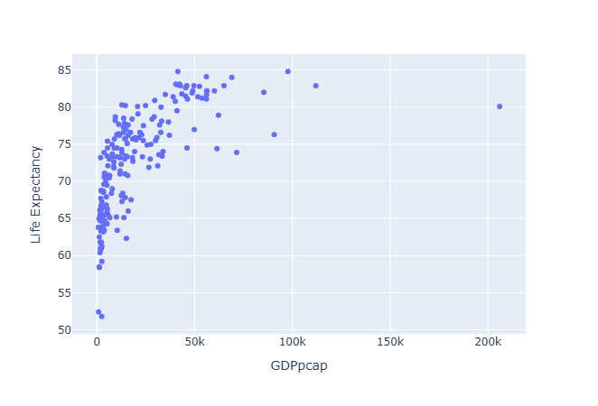
Plotly Example
Create scatter plot of Life Expectancy by GDP/cap in 2019
gwp_2019 = gapminder_df.query('Year == 2019' )
fig = px.scatter(
gwp_2019,
x='GDPpcap',
y='Life Expectancy' )
fig.show()

Slide 18
Your Turn!
Modify previous plot to recreate 2019 Gapminder World Poster using color and size aesthetics
fig = px.scatter(
gwp_2019,
x='GDPpcap',
y='Life Expectancy',
size='Population',
color = 'region',
log_x=True,
size_max = 60,
title='Life Expectancy vs GDP per Capita (2019)'
)
fig.show()

Slide 19
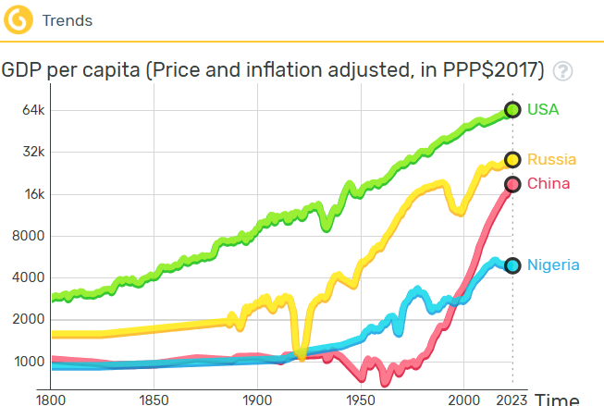
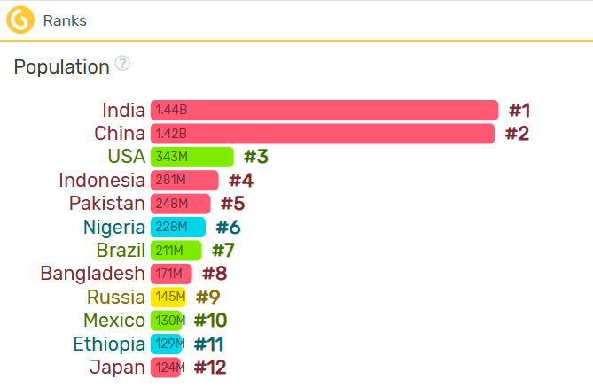
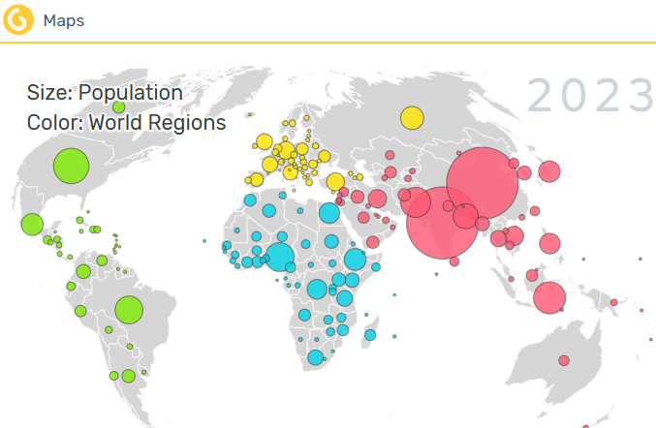
More plots
Other types of plots follow similar syntax, e.g.
Line charts
Bar charts
Maps

Slide 20
Your Turn!
Recreate this line chart (px.line)
gdp_trend = gapminder_df.query( "Year >= 1800 & Year <= 2022 & " \
"Country in ['China', 'USA', 'Russia', 'Nigeria' ] " )
fig = px.line(
gdp_trend,
x="Year",
y="GDPpcap",
color="Country",
title="GDP per Capita Trends (1800-2022)",
log_y=True
)
fig.show()

Slide 21
Your Turn!
Recreate this bar chart (px.bar)
pop_rank = gapminder_df.query('Year == 2019’) \
.sort_values(by='Population', ascending=False).head(15)
fig = px.bar(
pop_rank,
x='Population',
y='Country',
orientation='h',
title='Population Size Rank',
color='Country')
fig.show()

Slide 22
Your Turn!
Recreate this map (px.scatter_geo)
map_df = gapminder_df.query('Year == 2022')
fig = px.scatter_geo(
map_df,
lat = 'Latitude', # Column for latitude coordinates
lon = 'Longitude', # Column for longitude coordinates
size='Population',
color='region',
hover_name='Country',
scope='world',
size_max = 50
)
fig.show()

Slide 23
Resources
Free e-textbooks:
Python 4DS (for Data Science)
Python Data Science Handbook
Library references:
Plotly examples
Pandas tutorials (inlc. Joyful-Pandas in Chinese)
Online courses
Free versions in Kaggle Learn, Data Camp, Coursera, etc

Slide 24
Thank you!

Slide 25

How Did We Do?
Please fill in this feedback form:

