Slide 1

BACHELOR OF TECHNOLOGY
IN
Artificial Intelligence and Machine Learning
Batch Number: BT-5
Project Guide: Project Title :TextExtraction from Images
Prof. Sivakumar
Assistant professor
Batch Names & Roll Numbers
2211CS020112 :D.SRI LASYA
2211CS020114 :D.TRISHUL
2211CS020115 :D.SRIMANTH
2211CS020116 :D.SAI MOURYA SRI
2211CS020117 : D.SHIVA RAJ
Department of AIML, School of Engineering
Malla Reddy University Hyderabad.
Department of AIML, School of Engineering
Malla Reddy University Hyderabad.

Slide 2
ABSTRACT
Text extraction from images converts textual information into machine-readable formats for data digitization and automated tasks.
It involves stages like image pre-processing, text detection, and text recognition.
Traditional methods (edge detection, connected component analysis) and deep learning algorithms (CNNs, RNNs) are used for high accuracy.
Applications include scanning historical documents and real-time text recognition in videos or mobile apps.
Challenges include handling low-quality images, complex backgrounds, and non-standard fonts, with ongoing optimization of methods and tools.

Slide 3
Literature Survey
Introduction:
Text extraction from images is an important technology that helps convert printed or handwritten text into digital form. It is used in areas like document management, data entry, and accessibility, making it easier to process and find information.
Advanced Methods:
CNN (Convolutional Neural Networks): CNNs are used to detect and recognize text in images. They help recognize different fonts and sizes by analyzing small sections of the image.
CRNN (Convolutional Recurrent Neural Networks): This combines CNNs for feature extraction and RNNs (usually LSTMs) to recognize sequences of characters without needing to break them into parts first.
Future Directions:
Fully automated systems
Use of Transformer models
Post-processing with Natural Language Processing (NLP)
Using synthetic data for training
Optimization for mobile and edge devices
Conclusion:
Text extraction technology has advanced with modern techniques like OCR and machine learning. By combining the latest methods with smart image processing, we can improve efficiency and accuracy. Future research will focus on making these systems more scalable and accurate for wider applications.

Slide 4
Problem Statement
Problem Statement:
Accurate text extraction from images is challenging due to variations in fonts, backgrounds, and image quality. A robust solution is needed to handle diverse conditions and improve extraction accuracy. The goal is to develop a system that seamlessly integrates into existing workflows with minimal manual intervention.

Slide 5
Data Collection and Exploration ​
Data collection and exploration for text extraction from images are critical steps in developing effective OCR systems. The process begins with gathering a diverse dataset of images that contain text, sourced from scanned documents, photographs, and screenshots. This dataset should encompass various fonts, sizes, and backgrounds to ensure robustness. Once collected, images are annotated with their corresponding text, which can be done manually or with semi-automated tools.
Preprocessing is essential to enhance image quality, involving steps like resizing, noise reduction, and converting to grayscale. Exploratory data analysis (EDA) helps identify patterns and challenges within the dataset, guiding necessary adjustments. Finally, evaluating the dataset with test images ensures that the OCR system can generalize well to unseen data, leading to improved accuracy in text extraction.

Slide 6
Data Preprocessing
Image Preprocessing Text Alignment: Apply perspective transformation to correct skewed text layouts, ensuring that text is presented in a standard orientation across images. Text Region Cropping: Isolate the regions containing text from images to focus the model on relevant areas and eliminate distractions from the background.
Data Augmentation: Implement techniques such as rotation, scaling, and synthetic noise addition to diversify the dataset, helping improve the robustness of the text recognition model.
Feature Scaling: Normalize the extracted features, such as pixel intensity values, to a common range, facilitating more effective training of text recognition models.
Noise Reduction: Utilize techniques such as Gaussian blur to minimize visual noise and improve the clarity of text in images. For images captured in poor lighting, enhance contrast to make the text more distinguishable.
Outlier Removal: Identify and filter out images that contain excessive distortion or artifacts that could hinder the accuracy of text recognition.

Slide 7
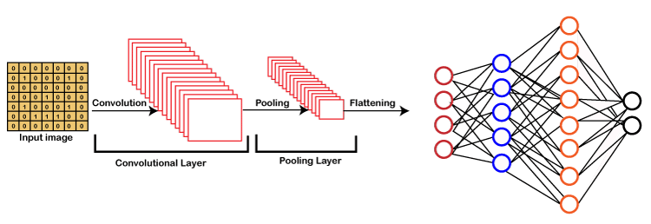
Model Selection
Convolutional Neural Network
Convolutional Neural Networks (CNNs) are a type of deep learning model designed specifically for processing grid-like data, such as images. They consist of layers that automatically detect important features like edges, textures, and patterns through the use of convolutional filters. CNNs are highly effective in tasks such as image classification, object detection, and text extraction due to their ability to capture spatial hierarchies in data. Key components of CNNs include convolutional layers, pooling layers, and fully connected layers, making them powerful for tasks requiring visual feature recognition.

Slide 8
Algorithms
KERAS OCR
It is a Python library that makes text recognition in images easy by using deep learning. Built on Keras, it comes with pre-trained models to detect and recognize text quickly. It supports various image formats and can be used in larger machine learning workflows. It's great for tasks like document processing and recognizing text in scenes.
TESSERACT
It is an open-source OCR engine by Google that converts text in images to machine-readable text. It supports over 100 languages and various character sets, making it highly accurate and versatile. Tesseract works with many image formats (like TIFF, PNG, JPEG) and is widely used in research and commercial projects for text recognition tasks.

Slide 9
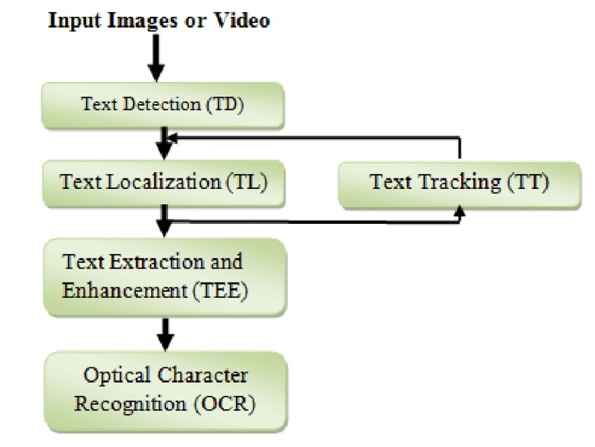
Architecture

