Slide 1
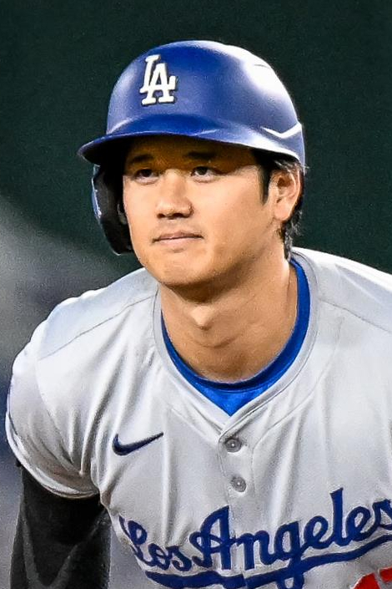
ENGLISH TALK · 5 MINUTES
Biased Sports News
One New York Post column about Shohei Ohtani —
and how a writer hides his opinion inside a “story.”
Jon Heyman · New York Post · 21 March 2024
Photo: All-Pro Reels / Wikimedia CC BY-SA 2.0
Notes:
SAY:
Today I will talk about media bias in sports news. Bias is not always a lie. Sometimes the writer uses other people’s “story” to push his own opinion. My example is a New York Post column about Shohei Ohtani.
中文提示：40 秒。點題即可，不要開始講案情。

Slide 2
BEFORE THE OPINION
What we know
01
02
03
The money
The firing
The claim
Millions of dollars left
Ohtani’s bank account.
The Dodgers fired his
interpreter, Ippei Mizuhara.
Ohtani’s lawyers said he was
the “victim of massive theft.”
Biased Sports News · Shohei Ohtani
2 / 7
Notes:
SAY:
First, the facts. In March 2024, millions of dollars left Ohtani’s account. The Dodgers fired his interpreter, Ippei Mizuhara. Ohtani’s lawyers said he was the victim of theft. At that time, the investigation was not finished.
中文提示：40 秒。只講事實，先不要罵報紙。

Slide 3
BIAS 1 · WORD CHOICE
The headline already chooses a side
“…a baseball legend and a financial dimwit”
dimwit = a stupid person
The writer does not say “questions about the money.” He judges Ohtani first.
Biased Sports News · Shohei Ohtani
3 / 7
Notes:
SAY:
The headline already chooses a side. It does not say “questions about the money.” It calls Ohtani a “financial dimwit.” That word means a stupid person about money. This is word-choice bias. The writer judges Ohtani before the facts are clear.
中文提示：50 秒。指紅字 dimwit。

Slide 4
BIAS 2 · LOADED PARAPHRASE
It looks like reporting. It is not.
CLOSER TO A REPORT
“The story of the Ohtani camp is that the interpreter fooled Ohtani for years…”
ADDED BY THE WRITER
“…and presumably that Ohtani is gullible and naïve, plus has terrible taste in best friends.”
Who is “presumably”? The writer — not the lawyers.
The lawyers never used these words. He puts his guess inside their “story.”
Biased Sports News · Shohei Ohtani
4 / 7
Notes:
SAY:
This paragraph looks like reporting. He says “the story of the Ohtani camp.” But look at the next words. The lawyers never said Ohtani is gullible or naïve. They never said he has terrible taste in friends. The writer adds these words. The key word is “presumably.” It means “I guess.” So the person who is guessing is the writer, not Ohtani’s team. He uses their story as a shell, and puts his opinion inside.
中文提示：80 秒。這張最重要。講慢，指紅字。

Slide 5

AFTER THE COLUMN
The later story was different
April 2024
Mizuhara was charged. Prosecutors said about $16 million was taken.
The method
They said he pretended to be Ohtani when he talked to the bank.
MLB
Ohtani was not involved in sports betting.
Photo: U.S. Embassy Tokyo · public domain
Biased Sports News · Shohei Ohtani
5 / 7
Notes:
SAY:
Later, federal prosecutors charged Mizuhara. They said he stole about 16 million dollars and even pretended to be Ohtani when he talked to the bank. MLB said Ohtani was not involved in betting. So the early “dimwit” story was not careful. It was a judgment, not news.
中文提示：50 秒。三點即可。

Slide 6



IN ONE SLIDE
Three kinds of bias
Word choice
Loaded paraphrase
Too early
Emotional labels
like dimwit and
gullible.
A fake summary.
He retells their story
with his words.
He judges Ohtani’s
character before the
investigation ends.
Biased Sports News · Shohei Ohtani
6 / 7
Notes:
SAY:
So I see three kinds of bias. First, emotional words. Second, a fake summary — he pretends to retell their story. Third, he decides the character of Ohtani too early.
中文提示：30 秒。三欄掃過即可。

Slide 7
TAKEAWAY
Same facts.
Different job: inform, or persuade.
A good reader asks: Is this a quote — or the writer’s guess?
Thank you.
Biased Sports News · Shohei Ohtani
7 / 7
Notes:
SAY:
Good readers ask: Is this a quote, or is this the writer’s guess? Thank you.
中文提示：10 秒。念完停住，不要加新例子。
若被問「專欄本來就可以有意見」：
Yes. But many people read it like news. And he writes “the story of the Ohtani camp,” so it looks like reporting.
若被問「這是假新聞嗎」：
He does not invent the bank transfers. Bias here is the extra judgment.

