Slide 1
US Psychological Regions
Group states by personalities

Slide 2
Data exploration
Data available at https://www.apa.org/news/press/releases/2013/10/regions-personalities
Data include personality traits such as Extraversion, Openness, Agreeableness, Neuroticism, Conscientiousness
Data downloaded into CSV file
Data includes all the states in United States.

Slide 3
Questions on Data
What are the correlations among the features?
How personality traits contribute to Psychological clusters?
How different clusters compare with each other?
Is classification better than the clusters?

Slide 4
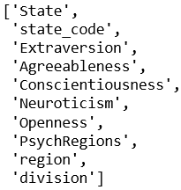

Check out the Schema
Features and the state codes

Slide 5
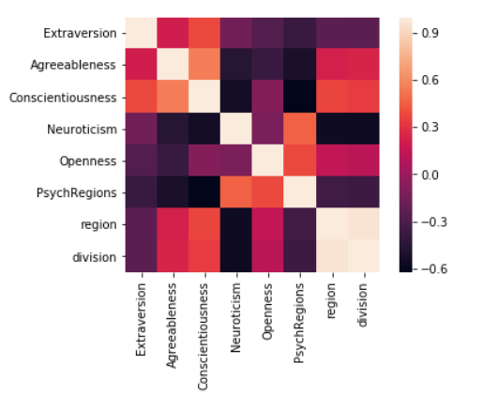
Correlations in Data
Lighter shades show higher correlations on Heatmap

Slide 6
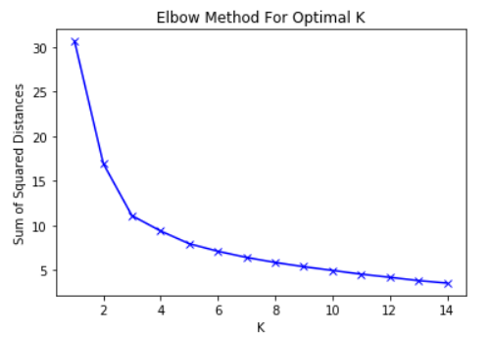
K-Means Clustering
CHART WILL GO HERE
1
Elbow method used for Optimal K
2
Picked K=3 where the elbow starts

Slide 7
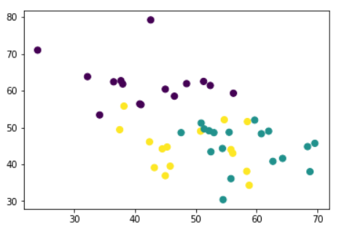
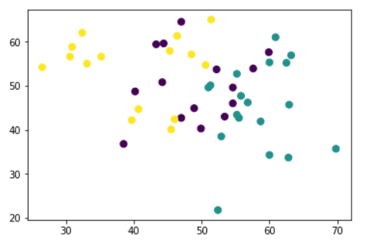
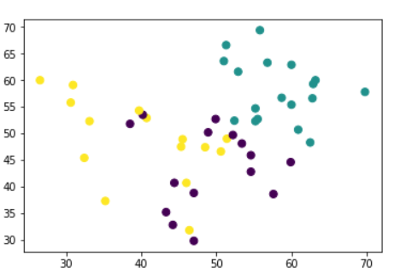
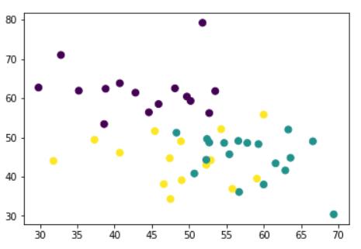
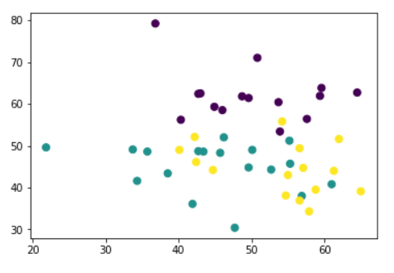
K-Means Clustered Regions
Conscientiousness-Neuroticism
Extraversion-Openness
1
Predicted clusters in scatter plots
2
Big five personalities in each plot
Extraversion-Agreeableness
Agreeableness-Neuroticism
Openness-Neuroticism

Slide 8
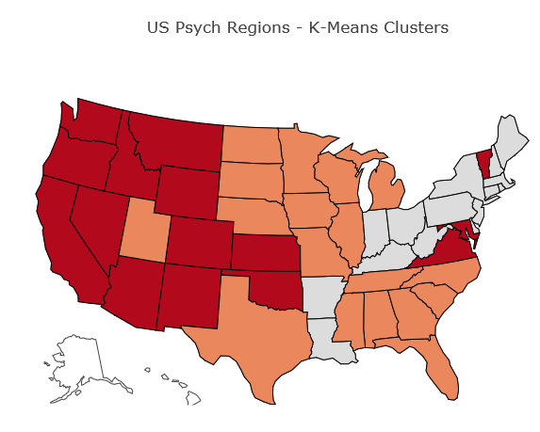
K-Means Clustered Regions
Cluster 1
PA,WV,AR,OH,CT,DE,MA,RI,NY,ME,IN,NJ,NH,KY,LA
Cluster 2
TN,SD,NC,ND,SC,NE,WI,AL,MS,MN,MI,UT,IA,IL,GA,FL,MO,TX
Cluster 3
VT,VA,WA,MT,OK,NM,NV,MD,KS,ID,CO,CA,AZ,OR,WY
Most of Mountain, West, and Central, and a few North east states are in two clusters

Slide 9
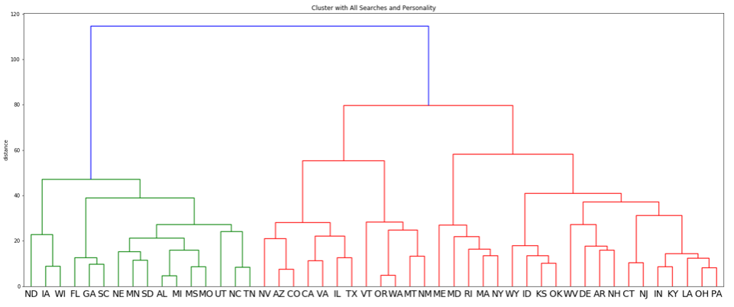
Dendogram Clusters - Hierarchical
Cluster 1
PA,WV,AR,OH,CT,DE,MA,RI, NY,ME,IN,NJ,NH,KY,LA, OK,KS,ID,WY,MD
Cluster 2
VT,VA,WA,MT,NM,NV,OR,TX, IL,CO,CA,AZ
Cluster 3
TN,SD,NC,SC,ND,NE,WI,AL, MS,MN,MI,UT,IA,GA,FL,MO
Most of Mountain, West, and some North East states are together in two clusters

Slide 10
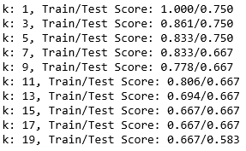
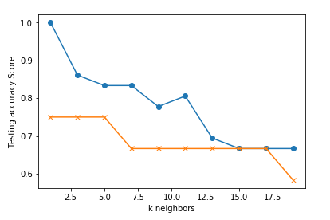
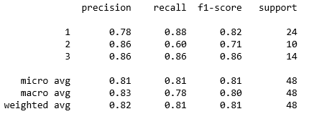
How about K-Nearest Neighbors?
K = 3 where the classifier starts to stabilize on train, test samples
Best accuracy of 0.82 when fitting on the original data and 0.5 on training data
Weighted average F1-Score of 0.81 when predicting on the original data

Slide 11
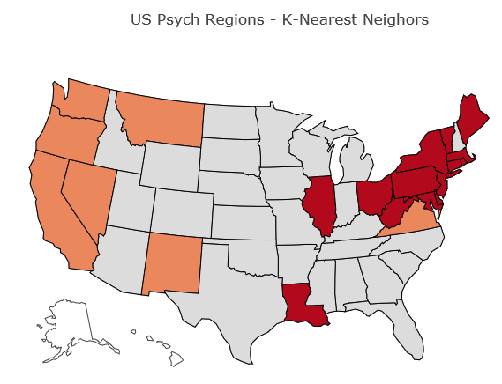
K-Nearest Neighbor Regions
Cluster 1
AL,UT,TX,TN,SD,SC,OK,ND,NC,NH,NE,WI,MO,MS,MN,MI,WY,ID,KY,KS,IA,IN,AR,FL,CO,GA,AZ
Cluster 2
OR,CA,MT,NV,VA,WA,NM
Cluster 3
VT,WV,CT,MD,PA,DE,ME,NY,NJ,IL,LA,MA,RI,OH
Most of Mountain, Central, and South East states are nearest neighbors in one cluster. Only a few from West, and few others in North east are in two clusters

Slide 12
Conclusions
K-Means clusters most of Mountain, West coast, and Central states in two clusters
Dendogram clusters similar to K-Means most of Mountain, West coast, but some North East states into two clusters
K-Nearest Neighbors (KNN) classifies most of the states from Mountain, Central, and South East states into one cluster

Slide 13
Questions?
I am glad to answer
Notes:
In Slide Show mode, click the arrows to visit links.

