Slide 1
US Psychological Regions
Group states by personalities

Slide 2
Data exploration
Data available at https://www.apa.org/news/press/releases/2013/10/regions-personalities
Data include personality traits such as Extraversion, Openness, Agreeableness, Neuroticism, Conscientiousness
Data downloaded into CSV file
Data includes all the states in United States.

Slide 3
Questions on Data
What are the correlations among the features?
How personality traits contribute to Psychological clusters?
How additional factors contribute to the Psychological clusters?
How different clusters compare with each other?
Is classification better than the clusters?

Slide 4
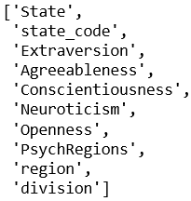

Check out the Schema
Features and the state codes

Slide 5
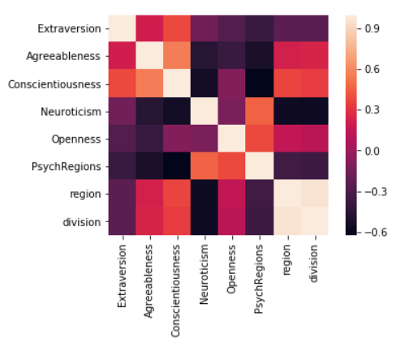
Correlations in Data
Lighter shades show higher correlations on Heatmap

Slide 6
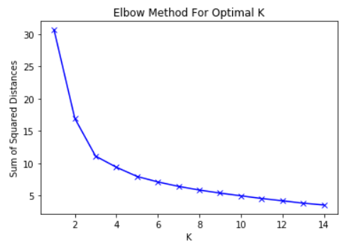
K-Means Clustering
CHART WILL GO HERE
1
Elbow method used for Optimal K
2
Picked K=3 where the elbow starts

Slide 7
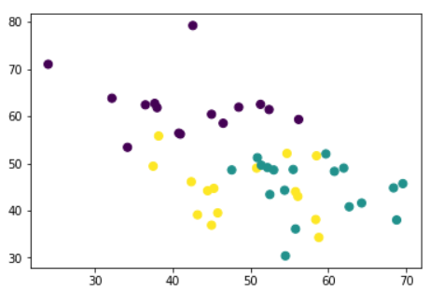
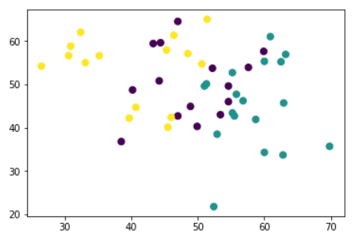
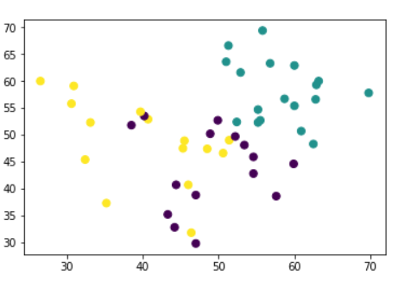
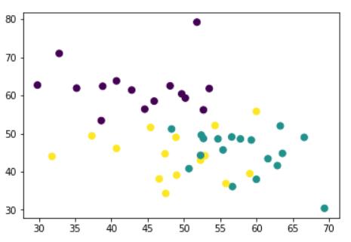
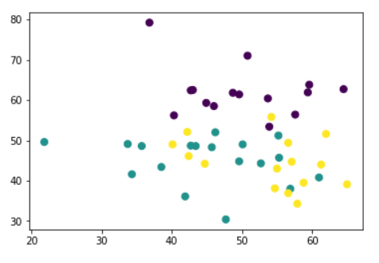
K-Means Clustered Regions
Conscientiousness-Neuroticism
Extraversion-Openness
Big Five personalities in the clusters
Extraversion-Agreeableness
Agreeableness-Neuroticism
Openness-Neuroticism

Slide 8
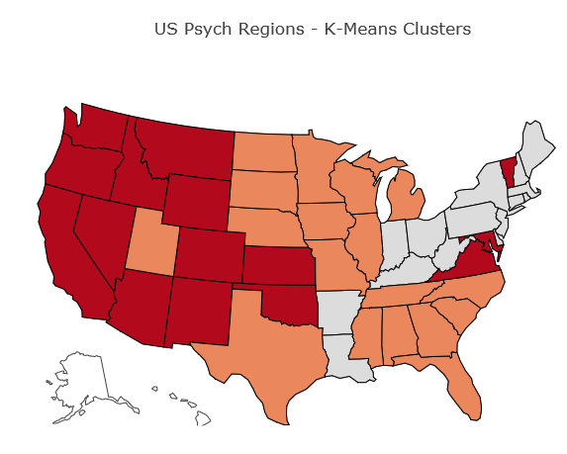
K-Means Clustered Regions
Cluster 1
PA,WV,AR,OH,CT,DE,MA,RI,NY,ME,IN,NJ,NH,KY,LA
Cluster 2
TN,SD,NC,ND,SC,NE,WI,AL,MS,MN,MI,UT,IA,IL,GA,FL,MO,TX
Cluster 3
VT,VA,WA,MT,OK,NM,NV,MD,KS,ID,CO,CA,AZ,OR,WY

Slide 9
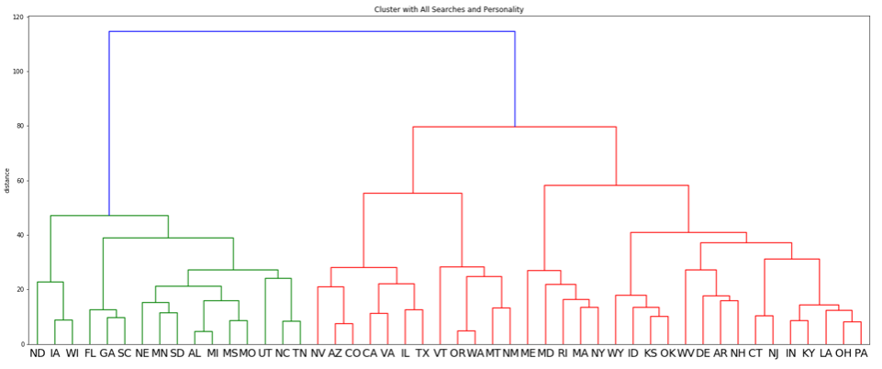
Dendogram Clusters - Linkage Matrix
Cluster 1
TN,SD,NC,SC,ND,NE,WI,AL, MS,MN,MI,UT,IA,GA,FL,MO
Cluster 2
VT,VA,WA,MT,NM,NV,OR,TX, IL,CO,CA,AZ
Cluster 3
PA,WV,AR,OH,CT,DE,MA,RI, ME,NY,LA,KY,IN,NJ,NH, OK,KS,ID,WY, MD
IL,MD,TX,OK,KS,ID, WY moved to different clusters.

Slide 10
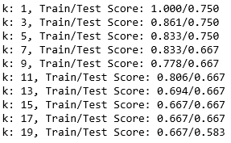
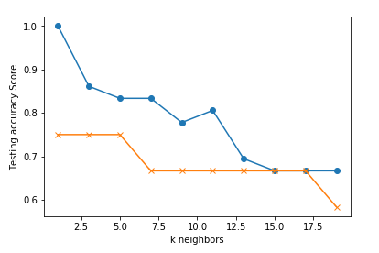
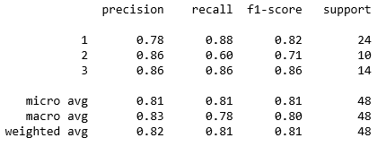
How about K-Nearest Neighbors?
K = 3 where the classifier starts to stabilize on train, test samples
Best accuracy of 0.82 when fitting on the original data
Weighted average F1-Score of 0.81 when predicting on the original data

Slide 11
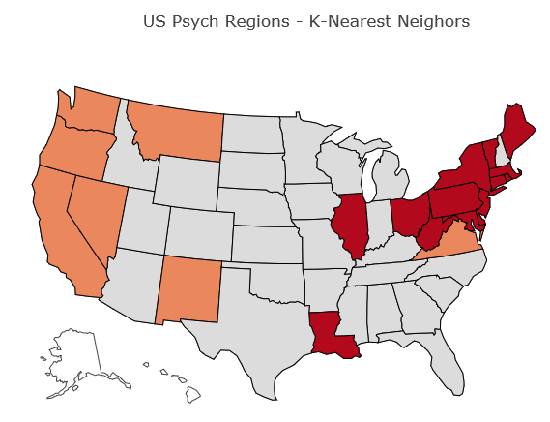
K-Means Clustered Regions
Cluster 1
AL,UT,TX,TN,SD,SC,OK,ND,NC,NH,NE,WI,MO,MS,MN,MI,WY,ID,KY,KS,IA,IN,AR,FL,CO,GA,AZ
Cluster 2
OR,CA,MT,NV,VA,WA,NM
Cluster 3
VT,WV,CT,MD,PA,DE,ME,NY,NJ,IL,LA,MA,RI,OH

Slide 12
Conclusions
K-Means indicates Big Five personalities contributing to the cluster of psychological regions
Dendogram linkage matrix clusters on similar lines of K-Means except MD,ID,OK move to red states

Slide 13
Conclusions
For future exploration I would like to…

Slide 14
More questions about our Dashboard?
I am glad to answer
Notes:
In Slide Show mode, click the arrows to visit links.

