Slide 1

YouTube Trending Video Analysis
Team06 Data Science Project1
Damodhar, Kavya, Mabel, Gael

Slide 2

Trending Hypothesis and Questions
Hypothesis
High trending videos get more likes than the low trending videos
Null Hypothesis
No difference in likes between high trending and low trending videos
Questions
Which category or channel title is getting more views?
Which category or channel title is getting more likes?
Which category or channel title is getting more review comments?
Which category or channel title has the highest number of comments
Which category or channel title has the highest number of likes or dislikes?

Slide 3

Trending Hypothesis and Questions
YouTube trending videos have data on likes, views, comments among different categories. We wanted to see relationships between these responses from users on high and low trending videos
We found trending video datasets for US and France downloaded from Kaggle. Given the volume, the data was easy to load in performing exploration using Microsoft Excel.
Our findings from the datasets very well support our hypothesis with adequate data trended over a period of 2 years for high and low trending videos.

Slide 4

Data Cleanup and Exploration
The US dataset has about 40,929 video uploads spanning years 2017 and 2018. Each video has an alphanumeric identifier with a title and associated with a category, trending date, likes, views, and comments.
There are about 32 categories including Music, Entertainment, Sports etc., in this data. The FR dataset has over 40,700 video uploads during the same span.
Around 241 US videos were published between 2006 and 2016 but trended in the year 2017 and 2018
Around 30 FR videos were published between 2009 and 2016 but trended in the year 2017 and 2018

Slide 5
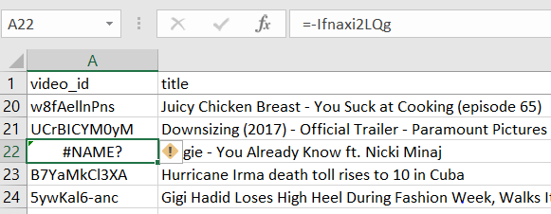
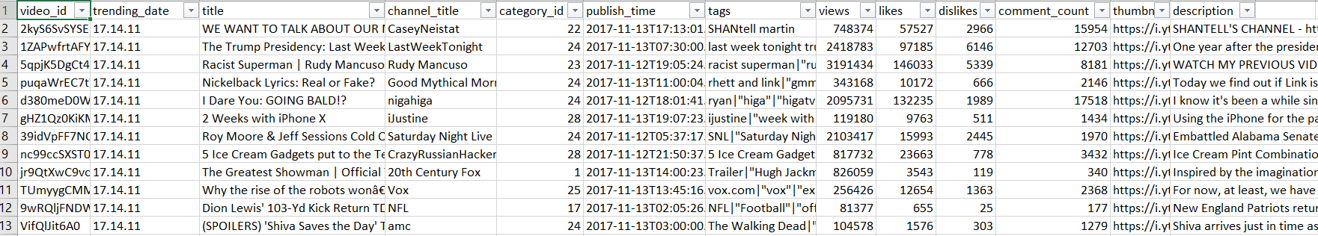
Data Cleanup and Exploration
We found a few #NAME errors in both the downloaded CSV files due to incorrect formula characters in video_id column. We corrected these errors using excel Text To Columns, Merge functions, and manual updates. The error example is shown below.
A snapshot of the US dataset is enclosed below.

Slide 6

Data Analysis
What are the analysis steps?
We have grouped each dataset by category and video, and took the number of likes, comments, and views from the last day of trending for each group. We calculated the number of trending days for each group based on the trending date
We got the high trending categories with
Greater than 10 million likes
Greater than 250 million views
Greater than around 1.4 million comments
We got the low trending categories with
Less than 10 million likes
Less than 250 million views
Less than 1.4 million comments

Slide 7
Data Analysis
What are the answers to questions?
Which category is getting more views?
US: Music France: Music
Which category is getting more likes?
US: Music France: Music
Which category is getting more review comments?
US: Music France: Music
Which category has the highest number of likes or dislikes?
US: Entertainment France: Entertainment
Overall US trended 16 categories and France trended 18 categories

Slide 8
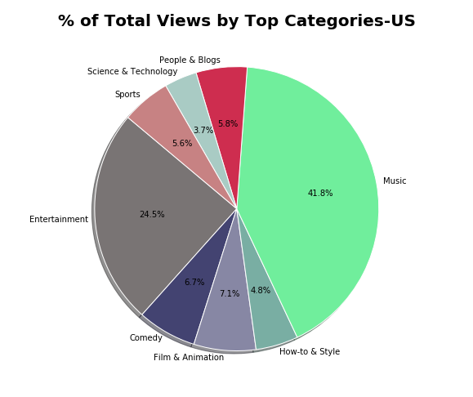
Data Analysis Figures
We have captured the following figures from our analysis output

Slide 9
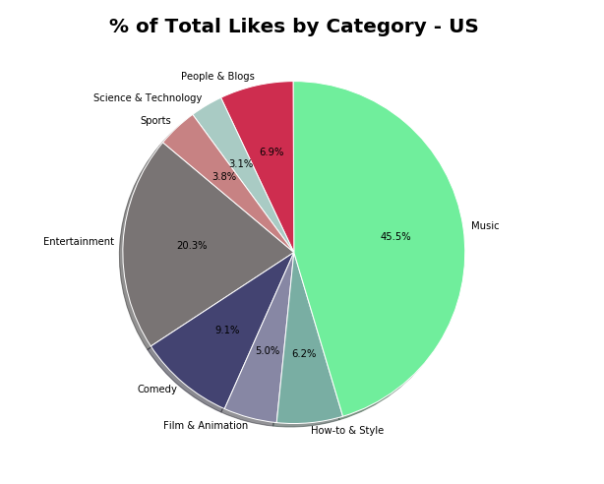
Data Analysis
Figures

Slide 10
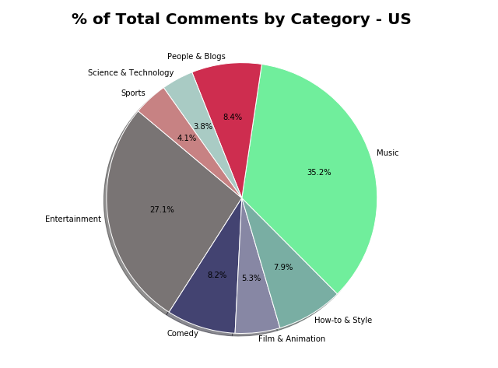
Data Analysis
Figures

Slide 11
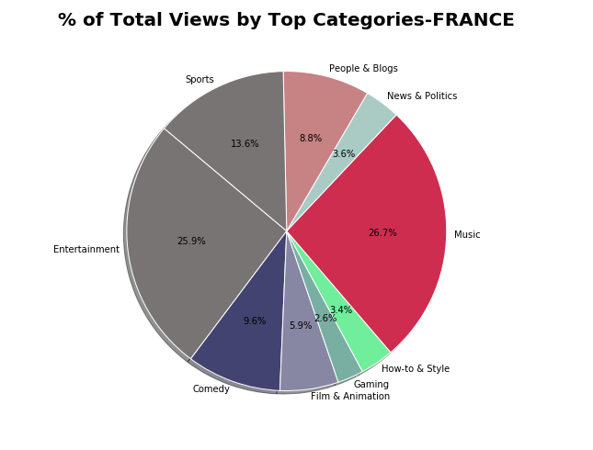
Data Analysis
Figures

Slide 12
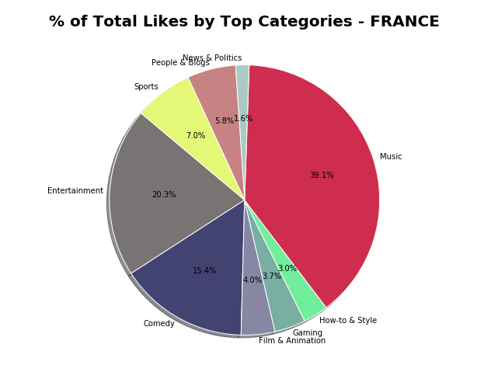
Data Analysis
Figures

Slide 13
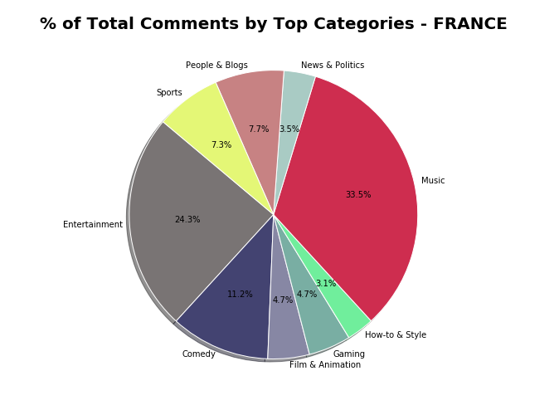
Data Analysis
Figures

Slide 14
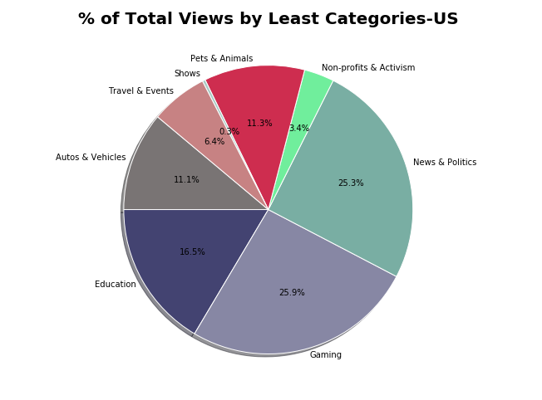
Data Analysis
Figures

Slide 15
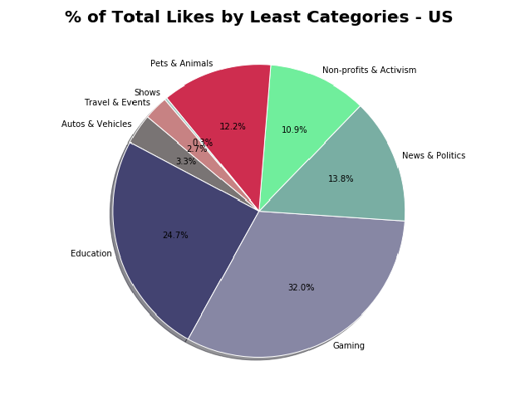
Data Analysis
Figures

Slide 16
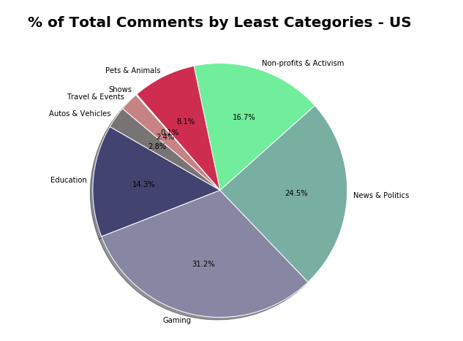
Data Analysis
Figures

Slide 17
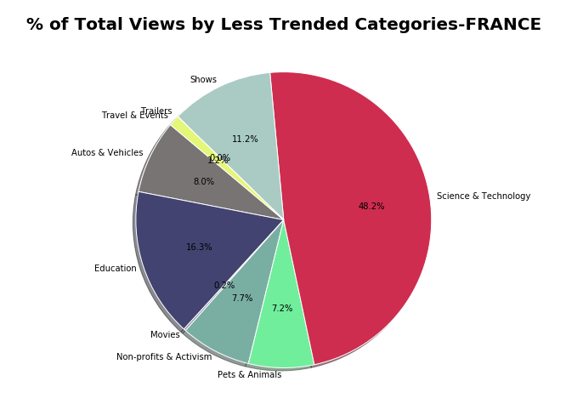
Data Analysis
Figures

Slide 18
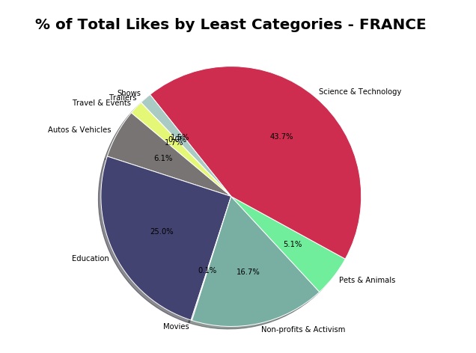
Data Analysis
Figures

Slide 19
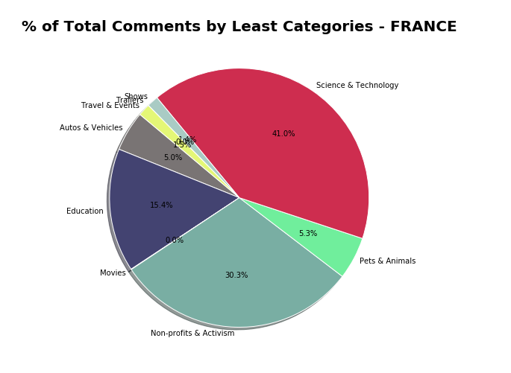
Data Analysis
Figures

Slide 20
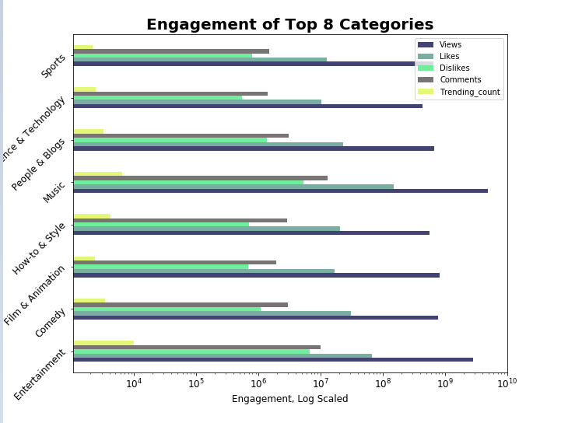
Data Analysis
Figures

Slide 21
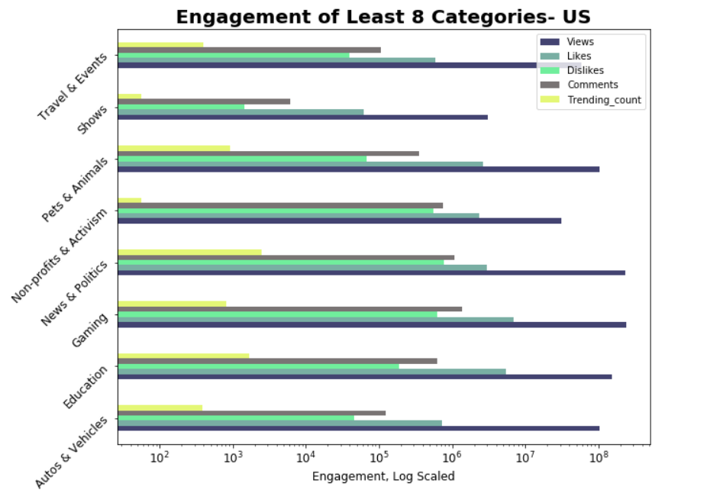
Data Analysis
Figures

Slide 22
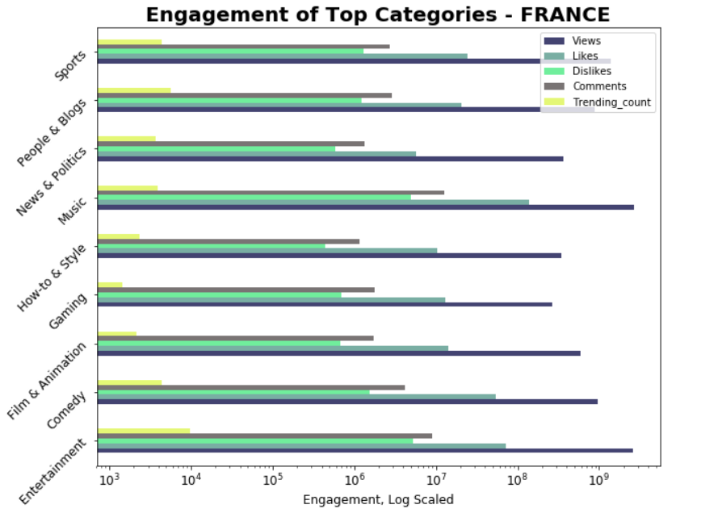
Data Analysis
Figures

Slide 23
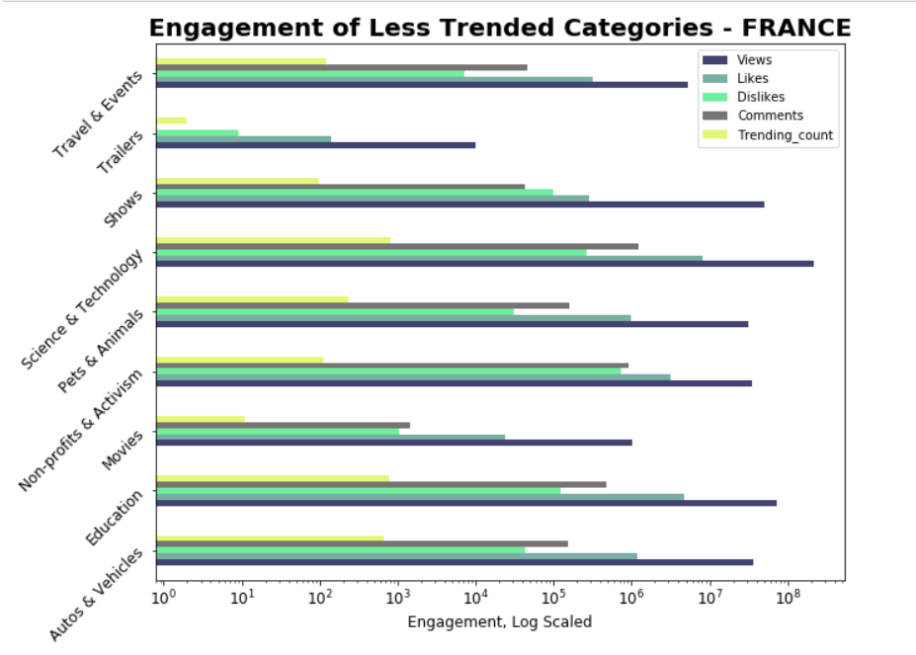
Data Analysis
Figures

Slide 24

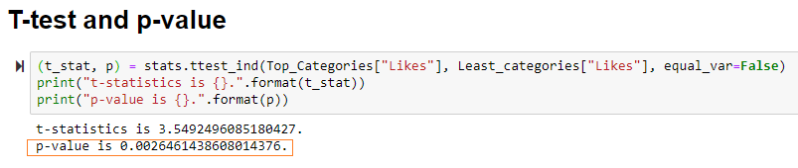
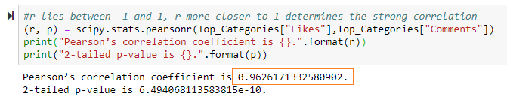
Discussions and Findings
What are high low trends saying?
Conclusions
We found what we expected in our results. The p-value for likes between top and low trended categories is 0.0026461438608014376, which is < 0.05, hence we reject our null hypothesis, “No difference in likes between high trending and low trending videos”.
We ran a correlation test between likes and comments of top trending categories. We found a correlation of 0.96 which shows that there is increased likelihood of comments being associated with a corresponding likes.

Slide 25
Discussions and Findings
We also have an interesting finding that higher trending counts are associated with higher number of dislikes.
Recommendations
We recommend music category to be the best to post our advertisements as Music is on top of all categories in both countries
What would you research next given more time?
Research and find relation between the tags for each video and the views

