Slide 1
padb-tools
PADB Simple & PADB Interactive
Automating PADB-R.exe extraction and plotting for SG6311A characterization data
SG6311A Test Engineering | C:\apps\padb\tools

Slide 2
Overview
Agenda
• What is padb-tools?
• Three tiers: Legacy, Simple, Interactive
• PADB Simple — walkthrough
• PADB Interactive — walkthrough
• Setting up your environment to create your own plots
• Where to get help
padb-tools
2

Slide 3
Overview
What is padb-tools?
• Drives PADB-R.exe headlessly: runs a .pod file's analytics, collects the CSV/native output
• Turns results into interactive HTML — Plotly embedded inline, no server needed
• Works straight off a network share; results are self-contained files
• One job.json file configures a run — what pod, what date range, where to publish
– PADB-R.exe is a real WinForms GUI app
– Needs an actual Windows desktop session — will not run over SSH or as a service
padb-tools
3

Slide 4
Overview
Three Tiers — Pick What You Need
Legacy
Simple
Interactive
mode omitted / "legacy"
"mode": "simple"
"mode": "interactive"
• Older per-analytic plot types
• accuracy_vs_freq, distribution, de_summary, etc.
• One job.json drives everything
• Literal PADB::Simple replacement
• PADB-R's own native PNG/PDF renders, no custom plotting
• One job.json, same shape as Legacy
• Full modern interactive suite
• scatter, stat_summary, boxplot, distribution, env_coverage, summary
• Two files: run job + plot job
padb-tools
4

Slide 5
PADB Simple
What It Is
• A direct, static replacement for the old Perl PADB::Simple tool
• Zero custom plotting or statistics — no scatter, no tolerance intervals, no filters
• Drives PADB-R's own native rendering: OutputConfig_OutputGraph=1, GraphFormat=png,pdf
• Wraps the native PNG/PDF output in a bare gallery page, one card per image
• Metadata table dumped from the pod's own extraction settings
• Download links for the original .sao / .pod / .txt / .csv files
• Best for: a quick static report, or matching exactly what the legacy tool produced
padb-tools
5

Slide 6
PADB Simple
job.json
{
"description": "SG6311A MiniMoab Self-Test",
"pod": "SelfTestMiniMoab_000.pod",
"mode": "simple",
"padb_exe": "C:\\Program Files\\KEYSIGHT\\PADB-R.NET\\PADB-R.exe",
"results_dir": "SelfTestMiniMoab_000_simple_results",
"padb_timeout": 7200,
"run_analytics": true,
"publish": {
"destination": "\\\\srsnas01...\\SG6311A\\PADB-Simple\\MiniMoab\\SelfTestMiniMoab_000"
}
}
padb-tools
6

Slide 7
PADB Simple
Running It
• Fastest path — generate the job.json straight from the pod:
py padb_make_job.py MyPod.pod --module MyModule
• Then run it — real PADB-R.exe execution, needs a desktop session:
py padb_run.py MyPod_job.json
• --module MyModule names the publish subfolder — always explicit, never guessed (more on slide 12)
• Output: results_dir\index.html — one card per native PNG (linked to its PDF)
• HOW_TO_USE.txt is written alongside it, explaining what this tier does and doesn't do
• Re-plot without re-extracting: py padb_run.py MyPod_job.json --plots-only
padb-tools
7

Slide 8
PADB Interactive
What It Is
• The full modern interactive suite — six views from one Type=80 Scatter CSV
• scatter, stat_summary, boxplot, distribution, env_coverage, summary
• Auto-selects the right view set from the data itself:
– Room-only data → scatter + boxplot
– Multi-temperature data → all six views
• Live filters: condition, serial, port, frequency range, temperature
• Tolerance intervals (parametric TI, non-parametric TI), spec pass/fail
• Best for: any new pod — richer feature set, no regenerating to explore the data
padb-tools
8

Slide 9
PADB Interactive
Two-Step Workflow
1
Extract
2
Plot
py padb_run.py ...
py padb_v2.py ...
Runs PADB-R.exe, writes a fresh CSV from the DB
Reads the CSV, builds all six interactive HTML views
CSV unchanged? Re-run step 2 alone — no need to touch PADB-R.exe again.
padb-tools
9

Slide 10
PADB Interactive
job.json — Two Files
• *_run_job.json — same schema as any padb_run.py job:
{ "pod": "MyPod.pod", "mode": "interactive",
"results_dir": "my_analysis_run_results",
"run_analytics": true }
• *_v2_job.json — drives padb_v2.py, different schema:
{ "title_prefix": "SG6311A My Analysis",
"csv_path": "...\\my_analysis_run_results\\padb\\Scatter.csv",
"results_dir": "my_analysis_v2_results",
"spec_direction": "auto" }
• Fastest path — generate both at once from the pod:
py padb_make_v2_job.py MyPod.pod --module MyModule
padb-tools
10

Slide 11
PADB Interactive
Key Interactive Features
• Filters — condition dropdowns, serial/DUT exclusion, port, frequency range, temperature
• Tolerance intervals — parametric TI and non-parametric (NP-TI), P/C selectors
• TLL display: Both / Upper only / Lower only
– Shown live only when the CSV has no spec limit at all — a real limit always wins
• Global Filter (GF) — set once in boxplot, propagates across every other view
• CSV export — download the currently filtered data from any view
• Everything recomputes client-side — no server, no regenerating to try a different filter
padb-tools
11

Slide 12
Both Tiers
Generators — Skip Writing job.json by Hand
• padb_make_job.py — Legacy / Simple / Interactive extract job, from a pod alone:
py padb_make_job.py MyPod.pod --module MyModule --mode simple
• padb_make_v2_job.py — full Interactive job set (run + one plot job per analytic):
py padb_make_v2_job.py MyPod.pod --module MyModule
• --module NAME sets the publish subfolder (e.g. MyModule → MiniMoab) — always explicit, never auto-guessed from the pod
• Both read the pod's own analytics directly — no manual guessing
• Auto-detects and fixes real pod issues: OutputFile collisions, disabled CSV output, one-sided specs with no configured limits
• Warns if a generated path nears Windows' 260-character limit
padb-tools
12

Slide 13
Environment Setup
Prerequisites
• Python 3 with the required packages:
py -m pip install pandas numpy matplotlib scipy plotly
• PADB-R.NET installed
– Default path: C:\Program Files\KEYSIGHT\PADB-R.NET\PADB-R.exe
– Override with padb_exe in job.json if yours differs
• A real Windows desktop session
– PADB-R.exe is a WinForms app — needs an actual GUI session
– Will not run over SSH or as a headless service
• A clone of the padb-tools repository
padb-tools
13

Slide 14
Environment Setup
Per-User Config (Optional, One-Time)
• Every script derives defaults from Path.home() — never hardcoded to one username
• Want to customize? Create padb_config.json once:
<Padb folder>\padb_config.json
{
"padb_exe": "C:\\Program Files\\KEYSIGHT\\PADB-R.NET\\PADB-R.exe",
"padb_output_dir": "...\\Padb\\R-Plots",
"padb_logs_dir": "...\\Padb\\Logs",
"data_dir": "...\\Padb\\Data",
"publish_root": "\\\\srsnas01...\\SG6311A\\PADB-Simple"
}
• Entirely optional — skip it and every key falls back to a sensible default
padb-tools
14

Slide 15
Environment Setup
Your First Plot — Checklist
• Get your .pod file
• Generate a job.json (or two, for Interactive):
– padb_make_job.py MyPod.pod --module MyModule --mode simple
– padb_make_v2_job.py MyPod.pod --module MyModule
• Run the extraction: py padb_run.py <job.json>
• Interactive only — build the plots: py padb_v2.py <v2_job.json>
• Open results_dir\index.html
• Before publishing, sanity-check against QA_Checklist.md
padb-tools
15

Slide 16
Wrap-Up
Where to Get Help
• New to this? Read in order:
– GETTING_STARTED.md → Quick_Start.md → PADB_Tools_Guide.md
• One-page steps, nothing else:
– Simple_Mode_Cheatsheet.md / Interactive_Mode_Cheatsheet.md
• Authoring or fixing a pod:
– PADB_Analytic_Requirements.md
• Before you publish new results:
– QA_Checklist.md
• Using Claude Code? Type /padb-tools for an on-demand summary of the
– architecture, gotchas, and new-pod checklist — no need to open all six docs
padb-tools
16

Slide 17
Environment Setup
Making Python Find Your Script Folder
• Two different goals need two different environment variables:
• Run scripts by name from any directory (padb_run.py job.json):
setx PATH "$env:PATH;C:\apps\padb\tools"
– Open a NEW terminal afterward — only helps for bare invocation
– (padb_run.py ...); typing "py padb_run.py ..." still resolves the
– path relative to your current directory, PATH doesn't help there
• Let other scripts import padb_run / padb_config from anywhere:
setx PYTHONPATH "C:\apps\padb\tools"
– Already have entries? Append instead: setx PYTHONPATH
– ("$env:PYTHONPATH;C:\apps\padb\tools")
padb-tools
17

Slide 18
Tutorial 1 — PADB Simple
The Pod: MaxPowerTutorial1.pod
• A real MaxPower-family pod, 6 analytics:
– 4 x Type=80 Scatter — Unleveled Log, Leveled Log, Leveled Linear, Unleveled Linear
– 1 x Type=90 SummaryPlot — Summary_Leveled_Linear
– 1 x Type=60 Environmental — Environmental_Leveled_Linear
• No spec limits configured (Limits_YLimit=None on every analytic) — Simple mode doesn't
– care; it posts whatever PADB-R renders natively, spec or no spec
• Goal: turn this pod into a browsable gallery with zero custom plotting code
padb-tools
18

Slide 19
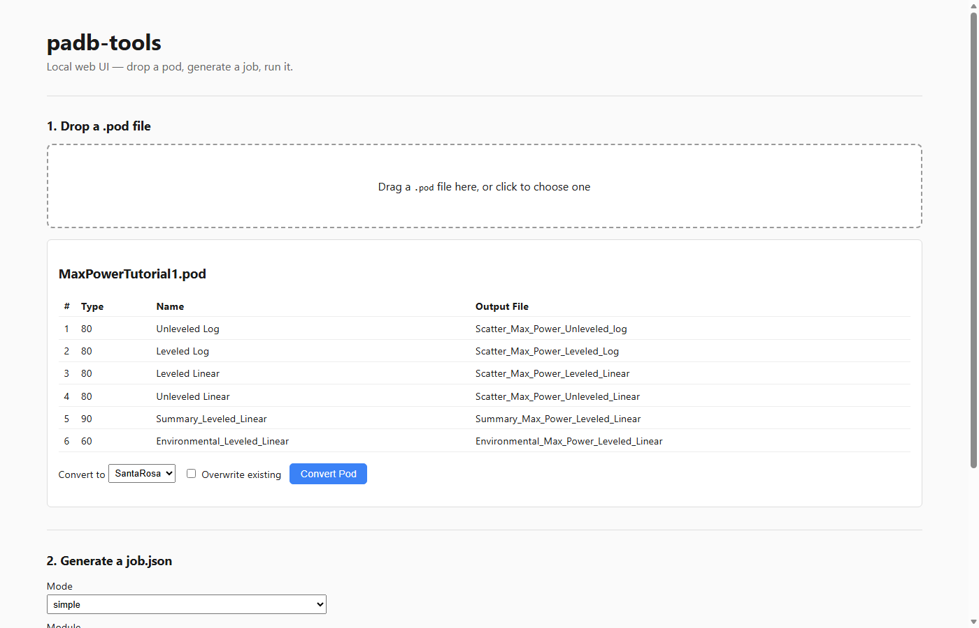
Tutorial 1 — PADB Simple
Step 1 — Drop the Pod, Generate the Job
py webapp\padb_web.py
Drag MaxPowerTutorial1.pod onto the page
Analytics parse instantly — no extraction needed to preview them
Mode: simple, Module: Tutorial
Click Generate Job — writes MaxPowerTutorial1_job.json next to the pod
padb-tools
19

Slide 20
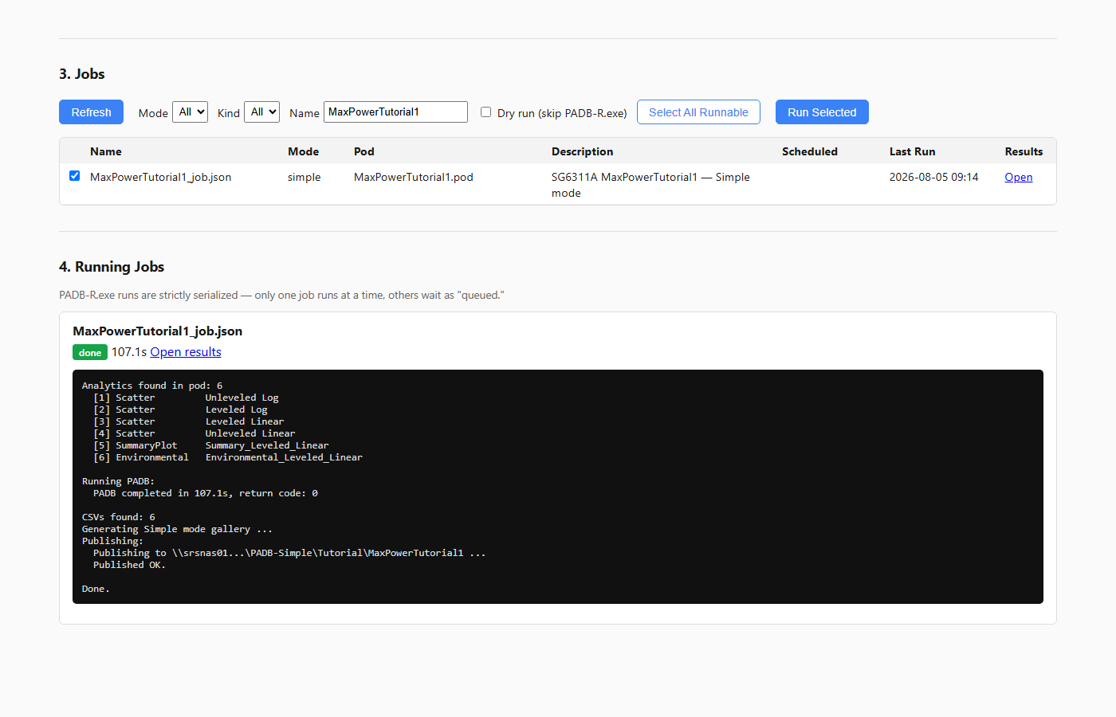
Tutorial 1 — PADB Simple
Step 2 — Check the Box, Run It
Check the job's row, click Run Selected
Real PADB-R.exe runs — the queue serializes it, so it's safe even if others are running jobs too
Status panel streams the live log
"done" + Open results link when it finishes — 107.1s, this run
padb-tools
20

Slide 21
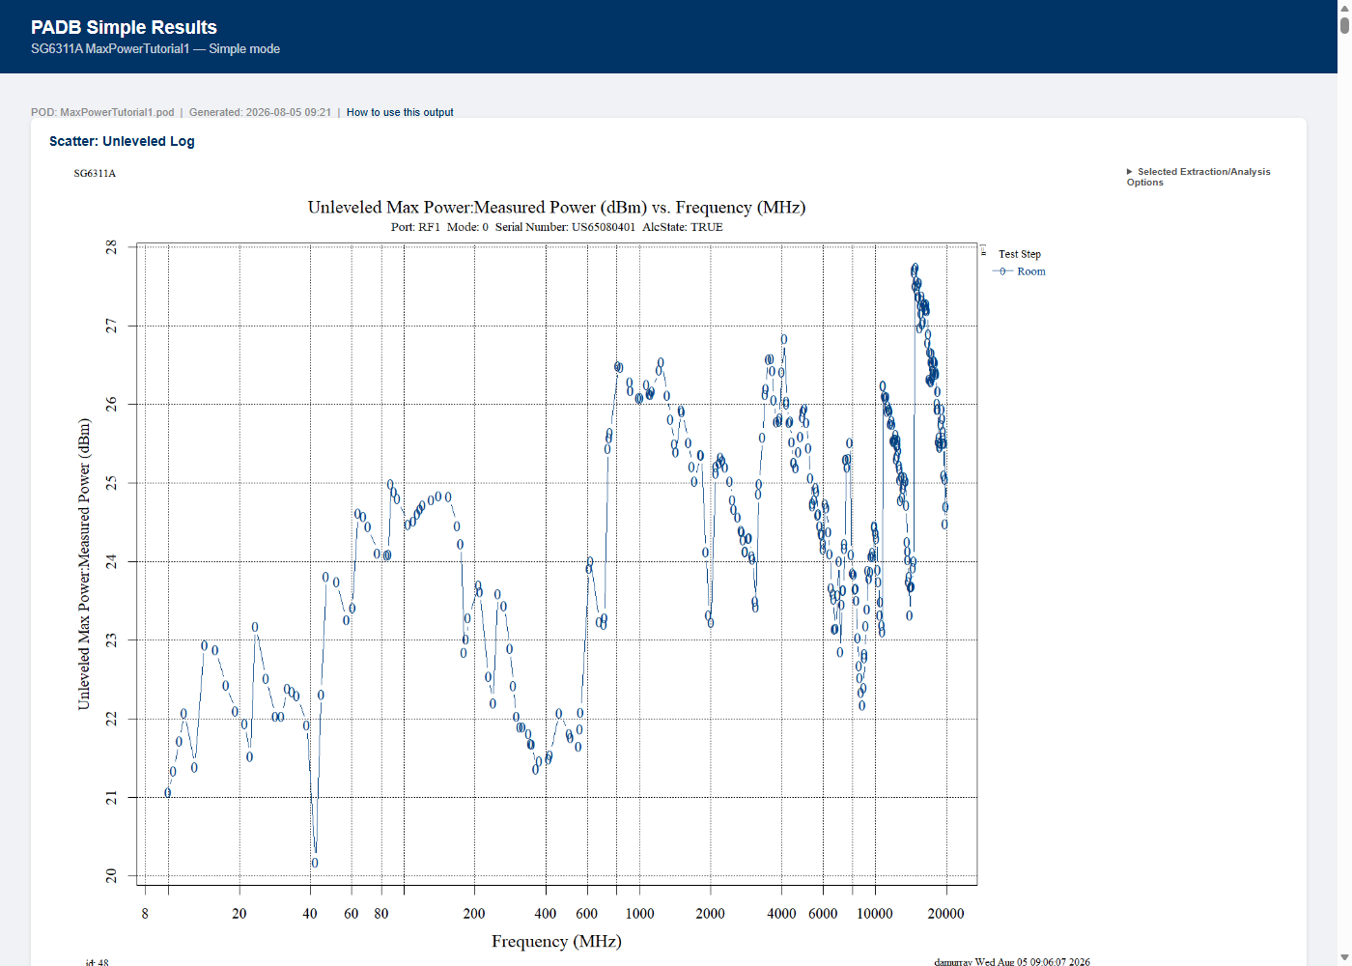
Tutorial 1 — PADB Simple
The Result
results_dir\index.html
• One card per native PNG, in pod/analytic order
• Metadata table (collapsed) shows the pod's own extraction settings
• Download links for .sao / .pod / .txt / .csv
• Zero custom code involved — this is exactly what PADB-R rendered
padb-tools
21

Slide 22
Tutorial 2 — PADB Interactive
The Pod: MaxPowerTutorial2.pod
• A focused MaxPower-family pod, 2 analytics — both Type=80 Scatter:
– Leveled Linear, Unleveled Linear
• No spec limits configured — same as Tutorial 1's pod
• Fewer analytics than Tutorial 1 on purpose: Interactive generates a full
– 6-view suite per analytic, so 2 analytics already means 12 HTML files
• Goal: the full interactive suite — filters, tolerance intervals, the live
– TLL display selector — not just a static gallery
padb-tools
22

Slide 23
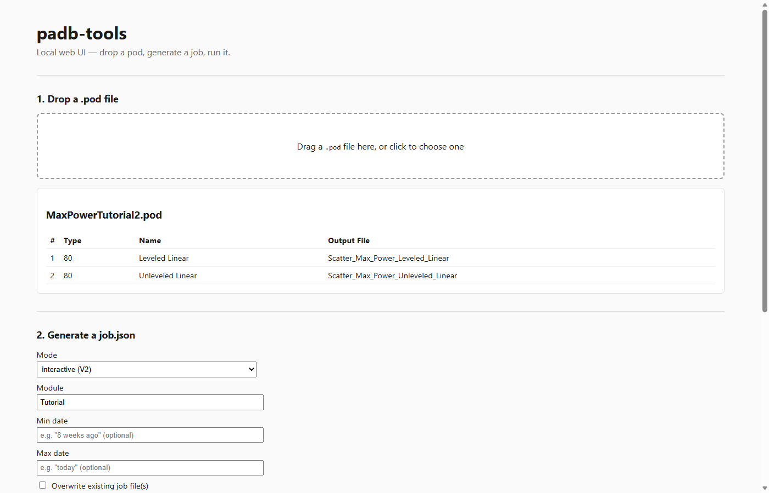
Tutorial 2 — PADB Interactive
Step 1 — Drop the Pod, Generate the Job
Same drop, different mode
Mode: interactive (V2), Module: Tutorial
One click, three files: 1 run job (extraction) + 1 plot job per analytic
csv_path in each plot job is PREDICTED — padb_v2.py verifies it against the real CSV once the run job has actually extracted
padb-tools
23

Slide 24
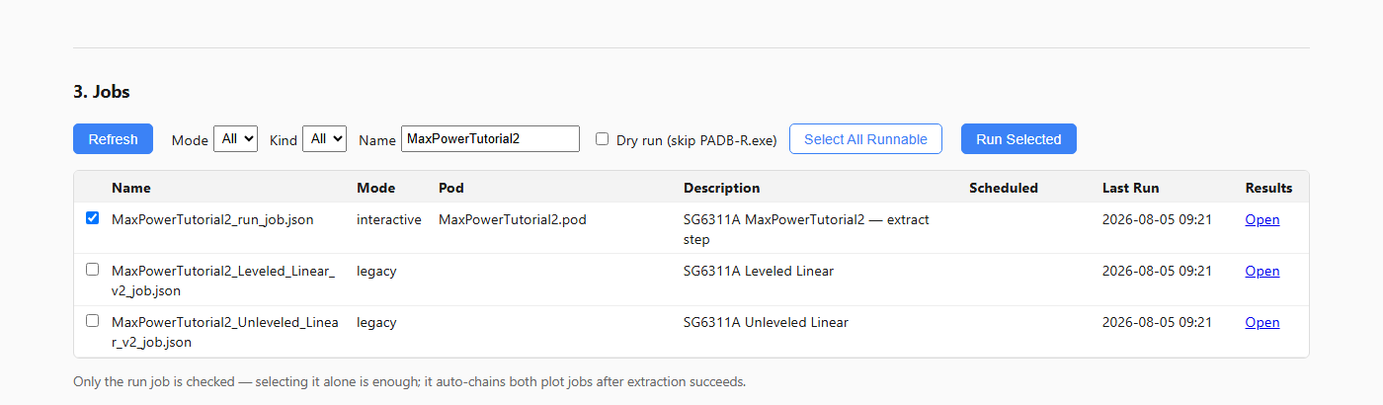
Tutorial 2 — PADB Interactive
Step 2 — Select Just the Run Job
• Three rows appear — the run job and both plot jobs. Check only the run job:
• You never need to check the plot-job rows yourself for a fresh dataset — the run job finds and runs them automatically once extraction succeeds
padb-tools
24

Slide 25
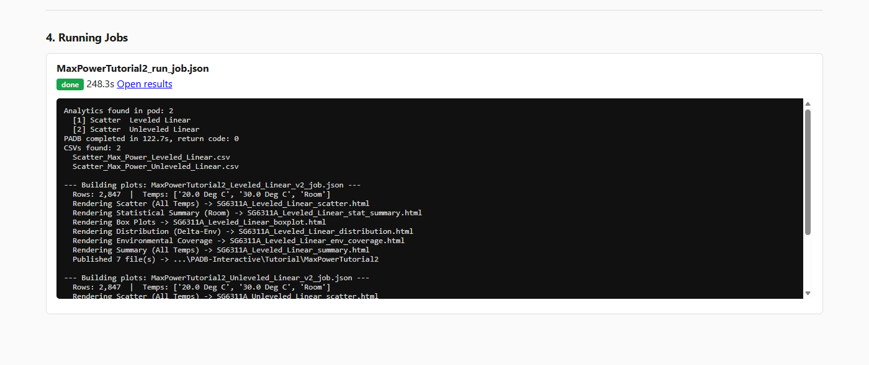
Tutorial 2 — PADB Interactive
Step 3 — One Click: Extract AND Build Plots
• Click Run Selected once. Real PADB-R.exe extraction, then both plot jobs build automatically — no second step:
• 3 temperatures (Room, 20°C, 30°C) — padb_v2.py auto-detects multi-temp data and builds the full six-view suite, no "views" key needed
padb-tools
25

Slide 26
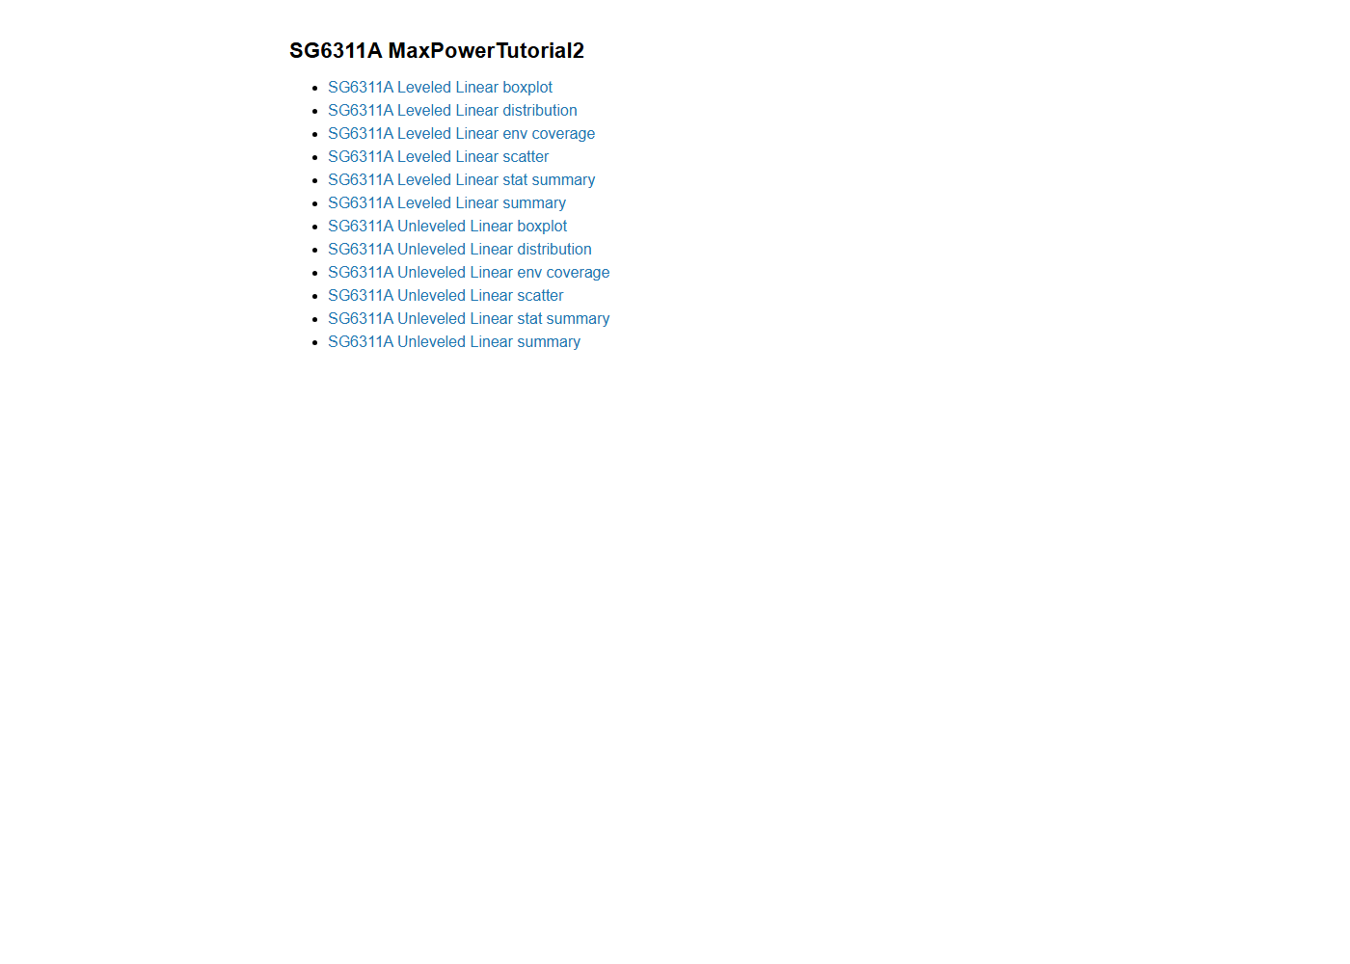
Tutorial 2 — PADB Interactive
The Result — Combined Gallery
MaxPowerTutorial2_v2_results\index.html
One index, 12 links: 2 analytics x 6 views each
(boxplot, distribution, env coverage, scatter, stat summary, summary)
Re-run just padb_v2.py to rebuild this instantly if you tweak a job.json —
no need to touch PADB-R.exe again unless the CSV itself changed
padb-tools
26

Slide 27
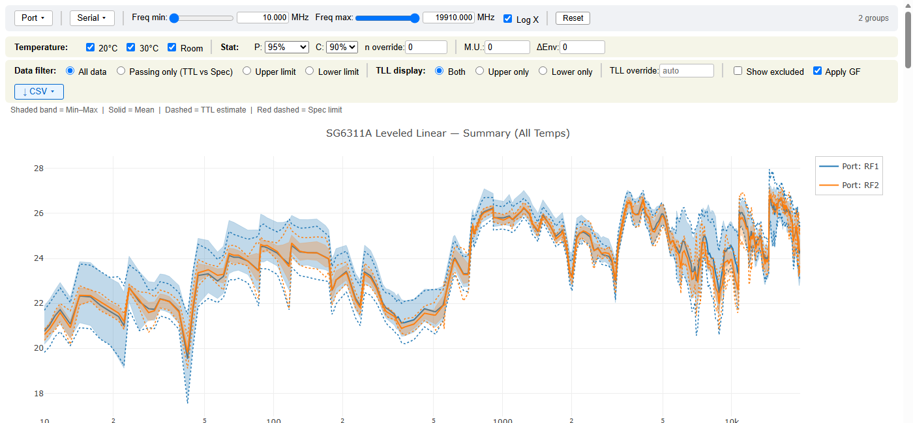
Tutorial 2 — PADB Interactive
The Result — Spec Pass/Fail
• This pod's CSV has real Upper (30 dBm) and Lower (23 dBm) limits, so both are detected
• automatically -- no manual override needed, and no live selector to switch (data beats config)
• MaxPower is a guaranteed-minimum-power measurement, so the Lower limit is the one that
• actually matters here -- watch the dashed lower spec line against the TTL band as you filter
padb-tools
27

Slide 28
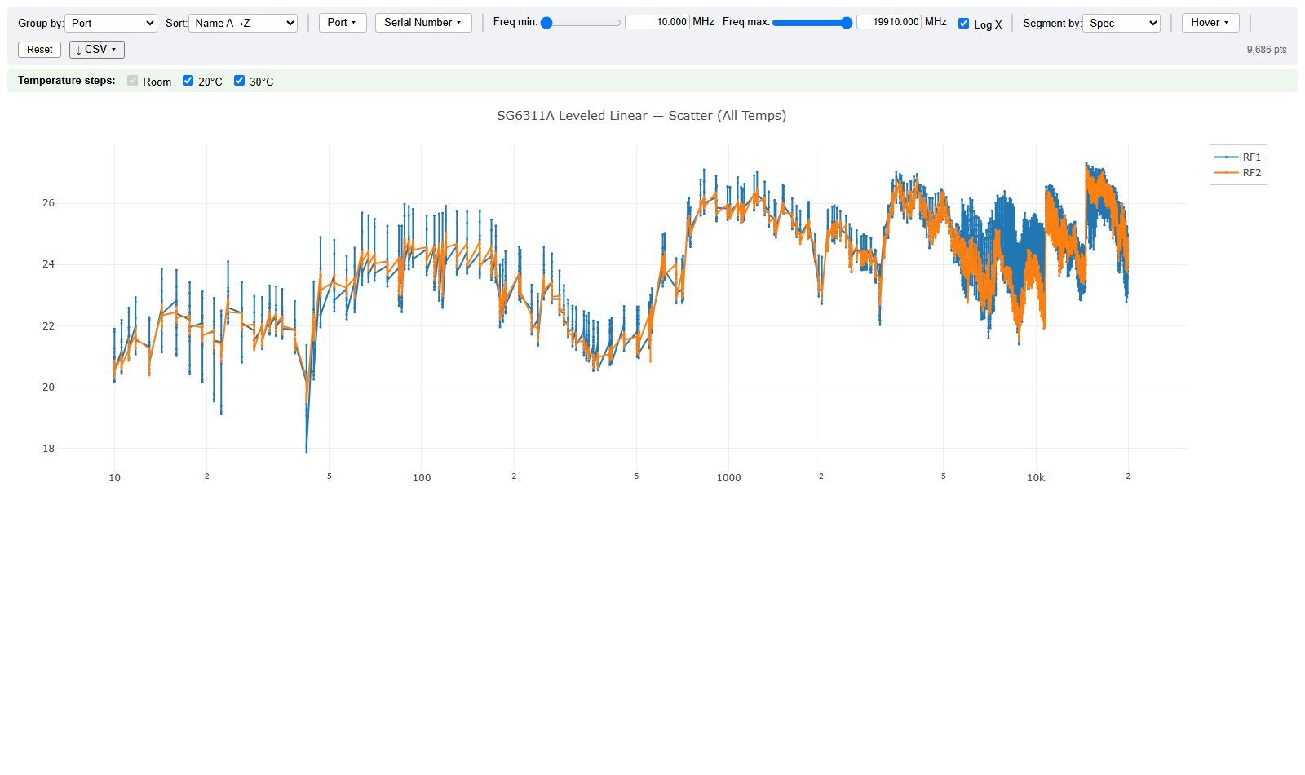
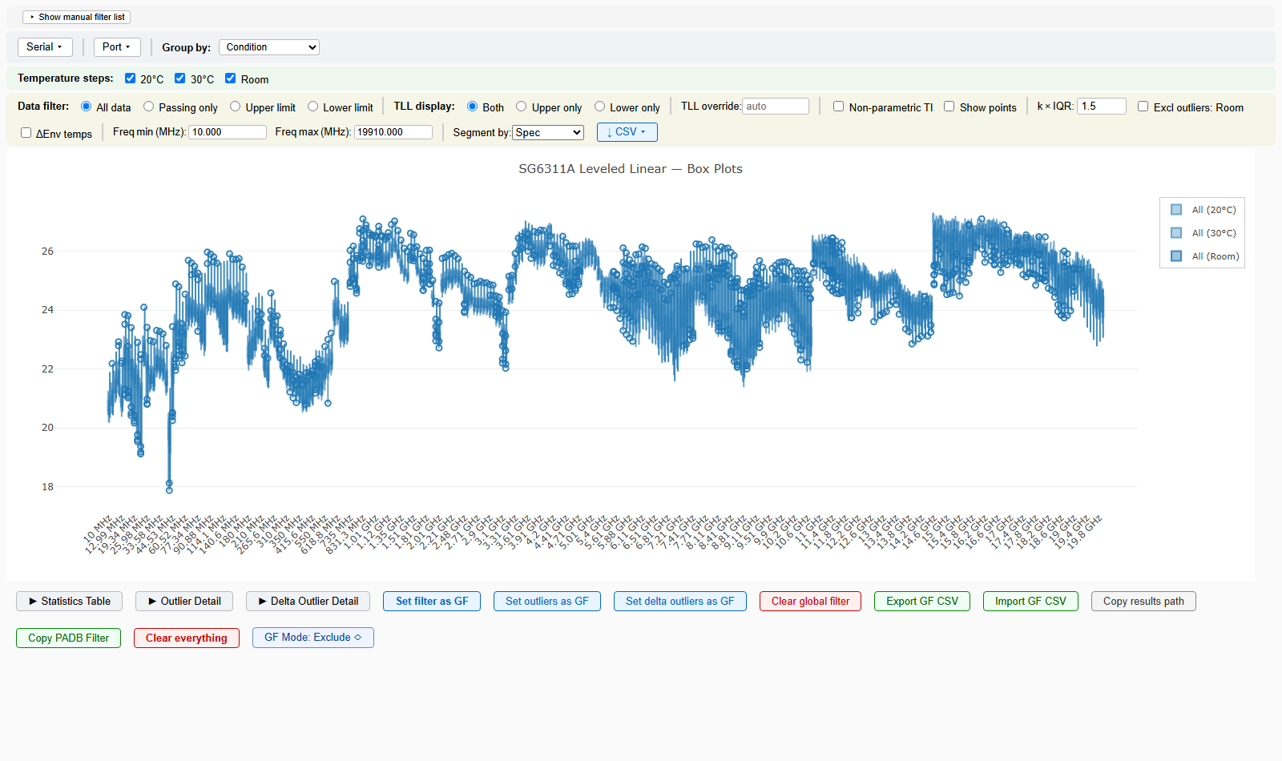
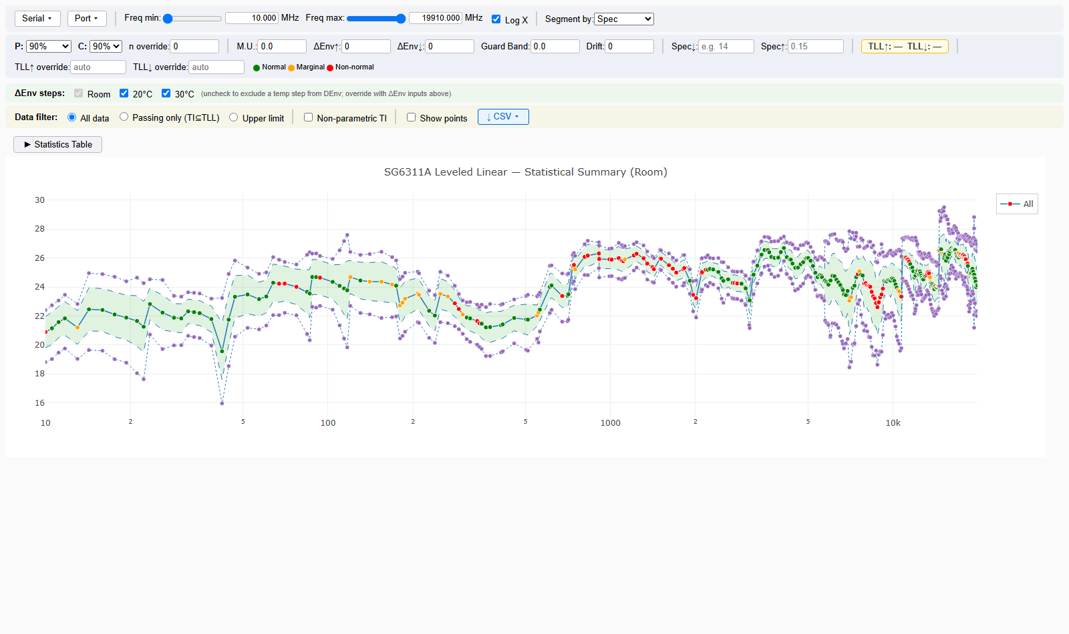
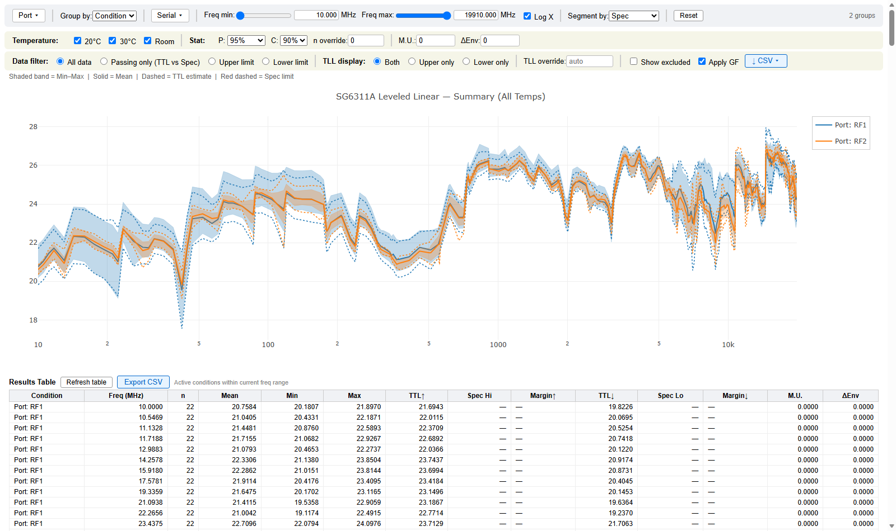
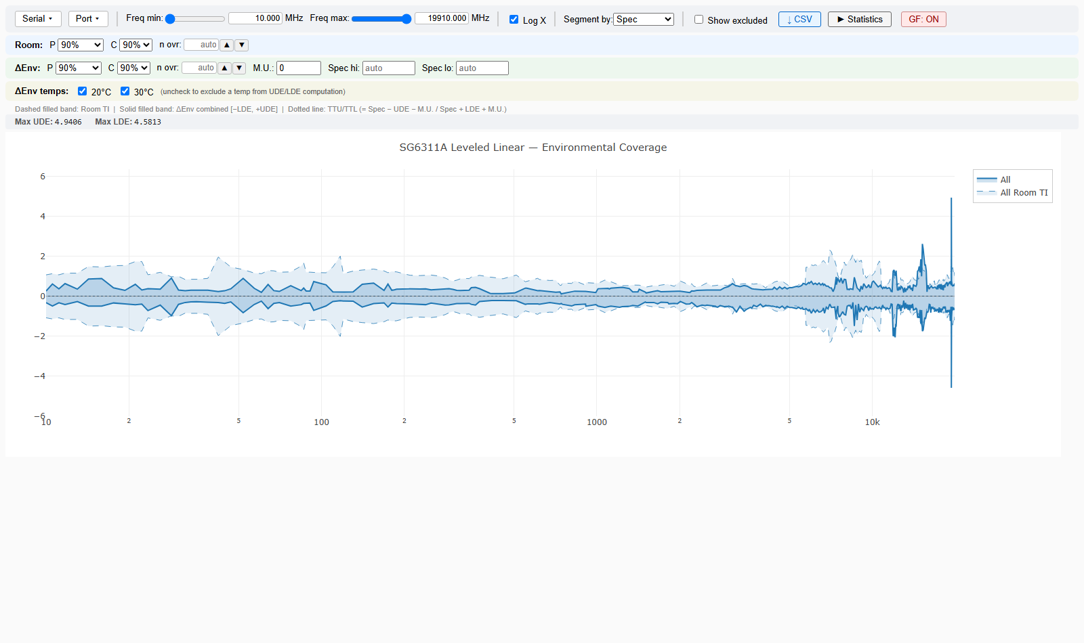
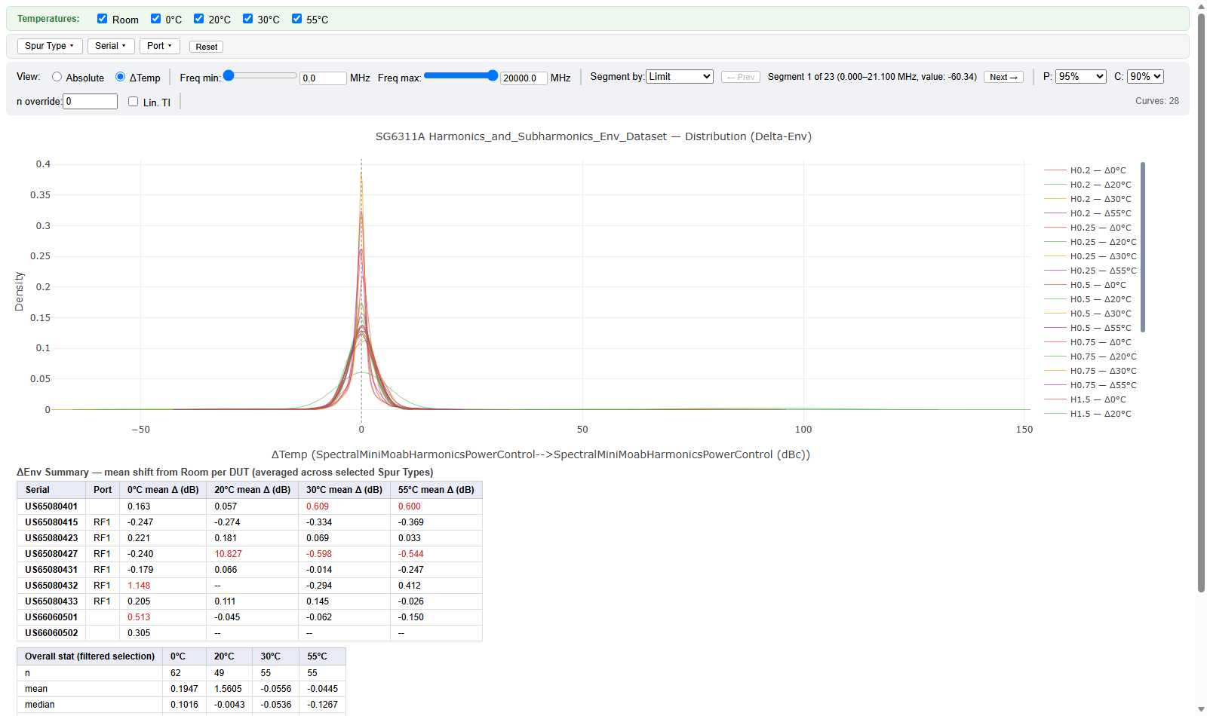
PADB Interactive — Deep Dive
The Six Views at a Glance
Scatter — raw per-measurement, all temps
Boxplot — box stats per condition/temperature
Stat Summary — room-temp per-DUT population stats
Summary — all-temp NP-TI summary
Env Coverage — carrier-power stability vs. temperature
Distribution — multi-temp Delta-Env KDE (Harmonics pod)
padb-tools
28

Slide 29
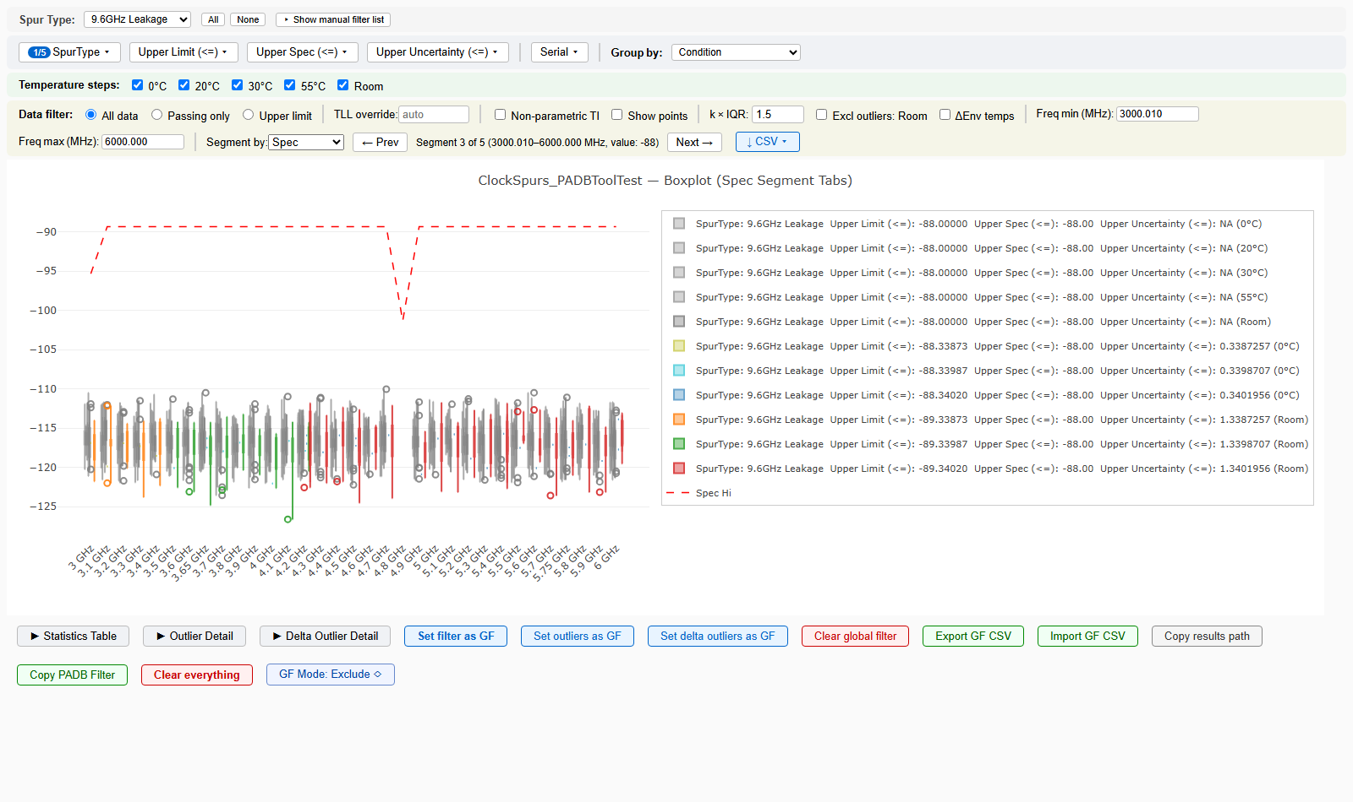
PADB Interactive — Deep Dive
Segment Tab-Through — Jump Between Spec Bands
ClockSpurs_PADBToolTest.pod
A real 5-level spec staircase per SpurType
"Segment by": Spec / Limit / Uncertainty
Prev / Next jump the freq window to each contiguous spec band
Isolate one SpurType first (dropdown, top-left) — segments are per-selection
Respects the Global Filter and serial/port filters: exclude a DUT and its own spec/limit/uncertainty contribution drops too
All six views: scatter, boxplot, distribution already had this; stat_summary, summary, env_coverage, and the real Delta-Env distribution view all got it this session
padb-tools
29

Slide 30
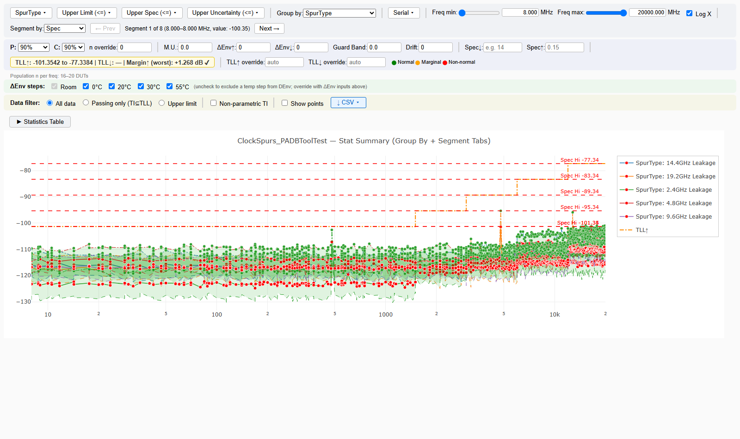
PADB Interactive — Deep Dive
Group By — Collapsing Fragmented Conditions
Stat Summary — Group by: SpurType
This pod's per-unit Group text fragments into 151 near-duplicate conditions
Group by collapses them to the 5 real spur types — one legend entry, one spec line each
Mean/min/max/quantiles pool exactly per DUT — a DUT's data falls under exactly one condition per dimension
NP-TI / spec take the worst case across the collapsed conditions
Same dropdown added to Summary and Env Coverage this session
padb-tools
30

Slide 31
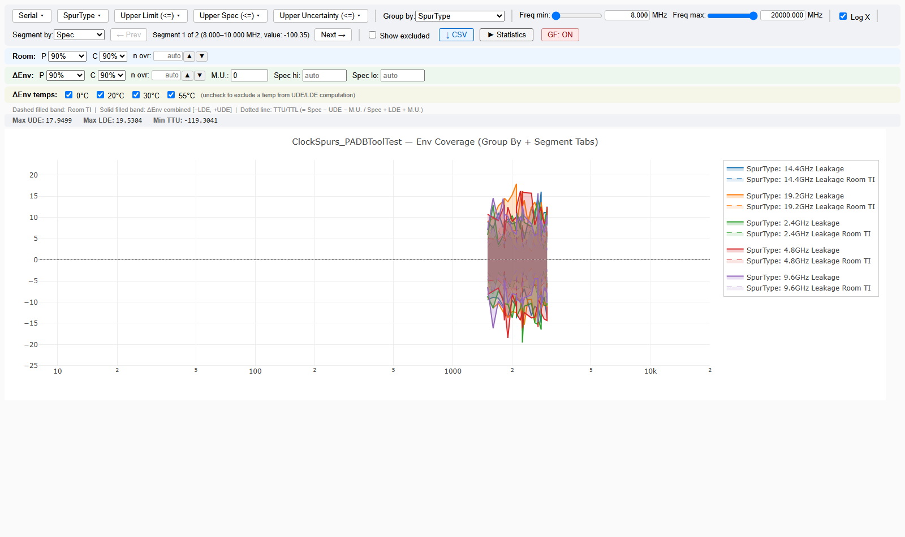
PADB Interactive — Deep Dive
Environmental Coverage — Group By + Segment Tabs
Env Coverage — Group by: SpurType, Segment by: Spec
Before this session: one flat spec value per condition, no per-frequency tracking at all
Now: per-frequency Upper/Lower Limit, Spec, and Uncertainty tracked and segment-tabbable, same as every other view
UDE/LDE/TTU/TTL recompute exactly on every Group By change — already derived from raw per-DUT data on each call
GF toggle (top-right) still applies per-DUT exclusions the same way
padb-tools
31

Slide 32
PADB Interactive — Deep Dive
Global Filter — Export/Import CSV, Copy PADB Filter
• GF buttons (boxplot) are additive, not replacing — "Set filter as GF" / "Set outliers as GF" / "Set delta outliers as GF" all add to the existing filter
– Use "Clear global filter" first if you want to start over from empty
• Export GF CSV — downloads a human-readable CSV (Serial, Condition, Temperature, Start/Stop Freq, N Points)
– Frequency columns are display-only context — the runtime match is on serial+condition+temperature only
• Import GF CSV — re-merges (adds to) the current filter from a previously exported CSV
• Copy PADB Filter — best-effort 'Serial Number' NOT IN {...} expression for pasting into PADB itself (under development)
• Once set, GF propagates automatically to summary and env_coverage — no need to re-select DUTs per view
padb-tools
32

Slide 33
PADB Interactive — Deep Dive
In-Page Help Panel — Explains Itself
• Every one of the 6 main views now has a collapsible ⓘ Help button
• Static explanation: what Filter / Group by / Segment by actually do, and how an unfiltered dimension can pool into extra segments or legend entries
• Dynamic check: flags rows where Upper_Limit < Lower_Limit or Spec_Hi < Spec_Lo (backwards from the usual convention)
– Names which filter-dimension value(s) the inverted rows are concentrated in
• Real example this caught: "14 segments where ~7 were expected" traced to one Serial Number with inverted spec rows across its whole dataset — a pod data issue, not a tool bug
• Run padb_csv_check.py (next slide) to catch the same class of issue before you even open the HTML
padb-tools
33

Slide 34
PADB Interactive — Deep Dive
Pre-Flight Check — padb_csv_check.py
• Run it between Step 2 (extraction) and Step 4 (build views) — before spending time on a build that turns out wrong:
py padb_csv_check.py path\to\Scatter.csv
• Calls the exact same CSV-loading function padb_v2.py itself uses — findings can't drift out of sync with what actually gets plotted
• Flags orphaned numeric columns (a second swept dimension sitting unused), inverted spec rows, high Group cardinality (>100 crowded, >500 genuinely slow), and missing grouping items (Serial/Port/Spec/Uncertainty)
• Exit code 1 on any WARN/FAIL — usable as a pre-flight gate in a script, not just an interactive read
padb-tools
34

Slide 35
Web App Reliability
Job Abort & Cross-Process PADB-R.exe Exclusivity
• Job abort — a queued or running job in the web app can now be cancelled from the status panel
• Run jobs execute before plot jobs whenever a mixed selection is run
• Cross-process exclusivity guard (padb_batch.py) — two PADB-R.exe instances interfere with and stall each other, even across separate process launches (e.g. a webapp restart mid-run)
– Every entry point (CLI and web app alike) now waits on the live OS process table before launching, rather than trusting one process's own in-memory queue
– If it never clears, it names the blocking PID(s) with the exact taskkill command to clear a genuinely-stuck instance by hand
padb-tools
35

Slide 36
Tutorial 3 — /padb-tools
What It Is, When to Use It
• A Claude Code command scoped to this repo (.claude/commands/padb-tools.md)
• Surfaces a condensed index of the tool's architecture, gotchas, and a
– 13-point new-pod checklist — without opening all six markdown docs
• Only works when Claude Code's working directory is inside the repo
– (e.g. C:\apps\padb\tools) — that's what makes it "repo-scoped"
• Use it when you're: onboarding a new pod, debugging a plot feature,
– reviewing generated HTML, or just orienting yourself in a new session
padb-tools
36

Slide 37
Tutorial 3 — /padb-tools
What It Actually Tells You
• A few of the 13 new-pod checklist items it surfaces immediately:
– TestRun_RunStatus — exit 0 but no CSV? Check the pod's default 'P'-only filter
– Environment_TestStep must be {All} or distribution/env_coverage/summary go empty
– OutputConfig_OutputCSV=False on a Scatter analytic — renders PNG, writes no CSV
– Generated job.json path length — warns before Windows' 260-char limit bites
• Plus: the architecture one-liner, common JS gotchas, and pointers to the
– full doc for anything it only summarizes
padb-tools
37

Slide 38
Tutorial 3 — /padb-tools
Worked Example: MaxPowerTutorial3.pod
• You've just been handed MaxPowerTutorial3.pod — 2 analytics, never run before
• Open Claude Code with your working directory inside the padb-tools repo
• Type: /padb-tools
• Ask directly: "Is MaxPowerTutorial3.pod ready to run in Interactive mode?"
• Claude reads the checklist above, then actually inspects the pod file —
– Limits_YLimit, Environment_TestStep, OutputConfig_OutputCSV, Group strings
• You get a direct answer grounded in this pod's real settings, not a guess
padb-tools
38

Slide 39
Multi-Site Testing
Same Test, Different Database
• Malaysia (AMC2) production ramp-up: the same test now also pulls from
– AMC2's own PADB Oracle database, not just Santa Rosa's
• Comparing a real Santa Rosa pod against its AMC2 counterpart: the only
– genuine differences are Device_Server and Device_Database in [Extract]
• Every AnalyticName and OutputConfig_OutputFile is otherwise identical —
– running both site variants writes identically-named CSVs
• Risk: point both at a shared results/publish location and one silently
– overwrites the other — same class of problem unique_output_filenames
– solves within one pod, but across two site-variant pods instead
padb-tools
39

Slide 40
Multi-Site Testing
padb_convert_site.py — Converting a Pod
• Site registry lives in padb_sites.json — add a new site there, no code changes:
py padb_convert_site.py --pod MyPod.pod --to AMC2
Wrote MyPod-AMC2.pod (SantaRosa -> AMC2)
Device_Server -> PADB ORACLE AMC2
Device_Database -> GALLEON_1
AnalyticName 'Leveled Linear' -> 'Leveled Linear AMC2'
OutputConfig_OutputFile '..._Linear' -> '..._Linear_AMC2'
WARNING: SaoFile now points at 'MyPod-AMC2.sao', which does not
exist yet -- supply a real .sao extracted at AMC2 before running
• Source pod is never touched. Round-trip verified byte-identical
– (SantaRosa -> AMC2 -> SantaRosa reproduces the original exactly)
padb-tools
40

Slide 41
Multi-Site Testing
padb_convert_site.py — Converting a Job
py padb_convert_site.py --job my_run_job.json --to AMC2
• Repoints "pod" and swaps the pod stem everywhere it appears:
Converted pod not found yet -- creating it first: ...
Wrote MyPod-AMC2_run_job.json (SantaRosa -> AMC2,
pod=MyPod-AMC2.pod)
This is a V2 run job -- also regenerate its plot
job(s) against the new pod:
py padb_make_v2_job.py MyPod-AMC2.pod --module <YourModule>
• Updates results_dir, publish/publish_to, and description too — not just "pod"
• --force overwrites an existing output; --list-sites prints the registry
padb-tools
41

Slide 42
Wrap-Up
Recent Updates
• Stat Summary & Boxplot: spec/margin columns now show both sides when direction is undetermined (was silently upper-only)
• Boxplot: "Passing only" now warns when there's nothing to compare against, instead of quietly doing nothing
• Env Coverage: drag-zoom now narrows the Statistics Table too — same behavior Stat Summary and Boxplot already had
• Large datasets: opt-in decimation + binary encoding cut file size dramatically (one real case: 400MB → 99MB)
• Compare Mode: x-axis units auto-detected and cross-checked between sites; new default PADB-Compare publish location
• Data integrity: results_padb is now the only trusted CSV source — no more silent R-Plots fallback substitution
• Web app: survives a restart mid-run, cleans up orphaned R-Host.exe processes, and the Running Jobs panel survives a browser refresh
padb-tools
42

Slide 43
Questions?
C:\apps\padb\tools | /padb-tools

Slide 44
Appendix
Setting Up From Zero — Assumes No Prior Access

Slide 45
Appendix
Getting the Code
• This repo isn't on a company-wide share by default — copy it from:
\\srsnas01.srs.is.keysight.com\prod\MIDRF3\SG6311A\Padb-tools\tools
• Copy that whole "tools" folder to a local path, e.g. C:\apps\padb\tools
• padb_batch.py is bundled directly inside the tools folder (added 2026-08-05) —
– no separate dependency to track down; the whole repo is self-contained
• Then follow the Prerequisites and Per-User Config slides earlier in this deck
padb-tools
44

Slide 46
Appendix
First Commands to Verify Your Setup
• From inside the tools folder, confirm everything imports cleanly:
py -c "import padb_run, padb_v2, padb_config"
• No output and no traceback = success
• Then generate your first job.json from any pod you have access to:
py padb_make_job.py YourPod.pod --module YourModule
• If PADB-R.exe launches and a real window briefly appears, you're fully set up
• Stuck? GETTING_STARTED.md → Quick_Start.md, or type /padb-tools once you're
– working inside the repo
padb-tools
45

