Slide 1
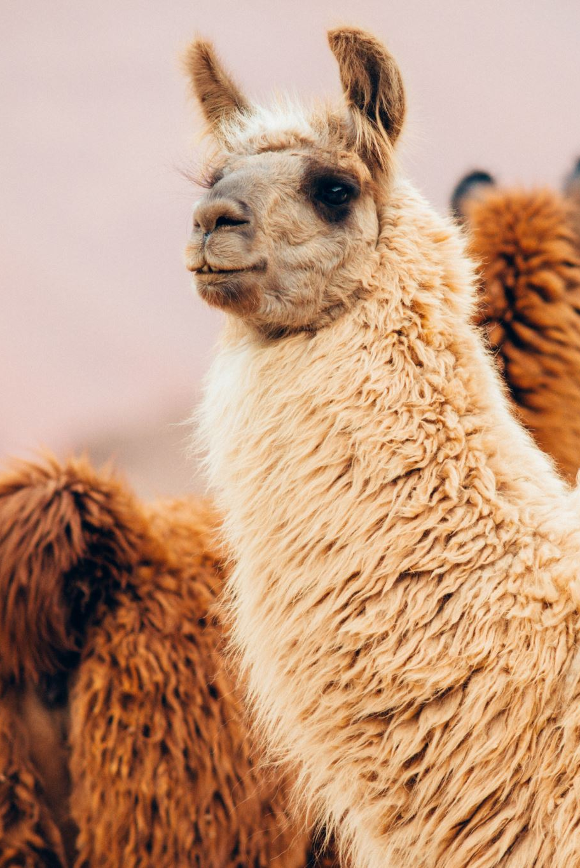
What is Llama Stack
Definition:
A framework by Meta that standardizes and simplifies generative AI development. It provides composable building blocks for seamless model training, evaluation, and deployment.
Purpose:
Standardization: Uniform interfaces for AI tools enhance interoperability.
Efficiency: Pre-defined blocks reduce development time, focusing on innovation.
Flexibility: Supports diverse AI models, adaptable to specific needs.

Slide 2
Core Components of Llama Stack
Inference API: Generates text and handles responses.
Safety API: Filters harmful or biased content.
Memory API: Retains past interactions for context.
Agentic System API: Enables use of external tools.
Evaluation API: Assesses model performance.
Post-Training API: Fine-tunes models for tasks.
Synthetic Data API: Generates training datasets.
Reward Scoring API: Assigns rewards for learning.

Slide 3

Llama Stack Distributions
Definition:
A tailored assembly of APIs and their corresponding providers, configured to deliver a cohesive environment for developing and deploying generative AI applications. By integrating various components—such as Inference, Safety, Memory, and Agentic System APIs—these distributions offer developers a unified interface, streamlining the creation of AI solutions
Deployment:
On-premises, cloud, single-node, or on-device setups.

Slide 4
Llama Stack API Providers
Meta Reference: Comprehensive, local support for Inference, Safety, Memory, and Agents.
Fireworks: Cloud-based for scalable Inference, Safety, and Memory.
AWS Bedrock: Cloud solution for Inference and Memory on AWS.
Together: Shared cloud resources for Inference and Memory.
Ollama: Local, Inference-focused.
TGI: Text generation for hosted or local setups.
Chroma: Local, optimized for Memory storage.
PG Vector: Vector-based Memory, single-node.
ExecuTorch (iOS): On-device Inference and Agents.

Slide 5
Introducing Llama 3.2
Overview:
Meta's Llama 3.2 introduces advanced AI models with notable features.
Multimodal Vision Models:
Sizes: 11B and 90B parameters
Capabilities: Process and understand both text and images
Applications: Image-based search, content generation
Lightweight Text-Only Models:
Sizes: 1B and 3B parameters
Optimization: Designed for mobile and edge devices
Benefits: Enable private, personalized AI experiences with minimal latency

Slide 6

Llama 3.2 1B and 3B Models
Hardware Requirements:
CPU: Multicore processor
RAM: Minimum 16 GB recommended
GPU: NVIDIA RTX series with at least 4 GB VRAM for the 1B model and 8 GB VRAM for the 3B model
Storage: Sufficient disk space for model files
Applications:
Mobile Assistants: Enhanced text messages and translations.
Edge Computing: Powers AI in IoT devices.
Privacy-Sensitive Tasks: Processes data locally, ensuring security.

Slide 7
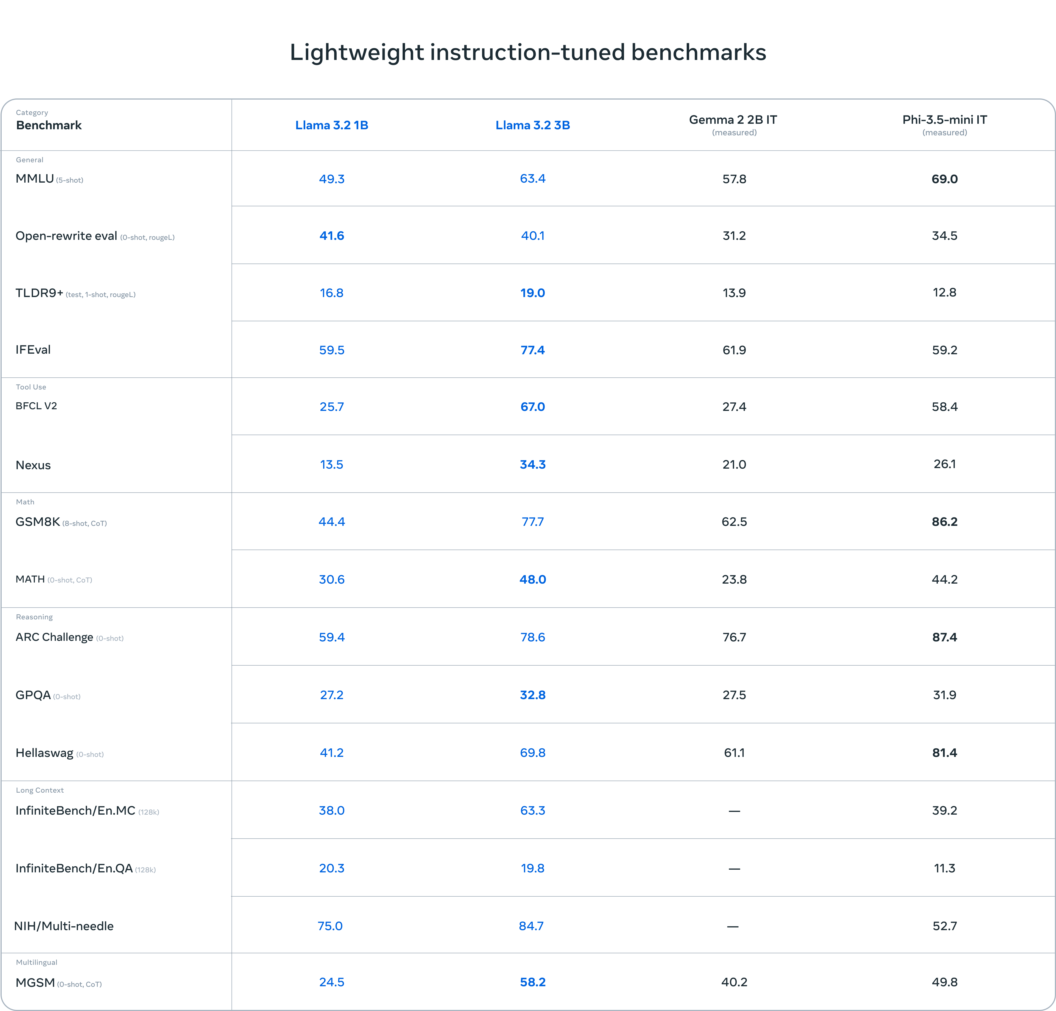

Slide 8
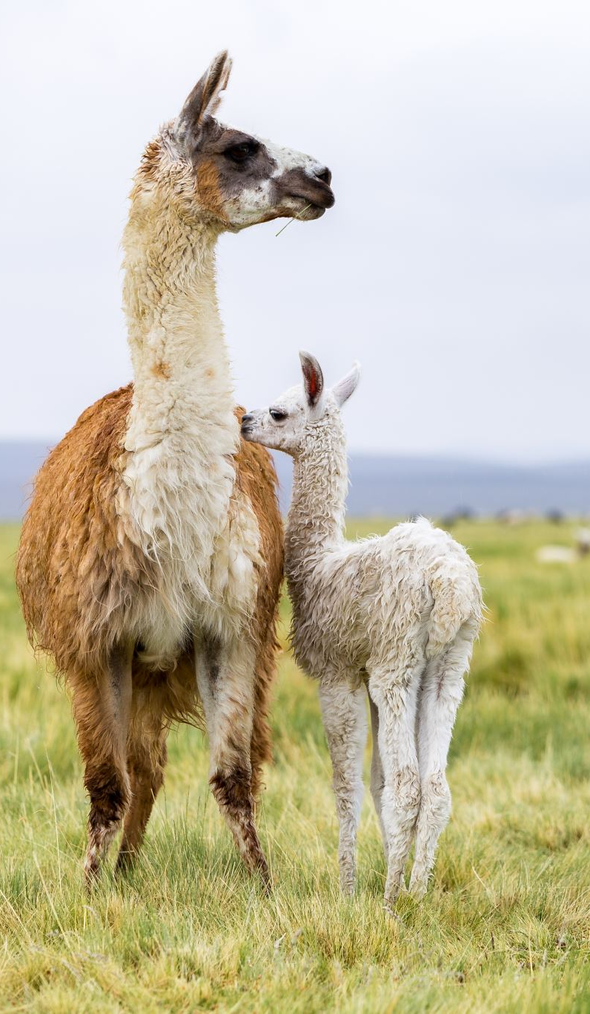
Integration of Llama 3.2 with Llama Stack
Standardized APIs: Uniform interfaces for easy integration into diverse applications.
Modular Architecture: Customizable building blocks for tailored AI solutions.
Flexible Deployment: Supports cloud, on-premises, and edge environments.
Improved Multimodal Processing: Enhances Llama 3.2's ability to handle both text and images

Slide 9
Future Developments and Roadmap
Expanded APIs: Introducing new APIs for building and deploying AI models.
Improved Multimodal Processing: Enhancing integration of text and image data.
Performance Optimization: Optimizing for better performance across various hardware configurations, including mobile and edge devices.
Open-Source Collaboration: Encouraging community contributions to foster innovation.

