Slide 1
Lose layer architecture
withe c++

Slide 2
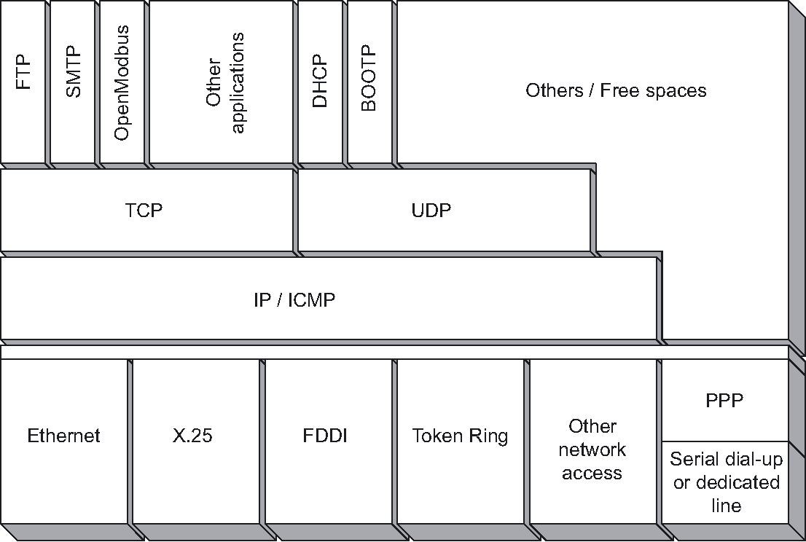
Problem
http://www.vaeprosys.cz
http://www.vaeprosys.cz

Slide 3
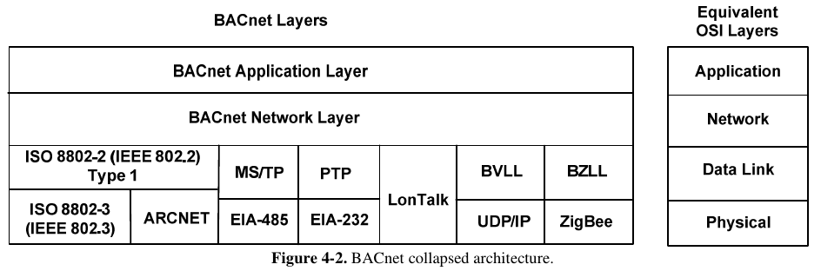
Problem
http://www.vaeprosys.cz

Slide 4
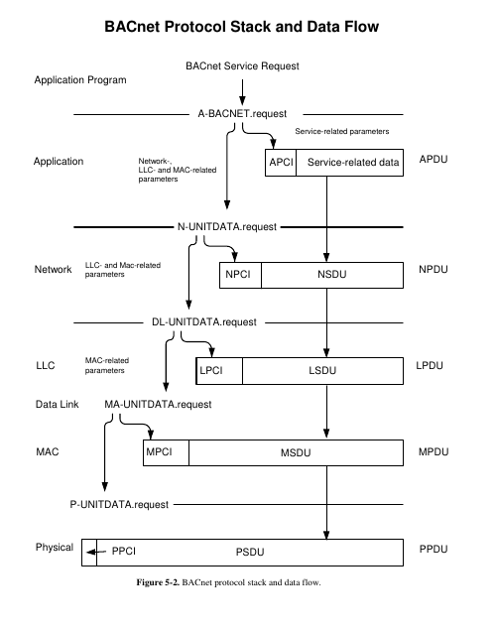

Slide 5
Classic oo solution
Base class / interface per layer
concrete implementation for an layer

Slide 6
Classic oo solution con
vtable look ups for interface functions
bloated code for each implementation
In c++ only multiple inheritance

Slide 7
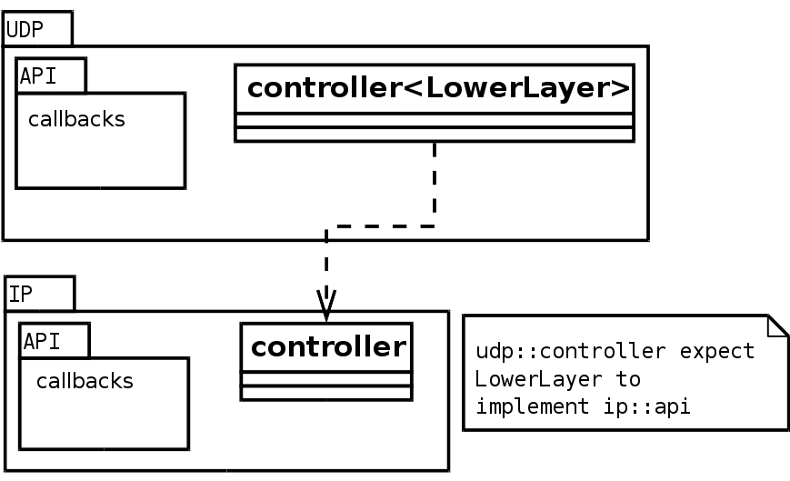
Idea

