Slide 1
graphics
graphics_dp
clk
clk
clk
BRAM0
Video
reset_n
reset_n
reset_n
muxRow(4..0) & muxCol(5..0)
10
WRADDR
rENB
‘1’
row
10
row
ctrl
ctrl
ctrl
exSel
Din
RDADDR
10
row(7..3) & column(7..3)
column
wrENB
DOUT
10
exData
1
muxData
0
10
fsmData
Mux
tmds
0
1
BRAM1
0
Selector
WRADDR
rENB
‘1’
1
tmdsb
exSel
Din
RDADDR
Mux
ch1
6
wrENB
DOUT
16
exRow
1
muxRow
muxCol(5)
39
fsmRow
Mux
0
exSel
column(8)
exCol
1
muxCol
Has 16 bits per pixel
Only using 2 Bits
00 scopeface background
01 Red
10 Green
11 Blue
fsmCol
Mux
0
exSel
exWen
1
muxWen
fsmWen
Mux
0
fsmSel
fsmRow
fsmCol
fsmWen
fsmData
5
6
16
graphics_fsm
clk
reset_n

Slide 2
graphics_dp.vhdl
BRAM_Image
Video
exRow & exCol
10
WRADDR
rENB
10
‘1’
row
4
row
row & column
exData
6
Din
RDADDR
column
6
column
exWen
wrENB
DOUT
6
tmds
tmdsb
cell_image
clk
clk
clk
reset_n
reset_n
reset_n
exWen
exCol
exRow
exData
5
4
6
slv_reg3[0]
slv_reg2[4:0]
slv_reg1[3:0]
slv_reg0[5:0]
5

Slide 3

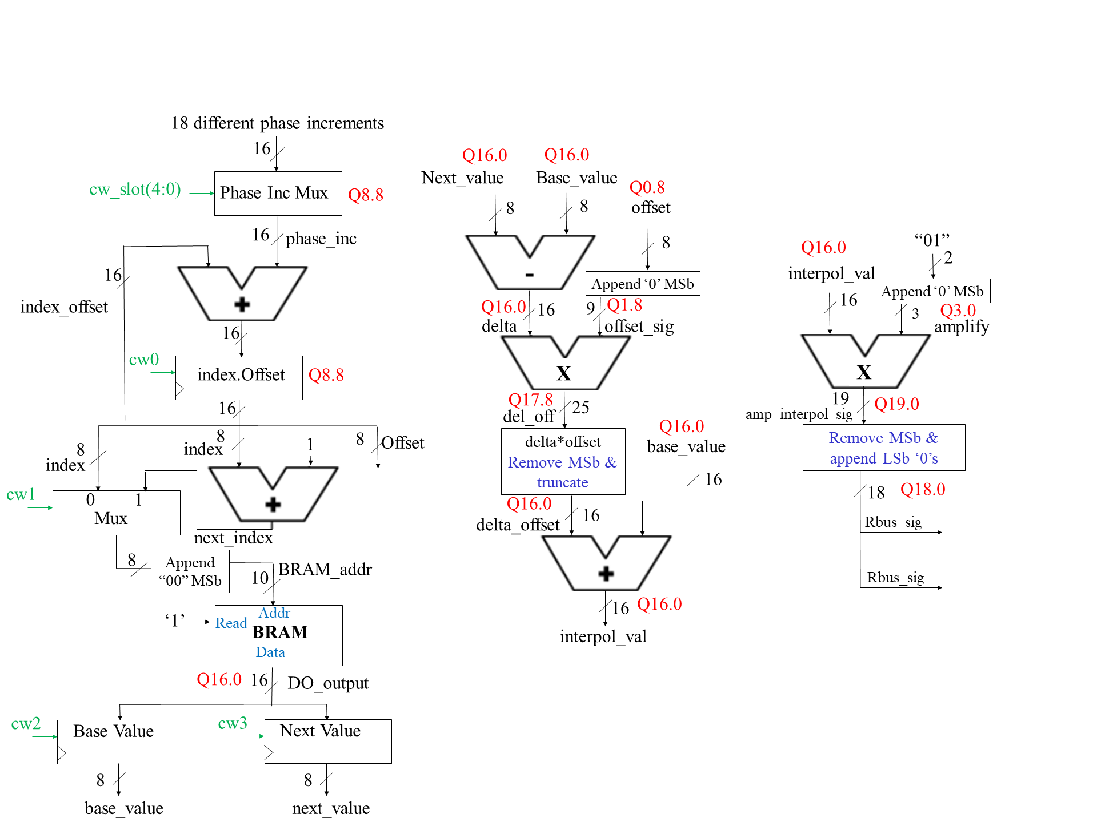
my_graphics_ip_v1_0_S00_AXI
graphics_datapath.vhd
ir_sensor.vhd
ir_fsm.vhd
Video
S_AXI_ACLK
clk
clk
clk
BRAM0
row
row
S_AXI_ARESETN
reset_n
reset_n
reset_n
graphic_write_addr
4
data
ir_data
cw
sw
tmds
tmds
‘0’ & exRow & exCol
rENB
‘1’
column
JA_Port(3)
slv_reg6(31:24)
data
flag
flag
10
WRADDR
graphic_read_addr
column
6
8
buttonScan
4
2
RDADDR
‘0’ & row & column
tmdsb
tmdsb
slv_reg7(0)
flag
ir_dp.vhd
exData
16
Din
10
cell_image
cw(2)
cw
sw
exWen
wrENB
DOUT
16
ch1
clk
clk
cw(3)
Shift Register
button
clk
reset_n
exWen
exCol
exRow
exData
reset_n
reset_n
clk
cw
4
cw
100000
5
4
16
sw
2
sw
18
S_AXI_ACLK
S_AXI_ARESETN
slv_reg3[0]
slv_reg2[4:0]
slv_reg1[3:0]
slv_reg0[15:0]
buttonScan
8
button
G
Compare
randomNum.vhd
halfBit Counter
i_sig
200000
AND
sw
S_AXI_ACLK
clk
18
S_AXI_ARESETN
reset_n
clk
G
slv_reg4(31:24)
rand
Compare
8
lab4.vhd
lab4_dp.vhd
clk
S_AXI_ACLK
Audio_Codec_Wrapper
reset_n
S_AXI_ARESETN
clk
clk
sim_live
‘0’
winFlag
slv_reg5(0)
reset_n
reset_n
ready
readyy
L_bus_in
Rbus_sig
ac_mclk
ac_mclk
18
R_bus_in
18
Rbus_sig
ac_adc_sdata
ac_adc_sdata(In)
L_bus_out
OPEN
ac_dac_sdata
ac_dac_sdata(Out)
18
16
slot_machine_fsm.vhd
R_bus_out
OPEN
ac_bclk
ac_bclk
18
clk
clk
ac_lrclk
ac_lrclk
reset_n
reset_n
scl
scl
sw_slot
sw_slot
sda
sda
cw_slot
5
cw_slot
2500000
lab4_fsm.vhd
durationCounter
26
clk
clk
Compare
sw_slot
reset_n
reset_n
clk
E
readdy
ready
winFlag
winFlag
cw
4
cw

Slide 4
Lab 3 – Architecture
Artix 7 (blackjack for final project)
AA19
V18
axi_uartlite_0 @ 40600000
RX
RX
TX
TX
MicroBlaze
blackjack_ip_v2_0.vhd @ 0x44a00000
blackjack.xdc
axi_lite
blackjack_ip_v2_0_S00_AXI.vhd
blakjack.c
graphics_dp.vhd
R4
G4
S_AXI_ACLK
clk
S_AXI_ARESETN
clk
reset_n
32x32
reset_n
main()
slv_reg0:7
(specific registers shown in block diagram)
graphics Signals
audio_dp.vhd
sw
sw
Final_project.xdc
clk
audio_fsm.vhd
reset_n
cw
cw
Signals going In/Out of Artix 7 Chip
Nets to Pins

Slide 5

18 different phase increments
16
Q16.0
Q16.0
cw_slot(4:0)
Phase Inc Mux
Next_value
Base_value
Q0.8
Q8.8
8
8
offset
16
phase_inc
8
Q16.0
“01”
interpol_val
2
16
-
Append ‘0’ MSb
index_offset
Q16.0
9
Q1.8
16
Append ‘0’ MSb
delta
16
offset_sig
3
Q3.0
16
amplify
cw0
index.Offset
Q8.8
X
X
16
Q17.8
25
19
Q19.0
del_off
Q16.0
amp_interpol_sig
8
1
8
Offset
delta*offset
Remove MSb & truncate
base_value
Remove MSb & append LSb ‘0’s
8
index
index
16
cw1
0
1
Q16.0
18
Q18.0
Mux
delta_offset
16
Rbus_sig
next_index
8
Append “00” MSb
BRAM_addr
10
Rbus_sig
Addr
16
Q16.0
‘1’
Read
BRAM
interpol_val
Data
Q16.0
16
DO_output
cw2
Base Value
cw3
Next Value
8
8
base_value
next_value

